Slide 1
Fusion3D Viewer
Basic Features
Saving and Opening a Project
DEM Loading Options
Point Cloud Loading
Texture Options
Displaying both first-hit and last-hit surfaces

Slide 2
Saving and Opening a Project
Under ‘File’ menu, ‘Save Project’ and ‘Open project’
Typical Project file
Project files store all important parameters of the current display
# ##################################################
# Parameters for Fusion3D Viewer
# Can be edited with any standard editor (see documentation on Parameter file and ASCII tags)
# ##################################################
# ##################################################
# Reference tags
# ##################################################
Ref-LL-Deg 35.092819 70.886490 # Center of tile 1
Stereo-Offset 2.500000
Stereo-On-Off on
# ##################################################
# Map ID tags
# ##################################################
# Map3d-Index-Loc locName ulLat ulLon lrLat lrLon defLat defLon elev dElev int/mrg
Map3d-Index-Loc Konar 35.117809 70.847244 34.920639 71.001740 35.092819 70.886490 1580.515747 99.000000 int
Map3d-Index-Find Konar C:\map3dview\rtv\Konar dem_1m_a2_konar_site16*.tif .tif mrg 2
Map3d-Index-MrSID Konar *.sid 0
# ##################################################
# Vector overlay files
# ##################################################
Vector-Over-File Konar display 1.000000 1.000000 1.000000 C:\map3dview\rtv\Konar/mrg_1m_a1_konar_site16_tile1.kml
Vector-Over-File Konar display 1.000000 1.000000 1.000000 C:\map3dview\rtv\Konar\mrg_1m_a1_konar_site16_tile2.kml
Vector-Over-File Konar display 1.000000 1.000000 1.000000 C:\map3dview\rtv\Konar/mrg_1m_a1_konar_site16_tile3.kml
Vector-Over-File Konar display 1.000000 1.000000 1.000000 C:\map3dview\rtv\Konar/mrg_1m_a1_konar_site16_tile4.kml
# ##################################################
# 3-D Maps tags
# ##################################################
Tiles-N 30 30 4 1
Tiles-Size 128
# ##################################################
# Bookmark tags
# ##################################################
Jump-To 3872650.341659 674145.803259 00.00.00
By convention, has suffix .s4d
File is ASCII and can be edited with Wordpad or any other editor
Tags defined in documentation
Less-used tags can be added in the editor to customize project

Slide 3
DEM Load Options – Multiple Tiles
Under ‘File’ menu, ‘Load DEM – BuckEye/HALOE/ALIRT – All files in Directory’
Typical Buckeye directory structure
Konar
Konar_Site16_tile1
dem_1m_a1_konar_site16_tile1.tif
dem_1m_a2_konar_site16_tile1.tif
int_1m_a1_konar_site16_tile1.tif
mrg_1m_a1_konar_site16_tile1.kml
mrg_1m_a1_konar_siet16_tile1.tif Konar_Site16_tile2 dem_1m_a1_konar_site16_tile2.tif
dem_1m_a2_konar_site16_tile2.tif
int_1m_a1_konar_site16_tile2.tif
mrg_1m_a1_konar_site16_tile2.kml
mrg_1m_a1_konar_siet16_tile2.tif
Konar_Site16_tile3
…
Konar_MrSID_Orthophotos
KonarSite16_200910_Block01_Complete.sdw
KonarSite16_200910_Block01_Complete.sid
KonarSite16_200910_Block01_Complete.aux
KonarSite16_200910_Block02_Complete.sdw
KonarSite16_200910_Block02_Complete.sid
KonarSite16_200910_Block02_Complete.aux
…
Load all tiles in a given directory simply by choosing the directory
All primary ‘a2’ DEMs
All secondary ‘a1’ DEMs
All false-color ‘mrg’ or intensity ‘int’ textures
All high-res MrSID orthophotos
Restrictions
Only for BuckEye, HALOE, and ALIRT sensors
All tiles must be from same sensor
All tiles must be from approximately the same region (viewer tries to construct a single map encompassing all tiles)

Slide 4
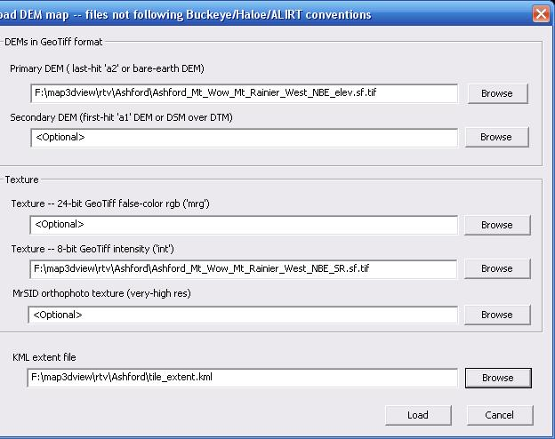
DEM Load Options – Other Sensors
Under ‘File’ menu, ‘Load DEM – Other’
Load tiles for sensor that doesn’t follow BuckEye, HALOE or ALIRT file conventions
Menu
Primary ‘a2’ DEM required
Secondary ‘a1’ DEM optional
either 8-bit or 24-bit texture or MrSID orthophotos required
Restrictions
DEMs must be in GeoTiff format
Resolutions of all DEMs must match
Texture files must be in GeoTiff or MrSID formats

Slide 5
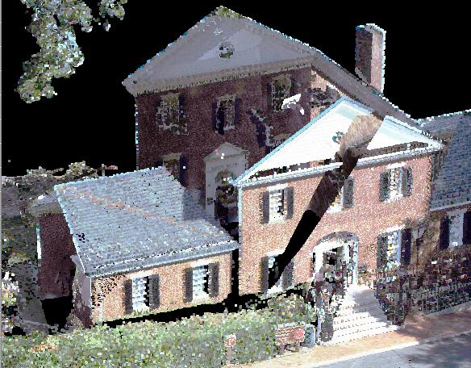
Load Options – Load Point Cloud
Under ‘File’ menu, ‘Load LAS or BPF point cloud’
LAS point cloud of a single building
Load lidar point cloud in LAS of BPF format
designed to complement DEM data for small areas, not as a primary map
Restrictions
LAS or BPF formats only
Large files will be decimated to fit memory and graphics card restrictions

Slide 6
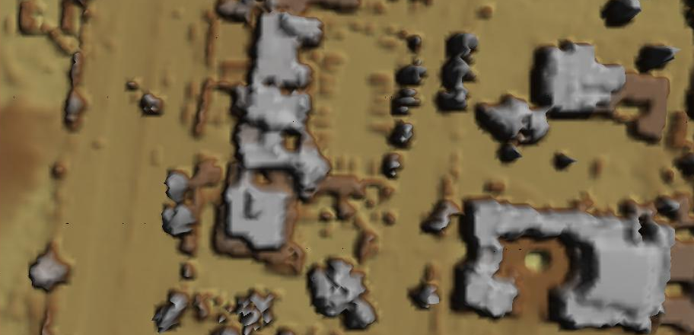
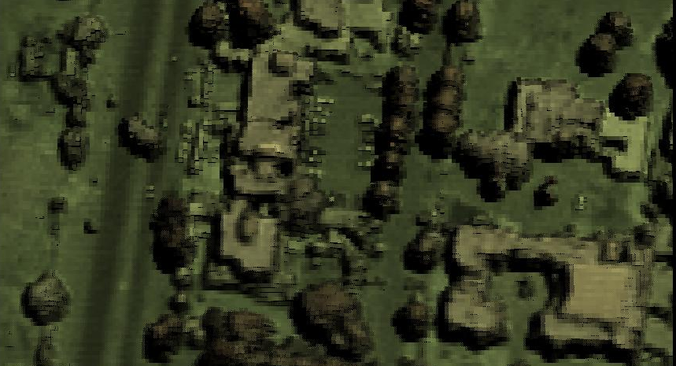
Textures
No texture, DEM only – This option not available in Fusion3D
False color indicates elevation, but this type of texture is too difficult to interpret to provide decent visualization.
Good texture from Lidar intensity image. (BuckEye ‘mrg’ file gives very similar image.)
Lidar intensity available for all common sensors
Adds contrast for critical features such as roads that have minimal elevation differences from adjacent areas

Slide 7
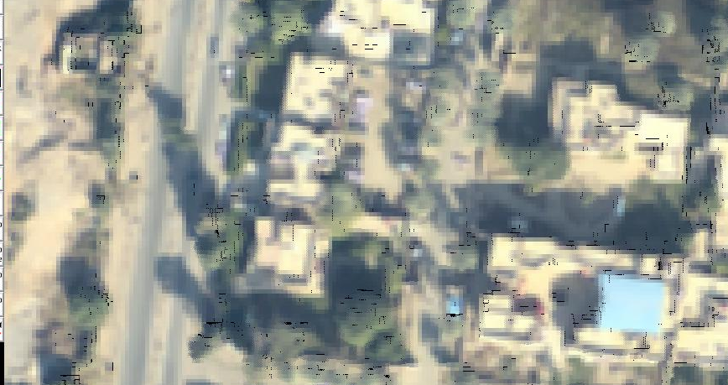
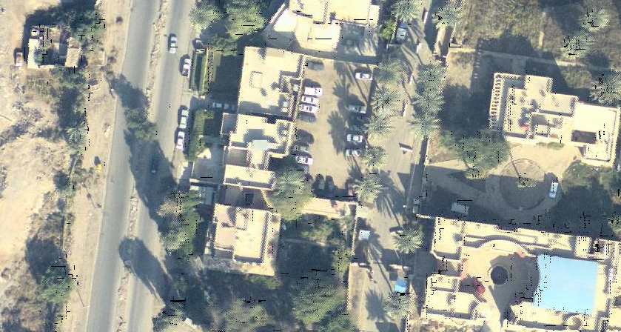
Textures
Better texture, like BuckEye orthophoto downsampled to DEM resolution
Many viewers limit orthophoto resolution to that of the DEM
Best texture – Full resolution BuckEye orthophoto
Key advantage for Fusion3D viewer
Available in many areas
Provides excellent situation awareness

Slide 8
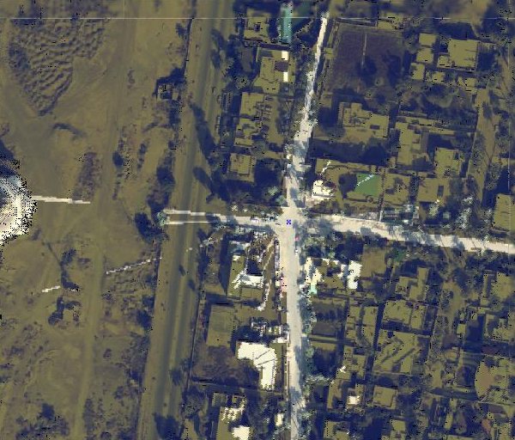
Line of Sight
Available from Line-of-Sight menu
Click on the desired center point (spotter location or location of incident) to bring it to the center of the screen
Calculations are always done to the screen center
Shaded areas indicate regions not visible from center point (equivalently, regions with no sight line to the center point).

Slide 9
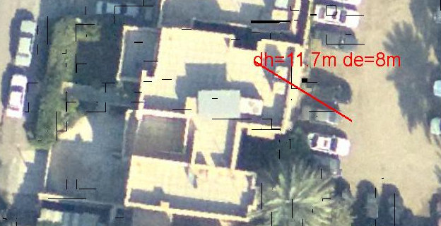
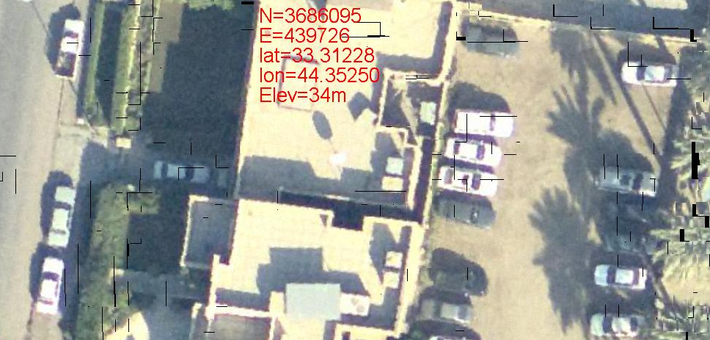
Mensuration
Distance measure option
Middle click on first point to get its elevation
Middle click on second point to get horizontal distance ‘dh’ and elevation difference ‘de’
This shows the building is 8m above the parking area
Point measure option
Middle click on a point to show Northing, Easting, Latitude, Longitude and elevation

Slide 10
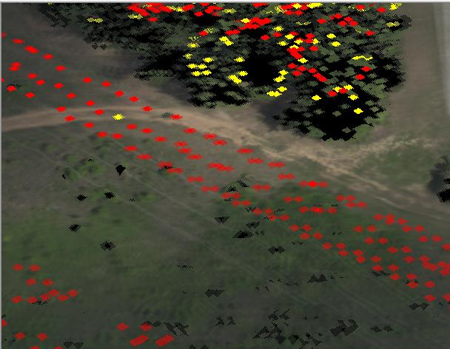
Simultaneous Display of First-Hit and Last-Hit Surfaces
When available, both primary ‘a2’ and secondary ‘a1’ DEMs are displayed
The primary ‘a2’ DEM is the base layer in the display
Where it differs, the first-hit ‘a1’ DEM is overlaid as discrete squares (highlighted in red/yellow)
The ‘a1’ shows the power line (3 wires in red)
The ‘a2’ shows the ground beneath

