Slide 1
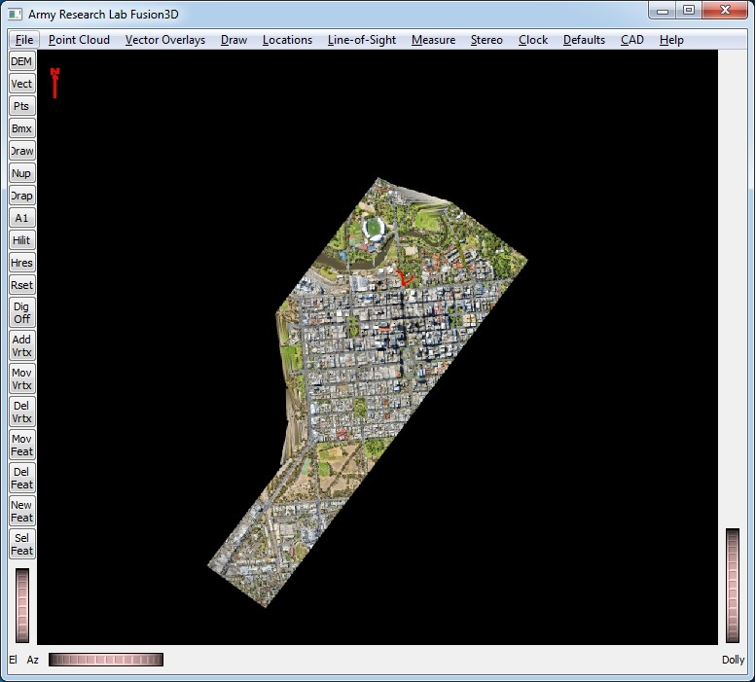
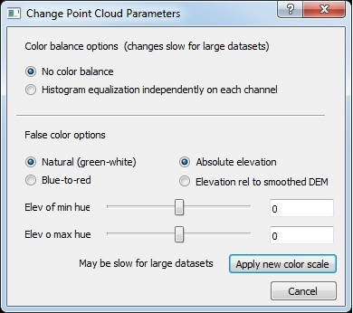
False-Color Options
Choose 2 different color palettes
Choose whether to set hues for absolute elevation or elevation relative to local terrain – very useful for hilly terrain

Slide 2
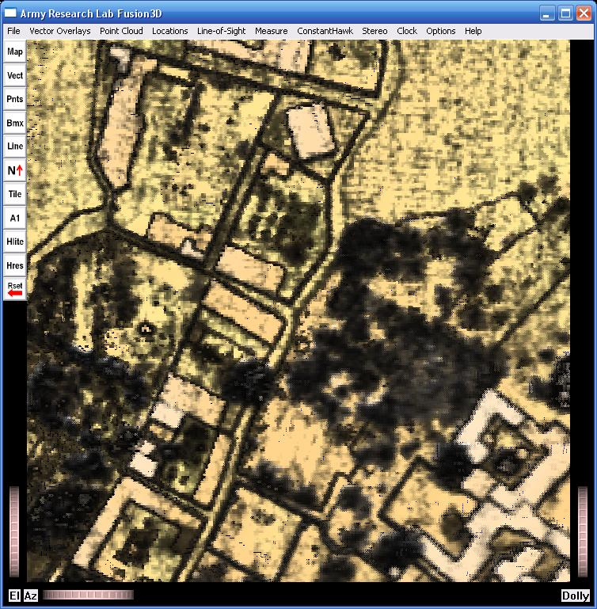
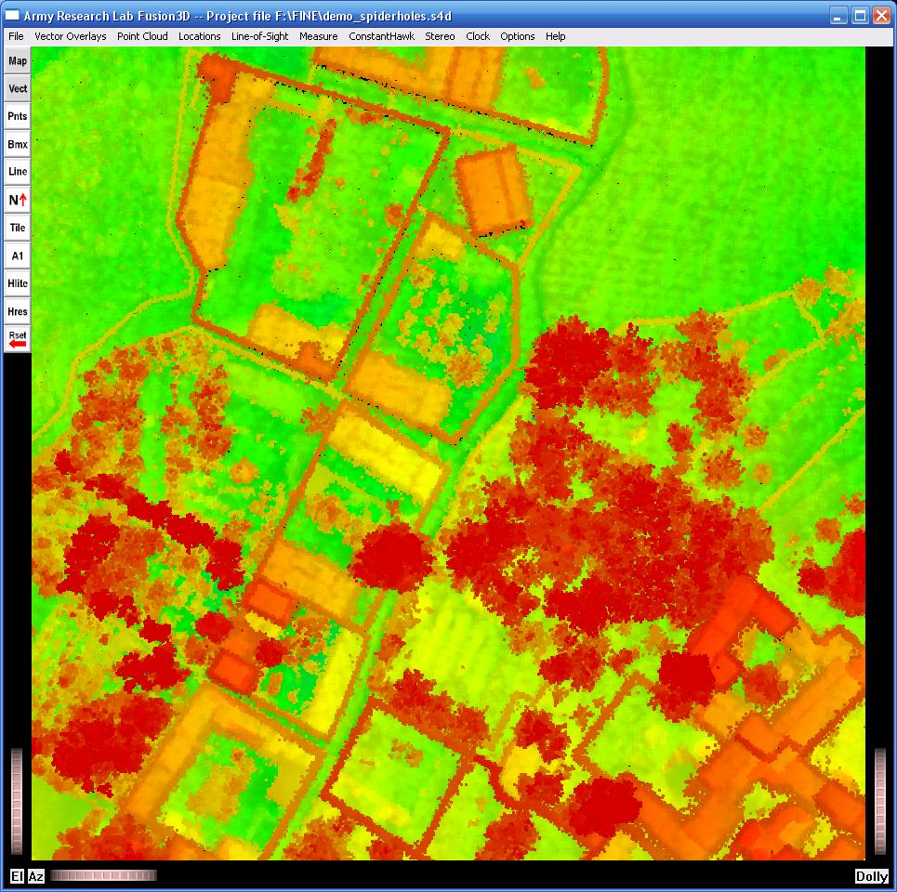
Natural and Red-Blue Color Palettes
Natural hues look more like actual terrain but don’t show as much detail.
Red through green to blue hues show detail but don’t look at all natural

Slide 3
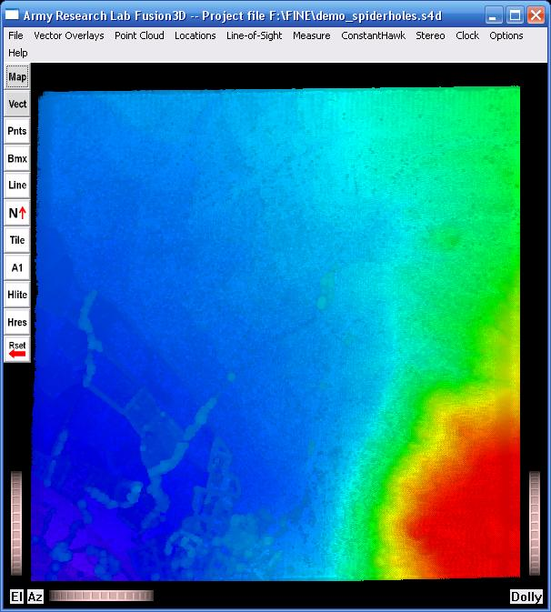
False-Color Hues for Absolute Elevation
Hues are typically determined by absolute elevations as shown in the sample scene left.
This false color scheme is sometimes helpful to show general slopes but it often misses details in any part of the scene.

Slide 4
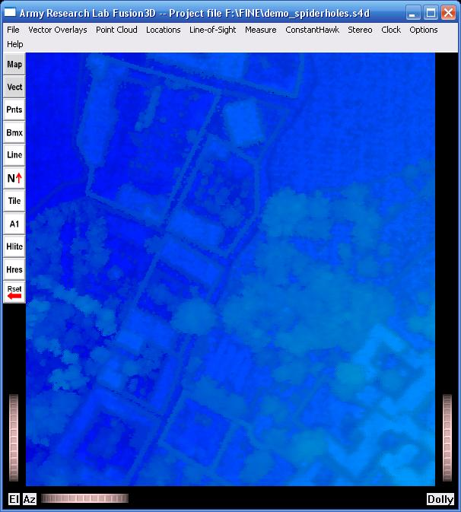
False-Color Hues for Absolute Elevation
Details of the town at the bottom of the previous scene are hard to see with this color scheme.

Slide 5
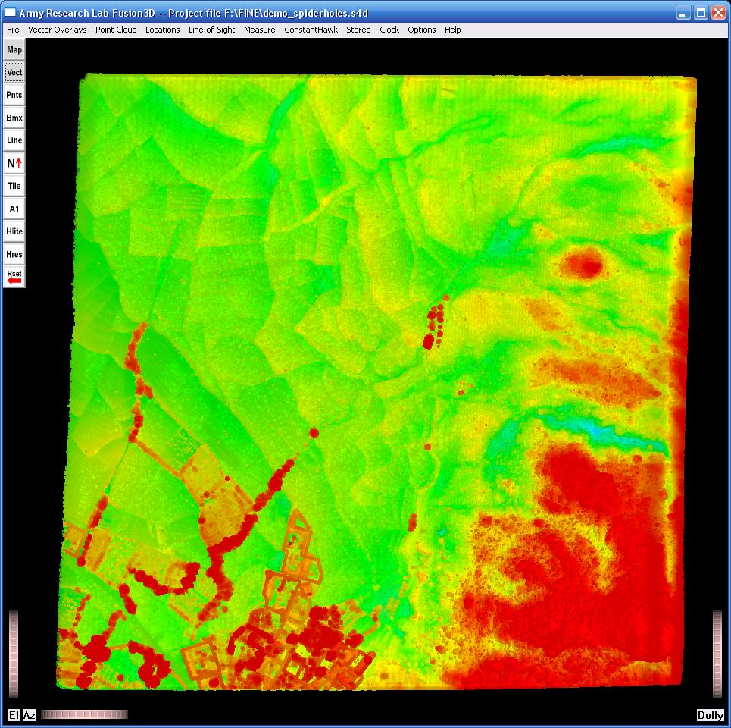
False-Color Hues Relative to Smoothed DEM
Shown here is the same scene using hues determined by the elevation relative to a smoothed DEM.
Trees, buildings and gullies are accentuated across the entire scene. A single color setting works across rough terrain and very large scenes.

Slide 6
False-Color Hues Relative to Smoothed DEM
Details of the town at the bottom of the scene can now be read at a glance.

Slide 7
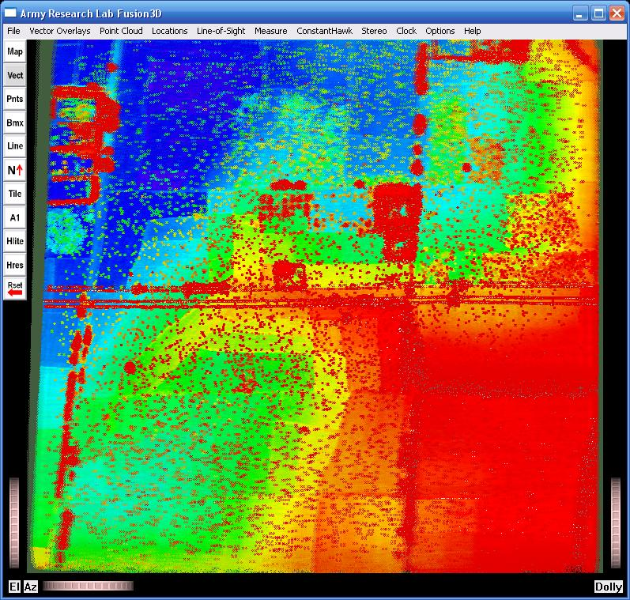
Second Scene with Power Lines -- Absolute
With absolute elevation coloring, power lines are obscured in some part of the image.
Thresholds adjusted for maximum detail on the power lines at the expense of some noise

Slide 8
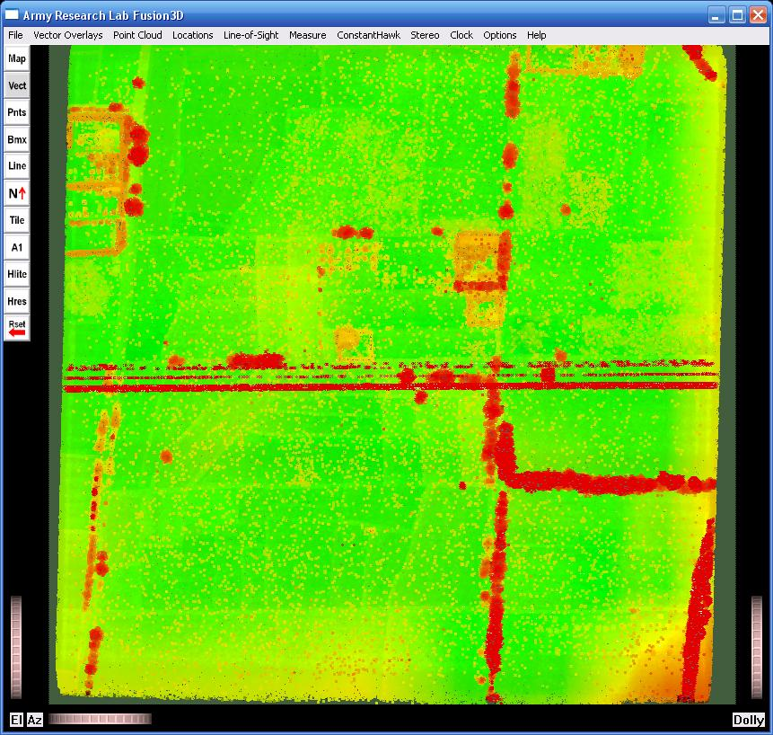
Second Scene with Power Lines -- Relative
With relative elevation coloring, power lines are clearly delineated across the entire image.
Thresholds adjusted to the same level as the previous slide

Slide 9
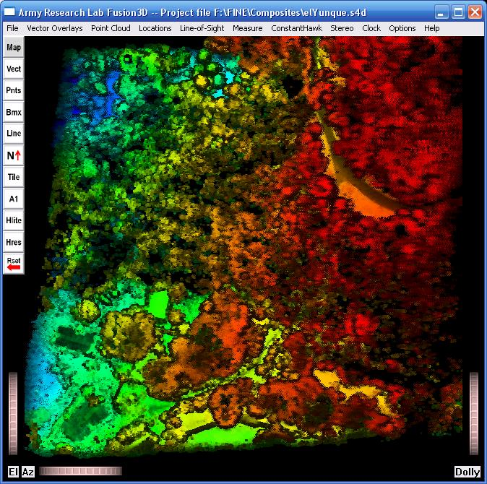
Third Scene -- Absolute
Shown is a second sample scene, elYunque, with the standard hues.

Slide 10
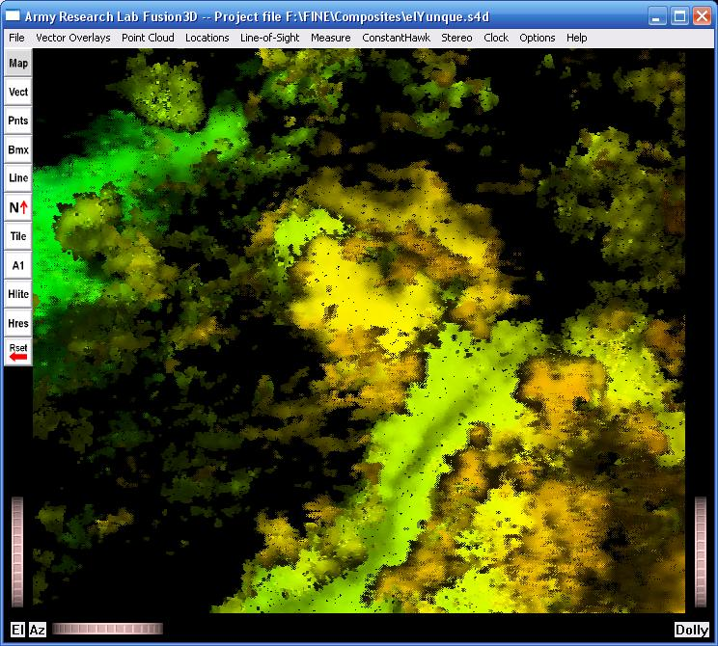
Third Scene Detail -- Absolute
Detail of two houses in the scene

Slide 11
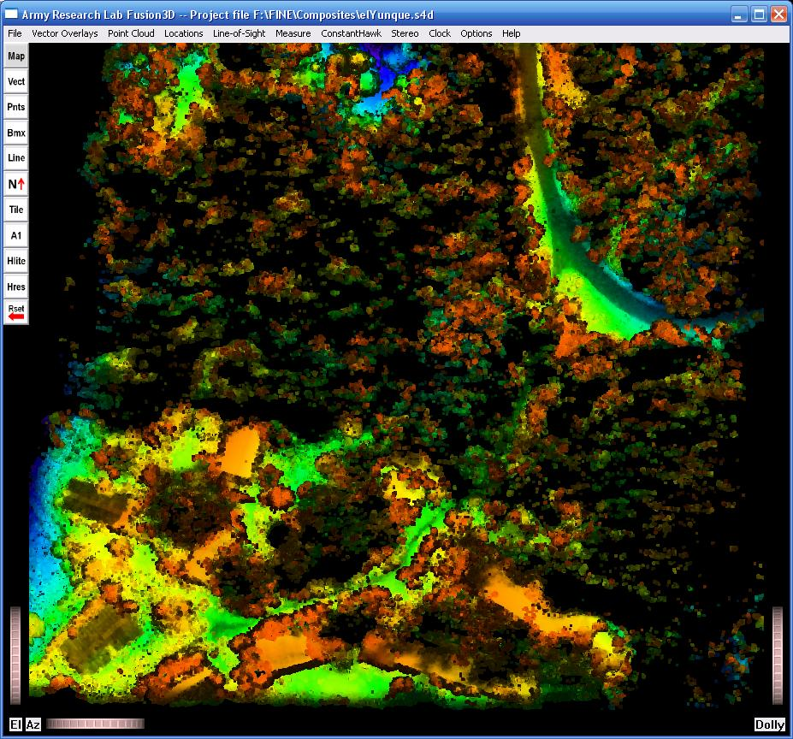
Third Scene -- Relative
The elYunque scene with relative hues

Slide 12
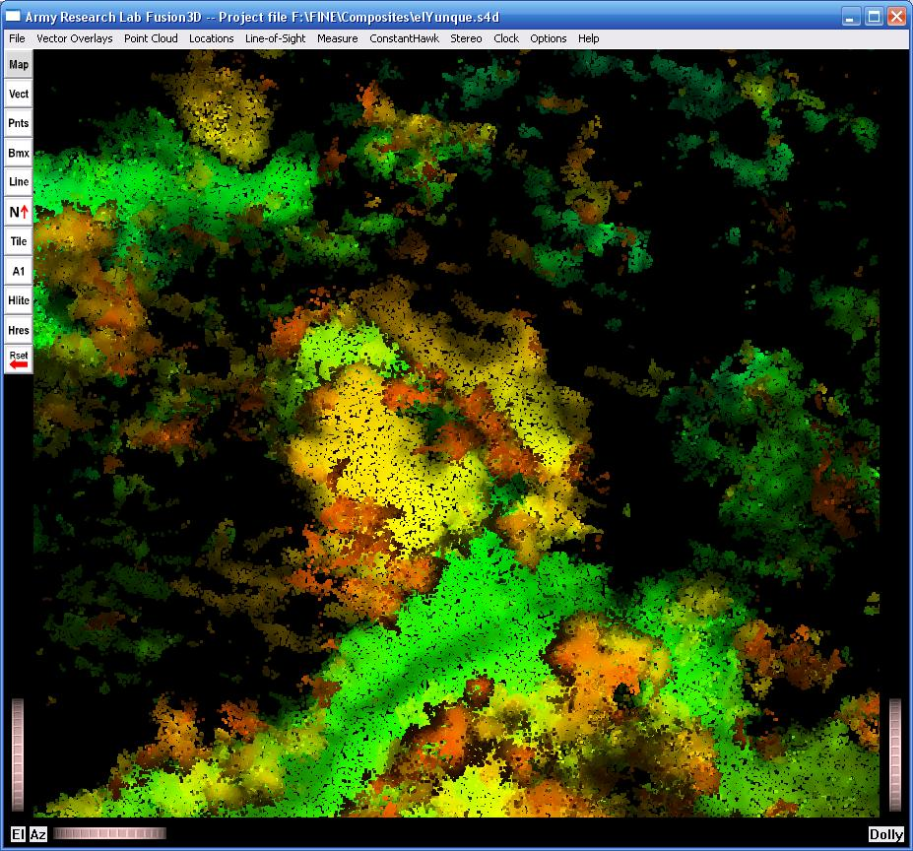
Third Scene Detail -- Relative
Detail of 2 houses from the elYunque scene with relative hues.
The houses in yellow stand out against both the green ground and the red trees.

