Slide 1
Fusion3D Viewer
Getting Started
Objective:
The Fusion3D viewer is based on rasterized Digital Surface Models (DSMs) . Its focus is on visualization of these maps and fusion with orthophotos, lidar point clouds, and annotation overlays.
Contact:
Developer:
Dr J.F. (Jeff) Dammann
tj71dammann@poetworld.net
For The Army Research Lab
Government POC:
Damon M. Conover
damon.m.conover.civ@mail.mil

Slide 2
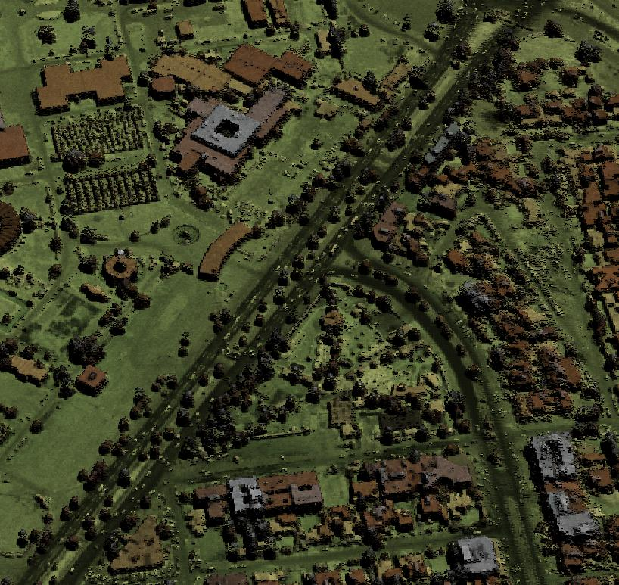
Installation
CMake files and a premade Visual Studio solution are provided
The viewer does not require formal installation.
Hardware Requirements
The viewer has been tested under Windows and Linux 64 bit versions.
It works best with a decent graphics card and a moderate amount of memory -- a workstation class machine with a good graphics card is recommended.
It also runs successfully on laptops and tablets with slower response.

Slide 3
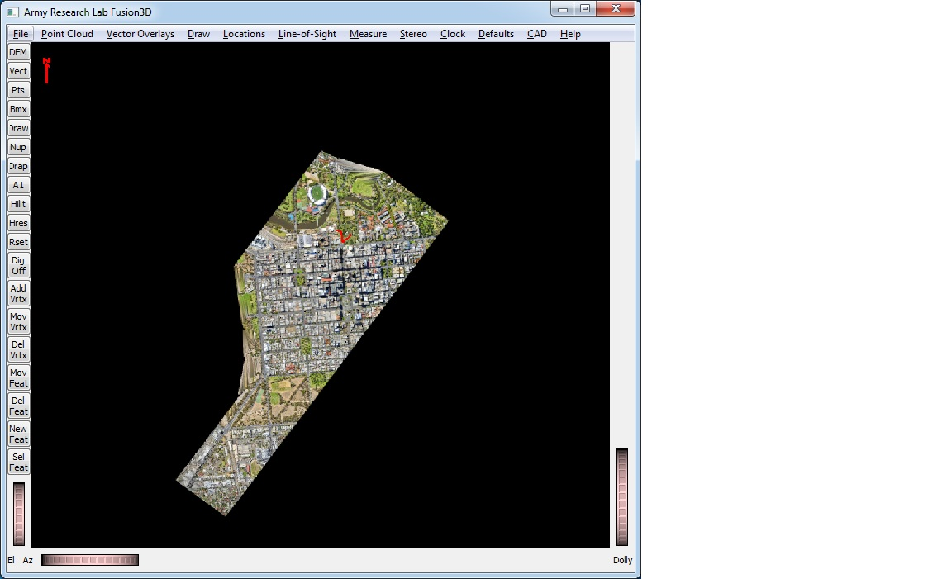
Running the Viewer
Run Fusion3D.exe to start the program and bring up the main window
From the ‘File’ menu, select ‘Open Project’ and open the Project file ‘Fusion3D/data/Scene/ sampleProjFile.s4d’
Contains DEM and Point Cloud layers that can be toggled with buttons at the top left

Slide 4
Navigation
Navigation is constrained to keep heads-up, to avoid going under the ground and, generally, to keep the view natural.
This thumbwheel tilts the scene
This thumbwheel rotates the scene
This thumbwheel and mouse wheel zooms
Left-mouse click a point to the center of the screen to pan
Right mouse to pan

Slide 5
Sensor Naming Conventions
The viewer makes it easy to load single or multiple tiles where the files follow the BuckEye, HALOE or ALIRT file-naming conventions.
Konar_Site16_tile1
dem_1m_a1_konar_site16_tile1.tif
dem_1m_a2_konar_site16_tile1.tif
int_1m_a1_konar_site16_tile1.tif
mrg_1m_a1_konar_site16_tile1.kml
mrg_1m_a1_konar_siet16_tile1.tif
KonarSite16_200910_Block01_Complete.sdw
KonarSite16_200910_Block01_Complete.sid
KonarSite16_200910_Block01_Complete.aux
Typical BuckEye directory structure with primary ‘a2’ and secondary ‘a1’ DEMs, false-color ‘mrg’ and lidar intensity ‘int’ textures, MrSID orthophotos and KML extent
345200N0710800E
345200N0710800E_EGM96_DSM.tif
345200N0710800E_WGS84_DSM.tif
345200N0710800E_INT.tif
345200N0710800E_REP.kml
Typical HALOE directory structure with 2 primary DEMs for different vertical datums, lidar intensity ‘int’ texture and KML extent
343000N0690600E
343000N0690600E_20101106170510_ALIRT_100_DSM_00_0_UFO.kml
343000N0690600E_20101106170510_ALIRT_100_DSM_00_0_UFO.tif
343000N0690600E_20101106170510_ALIRT_100_RII_00_0_UFO.tif
…
Typical ALIRT directory structure with primary DEM, 9 lidar intensity ‘RII’ texture files and KML extent

Slide 6
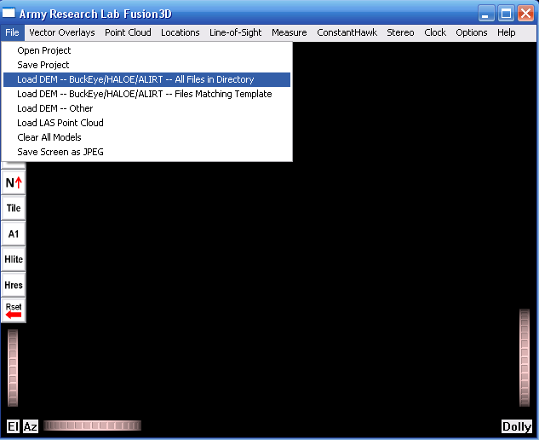
Loading a BuckEye DSM/DEM Map
Under the file menu, click on ‘Load DEM – BuckEye/HALOE/ALIRT – All files in directory’

Slide 7
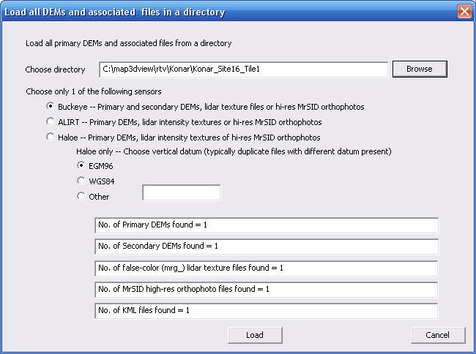
Loading a Buckeye DSM/DEM Map
If files follow BuckEye, HALOE or ALIRT naming conventions, the viewer loads all files for a tile -- or multiple tiles -- in one step
1. Choose the directory
2. Choose the sensor
3. For HALOE only, choose the vertical datum
4. All DEMs and associated files will be identified
5. Shows files found

Slide 8
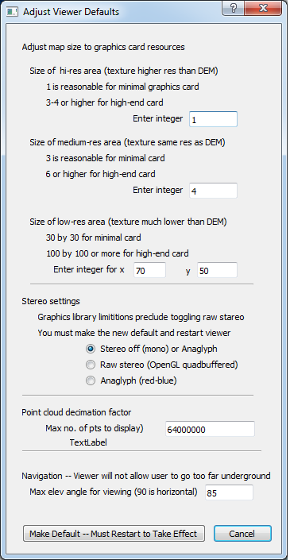
Modify Default Resources
Resources are set for minimal hardware. Users with better hardware can enlarge the map area displayed and turn on stereo
There is a high-resolution region at screen center, medium resolution beyond that and low resolution at map edges only for context
Increase the size of the hi-res area
increase the size of the medium-res area
Increase the size of the low-res area – about 30x30 is enough to cover an entire tile
Toggle the stereo – Note that you must restart the viewer to change this setting
Increase the max number of point-cloud points to display
You must restart Fusion3D for changes to take effect

Slide 9
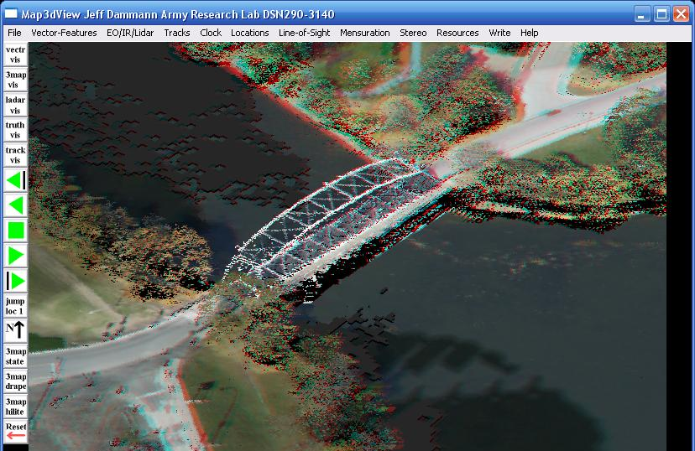
Check Out the Stereo
Anaglyph (red-blue) stereo can be turned on from the Stereo menu. Any cheap pair of paper red-blue glasses provides decent stereo. Great quality stereo is available with the quadbuffered stereo such as provided by the Nvidia hardware.

