Slide 1
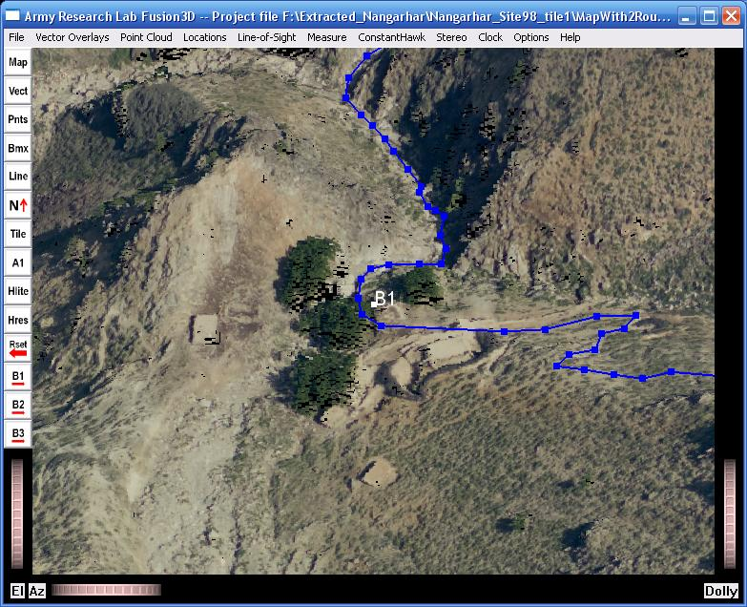
Making Routes
You can digitize detailed routes and save to either Shapefiles or KML files.
High-resolution elevations and stereo display help plan the best routes. Routes then follow these elevation contours.
You can edit the route, moving, deleting, or appending points or merging files.
You can measure true distances along the route, taking into account elevation changes and the winding nature of routes in rough terrain.
You can fly along the route spotting potential dangers.

Slide 2
Making Routes – Current Constraints
You can only work on a single route (a single line feature) at a time.
  So track editing and distance measure can only be done on a single track.
  Additional routes can be displayed as simple vector overlays

Slide 3
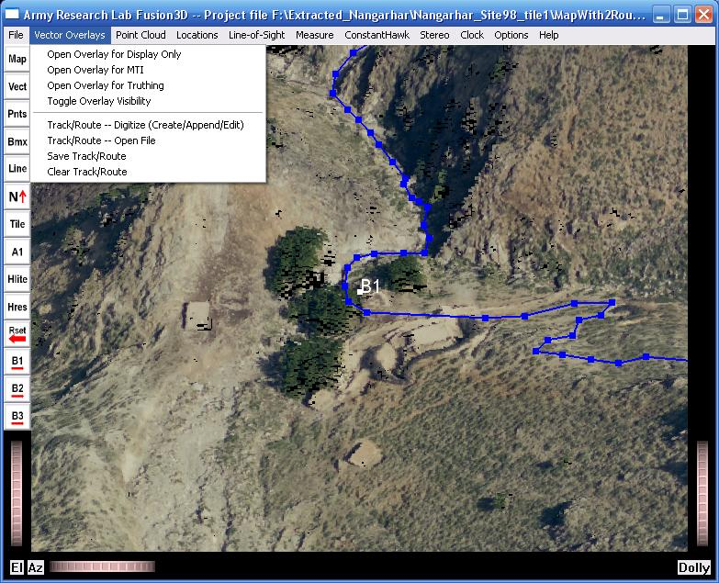
Making Routes – Menus
Digitize – Append points to the route, move points or delete points.
Open a file. The file will be merged with the current route. The order of old and new portions of the route will be adjusted for correct match.
Save the entire route to a Shapefile or KML file.
Clear the route.

Slide 4
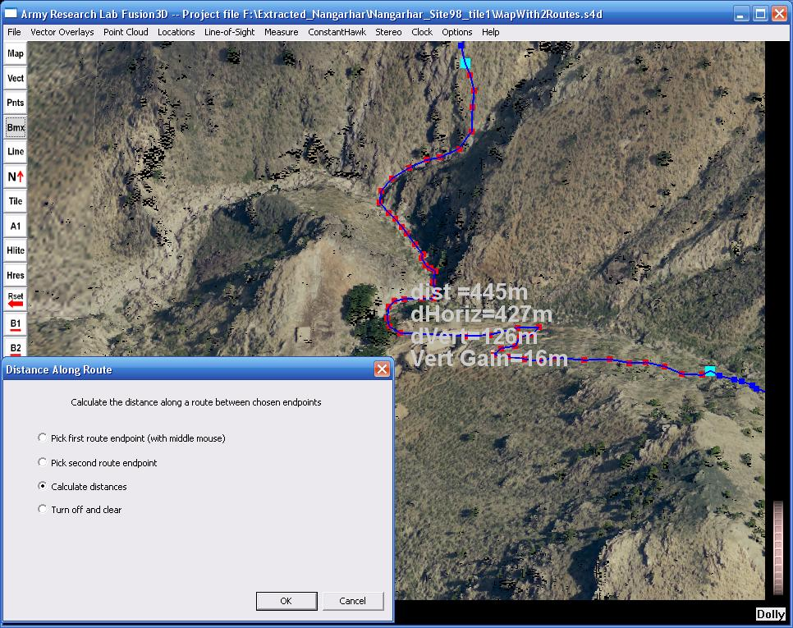
Making Routes – Measuring Distances
Step 1: Pick the first endpoint – click the first entry on the menu, then use middle mouse to choose the point
Step 2: Pick the second endpoint.
Step 3; Calculate distances.
Change either endpoint and repeat calculation if desired.
Clear all
Total distance walked
Horizontal distance
Vertical distance
Net elevation gain

Slide 5
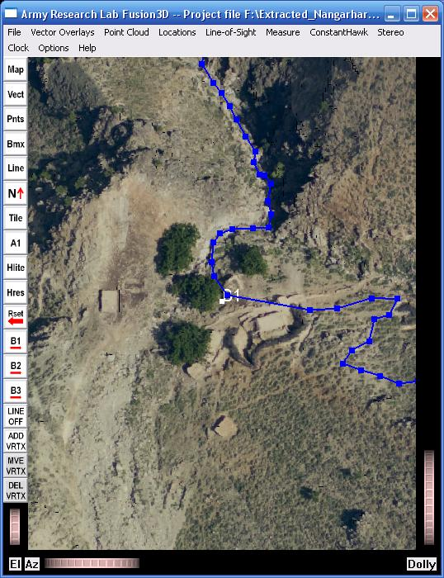
Making Routes – Digitizing and Editing
Use middle mouse for all editing functions.
If you click too far from the route, there will be no action.
Turn off editing.
Append points to the route.
Move a point – either drag or just click nearby.
Delete nearest point.

Slide 6
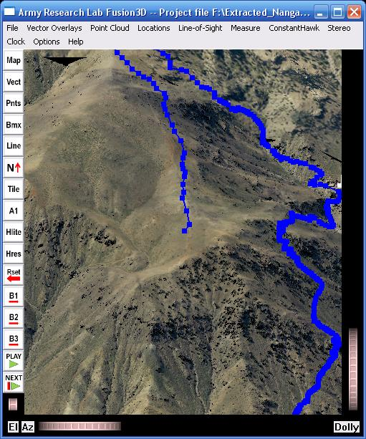
Making Routes – Flying Along the Route
Nice animations with some hand tuning.
You control the camera elevation and distance.
You can either control the camera azimuth yourself or set to automatically follow along the direction of motion.
You can ‘average’ to reduce jerkiness due to digitizing or abrupt changes in route direction.
Fly along the route
Move 1 step along the route.

