Slide 1
Stereo Options in Fusion3D
There are 3 stereo options in Fusion3D
  High-quality stereo. This can use either active or passive glasses, both of which are used with 3D monitors and TVs
  Lower-quality stereo using the red and blue colors and paper glasses like the original 3D movies (called anaglyph)
  No stereo (mono)
Due to limitations in the underlying libraries, you cant switch on the fly between the high-quality stereo option and the other 2 options (use the ‘Defaults’ menu and restart the viewer)
  You can temporarily turn off the high-quality stereo by setting the offset between the 2 eyes to zero
  You can set defaults so for either high-quality stereo or mono/anaglyph
  You can switch freely between mono and anaglyph

Slide 2
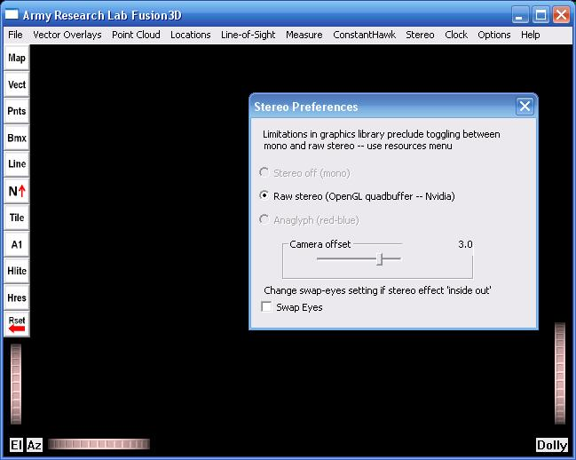
Temporarily Turn Off Stereo
Setting the ‘Camera offset’ slider to 0 effectively turns off stereo
Due to limitations in the underlying libraries, you cant switch to mono or anaglyph on the fly

Slide 3
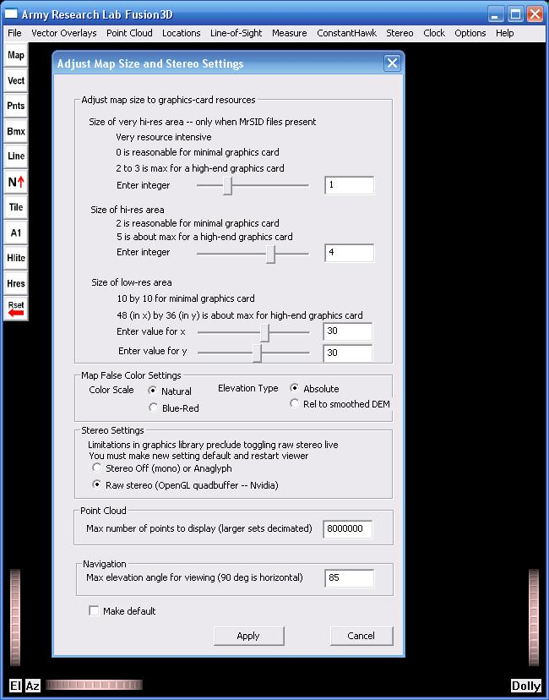
Change Default Color Settings
Change the stereo default setting. Due to limitations in the underlying libraries, you cant switch between high-quality (‘Raw’) stereo and mono/anaglyph on the fly.
Check the box to make this new setting the default.
Hit the ‘Apply’ button
Restart the viewer – it will initialize with the new setting.

Slide 4
Adjusting Stereo Separation
Try adjusting the ‘Camera offset’ to find a comfortable stereo separation.
Large offsets are very dramatic but may cause eye fatigue.

Slide 5
Swapping Eyes
Some types of stereo hardware may not totally sync and may get the right and left eyes crossed.
This will make the scene look ‘inside-out’ where things that should be closer to you look further away and vice-versa.
Try toggling the ‘Swap Eyes’ button – it will be obvious which setting is right.

Slide 6
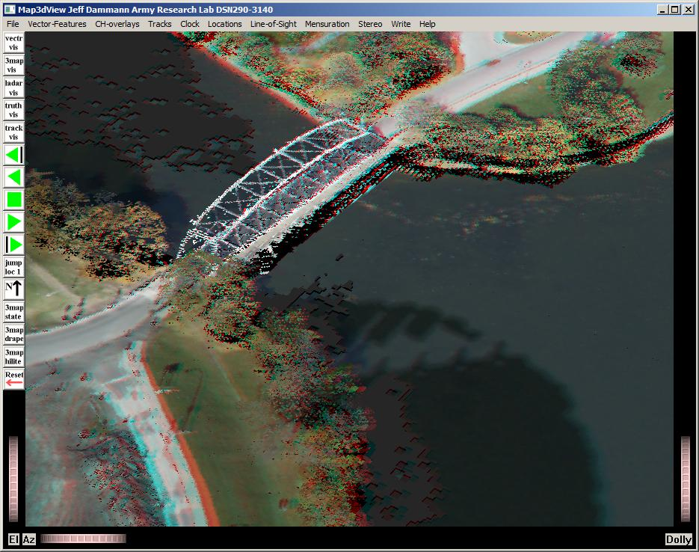
Anaglyph (Red-Blue) Stereo
This type of stereo is much lower quality, but requires no special computer hardware and only cheap paper glasses
Sample image

Slide 7
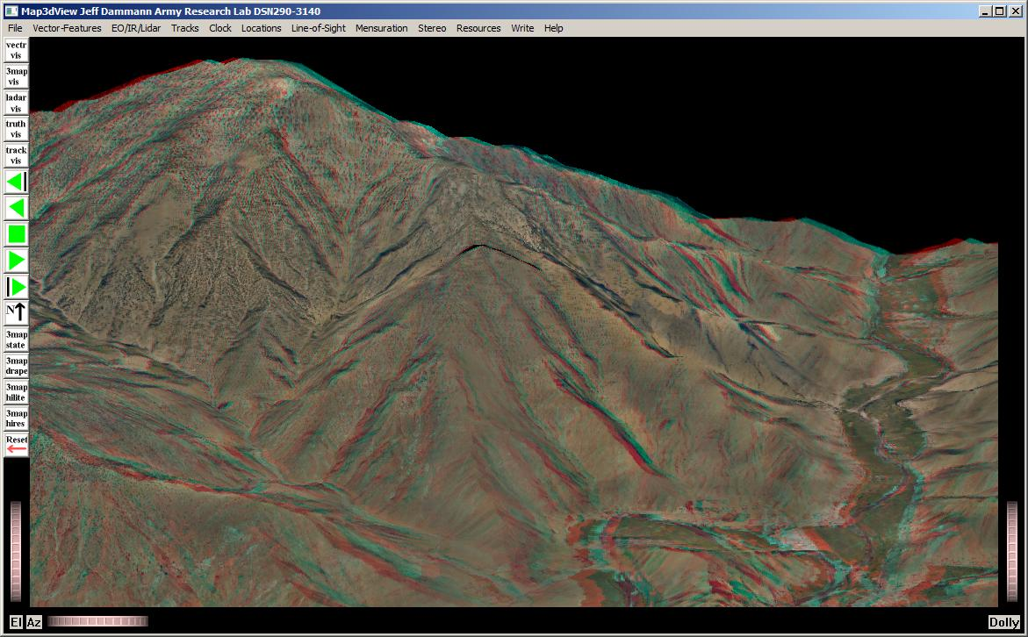
Anaglyph (Red-Blue) Stereo
Another sample anaglyph image

