Slide 1
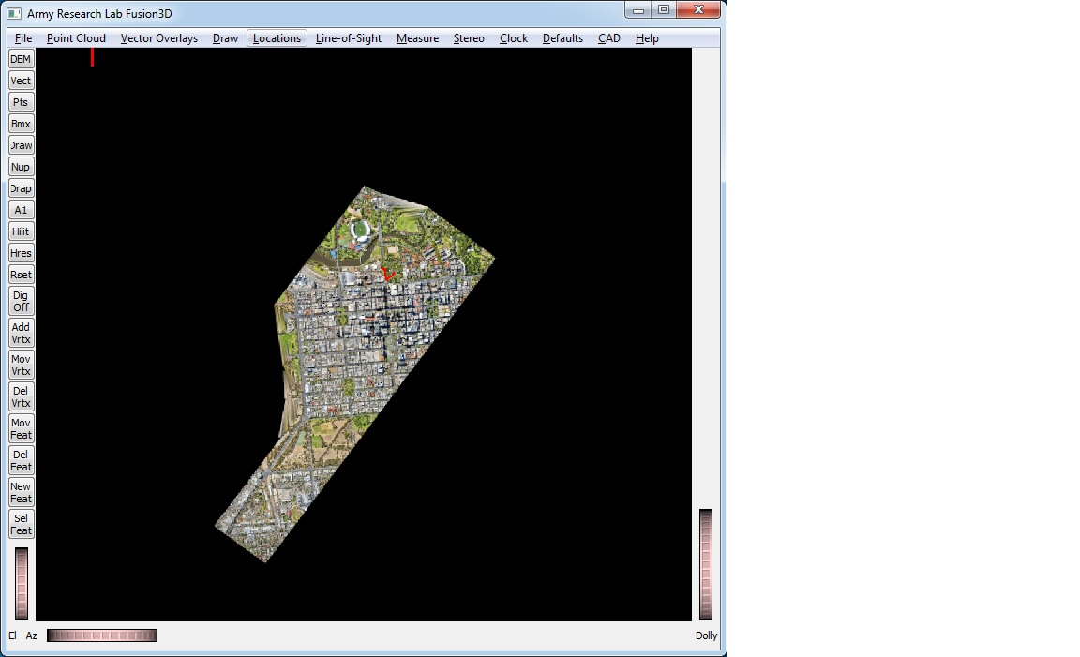
Fusion3D Buttons
DEM Map
Vector Overlays
Point Clouds
Toggle
Layers
Bookmarks
Draw Objects
Rotate North Up
DEM Vis
Params
Drape DEMs
Toggle First-Hit DEM
Highlight Vertical Obstructions
Toggle Highest-Res Textures
Reset to Original Orientation
Optional
Draw
Buttons
Digitize Off
Add Vertex
Move Vertex
Delete Vertex
Move Feature
Delete Feature
New Feature
Select Feature

