Slide 1
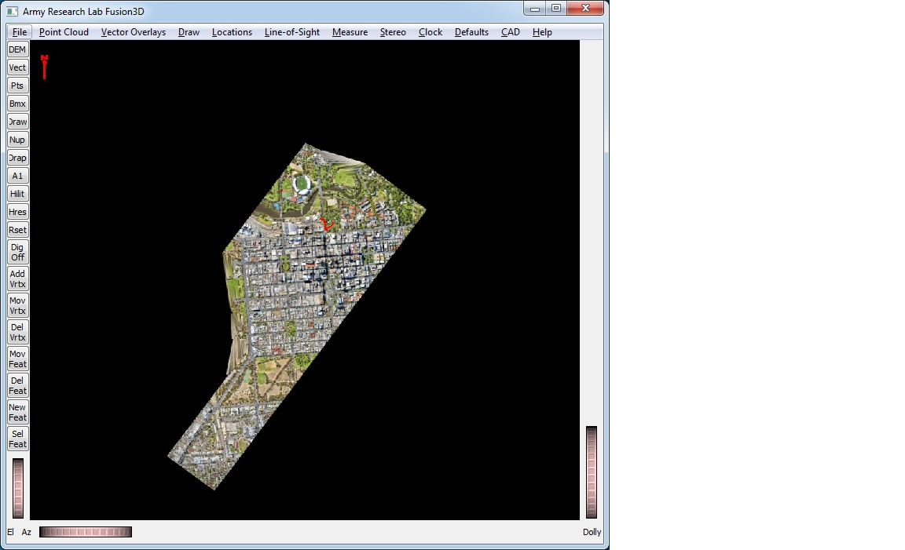
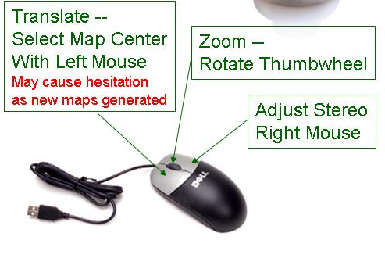
Fusion3D Navigation
North Pointer
Drag to Rotate
Tilt
Rotate
Zoom

