Slide 1
A Better Way of Deriving a Digital Surface Model (DSM)
International Lidar Mapping Forum
24 January 2012
John F. (Jeff) Dammann Jr.
Army Research Lab

Slide 2
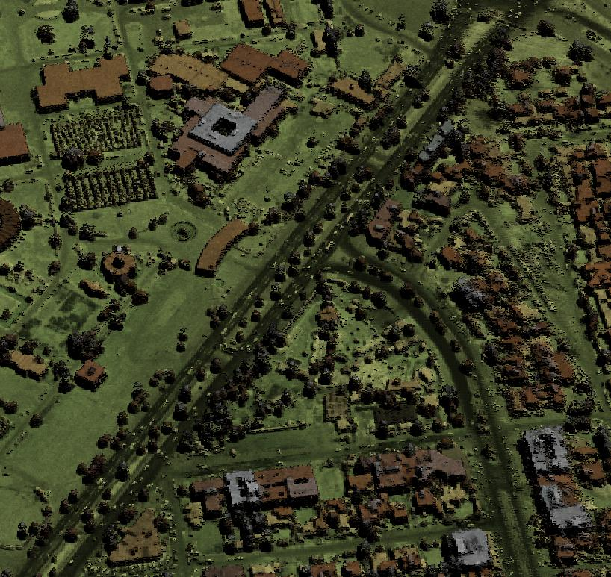
Outline
Convert point cloud to raster digital surface model (DSM) – call it Gridding
Current technique
  Strengths and weaknesses
New approach
Examples of the differences

Slide 3
My Background
User, not a producer, of lidar data
BuckEye DSMs (they call them DEMs)
  Generated by QT Modeler
  1-m resolution or better
  Produces 2 surfaces: first-hit, last-hit
Military applications
  Feature recognition
  Situation awareness
  Fusion with sensor data

Slide 4
Current Technique
Step 1: Create a surface from the irregularly spaced points
Step 2: Sample that surface at regular intervals to create raster DSM
Several software packages
  QT Modeler
  ArcGIS 3-D Analyst
  ERDAS Imagine
  Grass

Slide 5
Current Technique
Aspects of the problem modeled very well
  Creates very nice smooth surfaces
  Lots of very sophisticated interpolation techniques
But discretes modeled poorly
  Vertical obstructions – power lines and poles, light poles, towers
  Man-made objects – houses, walls, fences
  Trees and bushes
  Common and ‘interesting’ features
  Averages discrete features into the surrounding surface
Samples at pixel centers

Slide 6
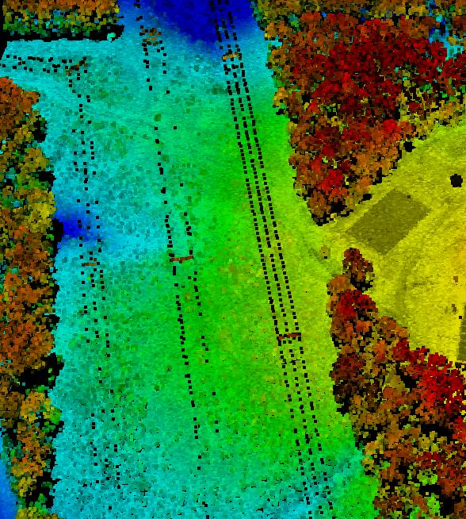
Power Line Example
The raw LAS data shows a set of power lines with 3 parallel lines at the same elevation. The 3 rows of black dots are hits on the lines and clearly show only 3 lines at a uniform elevation (except for typical sag in the lines between the poles).

Slide 7
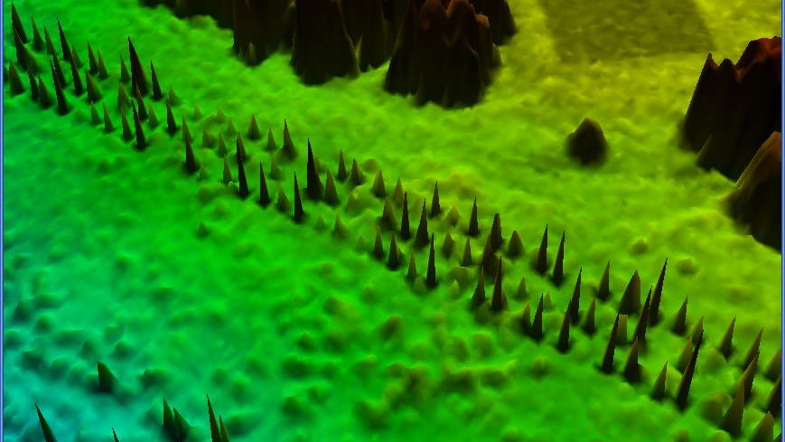
Power Line Example, Old Technique
Power line
The BuckEye product DSM (using the older QT Modeler algorithm) shows random elevations between the ground and power-line. Almost all pixels for the power line are at bogus elevations – neither the ground or the line. This makes it much more difficult for a person or machine to interpret the data.

Slide 8
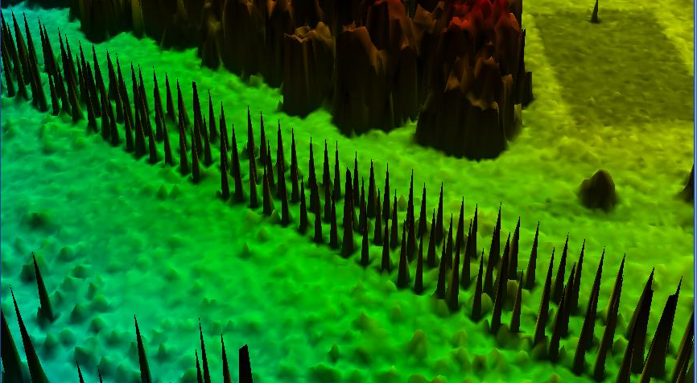
Power Line Example, New Technique
The new technique shows hits at the proper power-line elevation.

Slide 9
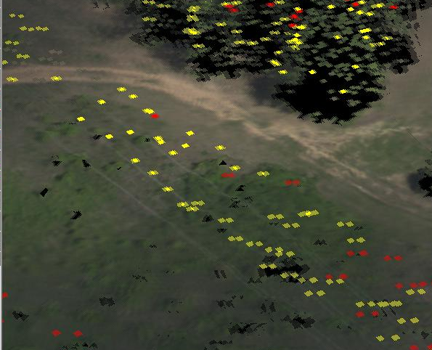
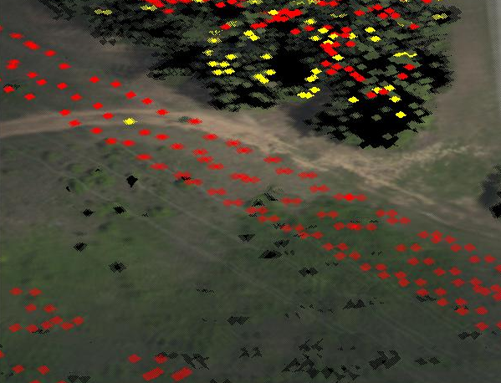
Power Line Example, Different Viewer
New
Old
Different viewer visualizes terrain as smooth surface and discrete hits on powerline as highlighted red squares. From an angle, new gridding technique shows much clearer pattern of hits.

Slide 10
New Technique
(x1, y1, z1)
(x2, y2, z2)
(x3, y3, z3)
. . .
discard
For each raster pixel, collects statistics on points falling within that pixel
  Each hit contributes to pixel, then discarded
  Very efficient, scalable
Discriminates whether there are multiple objects within the pixel or only one
If one object, uses the average of all the pixels
  Averages over noise, small-scale clutter
If multiple objects, uses the max, min value
  Max captures the vertical obstructions
  If a second surface, min captures the ground level at the pixel
add stats
add stats

Slide 11
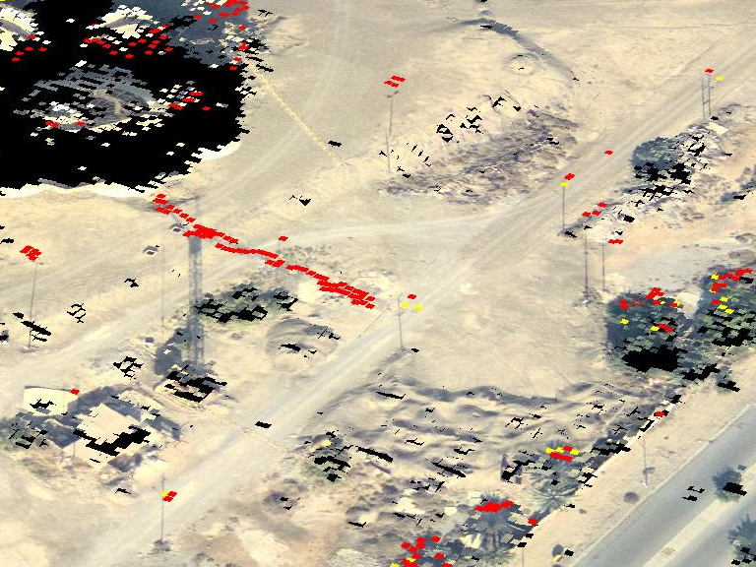
Baghdad Crane and Light poles, New Technique
The crane boom is clear. Also the height and multiple lights on some of the poles can be discerned.

Slide 12
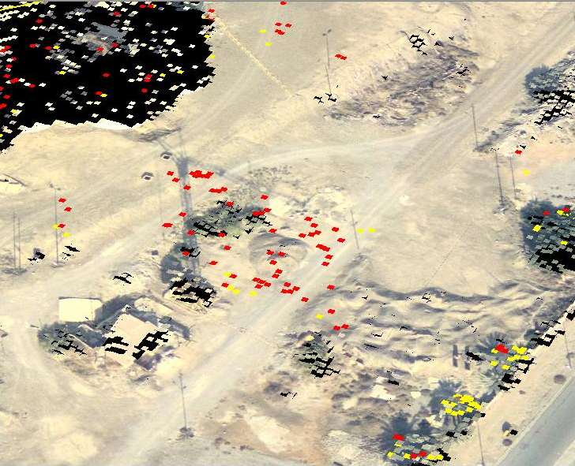
Baghdad Crane and Light poles, Old Technique
Power line
The BuckEye product DSM (using the older QT Modeler algorithm) showing a crane and light poles (note the shadows)

Slide 13
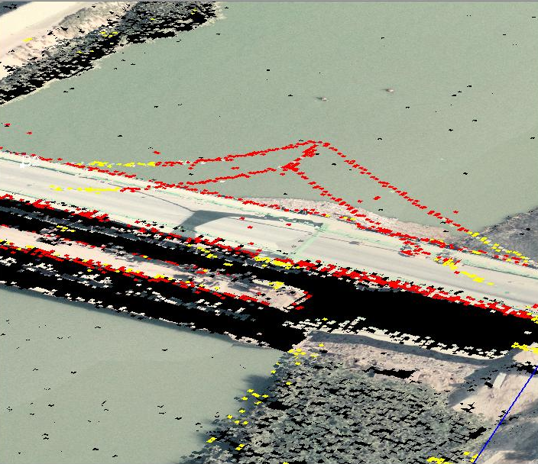
Baghdad Bridge, New Technique
The new technique shows hits at the proper elevations. Bridge suspension tower and cables show clearly. Sides of bridge much clearer.

Slide 14
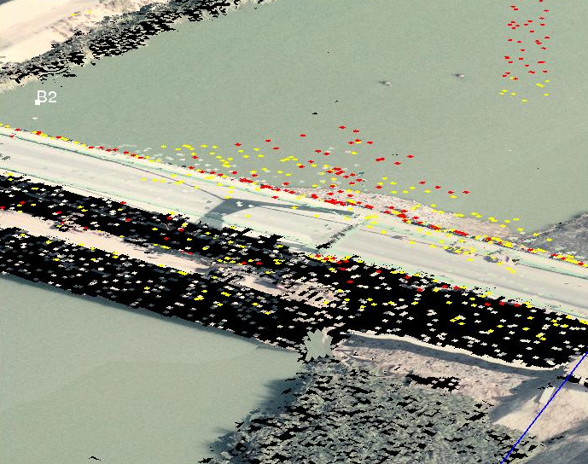
Baghdad Bridge, Old Technique
Power line
The BuckEye product DSM (using the older QT Modeler algorithm) shows random elevations for bridge superstructure and area below the bridge. Many pixels are at bogus elevations and structures are muddled.

Slide 15
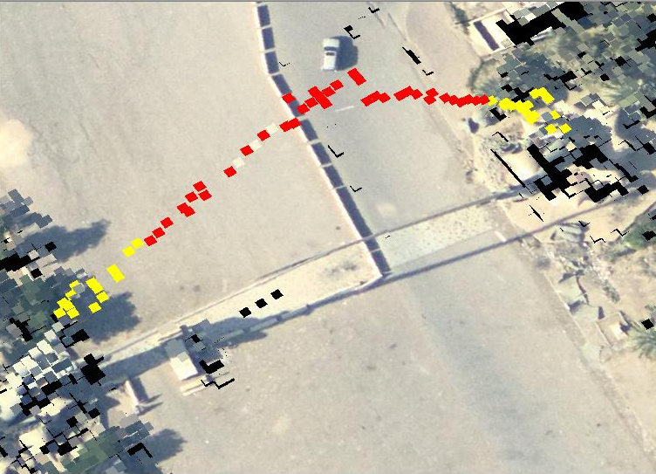
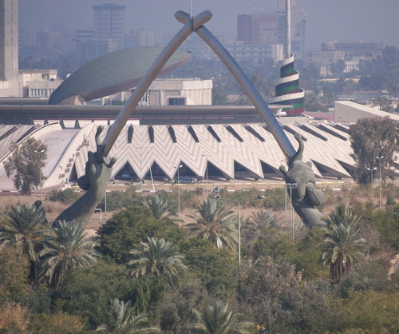
Baghdad Monument, New Technique
The monument shows crossed sabers. The new technique makes this structure clear.

Slide 16
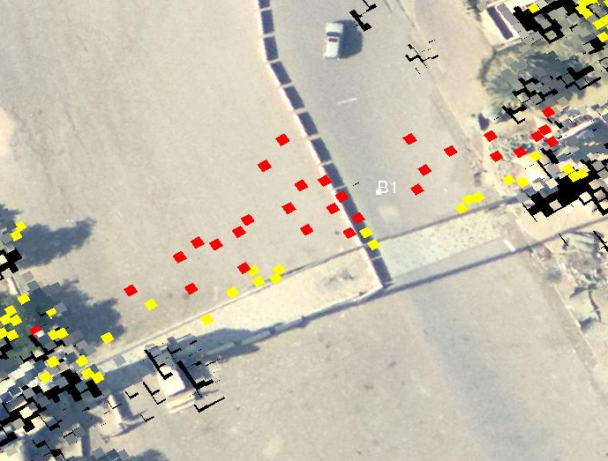
Baghdad Monument, Old Technique
Power line
The BuckEye product DSM (using the older QT Modeler algorithm) shows random elevations with many pixels at bogus elevations and structures obscured.

Slide 17
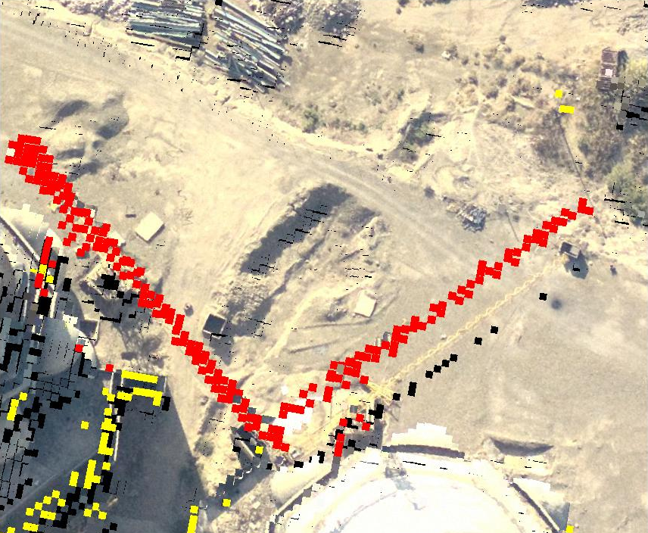
Baghdad Grand Mosque, New Technique
Two cranes above the mosque. The new technique makes the booms and towers clear.

Slide 18
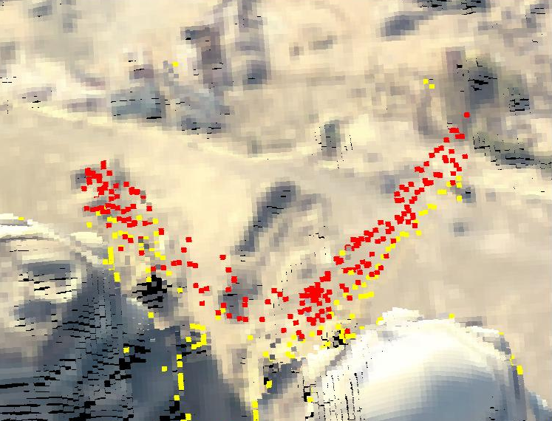
Baghdad Grand Mosque, Old Technique
Power line
The BuckEye product DSM (using the older QT Modeler algorithm) shows random elevations with many pixels at bogus elevations and structures obscured.

Slide 19
Conclusions
Which gridding technique you use is important
  Big differences for vertical obstructions, other man-made objects
I have written my own gridding package
  Simple but works well
  Not ready for general use
QT Modeler has just introduced new gridding options based on this technique
  Based on talks with them
  Not exactly as I would have done it, but basically right
Could merge best of old, new techniques

