Slide 1
Fusion3D Viewer Highlighting Feature
Highlighting vertical obstructions makes checking flight paths and landing zones faster and more reliable
Dr. J.F. Dammann Jr
tj71dammann@poetworld.net
301-787-5346
For DEVCOM Army Research Laboratory

Slide 2
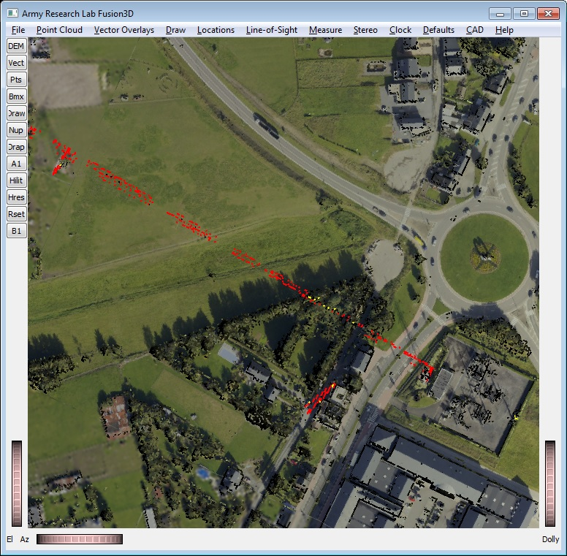
Vertical Obstructions are Highlighted in Red
Any point more than threshold amount above the local elevation is highlighted in red.
Points above a lower threshold are highlighted in yellow.
Powerline is highlighted in red with a few yellow points on lower areas
A crane is also highlighted.

Slide 3
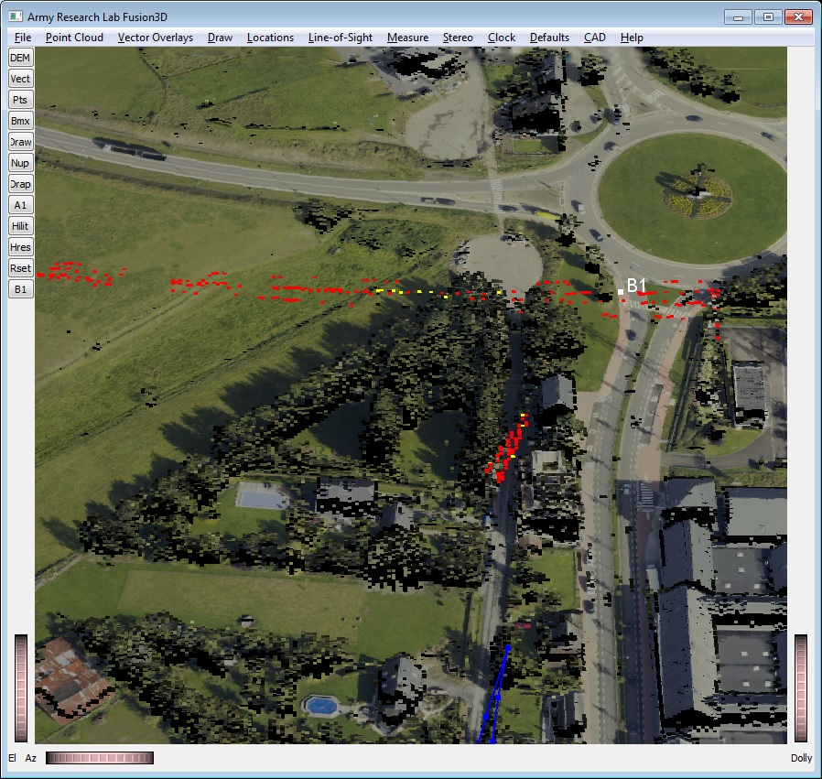
Closer View of Highlighted Features
BuckEye Datasets
Elevations and EO imagery from the BuckEye program.
Elevation Digital Surface Model (DSM) has 1-m resolution. The EO imagery resolution is 10cm.
3 powerlines can be clearly seen even in a cluttered scene.
There are often anomalies in the data. The crane was moving as the lidar data were taken resulting in a double image.

Slide 4
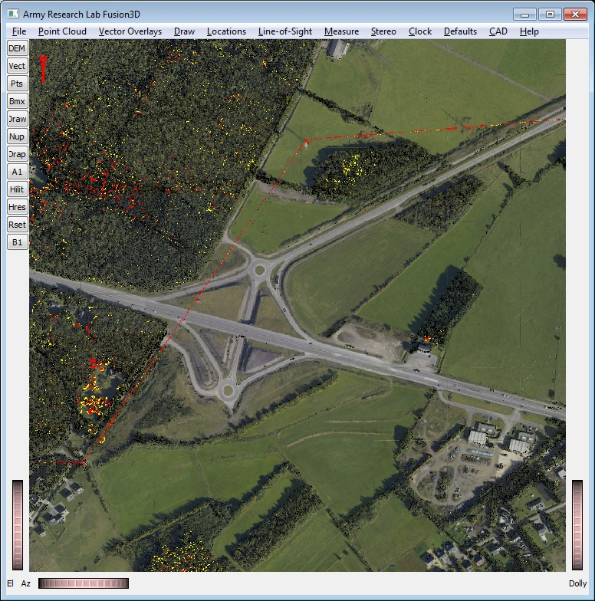
Highlighting Makes Even Smallest Features Visible
The powerline zigzag is easily seen in a large cluttered scene even though it is only a few scattered pixels wide.
Significant obstructions may only catch a few pixels in the elevation map and are easy to overlook without highlighting.

Slide 5
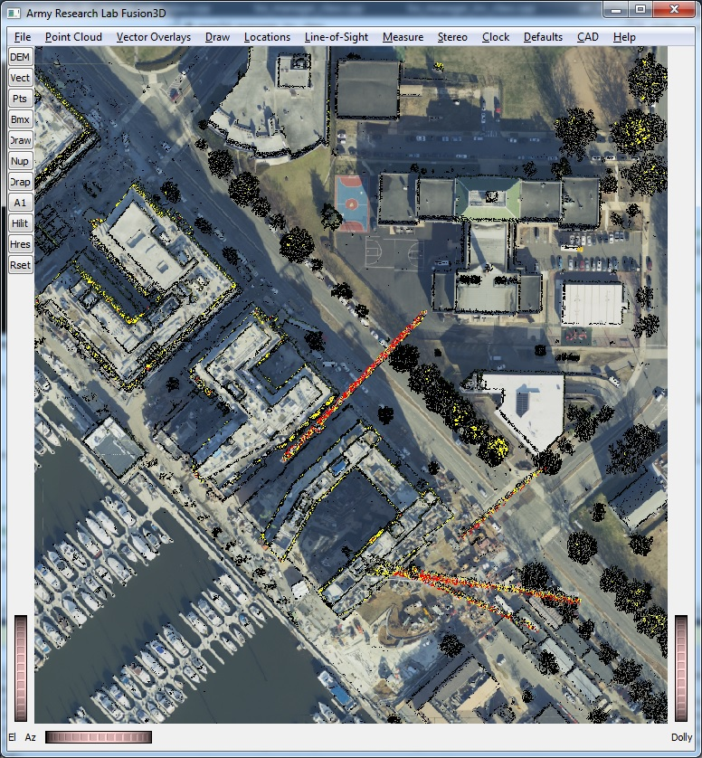
More Cranes on DC Waterfront

Slide 6
Proper Gridding is Important for Analysis of Vertical Obstructions
Gridding is the process of making a regularly-spaced Digital Surface Model from point cloud data.
Improper gridding can put pixels at bogus elevations making vertical obstructions hard to interpret.
It can also underestimate the height of poles, powerlines and other objects that may only receive a few point-cloud hits.

Slide 7
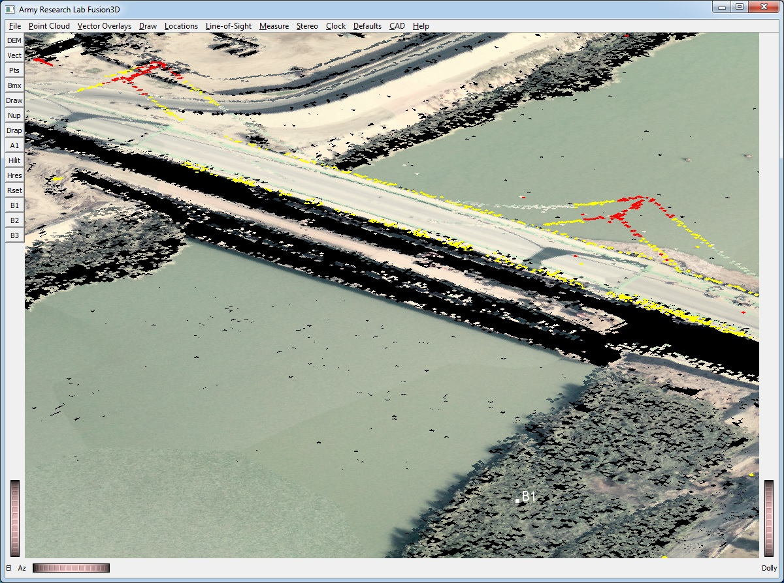
Proper Gridding is Important for Vertical Obstructions
The scene here is a suspension bridge in Baghdad.
The bridge towers and cables are clearly captured and easy to interpret
Proper gridding puts all the points – particularly the highest ones -- at the proper height

Slide 8
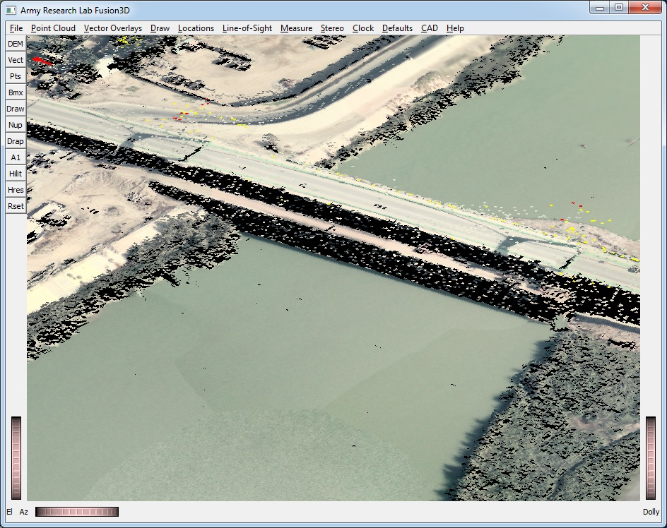
Improper Gridding Makes Interpretation Harder
Improper gridding of the previous scene puts bogus points at elevations not part of the bridge.
There are only a few highlighted points on the critical areas of the bridge, near the towers.

Slide 9
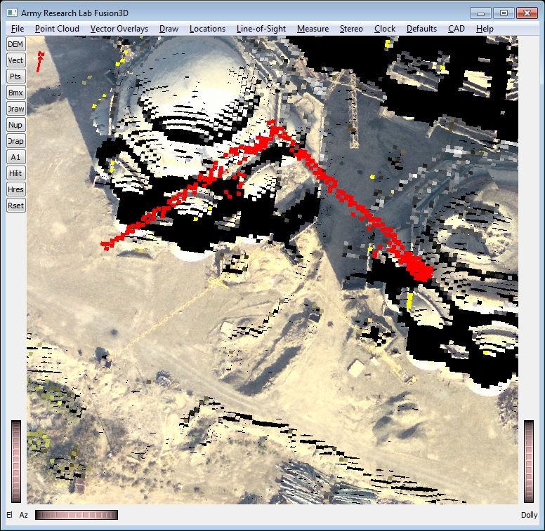
Proper Gridding is Important for Vertical Obstructions
The scene here is a portion of the Grand Mosque in Baghdad showing 2 cranes.
The cranes’ booms are clearly captured and easy to interpret
Proper gridding puts all the points at the proper height of the booms

Slide 10
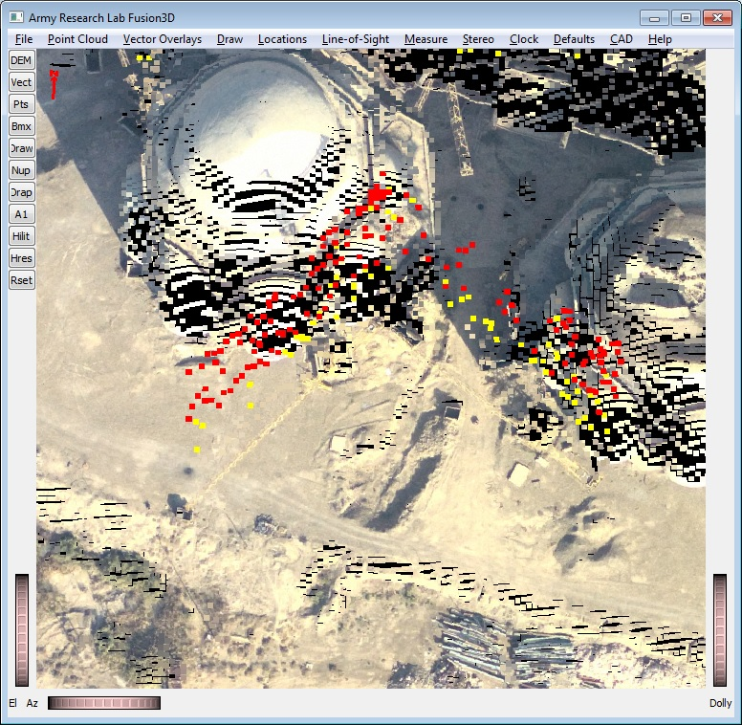
Improper Gridding Makes Interpretation Harder
Improper gridding of the previous scene puts bogus points at elevations between the crane and the ground.

