Slide 1
Fusion3D Viewer Line of Sight
Fast algorithm allows interactive analysis
Unique visualization technique aids interpretation of ambiguous areas
Additional diagnostics also available

Slide 2
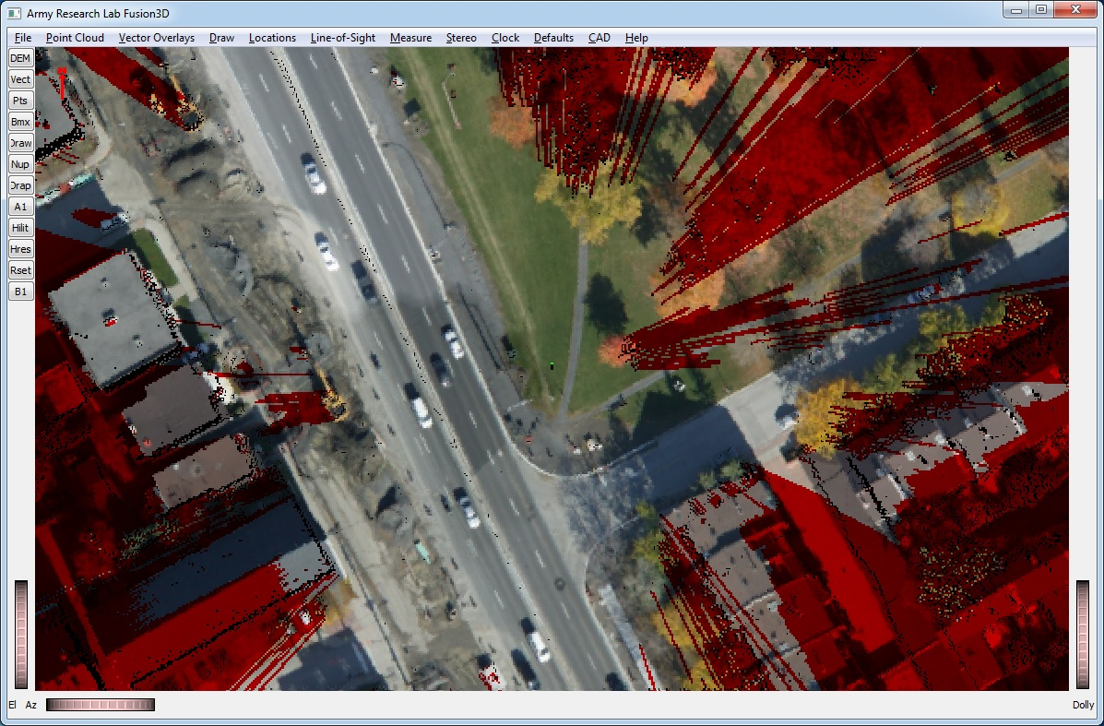
Obscured Regions Can be Visualized in 3D
Shaded areas indicate regions not visible from center point.
Conversely, it can show regions with no sight line to the center point.
green dot at center of pattern shows sensor location
Trees cause irregular obscuration

Slide 3
Visualization techniques aid interpretation of ambiguous areas
Trees and some structures partially obscure but don’t completely obscure objects behind them
The Fusion3D viewer provides additional diagnostics to help interpret these regions
The unique visualization technique also helps to interpret these areas

Slide 4
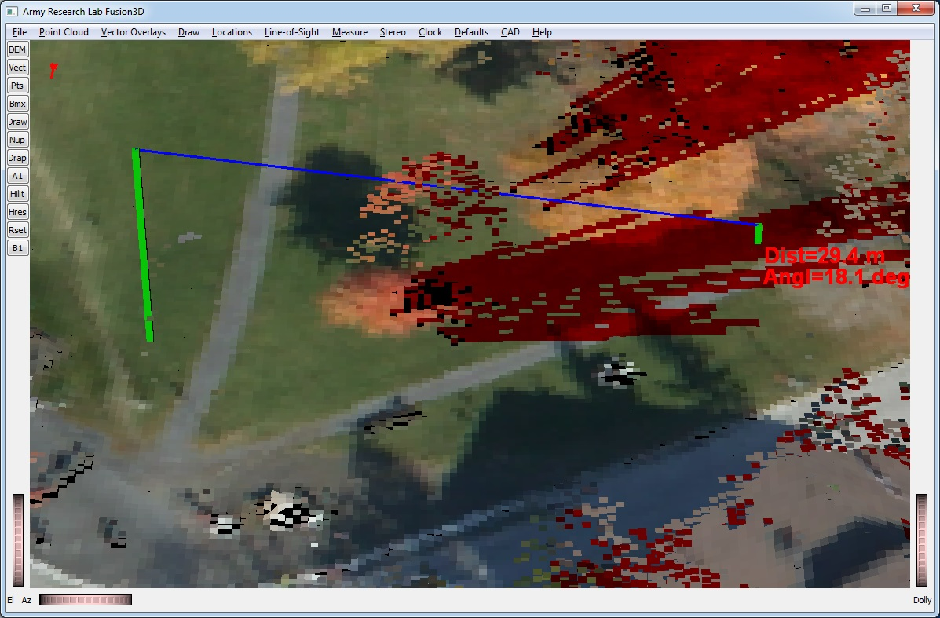
Diagnostics Help to Interpret Ambiguous Areas
One can pick any point in the image and see the LOS from the sensor to that point
Ray from sensor to object passes through fairly dense trees indicating that this area is mostly obscured
Green post indicates elevation of sensor above ground
This post indicates min height of object to be sensed at chosen location

Slide 5
Visualization techniques
The patented Fusion3D rendering technique is unique among terrain viewers
This hybrid approach renders smooth surfaces as smooth but rough areas like trees more like a point cloud
It makes it much easier to interpret areas of partial LOS obscuration

Slide 6
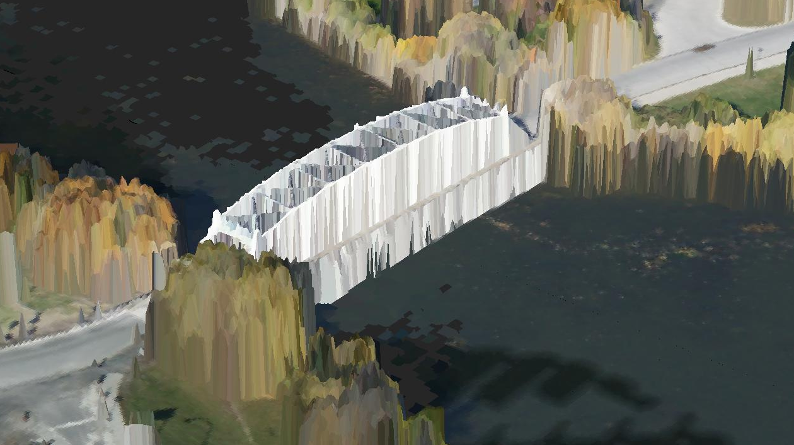
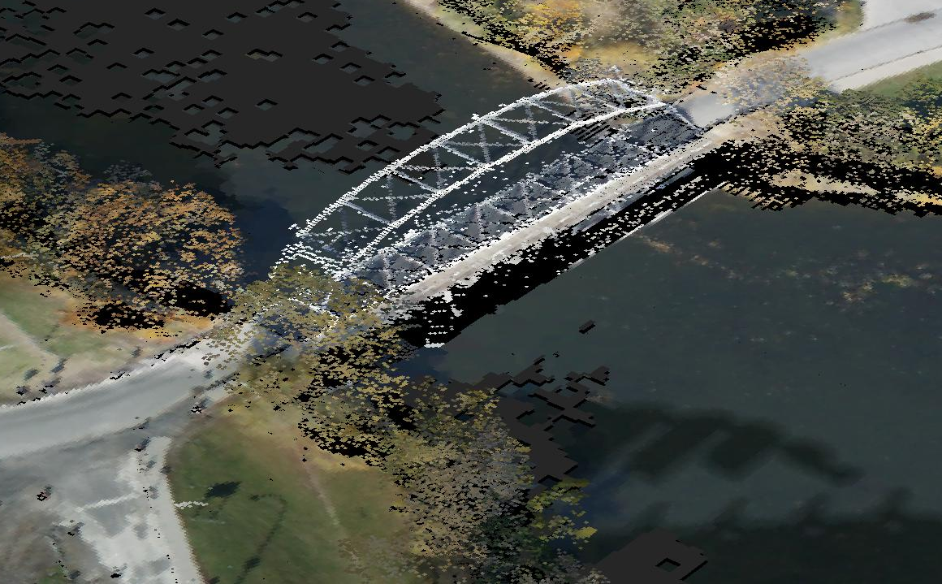
Rendering Technique Clarifies Complex Structures
DSM of Bridge as it would be rendered by any other viewer
Bridge structure is unclear
Exactly the same DSM data as shown above but rendered in Fusion3D
Bridge superstructure would not obscure the area behind it

Slide 7
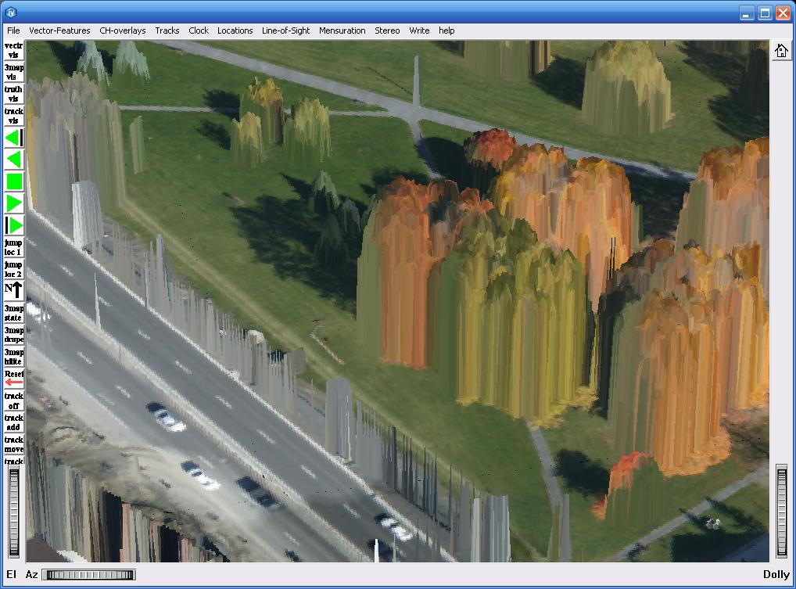
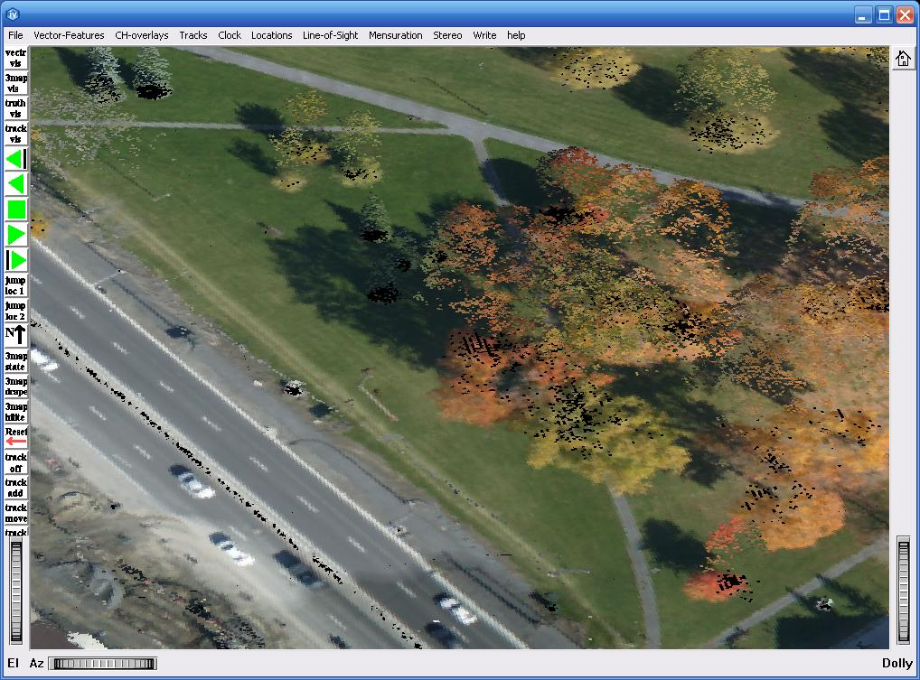
The Effects of Trees are Also Easier to Judge
DSM of trees as it would be rendered by any other viewer
Bridge structure is unclear
Powerline looks like a curtain and can be confused with trees
Exactly the same DSM data as shown above but rendered in Fusion3D
Tree density is much clearer
Sparse trees
Dense trees
Power line, no obscuration

Slide 8
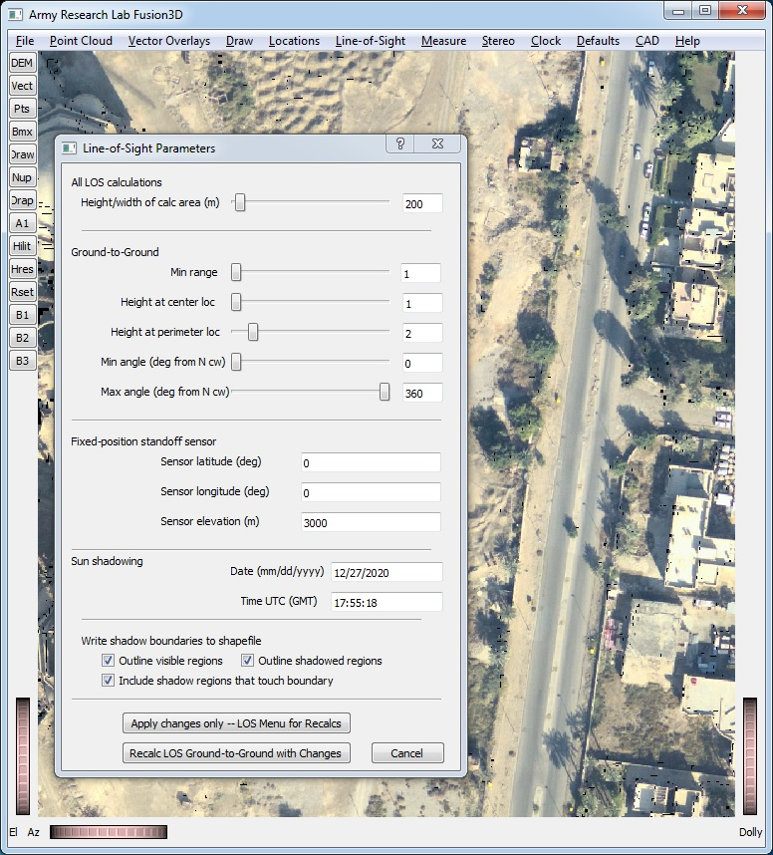
LOS Parameter Menu
Three types of LOS calculations
Ground-to-ground
Standoff sensor where distance is so great that angles to all points the same
Sun shadowing given time, date and location

Slide 9
LOS Parameter Menu
Ground-to-ground parameters
Max range of calcs – square region
Min range – excludes all objects within this range from calcs
Height of center observer and minimum height of objects to be observed
Angular region for sensor like a camera

Slide 10
LOS Outputs – Obscuration Mask
The mask can be saved in GeoTiff format
White areas (non-zero in the mask file) are obscured from the sensor
Black areas are visible

Slide 11
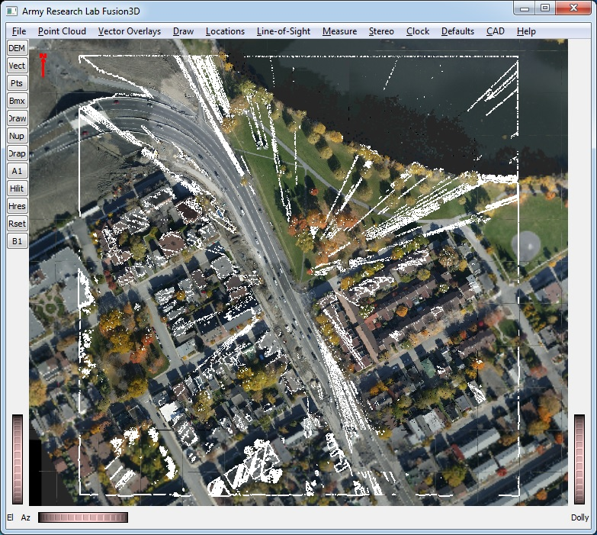
LOS Outputs – Obscuration Outlines
Vector outlines of obscured regions can be saved in kml or shapefile formats

