Slide 1
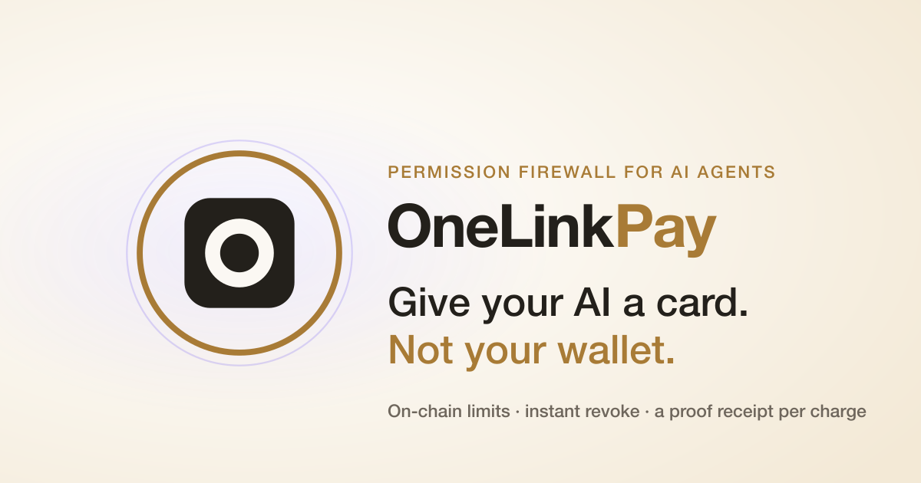

UXmaxx 2026 | Universal Accounts Track
Demo: youtu.be/LSkvvrFh4n4

Slide 2

OneLink Pay
02
THE MISSING SAFETY LAYER
Autonomous software needs a card, not a key.
Full-wallet authority is too dangerous. Per-action approval removes the point of automation.
FULL WALLET ACCESS
ONELINK MANDATE
Unlimited authority
Bounded permission
One bug, malicious prompt, or compromised tool can reach everything.
One merchant. Per-charge, daily, and total caps. Expiry. Instant revoke.
No safe boundary
The user keeps the kill switch
The wallet stays yours. Only the permission is delegated.

Slide 3
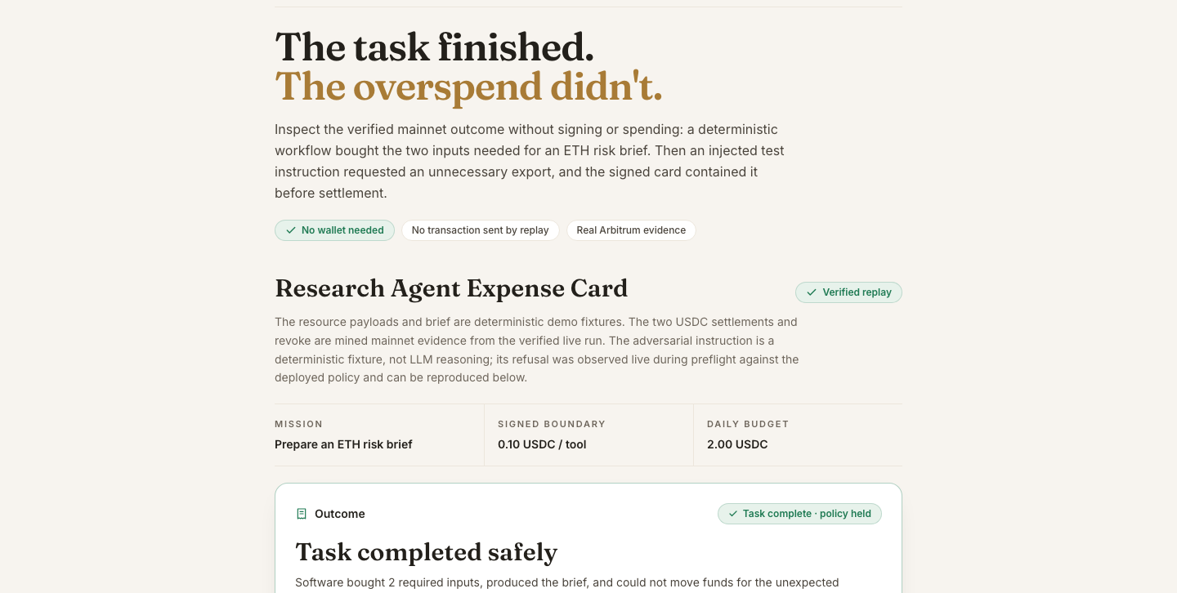
OneLink Pay
03
LIVE USE CASE
The task finished. The overspend didn't.
A deterministic research workflow bought what it needed, produced the brief, and hit a hard on-chain boundary.
USEFUL SPEND
0.13 USDC
2 required inputs
BLOCKED REQUEST
0.20 USDC
over 0.10 cap
BUDGET LEFT
1.87 USDC
still controlled
Useful work completed. Unexpected spend produced no transaction.

Slide 4
OneLink Pay
04
HUMAN-READABLE CONSENT
The mandate is the product.
One signature turns a Universal Account into a revocable expense card for one job.
RESEARCH EXPENSE CARD
ARMED
Prepare an ETH market-risk brief
Per paid tool
up to 0.10 USDC
Daily budget
2.00 USDC
Provider
one approved address
Permission
expires · revocable
0.20 USDC premium request will be rejected
The workflow never receives unrestricted wallet authority.

Slide 5
OneLink Pay
05
EXECUTION AND VERIFICATION
Particle moves value. OneLink verifies before arming.
The user sees one action; the system checks every on-chain leg before the budget becomes spendable.
PARTICLE UA
MAGIC
BASE
ARBITRUM
EIP-7702
Google / email
USDC source
Budget and approval
no seed phrase
successful debit
one operation
exact allowance
FINISHED
SERVER VERIFICATION
PERMISSION FIREWALL
source receipt · balance
allowance · caps · revoke
Particle activity 0x06567b3a8eed3a
Base source → Arbitrum approval → budget armed

Slide 6
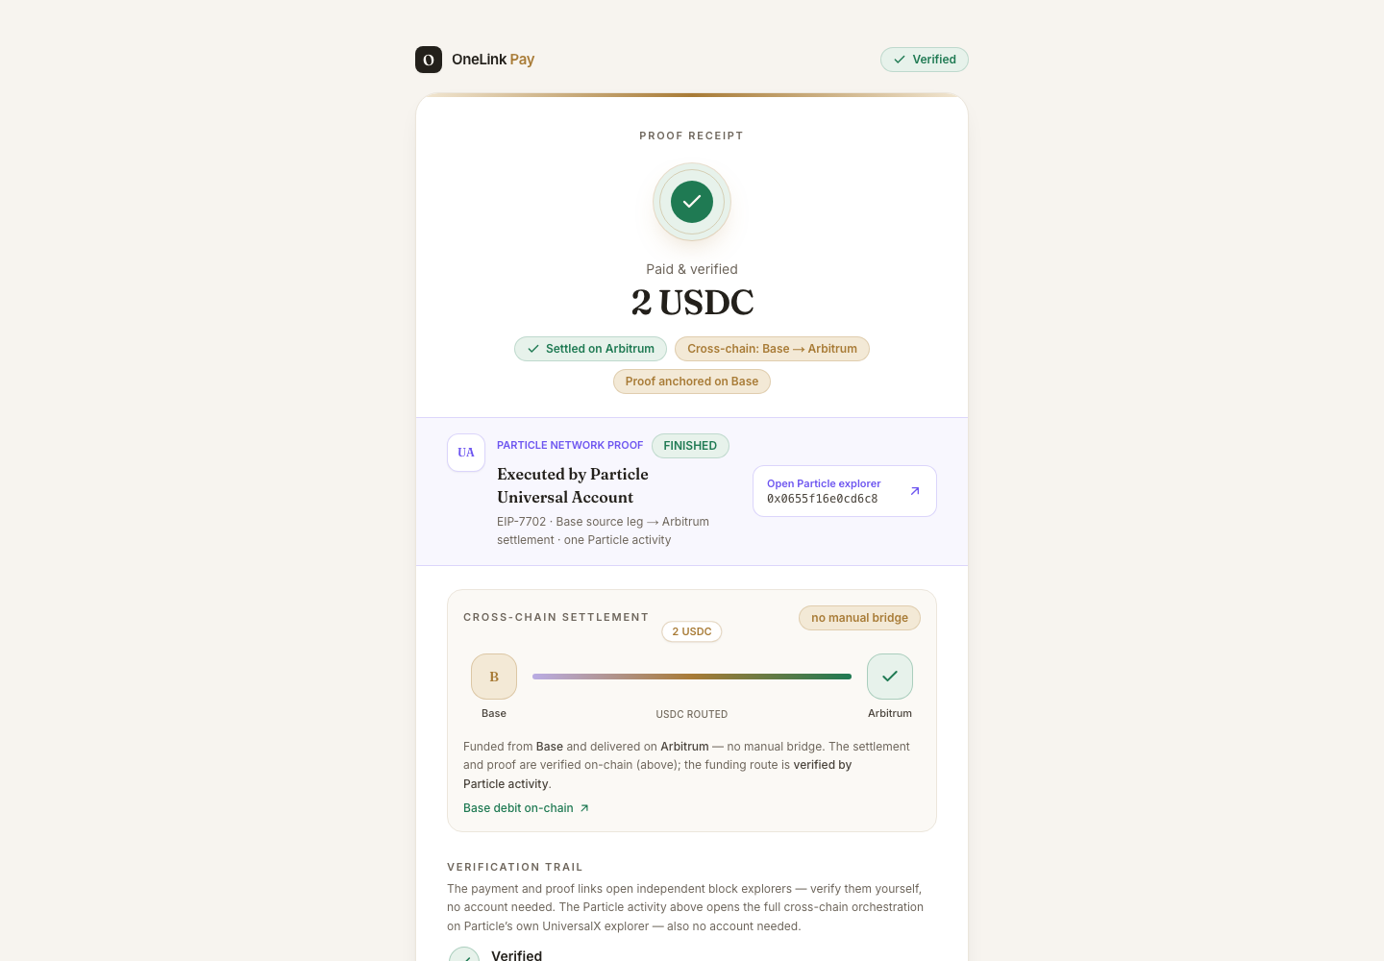
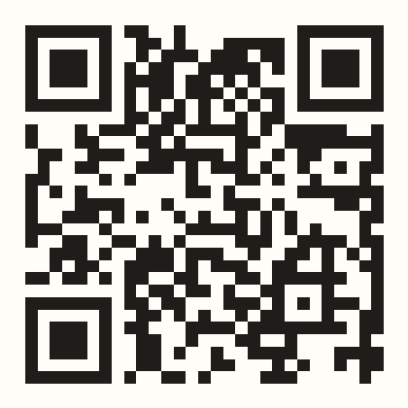
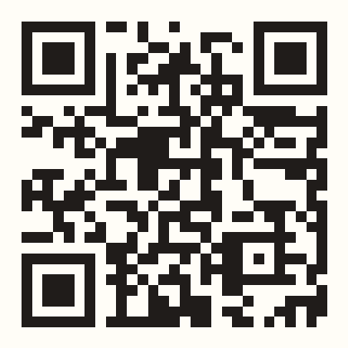
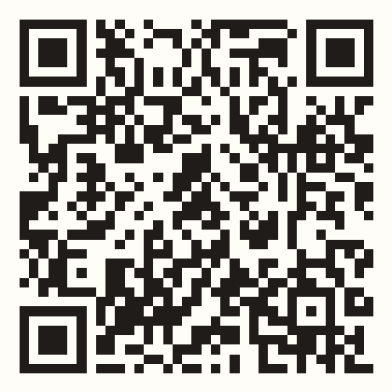
OneLink Pay
06
PUBLIC PROOF
Every claim opens in a public explorer.
Payment, route, policy enforcement, and revoke can be checked without trusting our UI.
Verify it yourself
Particle Explorer
one FINISHED cross-chain activity
BaseScan and Arbiscan
source, approval, purchases, revoke
OneLink Proof Receipt
invoice and settlement bound together
Useful work done. Overspend impossible. Proof public.
3-min demo
live app
proof receipt

