Slide 1
SPARKLER
A web-crawler on Apache Spark
Thamme Gowda
@thammegowda
Karanjeet Singh
@karanjeet_tw
Dr. Chris Mattmann
@chrismattmann
https://github.com/USCDataScience/sparkler
Notes:
Slides can vary as per your presentation, but header and footer should be consistent

Slide 2
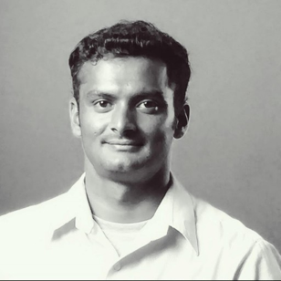
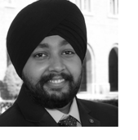

ABOUT
Information Retrieval and Data Science (IRDS) Group
University of Southern California, Los Angeles, CA
Home page: https://irds.usc.edu Email: irds-L@mymaillists.usc.edu
Thamme Gowda
Karanjeet Singh
Dr. Chris Mattmann
Graduate Student
@thammegowda
Graduate Student
@karanjeet_tw
Director, IRDS
@chrismattmann

Slide 4
THANK YOU

