Slide 1
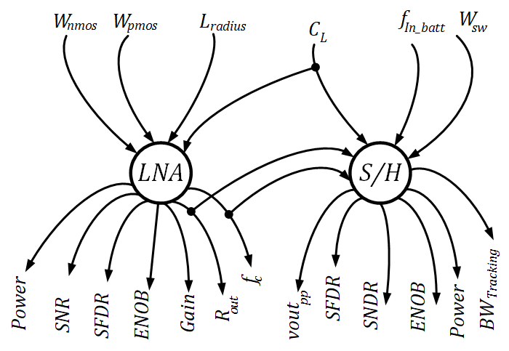
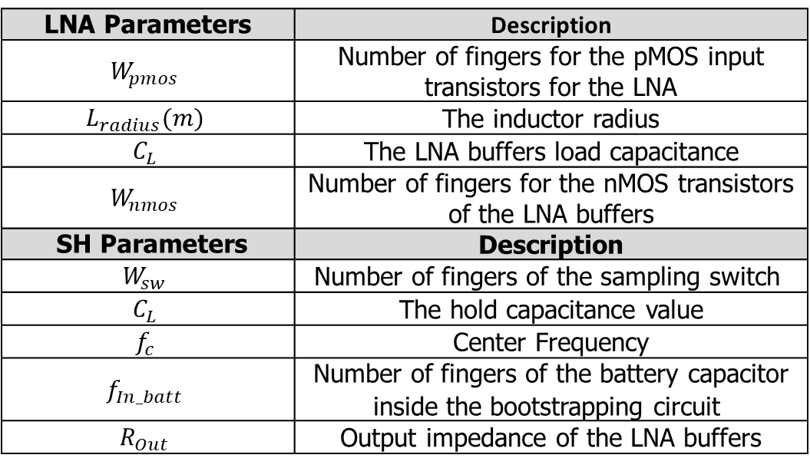
The Module Graph and The Design Parameters
Connection of the Logic-Diagram
LNA Parameters | Description
$$W_{pmos}$$ | Number of fingers for the pMOS input transistors for the LNA
$$L_{radius}(m)$$ | The inductor radius
$$C_{L}$$ | The LNA buffers load capacitance
$$W_{nmos}$$ | Number of fingers for the nMOS transistors of the LNA buffers
SH Parameters | Description
$$W_{sw}$$ | Number of fingers of the sampling switch
$$C_{L}$$ | The hold capacitance value
$$f_{c}$$ | Center Frequency
$$f_{In_batt}$$ | Number of fingers of the battery capacitor inside the bootstrapping circuit
$$R_{Out}$$ | Output impedance of the LNA buffers

Slide 2
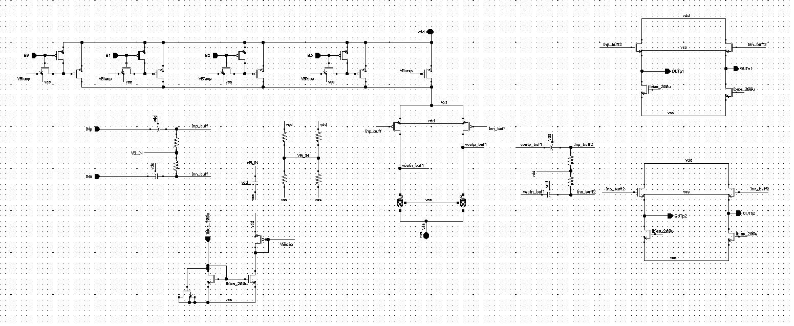
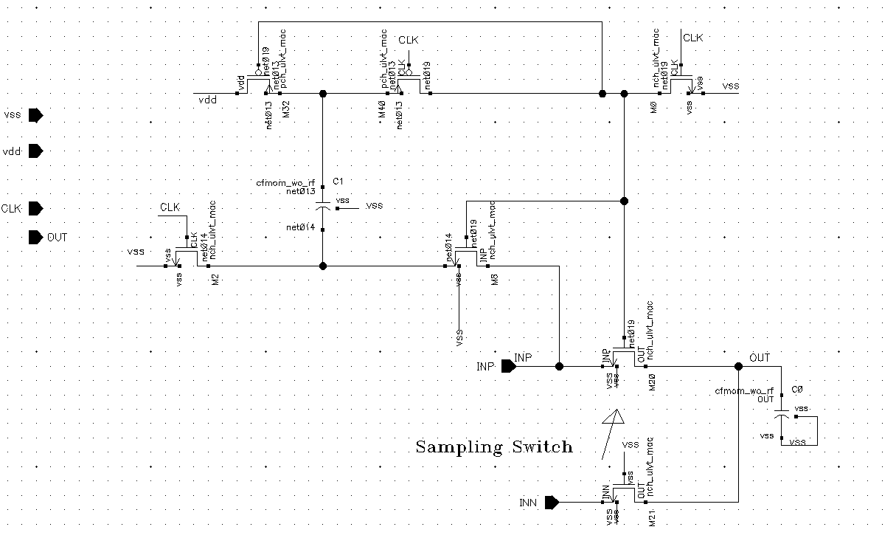
Circuit Schematics
Biasing Cell
Inductive Loaded Diff Pair
LNA Buffers
Bootstrapping Circuit
Sample and Hold Circuit

Slide 3
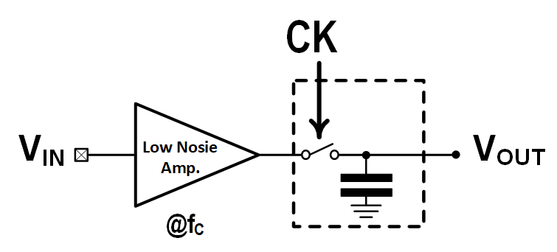
Comparison between Specs from AMPSE vs. Cadence Virtuoso
Case 1: Center Frequency for 30.86GHz
Overall Achieved Metrics | Generated using AMPSE | Rechecked using Cadence Virtuoso®
Overall Power Consumption (W) | 14.02m | 13.85m
Output PP Amplitude (V) | 955m | 370m
Tracking Bandwidth (GHz) | 19 | 23.5
ENOB (bit) | 7.21 | 7.53
SNR (dB) | 44.1 | 47.11
SFDR (dB) | 44.77 | 48
Center Frequency (GHz) | 30.86G | 30.55G

Slide 4
Comparison between Specs from AMPSE vs. Cadence Virtuoso
Case 1: Center Frequency for 30.86GHz
Overall Achieved Metrics | Generated using AMPSE | Rechecked using Cadence Virtuoso®
Overall Power Consumption (W) | 14.02m | 13.85m
Output PP Amplitude (V) | 955m | 370m
Tracking Bandwidth (GHz) | 19 | 23.5
ENOB (bit) | 7.21 | 7.53
SNR (dB) | 44.1 | 47.11
SFDR (dB) | 44.77 | 48
Center Frequency (GHz) | 30.86G | 30.55G

Slide 5
Comparison between Specs from AMPSE vs. Cadence Virtuoso
Case 2: Center Frequency for 22.4GHz
Overall Achieved Metrics | Generated using AMPSE | Rechecked using Cadence Virtuoso®
Overall Power Consumption (W) | 14.17m | 14.15m
Output PP Amplitude (V) | 0.936 | 0.9
Tracking Bandwidth (Hz) | 18G | 18G
ENOB (bit) | 6.9 | 5.2
SNR (dB) | 43.77 | 35.7
SFDR (dB) | 43.36 | 36.2
Center Frequency (Hz) | 22.4G | 22.27
Case 3: Center Frequency for 32GHz
Overall Achieved Metrics | Generated using AMPSE | Rechecked using Cadence Virtuoso®
Overall Power Consumption (W) | 14.2m | 14.35
Output PP Amplitude (V) | 0.838 | 0.91
Tracking Bandwidth (Hz) | 18.2G | 21.6
ENOB (bit) | 6.6 | 6.2
SNR (dB) | 41.72 | 41.32
SFDR (dB) | 43.3 | 44.8
Center Frequency (Hz) | 32G | 31.6G

Slide 6
Comparison between Specs from AMPSE vs. Cadence Virtuoso
Key point: we can design a variety of RF/mm-Wave Sub-sampling Receiver Front-Ends with the help of AMPSE.

Slide 7
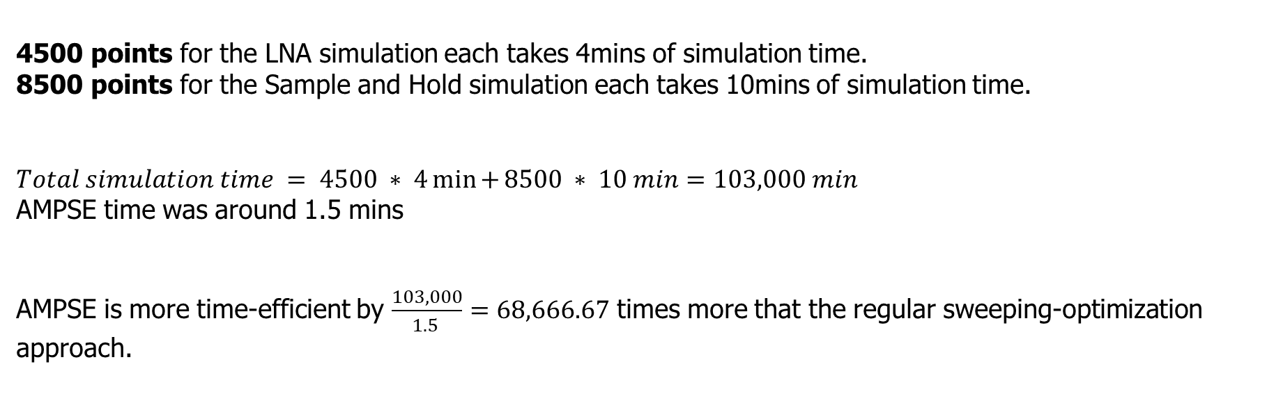
Time-to-Design Comparison
4500 points for the LNA simulation each takes 4mins of simulation time.
8500 points for the Sample and Hold simulation each takes 10mins of simulation time.
$$Total simulation time = 4500 ∗ 4\min{+}8500 ∗ 10 min=103,000 min$$
AMPSE time was around 1.5 mins
AMPSE is more time-efficient by $\frac{103,000}{1.5 }=68,666.67$ times more that the regular sweeping-optimization approach.

