Slide 1
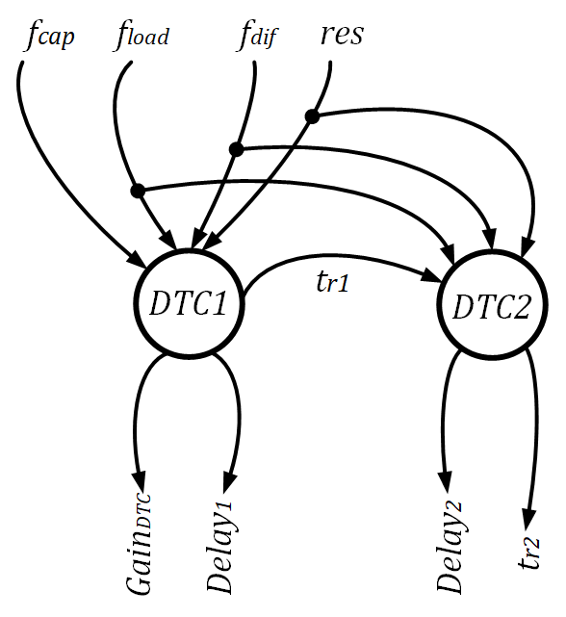
Module Graph
Connection Logic Diagram

Slide 2
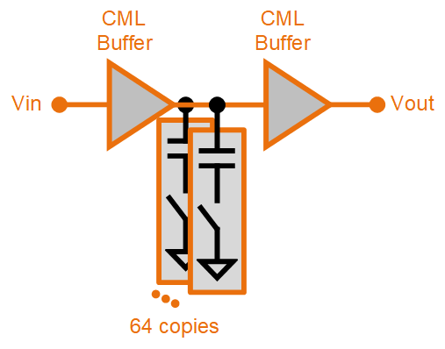
Comparison between Specs from AMPSE vs. Cadence Virtuoso
Overall Achieved Metrics | Generated using AMPSE | Rechecked using Cadence Virtuoso®
DTC Gain (ps) | 169 | 176
DTC Offset (ps) | 177.6 | 193.7
Rise Time (ps) | 50 | 89

Slide 3
Comparison between Specs from AMPSE vs. Cadence Virtuoso
Overall Achieved Metrics | Generated using AMPSE | Rechecked using Cadence Virtuoso®
DTC Gain (ps) | 140 | 138.2
DTC Offset (ps) | 165 | 172.5
Rise Time (ps) | 64 | 87.3

