Slide 1
GF65nm 12b SAR ADC
ADC Simulation Results
Test Benches provided in submission library

Slide 2
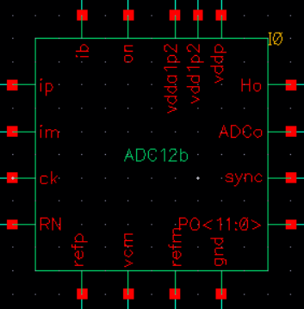
ADC pin out definitions
ip & im: differential input; on: logic 1 to turn on ADC
ck: clock input (sampling rate x 14); RN: logic 0 to reset ADC
refp & refm: differential reference inputs (refp = 1.2V & refm = 0V)
vcm: common-mode input (set to 0.6V)
gnd: ground; vdda1p2: 1.2V analog supply; vddd1p2: 1.2V digital supply; vddp = 1.2V output pad driver supply; ib: current bias input (10uA source to ib)
Ho: serial data sync signal; ADCo: ADC serial data output starting after Ho (Both Ho & ADCo need LVDS drivers (not included))
sync: sync signal for parallel output; PO<11:0>: 12-bit parallel ADC output starting at the falling edge of sync (max 10pF at outputs for 20MS/s)

Slide 3
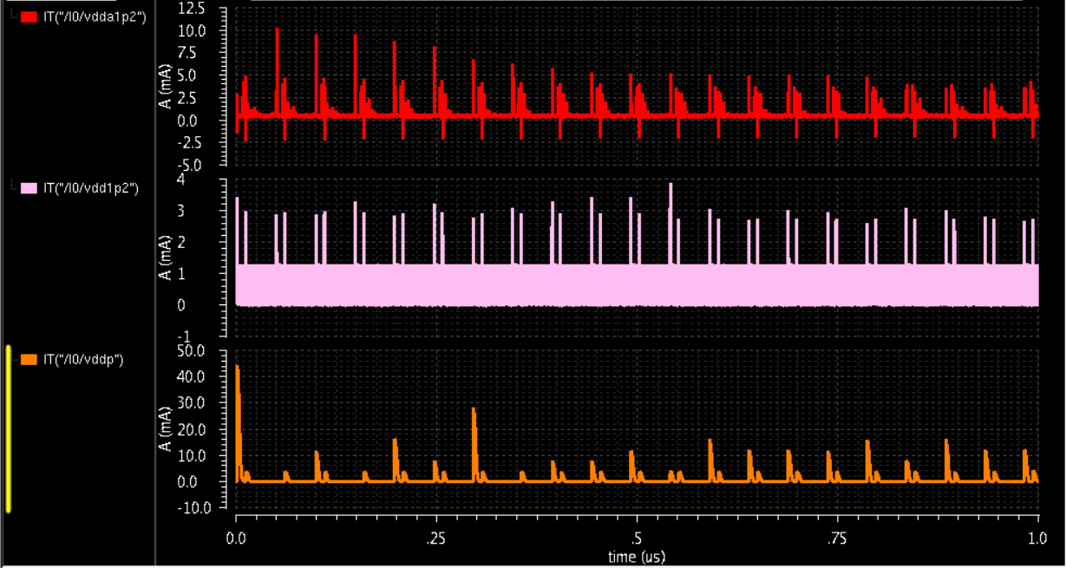
Test Bench test_ADC12b (I): supply current
Schematic: test_ADC12b
Sampling rate ~ 20MS/s (sample period = 14 x 3.5ns), Vdd = 1.2V
Top – analog supply current (avg. = 483.4uA); middle – digital supply current (avg. = 93.1uA); bottom – output driver supply current (avg. = 1.024mA)

Slide 4
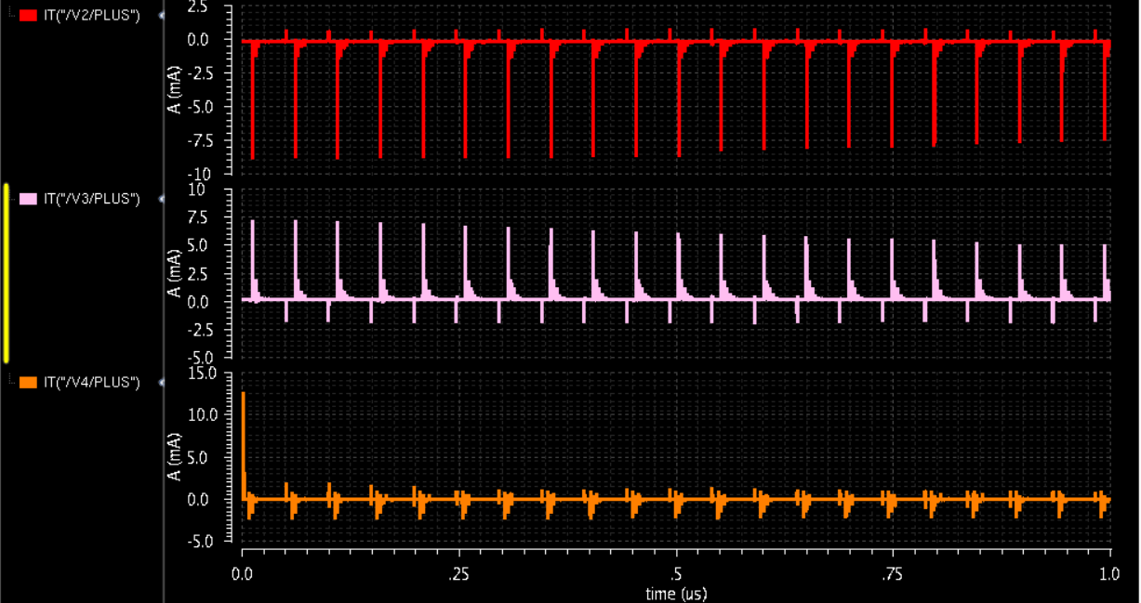
test_ADC12b (II): current drawn by references
Top – refp (avg. = 189.3uA); middle – vcm (avg. = 196.2uA); bottom – refm (avg. = 1.2uA)

Slide 5
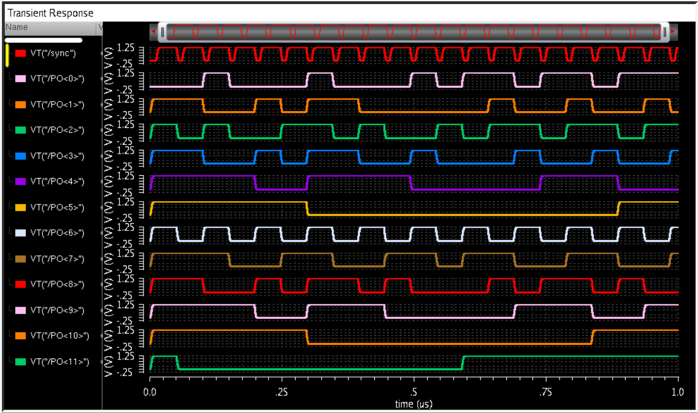
Test Bench test_ADC12b (III): sync & PO<11:1>
Differential linear ramp down input from 1.2V to 0V from 0 to 1us (shown in next slide)
Parallel outputs (PO<11:0>) and sync have 10pF cap loads

Slide 6
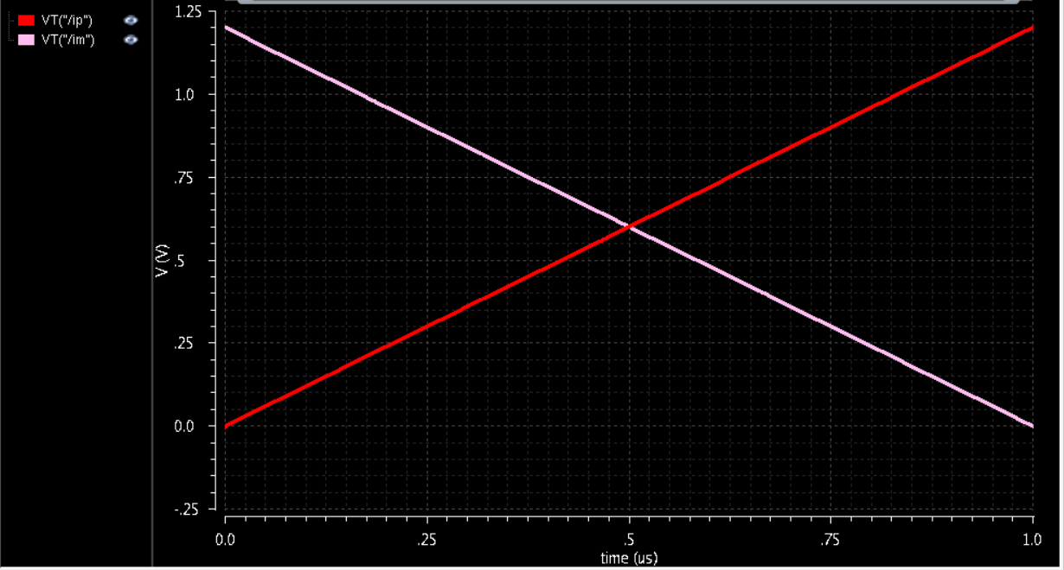
Test Bench test_ADC12b (IV): differential input

Slide 7
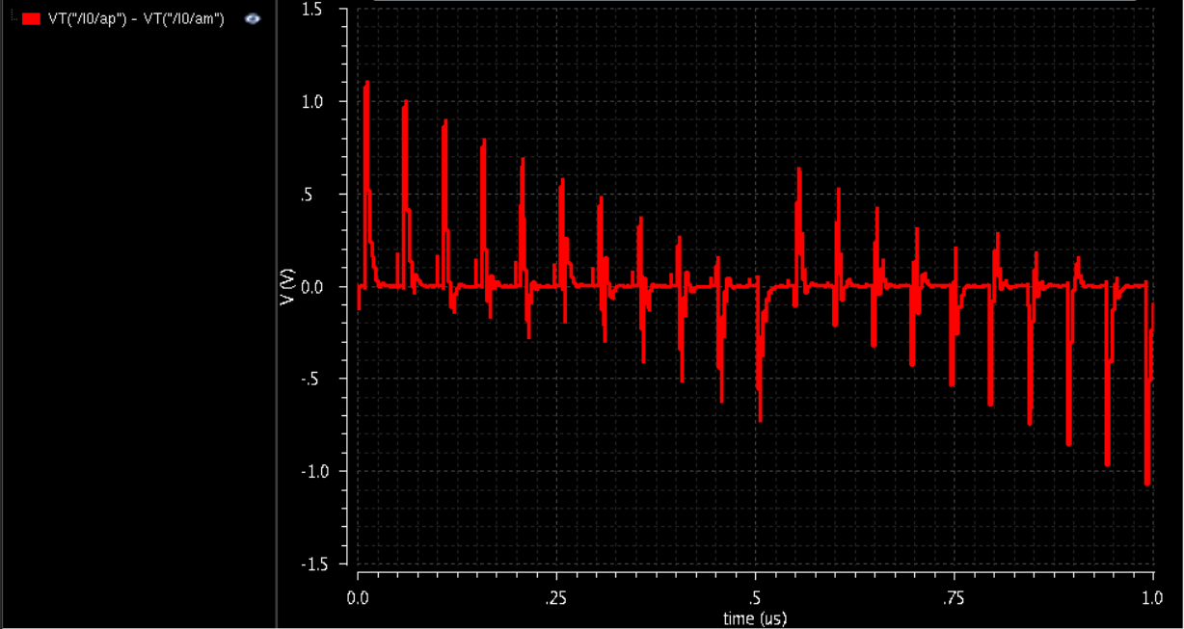
test_ADC12b (V): difference b/w comparator input

Slide 8
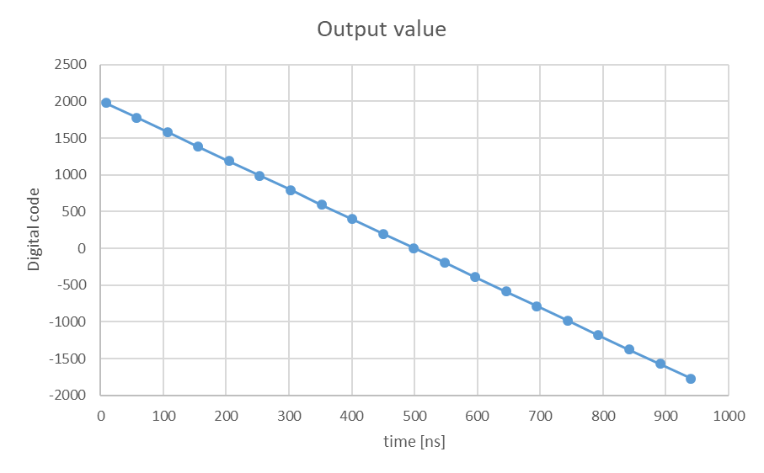
test_ADC12b (VI): reconstruction output
Output = (1-2*PO<11>)*(2^10*PO<10> + … + 2^0*PO<0>)
Refer to schematic for formula that calculates output from serial output data
Linearity is within -0.79 LSB and +1.37 LSB (1 V_LSB ~ 0.586mV)

Slide 9
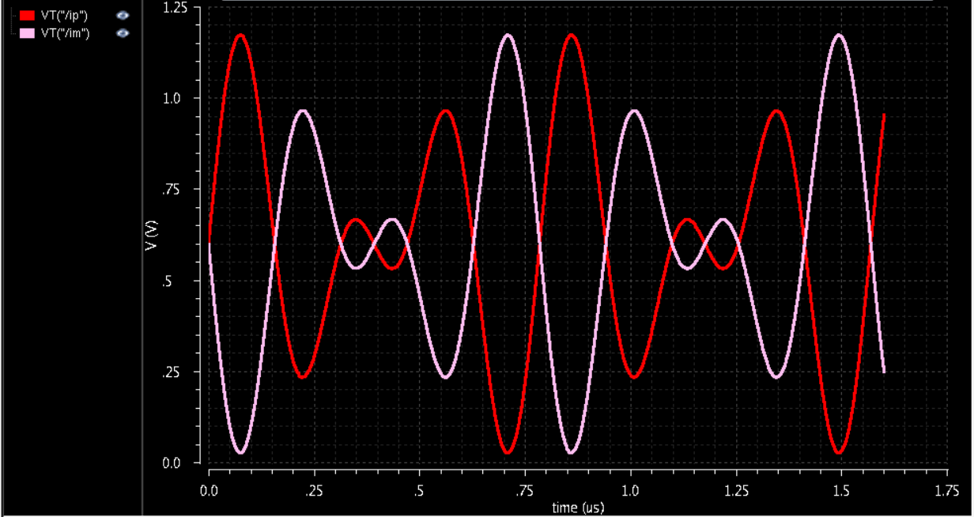
Test Bench test_ADC12b_sin (I): differential input
Schematic: test_ADC12b_sin
Sampling rate ~ 20MS/s (sample period = 14 x 3.5ns), Vdd = 1.2V
Input frequencies: 4/(32 x 14 x 3.5ns) ~ 2.551MHz & 6/(32 x 14 x 3.5ns) ~ 3.827MHz with equal diff. amplitude (diff. peak value) = 600mV

Slide 10
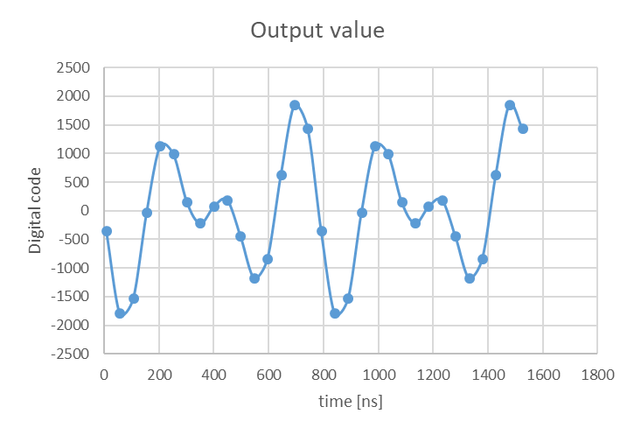
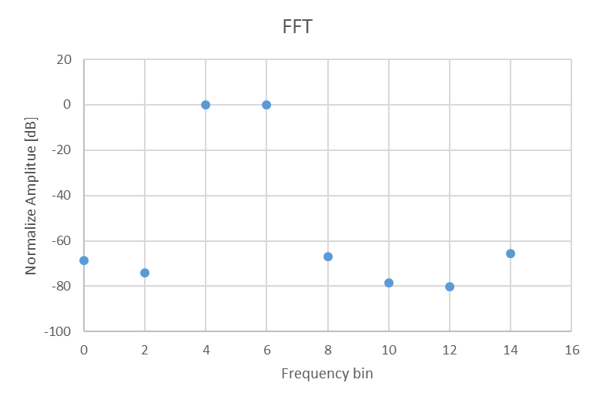
test_ADC12b_sin (II): reconstruction output
Each frequency bin = 1/(32 x 14 x 3.5ns) ~ 637.755kHz
IMD₃ < -66.98dB
SNDR = 64.72 dB

Slide 11
GF65nm 12b SAR ADC
Comparator Simulation Results
Test Benches provided in submission library

Slide 12
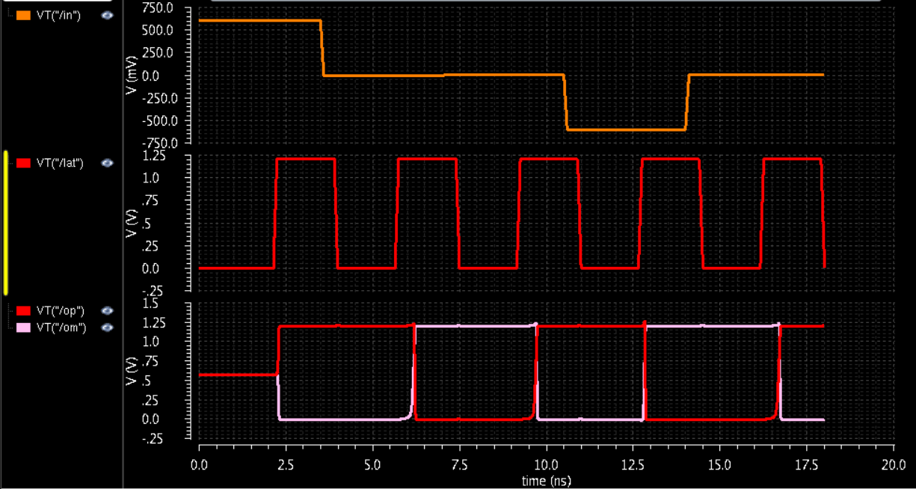
Comparator Sim. Setup (1): (test_comp2)
ADC full range: -1.2V – 1.2V for 12-bit resolutions
V_LSB = 2.4V/4096 = 0.586mV → simulated with ½ V_LSB
Differential input values: 0.6V, -0.29mV, 0.29mV, -0.6V, 0.29mV
Set signal “lat” to logic 1 to latch the outputs (op & om)

Slide 13
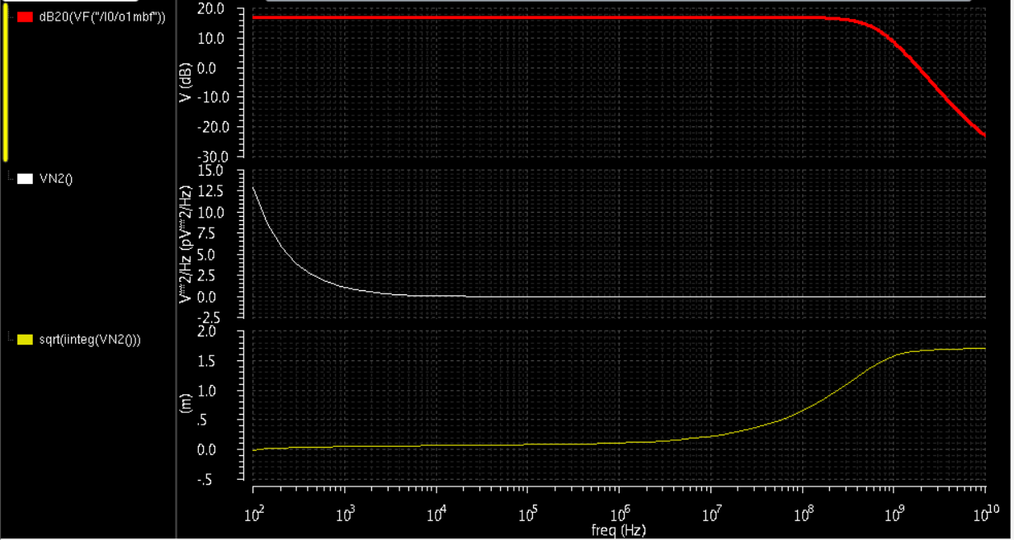
Comparator Sim. setup (2): (test_comp2_ac)
Red – single-ended comparator pre-amp low frequency gain (diff. gain ~ 16.83dB + 6.02dB)
Noise due to comparator latch can be ignored due to sufficient pre-amp gain
White – output pre-amp noise power density vs. freq.
Yellow – Integrated output pre-amp noise voltage vs. freq. (Total pre-amp output noise ~ 1.697mV)
Pre-amp input referred noise = 1.697mV/(10^((16.83dB + 6.02dB)/20)) ~ 122uV < ½ V_LSB

