Slide 1
GF65 to PTM65 Conversion

Slide 2
Description
10-bit linearity OPAMP and 6-pole triple-biquad 7-MHz Anti-Alias Filter (AAFilter) designed, simulated at 39 PVT corners, fabricated and measured in GF65 process.
Problem: Transition above to PTM65
PTM65 is bulk mosfet, bsim4v5 model decks, with no binning => Multifinger device layout parasitics and strain-related device performance variation is *NOT* captured.
  Has only one nfet and one pfet device model
  Has no process corner other than typical
    Limited utility for translation to practical, fabricable designs with acceptable yield in foundry process
  No resistor or capacitor devices. GF65 has resistors with different tempco and different capacitor models (MOM, MIM, Varactor).
    Ideal passives used in PTM design.
  GF65 design uses regular Vt NFET, thin-oxide native NFET and Low-Vt PFET
Solution Approach
  To preserve OPAMP architecture, we “create” a thin-oxide native-nfet PTM model which is a reduced Vt version of existing PTM65 model.
  We preserve geometry parameters of each transistor in the schematic as we migrate from GF65 to PTM65 for estimated extrinsic device parasitics.
  We maintain multiplicity of devices in PTM65 OPAMP schematic as in GF65 schematic.
  Wiring capacitance and resistance is not included or estimated in GF65 or PTM65 schematic.
  Created PTM65 device library in Cadence for schematic capture and simulation.

Slide 3
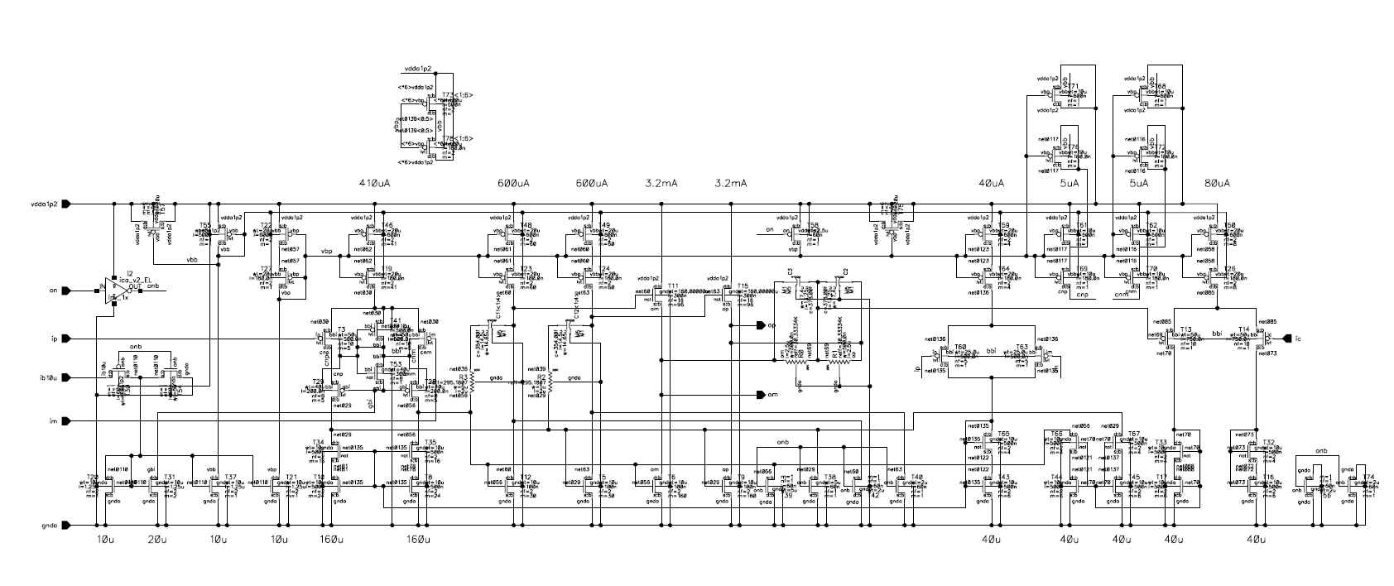
OPAMP Schematic designed in GF65
Multi Stage, differential input, differential output OPAMP with common-mode feedback control circuit designed and validated in GF65 process technology: Design comprises of 87 transistors including subcircuits.

Slide 4
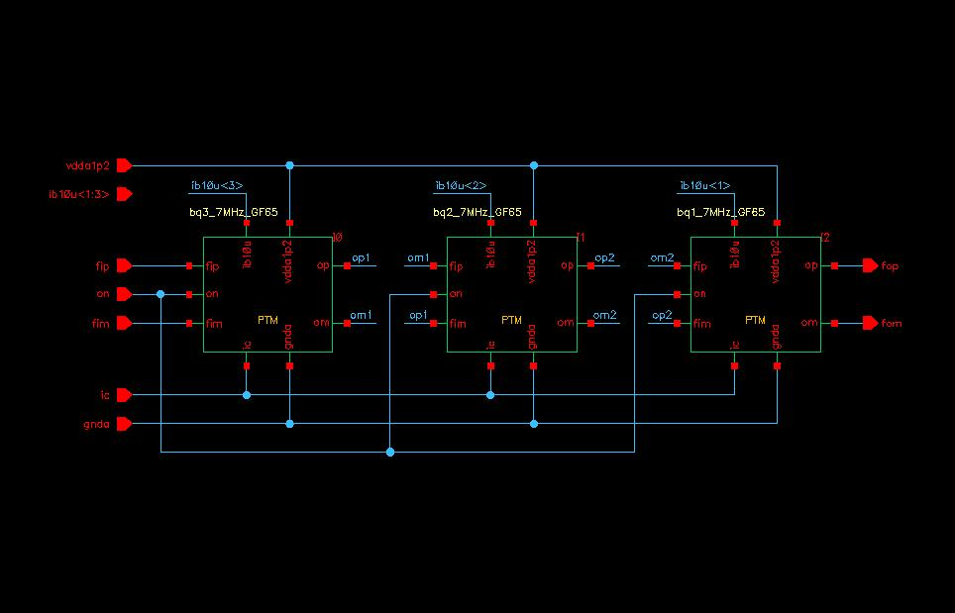
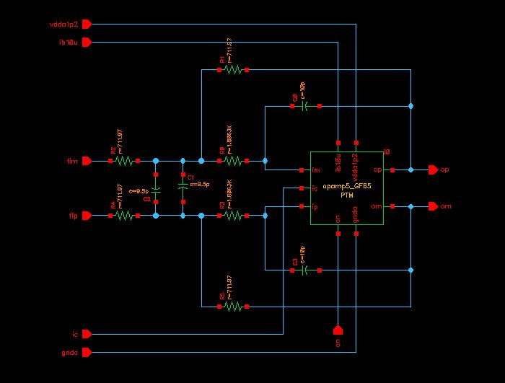
OPAMP-based, differential input, differential output, Six-pole Triple-Biquad 7MHz AAFilter
Six-pole triple-biquad 7MHz AAFilter
Biquad active filter section

Slide 5
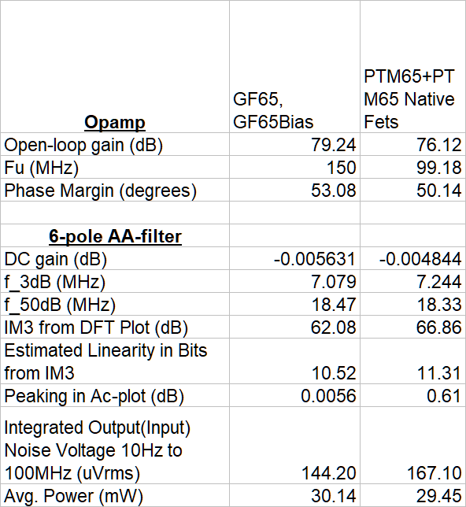
Comparison Summary at Nominal PVT corner
PTM65 transistors have higher FET model diffusion capacitance parameters than GF65
  Reduced open-loop bandwidth and phase-margin
  Increased peaking in closed-loop response (0.61 dB vs. 0.0056dB for GF65 AAFilter)
PTM65 transistors have lower rds => reduced open-loop gain
Available PTM65 transistors have lower threshold voltage than GF65 => slightly more headroom for schematic that uses GF65 devices.
  Third harmonic IM suppression in two-tone simulation is 66.86 dB (11.31 bits) for PTM65 AA-Filter instead of 62.08 dB (10.52 bits) for GF65 AAFilter.

Slide 6
Why are the results so close without redesign ?
Closed-loop design with design objectives determined by passive devices has reduced sensitivity to open-loop component variations
Open-loop design will be more exposed (e.g. traditional digital circuits)
Increasingly constrained process design “box” with decreasing feature size
  Transistor models across foundries (including PTM) will be reasonably close for the same device (transistor) architecture. Differences are likely to be within 20%, which is large enough for make or break (put at risk) high-volume IC designs
    IC Designs are usually platform designs of an entire product family to amortize mask and fab costs across wafer-programmable parts.
      Increases design cost
      Decreases power efficiency to make some other product design metric or vice-versa, which is why the 20% is important in general.
  At the end of Moore’s law, the ultimate differentiation will be via super-custom silicon – co-design of transistor and circuit, which could be seen as a logical extension of POSH.
    Co-design is about adjusting required transistor small-signal or dc-parameters to achieve a desired analog result without revolutionary device architecture change. E.g. High rds “Analog” transistor for super, power-efficient analog front-end
PTM is missing the variety of devices available in modern foundries, which are required to make analog (and to a lesser extent, digital) designs successful in digital, fine feature-size processes.
  Recommend funding revamped, up-to-date PTM models.
  Comprehend newer devices such as vertically stacked, gate-all-around (GAA) nano-sheet transistors (sub 3-nm process technology)

Slide 7
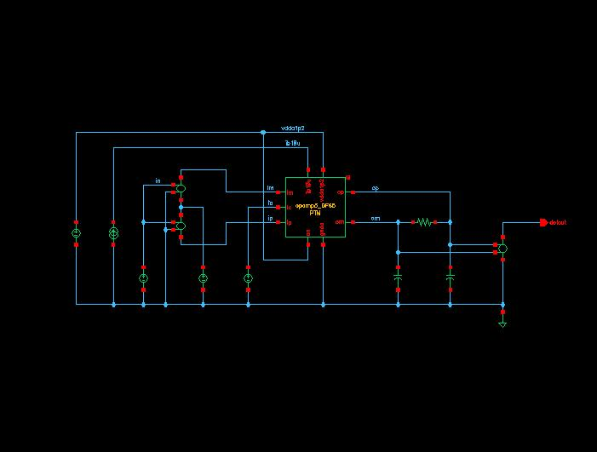
OPAMP Test Schematic
Open-loop OPAMP Test Schematic
Differential Input, Differential Output
Ideal Input Bias Current in Test Schematic

Slide 8
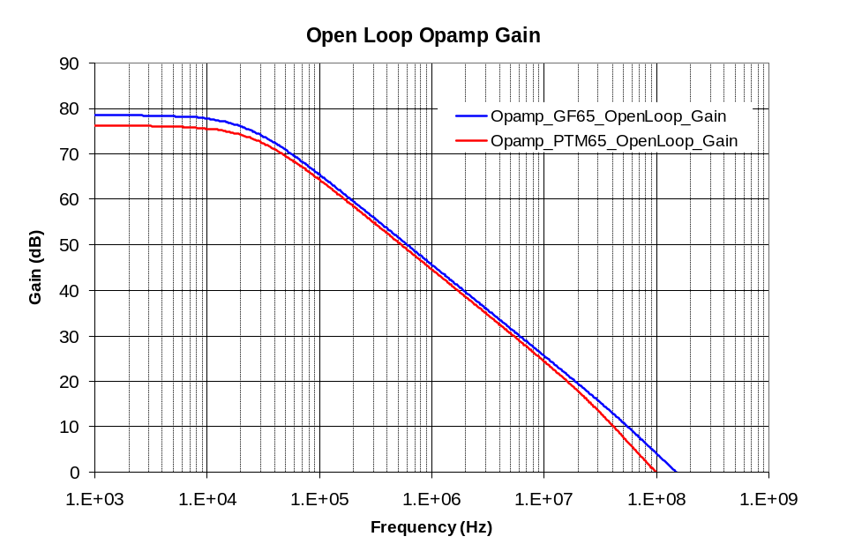
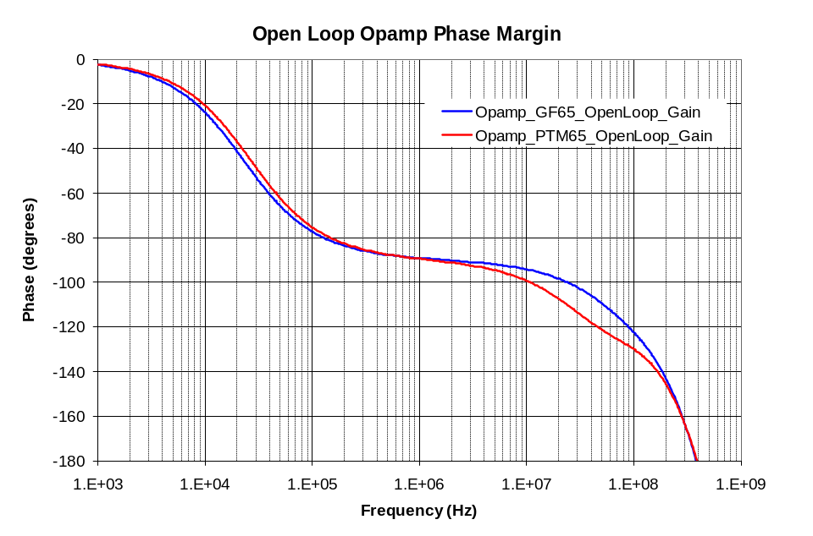
Comparison of GF65 and PTM65 Open Loop OPAMP Gain and Phase Margin
Nominal schematic (with estimated device parasitics) simulation conditions: TT, 1.2V, 27C
  Device parasitics correspond to geometry parameters of each MOSFET in schematic.
  No estimated wiring or layout-related parasitics in schematic.
  Reduced Phase-Margin of PTM65 OPAMP (red curve) results in peaking in closed-loop AAFIlter frequency response.

Slide 9
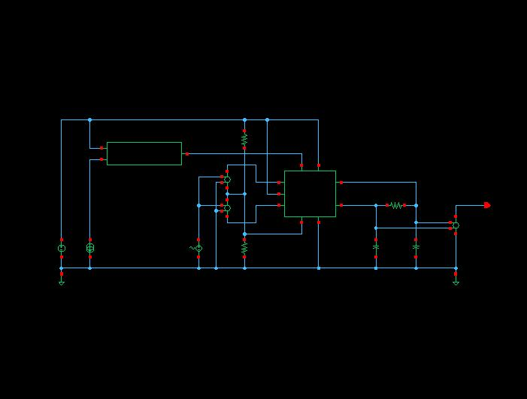
Six-Pole, 7MHz, >10-bit Linearity AAFilter
Six-pole 7-MHz triple-biquad AAFilter Test Schematic
Differential Input, Differential Output
Current-mirror supplies bias current to OPAMPs in AAFilter

Slide 10
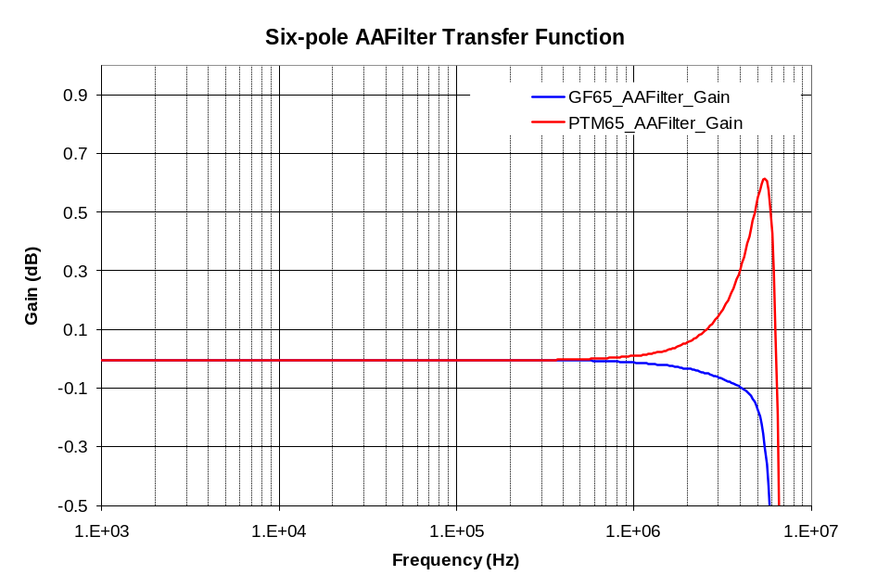
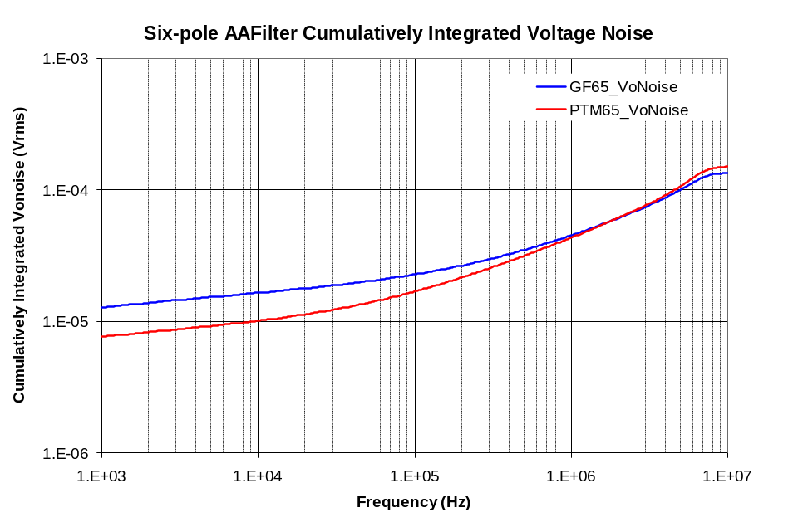
Comparison of Transfer Functions
Reduced Phase Margin of PTM65 OPAMP causes peaking in closed-loop response

Slide 11
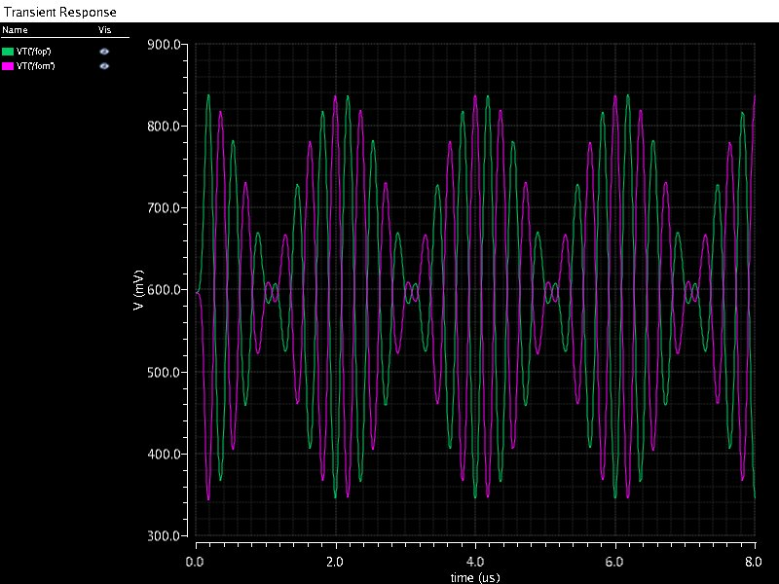
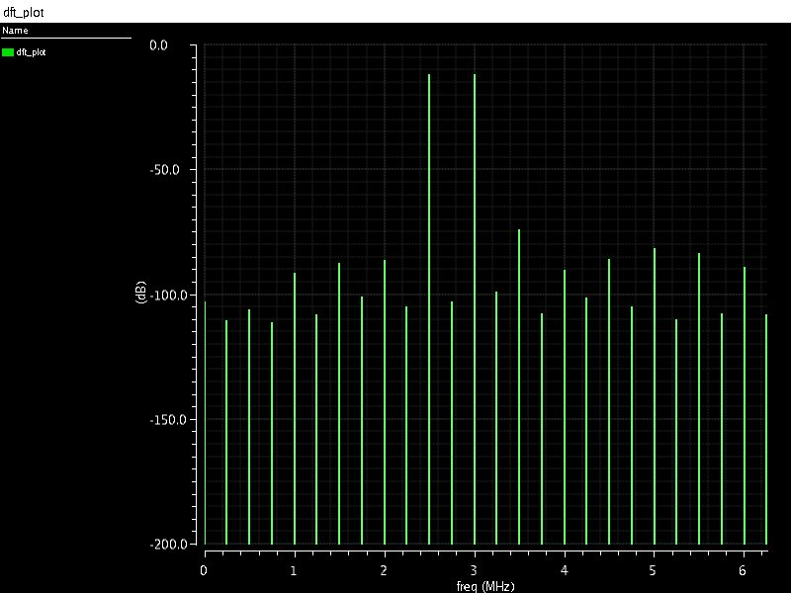
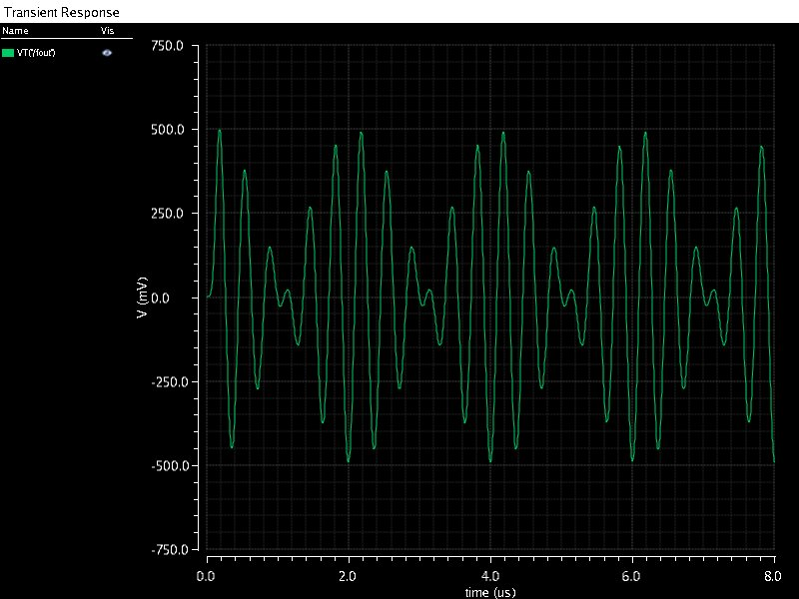
Simulated Two-Tone Test of GF65 AAFilter Schematic
62.08 dB
Transient Waveform at Plus and Minus Outputs
DFT of Two-Tone Test, with 2.5 and 3 MHz sine-wave
Input signals, each having 250mV amplitude.
Differential Output transient waveform

Slide 12
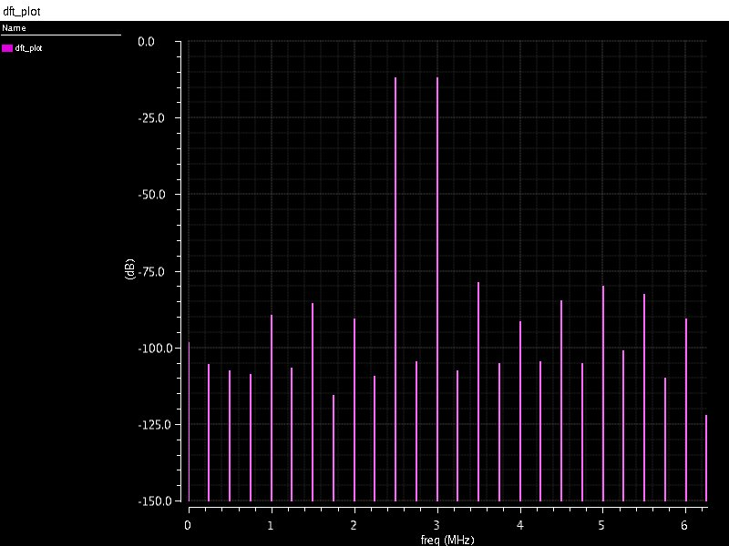
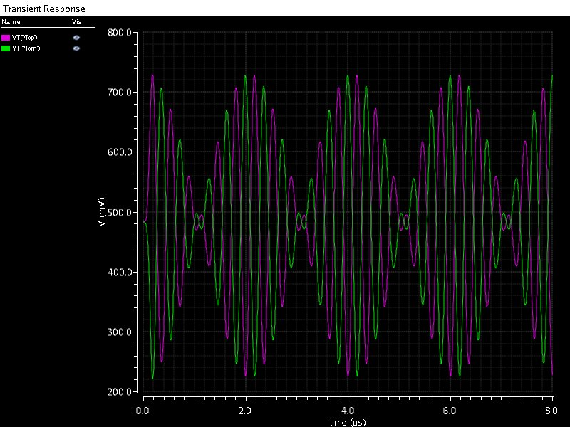
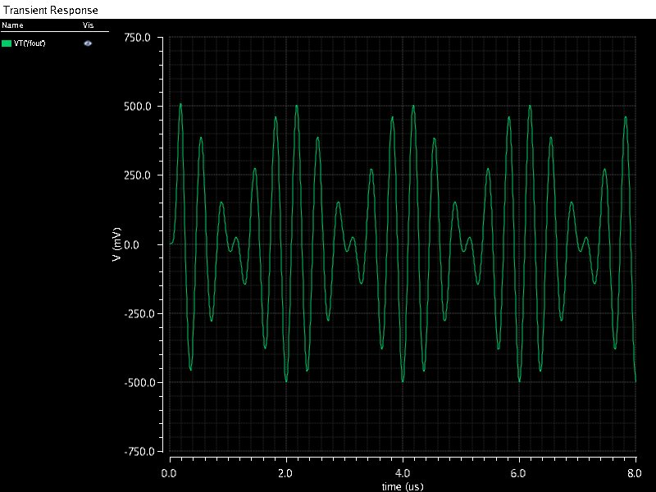
Simulated Two-Tone Test of PTM65 AAFilter Schematic
66.86 dB
Transient Waveform at Plus and Minus Outputs
DFT of Two-Tone Test, with 2.5 and 3 MHz sine-wave
Input signals, each having 250mV amplitude.
Differential Output transient waveform

Slide 13
NFET Device Comparison

Slide 14
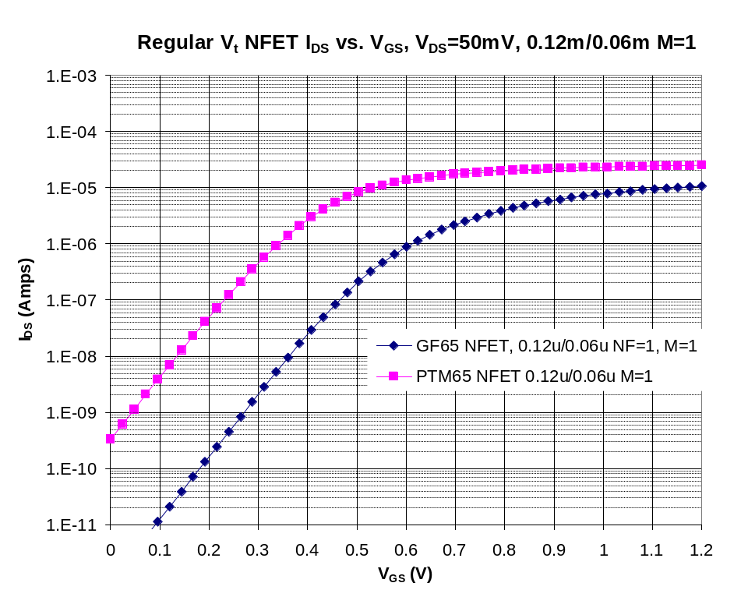
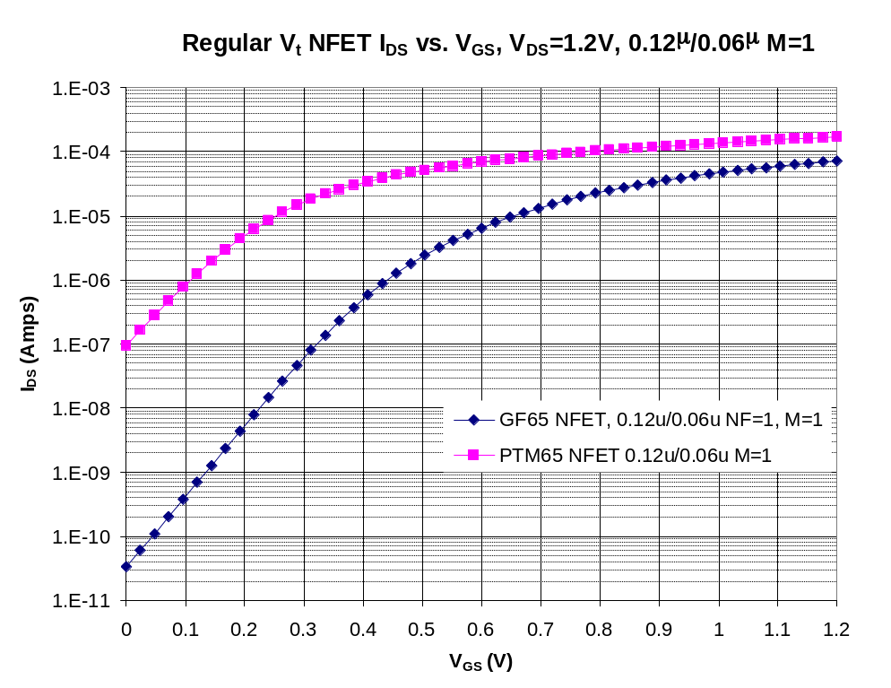
I_{DS} vs V_{GS} for 0.12u/0.06u M=1 NFET
Estimate Vtlin at Vds=50 mV, Vbs=0V using
IDS = 0.1uA * (W/L) per CCM
Estimate Vtsat at Vds=1.2 V, Vbs=0V using
IDS = 0.1uA * (W/L) per CCM

Slide 15
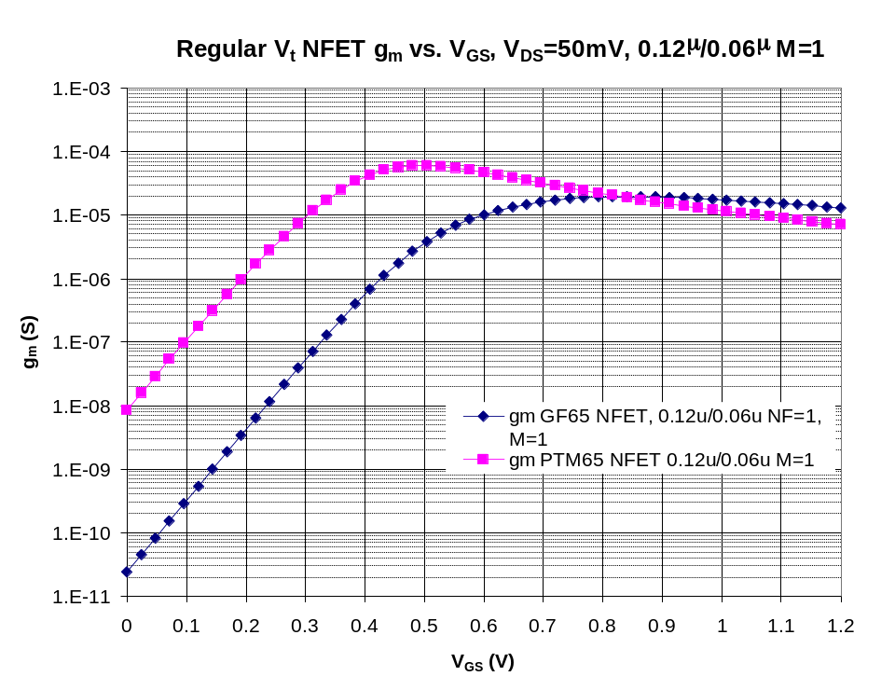
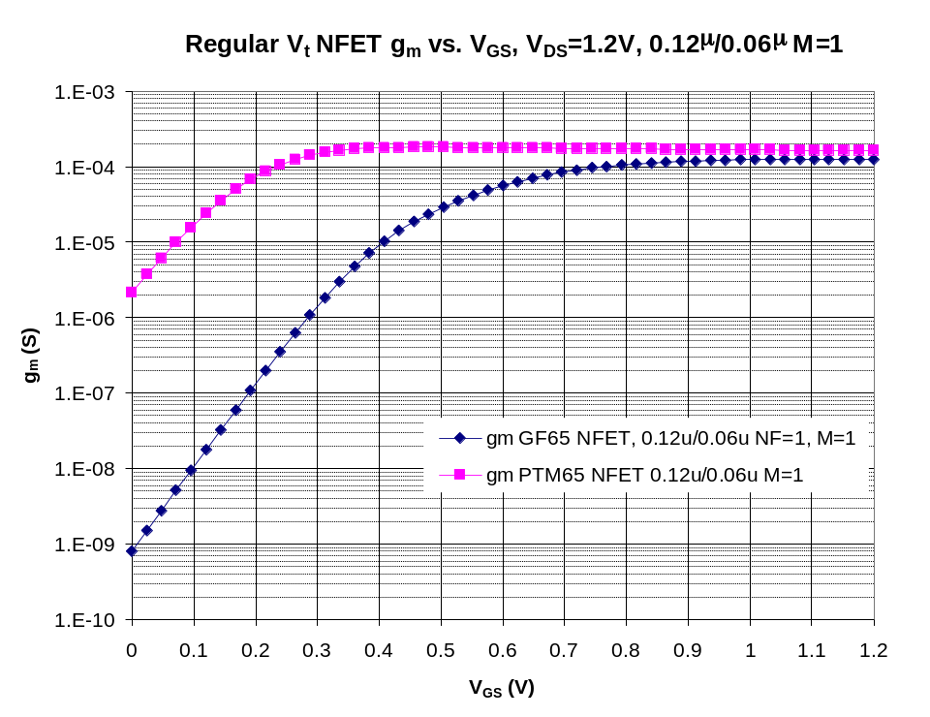
g_{m} vs V_{GS} for 0.12u/0.06u M=1 NFET
V_{DS} = 50 mV, V_{BS} = 0V, Varying V_{GS}
V_{DS} = 1.2 V, V_{BS} = 0V, Varying V_{GS}

Slide 16
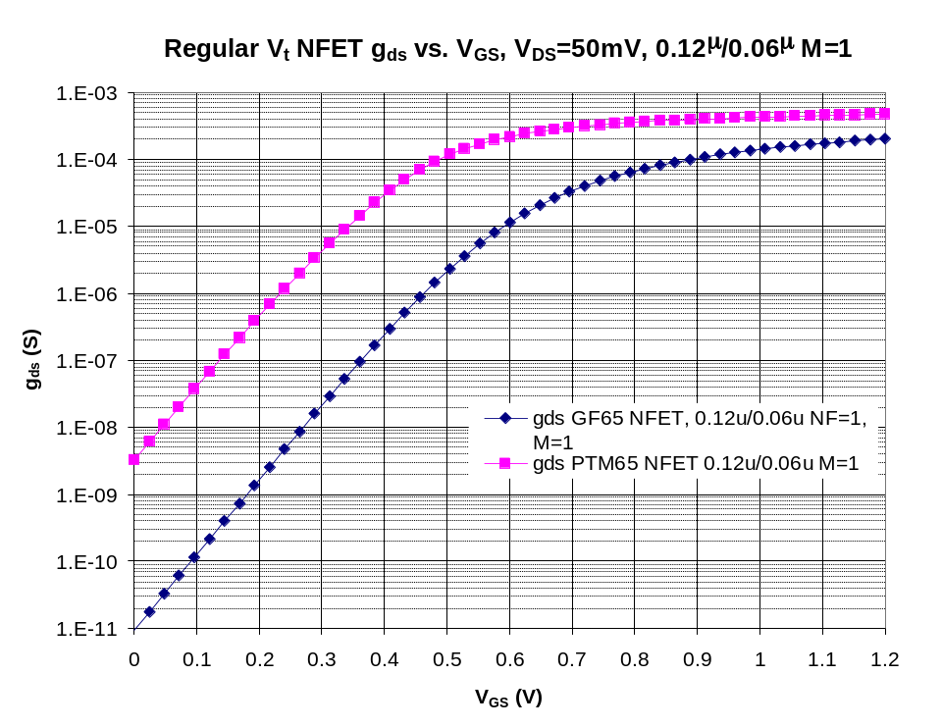
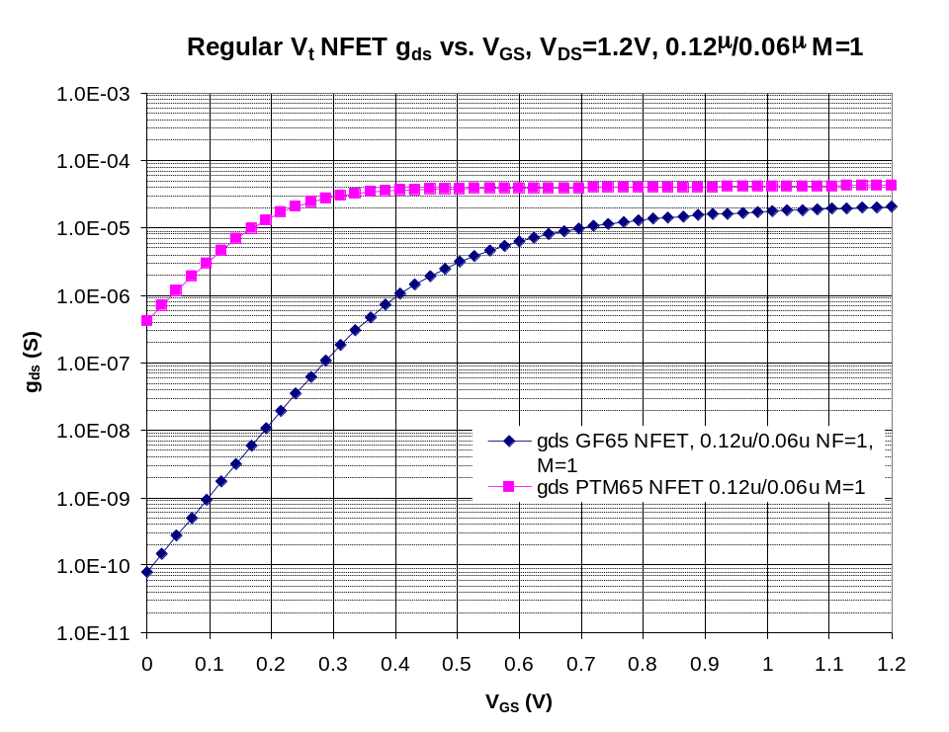
g_{ds} vs V_{GS} for 0.12u/0.06u M=1 NFET
V_{DS} = 50 mV, V_{BS} = 0V, Varying V_{GS}
V_{DS} = 1.2 V, V_{BS} = 0V, Varying V_{GS}
Lower is better.

Slide 17
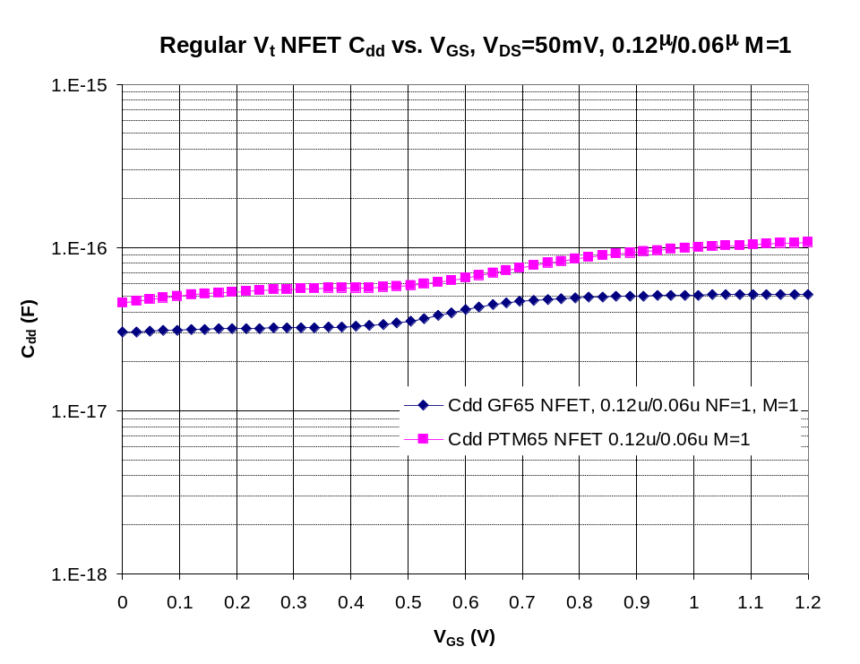
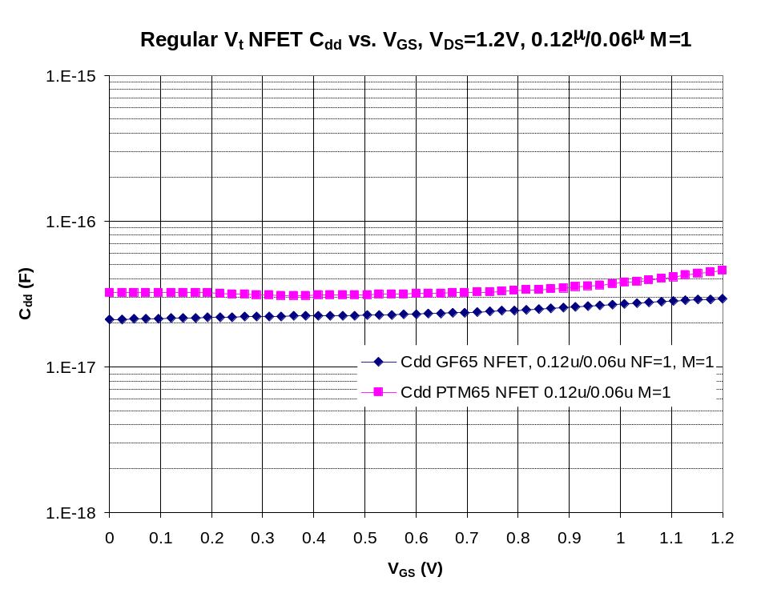
C_{dd} vs V_{GS} for 0.12u/0.06u M=1 NFET
V_{DS} = 50 mV, V_{BS} = 0V, Varying V_{GS}
V_{DS} = 1.2 V, V_{BS} = 0V, Varying V_{GS}
Lower is better.

Slide 18
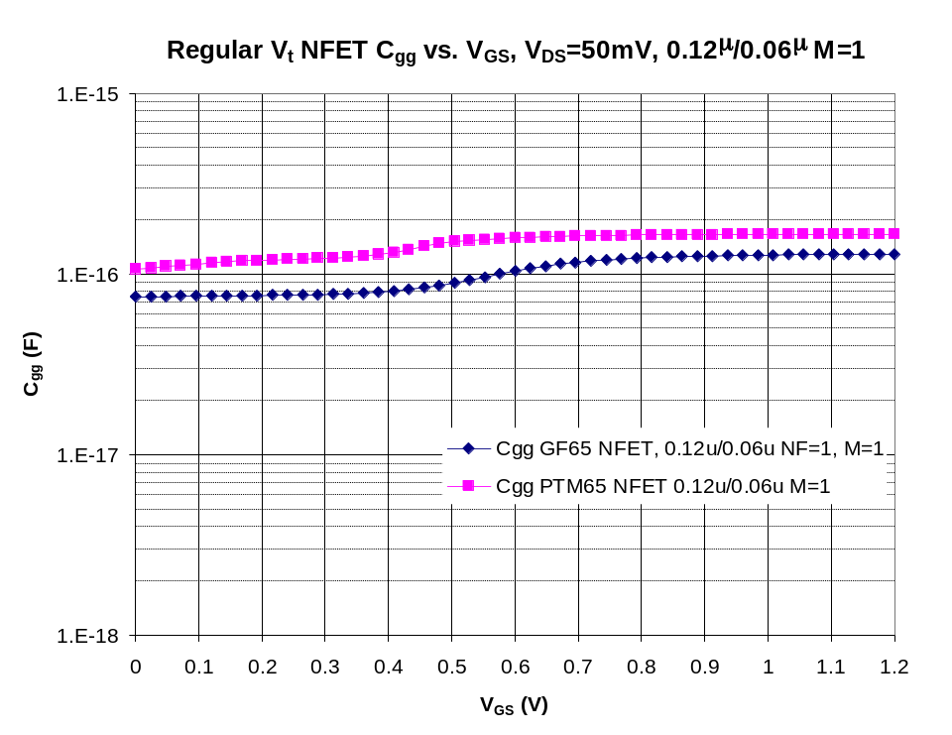
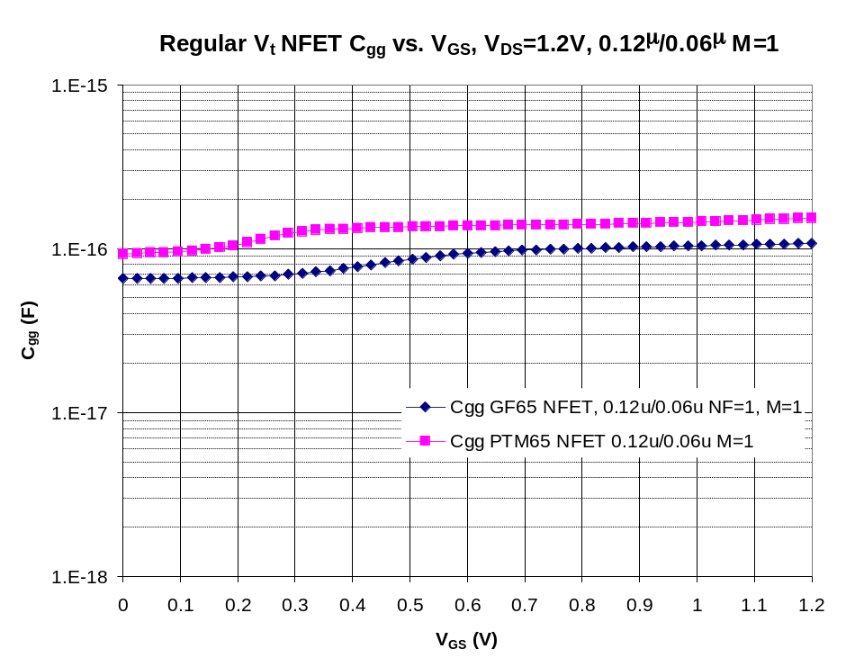
C_{gg} vs V_{GS} for 0.12u/0.06u M=1 NFET
V_{DS} = 50 mV, V_{BS} = 0V, Varying V_{GS}
V_{DS} = 1.2 V, V_{BS} = 0V, Varying V_{GS}
Lower is better.

Slide 19
Thin Oxide Native NFET Device Comparison

Slide 20
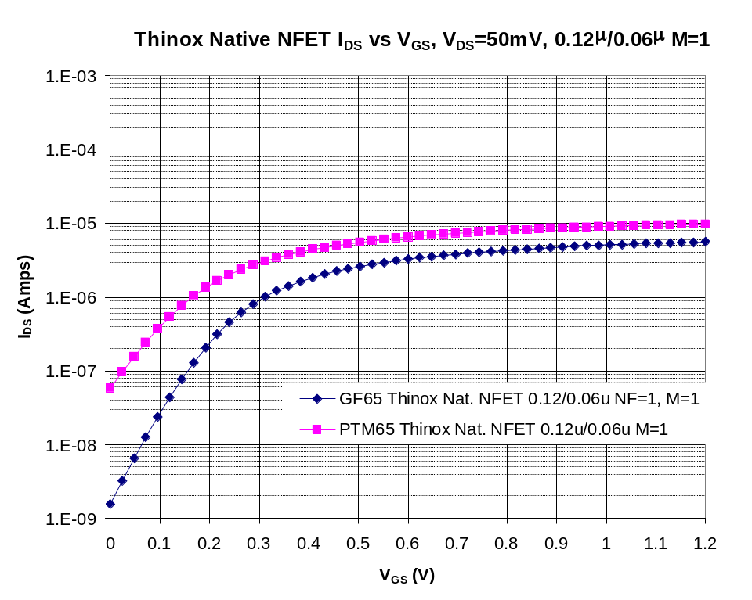
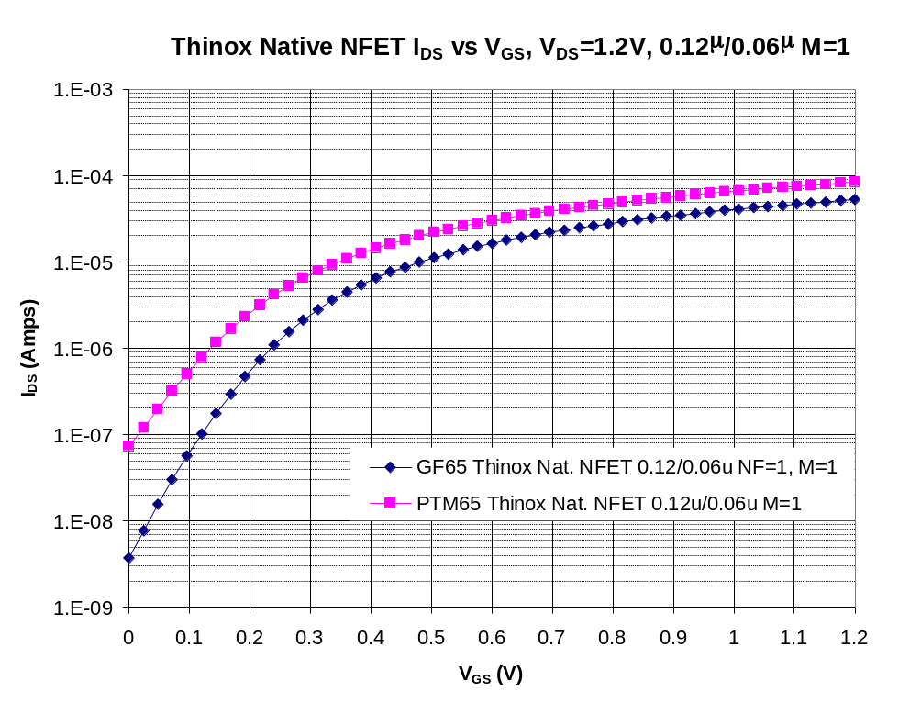
I_{DS} vs V_{GS} for 0.12u/0.06u M=1 ThinOx Native NFET
Estimate Vtlin at Vds=50 mV, Vbs=0V using
IDS = 0.1uA * (W/L) per CCM
Estimate Vtsat at Vds=1.2 V, Vbs=0V using
IDS = 0.1uA * (W/L) per CCM

Slide 21
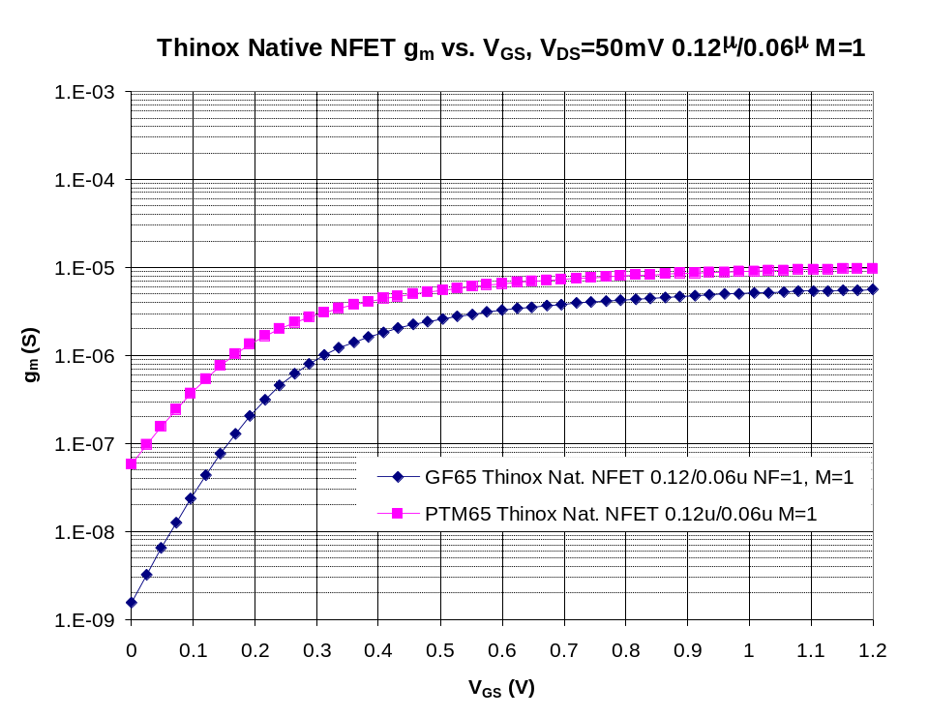
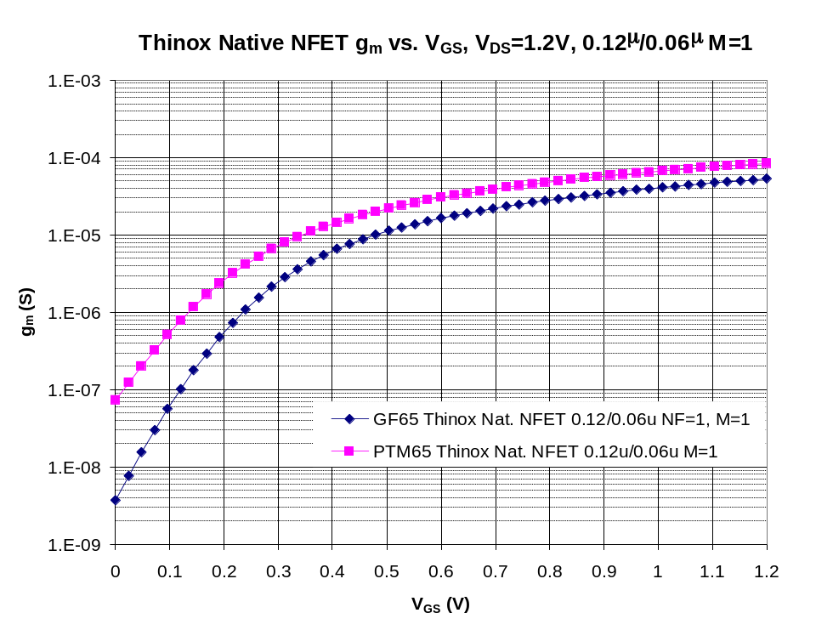
g_{m} vs V_{GS} for 0.12u/0.06u M=1 ThinOx Native NFET
V_{DS} = 50 mV, V_{BS} = 0V, Varying V_{GS}
V_{DS} = 1.2 V, V_{BS} = 0V, Varying V_{GS}

Slide 22
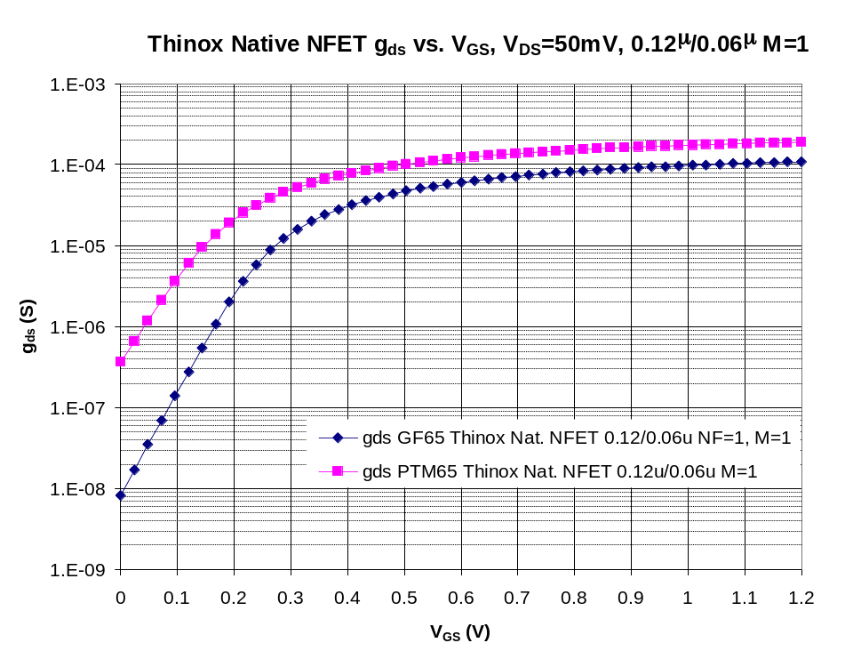
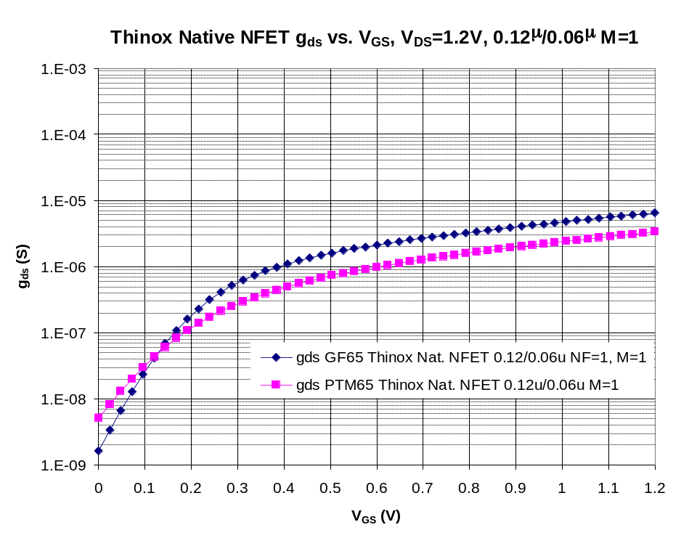
g_{ds} vs V_{GS} for 0.12u/0.06u M=1 ThinOx Native NFET
V_{DS} = 50 mV, V_{BS} = 0V, Varying V_{GS}
V_{DS} = 1.2 V, V_{BS} = 0V, Varying V_{GS}
Lower is better.

Slide 23
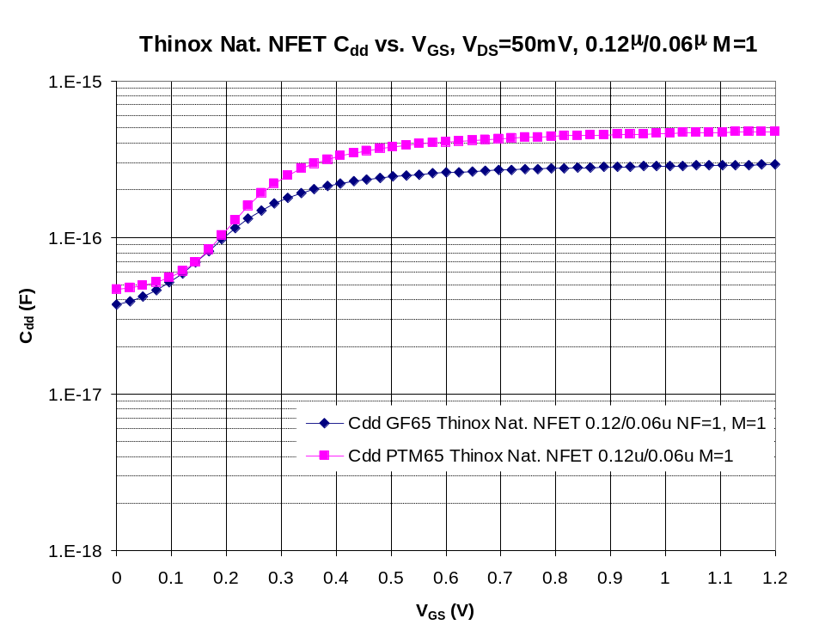
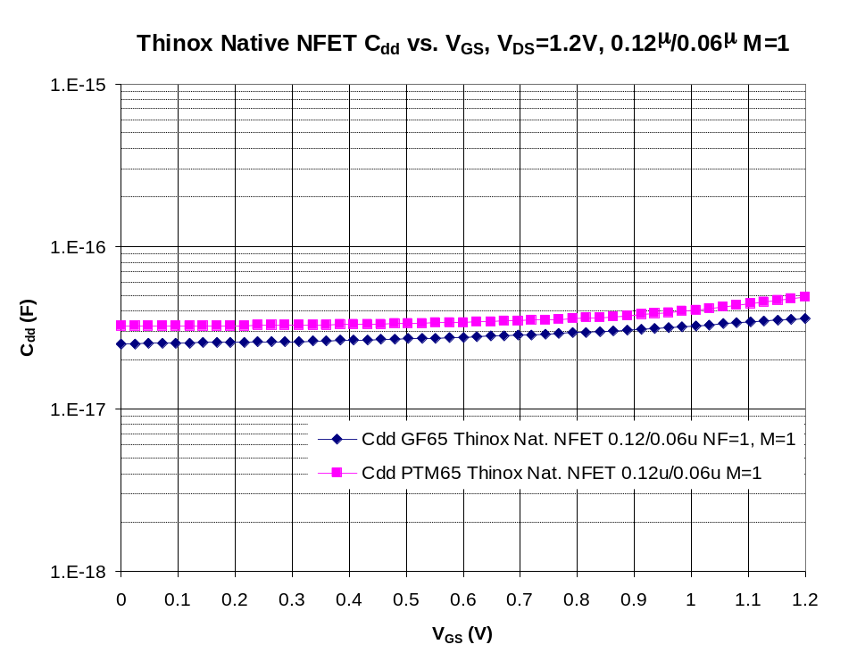
C_{dd} vs V_{GS} for 0.12u/0.06u M=1 ThinOx Native NFET
V_{DS} = 50 mV, V_{BS} = 0V, Varying V_{GS}
V_{DS} = 1.2 V, V_{BS} = 0V, Varying V_{GS}
Lower is better.

Slide 24
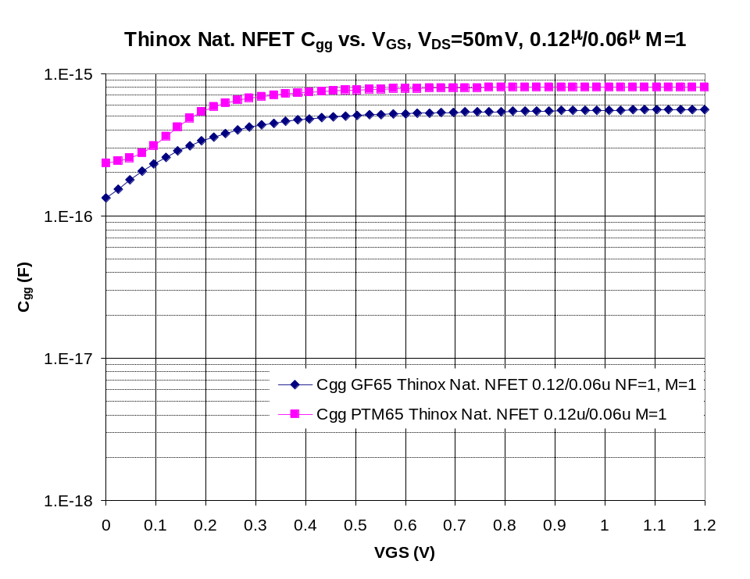
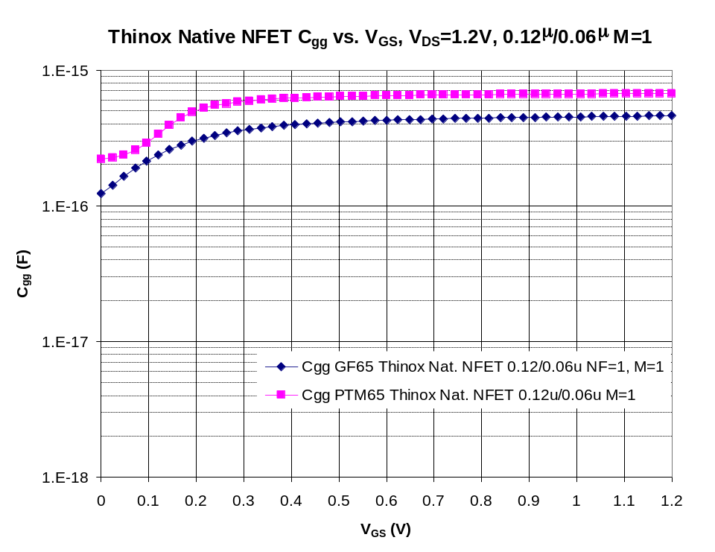
C_{gg} vs V_{GS} for 0.12u/0.06u M=1 ThinOx Native NFET
V_{DS} = 50 mV, V_{BS} = 0V, Varying V_{GS}
V_{DS} = 1.2 V, V_{BS} = 0V, Varying V_{GS}
Lower is better.

