Slide 1

Happy Scientist Seminar Series
Introduction to Collaborating with GitHub
Notes:
Welcome to the happy scientist seminar series. This is the first and hopefully not the last in a series of talks to present tools to make researchers’ lives easier.

Slide 2
What is Git?
Git is software.
Git is a version control system that is used for software development and other version control tasks. As a distributed revision control system it is aimed at speed, data integrity, and support for distributed, non-linear workflows.
As with most other distributed version control systems, and unlike most client–server systems, every Git directory on every computer is a full-fledged repository with complete history and full version-tracking capabilities, independent of network access or a central server.
Notes:
Git is software. What does it do? It tracks changes made to files. Basically you create a directory and you tell Git to track the changes you make. This directory is called a repository. I’ll talk about that more later. Git doesn’t track the changes whenever you make a save. Instead you have to tell it when to save the changes. This is called a commit. I’ll talk more about that later. Another key factor about Git is it is decentralized.

Slide 3
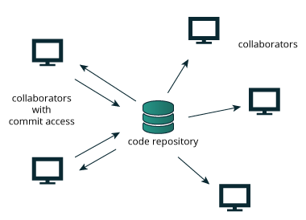
Centralized Management
Notes:
In a centralized management system there is only one copy of the Git repository. A file has to be checked out from the repository, have modifications done and then reposted. Connection to the server must be available.

Slide 4
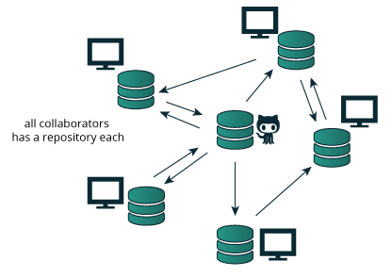
Decentralized Management
Notes:
In a decentralized environment everybody has a complete copy of the repository. There is usually a central repository that is called the origin. I’ll speak more about that later. It is possible to get a copy of the repository from someone else other than the central repository.

Slide 5
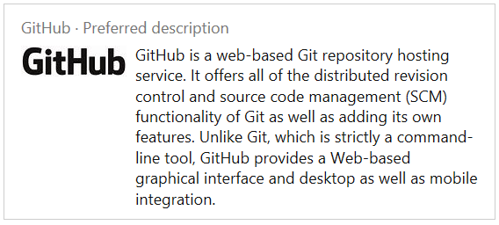
What is GitHub?
GitHub is a service.
Notes:
GitHub is a service. It serves as the central repository. Let’s look at the last slide. The repository with the cat beside it represents the GitHub. There are other git repository systems like BitBucket and GitLab. All these services add functionality and include useful tools for maintaining repositories such as limiting access.

Slide 6
Why Use GitHub?
Revision Tracking – Can track changes and revert to previous versions
Collaboration – Multiple people can work on the same repository simultaneously
Distribution – A repository can be made public allowing others to download your files
Backup – Not the intent of GitHub but if something happens to your computer you can recover the repository from GitHub or another computer that has the repository
Notes:
Revision tracking is not the same as tracking changes. Working on the same file simultaneously can create merging problems. If we have time I’ll go over and example. If you really want a backup, copy the repository (directory) to server.

Slide 7
GitHub Terms
Organization – A type of account that has several people as members
Repository – A set of related files that are having their revisions tracked
Public Repository – A repository can be read by anyone
Private Repository – A repository that can only be read by a specified group of people
Team – A group of people in an organization that have been grouped together for a specific purpose
Project – A job several people can be working on. A repository may have more than one project. Quite often people refer to a repository as a project. This is even done on GitHub’s website.
Notes:
Private accounts only have one user. I will try to use repository but sometimes I’ll call it a project.

Slide 8
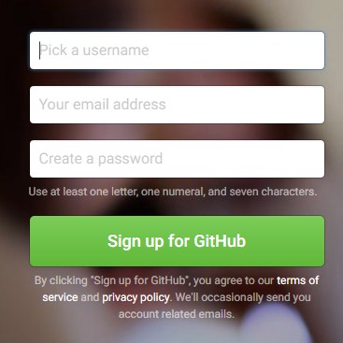
Creating an Account on GitHub
Go to http://github.com
Fill in the boxes and click Sign up for GitHub.
Notes:
This is just a portion of the screen but all you have to do is fill in the blanks.

Slide 9
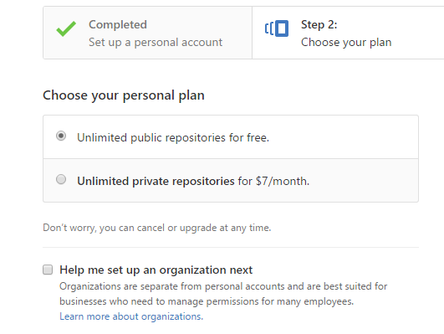
Creating an Account on GitHub
Selecting account type
Notes:
Again this is just part of the screen. You can create your only private account. There is really no need. We will make you a member of the USCbiostats organization that has unlimited private repositories.

Slide 10
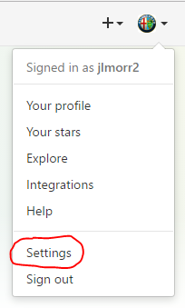
Creating an Account on GitHub
Check your e-mail. You should have received an e-mail from GitHub.
Click on the verify e-mail address in the e-mail.
Update your account settings. This is done by selecting the strange icon in the upper right and selecting Settings.
Notes:
You don’t have to do this but it makes it a little easier to identify you.

Slide 11
Joining the USCbiostats Organization
Send me an e-mail, jmorr@usc.edu asking to join. Include your GitHub account name.
I will generate an invitation to join the organization in GitHub.
You will receive the invitation from GitHub.
Click on the Join button in the e-mail. You will be sent to the GitHub website. Log on if necessary. Click on the Join button.
Notes:
You can also email Jim. We may add other people later.

Slide 12
Creating a Repository
On the first page when you log on there is a button that says “Start a Project”. It should say “Create a Repository”. Project is sometimes used to mean repository but a repository can consist of several projects.
You can create repositories in your own account. These will be public.

Slide 13
Creating a Repository in the USCbiostats Organization
Creating a repository in the USCbiostats organization requires special permissions. You will need to ask someone with these permissions to create the account. You will need to provide the following information.
Name of the repository
Team or people that will need access
Is this a public or private repository
Notes:
Again Jim and I are the only people that can do this now. We will add others in the future. User will have owner privileges to the repository.

Slide 14
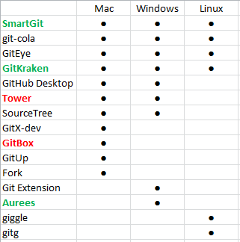
Tools for Accessing the Repository
Green – Commercial product with free non-profit version
Red – Commercial product
Notes:
These are GUI tools. There is also a tool called TortoiseGit for Windows that I really like. Most of these you have to do to the programs website and download it. GitHub desktop is a little easier to install. I’ll show that later.

Slide 15
Development Tools that can Access Git Repositories
Some development tools can be configured to access Git Repositories.
R Studio
Eclipse
Atom
Jupyter
Visual Studio 2015
Notes:
Atom and GitHub Desktop already have a connection.

Slide 16
Show and Tell
Tour of GitHub
GitHub Desktop
Source Tree
R Studio

