Slide 1
Hypothesis Testing
Kim Siegmund
kims@usc.edu

Slide 2
What do the following questions have in common?
Is mean blood pressure level the same in smokers and non-smokers?
Is mean cholesterol level the same in persons who eat meat compared to those who eat plant-based proteins?
E
Y
e.g., Smoking
Blood pressure

Slide 3
They both compare the mean of a quantitative variable in 2 groups
What other characteristics of quantitative variables might we compare?

Slide 4
Procedures for Testing Statistical Hypotheses
Part I: Design the Study
What? How? How many?
Part II: Perform the study
Notes:
What is the research question?
How will you test the research question? What test statistic?
How many samples do I need to collect?

Slide 5
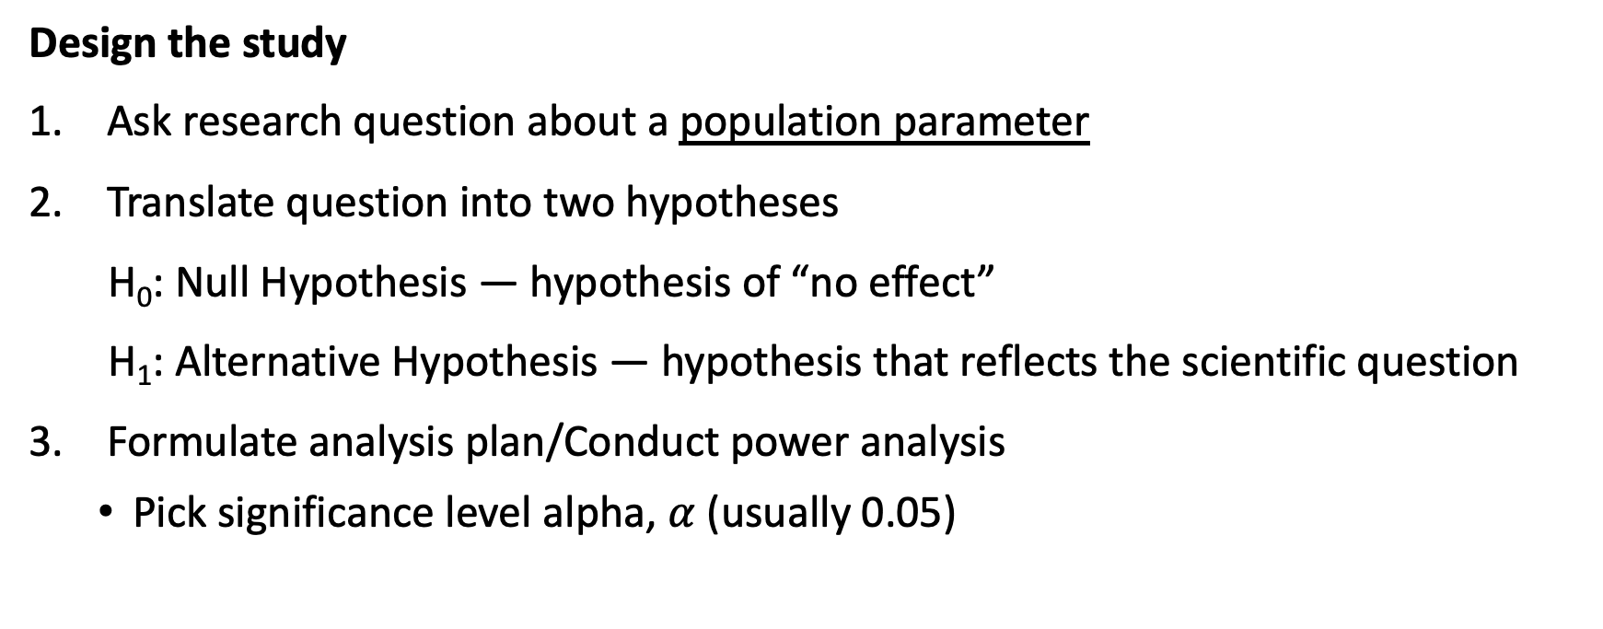
Procedures for Testing Statistical Hypotheses: Part I
Design the study
Ask research question about a population parameter
Translate question into two hypotheses
H₀: Null Hypothesis — hypothesis of “no effect”
H₁: Alternative Hypothesis — hypothesis that reflects the scientific question
Formulate analysis plan/Conduct power analysis
Pick significance level alpha, $α$ (usually 0.05)
Notes:
Question: Is the mean lung function from teens that vape less than 80%?

Slide 6
Procedures for Testing Statistical Hypotheses: Part II
Perform the Study
Collect the data…
Calculate test statistic
Note: the choice of statistic is made BEFORE data is collected
Convert test statistic to p-value (p) (1- or 2-sided?)
Make a decision – to reject or not reject, that is the question
Compare p to α, usually 0.05
If p ≤ α, reject H₀. Statistically significant
If p > α, do not reject H₀. Not statistically scientific (NS).
Conclusion

Slide 7
Hypothesis testing
We specify the following:
Null hypothesis (H₀) is what we want to ‘disprove’
Alternative Hypothesis (H_{A}) is what we want to find
Significance Level probability of making the wrong decision when H₀ is true
(fix by design)

Slide 8
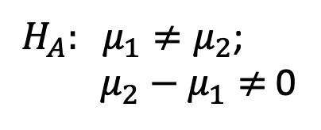
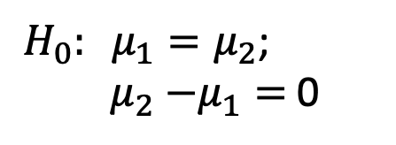
Test equality of means
The Null hypothesis
H₀: mean blood pressure is the same in groups 1 and 2
The Alternative hypothesis
H_{A}: mean blood pressure is different in groups 1 and 2
$H_{0}: μ_{1}=μ_{2}$;
${ μ}_{2}$ $−μ_{1}=$ 0
$H_{A}: μ_{1}≠μ_{2}$;
${ μ}_{2}$ $− μ_{1}≠$ 0

Slide 9
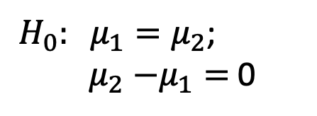
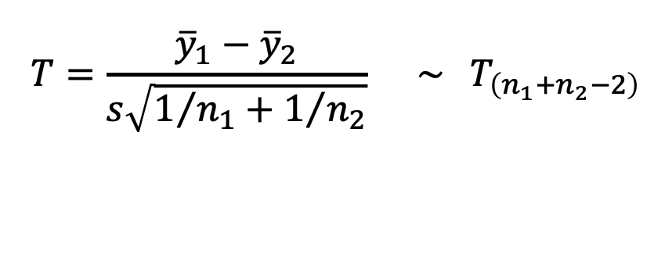
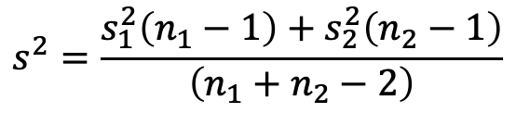
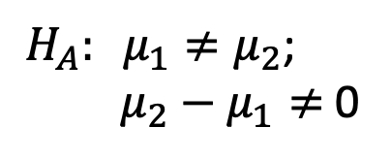
Two-sample t-test: equal variances
$$T=\frac{{\overline{y}}_{1}−{\overline{y}}_{2}}{s\sqrt{1/{n_{1}}+1/{n_{2}}}} \sim { T}_{\left(n_{1}+n_{2}−2\right)}$$
under
H₀
$$s^{2}=\frac{s_{1}^{2}\left(n_{1}−1\right)+s_{2}^{2}\left(n_{2}−1\right)}{\left(n_{1}+n_{2}−2\right)}$$
$H_{0}: μ_{1}=μ_{2}$;
${ μ}_{2}$ $−μ_{1}=$ 0
$H_{A}: μ_{1}≠μ_{2}$;
${ μ}_{2}$ $− μ_{1}≠$ 0

Slide 10
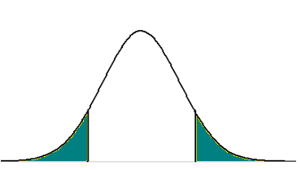
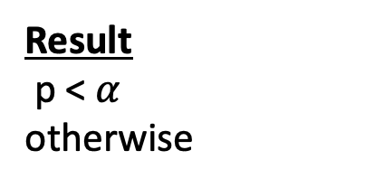
The roll of P-values in hypothesis testing
Is the probability under H_{O} of
obtaining a value of T as or more
extreme than its observed value
Distribution of T under H₀
P-value
T_{observed}
Result
p < $α$
otherwise
Conclusion
reject H₀ (statistically significant)
do not reject H₀ (null)
Notes:
Often we conduct the decision rule using a p-value, instead of a critical value.
The p-value is defined as the probability under the null distribution of observing your test statistic (T_observed) or one more extreme.
If the pvalue from our 2-sample t-test is < alpha, we reject
Otherwise if it is larger, we do not reject H0

Slide 11
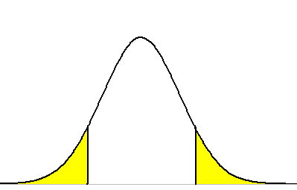
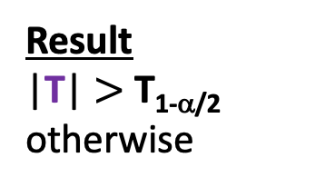
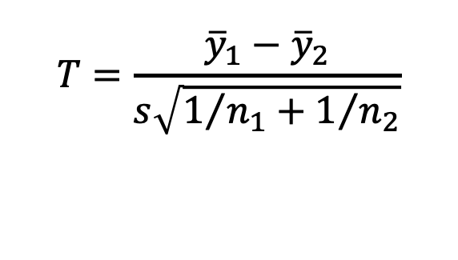
Fix $α$, the significance level.
$$T=\frac{{\overline{y}}_{1}−{\overline{y}}_{2}}{s\sqrt{1/{n_{1}}+1/{n_{2}}}}$$
Distribution of T under H₀
Area = α/2
Area = α/2
T_{α/2}
T_{1-α/2}
0
Rejection
Region
Null
Rejection
region
Result
|T| $>$ T_{1-α/2}
otherwise
Conclusion
reject H₀ (statistically significant)
do not reject H₀ (null)
Notes:
To make a decision, we fix the significance level.
The significance level is the probability of making the wrong decision when the null hypothesis is true. This is the area in yellow and is set a priori, by design.
We draw the distribution of the 2-sample T statistic under the null hypothesis. Notice it is centered at 0 for the null hypothesis of no difference in mean expression between our 2 groups.
Find the cutoff values of the T statistic, the critical values, where the area in the tail, representing the probability of a statistic more extreme than the critical value, equals alpha, our significance level. For a 2-tailed test, we split this probability equally in both tails.
Now we can define the rejection region as the set of all T-values that are more extreme than our critical values.
If our T-statistic from our sample lies in the rejection region, we reject H0, the null hypothesis, and say that our result is statistically significant.
The region around 0, we can call the null. If our statistic lies here, we do not reject Ho.

Slide 12

Set $α$ = 0.05
Distribution of T under H₀
Area = .025
Area = .025
T_{.025}
T_{.975}
0

Slide 13
The roll of P-values in hypothesis testing
Is the probability under H_{O} of
obtaining a value of T as or more
extreme than its observed value
Distribution of T under H₀
P-value
T_{observed}
Result
p < $α$
otherwise
Conclusion
reject H₀ (statistically significant)
do not reject H₀ (null)
Notes:
Often we conduct the decision rule using a p-value, instead of a critical value.
The p-value is defined as the probability under the null distribution of observing your test statistic (T_observed) or one more extreme.
If the pvalue from our 2-sample t-test is < alpha, we reject
Otherwise if it is larger, we do not reject H0

Slide 14
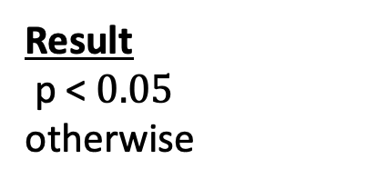
Set $α$ = 0.05
Distribution of T under H₀
P-value
T_{observed}
Result
p < $0.05$
otherwise
Conclusion
reject H₀ (statistically significant)
do not reject H₀ (null)

Slide 15
Case study on Parkinson’s Disease
Having a history of head trauma (p=0.005), high blood pressure (p= 0.01), or exposure to agricultural pesticides (p=0.04) is related to 25-60% higher risk of PD.
Surprisingly, current cigarette smokers were at 40% lower risk of PD as compared to non-smokers (p=0.02).
And non-smokers exposed to second-hand smoke had 12% lower PD risk as compared to non-smokers without exposure to second-hand smoke, but this association was not formally statistically significant (p=0.07).

Slide 16
Positive and negative test results
Recall the following:
Null hypothesis (H₀) we want to disprove this
Alternative Hypothesis (H_{A}) we want to conclude this
Reject H₀ positive test (want to conclude this)
Do not reject H₀ negative test
BUT there is always a chance we draw the wrong conclusion

Slide 17
Decision
(test result)
Do not
Reject H₀
Reject H₀
True
False
Reality
H₀ (null)
is True
Negative
Positive
False
True
The significance level is
the probability of an error.
Which one?
Negative
Positive
H₁ (alternative)
is True

Slide 18


The following test result is likely a:
A: False-positive
B: False-negative
C: True-positive
D: Both B and C

Slide 19

The following test result is likely a:
A: False-positive
B: False-negative
C: True-positive
D: Both B and C

Slide 20
Analogy: Hypothesis Testing and the Legal System
Legal concept | Statistical Test
Accused is Innocent | Null Hypothesis
Accused is Guilty | Alternative Hypothesis
Reasonable Doubt | Level of Significance
Convict a Felon | Correctly Reject H₀
Acquit an Innocent | Correctly Fail to Reject H₀
Convict an Innocent | Type I Error
Acquit a Felon | Type II Error

Slide 21
Class activity

Slide 22
Types of tests
difference in means
difference in variances
different distributions
different proportions
correlation
….
Tests about different parameters/variable types use different statistics,
but the hypothesis testing
procedures are similar.

Slide 23
We find that the average blood pressure level is different in smokers and non-smokers (p=0.002). Does smoking cause high blood pressure?
C?
E
Y
e.g., Smoking
Blood pressure

Slide 24
Summary
We test hypotheses about population-based parameters
There is a chance we draw the wrong conclusion (false-positive or false-negative)
Rejecting the null hypothesis does not imply causation
HOWEVER, we can describe the circumstances under which a causal association could be inferred (Dr. Garcia’s lecture)

