Slide 1
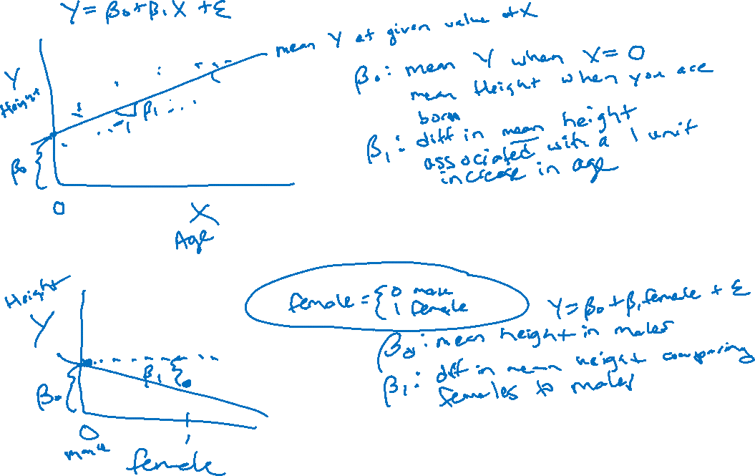
LA’s BeST @ USC
Introduction to Linear Regression

Slide 2
Topics + Learning objectives
Explore Dr. Sandy Eckel’s career path + current work
Define and use correlation to describe linear association between two continuous variables
Define linear regression relating continuous outcome (Y) to predictor (X)
Continuous X
Binary X
Evaluate assumptions of linear regression
Describe similarity between t-test and linear regression with binary X

Slide 3

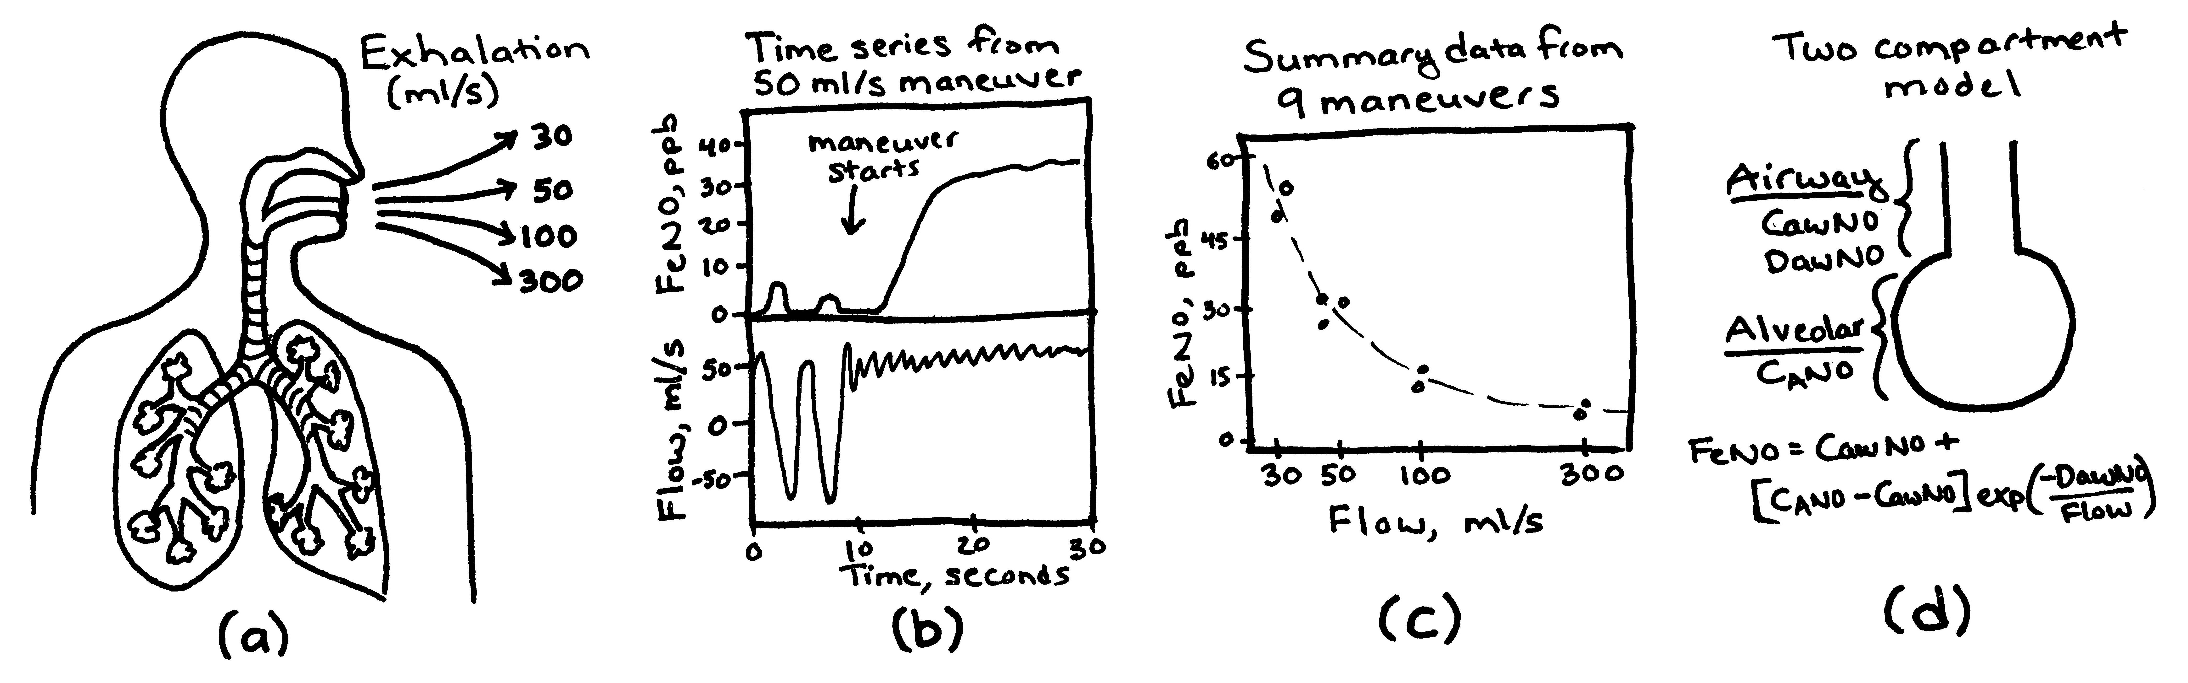
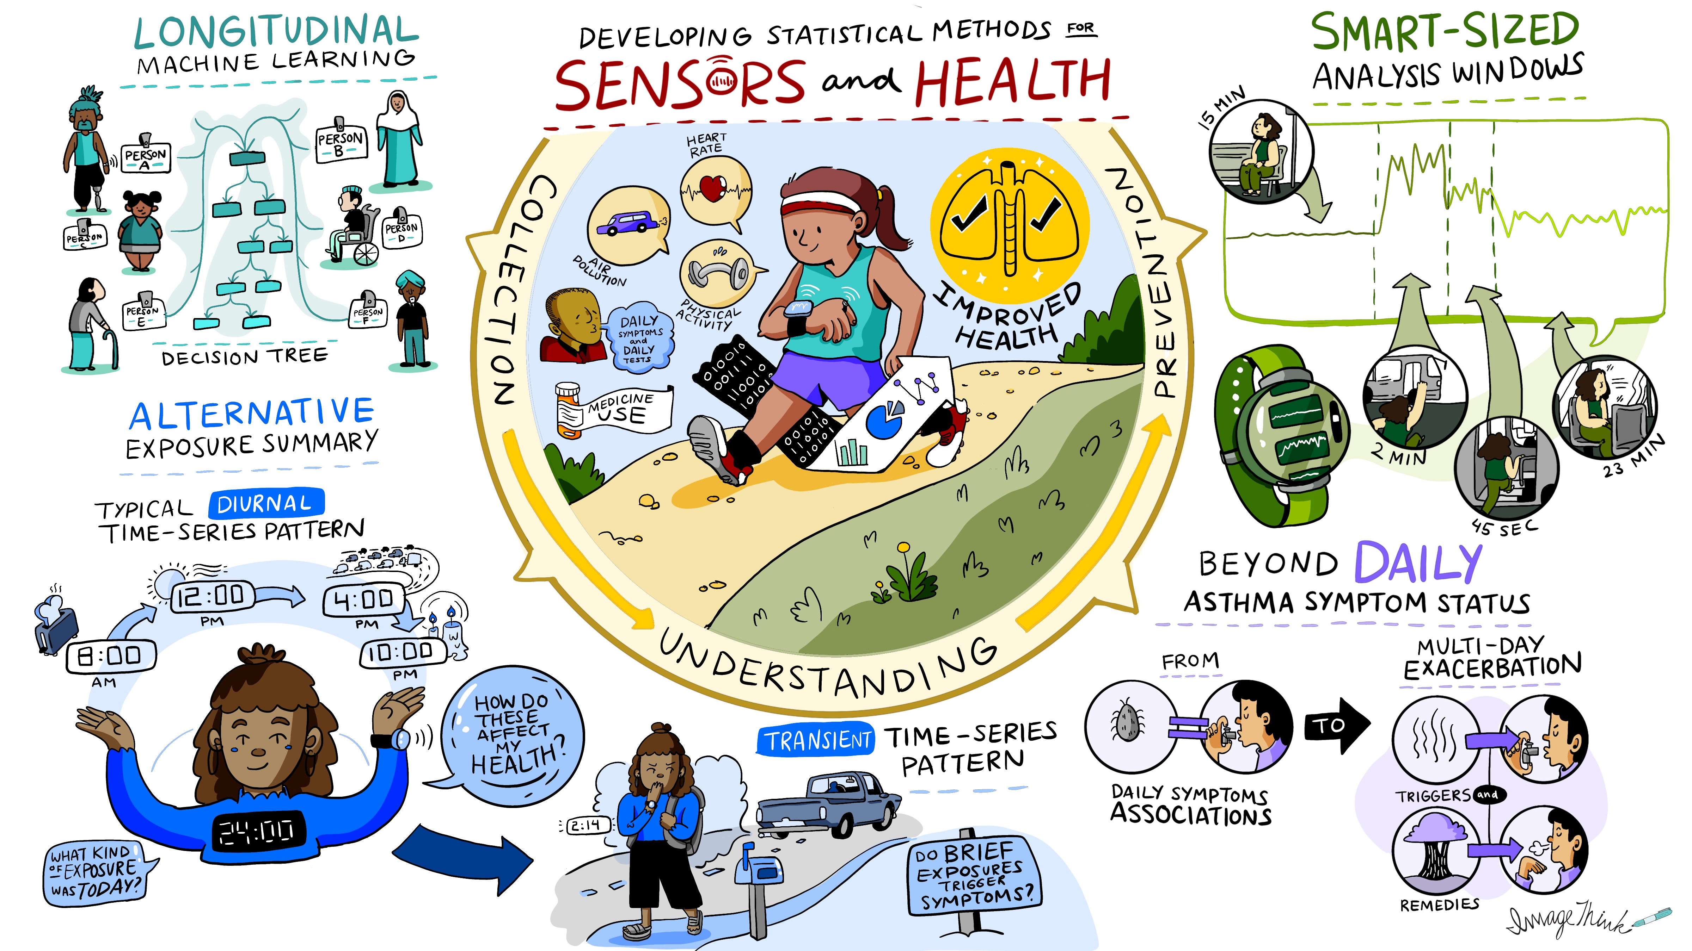
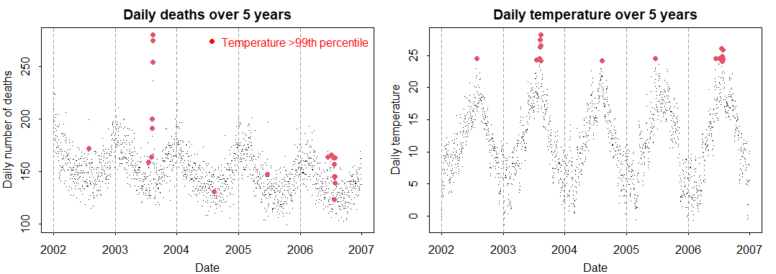


Who am I?
Associate Professor of Biostatistics
Department of Population and Public Health Sciences
Keck School of Medicine of USC
What do I do?
Teaching (~21%)
Direct PhD Program (~20%)
Research (~51%), e.g., NIH funded grants
Statistical methods work for:
Exhaled breath biomarker, FeNO
Wearable sensor data in studies of pediatric asthma
Climate Change and Health
Team science work: 7+ other collaborative projects
Sandy Eckel, PhD eckel@usc.edu
https://eckel.usc.edu/

Slide 4


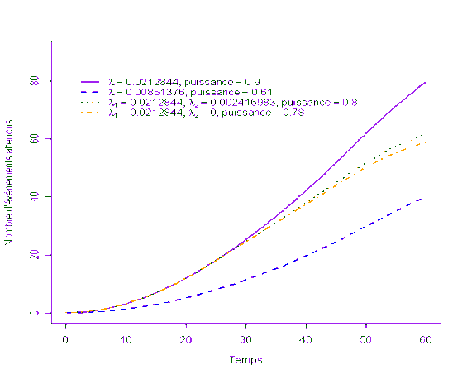



How did I become Biostat faculty at USC?
Undergrad – studied French and math
Junior year in Paris
Biostatistics internship
Senior: took every stat class available
Directly entered a biostatistics PhD Program Thesis: Statistical methods for studying air pollution health effects in older adults
Joined USC as a postdoctoral researcher to study air pollution health effects
Children’s Health Study
Tenure-track faculty position at USC
National search

Slide 5
Back to our learning objectives
Explore Dr. Sandy Eckel’s career path + current work
Define and use correlation to describe linear association between two continuous variables
Define linear regression relating continuous outcome (Y) to predictor (X)
Continuous X
Binary X
Evaluate assumptions of linear regression
Describe similarity between t-test and linear regression with binary X

Slide 6
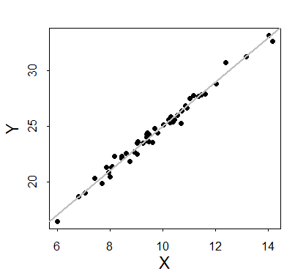
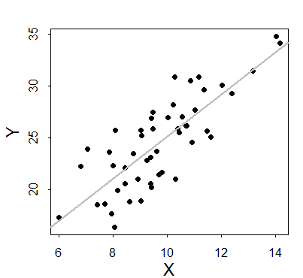
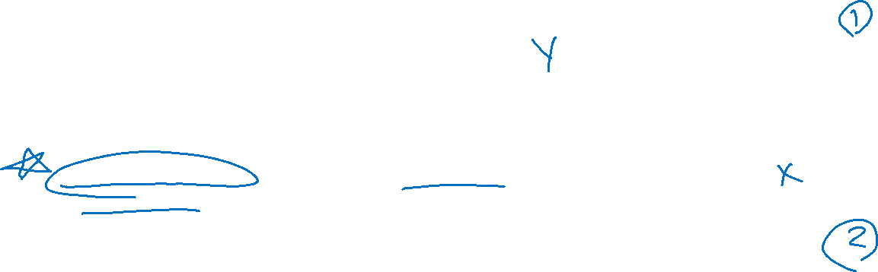
Correlation
Consider the relation between two random variables X and Y
How do we quantify the strength of the linear association between these two variables?
Example: Both figures relate a Y to an X, but the relation seems “stronger” in the top figure

Slide 7
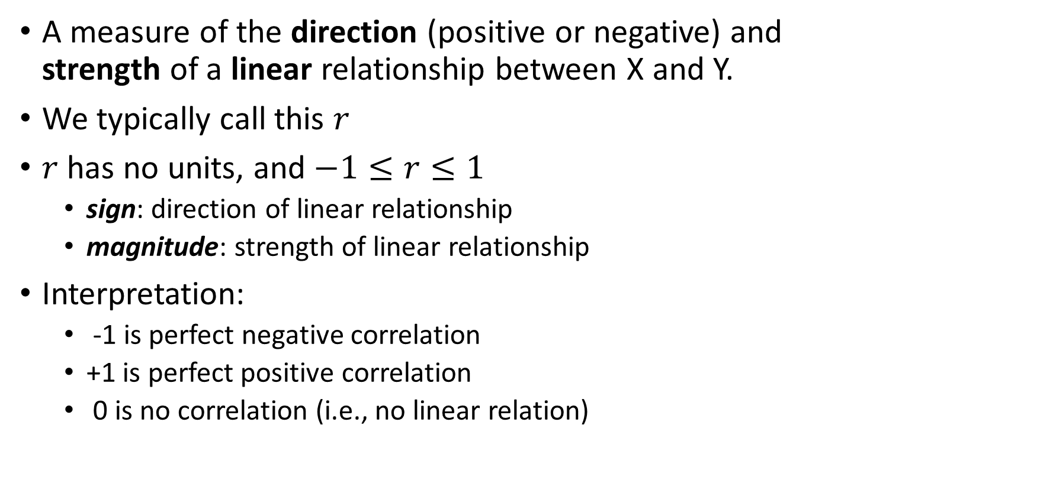
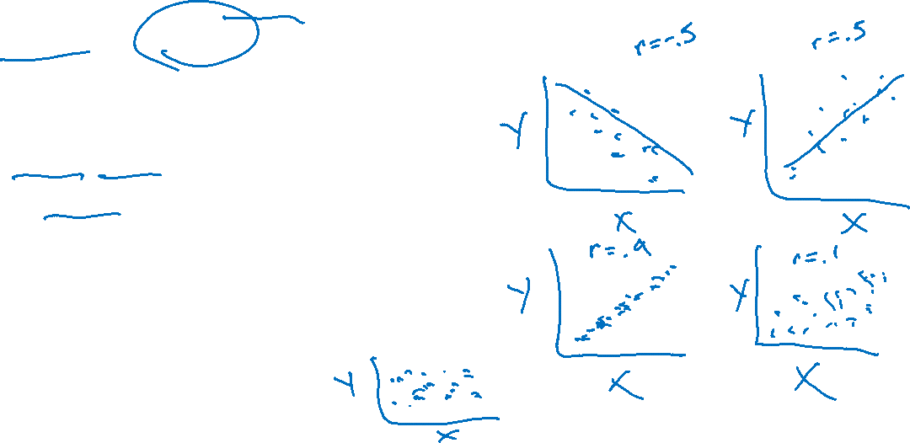
Pearson’s Correlation Coefficient
A measure of the direction (positive or negative) and strength of a linear relationship between X and Y.
We typically call this $r$
$r$ has no units, and $−1≤r≤1$
sign: direction of linear relationship
magnitude: strength of linear relationship
Interpretation:
-1 is perfect negative correlation
+1 is perfect positive correlation
0 is no correlation (i.e., no linear relation)

Slide 8
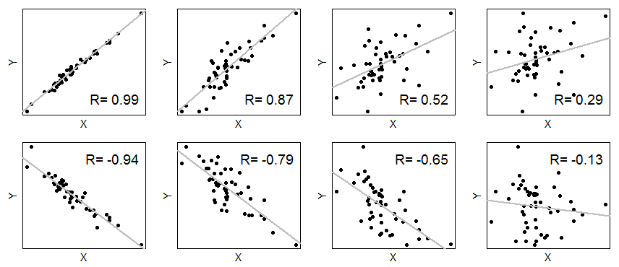
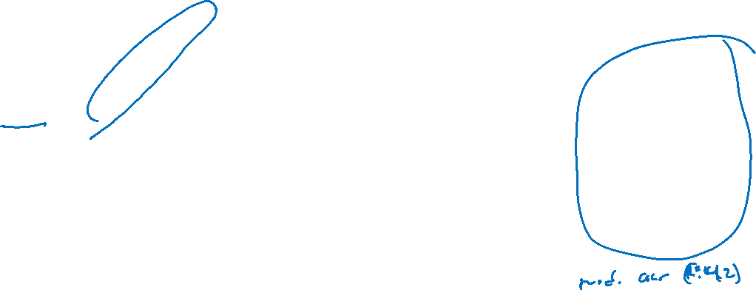
Pearson’s Correlation Coefficient Examples
Value | Effect Size
0 | None
±0.1 | Small
±0.3 | Medium
±0.5 | Large

Slide 9
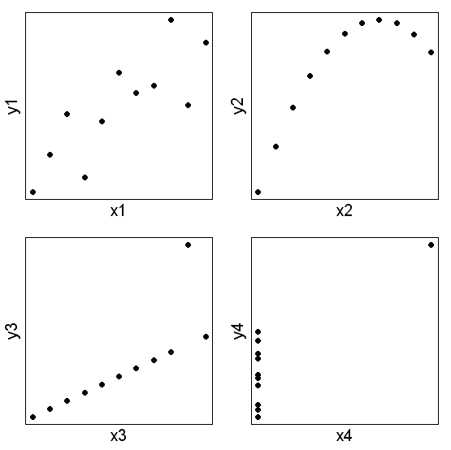
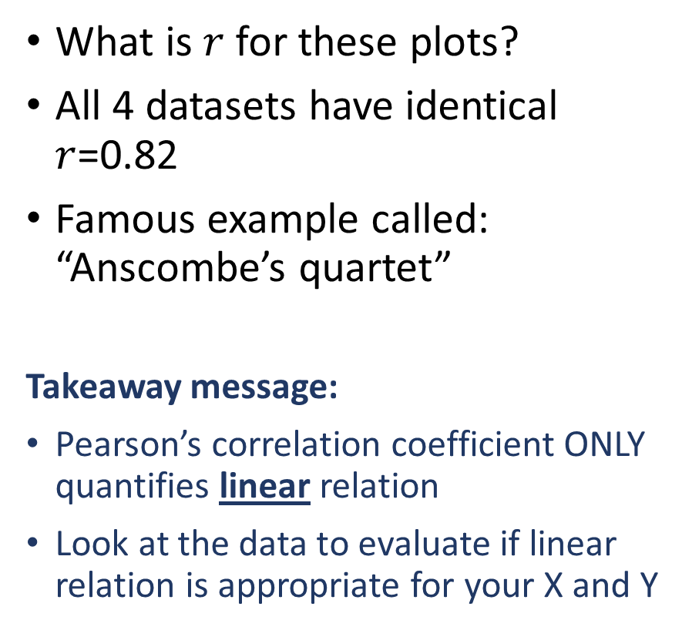
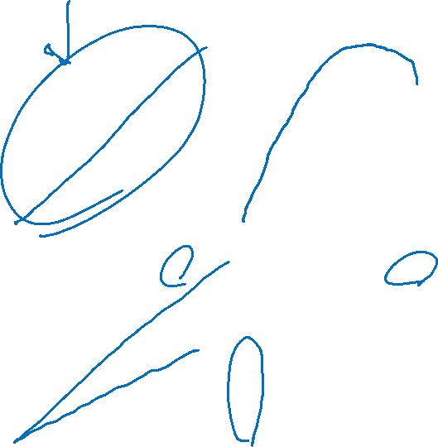
Pearson’s Correlation Coefficient – BEWARE!
What is $r$ for these plots?
All 4 datasets have identical $r$=0.82
Famous example called: “Anscombe’s quartet”
Takeaway message:
Pearson’s correlation coefficient ONLY quantifies linear relation
Look at the data to evaluate if linear relation is appropriate for your X and Y

Slide 10


Formula for $r$
For your reference, Pearson’s correlation coefficient is calculated as:

Slide 11
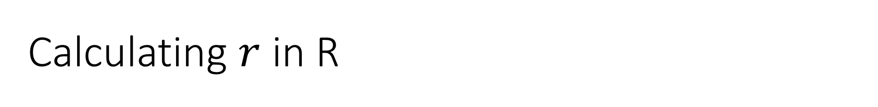
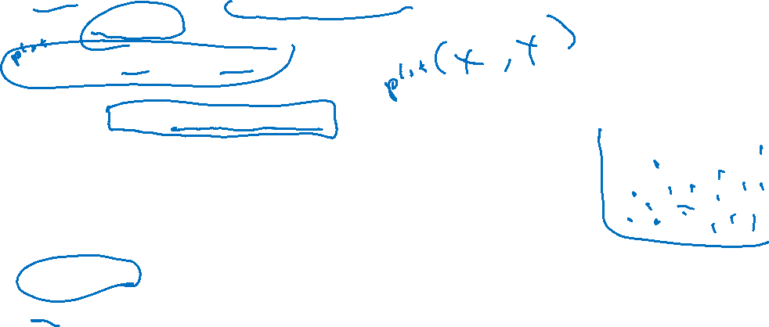
Calculating $r$ in R
Example 1: is cholesterol correlated with age?
Read in cholesterol dataset (chol.csv)
chol <- read.csv("C:/my directory/chol.csv")
Calculate Pearson’s Correlation Coefficient:
cor(chol$chol,chol$age)
[1] NA
summary(chol[,c("chol","age")])
chol age
Min. :108.0 Min. : 2.0
1st Qu.:152.2 1st Qu.:11.0
Median :179.0 Median :17.0
Mean :198.5 Mean :22.6
3rd Qu.:216.5 3rd Qu.:35.0
Max. :468.0 Max. :68.0
NA's :2
cor(chol$chol,chol$age,use="complete")
[1] 0.2103558
Option: use=“complete” handles missing values (NA) in the dataset

Slide 12
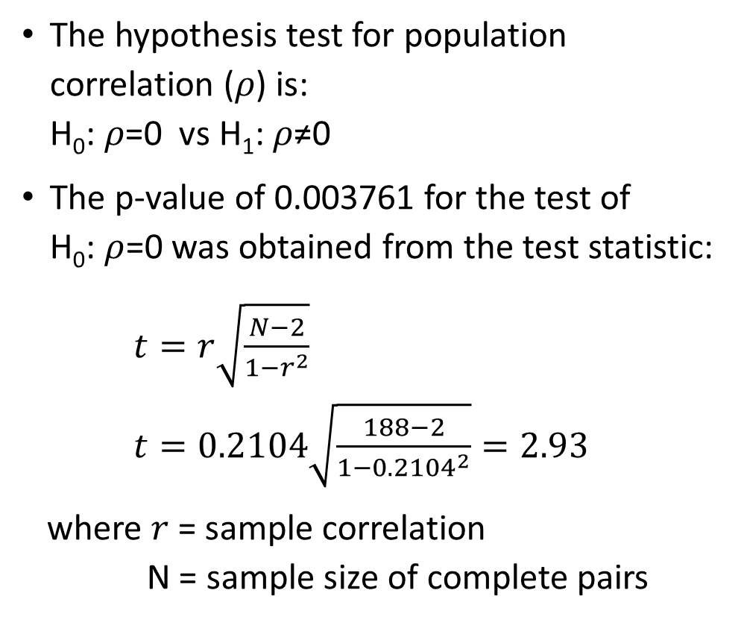
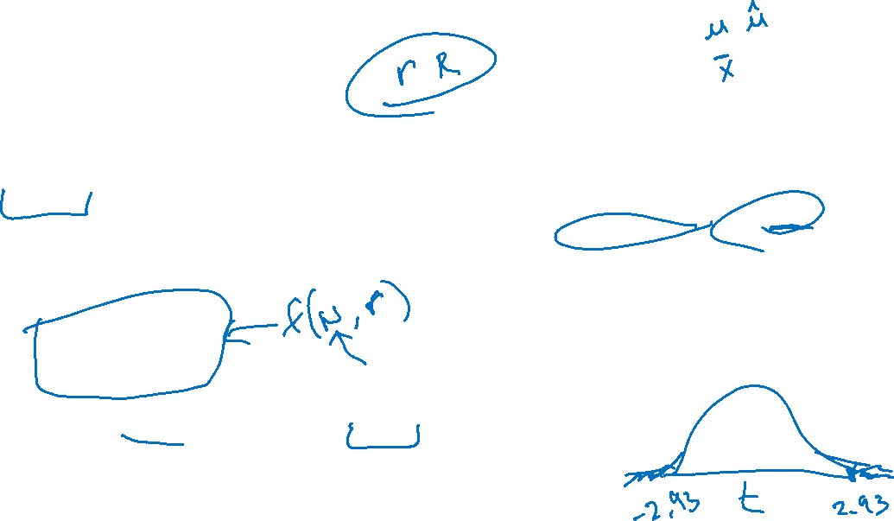
Hypothesis Testing for Correlation
The hypothesis test for population correlation (𝜌) is: H₀: 𝜌=0 vs H₁: 𝜌≠0
The p-value of 0.003761 for the test of H₀: $ρ$=0 was obtained from the test statistic:
$t=r\sqrt{\frac{N−2}{1−r^{2}}}$ $t=0.2104\sqrt{\frac{188−2}{1−{0.2104}^{2}}}=2.93$
where $r$ = sample correlation N = sample size of complete pairs
cor.test(chol$chol, chol$age)
Pearson's product-moment correlation
data: chol$chol and chol$age
t = 2.9345, df = 186, p-value = 0.003761
alternative hypothesis: true correlation is not equal to 0
95 percent confidence interval:
0.0693328 0.3431363
sample estimates:
cor
0.2103558

Slide 13
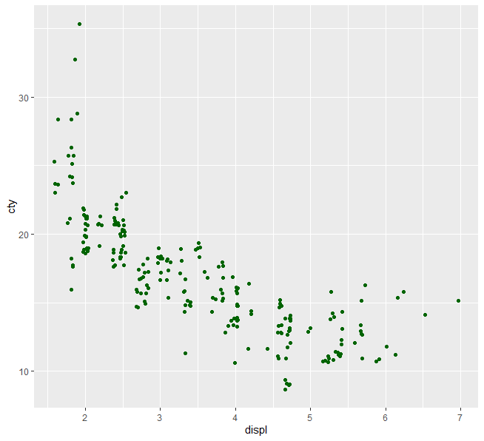

Example 2: MPG Data set
Let’s use ggplot2’s MPG data set to examine the correlation between engine displacement and city miles per gallon (MPG) in cars.
Do you trust this correlation coefficient?
> mpg <- ggplot2::mpg
> cor(mpg$cty, mpg$displ)
-0.798524

Slide 14
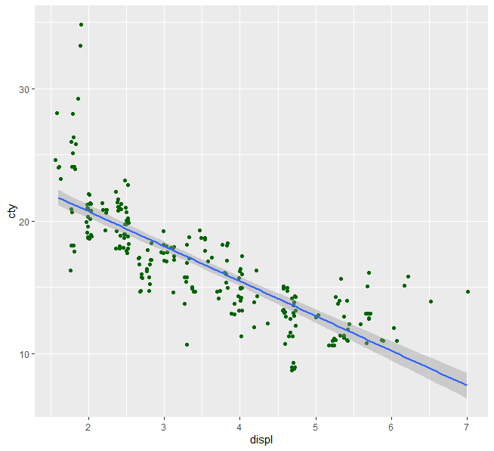

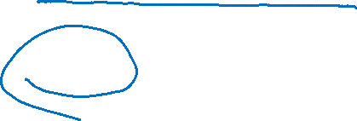
What happens when linearity assumption for $r$ isn’t met?
Relation between cty and displ isn’t linear!
What can we do?
Apply a transformation of some sort
Use a nonparameteric test (e.g., Spearman’s correlation!)

Slide 15
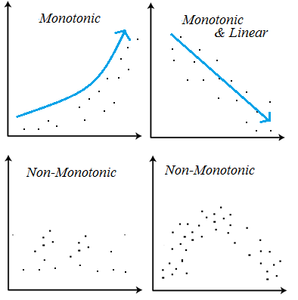
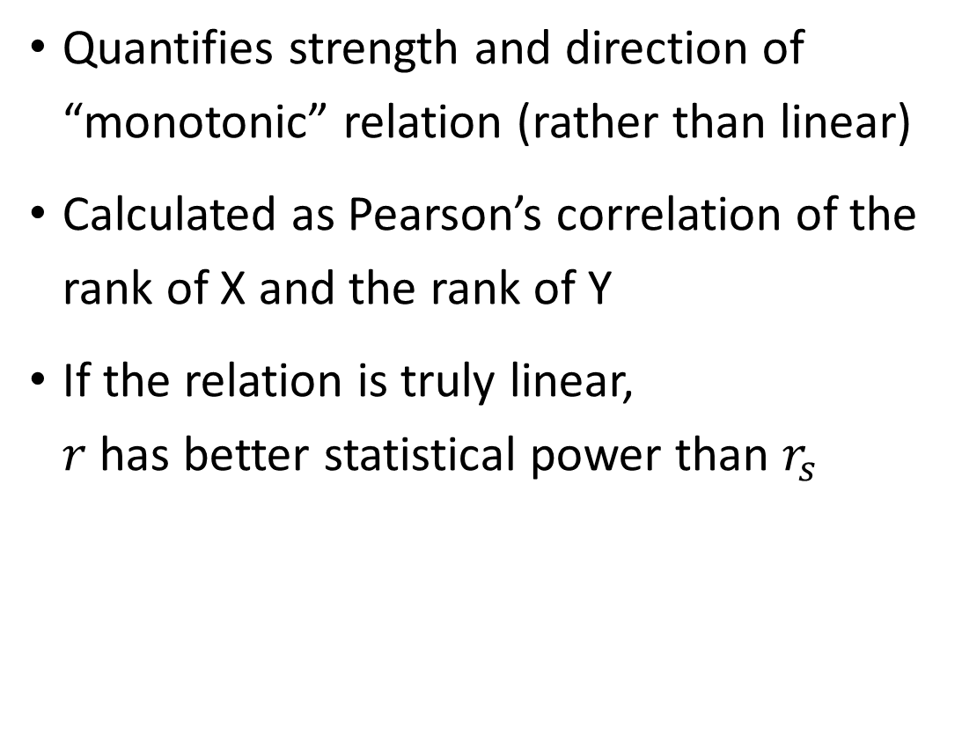

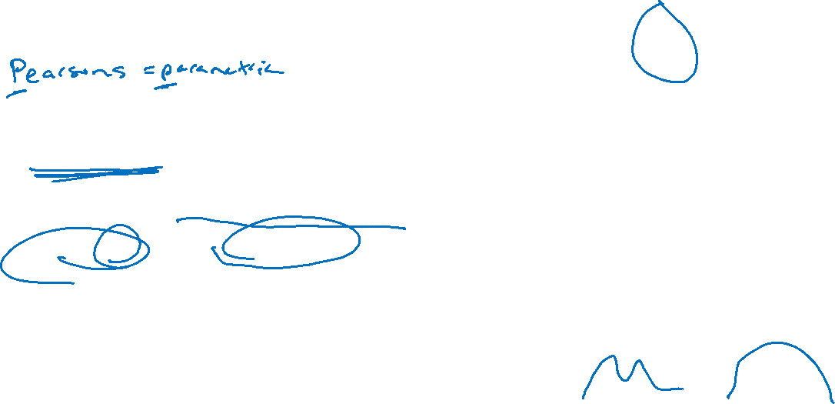
Spearman’s Correlation Coefficient, $r_{s}$
Quantifies strength and direction of “monotonic” relation (rather than linear)
Calculated as Pearson’s correlation of the rank of X and the rank of Y
If the relation is truly linear, $r$ has better statistical power than $r_{s}$

Slide 16
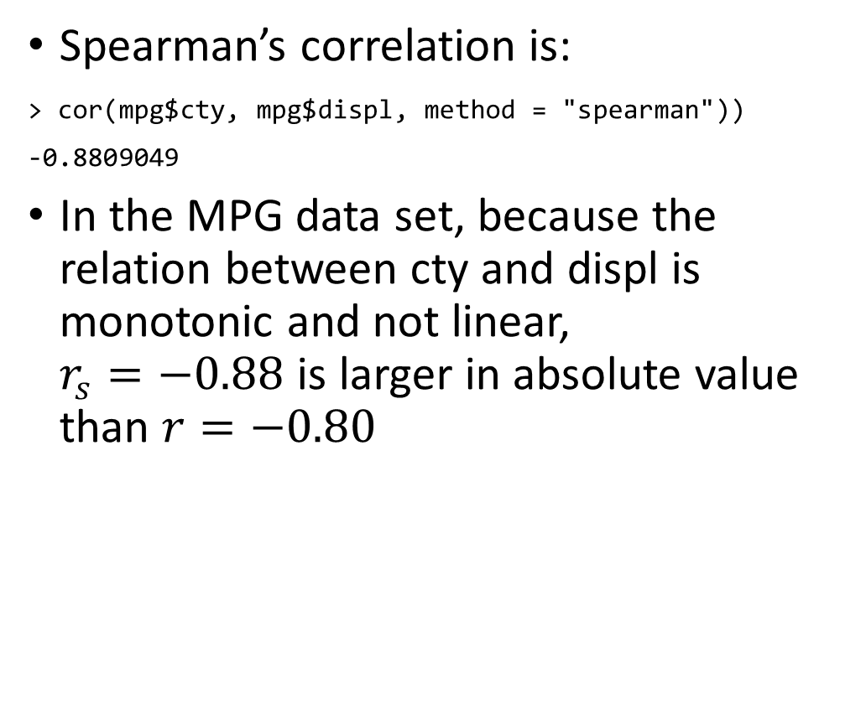
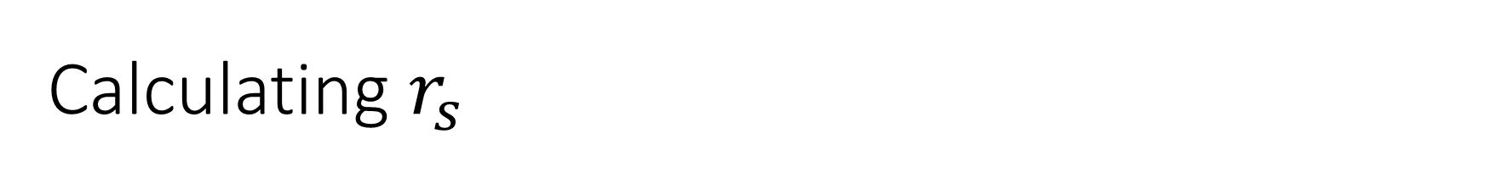

Calculating $r_{s}$
Spearman’s correlation is:
> cor(mpg$cty, mpg$displ, method = "spearman"))
-0.8809049
In the MPG data set, because the relation between cty and displ is monotonic and not linear, $r_{s}=−0.88$ is larger in absolute value than $r=−0.80$

Slide 17


Your turn with correlation!
Visually examine the relation between chol and age in the chol data
Compute $r_{s}$ and $r$for chol and age
Which measure is higher? Why?

Slide 18
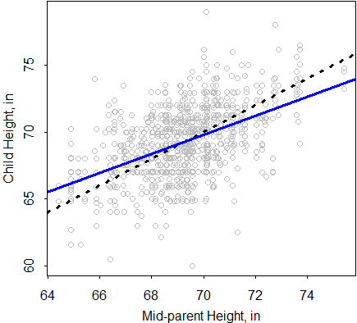
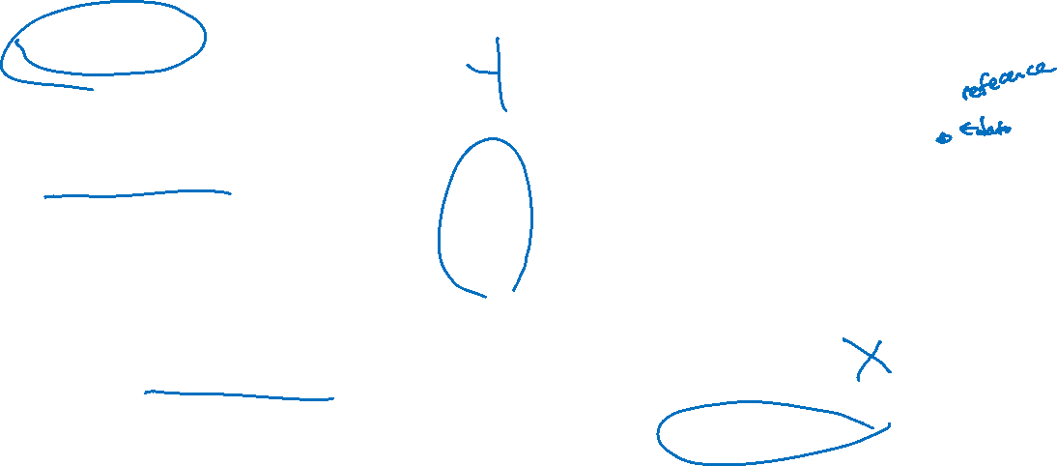
Introduction to linear regression What is regression?
Galton, F. (1886). Regression Towards Mediocrity in Hereditary Stature Journal of the Anthropological Institute, 15, 246-263
Notes:
Dashed line = 1-1 relation; blue line = what was observed

Slide 19
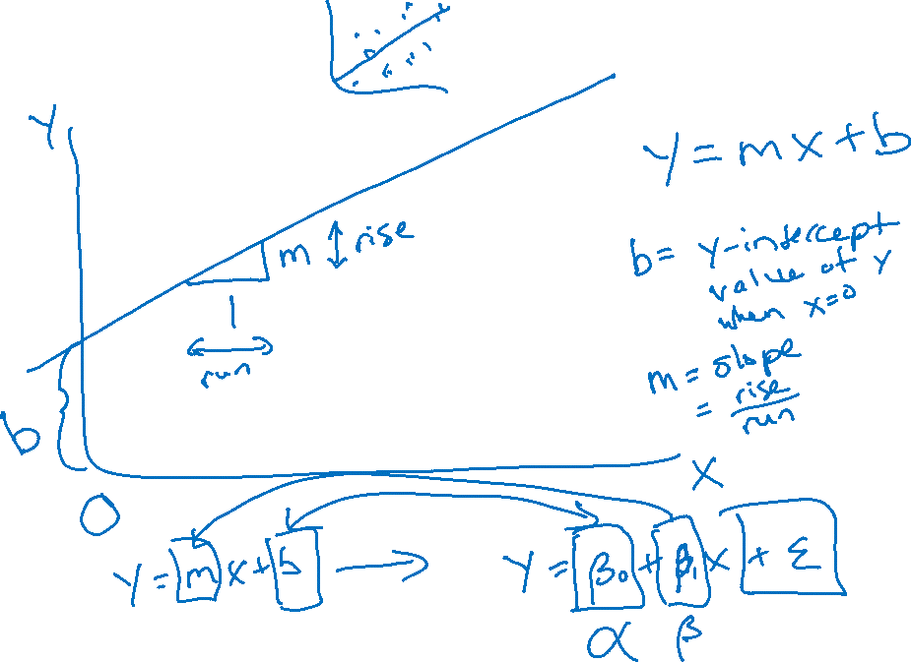
What is a line?
Notes:
Here, draw out the equation for a line Y= aX + B

Slide 20
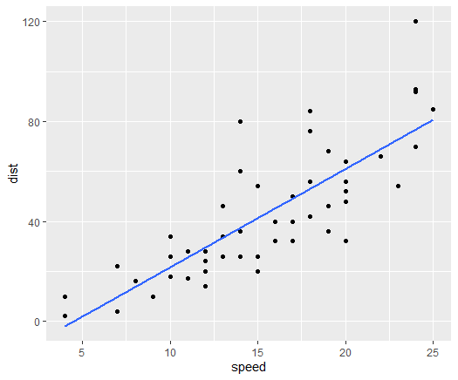
Studying Linear Relationships using Regression
We’ve talked about how correlation quantifies “linear” relations…
While we will go into more detail about how to examine linearity, the relationship to the right just looks linear to us.

Slide 21
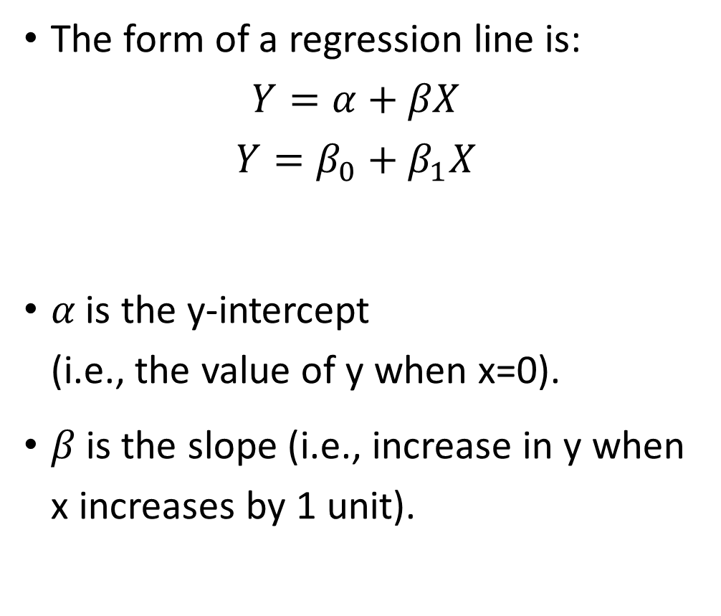
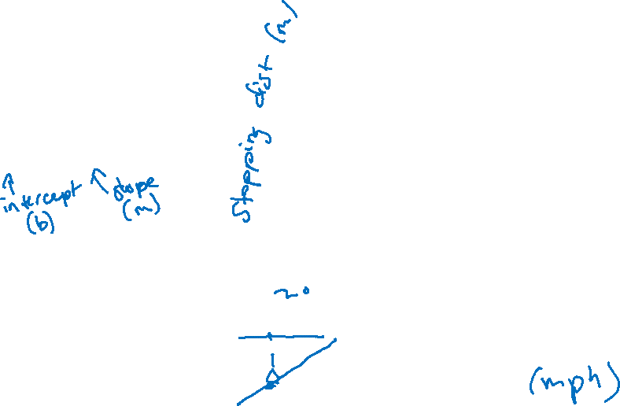
The Regression Line
The form of a regression line is:
$$Y=α+βX$$
$$Y=β_{0}+β_{1}X$$
𝛼 is the y-intercept (i.e., the value of y when x=0).
𝛽 is the slope (i.e., increase in y when x increases by 1 unit).
You can use either notation!

Slide 22
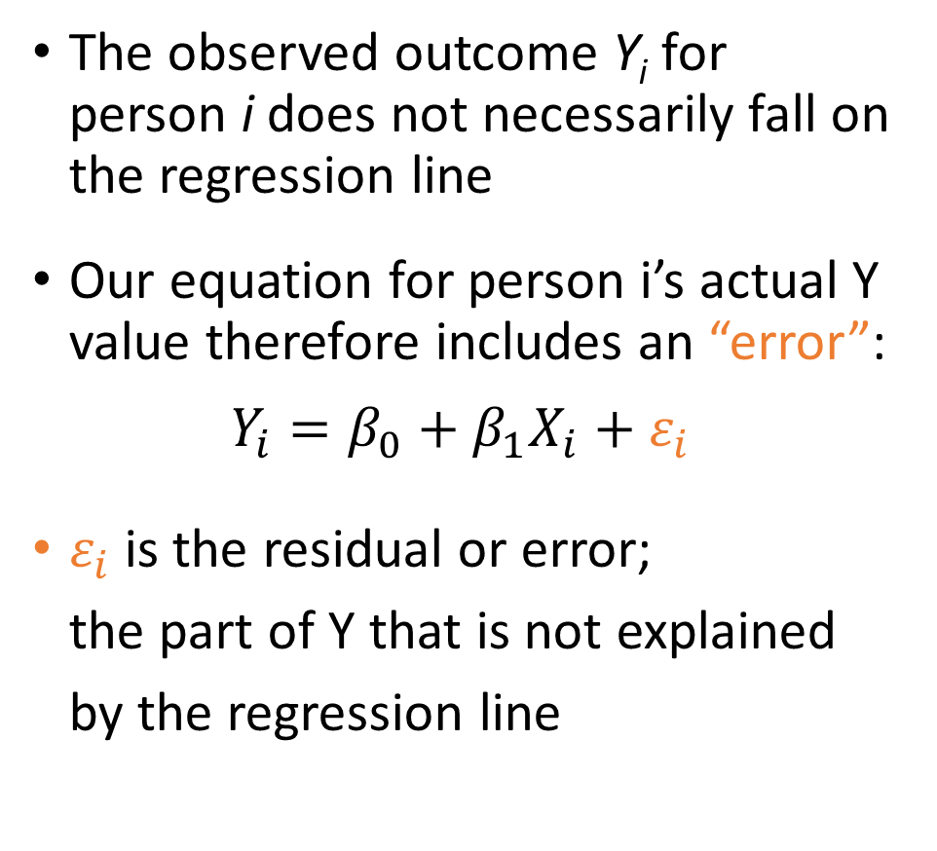
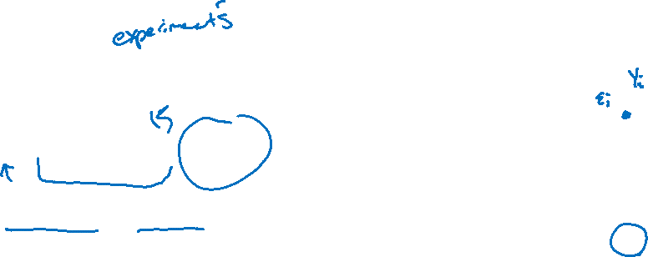
The full regression model Line vs. observations
The observed outcome Y_{i} for person i does not necessarily fall on the regression line
Our equation for person i’s actual Y value therefore includes an “error”:
$$Y_{i}=β_{0}+β_{1}X_{i}+ε_{i}$$
$ε_{i}$is the residual or error; the part of Y that is not explained by the regression line

Slide 23
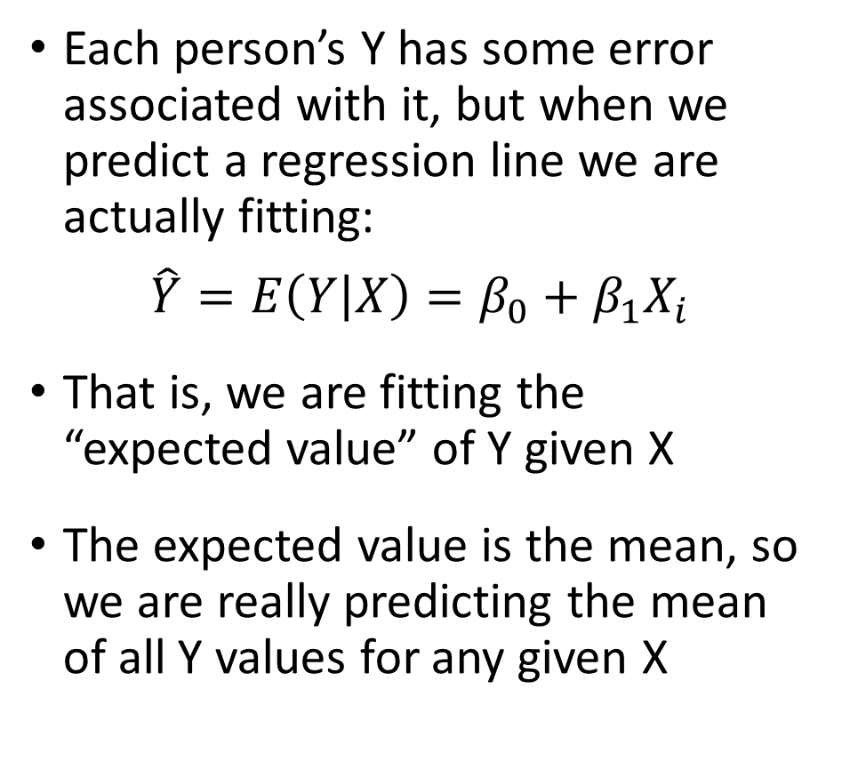
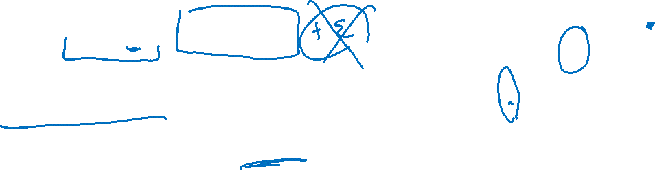
Predicting the mean Y at a given value of X
Each person’s Y has some error associated with it, but when we predict a regression line we are actually fitting:
$$\hat{Y}=E\left(Y | X\right)=β_{0}+β_{1}X_{i}$$
That is, we are fitting the “expected value” of Y given X
The expected value is the mean, so we are really predicting the mean of all Y values for any given X

Slide 24
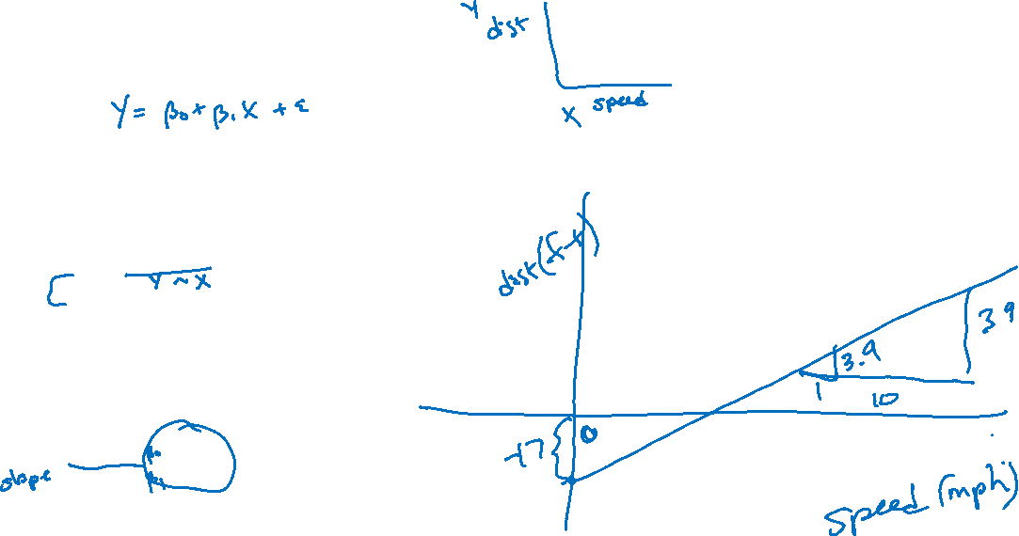
Linear Regression in R
How does stopping distance relate to speed in cars?
We will use the R data set “cars”
cars <- data(cars)
fit <- lm(dist ~ speed, data = cars)
summary(fit)
Residuals:
Min 1Q Median 3Q Max
-29.069 -9.525 -2.272 9.215 43.201
Coefficients:
Estimate Std. Error t value Pr(>|t|)
(Intercept) -17.5791 6.7584 -2.601 0.0123 *
speed 3.9324 0.4155 9.464 1.49e-12 ***
---
Signif. codes: 0 ‘***’ 0.001 ‘**’ 0.01 ‘*’ 0.05 ‘.’ 0.1 ‘ ’ 1
Residual standard error: 15.38 on 48 degrees of freedom
Multiple R-squared: 0.6511, Adjusted R-squared: 0.6438
F-statistic: 89.57 on 1 and 48 DF, p-value: 1.49e-12

Slide 25

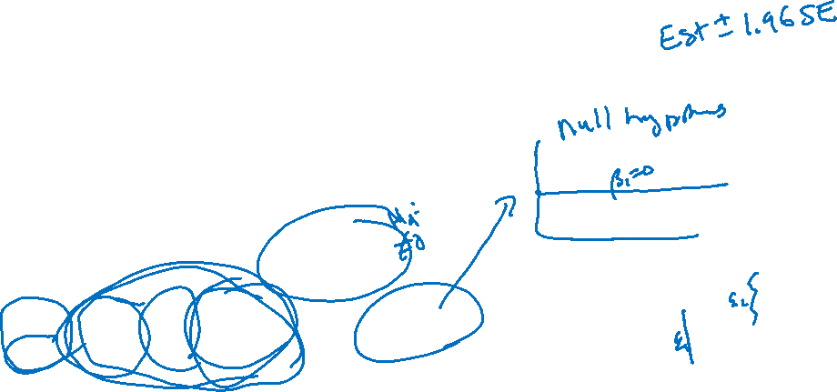

Interpreting Linear Regression Output
cars <- data(cars)
fit <- lm(dist ~ speed, data = cars)
summary(fit)
Residuals:
Min 1Q Median 3Q Max
-29.069 -9.525 -2.272 9.215 43.201
Coefficients:
Estimate Std. Error t value Pr(>|t|)
(Intercept) -17.5791 6.7584 -2.601 0.0123 *
speed 3.9324 0.4155 9.464 1.49e-12 ***
---
Signif. codes: 0 ‘***’ 0.001 ‘**’ 0.01 ‘*’ 0.05 ‘.’ 0.1 ‘ ’ 1
Residual standard error: 15.38 on 48 degrees of freedom
Multiple R-squared: 0.6511, Adjusted R-squared: 0.6438
F-statistic: 89.57 on 1 and 48 DF, p-value: 1.49e-12
H₀: β₀=0
H₀: β₁=0
Regression coefficients follow a t-distribution with n-p-1 df.
$$β_{0}$$
$β_{1}$, or
$$β_{SPEED}$$

Slide 26
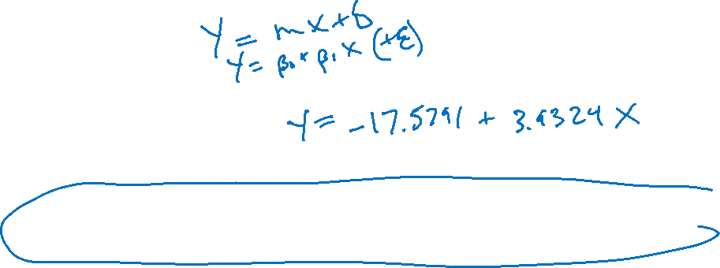
Interpreting Output
Your Turn
What is the equation that describes the relationship between stopping distance and speed?
Is stopping distance related to speed?
What is the predicted stopping distance for a car that is not moving?
fit <- lm(dist ~ speed, data = cars)
summary(fit)
Coefficients:
Estimate Std. Error t value Pr(>|t|)
(Intercept) -17.5791 6.7584 -2.601 0.0123 *
speed 3.9324 0.4155 9.464 1.49e-12 ***

Slide 27
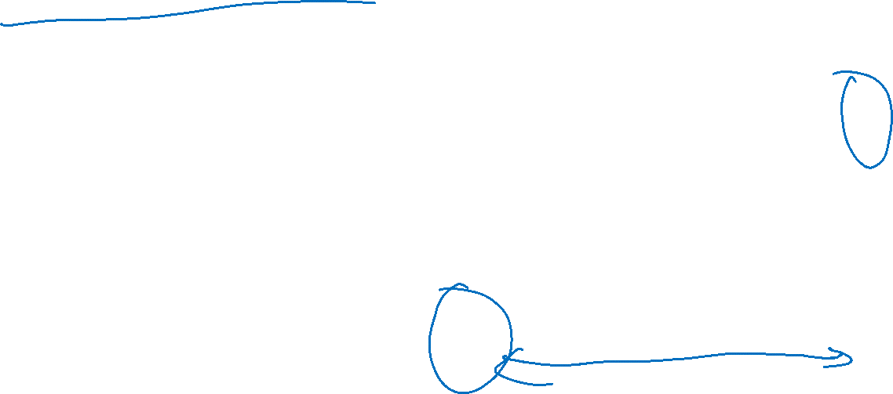
Note on Extrapolation
We didn’t observe any speed values <4 or >25 mph
When we fit a linear regression, we can only reasonably predict Y across the range of X in our data
This is because the relation may be different (e.g., nonlinear) for values of X beyond observed range

Slide 28
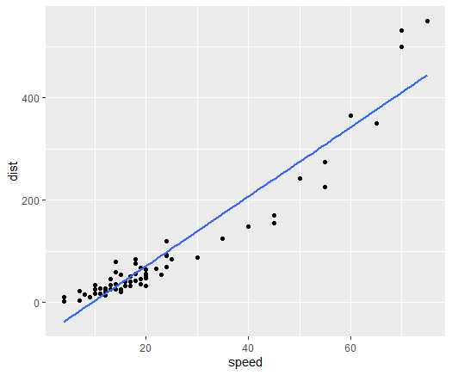
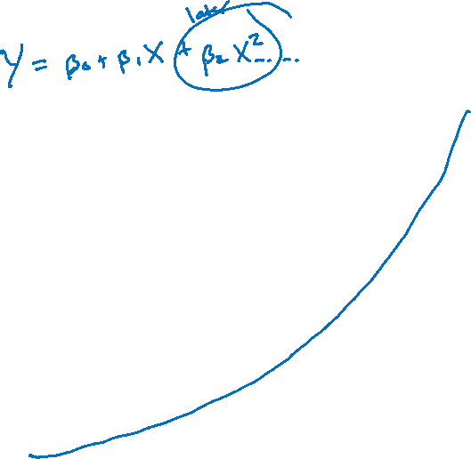
Note on Extrapolation
If we observed more speeds, say up to 90mph, what do we observe?
Y does increase as X increases, but a straight line is not the best fit
There are other ways to model this (e.g., variable transformations) beyond today’s lecture

Slide 29

Assumptions of Linear Regression
A linear regression model is only valid if it satisfies certain assumptions
While mild violations of the assumptions are common, more serious violations can be a cause for concern
There are four assumptions of LINEar regression:
Linearity
Independence
Normality
Equality of variances

Slide 30
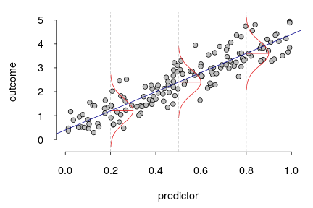
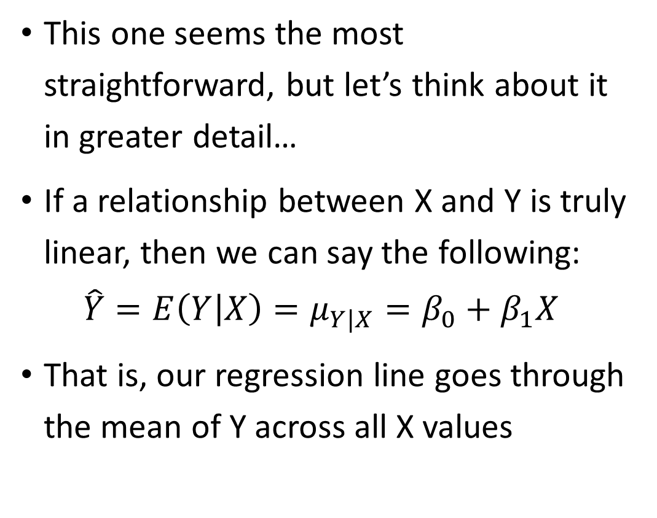
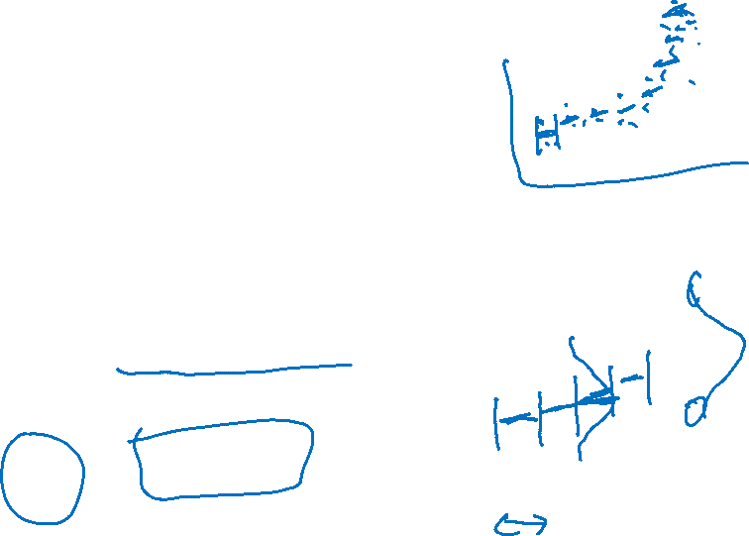
Linearity
This one seems the most straightforward, but let’s think about it in greater detail…
If a relationship between X and Y is truly linear, then we can say the following:
$$\hat{Y}=E\left(Y | X\right)=μ_{Y|X}=β_{0}+β_{1}X$$
That is, our regression line goes through the mean of Y across all X values
(Y)
(X)

Slide 31
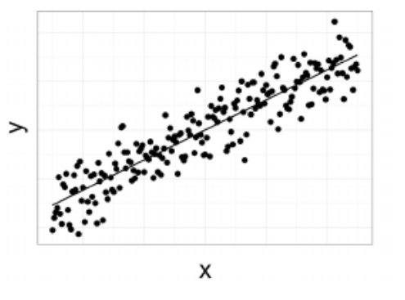
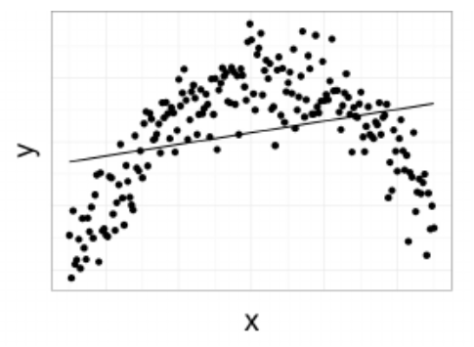

Linearity
In which plot does the regression line appear to fit the mean of all the Y values for any given X?
A prediction at the orange circle on the bottom figure probably would not reflect the mean of Y at that X value – residuals will be large here

Slide 32

Independence
Conditional on X, the Y values should be statistically independent of one another
That is, the error terms should be independent of one another
Do any of these situations violate the independence assumption?
A chart review of comorbidities of patients undergoing COVID treatment at LAC+USC hospital
A study on visual acuity at Roski Eye Institute where visual acuity was measured in the participants’ left and right eyes
The relationship between BMI and exercise was assessed in children in which the entire family was recruited to the study

Slide 33

Normality
For any value of X, Y has a normal distribution (i.e., Y|X ~ N)
Equivalently, the residuals have a normal distribution
Note that Y itself doesn’t need to be normally distributed!

Slide 34



Equality of Variances, i.e., homoscedasticity
For any value of X, the variance of Y is constant (i.e., $σ_{Y|X}^{2}=σ^{2}$).
Below, the assumptions of normality and homoscedasticity are violated – Why?

Slide 35


The Best Fit Line
Let’s examine the relationship between BMI and triglycerides
We can have R add the “best fit” line… but how is this line actually fit?
chol %>% ggplot(aes(x=bmi_new, y=tg)) + geom_point() + geom_smooth(method="lm")
or
plot(tg~bmi_new, data=chol)
model1 <- lm(tg~bmi_new, data=chol)
abline(model1, col="red")

Slide 36


Finding the Best-Fit Line in R
The lm() function performs least-squares regression to produce the estimates of interest: ${\hat{β}}_{0}$ and ${\hat{β}}_{1}$.
The general form is: modelname <- lm(y~x, data=dataname)
The resulting model data can be retrieved and includes:
coefficients
residuals
fitted.values

Slide 37
The Best Fit Line
Your Turn
Find the best-fit line by using the lm() function
Write the best-fit equation
Interpret the parameter estimates

Slide 38

More Output Interpretation
> model1 <- lm(tg ~ bmi_new, data=chol)
> summary(model1)
Residuals:
Min 1Q Median 3Q Max
-67.135 -25.703 -6.967 14.450 216.508
Coefficients:
Estimate Std. Error t value Pr(>|t|)
(Intercept) 4.1458 12.9107 0.321 0.748
bmi_new 3.4544 0.5774 5.983 1.1e-08 ***
---
Signif. codes: 0 ‘***’ 0.001 ‘**’ 0.01 ‘*’ 0.05 ‘.’ 0.1 ‘ ’ 1
Residual standard error: 40.12 on 186 degrees of freedom
Multiple R-squared: 0.1614, Adjusted R-squared: 0.1569
F-statistic: 35.79 on 1 and 186 DF, p-value: 1.104e-08
This gives information about the residuals. Remember: we want them to be normally distributed with mean 0.
$$\hat{Y}=4.15+3.45X_{BMI}$$
???

Slide 39

More Output Interpretation
$$\hat{Y}=4.15+3.45X_{BMI}$$
Slope – For each 1-unit increase in BMI, the value of triglycerides is expected to increase by 3.45.
Intercept – When BMI=0, the expected value of triglycerides is 4.15 (not very helpful here).

Slide 40


Coefficient of Determination
$R^{2}$ is the amount of variation in Y explained by the model
It is closely associated with the correlation coefficient – it is literally $r^{2}$
Larger values indicate that our model fits better
In our example, 16.1% of the variation in triglycerides is explained by BMI

Slide 41


Correlation vs. Regression
Correlation Coefficient: how strongly two variables are related
Regression Coefficients: the nature of how two variables are related.
Note: the hypothesis tests for correlation and regression are equivalent!
$H_{0}:ρ=0$(The population correlation coefficient = 0) $H_{0}:β=0$(The population regression slope = 0)
And the two measures are closely related:
$$R=\frac{s_{x}}{s_{y}}\hat{β}$$

Slide 42
Checking Assumptions
Let’s go back to our example and check the assumptions of linear regression
model1 <- lm(tg ~ bmi_new, data=chol)
Remember – LINE!

Slide 43


Checking Linearity - concept
Plot the residuals vs. the fitted values
We want to see that there is no pattern evident in this plot

Slide 44


Checking Linearity – our example
Plot the residuals vs. the fitted values
Does it seem like there is a pattern evident?
plot(model1, which=1) # residuals vs fitted
OR
> chol %>%
+ ggplot(aes(x=model1$fitted.values, y=model1$residuals)) +
+ geom_point() +
+ geom_smooth()

Slide 45


Checking Normality - concept
Plot a histogram of the residuals, a QQ plot, and get diagnostics on the residuals

Slide 46


Checking Normality – our example
Plot a histogram of the residuals, a QQ plot, and get diagnostics on the residuals
> chol %>%
+ ggplot(aes(x=model1$fitted.values, y=model1$residuals)) +
+ geom_point() +
+ geom_smooth()
> chol %>%
+ ggplot(aes(sample=model1$residuals)) +
+ geom_qq() +
+ geom_qq_line()
> summary(model1$residuals)
Alternatively:
Histogram of residuals
hist(model1$resid)
QQ plot of residuals
plot(model1, which=2)
Look for a normal distribution
Look for points that align with the line
Look for mean roughly equal to the median

Slide 47



Checking Equal Variance - concept
Plot the residuals across the X values
The variance of the residuals shouldn’t change across X

Slide 48

Checking Equal Variance – our example
What do we think about the assumption of constant variance?
plot(model1, which=1) # residuals vs fitted
OR
> chol %>%
+ ggplot(aes(x=model1$fitted.values, y=model1$residuals)) +
+ geom_point() +
+ geom_smooth()

Slide 49

When Assumptions Are Not Met
Change our variables
Convert variables to categorical
Transform the outcome variable
Transform the predictor variable
Examine your predictors
You may be omitting important predictors – we will discuss in multiple regression
Change your modeling approach
Use another model such as logistic, Poisson, etc.

Slide 50

Binary Predictors
We know how to look at the relationship between a continuous predictor and a continuous outcome
Let’s look at how to model a dichotomous/binary predictor
Example: how does gender relate to HDL cholesterol?

Slide 51


Binary Predictors
Option 1. We already know how to perform a t-test for this relationship! (I’ll assume the variance in HDL is the same for male and female)
> t.test(hdl ~ gender, var.equal=T, data=chol)
Two Sample t-test
data: hdl by gender
t = 3.1333, df = 186, p-value = 0.002009
alternative hypothesis: true difference in means is not equal to 0
95 percent confidence interval:
1.855813 8.165463
sample estimates:
mean in group Female mean in group Male
51.22340 46.21277

Slide 52

Binary Predictors
Option 2. We could also answer this question using a regression framework
Best to code X as an “indicator” variable (takes values of 0 and 1)
“baseline” category should be coded 0
“other” category should be coded 1 (i.e., a 1-unit higher X compares “other” group to “baseline” group)

Slide 53



Binary Predictors
Similar ggplot: chol %>%
ggplot(aes(x=female, y=hdl)) +
geom_point() +
geom_smooth(method="glm")
Let’s use the indicator variable for female, checking the distribution
table(chol$female)
0 1
95 95
Let’s plot HDL vs. female, fit a linear regression, and plot the estimated line
plot(hdl~female, data=chol)
fit <- lm(hdl~female, data=chol)
abline(fit, col="red")

Slide 54
Binary Predictors
Your turn!
Run the regression of HDL vs. sex and find the estimated regression coefficients
What is the value of the y-intercept, and what is its interpretation?
What is the value of the slope, and what is its interpretation?
What would be the value of the slope if there were no difference in HDL between males and females?

Slide 55


Comparing the t-test and regression
> t.test(hdl ~ gender, var.equal=T, data=chol)
Two Sample t-test
data: hdl by gender
t = 3.1333, df = 186, p-value = 0.002009
alternative hypothesis: true difference in means is not equal to 0
95 percent confidence interval:
1.855813 8.165463
sample estimates:
mean in group Female mean in group Male
51.22340 46.21277
> fit <- lm(hdl~gender, data=chol) > summary(fit)
Coefficients:
Estimate Std. Error t value Pr(>|t|)
(Intercept) 51.223 1.131 45.299 < 2e-16 ***
genderMale -5.011 1.599 -3.133 0.00201 **
---
Signif. codes: 0 ‘***’ 0.001 ‘**’ 0.01 ‘*’ 0.05 ‘.’ 0.1 ‘ ’ 1
Residual standard error: 10.96 on 186 degrees of freedom
Multiple R-squared: 0.05014, Adjusted R-squared: 0.04503
F-statistic: 9.818 on 1 and 186 DF, p-value: 0.002009

Slide 56
Recap: Topics & Learning objectives
Explore Dr. Sandy Eckel’s career path + current work
Define and use correlation to describe linear association between two continuous variables
Define linear regression relating continuous outcome (Y) to predictor (X)
Continuous X
Binary X
Evaluate assumptions of linear regression
Describe similarity between t-test and linear regression with binary X

