Slide 1
LA’s BeST @ USC
Introduction to Multiple Regression
Notes:
Next time, maybe start with age + sex MLR example

Slide 2



Slide 3
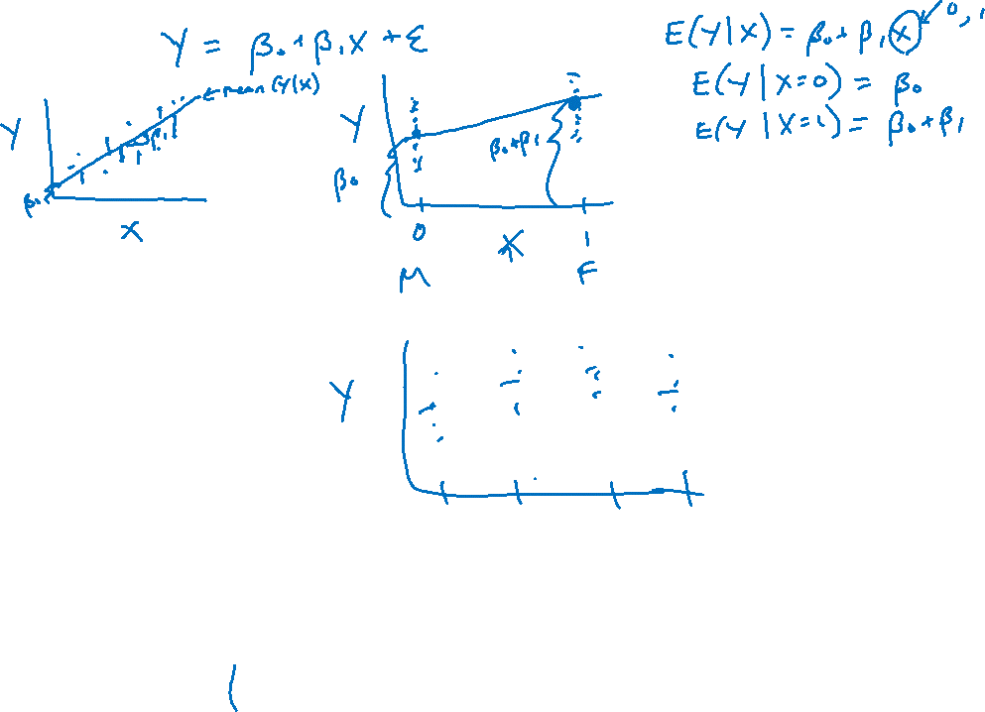

Slide 5

Categorical Predictors
Last session we discussed linear regression with a dichotomous/binary predictor
How could we use a regression approach with a multi-category predictor?
Example: is city miles per gallon (Y) associated with car manufacturer (X)? (We’ll focus on only 4 manufacturers for simplicity)

Slide 6
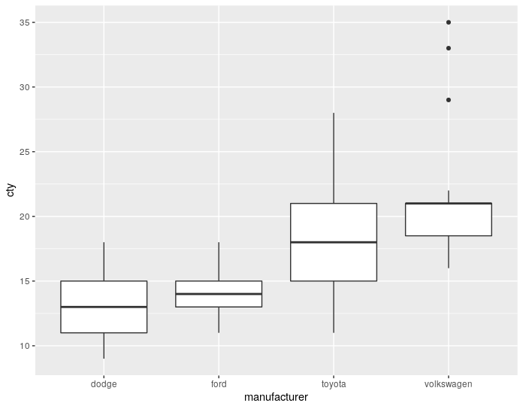
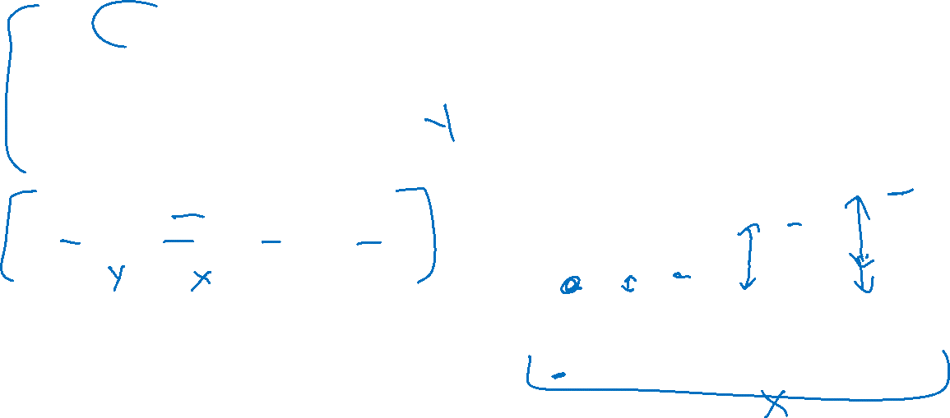
Categorical Predictors
mpg2 <- mpg %>% filter(manufacturer %in% c("dodge", "ford", "toyota", "volkswagen"))
mpg2 %>% ggplot(aes(x=manufacturer, group=manufacturer, y=cty)) + geom_boxplot()
OR
mpg2 <- subset(mpg, manufacturer %in% c("dodge", "ford", "toyota","volkswagen"))
boxplot(cty ~ manufacturer, mpg2)
It appears that cty (city MPG) varies by manufacturer

Slide 7

Identifying a Reference Group
We will code “manufacturer” with a series of indicator variables (extension of indicator for female last session)
To do this, we must pick a reference group. The reference group is somewhat arbitrary, but consider the following suggestions:
Reference group should serve as a useful “baseline” comparison (e.g., a control group).
Reference group should be a well-defined group for clear interpretations; not a “catch-all” group (e.g., “other”)
Avoid a reference group with very small sample size

Slide 8
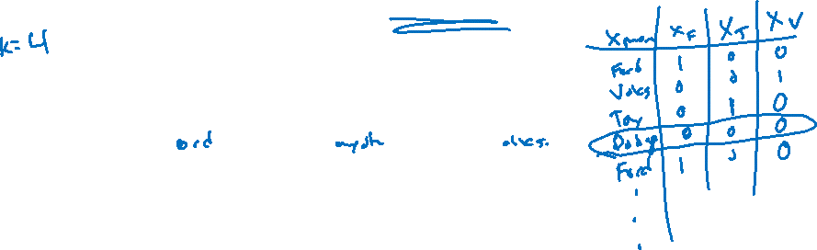
Creating indicator variables for categorical X
Let’s create a set of indicator variables using “Dodge” as the reference group
For a variable with k categories, we will create k-1 variables
X_{MANUFACTURER} | X_{F} | X_{T} | X_{V}
Ford | 1 | 0 | 0
Toyota | 0 | 1 | 0
Volkswagen | 0 | 0 | 1
Dodge | 0 | 0 | 0

Slide 9
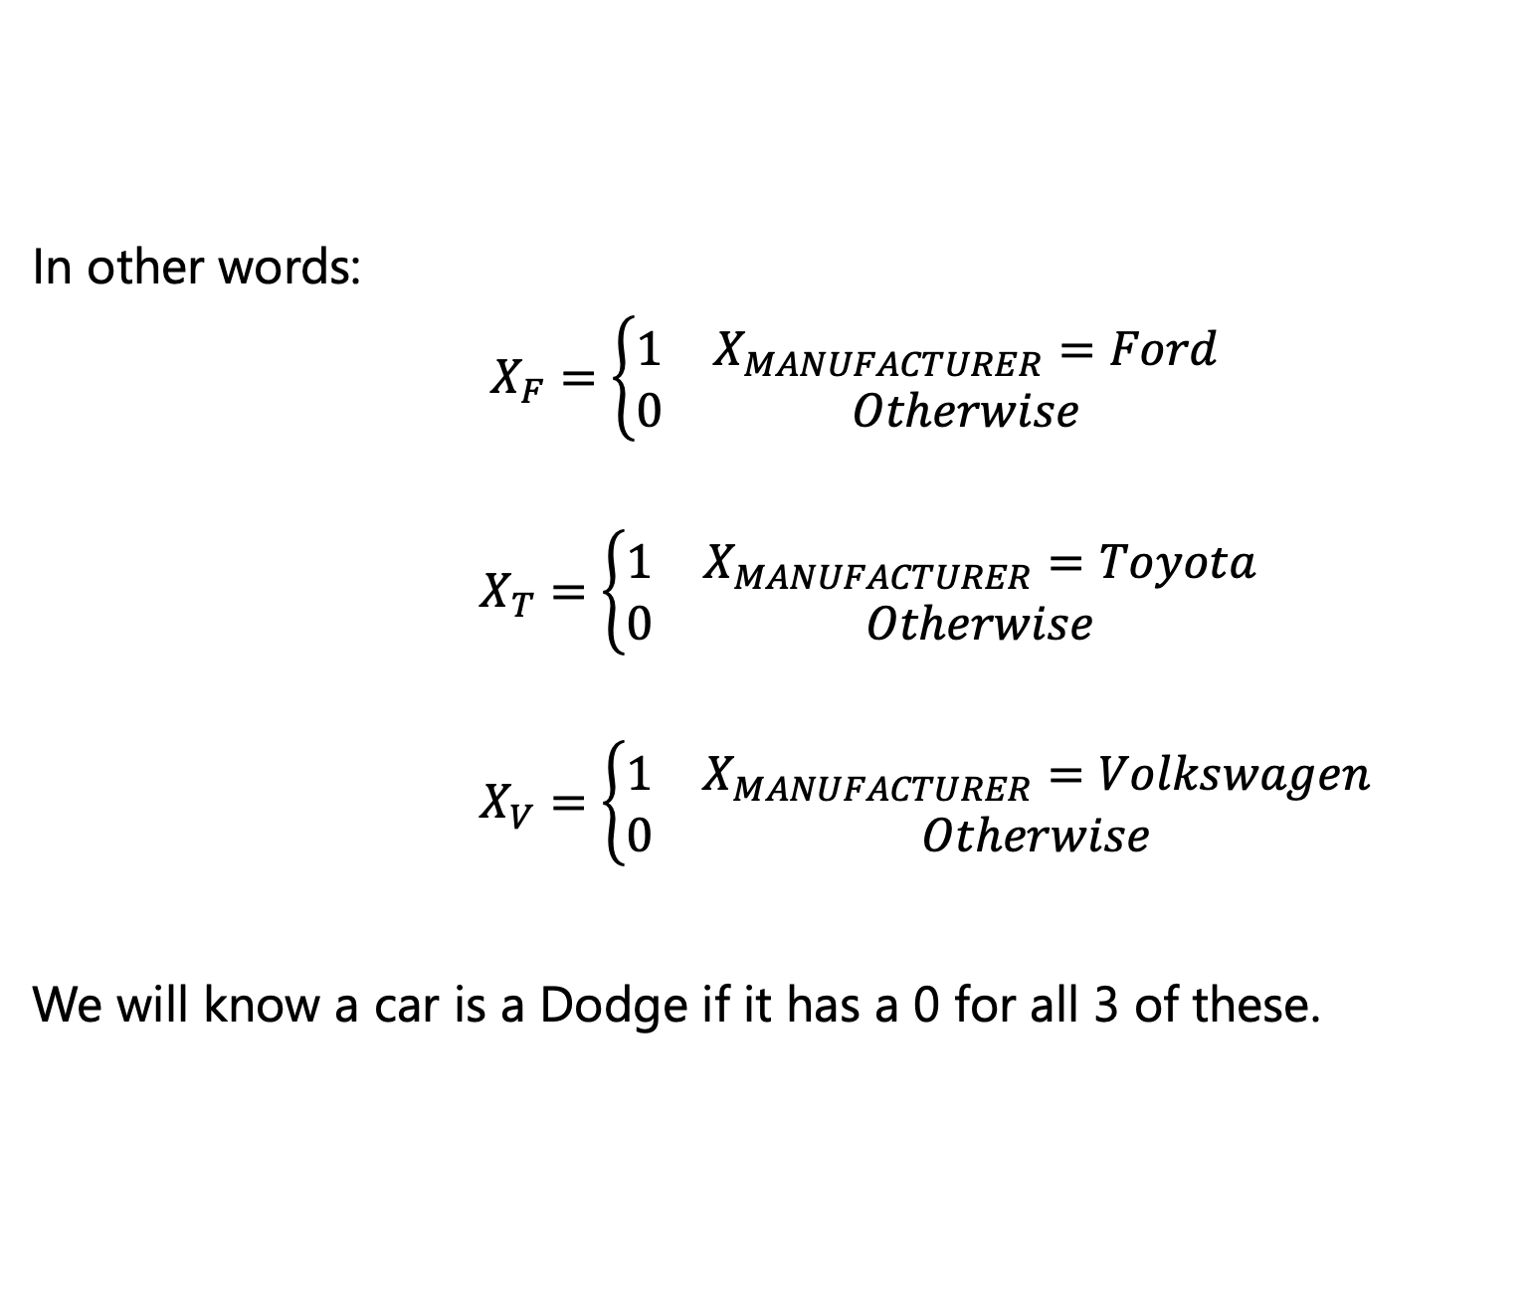

Creating indicator variables for categorical X
In other words:
$X_{F}=\left\{\begin{matrix}1 & X_{MANUFACTURER}=Ford \\ 0 & Otherwise\end{matrix}\begin{aligned} \\ \end{aligned}\right.$
$X_{T}=\left\{\begin{matrix}1 & X_{MANUFACTURER}=Toyota \\ 0 & Otherwise\end{matrix}\begin{aligned} \\ \end{aligned}\right.$
$X_{V}=\left\{\begin{matrix}1 & X_{MANUFACTURER}=Volkswagen \\ 0 & Otherwise\end{matrix}\right.$
We will know a car is a Dodge if it has a 0 for all 3 of these.

Slide 10

Creating indicator variables for categorical X
Let’s create the variables needed
mpg2 <- mpg2 %>% mutate(mf_f = if_else(manufacturer=="ford", 1, 0), mf_t = if_else(manufacturer=="toyota", 1, 0), mf_v = if_else(manufacturer=="volkswagen", 1, 0))
OR
mpg2$mf_f <- ifelse(mpg2$manufacturer=="ford", 1, 0)
mpg2$mf_t <- ifelse(mpg2$manufacturer=="toyota", 1, 0)
mpg2$mf_v <- ifelse(mpg2$manufacturer=="volkswagen", 1, 0)

Slide 11
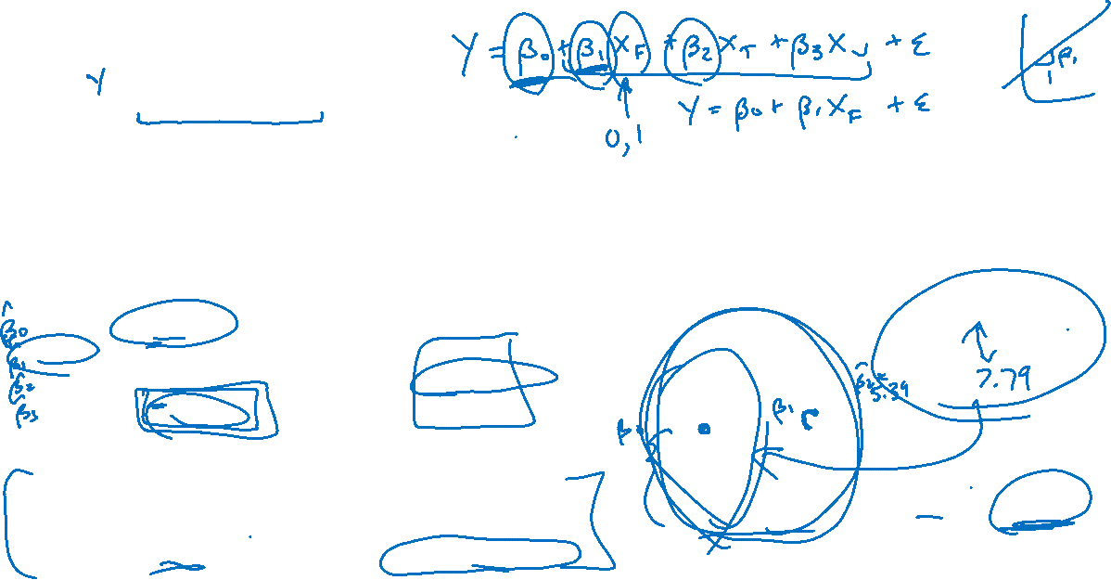
Regression with the set of indicator variables Code implementation
> lm(cty ~ mf_f + mf_t + mf_v, data=mpg2) %>% summary()
Residuals:
Min 1Q Median 3Q Max
-7.5294 -2.1351 -0.1351 1.4695 14.0741
Coefficients:
Estimate Std. Error t value Pr(>|t|)
(Intercept) 13.1351 0.5620 23.372 < 2e-16 ***
mf_f 0.8649 0.8850 0.977 0.33
mf_t 5.3943 0.8121 6.642 9.75e-10 ***
mf_v 7.7908 0.8653 9.004 4.25e-15 ***
---
Signif. codes: 0 ‘***’ 0.001 ‘**’ 0.01 ‘*’ 0.05 ‘.’ 0.1 ‘ ’ 1
Residual standard error: 3.418 on 119 degrees of freedom
Multiple R-squared: 0.4722, Adjusted R-squared: 0.4589
F-statistic: 35.49 on 3 and 119 DF, p-value: < 2.2e-16

Slide 12
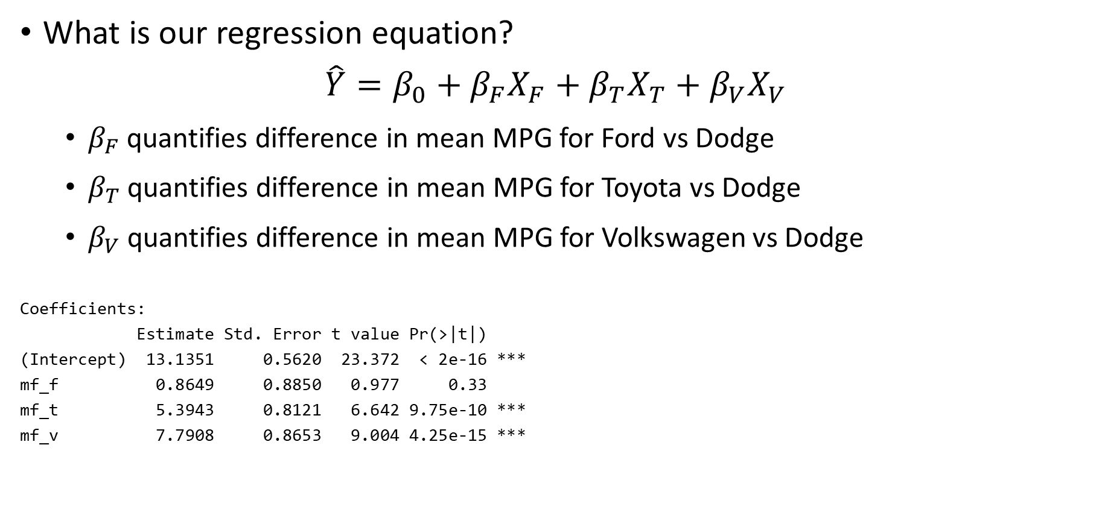
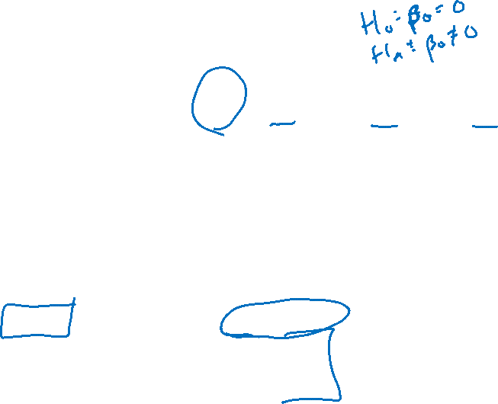
Regression with the set of indicator variables Model and interpretation
What is our regression equation?
$$\hat{Y}=β_{0}+β_{F}X_{F}+β_{T}X_{T}+β_{V}X_{V}$$
$β_{F}$ quantifies difference in mean MPG for Ford vs Dodge
$β_{T}$ quantifies difference in mean MPG for Toyota vs Dodge
$β_{V}$ quantifies difference in mean MPG for Volkswagen vs Dodge
Coefficients:
Estimate Std. Error t value Pr(>|t|)
(Intercept) 13.1351 0.5620 23.372 < 2e-16 ***
mf_f 0.8649 0.8850 0.977 0.33
mf_t 5.3943 0.8121 6.642 9.75e-10 ***
mf_v 7.7908 0.8653 9.004 4.25e-15 ***

Slide 13
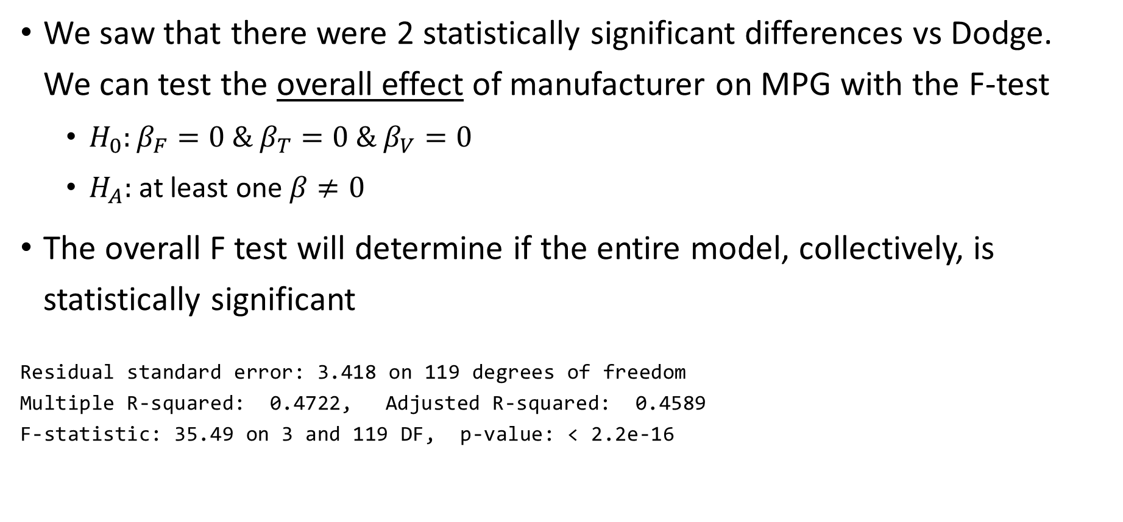
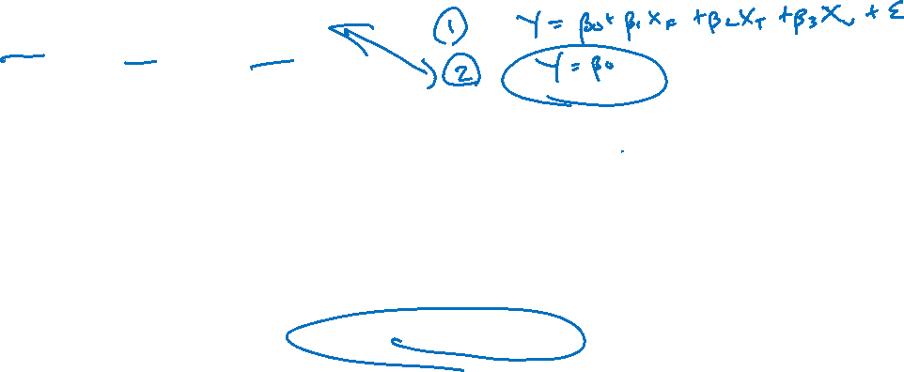
Regression with the set of indicator variables Overall F-test
We saw that there were 2 statistically significant differences vs Dodge. We can test the overall effect of manufacturer on MPG with the F-test
$H_{0}:β_{F}=0 \& β_{T}=0 \& β_{V}=0$
$H_{A}:$at least one $β≠0$
The overall F test will determine if the entire model, collectively, is statistically significant
Residual standard error: 3.418 on 119 degrees of freedom
Multiple R-squared: 0.4722, Adjusted R-squared: 0.4589
F-statistic: 35.49 on 3 and 119 DF, p-value: < 2.2e-16

Slide 14

Factor Variables in R
Using a factor variable in a linear regression model will automatically create the indicator variables for us
> lm(cty ~ factor(manufacturer), data=mpg2) %>% summary()
Residuals:
Min 1Q Median 3Q Max
-7.5294 -2.1351 -0.1351 1.4695 14.0741
Coefficients:
Estimate Std. Error t value Pr(>|t|)
(Intercept) 13.1351 0.5620 23.372 < 2e-16 ***
factor(manufacturer)ford 0.8649 0.8850 0.977 0.33
factor(manufacturer)toyota 5.3943 0.8121 6.642 9.75e-10 ***
factor(manufacturer)volkswagen 7.7908 0.8653 9.004 4.25e-15 ***
---
Signif. codes: 0 ‘***’ 0.001 ‘**’ 0.01 ‘*’ 0.05 ‘.’ 0.1 ‘ ’ 1
Residual standard error: 3.418 on 119 degrees of freedom
Multiple R-squared: 0.4722, Adjusted R-squared: 0.4589
F-statistic: 35.49 on 3 and 119 DF, p-value: < 2.2e-16

Slide 15

Notes on Categorical Predictors
Each value of the manufacturer variable will be translated into a unique combination of indicator values
All indicator variable coefficients will be interpreted relative to the reference group
All indicator variables must be included in the regression equation as a complete set
Note: this method is analogous to a one-way ANOVA

Slide 16
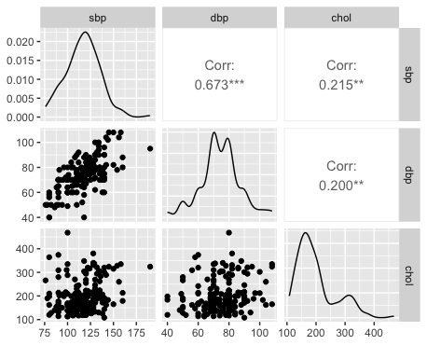
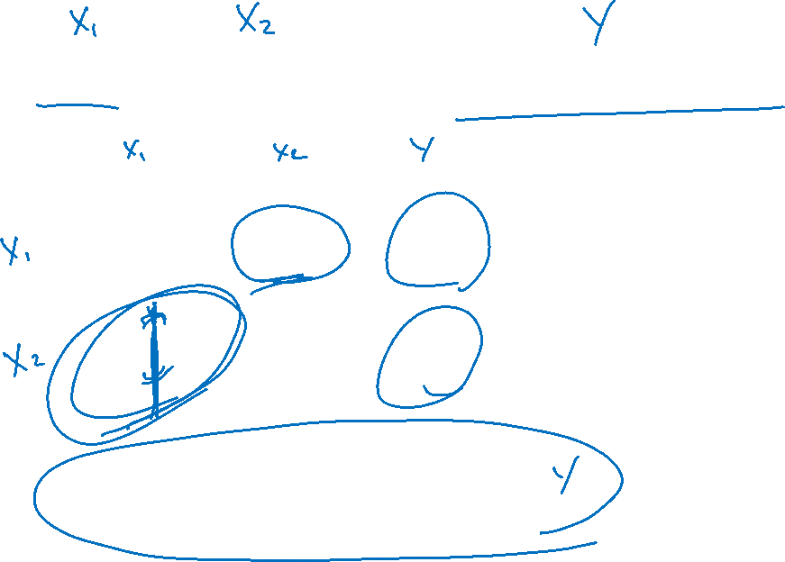
How do SBP and DBP affect total cholesterol?

Slide 17
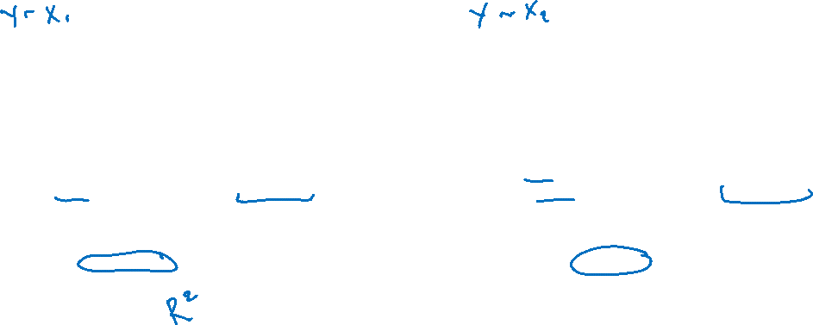
Multiple Single Regression Equations
How do SBP and DBP affect total cholesterol?
One way to examine this would be to perform two separate regressions:
> lm(chol ~ sbp, data=chol) %>% summary()
Residuals:
Min 1Q Median 3Q Max
-108.67 -43.15 -20.74 23.99 282.51
Coefficients:
Estimate Std. Error t value Pr(>|t|)
(Intercept) 107.5553 30.6800 3.506 0.000571 ***
sbp 0.7794 0.2597 3.001 0.003058 **
---
Signif. codes: 0 ‘***’ 0.001 ‘**’ 0.01 ‘*’ 0.05 ‘.’ 0.1 ‘ ’ 1
Residual standard error: 65.32 on 186 degrees of freedom
Multiple R-squared: 0.04619, Adjusted R-squared: 0.04106
F-statistic: 9.007 on 1 and 186 DF, p-value: 0.003058
> lm(chol ~ dbp, data=chol) %>% summary()
Residuals:
Min 1Q Median 3Q Max
-106.91 -44.11 -17.55 22.63 263.55
Coefficients:
Estimate Std. Error t value Pr(>|t|)
(Intercept) 120.835 28.351 4.262 3.21e-05 ***
dbp 1.045 0.376 2.780 0.006 **
---
Signif. codes: 0 ‘***’ 0.001 ‘**’ 0.01 ‘*’ 0.05 ‘.’ 0.1 ‘ ’ 1
Residual standard error: 65.54 on 186 degrees of freedom
Multiple R-squared: 0.03989, Adjusted R-squared: 0.03473
F-statistic: 7.727 on 1 and 186 DF, p-value: 0.005999

Slide 18
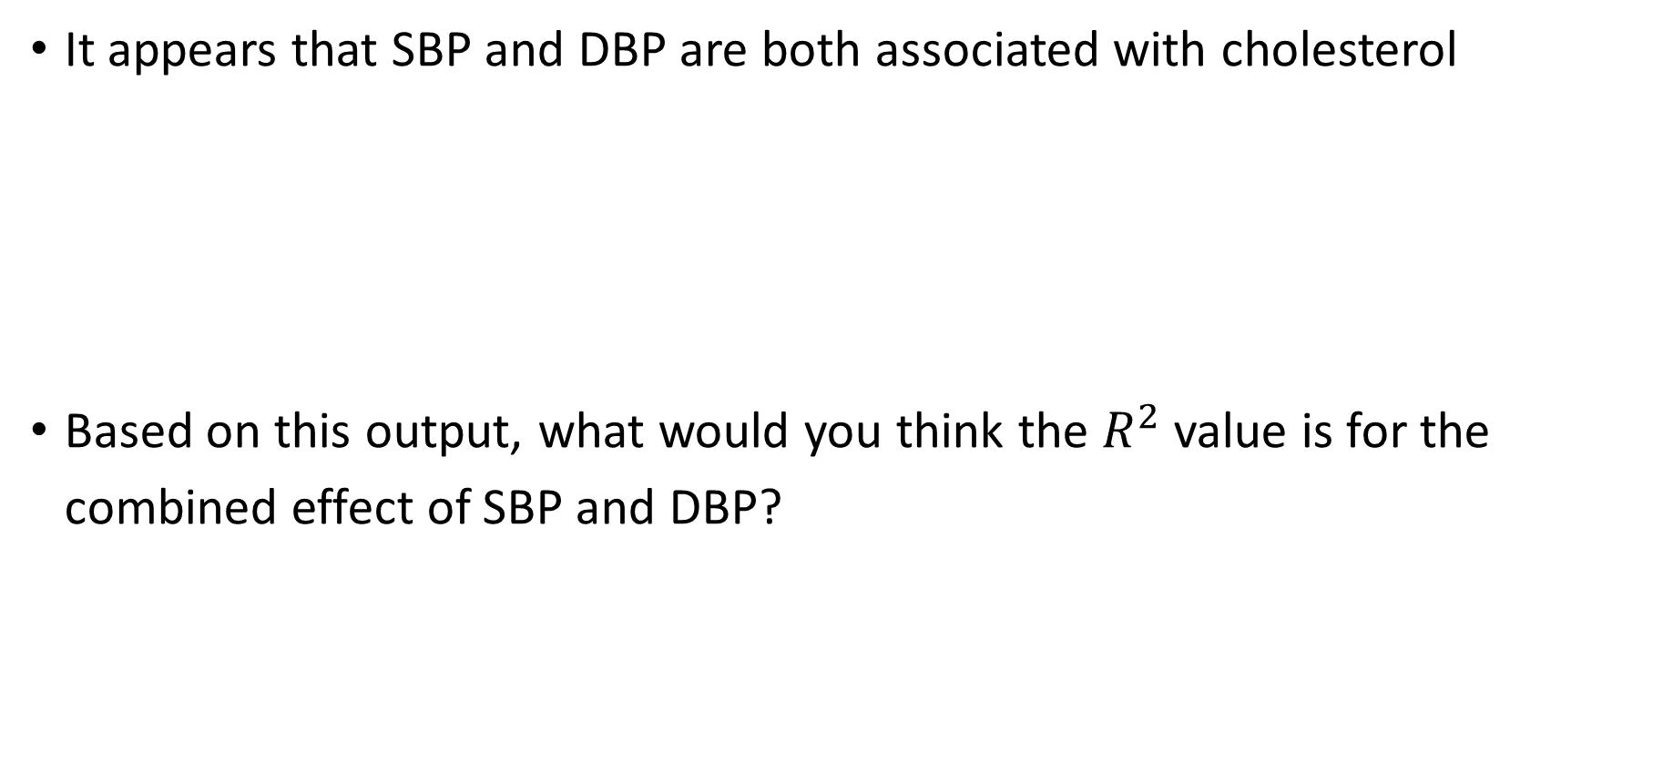

Multiple Single Regression Equations
It appears that SBP and DBP are both associated with cholesterol
Based on this output, what would you think the $R^{2}$ value is for the combined effect of SBP and DBP?
Model | Beta | P-Value | R²
1: SBP | 0.78 | 0.003 | 0.05
2: DBP | 1.05 | 0.006 | 0.04

Slide 19
Multivariable Regression
We can examine the effect of SBP and DBP on cholesterol simultaneously
> lm(chol ~ sbp + dbp, data=chol) %>% summary()

Slide 20
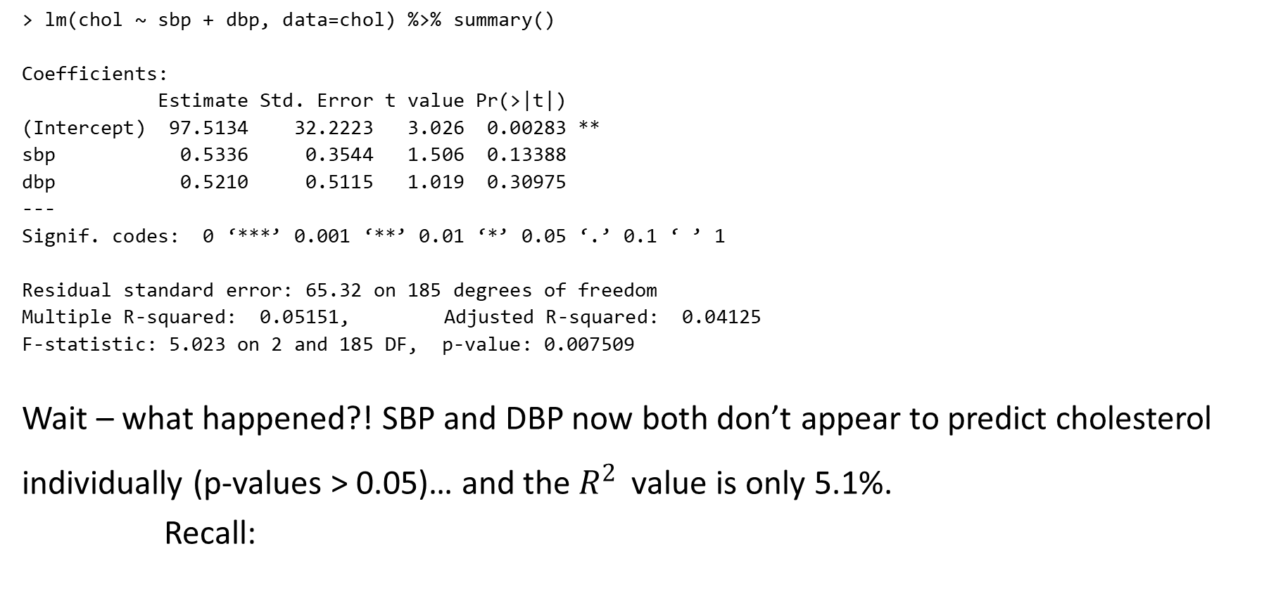
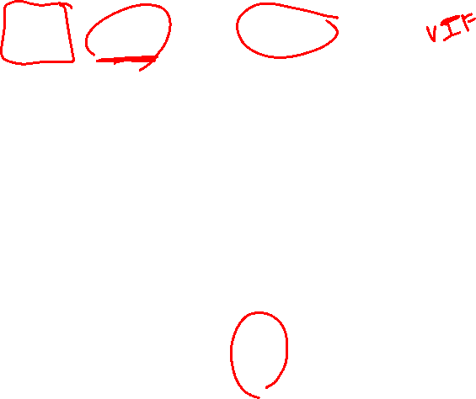
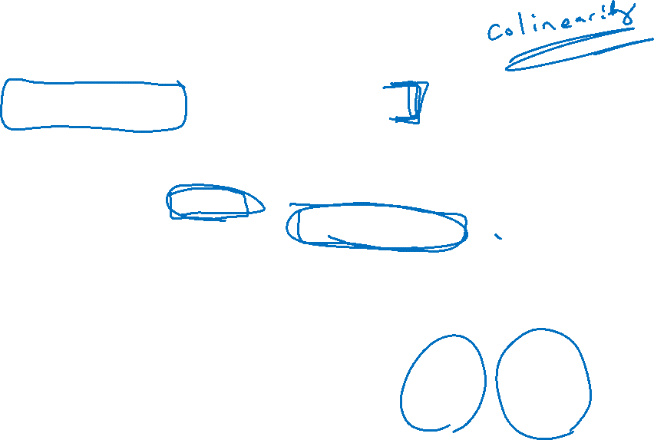
Multivariable Regression
> lm(chol ~ sbp + dbp, data=chol) %>% summary()
Coefficients:
Estimate Std. Error t value Pr(>|t|)
(Intercept) 97.5134 32.2223 3.026 0.00283 **
sbp 0.5336 0.3544 1.506 0.13388
dbp 0.5210 0.5115 1.019 0.30975
---
Signif. codes: 0 ‘***’ 0.001 ‘**’ 0.01 ‘*’ 0.05 ‘.’ 0.1 ‘ ’ 1
Residual standard error: 65.32 on 185 degrees of freedom
Multiple R-squared: 0.05151, Adjusted R-squared: 0.04125
F-statistic: 5.023 on 2 and 185 DF, p-value: 0.007509
Wait – what happened?! SBP and DBP now both don’t appear to predict cholesterol individually (p-values > 0.05)… and the $R^{2}$ value is only 5.1%.
Recall:
Model | Beta | P-Value | R²
1: SBP | 0.78 | 0.003 | 0.05
2: DBP | 1.05 | 0.006 | 0.04

Slide 21
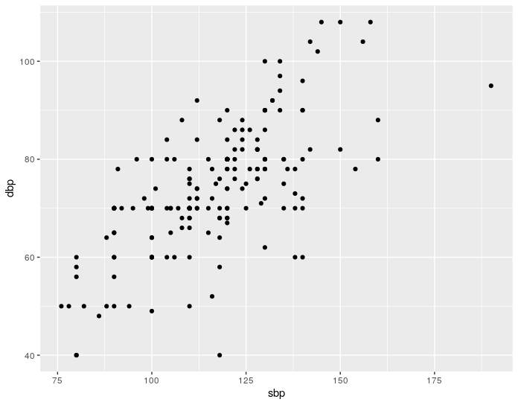

Shared Variance
This is because SBP and DBP are related to each other, so they do not contribute independent effects on cholesterol.
i.e., part of the reason that SBP is associated with cholesterol is because DBP is associated with cholesterol, and SBP is associated with DBP
We saw in the model that after “adjusting” for one another, neither SBP nor DBP uniquely predicts cholesterol

Slide 22

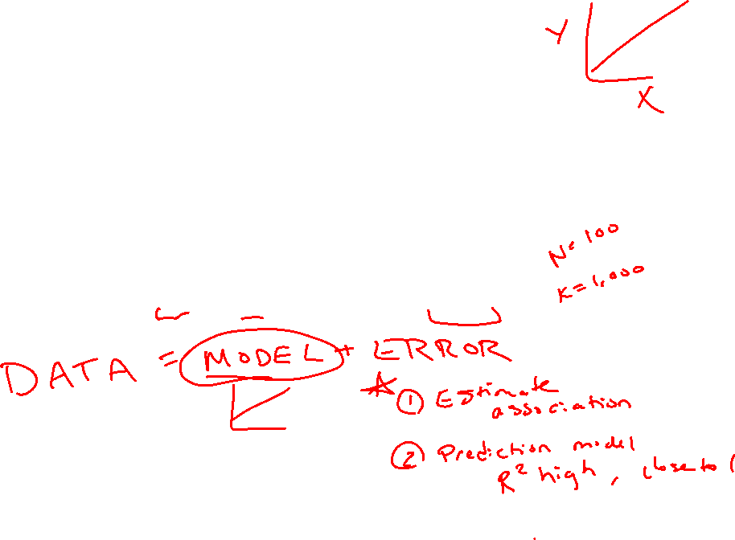
Multiple Regression Equation
The multiple regression equation gives us a way to examine the effects of certain independent variables, adjusting for others in the model
The multiple regression equation is defined as:
$$\hat{Y}=β_{0}+β_{1}X_{1}+β_{2}X_{2}+…+β_{K}X_{K}$$

Slide 23

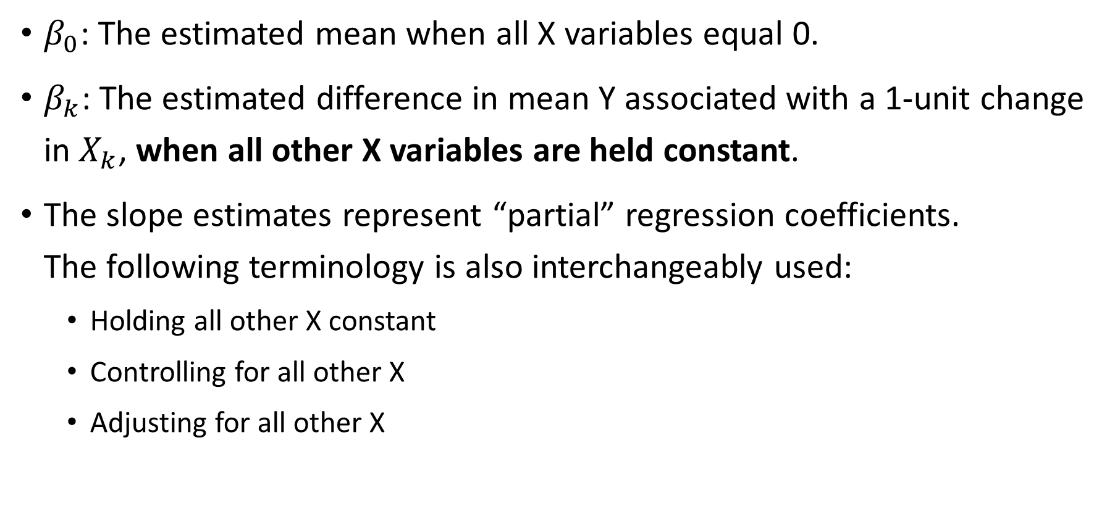
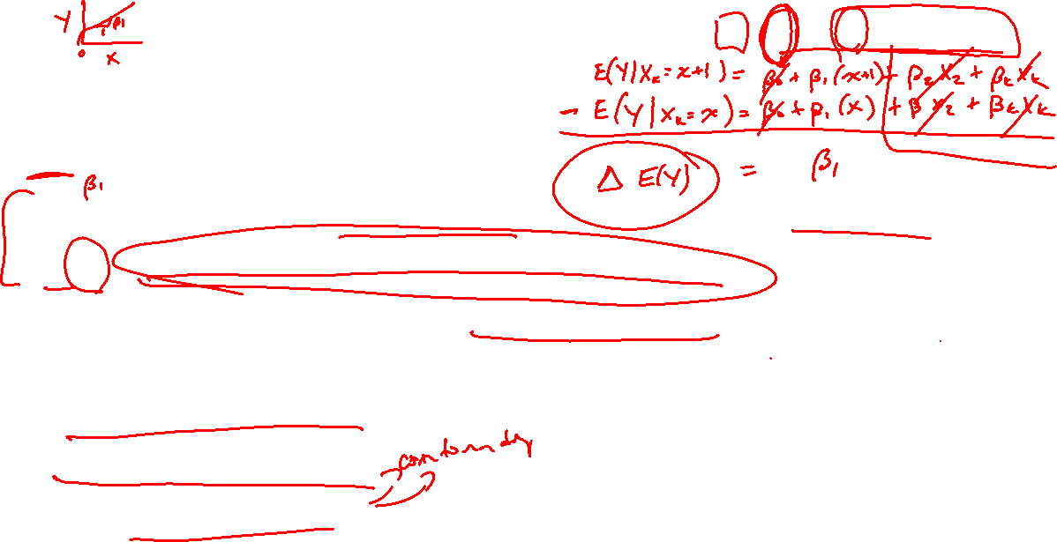
Parameter Interpretations
$$\hat{Y}=β_{0}+β_{1}X_{1}+β_{2}X_{2}+…+β_{K}X_{K}$$
$β_{0}$: The estimated mean when all X variables equal 0.
$β_{k}$: The estimated difference in mean Y associated with a 1-unit change in $X_{k}$, when all other X variables are held constant.
The slope estimates represent “partial” regression coefficients. The following terminology is also interchangeably used:
Holding all other X constant
Controlling for all other X
Adjusting for all other X

Slide 24
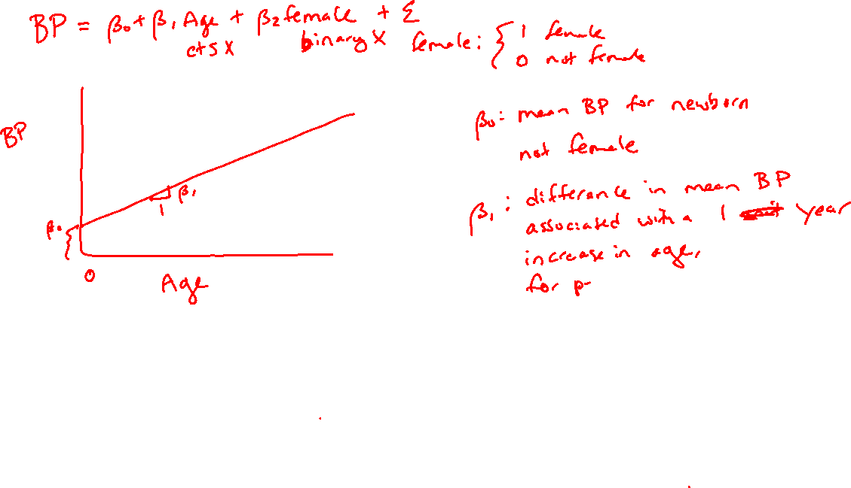

Slide 25
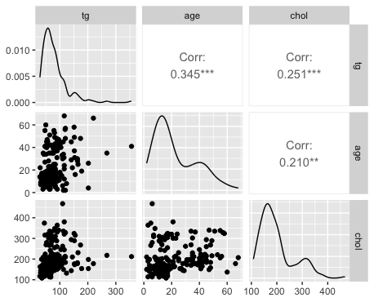
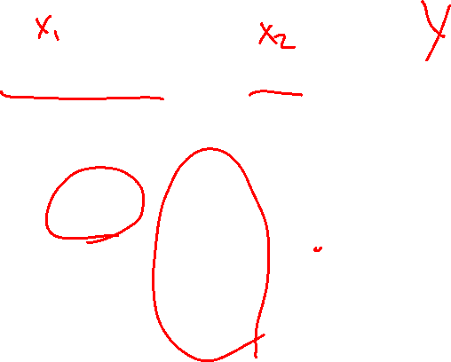
Another Example
What is the effect of triglycerides and age on cholesterol levels?

Slide 26

Another Example
What is the effect of triglycerides and age on cholesterol levels?
> lm(chol ~ tg, data=chol) %>% summary()
Call:
lm(formula = chol ~ tg, data = chol)
Residuals:
Min 1Q Median 3Q Max
-92.34 -44.97 -19.76 19.71 257.77
Coefficients:
Estimate Std. Error t value Pr(>|t|)
(Intercept) 168.1503 9.8133 17.14 < 2e-16 ***
tg 0.3825 0.1084 3.53 0.000524 ***
---
Signif. codes: 0 ‘***’ 0.001 ‘**’ 0.01 ‘*’ 0.05 ‘.’ 0.1 ‘ ’ 1
Residual standard error: 64.75 on 186 degrees of freedom
Multiple R-squared: 0.06279, Adjusted R-squared: 0.05775
F-statistic: 12.46 on 1 and 186 DF, p-value: 0.0005239
> lm(chol ~ tg + age, data=chol) %>% summary()
Call:
lm(formula = chol ~ tg + age, data = chol)
Residuals:
Min 1Q Median 3Q Max
-90.45 -42.52 -19.95 19.49 270.17
Coefficients:
Estimate Std. Error t value Pr(>|t|)
(Intercept) 160.2270 10.6258 15.079 < 2e-16 ***
tg 0.3085 0.1147 2.690 0.00779 **
age 0.6113 0.3263 1.873 0.06260 .
---
Signif. codes: 0 ‘***’ 0.001 ‘**’ 0.01 ‘*’ 0.05 ‘.’ 0.1 ‘ ’ 1
Residual standard error: 64.32 on 185 degrees of freedom
Multiple R-squared: 0.08023, Adjusted R-squared: 0.07029
F-statistic: 8.069 on 2 and 185 DF, p-value: 0.0004367

Slide 27
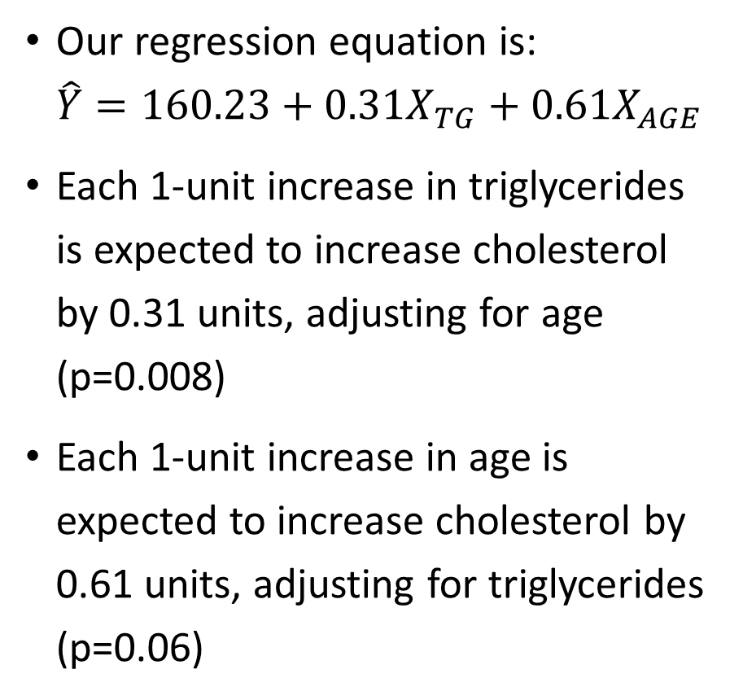
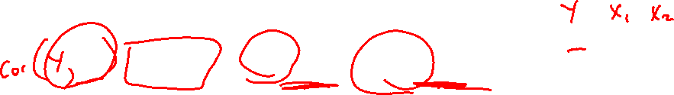
Interpreting Multiple Regression Output
Our regression equation is: $\hat{Y}=160.23+0.31X_{TG}+0.61X_{AGE}$
Each 1-unit increase in triglycerides is expected to increase cholesterol by 0.31 units, adjusting for age (p=0.008)
Each 1-unit increase in age is expected to increase cholesterol by 0.61 units, adjusting for triglycerides (p=0.06)
> lm(chol ~ tg + age, data=chol) %>% summary()
Call:
lm(formula = chol ~ tg + age, data = chol)
Residuals:
Min 1Q Median 3Q Max
-90.45 -42.52 -19.95 19.49 270.17
Coefficients:
Estimate Std. Error t value Pr(>|t|)
(Intercept) 160.2270 10.6258 15.079 < 2e-16 ***
tg 0.3085 0.1147 2.690 0.00779 **
age 0.6113 0.3263 1.873 0.06260 .
---
Signif. codes: 0 ‘***’ 0.001 ‘**’ 0.01 ‘*’ 0.05 ‘.’ 0.1 ‘ ’ 1
Residual standard error: 64.32 on 185 degrees of freedom
Multiple R-squared: 0.08023, Adjusted R-squared: 0.07029
F-statistic: 8.069 on 2 and 185 DF, p-value: 0.0004367

Slide 28
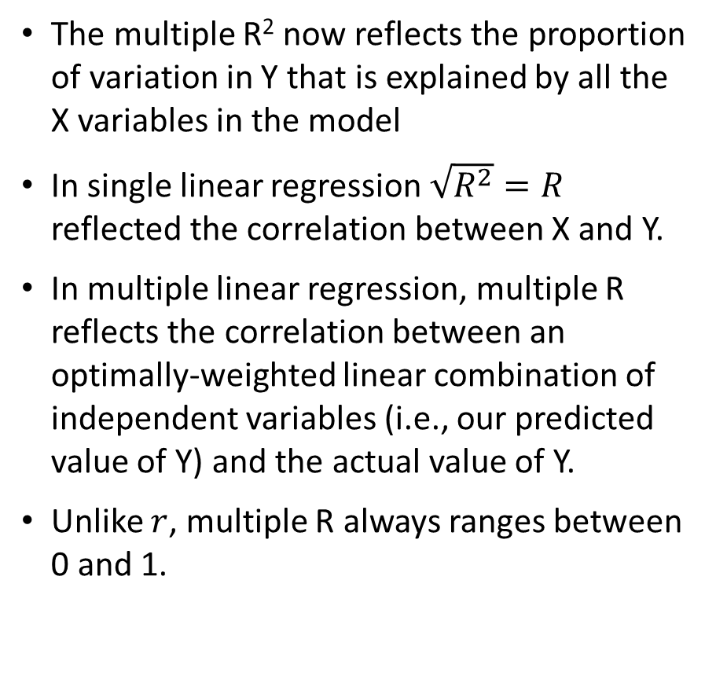

Interpreting Multiple Regression Output
The multiple R² now reflects the proportion of variation in Y that is explained by all the X variables in the model
In single linear regression $\sqrt{R^{2}}=R$ reflected the correlation between X and Y.
In multiple linear regression, multiple R reflects the correlation between an optimally-weighted linear combination of independent variables (i.e., our predicted value of Y) and the actual value of Y.
Unlike $r$, multiple R always ranges between 0 and 1.
> lm(chol ~ tg + age, data=chol) %>% summary()
Call:
lm(formula = chol ~ tg + age, data = chol)
Residuals:
Min 1Q Median 3Q Max
-90.45 -42.52 -19.95 19.49 270.17
Coefficients:
Estimate Std. Error t value Pr(>|t|)
(Intercept) 160.2270 10.6258 15.079 < 2e-16 ***
tg 0.3085 0.1147 2.690 0.00779 **
age 0.6113 0.3263 1.873 0.06260 .
---
Signif. codes: 0 ‘***’ 0.001 ‘**’ 0.01 ‘*’ 0.05 ‘.’ 0.1 ‘ ’ 1
Residual standard error: 64.32 on 185 degrees of freedom
Multiple R-squared: 0.08023, Adjusted R-squared: 0.07029
F-statistic: 8.069 on 2 and 185 DF, p-value: 0.0004367

Slide 29
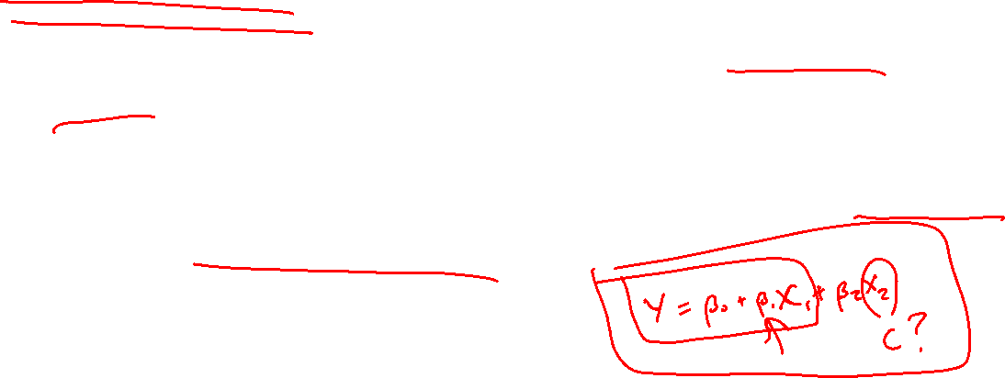
Confounding
If we were interested in the association between triglycerides and cholesterol, we might want to develop a model that provides the best “picture” of this association
Confounding occurs when the association between an outcome (Y) and an independent variable (X) is distorted by the influence of a third (or more) variable
Questions to ask:
Does the effect estimate change by more than ~10-20% after adding the confounder?
Can the variable sensibly be a confounder?

Slide 30

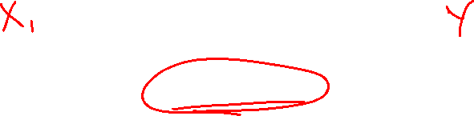
Confounding
Our original research question might be: how is triglycerides related to cholesterol?
Triglycerides
Cholesterol
$$\hat{β}=0.38$$

Slide 31

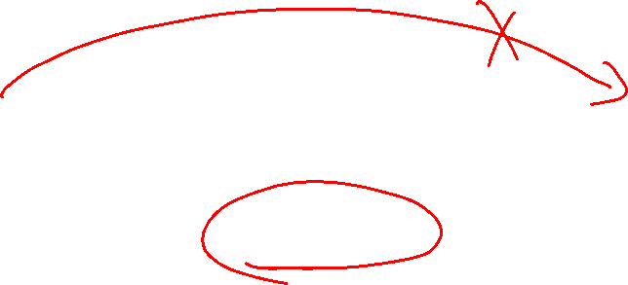
Confounding
What if we consider the effect of age? Can age be amplifying the true relationship between triglycerides and cholesterol because it is associated with both variables?
Age
Triglycerides
Cholesterol
$$\hat{β}=0.31$$

Slide 32
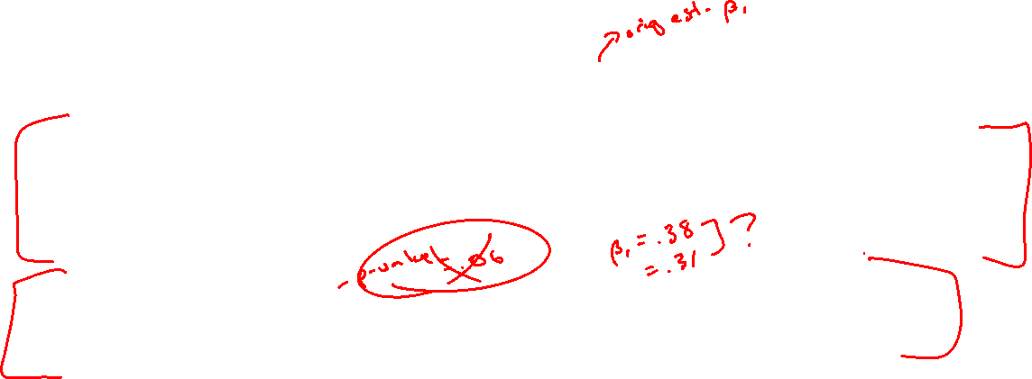
Confounding
The slope coefficient for triglycerides went from 0.38 in the unadjusted model to 0.31 in the adjusted model
This is a percent change of (0.38-0.31)/0.38 = 0.18 = 18%
We can conclude age is a confounder of this relationship and, to get a better sense of the relationship between triglycerides and cholesterol, we should include age in the model
Note: we include age as a confounder regardless of its statistical significance

Slide 33
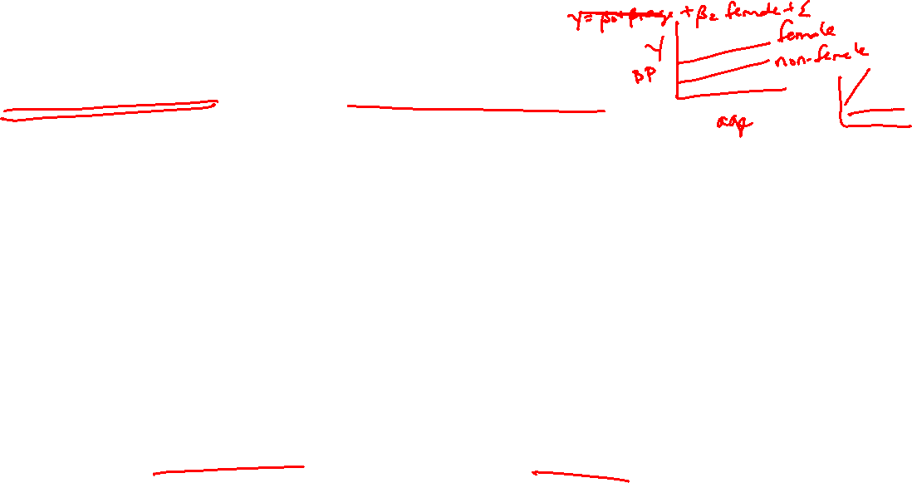
Interactions / Effect Modification
We have so far assumed that the effect of our variables is constant for everybody in the data set
What if we wanted to allow these relationships to be different for certain subgroups (e.g., males vs. females)?
Interactions occur when the association between an outcome (Y) and an independent variable of interest (X) depends on a third variable
Example: is HDL cholesterol associated with BMI?

Slide 34
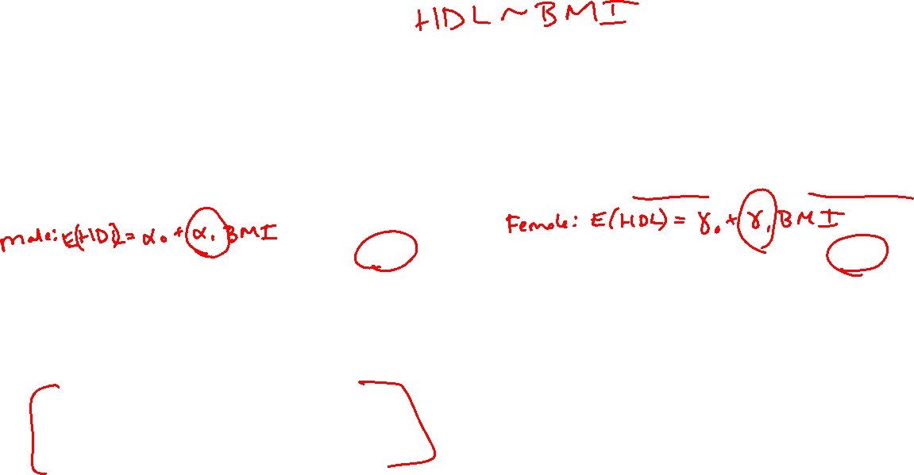
Approach 1: Separate Regressions
We could run separate regressions for this association
Here we see that BMI is associated with HDL for men but not women (take note of these equations!)
> lm(hdl ~ bmi_new, data=chol %>% filter(gender=="Male")) %>% summary()
Call:
lm(formula = hdl ~ bmi_new, data = chol %>% filter(gender ==
"Male"))
Residuals:
Min 1Q Median 3Q Max
-19.0015 -8.9759 -0.6354 7.7349 22.4085
Coefficients:
Estimate Std. Error t value Pr(>|t|)
(Intercept) 59.4159 5.1341 11.57 <2e-16 ***
bmi_new -0.5815 0.2211 -2.63 0.01 *
---
Signif. codes: 0 ‘***’ 0.001 ‘**’ 0.01 ‘*’ 0.05 ‘.’ 0.1 ‘ ’ 1
Residual standard error: 10.44 on 92 degrees of freedom
Multiple R-squared: 0.06993, Adjusted R-squared: 0.05983
F-statistic: 6.918 on 1 and 92 DF, p-value: 0.01
> lm(hdl ~ bmi_new, data=chol %>% filter(gender=="Female")) %>% summary()
Call:
lm(formula = hdl ~ bmi_new, data = chol %>% filter(gender ==
"Female"))
Residuals:
Min 1Q Median 3Q Max
-18.727 -7.958 -1.205 5.522 26.684
Coefficients:
Estimate Std. Error t value Pr(>|t|)
(Intercept) 49.45668 4.87364 10.148 <2e-16 ***
bmi_new 0.08473 0.22706 0.373 0.71
---
Signif. codes: 0 ‘***’ 0.001 ‘**’ 0.01 ‘*’ 0.05 ‘.’ 0.1 ‘ ’ 1
Residual standard error: 11.21 on 92 degrees of freedom
Multiple R-squared: 0.001511, Adjusted R-squared: -0.009342
F-statistic: 0.1392 on 1 and 92 DF, p-value: 0.7099

Slide 35
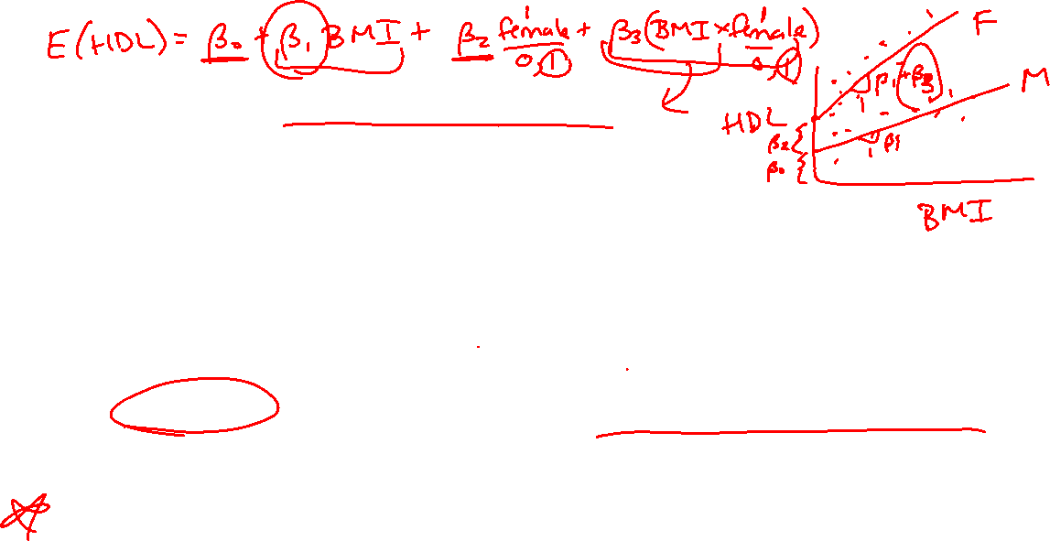


Approach 2: Interaction Term
Another approach is to add an interaction term: a multiplicative term between X and X (literally: X times Z)
Allows the relation between X and Y to vary based on the level of Z
Why use an interaction instead of stratifying?
Fit one model instead of two, assumes similarities between group in error variance (and any other terms in model)
Allows for straightforward test of difference in slopes between groups (e.g., p-value for the multiplicative term tells us if an interaction exists)

Slide 36
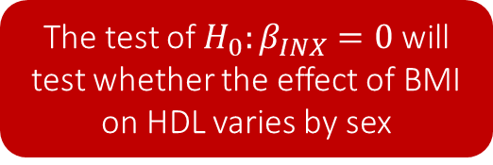
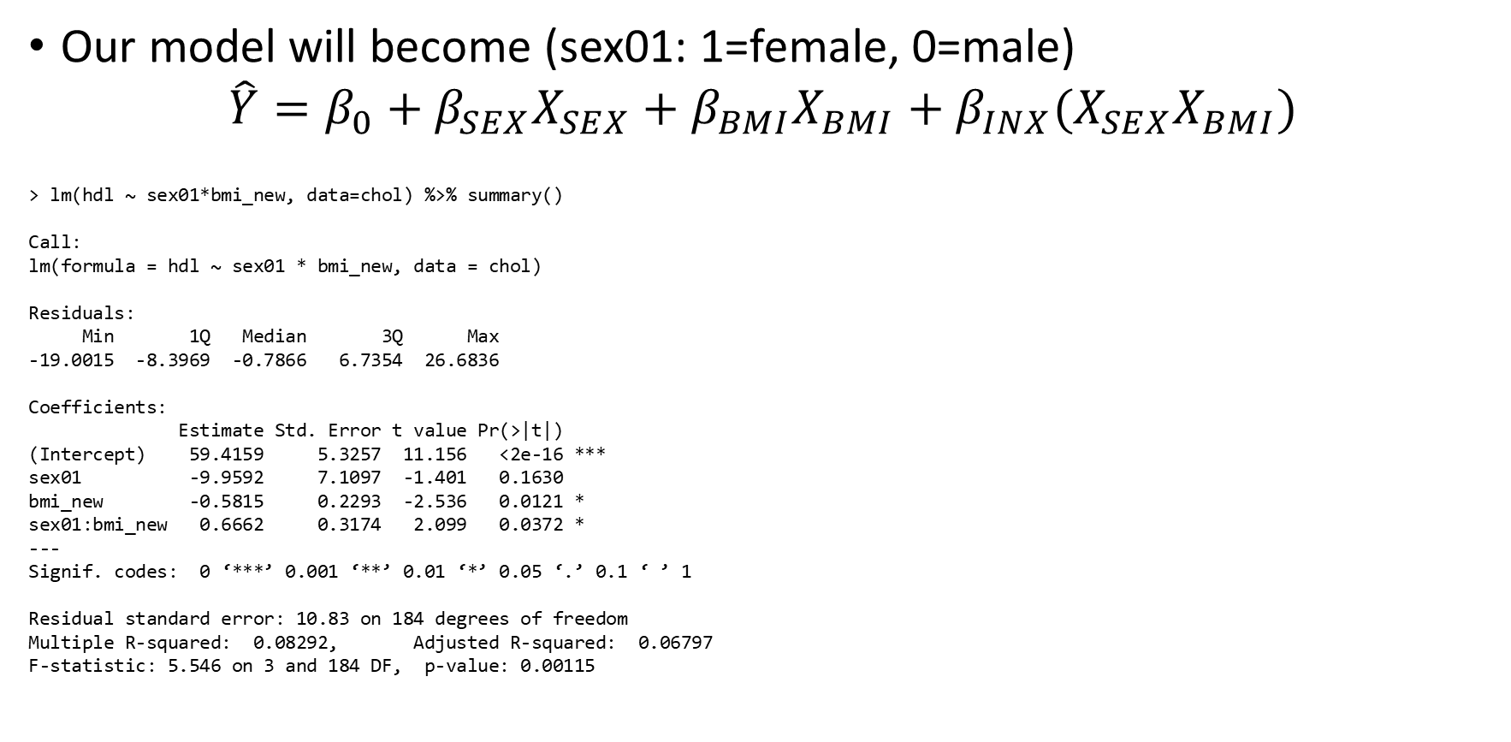

Interpreting the Interaction
Our model will become (sex01: 1=female, 0=male) $\hat{Y}=β_{0}+β_{SEX}X_{SEX}+β_{BMI}X_{BMI}+β_{INX}(X_{SEX}X_{BMI})$
> lm(hdl ~ sex01*bmi_new, data=chol) %>% summary()
Call:
lm(formula = hdl ~ sex01 * bmi_new, data = chol)
Residuals:
Min 1Q Median 3Q Max
-19.0015 -8.3969 -0.7866 6.7354 26.6836
Coefficients:
Estimate Std. Error t value Pr(>|t|)
(Intercept) 59.4159 5.3257 11.156 <2e-16 ***
sex01 -9.9592 7.1097 -1.401 0.1630
bmi_new -0.5815 0.2293 -2.536 0.0121 *
sex01:bmi_new 0.6662 0.3174 2.099 0.0372 *
---
Signif. codes: 0 ‘***’ 0.001 ‘**’ 0.01 ‘*’ 0.05 ‘.’ 0.1 ‘ ’ 1
Residual standard error: 10.83 on 184 degrees of freedom
Multiple R-squared: 0.08292, Adjusted R-squared: 0.06797
F-statistic: 5.546 on 3 and 184 DF, p-value: 0.00115
The test of $H_{0}:β_{INX}=0$ will test whether the effect of BMI on HDL varies by sex

Slide 37
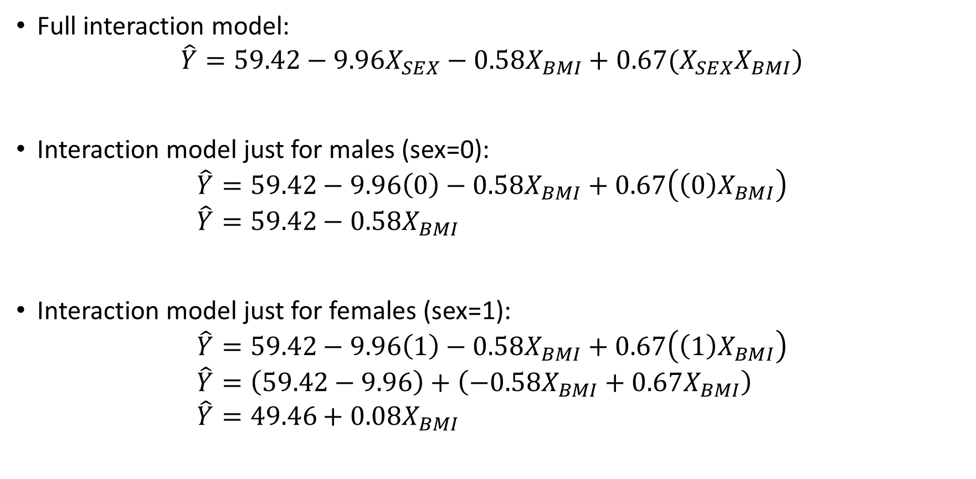

Interpreting the Interaction
Full interaction model: $\hat{Y}=59.42−9.96X_{SEX}−0.58X_{BMI}+0.67(X_{SEX}X_{BMI})$
Interaction model just for males (sex=0): $\hat{Y}=59.42−9.96\left(0\right)−0.58X_{BMI}+0.67\left(\left(0\right)X_{BMI}\right)$ $\hat{Y}=59.42−0.58X_{BMI}$
Interaction model just for females (sex=1): $\hat{Y}=59.42−9.96\left(1\right)−0.58X_{BMI}+0.67\left(\left(1\right)X_{BMI}\right)$ $\hat{Y}=\left(59.42−9.96\right)+\left(−0.58X_{BMI}+0.67X_{BMI}\right)$ $\hat{Y}=49.46+0.08X_{BMI}$

Slide 38
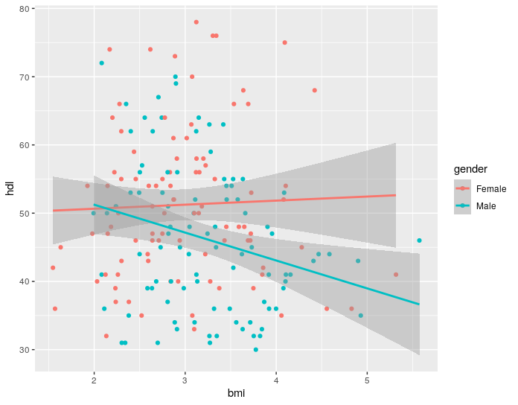
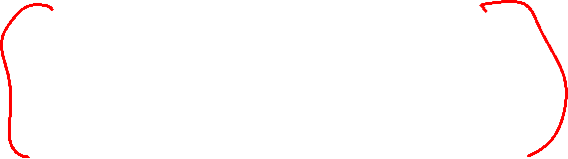
Interpreting the Interaction
Thus we can reproduce the sex-specific equations from before
We can also graph these effects
> chol %>%
+ ggplot(aes(x=bmi, y=hdl, group=gender, color=gender)) +
+ geom_point() +
+ geom_smooth(method="glm")

Slide 39
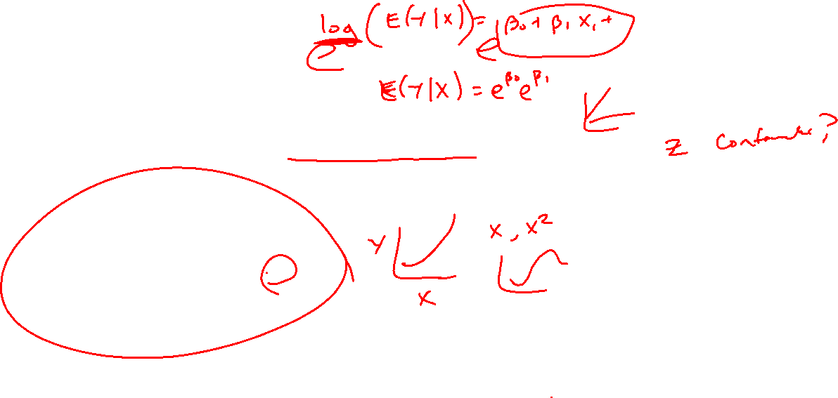
Flowchart for Assessing Interactions & Confounding
Is the association between X and Y different across levels of Z? (Is there effect modification?)
Yes
No
In the presence of effect modification, report the β for X-Y by levels of Z
In the absence of effect modification, report a single β estimate to summarize the association between X-Y
Does the β for X change when adjusting for Z? (Is Z a confounder?)
No
Yes
Report and test the unadjusted β
Report and test the Z-adjusted β

