Slide 1
Clinical Trials
July 6, 2022
Michelle M. Nuño, Ph.D.

Slide 2
Clinical Trials Impact Our Daily Lives
”FDA Grants Accelerated Approval for Alzheimer’s Drug”
”FDA approves new drug to improve heart function in adults with rare heart condition”
“FDA approves add-on therapy to lower cholesterol among high-risk adults”
”Pfizer and BioNTech Announce Phase 3 Trial Data Showing High Efficacy of a Booster Dose of their COVID-19 Vaccine”

Slide 3
What is a clinical trial?
Clinical trial (clinicaltrials.gov): A type of clinical study in which participants are assigned to groups that receive one or more intervention/treatment (or no intervention) so that researchers can evaluate the effects of the interventions on biomedical or health-related outcomes. The assignments are determined by the study's protocol. Participants may receive diagnostic, therapeutic, or other types of interventions.
Randomized control trial (RCT): Participants are RANDOMLY assigned to a treatment/intervention
The gold standard for evaluating efficacy and safety of a new treatment
Important notes:
Participants are volunteers!!
Interventions must have equipoise (will get to this soon)

Slide 4
Clinical Trials Must..
Answer a scientifically meaningful question
Provide results that inform medical practice
Be ethically justifiable for trial participants
Minimize harm and maximize benefit
Control arm is selected to be the standard of care (or placebo if there are no available treatments)

Slide 5
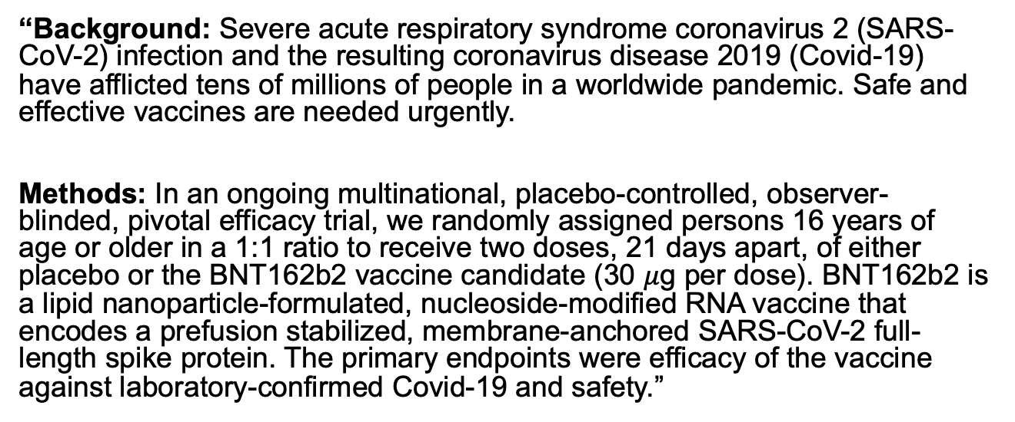
Safety and Efficacy of the BNT162b2 mRNA Covid-19 Vaccine
“Background: Severe acute respiratory syndrome coronavirus 2 (SARS-CoV-2) infection and the resulting coronavirus disease 2019 (Covid-19) have afflicted tens of millions of people in a worldwide pandemic. Safe and effective vaccines are needed urgently.
Methods: In an ongoing multinational, placebo-controlled, observer-blinded, pivotal efficacy trial, we randomly assigned persons 16 years of age or older in a 1:1 ratio to receive two doses, 21 days apart, of either placebo or the BNT162b2 vaccine candidate (30 $μ$g per dose). BNT162b2 is a lipid nanoparticle-formulated, nucleoside-modified RNA vaccine that encodes a prefusion stabilized, membrane-anchored SARS-CoV-2 full-length spike protein. The primary endpoints were efficacy of the vaccine against laboratory-confirmed Covid-19 and safety.”
(Polack et al., 2020)

Slide 6
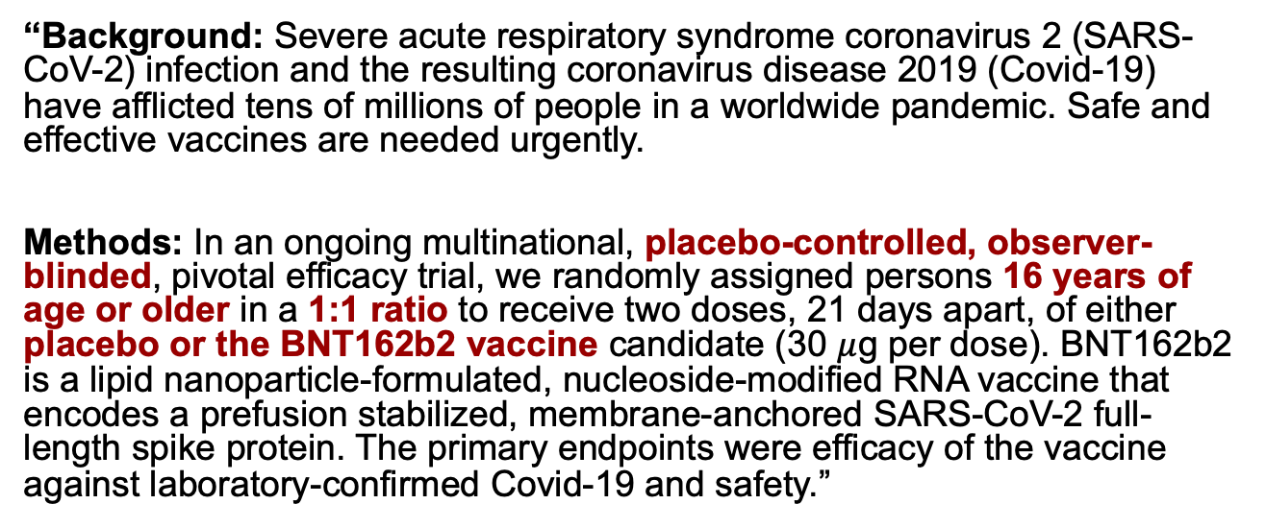
Safety and Efficacy of the BNT162b2 mRNA Covid-19 Vaccine
“Background: Severe acute respiratory syndrome coronavirus 2 (SARS-CoV-2) infection and the resulting coronavirus disease 2019 (Covid-19) have afflicted tens of millions of people in a worldwide pandemic. Safe and effective vaccines are needed urgently.
Methods: In an ongoing multinational, placebo-controlled, observer-blinded, pivotal efficacy trial, we randomly assigned persons 16 years of age or older in a 1:1 ratio to receive two doses, 21 days apart, of either placebo or the BNT162b2 vaccine candidate (30 $μ$g per dose). BNT162b2 is a lipid nanoparticle-formulated, nucleoside-modified RNA vaccine that encodes a prefusion stabilized, membrane-anchored SARS-CoV-2 full-length spike protein. The primary endpoints were efficacy of the vaccine against laboratory-confirmed Covid-19 and safety.”
(Polack et al., 2020)

Slide 7
Randomized Control Trial
Patients assessed for eligibility
Eligible patients are enrolled
Treatment/
Experimental Arm
Patients are randomized
Control Arm
(standard of care or placebo)
Outcomes Assessed
Outcomes Assessed

Slide 8
Randomized Control Trial
Determines the population that we will be sampling from
Should reflect patients who will be treated with the drug if the drug is approved
“16 years of age or older"
Patients assessed for eligibility
Eligible patients are enrolled
Treatment/
Experimental Arm
Patients are randomized
Control Arm
(standard of care or placebo)
Outcomes Assessed
Outcomes Assessed

Slide 9
Safety and Efficacy of the BNT162b2 mRNA Covid-19 Vaccine
Recall the first age group that was approved to receive the Pfizer vaccine…
Why would we limit who can receive the vaccine?

Slide 10
Randomized Control Trial
Randomization is used to ensure (theoretically) that potential prognostic factors are balanced between the intervention groups
Makes comparisons feasible
“1:1 randomization”
Patients assessed for eligibility
Eligible patients are enrolled
Treatment/
Experimental Arm
Patients are randomized
Control Arm
(standard of care or placebo)
Outcomes Assessed
Outcomes Assessed

Slide 11
Placebo or Standard of Care?
“Participants in the trial were randomly assigned in a 1:1 ratio to receive 30 μg of BNT162b2 (0.3 ml volume per dose) or saline placebo”
Why was placebo used for the control arm?

Slide 12
Randomization
Randomization will (theoretically) balance characteristics of patients between intervention groups
If patients in the intervention groups are similar, can conduct a fair comparison between the intervention groups

Slide 13
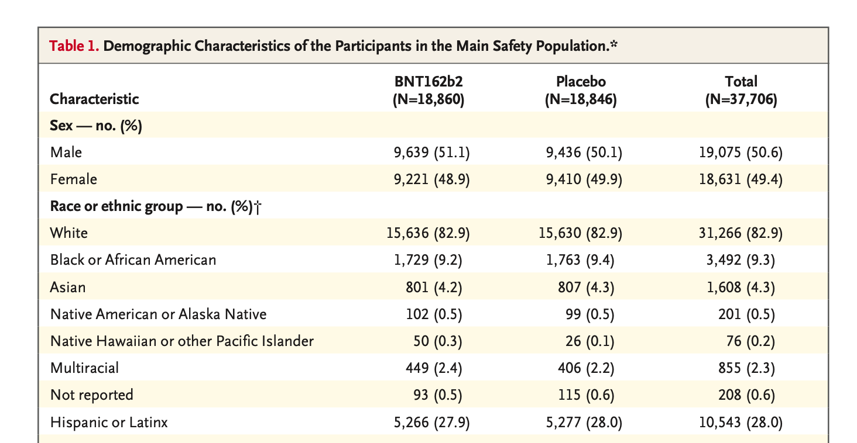
Safety and Efficacy of the BNT162b2 mRNA Covid-19 Vaccine
(table from Polack et al., 2020)

Slide 14
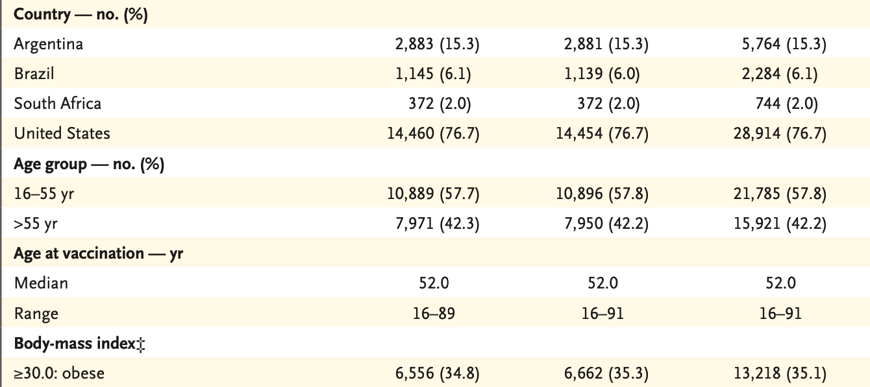
Safety and Efficacy of the BNT162b2 mRNA Covid-19 Vaccine
(table from Polack et al., 2020)

Slide 15
Randomization Stratified Randomization
Stratified randomization: Randomization occurs within certain groups (e.g., age)
This will ensure that this characteristic/prognostic factor is balanced between both treatment arms
Treatment A
Treatment B
Treatment A
Treatment B
Treatment A
Treatment B

Slide 16
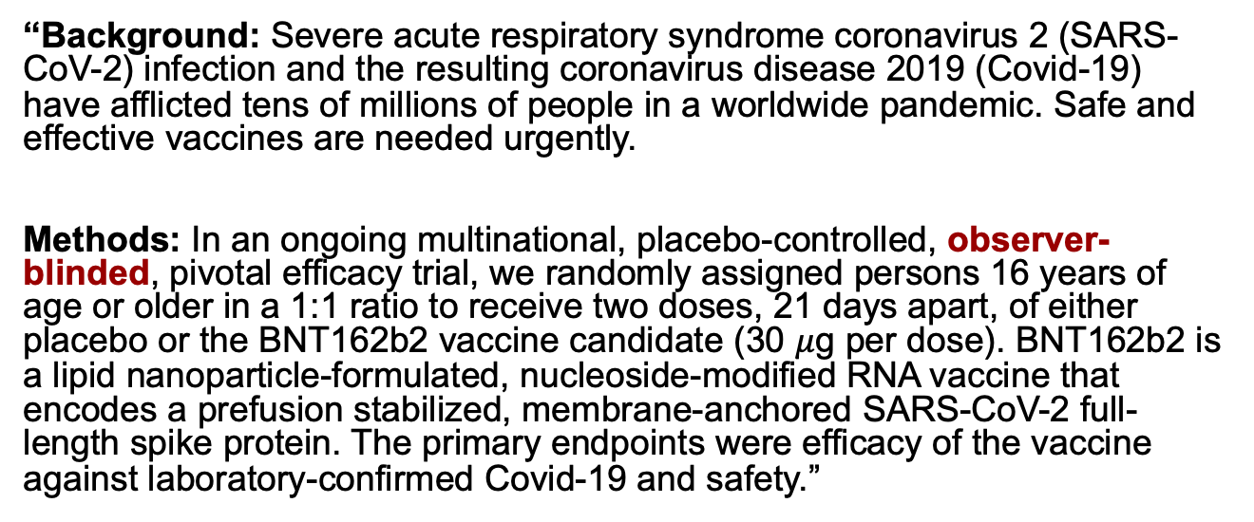
Safety and Efficacy of the BNT162b2 mRNA Covid-19 Vaccine
“Background: Severe acute respiratory syndrome coronavirus 2 (SARS-CoV-2) infection and the resulting coronavirus disease 2019 (Covid-19) have afflicted tens of millions of people in a worldwide pandemic. Safe and effective vaccines are needed urgently.
Methods: In an ongoing multinational, placebo-controlled, observer-blinded, pivotal efficacy trial, we randomly assigned persons 16 years of age or older in a 1:1 ratio to receive two doses, 21 days apart, of either placebo or the BNT162b2 vaccine candidate (30 $μ$g per dose). BNT162b2 is a lipid nanoparticle-formulated, nucleoside-modified RNA vaccine that encodes a prefusion stabilized, membrane-anchored SARS-CoV-2 full-length spike protein. The primary endpoints were efficacy of the vaccine against laboratory-confirmed Covid-19 and safety.”
(Polack et al., 2020)

Slide 17


Helping to Reduce Bias in a Clinical Trial: Blinding
Blinding of the treatment group assignment helps reduce bias when comparing group outcomes
Double blinded:
Single blinded:
OR
Unblinded:
Participant Investigator/Researcher

Slide 18
Safety and Efficacy of the BNT162b2 mRNA Covid-19 Vaccine
“Site staff who were responsible for safety evaluation and were unaware of group assignments observed participants for 30 minutes after vaccination for any acute reactions.”
Why is it important that site staff are blinded?
(Polack et al., 2020)

Slide 19
How will the treatments be compared?
Superiority trial: Test the hypothesis that the experimental intervention will provide better outcomes than the control
Want to find a better treatment
Non-inferiority trial: Test the hypothesis that the experimental intervention will provide outcomes that are no worse than the control
Often used when a less expensive, less toxic, or less invasive treatment is needed

Slide 20
How will the treatments be compared?
We must carefully select the outcomes of the study to answer our scientific question
Primary endpoints: The main outcome used to compare the interventions
Secondary endpoints: Any other outcomes of interest for comparing the interventions
Safety: Often include monitoring for safety (looking at certain toxicities, etc.)
It is now also common (or becoming increasingly common) to compare quality of life outcomes
How does the quality of life compare for the two treatment groups (these are often secondary/exploratory)

Slide 21
Safety and Efficacy of the BNT162b2 mRNA Covid-19 Vaccine
Efficacy:
“The first primary end point was the efficacy of BNT162b2 against confirmed Covid-19 with onset at least 7 days after the second dose in participants who had been without serologic or virologic evidence of SARS-CoV-2 infection up to 7 days after the second dose; the second primary end point was efficacy in participants with and participants without evidence of prior infection. Confirmed Covid-19 was defined according to the Food and Drug Administration (FDA) criteria as the presence of at least one of the following symptoms: fever, new or increased cough, new or increased shortness of breath, chills, new or increased muscle pain, new loss of taste or smell, sore throat, diarrhea, or vomiting, combined with a respiratory specimen obtained during the symptomatic period or within 4 days before or after it that was positive for SARS-CoV-2 by nucleic acid amplification–based testing, either at the central laboratory or at a local testing facility (using a protocol-defined acceptable test).
Major secondary end points included the efficacy of BNT162b2 against severe Covid-19. Se- vere Covid-19 is defined by the FDA as confirmed Covid-19 with one of the following additional features: clinical signs at rest that are indicative of severe systemic illness; respiratory failure; evidence of shock; significant acute renal, hepatic, or neurologic dysfunction; admission to an intensive care unit; or death. Details are provided in the protocol.”

Slide 22
Who will be included in the analysis?
Participants are randomized to one of the intervention groups
The protocol states how each intervention should be administered, how often, etc.
Not all patients will be able to receive the treatment as stated in the protocol (toxicity, dropout, etc)
Some patients do not receive the treatment they were randomized to
How do we account for these patients in the analysis?
Per-protocol analyses: Include patients only if they received the treatment exactly as stated in the protocol
Usually not recommended as confounding could occur (“compliant” patients and ”non-compliant” patients could differ on important prognostic factors)
Often used as part of secondary analyses
Intention-to-treat (most common and recommended approach): Includes patients in the group they were assigned to, regardless of whether they received the treatment or not
Reduces risk of confounding
Modified Intention-to-treat: intention-to-treat analysis with some exceptions regarding patients who should be excluded from the analysis (e.g. patients who never received treatment for reasons unrelated to the treatment)

Slide 23
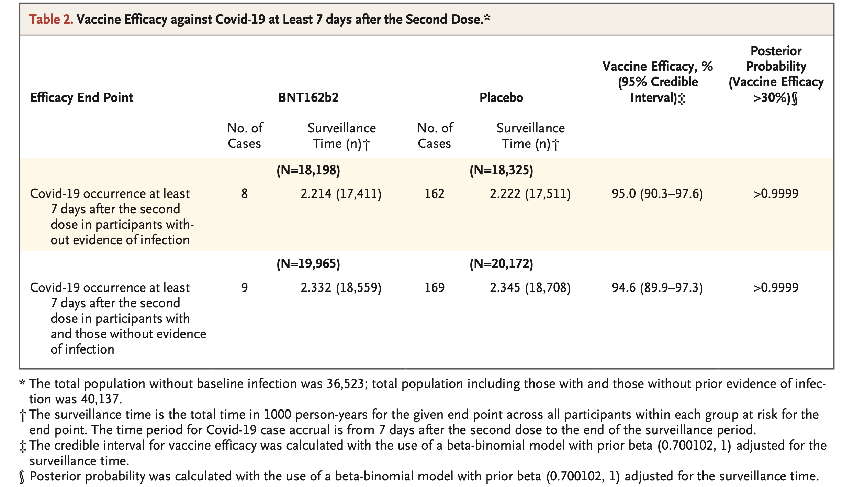
Safety and Efficacy of the BNT162b2 mRNA Covid-19 Vaccine
“Vaccine efficacy was estimated by 100×(1−IRR), where IRR is the calculated ratio of confirmed cases of Covid-19 illness per 1000 person-years of follow-up in the active vaccine group to the corresponding illness rate in the placebo group.”
(table from Polack et al., 2020)

Slide 24
Phases of a clinical trial
Phase I:
Drug/treatment is tested for the first time
Small sample
Dose-finding
Learn about safety/side effects
Phase II trials:
Safety & possible efficacy
Larger sample size than Phase I trials
Phase III trials:
Large group of people
Confirm effectiveness
Monitor safety/side effects
Compare to standard of care
Phase IV trials:
After FDA approval
Identify or monitor longer-term/rare adverse effects
(Mack, 2019; https://www.nih.gov/health-information/nih-clinical-research-trials-you/basics)

Slide 25
Phases of a clinical trial
Phase I:
Drug/treatment is tested for the first time
Small sample
Dose-finding
Learn about safety/side effects
Phase II trials:
Safety & possible efficacy
Larger sample size than Phase I trials
Phase III trials:
Large group of people
Confirm effectiveness
Monitor safety/side effects
Compare to standard of care
Phase IV trials:
After FDA approval
Identify or monitor longer-term/rare adverse effects
(Mack, 2019; https://www.nih.gov/health-information/nih-clinical-research-trials-you/basics)

Slide 26
What should be included in the Statistical Analysis Plan?
Statistical Analysis Plan: A detailed analysis plan that is prepared before the start of the study and includes…
Study objectives and endpoints
Study design/methods
Inclusion/exclusion criteria
Randomization
Blinding
Assessments and timing of assessments
Sample size/power calculations
Timing of analyses
Per-protocol vs intention-to-treat

Slide 27
What should be included in the Statistical Analysis Plan?
A detailed analysis plan that is prepared before the start of the study and includes…
How will missing data be handled?
Adjustments for multiple testing?
Will interim analyses be conducted?
Timing of analyses
Safety/Futility/Efficacy?
Stopping rules
Adherence
Efficacy analyses (primary, secondary, exploratory)
Safety
Adverse events (should be presented by arm)

Slide 28
Determining the Size of the Trial
Once the primary outcomes have been defined and the analysis plan has been decided upon, we need to determine how many patients will be needed for the study
This will be determined by the analysis plan
Must consider what will be a meaningful difference between the groups
If the trial is too small, we may not be able to identify a statistically meaningful difference
If the trial is too large, we could be wasting precious resources

Slide 29
Ethical Principles for Medical Research Involving Human Subjects: World Medical Association Declaration of Helsinki (summary of main concepts)
Statement of ethical principles for medical research involving human subjects
Risks, burdens, and benefits
Benefits must outweigh the risks/burdens to research subjects
Minimize risk to participants
When the risks are found to outweigh the benefits, or have a clear answer, must determine whether to stop the study
Vulnerable populations
Should receive specifically considered protection
Research in vulnerable populations only allowed if the question cannot be answered by studying other populations
https://www.wma.net/policies-post/wma-declaration-of-helsinki-ethical-principles-for-medical-research-involving-human-subjects/

Slide 30
Ethical Principles for Medical Research Involving Human Subjects: World Medical Association Declaration of Helsinki (summary of main concepts)
Statement of ethical principles for medical research involving human subjects
Scientific Requirements and Research Protocols
There must be scientific rationale for conducting the study
Research Ethics Committees
The protocol must be reviewed and approved by independent research ethics committee
An independent committee will monitor the study, and any changes must be approved by the committee
Informed Consent
Participation is voluntary and consent can be withdrawn at any point
Participants must be informed of the study aims, potential benefits/risks
Use of a placebo
Standard of care should be used unless no treatments are available, in which case placebo can be used
https://www.wma.net/policies-post/wma-declaration-of-helsinki-ethical-principles-for-medical-research-involving-human-subjects/

Slide 31
Clinical Trials in Pediatric Patients
Children cannot give informed consent until they are at least 18 years old
Assent is required for children under 18 years of age except in special circumstance (e.g. the child is not old enough to understand the trial and what will be asked of them)
Child agrees to take part in the trial
Several sessions may be required to help the child understand what will be asked of them
Both parents must give their permission for the child to participate in the trial (with some exceptions)
(National Cancer Institute)

Slide 32
Ethical Considerations
Scientific standards: ”If a trail is of sufficiently poor quality that it cannot make a meaningful contribution to medical knowledge, then it should be declared unethical.” (Pocock, 1983)
Clinical equipoise requires that no treatment is known to be ”better” than the other at the time of the design/start of the clinical trial
Participants must sign an informed consent document
Informed consent: a document that has been approved by an Institutional Review Board and states in language that the patient can understand:
A description of the trial
Potential risks/benefits
Participant/physician obligations
Institutional Review Board: an administrative body whose purpose is to protect the rights of human research subjects
Data Safety Monitoring Board
(Mack, 2019)

Slide 33
Monitoring Patient Safety: Data Safety Monitoring Boards
Goes by different names
Data Safety Monitoring Boards (DSMB)
Data Safety Monitoring Committee (DSMC)
Independent Data Monitoring Committee (IDMC)
Data Monitoring Committee (DMC)
DSMC composition:
Subject-matter specialists (2-4)
Biostatistician (1-2)
(Gillen and Kittelson, 2017)

Slide 34
Monitoring Patient Safety: Data Safety Monitoring Boards
The role of a DSMB
Ensure unbiased decisions
DSMB members are independent of the study investigators
DSMB reviews unblinded data in the midst of a trial to:
Assure the trial is safe to continue
Make decisions about early termination based on the statistical monitoring plan
Early termination can be due to efficacy, futility, or safety
Decision to terminate early must be considered in balance with all aspects of the trial and what we can learn (i.e. stopping early due to efficacy may make it difficult to learn about safety)
(Gillen and Kittelson, 2017)

Slide 35
One More Example..

Slide 36
Phase III Children’s Oncology Group Trial AAML0531
Acute Myeloid Leukemia (AML) is difficult to treat
Disease heterogeneity
High relapse
Toxic mortality
Treatment intensification has been used to help improve outcomes, but previous studies have shown that continuing to increase intensification leads to higher treatment-related mortality (limits reached)
Phase II studies have shown potential benefit and safety of gemtuzumab-ozogamicin (GO) in combination with chemotherapy
Primary objective: To determine whether GO added to standard chemotherapy improved EFS and OS in children with newly diagnosed AML.
(Gamis, et al., 2014)

Slide 37
Phase III Children’s Oncology Group Trial AAML0531
“The National Cancer Institute’s central institutional review board and institutional review boards at each enrolling center (n = 181) approved the study; patients and their families provided informed consent or assent as appropriate. The trial was conducted in accordance with the Declaration of Helsinki. The trial was registered at www.clinicaltrials.gov as NCT00372593.”
(Gamis, et al., 2014)

Slide 38
Phase III Children’s Oncology Group Trial AAML0531
Exclusion Criteria:
Prior chemotherapy (except intrathecal cytarabine)
Acute promyelocytic leukemia [t(15;17)]
Juvenile myelomonocytic leukemia
Bone marrow failure syndromes
Secondary AML
Patients were randomly assigned
Standard therapy alone (No-GO)
Standard therapy + GO (GO)
“Blocked randomization with blocks of size 4 that were concealed from enrolling centers was used for treatment arm assignment. The COG Data and Statistical Center assigned patients to the treatment arms, after they were enrolled by the patient’s institution through an automated Web portal.”
(Gamis, et al., 2014)

Slide 39
Phase III Children’s Oncology Group Trial AAML0531
Primary endpoints: Overall survival (OS) and event-free survival (EFS)
EFS was defined as the time from study entry until death, induction failure, or relapse of any type
(Gamis, et al., 2014)

Slide 40
Phase III Children’s Oncology Group Trial AAML0531
“The study had a goal to enroll 1,000 eligible patients who did not have Down syndrome and was designed to have 80% power with one-sided 2.5% type I error to detect a 9% improvement in long-term EFS (54% v 45%) and long- term OS (59% v 50%) between the two study arms. The study was monitored by a data safety monitoring committee.”
(Gamis, et al., 2014)

Slide 41
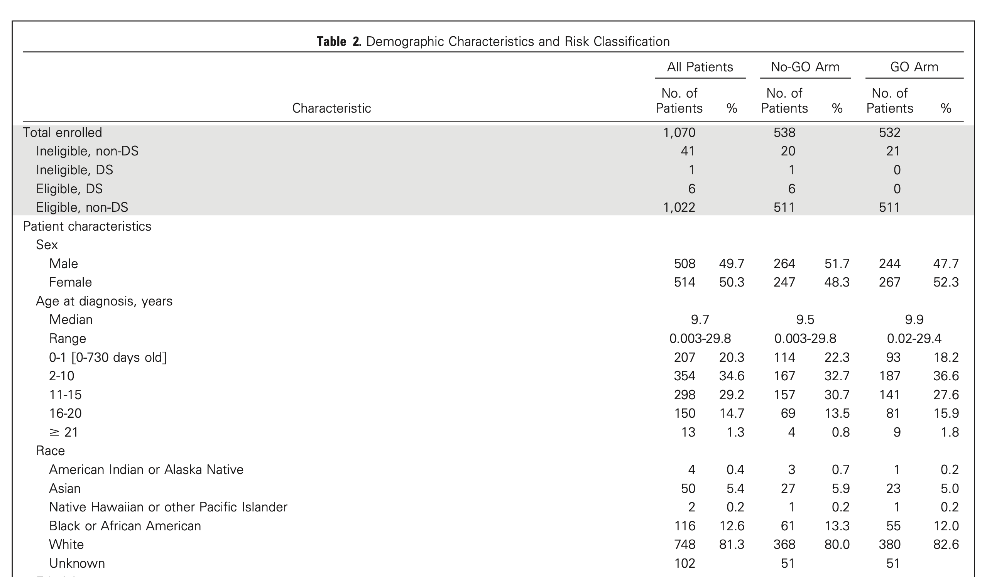
Phase III Children’s Oncology Group Trial AAML0531
(Gamis, et al., 2014)

Slide 42
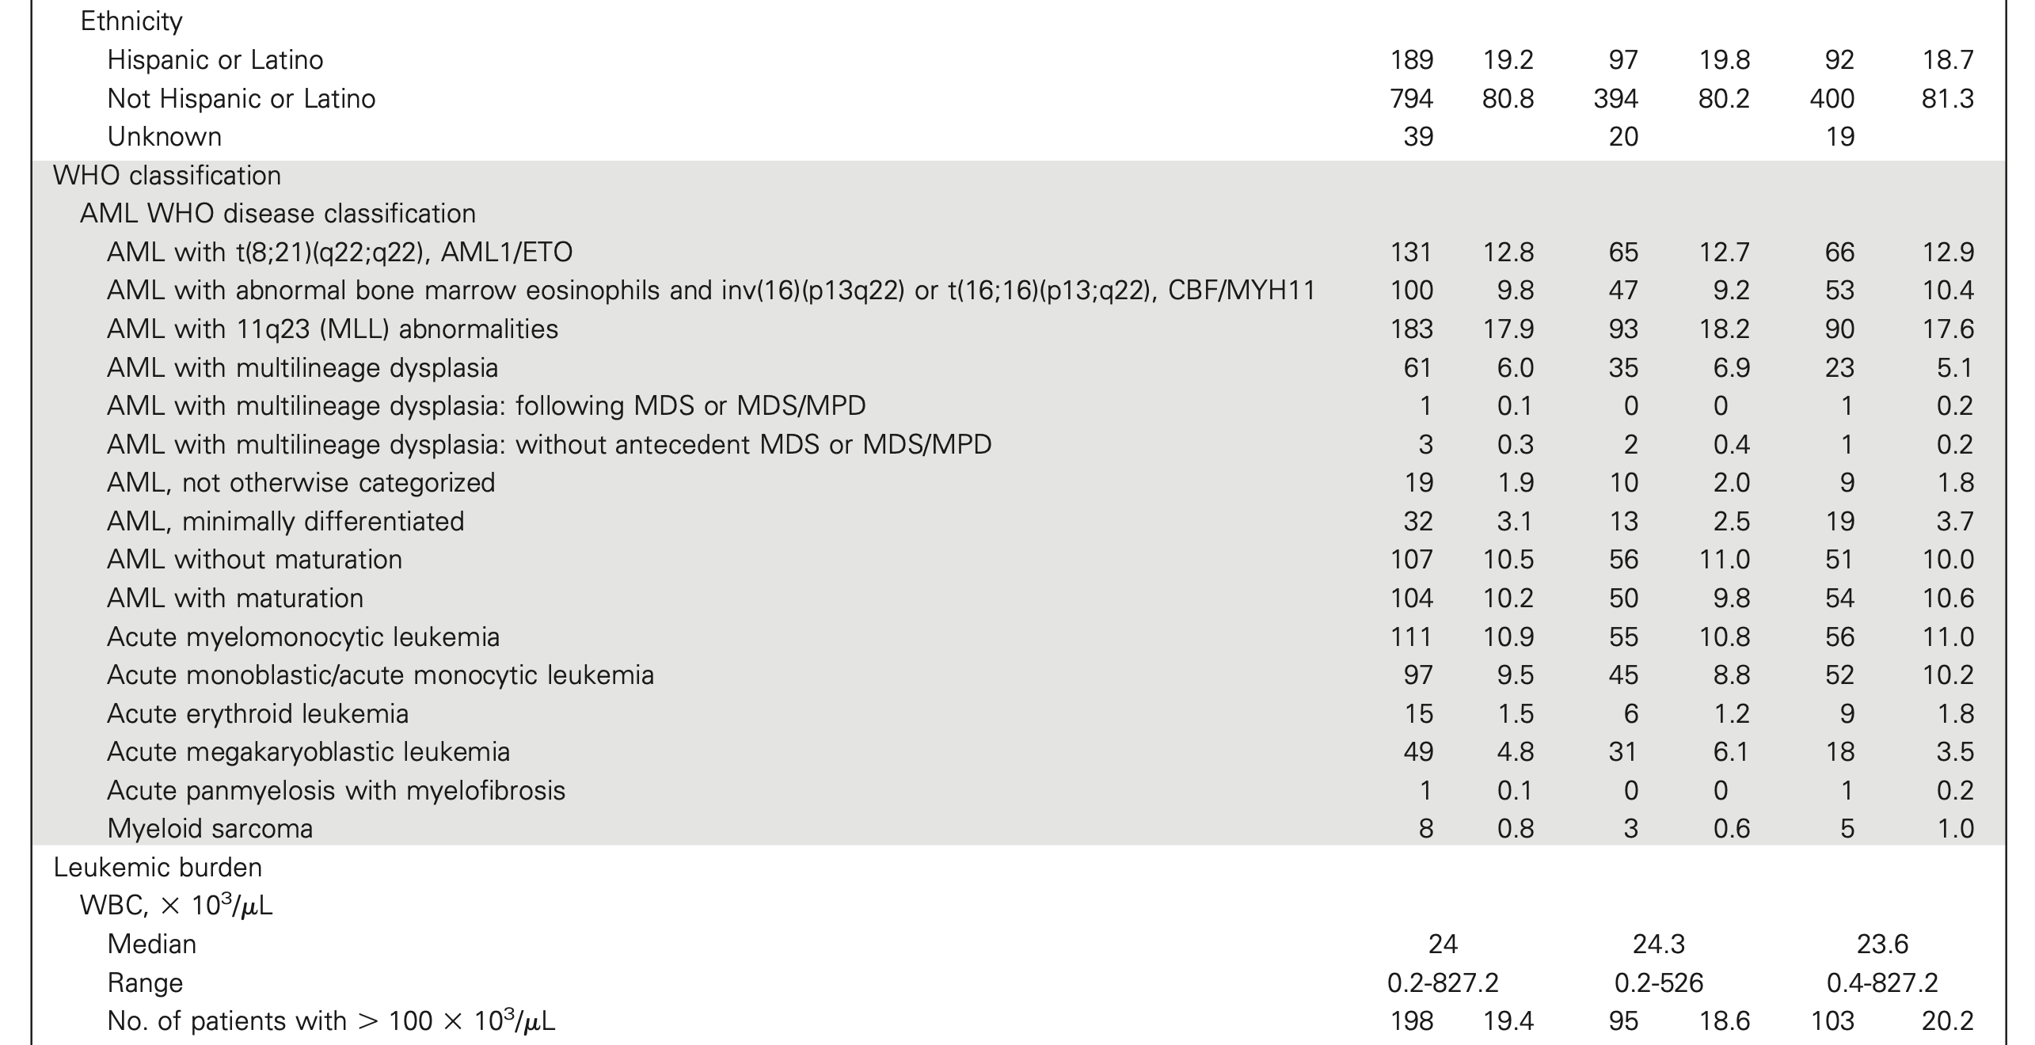
Phase III Children’s Oncology Group Trial AAML0531
(Gamis, et al., 2014)

Slide 43
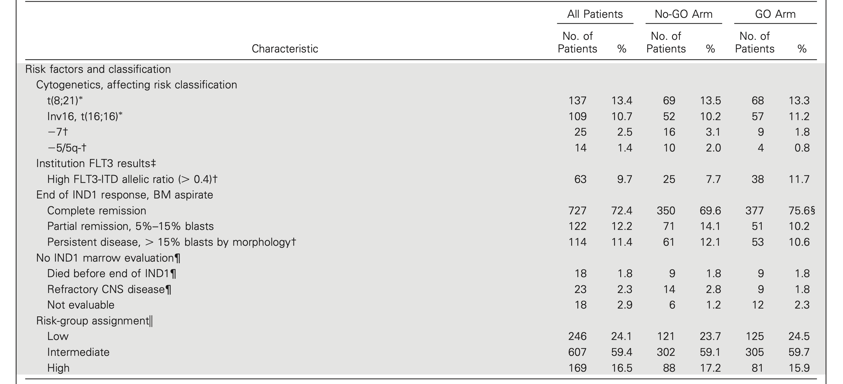
Phase III Children’s Oncology Group Trial AAML0531
(Gamis, et al., 2014)

Slide 44
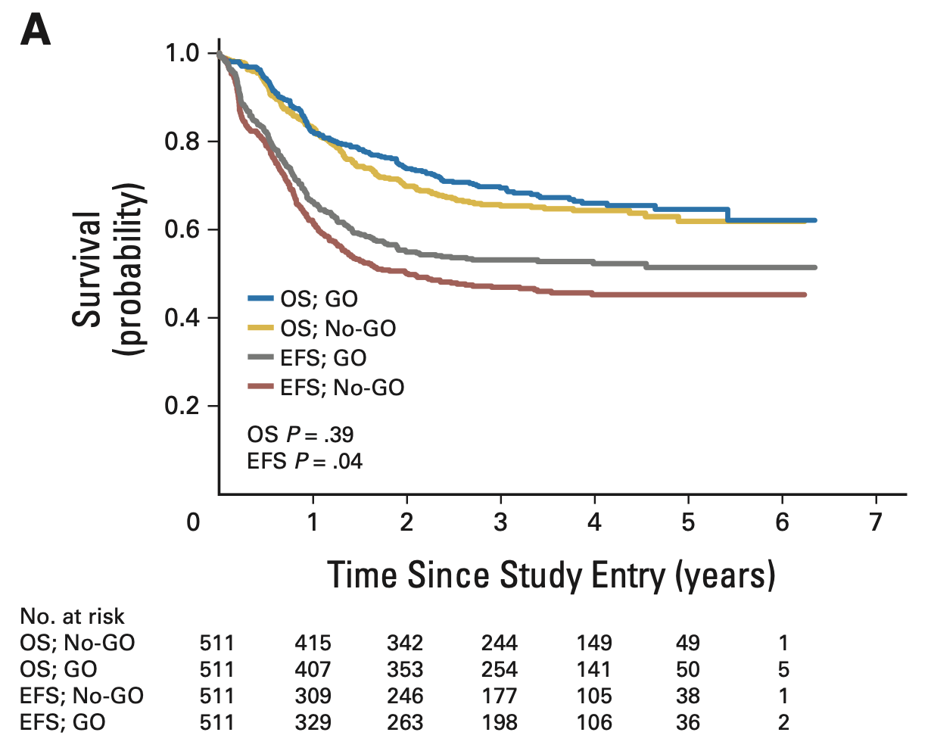
Phase III Children’s Oncology Group Trial AAML0531
(Gamis, et al., 2014)

Slide 45
References
“Child Assent.” National Cancer Institute. https://www.cancer.gov/about-cancer/treatment/clinical-trials/patient-safety/childrens-assent. Accessed July 5, 2022.
Gamis, Alan S., et al. "Gemtuzumab ozogamicin in children and adolescents with de novo acute myeloid leukemia improves event-free survival by reducing relapse risk: results from the randomized phase III Children's Oncology Group trial AAML0531." Journal of Clinical Oncology 32.27 (2014): 3021.
Gillen, Daniel L., Kittelson, John M., “Evaluation of Group Sequential Clinical Trials.” 26 July 2017. Summer Institute in Statistical for Clinical Research (SISCR). University of Washington.
Mack, Wendy. “Clinical Trials.” 10 July 2019. LA’s BEST. University of Southern California.
Polack, Fernando P., et al. "Safety and efficacy of the BNT162b2 mRNA Covid-19 vaccine." New England journal of medicine (2020)

