Slide 1



Time-Series Analysis of Heat and Heat-Related Emergency Department Visits
LA’s BeST data analysis project Summer 2026
Erika Garcia, PhD – Environmental Health
Sandy Eckel, PhD – Biostatistics
Notes:
GIF source: https://giphy.com/gifs/illustration-cartoon-J43yvW6uFabIpBBsPO

Slide 2


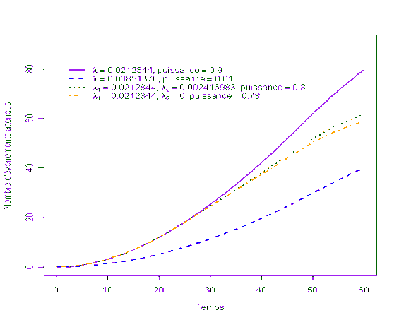


Sandy Eckel - Background
Academic journey
Vassar College math/French double major
Junior year abroad in Paris, biostats intern
First learned R in 2003, installed via CD (!)
JHSPH Biostatistics PhD
Mentor: Tom Louis, and worked with: Francesca Domenici, Roger Peng
Dissertation included work on NMMAPS: multi-site time-series study of air pollution health effects
USC postdoc, mentor: Kiros Berhane
USC faculty since 2011 & Director PhD Program in Biostatistics
I ❤ teaching data analysis: PM511a (9 years) and PM511c (currently)
General research area: stats methods and applications for air pollution health effects
Current research related to climate change and health:
Extreme heat, wildfire smoke, power outages and heart failure hospitalizations (Garcia/Eckel)
EV transition co-benefits (Garcia)
Drought: Salton sea (Johnston, Farzan)
Decarbonizing medicine (McConnell, Hu, Sharma)
Future directions of interest
Climate change mitigation co-benefits to provide evidence of benefit to public health
Methods for intervention studies, large administrative time-series datasets

Slide 3

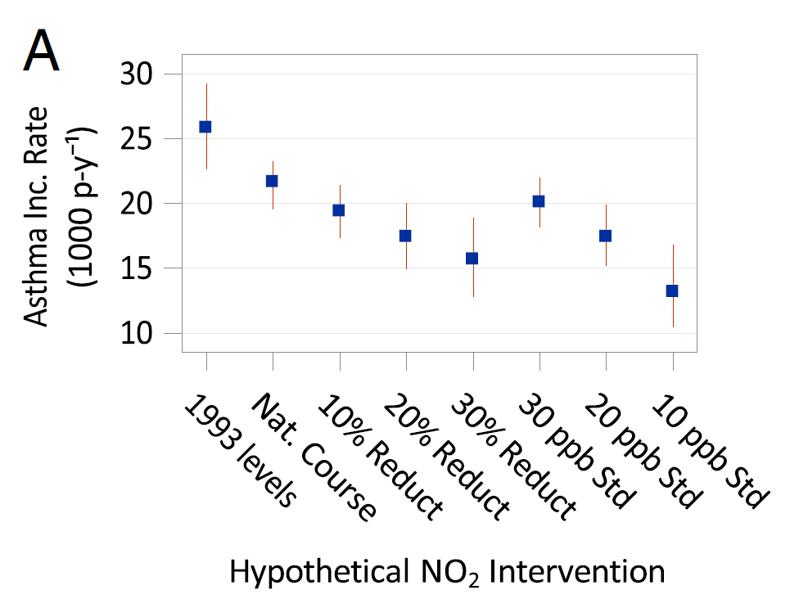
Erika Garcia – Background
Associate Professor of Population and Public Health Sciences (Environmental Health) at the Keck School of Medicine
PhD in Environmental Health Sciences from UC Berkeley
Trained as in Occupational Epidemiology but now work more broadly in Environmental Epidemiology
Also teach PM617: Introduction to Causal Inference in Epidemiology

Slide 4



Class: Data Science Methods for Climate Change Health Research PM619/GEOL619
Goal: provide the framework and tools to empower the next generation of data scientists to improve the future of human health in a changing climate.
Introduce data science methods to study the impacts of climate related events on human health.
Study methods to evaluate evidence for adaptation, co-benefits of mitigation, vulnerability, and attribution.
Interdisciplinary Instructional Team
2023 Sustainability Across the Curriculum New Course Award
2023 DPPHS Chair’s Citation on Pedagogical Excellence Award
Sandy Eckel Biostatistics
Erika Garcia Environ Health
Sam Silva Dept Earth Sciences

Slide 5
Climate Change and Health
Broad context for this project

Slide 6
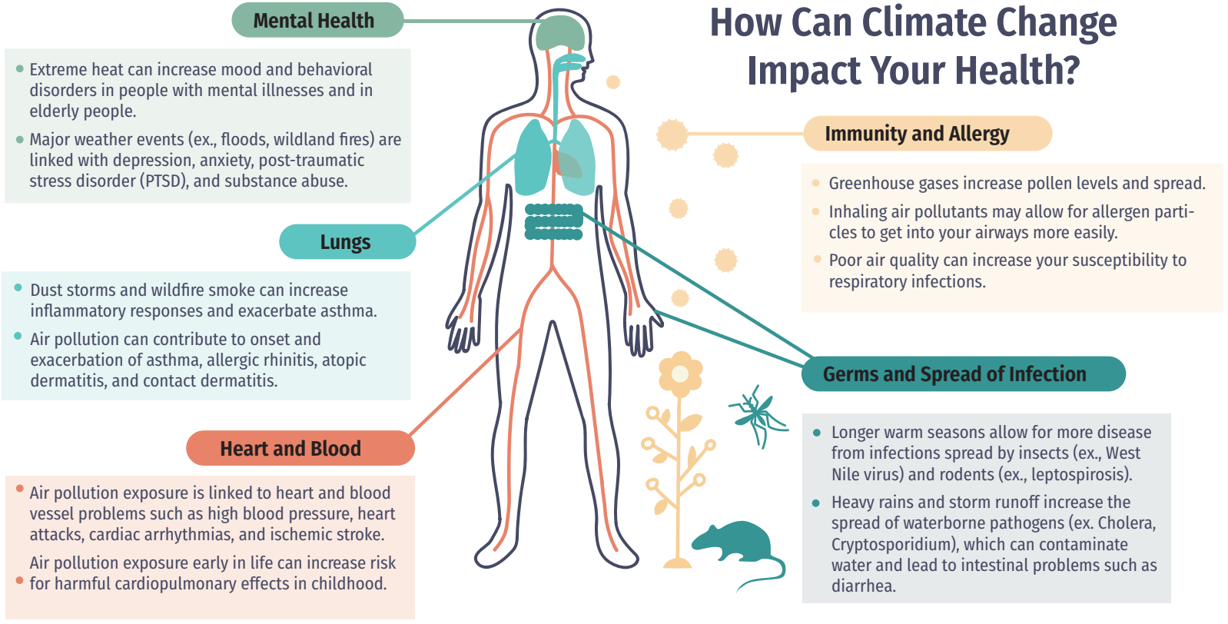
Chinthrajah S, Garcia E, Hasan Z, Hy A, Wong L. Climate Change Health Effects and What You Can Do. American Journal of Respiratory and Critical Care Medicine. 2022 Jan 1;205(1):P1-2.

Slide 7
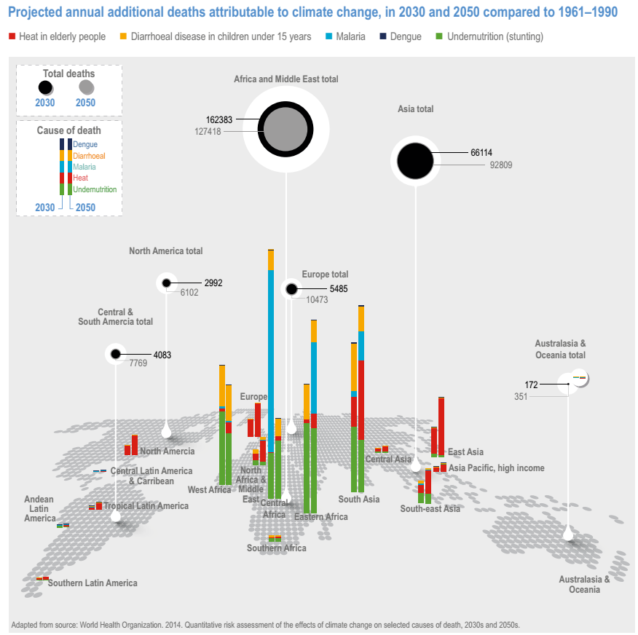
https://www.ipcc.ch/report/ar6/wg2/downloads/report/IPCC_AR6_WGII_Chapter07.pdf
Climate change acts like a stress multiplier
2015 Lancet Commission:
“Climate change is the greatest global health threat facing the world in the 21st century…”

Slide 8
“…tackling climate change could be the greatest global health opportunity of the 21st century”
“Many mitigation and adaptation responses to climate change are “no-regret” options, which lead to direct reductions in the burden of ill-health, enhance community resilience, alleviate poverty, and address global inequity. Benefits are realised by ensuring that countries are unconstrained by climate change, enabling them to achieve better health and wellbeing for their populations. These strategies will also reduce pressures on national health budgets, delivering potentially large cost savings, and enable investments in stronger, more resilient health systems.”
Watts N, Adger WN, Agnolucci P, Blackstock J, Byass P, Cai W, Chaytor S, Colbourn T, Collins M, Cooper A, Cox PM. Health and climate change: policy responses to protect public health. The Lancet. 2015 Nov 7;386(10006):1861-914.

Slide 9
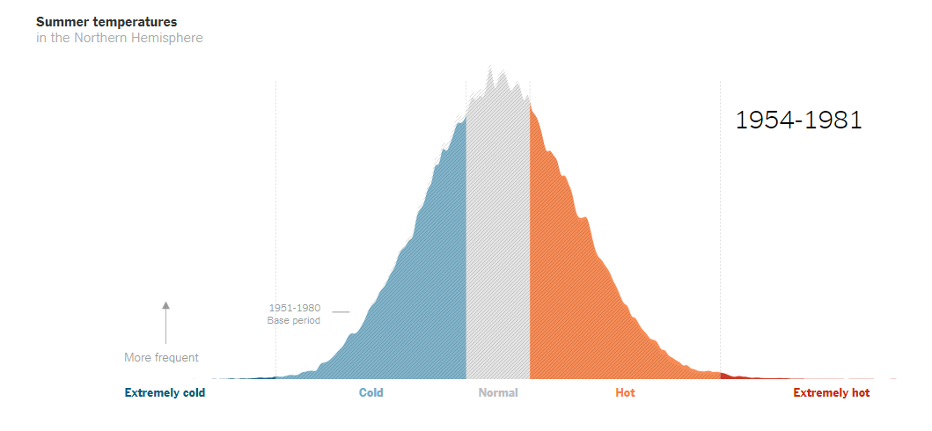
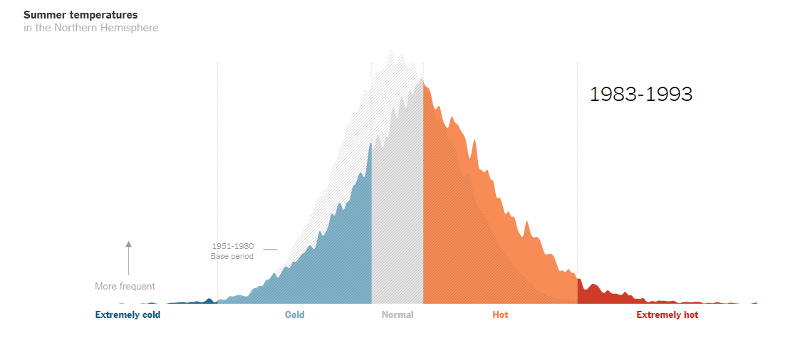
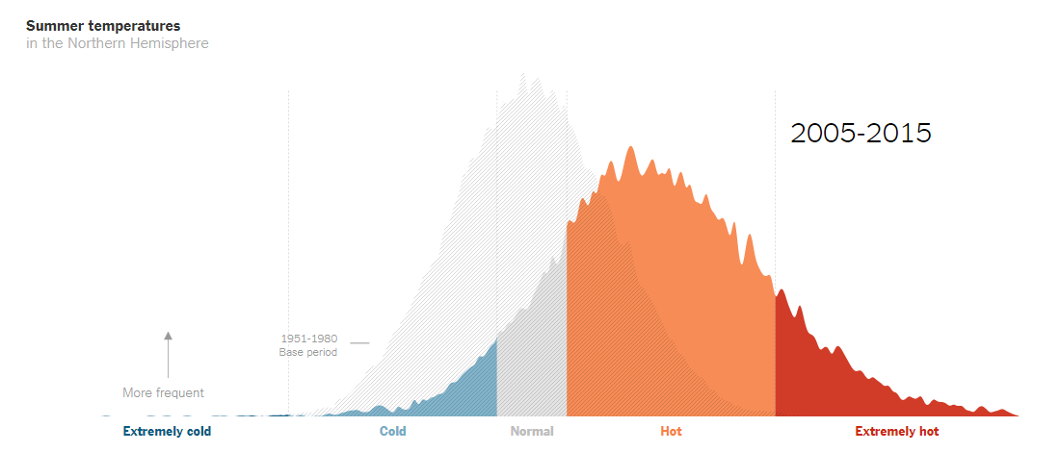
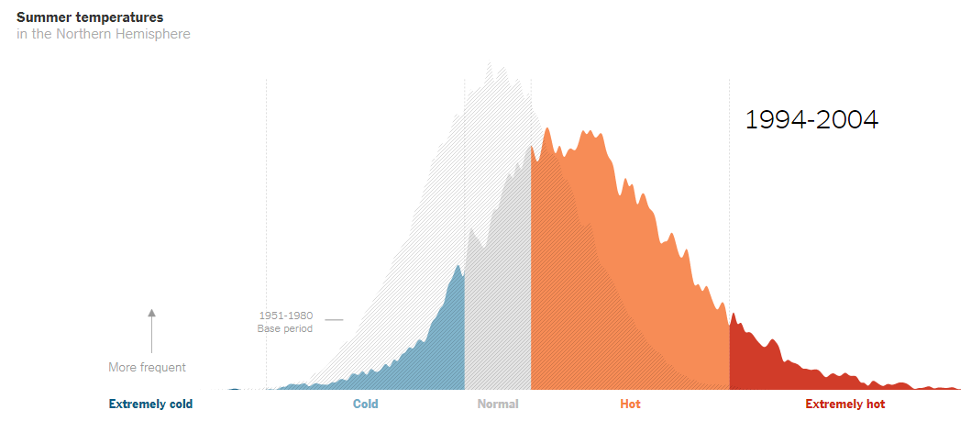
Why are we talking about heat? Northern Hemisphere, summer
https://www.nytimes.com/2019/02/28/learning/teach-about-climate-change-with-these-24-new-york-times-graphs.html

Slide 10
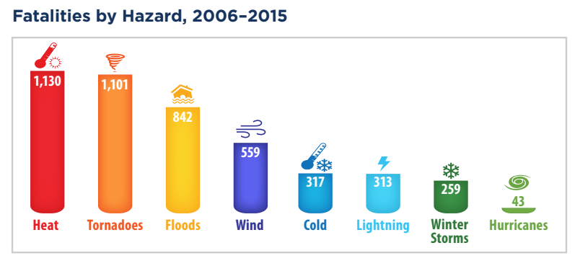
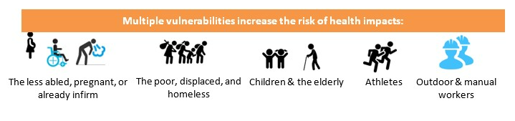
Wide range of health impacts from hot temperatures and heatwaves
Heat illness: dehydration, heat cramps, heat stroke
ER visits, hospitalizations: cardiovascular, respiratory, diabetes, stroke, mental health, renal disease
Adverse pregnancy and birth outcomes
Mortality: cardiovascular, respiratory, mental health, renal disease
Heat is one of the largest weather-related causes of death in high-income countries
(United States)
NOAA National Weather Service, 2016
https://www.who.int/news-room/fact-sheets/detail/climate-change-heat-and-health

Slide 11
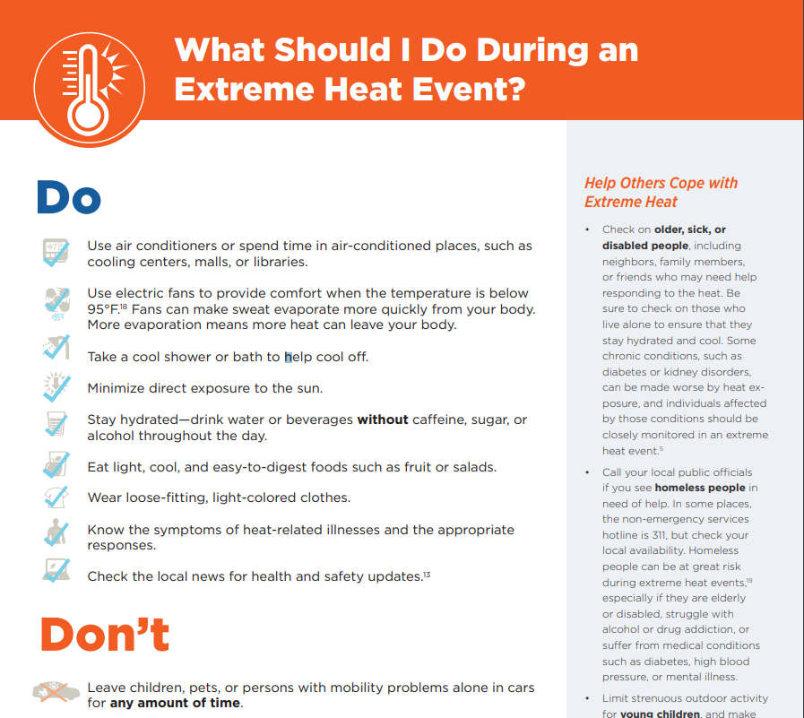
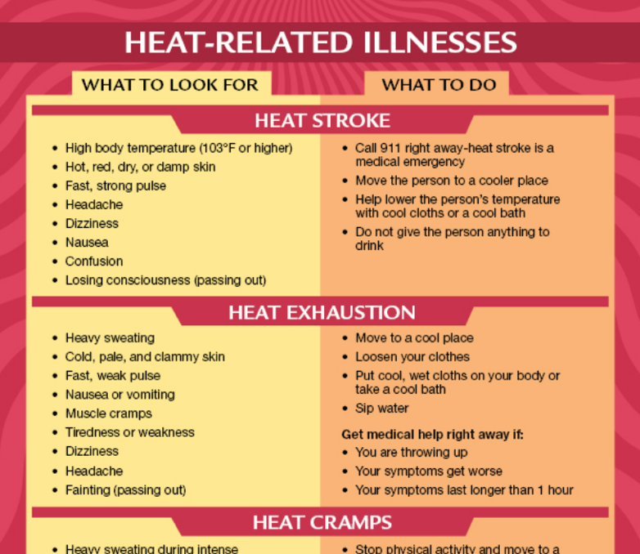
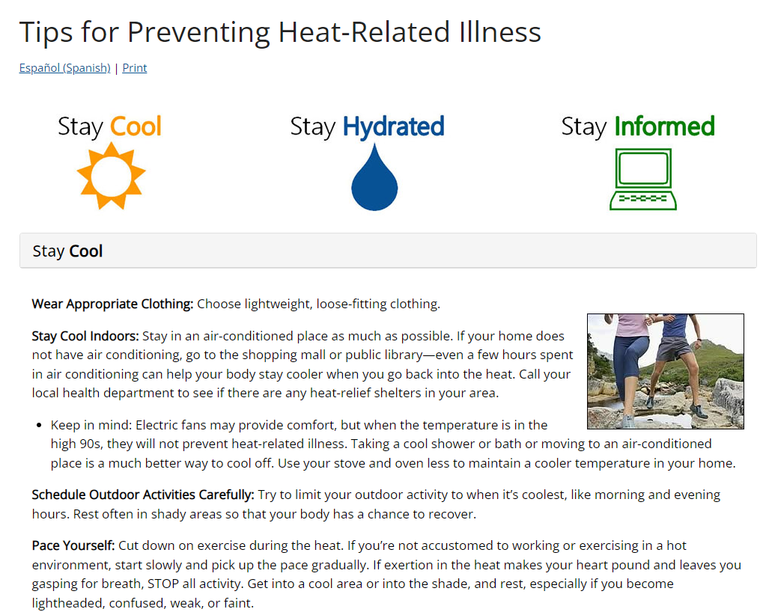
Importance of preparedness and prevention!
Heat-related morbidity and mortality can be prevented
Improved preparedness
Avoiding exposure
Consider methods for evaluating risk factors (vulnerabilities) and possible interventions/adaptations (e.g., effect modification, interaction)
https://www.cdc.gov/climateandhealth/effects/temperature_extremes.htm

Slide 12
Climate change adaptation through Heat preparedness and public health surveillance
Extreme heat is among the deadliest weather-related hazards in the United States
Heat-related illness can lead to emergency department visits, hospitalizations, and death
As extreme heat becomes more frequent, health departments are expanding syndromic surveillance systems to track health impacts and inform adaptation efforts.
Question: Using publicly available real-time syndromic surveillance system data, what is the association of daily temperature with heat-related emergency department visits?

Slide 13
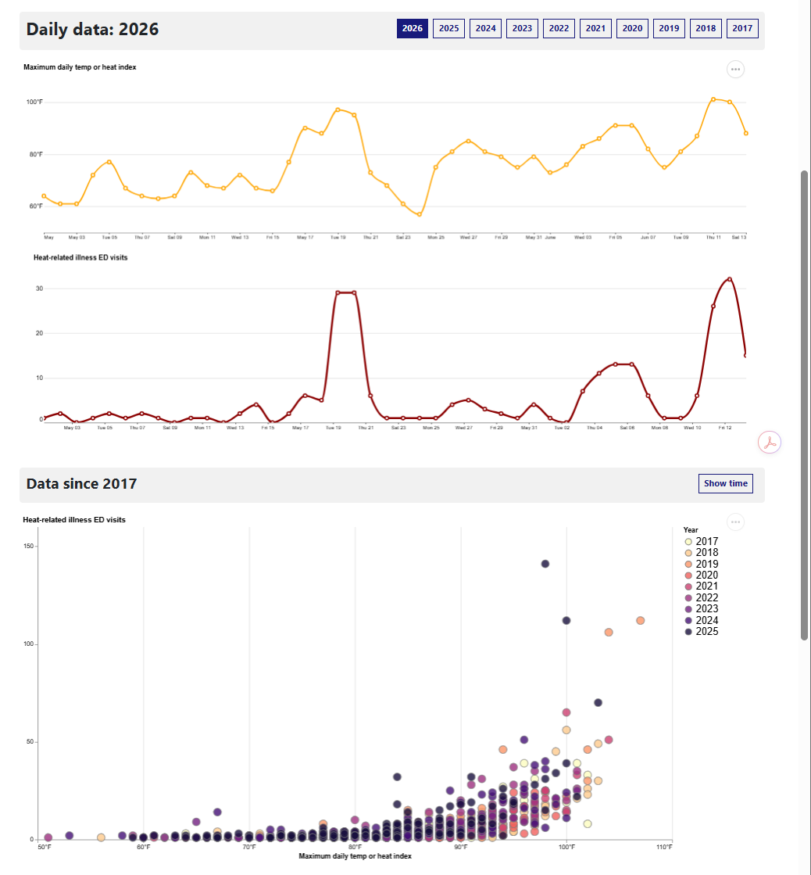
Real-time heat-related illness for NYC
Heat-related illness, including heat exhaustion, muscle cramps, fainting and heat stroke, are tracked using near real-time electronic data from emergency departments at hospitals throughout NYC. These data include illnesses directly attributed to heat, not the full burden of heat-related health impacts.
We track these outcomes throughout NYC using a system called syndromic surveillance which lets us know how many people who visit the emergency room (ED) are being affected by certain health conditions. About 10,000 patients visit the ED per day in NYC, and reasons for their visits are captured in hospital records. These reasons are de-identified and sent to the Health Department. The Health Department then searches the records for diagnostic codes (when available) and words describing why patients are at the ED to track specific health conditions in near real-time and understand citywide trends.
Near real-time hospital data provide an early indicator of community health impacts during heat events.
Linking ED visits with temperature data helps quantify the health burden of extreme heat.
https://a816-dohbesp.nyc.gov/IndicatorPublic/data-features/heat-syndrome/

Slide 14
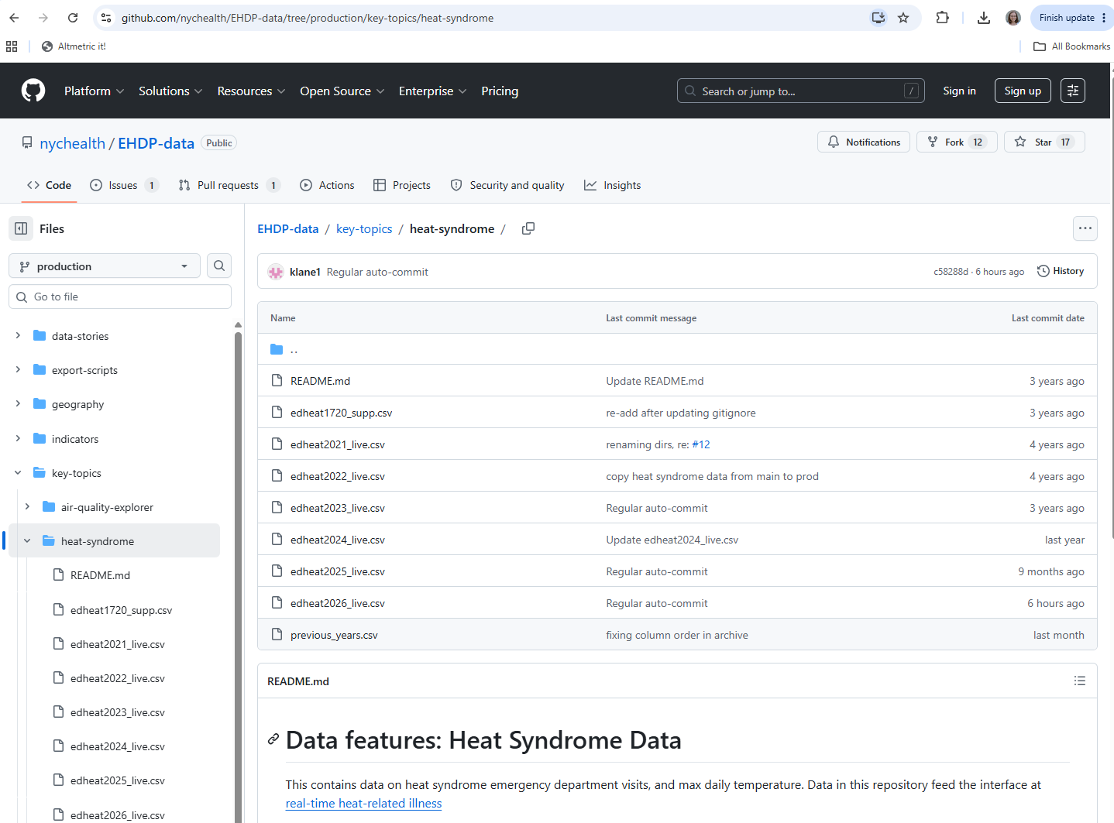
NYC Data publicly available https://github.com/nychealth/EHDP-data/tree/production/key-topics/heat-syndrome

Slide 15
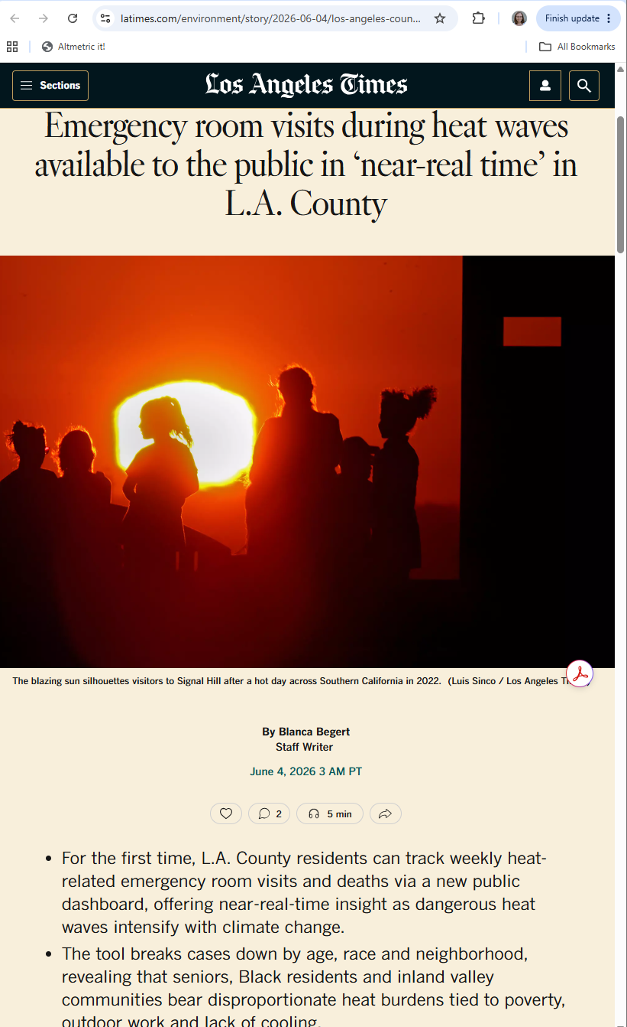
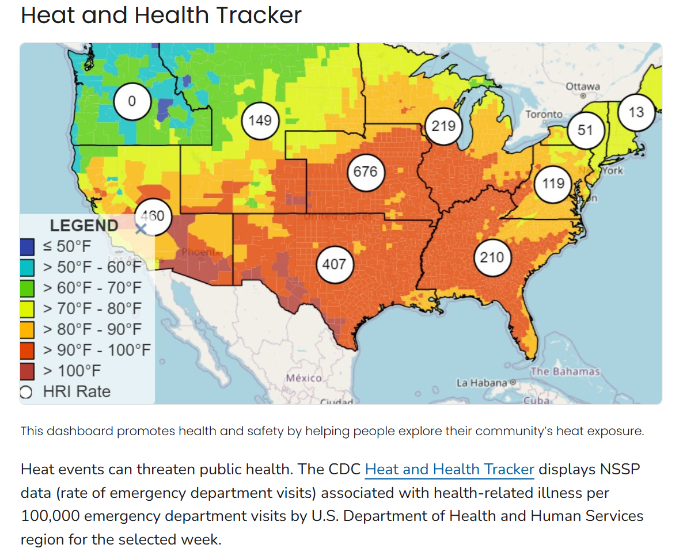
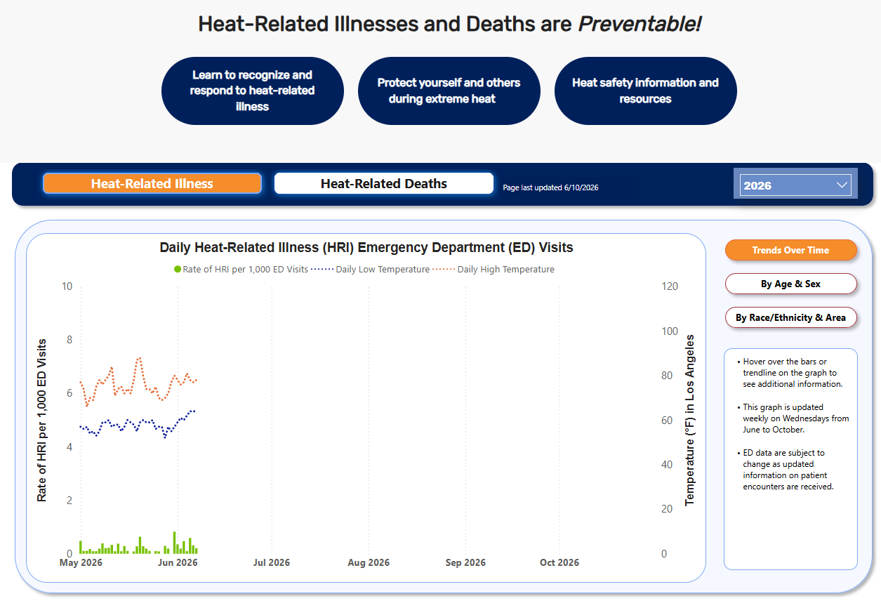
Why NYC? Well-established daily data with easy data download
National Syndromic Surveillance Program (NSSP) from US Centers for Disease Control and Prevention, aims to improve public health by gathering and providing syndromic data from collaborations with state and local health departments. Other illnesses tracked include: COVID-19, drug overdose, tick bites, mental health
Other locations have syndromic surveillance for heat-related ED visits:
Nationwide (CDC) https://ephtracking.cdc.gov/Applications/heatTracker/
Virgina [weekly counts, data downloadable] https://www.vdh.virginia.gov/surveillance-and-investigation/syndromic-surveillance/hri-surveillance/
Los Angeles [brand new!, no data downloads] https://egis-lacounty.hub.arcgis.com/pages/heat-illness-mortality~d8341bd6653741069043560c75e9a5c0

Slide 16
Data and Suggested Analysis Plan
Data: Daily values from across NYC
Develop your research question
Obtain and prepare data
Exploratory analyses,
Develop Conceptual Causal Model via a Directed Acyclic Graph (DAG)
Develop model relating heat to ED visit counts Unadjusted and Adjusted analyses, possibly: linear regression, Poisson regression and/or Negative Binomial regression Careful consideration of time-varying factors (seasonality, year, etc)
Write up results and interpretation (poster, presentation, etc)
Variable | Type | Description
Date | Date | Calendar date of observation
Maximum daily temperature (°F) | Numeric | Daily maximum temperature, defined as the higher of the heat index or air temperature recorded at LaGuardia Airport
Heat-related ED visits | Integer | Number of emergency department visits classified as suspected heat-related illness that day
Skills: visualizations, time series data analysis, regression for count outcomes, accounting for confounders, acknowledge strengths/ limitations of data & study design
Potential bonus opportunities:
Incorporate additional data (e.g., gridMET meteorology, or heatwave characteristics)
Compare with results from another location with syndromic surveillance

Slide 17
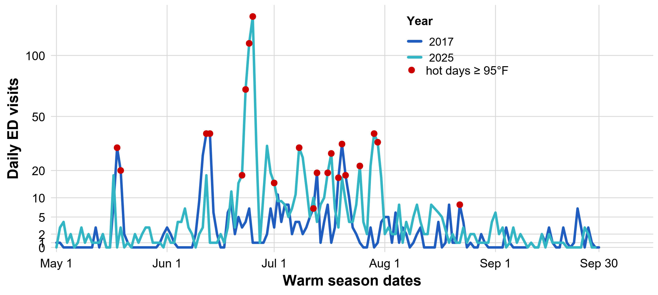
Example data visualization

Slide 18
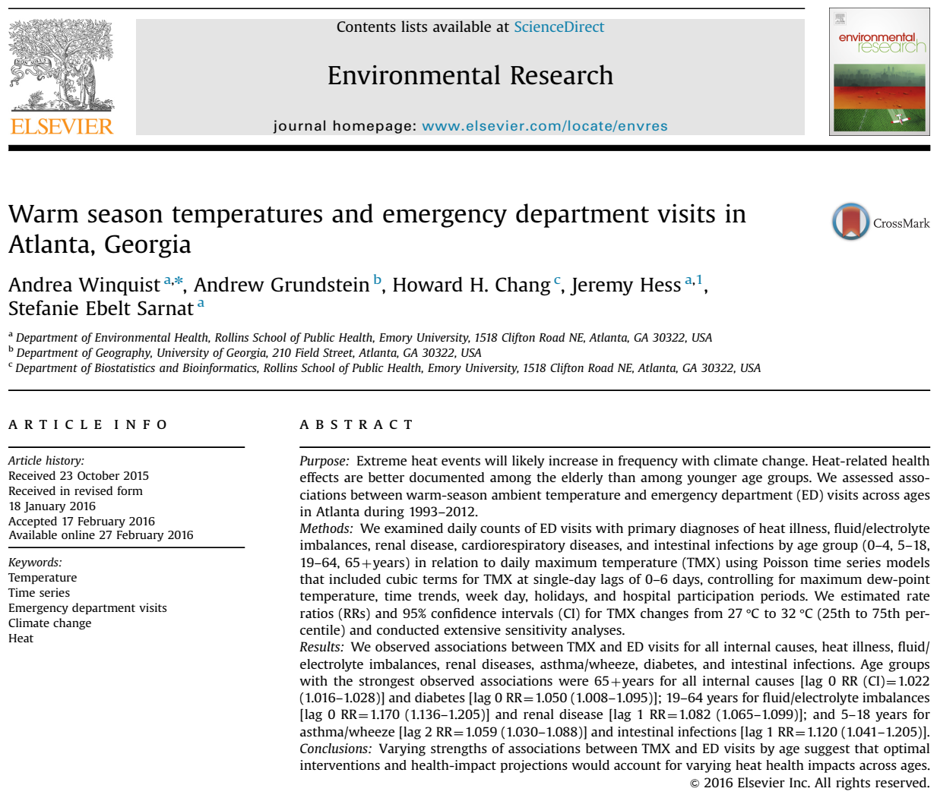
Example in the literature https://pubmed.ncbi.nlm.nih.gov/26922412/
Winquist A, Grundstein A, Chang HH, Hess J, Sarnat SE. Warm season temperatures and emergency department visits in Atlanta, Georgia. Environ Res. 2016 May;147:314-23. doi: 10.1016/j.envres.2016.02.022. Epub 2016 Feb 27. PMID: 26922412; PMCID: PMC4821766.

Slide 19
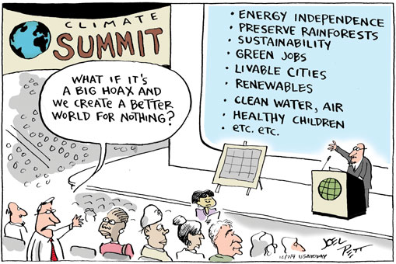
Thank you!
Sandy Eckel: eckel@usc.edu
Erika Garcia: garc991@usc.edu

