Slide 1
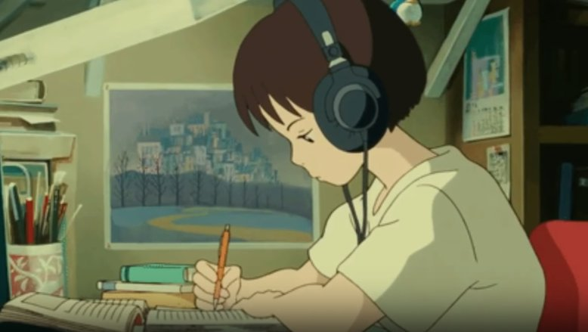
How to read a scientific paper
June 21, 2022
Nick Mancuso, PhD

Slide 2
Outline
Who am I?
What is a scientific paper and why should we care?
How is a scientific paper structured?
How should we read a scientific paper?
Case study:
Peters, John M., et al. "A study of twelve Southern California communities with differing levels and types of air pollution: II. Effects on pulmonary function." American journal of respiratory and critical care medicine 159.3 (1999): 768-775.

Slide 3
Outline
Who am I?
What is a scientific paper and why should we care?
How is a scientific paper structured?
How should we read a scientific paper?
Case study:
Peters, John M., et al. "A study of twelve Southern California communities with differing levels and types of air pollution: II. Effects on pulmonary function." American journal of respiratory and critical care medicine 159.3 (1999): 768-775.

Slide 4

Who am I? I am Nick. Nice to meet you!
Nick Mancuso, PhD
He/Him
Assistant Professor in Biostatistics, 2019-
Computer Science BS & PhD @ GSU
Postdoc in Statistical Genetics @ UCLA
Interested in understanding genetic basis for complex disease
Complex traits too!
Photo that will be wildly outdated, yet still on my website one day

Slide 5
Outline
Who am I?
What is a scientific paper and why should we care?
How is a scientific paper structured?
How should we read a scientific paper?
Case study:
Peters, John M., et al. "A study of twelve Southern California communities with differing levels and types of air pollution: II. Effects on pulmonary function." American journal of respiratory and critical care medicine 159.3 (1999): 768-775.

Slide 6
What is a scientific paper?
Novel research presents original
data/results/analyses to a field
Review summarizes
state of the field, given recent advancements
Either can go through peer review and publication in scientific journals
Novel research represents the state-of-the-art in terms of understanding

Slide 7
Outline
Who am I?
What is a scientific paper and why should we care?
How is a scientific paper structured?
How should we read a scientific paper?
Case study:
Peters, John M., et al. "A study of twelve Southern California communities with differing levels and types of air pollution: II. Effects on pulmonary function." American journal of respiratory and critical care medicine 159.3 (1999): 768-775.

Slide 8
Structure of a paper
Title, Author list
Abstract
Introduction
Methods
Results (includes figures, tables, etc)
Discussion (conclusion)
Supplemental material/data
Carey, Maureen A. et al. PLoS CompBio. (2020)

Slide 9
Outline
Who am I?
What is a scientific paper and why should we care?
How is a scientific paper structured?
How should we read a scientific paper?
Case study:
Peters, John M., et al. "A study of twelve Southern California communities with differing levels and types of air pollution: II. Effects on pulmonary function." American journal of respiratory and critical care medicine 159.3 (1999): 768-775.

Slide 10
How should we read a scientific paper?
What do we want to learn?
Latest results for our field?
Latest method for our field?
Dictates what we should prioritize
Adjust your priorities and amount of attention given based on your experience
Results?
Is their study design sensible
Do they have a calibrated null
Methods?
Do results include a sensible baseline
Do results include performance under model misspecification

Slide 11
Outline
Who am I?
What is a scientific paper and why should we care?
How is a scientific paper structured?
How should we read a scientific paper?
Case study:
Peters, John M., et al. "A study of twelve Southern California communities with differing levels and types of air pollution: II. Effects on pulmonary function." American journal of respiratory and critical care medicine 159.3 (1999): 768-775.

Slide 12
Thanks!
References
https://www.nature.com/scitable/topicpage/scientific-papers-13815490/
Carey, Maureen A., Kevin L. Steiner, and William A. Petri Jr. "Ten simple rules for reading a scientific paper." PLoS computational biology 16.7 (2020): e1008032.
Pain, Elisabeth. "How to (seriously) read a scientific paper." Science 10 (2016).
Peters, John M., et al. "A study of twelve Southern California communities with differing levels and types of air pollution: II. Effects on pulmonary function." American journal of respiratory and critical care medicine 159.3 (1999): 768-775.

