Slide 1
Hypothesis Testing
Kim Siegmund
kims@usc.edu

Slide 2
What do the following questions have in common?
Is mean blood pressure level different in smokers and non-smokers?
Is mean cholesterol level different in persons who eat meat compared to those who eat plant-based proteins?
E
Y
e.g., Smoking
Blood pressure

Slide 3
They both compare the mean of a quantitative variable in 2 groups
What other characteristics of quantitative variables might we compare?

Slide 4




Procedures for Testing Statistical Hypotheses
I: Design Study
II: Conduct Study

Slide 5

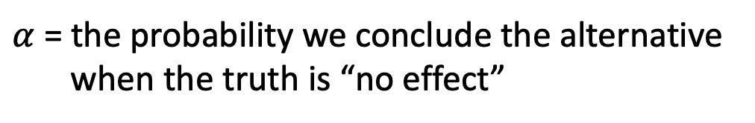
I. Design the Study
What?
How?
How many?
Ask research question about a population parameter
Translate question into two hypotheses
H₀: Null Hypothesis — hypothesis of “no effect”
H_{A}: Alternative Hypothesis — hypothesis that reflects the scientific question
Formulate analysis plan (pick test statistic)/Conduct power analysis
Pick significance level alpha, $α$ (usually 0.05)
$α$ = the probability we conclude the alternative
when the truth is “no effect”
Notes:
Question: Is the mean blood pressure the same in smokers and non-smokers?

Slide 6
II. Perform the Study
Collect the data…
Calculate test statistic
Note: the choice of statistic is made BEFORE data is collected
Convert test statistic to p-value (p)
Make a decision – to reject or not reject, that is the question
Compare p to α, usually 0.05
If p ≤ α, reject H₀. Statistically significant
If p > α, do not reject H₀. Not statistically scientific (NS)
Conclusion

Slide 7
Study Design (review)
We specify the following:
Null hypothesis (H₀) is what we want to ‘disprove’
Alternative Hypothesis (H_{A}) is what we want to find
Significance Level probability of making the wrong decision when H₀ is true
(fix by design)

Slide 8
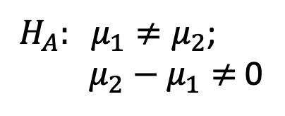
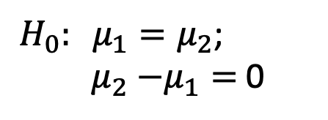
Test equality of means
The Null hypothesis
H₀: mean blood pressure is the same in groups 1 and 2
The Alternative hypothesis
H_{A}: mean blood pressure is different in groups 1 and 2
$H_{0}: μ_{1}=μ_{2}$;
${ μ}_{2}$ $−μ_{1}=$ 0
$H_{A}: μ_{1}≠μ_{2}$;
${ μ}_{2}$ $− μ_{1}≠$ 0

Slide 9
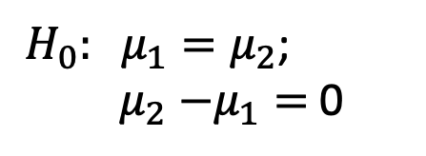
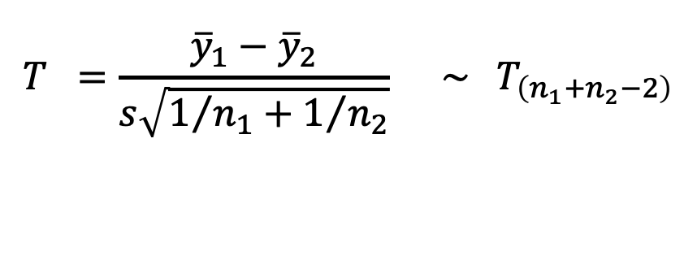
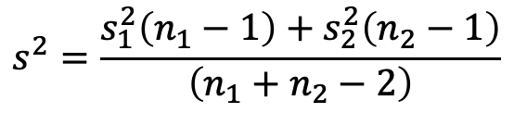
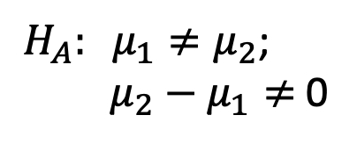
Collect data and calculate the test statistic
Two-sample t-test: equal variance
$$T =\frac{{\overline{y}}_{1}−{\overline{y}}_{2}}{s\sqrt{1/{n_{1}}+1/{n_{2}}}} \sim { T}_{\left(n_{1}+n_{2}−2\right)}$$
under
H₀
$$s^{2}=\frac{s_{1}^{2}\left(n_{1}−1\right)+s_{2}^{2}\left(n_{2}−1\right)}{\left(n_{1}+n_{2}−2\right)}$$
$H_{0}: μ_{1}=μ_{2}$;
${ μ}_{2}$ $−μ_{1}=$ 0
$H_{A}: μ_{1}≠μ_{2}$;
${ μ}_{2}$ $− μ_{1}≠$ 0
function in R: t.test()

Slide 10
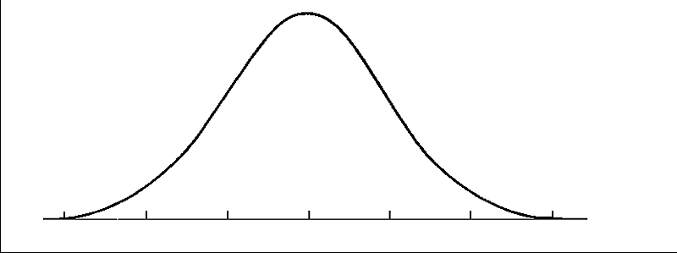
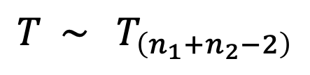
When there is no difference (H₀)
$$T \sim { T}_{\left(n_{1}+n_{2}−2\right)}$$
Bell-shaped curve
Area under the curve = 1
‘fatter tails’ than the Normal Dist.
0

Slide 11
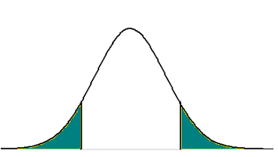
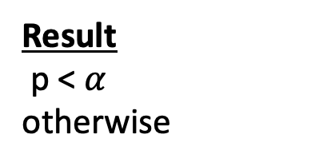
Convert the test statistic T_{observed} to a P-value
Distribution of T under H₀
P-value = the probability under H_{O} of obtaining a value of T as or more extreme than its observed value
T_{observed}
Result
p < $α$
otherwise
Conclusion
reject H₀ (statistically significant)
do not reject H₀ (null)
Notes:
The p-value is defined as the probability under the null distribution of observing your test statistic (T_observed) or one more extreme.
If the pvalue from our 2-sample t-test is < alpha, we reject
Otherwise if it is larger, we do not reject H0

Slide 12

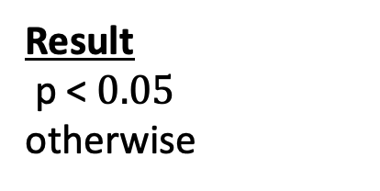
Set significance $level, α$ = 0.05
Distribution of T under H₀
P-value = 0.08
T_{observed}
Result
p < $0.05$
otherwise
Conclusion
reject H₀ (statistically significant)
do not reject H₀ (null)

Slide 13
Case study on Parkinson’s Disease
Having a history of head trauma (p=0.005), high blood pressure (p= 0.01), or exposure to agricultural pesticides (p=0.04) is related to 25-60% higher risk of PD.
Surprisingly, current cigarette smokers were at 40% lower risk of PD as compared to non-smokers (p=0.02).
And non-smokers exposed to second-hand smoke had 12% lower PD risk as compared to non-smokers without exposure to second-hand smoke, but this association was not formally statistically significant (p=0.07).

Slide 14
Positive and negative test results
Recall the following:
Null hypothesis (H₀) we want to disprove this
Alternative Hypothesis (H_{A}) we want to conclude this
Reject H₀ positive test (want to conclude this)
Do not reject H₀ negative test
BUT there is always a chance we draw the wrong conclusion

Slide 15
Decision
(test result)
Do not
Reject H₀
Reject H₀
True
False
Reality
H₀ (null)
is True
Negative
Positive
False
True
The significance level is
the probability of an error.
Which one?
Negative
Positive
H₁ (alternative)
is True

Slide 16


The following test result is likely a:
A: False-positive
B: False-negative
C: True-positive
D: Both B and C

Slide 17

The following test result is likely a:
A: False-positive
B: False-negative
C: True-positive
D: Both B and C

Slide 18
Analogy: Hypothesis Testing and the Legal System
Legal concept | Statistical Test
Accused is Innocent | Null Hypothesis
Accused is Guilty | Alternative Hypothesis
Reasonable Doubt | Level of Significance
Convict a Felon | Correctly Reject H₀
Acquit an Innocent | Correctly Fail to Reject H₀
Convict an Innocent | Type I Error
Acquit a Felon | Type II Error

Slide 19
Class activity

Slide 20
Types of tests
difference in means
difference in variances
different proportions
different distributions
correlation
….
Tests about different parameters/variable types use different statistics,
but the hypothesis testing
procedures are similar.

Slide 21
We find that the average blood pressure level is different in smokers and non-smokers (p=0.002). Does smoking cause high blood pressure?
C?
E
Y
e.g., Smoking
Blood pressure

Slide 22
Summary
We test hypotheses about population-based parameters
There is a chance we draw the wrong conclusion (false-positive or false-negative)
Rejecting the null hypothesis does not imply causation
HOWEVER, we can describe the circumstances under which a causal association could be inferred (Dr. Garcia’s lecture)

