Slide 1
Opportunities of Research Career at Kaiser Permanente Southern California
For LA’s BEST career day for USC’s summer biostatistics program for undergraduates
July 20, 2022 1-2pm via Zoom

Slide 2
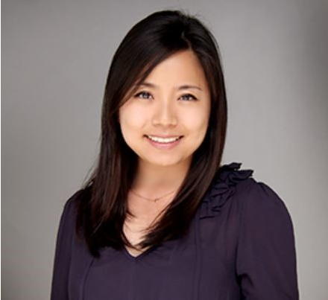
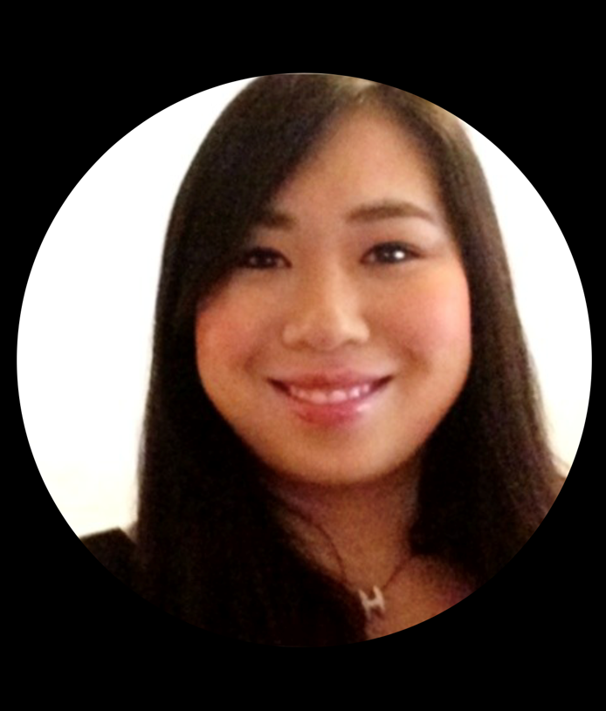

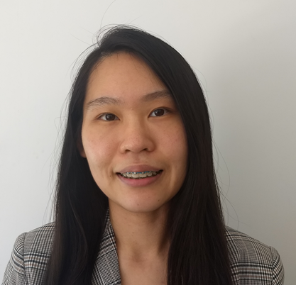


Volunteers from Research & Evaluation
Jeniffer Kim, PhD, MPH
Research Project Manager
Rui Yan, MS
Biostatistician
Mayra Martinez, MPH
Research Project Manager
Ting Chow, MPH
Programmer
Janet Mora Marquez, BS
Research Associate
Anny Xiang, PhD, MS
Director: Biostatistics Research

Slide 3
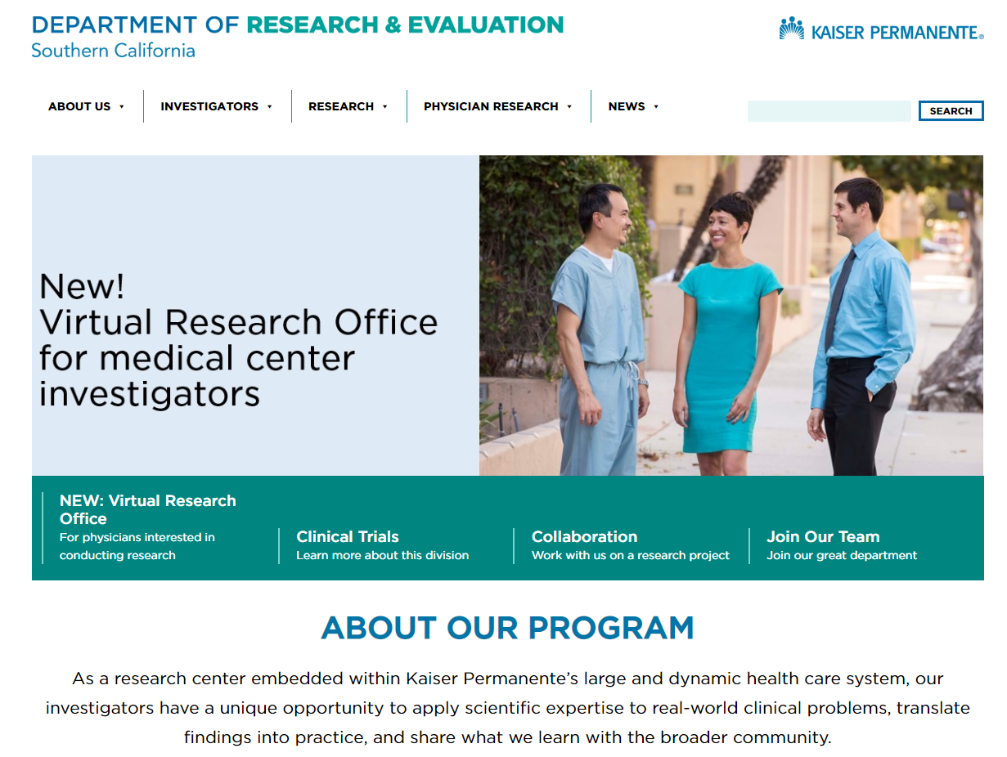
Who are we? – Research hub for KP Scal
https://www.kp-scalresearch.org/

Slide 4
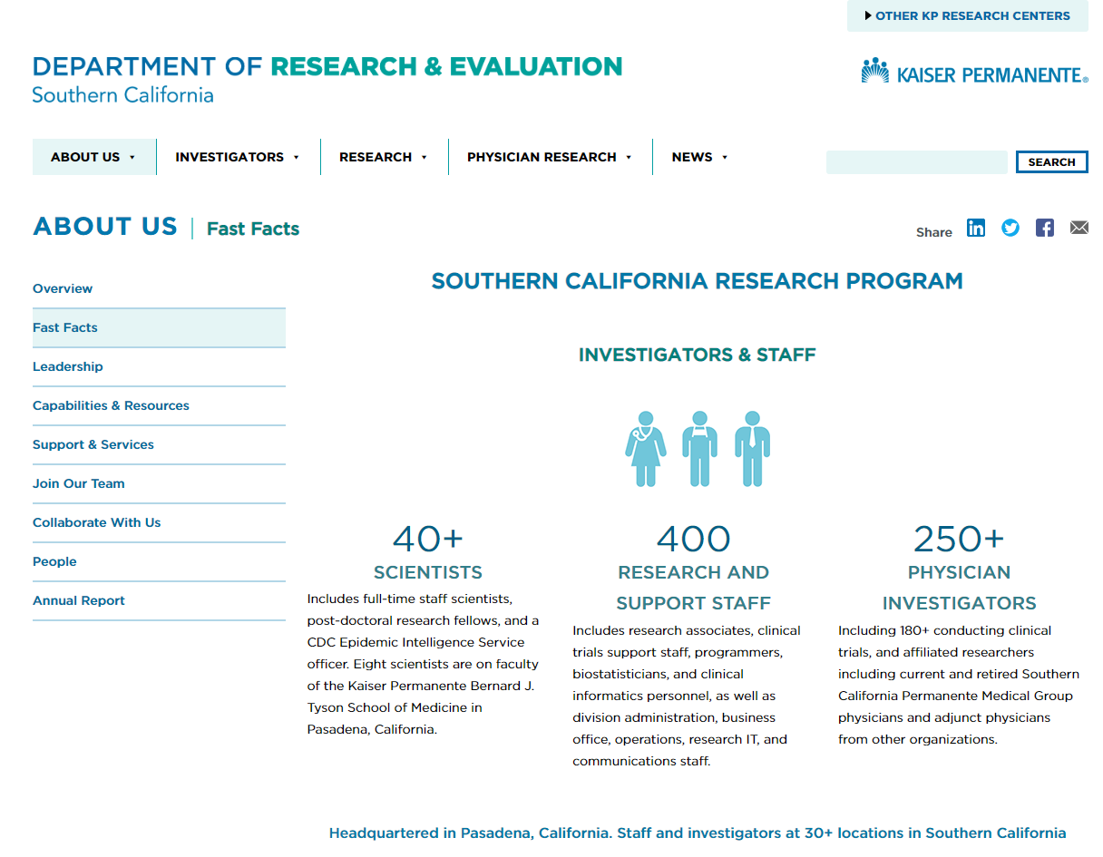
Who are we?
https://www.kp-scalresearch.org/

Slide 5
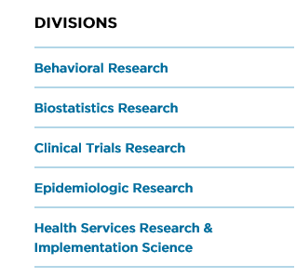
Current Structure
Central Shared Services
https://www.kp-scalresearch.org/

Slide 6
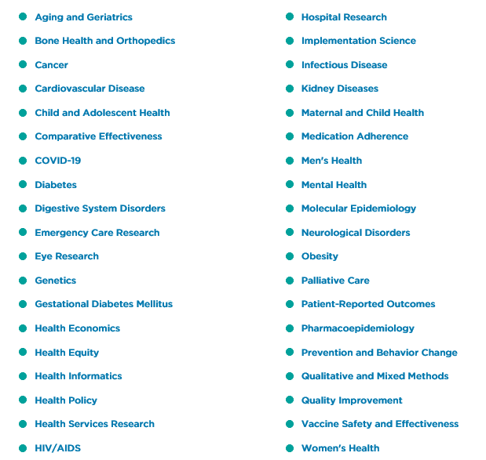
Disease areas of research
https://www.kp-scalresearch.org/

