Slide 1
LA’s BEST @ USC
Introduction to Linear Regression

Slide 2
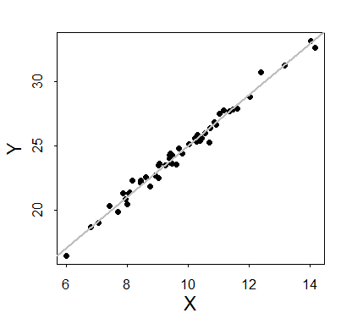
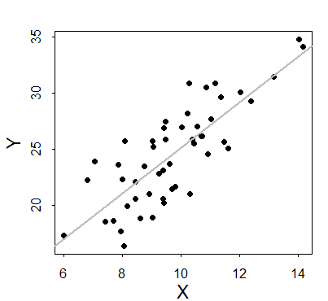
Correlation
Consider the relationship between two random variables X and Y
How do we quantify the strength of the linear association between these two variables?
Example: both figures show an association between some X and Y, but the relationship seems to “fit better” in the top figure

Slide 3
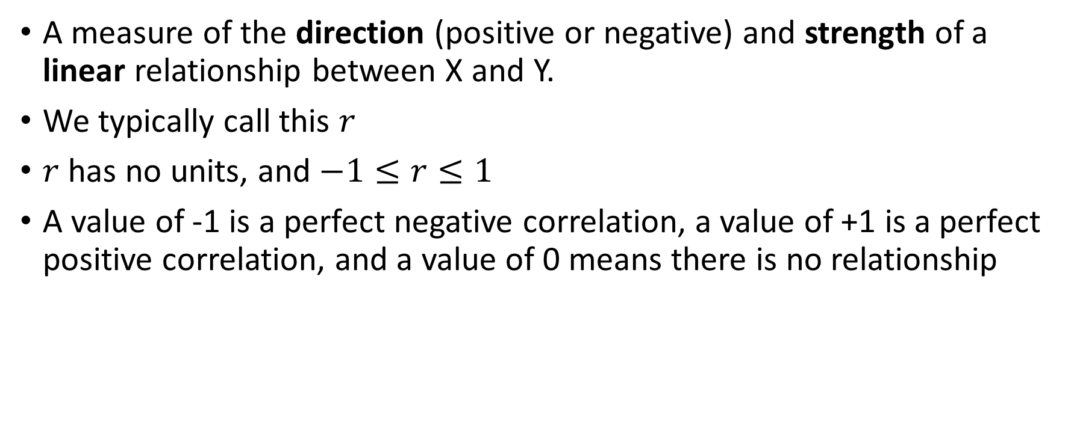
Pearson’s Correlation Coefficient
A measure of the direction (positive or negative) and strength of a linear relationship between X and Y.
We typically call this $r$
$r$ has no units, and $−1≤r≤1$
A value of -1 is a perfect negative correlation, a value of +1 is a perfect positive correlation, and a value of 0 means there is no relationship

Slide 4
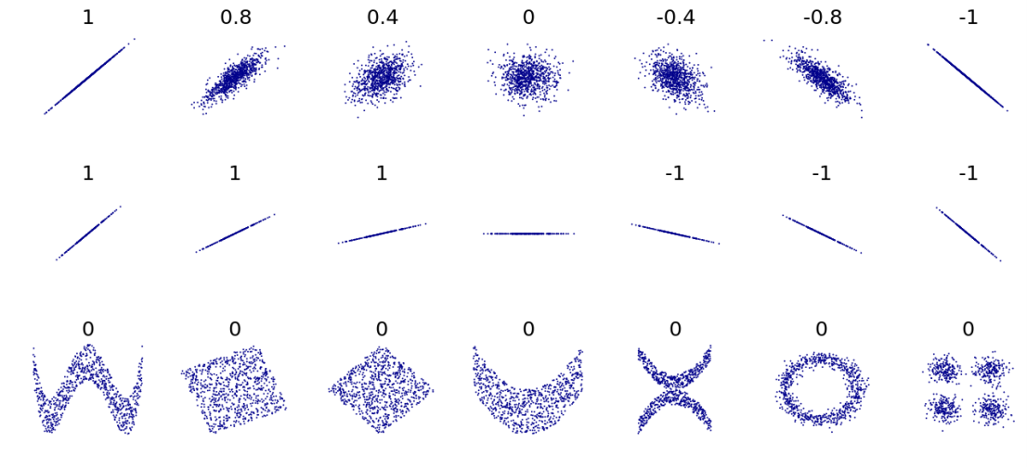

Pearson’s Correlation Coefficient
Recall that only linear relationships are detected (row 3)
The exact description of the relationship is not captured by $r$ (row 2)
The interpretation of the effect size of $r$ can vary widely by academic discipline
Value | Effect Size
0 | None
±0.1 | Small
±0.3 | Medium
±0.5 | Large

Slide 5

The Formula for $r$
Just so we know…

Slide 6

$r$ in R
Is cholesterol correlated with age?
Using cholesterol dataset (chol.csv):
cor(chol$chol, chol$age, use="complete")
cor.test(chol$chol, chol$age)
The first method requires us to deal with any “NA” (missing values) in the dataset
The second method provides us a statistical test of whether or not the correlation is statistically significant.
Pearson's product-moment correlation
data: chol$chol and chol$age
t = 2.9345, df = 186, p-value = 0.003761
alternative hypothesis: true correlation is not equal to 0
95 percent confidence interval:
0.0693328 0.3431363
sample estimates:
cor
0.2103558

Slide 7
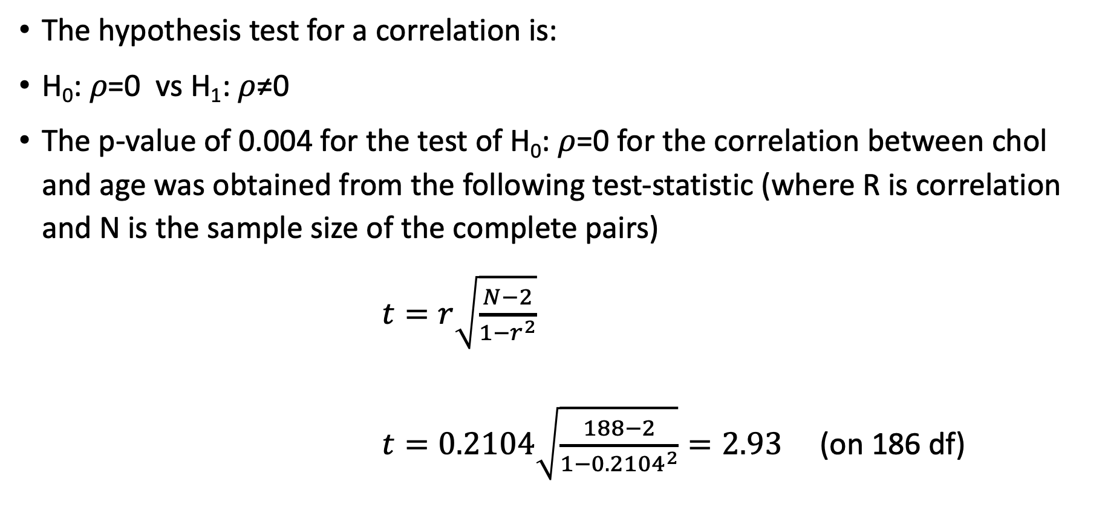
Hypothesis Testing for Correlation
The hypothesis test for a correlation is:
H₀: 𝜌=0 vs H₁: 𝜌≠0
The p-value of 0.004 for the test of H₀: $ρ$=0 for the correlation between chol and age was obtained from the following test-statistic (where R is correlation and N is the sample size of the complete pairs)
$t=r\sqrt{\frac{N−2}{1−r^{2}}}$ $t=0.2104\sqrt{\frac{188−2}{1−{0.2104}^{2}}}=2.93$ (on 186 df)

Slide 8
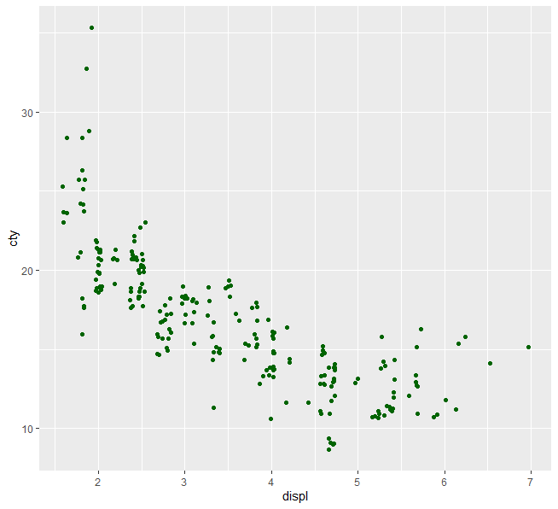
MPG Data set
Let’s use ggplot2’s MPG data set to examine the correlation between engine displacement and city MPG in cars.
Do you trust this correlation coefficient?
> mpg <- ggplot2::mpg
> cor.test(mpg$cty, mpg$displ)
Pearson's product-moment correlation
data: mpg$cty and mpg$displ
t = -20.205, df = 232, p-value < 2.2e-16
alternative hypothesis: true correlation is not equal to 0
95 percent confidence interval:
-0.8406782 -0.7467508
sample estimates:
cor
-0.798524

Slide 9
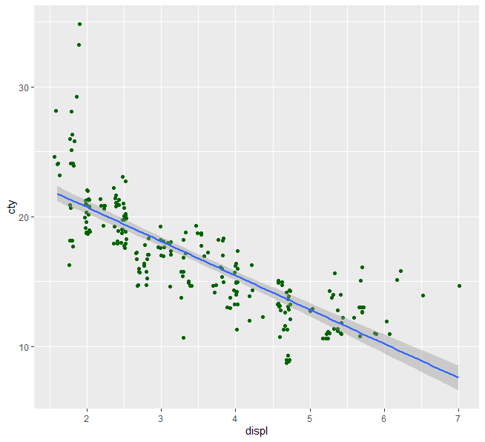

What happens when $r$ isn’t sufficient?
The relationship between cty and displ isn’t linear!
What can we do?
Apply a transformation of some sort
Use a nonparameteric test

Slide 10
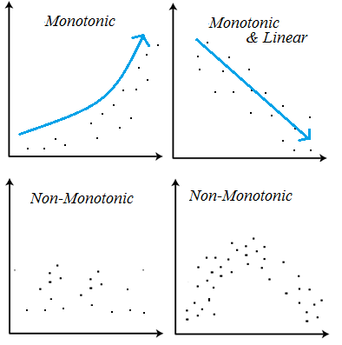


Spearman’s Correlation Coefficient $r_{s}$
Doesn’t detect a “linear” relationship but, rather, a monotonic relationship
If the relationship is truly linear, then $r$ has more power than $r_{s}$

Slide 11
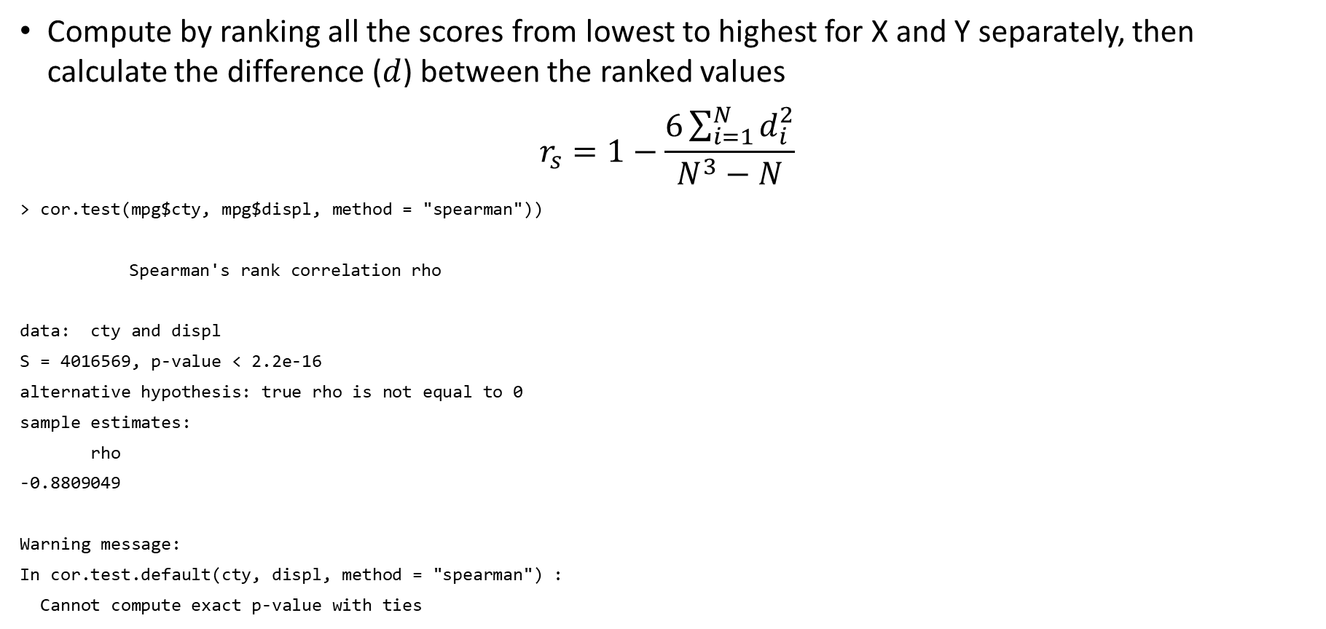
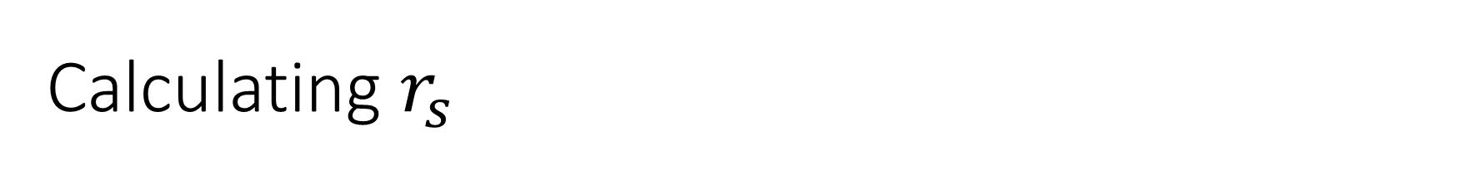
Calculating $r_{s}$
Compute by ranking all the scores from lowest to highest for X and Y separately, then calculate the difference ($d$) between the ranked values
$$r_{s}=1−\frac{6\sum_{i=1}^{N}{d_{i}^{2}}}{N^{3}−N}$$
> cor.test(mpg$cty, mpg$displ, method = "spearman"))
Spearman's rank correlation rho
data: cty and displ
S = 4016569, p-value < 2.2e-16
alternative hypothesis: true rho is not equal to 0
sample estimates:
rho
-0.8809049
Warning message:
In cor.test.default(cty, displ, method = "spearman") :
Cannot compute exact p-value with ties

Slide 12
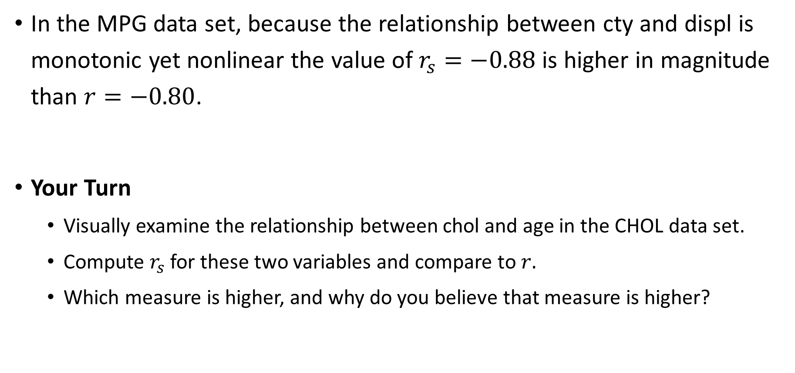

Comparing $r_{s}$ with $r$
In the MPG data set, because the relationship between cty and displ is monotonic yet nonlinear the value of $r_{s}=−0.88$ is higher in magnitude than $r=−0.80$.
Your Turn
Visually examine the relationship between chol and age in the CHOL data set.
Compute $r_{s}$ for these two variables and compare to $r.$
Which measure is higher, and why do you believe that measure is higher?

Slide 13
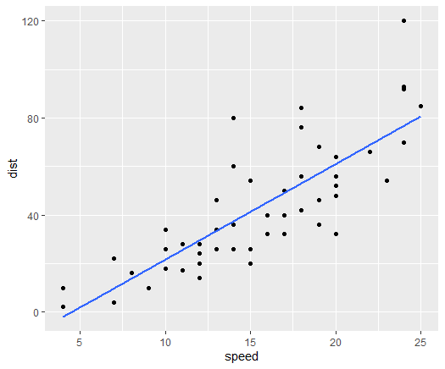
Linear Relationships
We’ve talked about how correlation can detect “linear” relationships…
While we will go into more detail about how to examine linearity, the relationship to the right just looks linear to us.

Slide 14
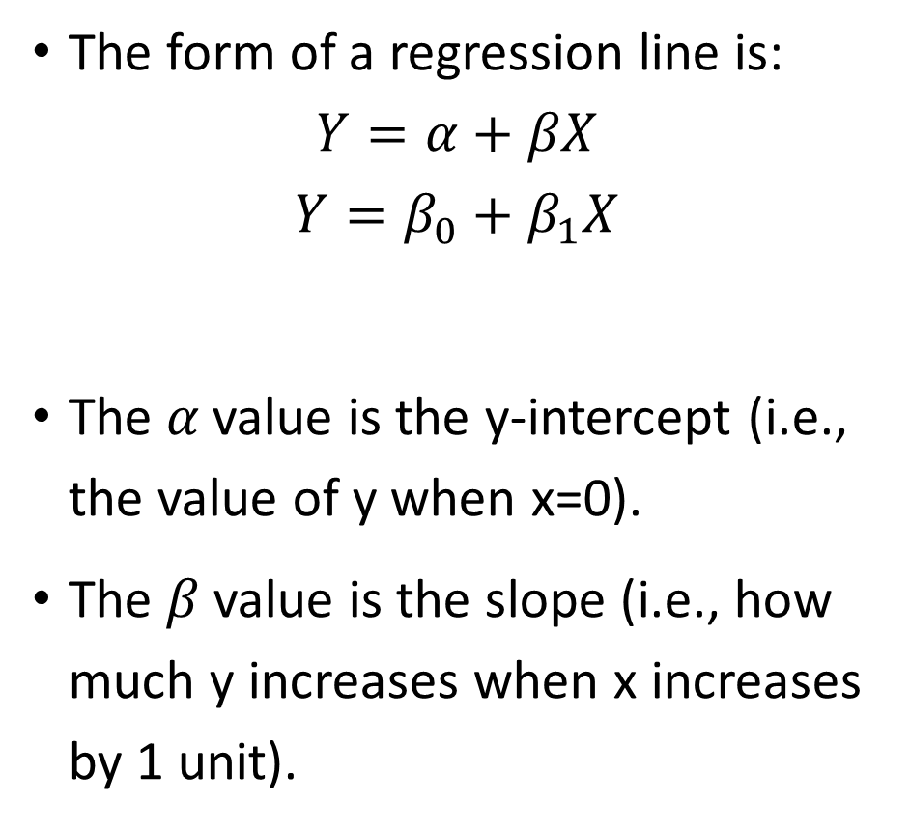
The Regression Line
The form of a regression line is:
$$Y=α+βX$$
$$Y=β_{0}+β_{1}X$$
The 𝛼 value is the y-intercept (i.e., the value of y when x=0).
The 𝛽 value is the slope (i.e., how much y increases when x increases by 1 unit).
Take your pick. It’s just a difference in notation.

Slide 15
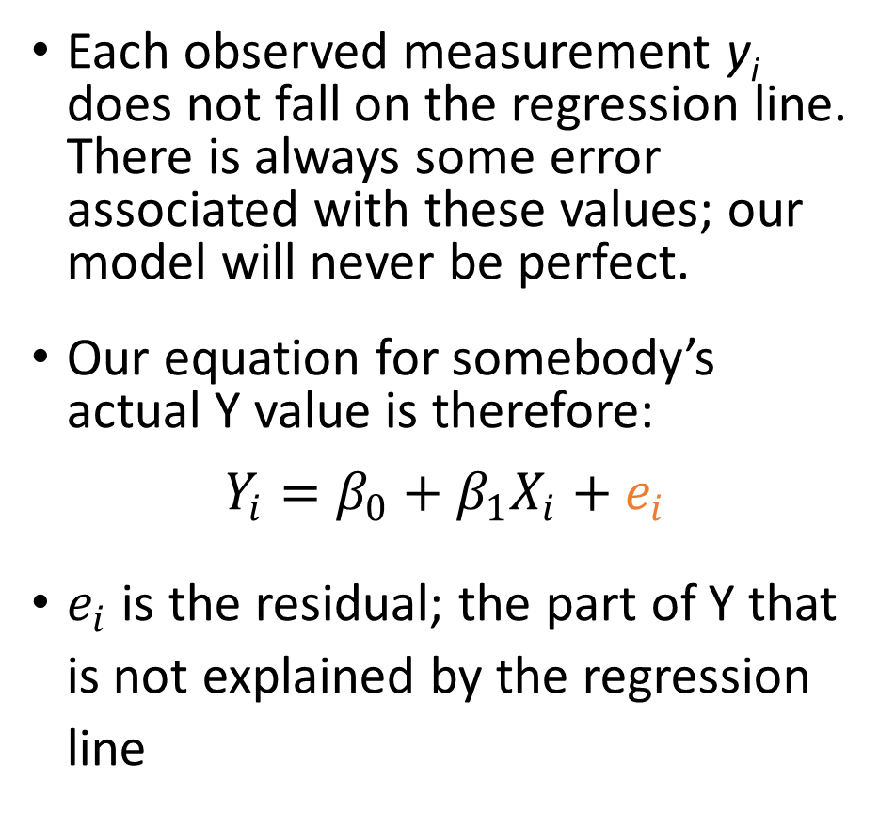
Predictions vs. Reality
Each observed measurement y_{i} does not fall on the regression line. There is always some error associated with these values; our model will never be perfect.
Our equation for somebody’s actual Y value is therefore:
$$Y_{i}=β_{0}+β_{1}X_{i}+e_{i}$$
$e_{i}$ is the residual; the part of Y that is not explained by the regression line

Slide 16
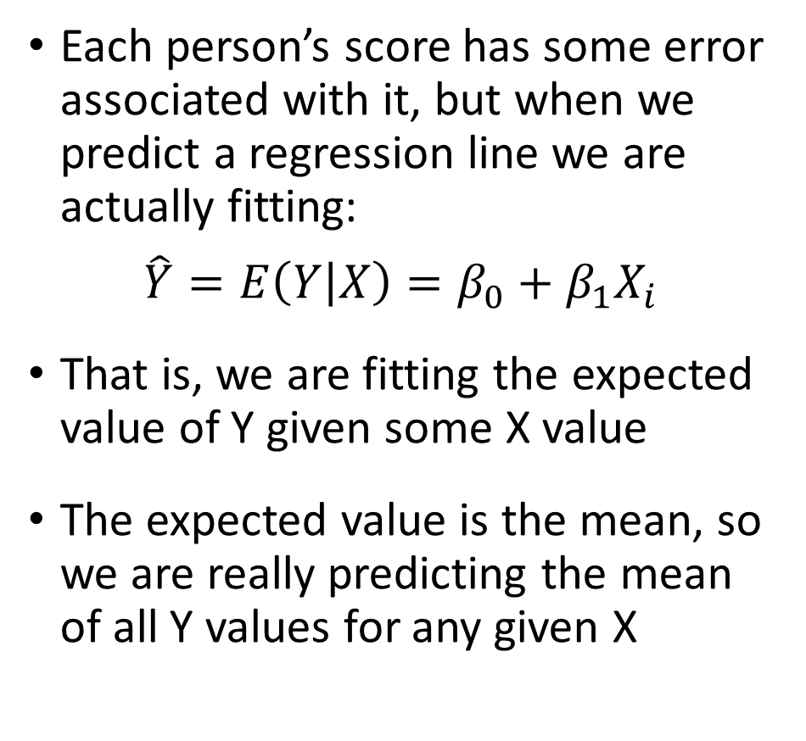
Predicting the Mean of Y
Each person’s score has some error associated with it, but when we predict a regression line we are actually fitting:
$$\hat{Y}=E\left(Y | X\right)=β_{0}+β_{1}X_{i}$$
That is, we are fitting the expected value of Y given some X value
The expected value is the mean, so we are really predicting the mean of all Y values for any given X

Slide 17
Linear Regression in R
How does stopping distance relate to speed in cars?
We will use the R data set “cars”
cars <- data(cars)
> lm(dist ~ speed, data = cars) %>%
+ summary()
Call:
lm(formula = dist ~ speed, data = cars)
Residuals:
Min 1Q Median 3Q Max
-29.069 -9.525 -2.272 9.215 43.201
Coefficients:
Estimate Std. Error t value Pr(>|t|)
(Intercept) -17.5791 6.7584 -2.601 0.0123 *
speed 3.9324 0.4155 9.464 1.49e-12 ***
---
Signif. codes: 0 ‘***’ 0.001 ‘**’ 0.01 ‘*’ 0.05 ‘.’ 0.1 ‘ ’ 1
Residual standard error: 15.38 on 48 degrees of freedom
Multiple R-squared: 0.6511, Adjusted R-squared: 0.6438
F-statistic: 89.57 on 1 and 48 DF, p-value: 1.49e-12

Slide 18



Interpreting Linear Regression Output
> lm(dist ~ speed, data = cars) %>%
+ summary()
Call:
lm(formula = dist ~ speed, data = cars)
Residuals:
Min 1Q Median 3Q Max
-29.069 -9.525 -2.272 9.215 43.201
Coefficients:
Estimate Std. Error t value Pr(>|t|)
(Intercept) -17.5791 6.7584 -2.601 0.0123 *
speed 3.9324 0.4155 9.464 1.49e-12 ***
---
Signif. codes: 0 ‘***’ 0.001 ‘**’ 0.01 ‘*’ 0.05 ‘.’ 0.1 ‘ ’ 1
Residual standard error: 15.38 on 48 degrees of freedom
Multiple R-squared: 0.6511, Adjusted R-squared: 0.6438
F-statistic: 89.57 on 1 and 48 DF, p-value: 1.49e-12
H₀: β₀=0
H₀: β₁=0
Regression coefficients follow a t-distribution on 1 df.
$$β_{0}$$
$β_{1}$, or
$$β_{SPEED}$$

Slide 19
Interpreting Output
Your Turn
What is the equation that describes the relationship between stopping distance and speed?
Is stopping distance related to speed?
What is the predicted stopping distance for a car that is not moving?

Slide 20
Note on Extrapolation
We didn’t observe any speed values lower than 4, or greater than 25 mph
When we perform a linear regression, we can only reasonably predict Y values across the range of X under study
This is because the relationship may be different (e.g., nonlinear) for X values not under study

Slide 21
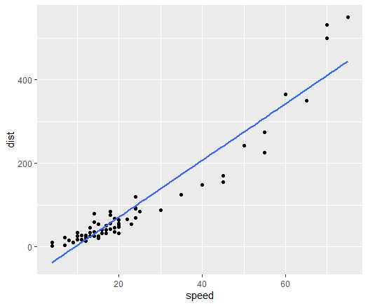
Note on Extrapolation
If we observed more speeds – say up to 90mph, what do we observe?
Y does increase as X increases, but a straight line may not be the best way to fit this relationship
There are other ways to model this (e.g., variable transformations) that we will not discuss today

Slide 22
Assumptions of Linear Regression
A linear regression model is only valid if it satisfies certain assumptions
While mild violations of the assumptions are common, more serious violations can be a cause for concern
There are four assumptions of LINEar regression:
Linearity
Independence
Normality
Equality of variances

Slide 23
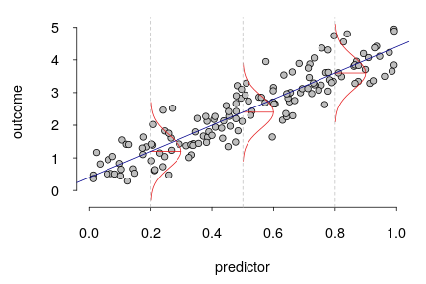
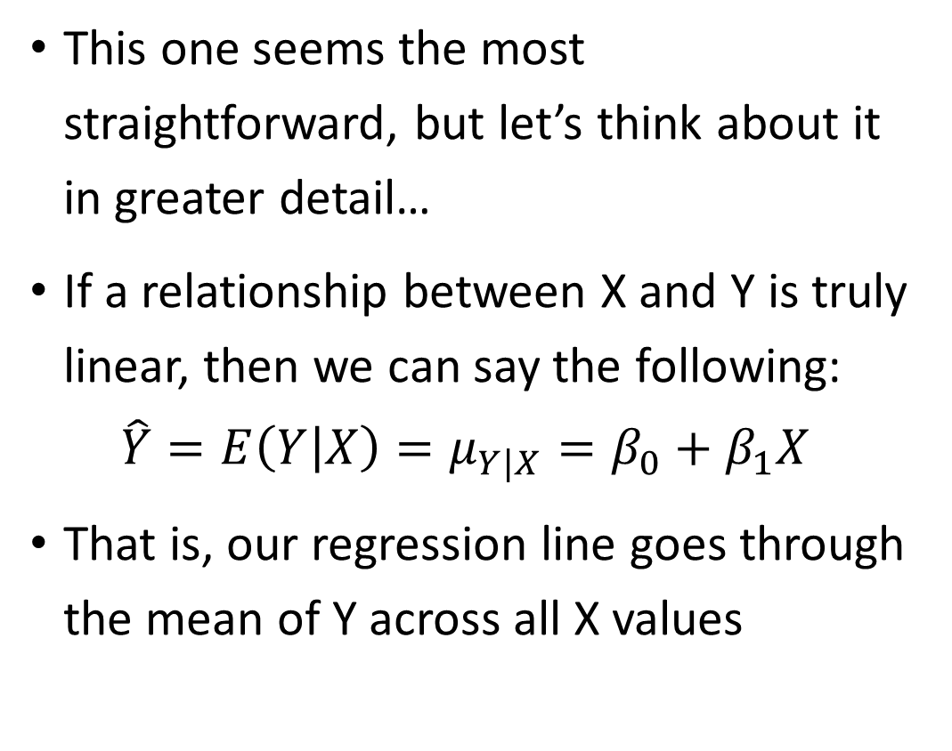
Linearity
This one seems the most straightforward, but let’s think about it in greater detail…
If a relationship between X and Y is truly linear, then we can say the following:
$$\hat{Y}=E\left(Y | X\right)=μ_{Y|X}=β_{0}+β_{1}X$$
That is, our regression line goes through the mean of Y across all X values
(Y)
(X)

Slide 24
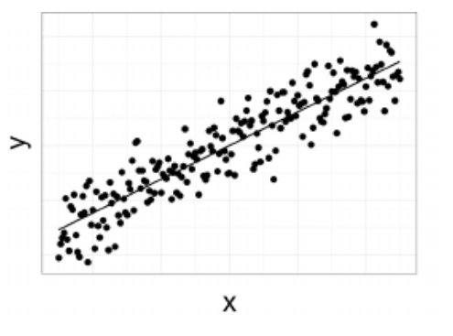
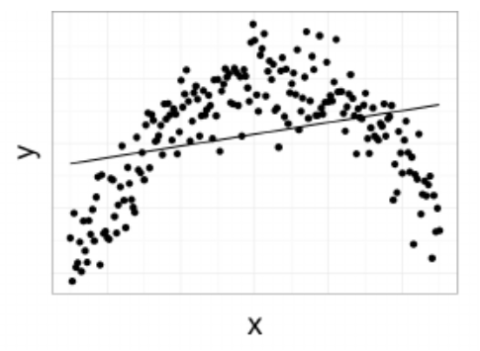
Linearity
In these two cases, in which does the regression line appear to fit the mean of all the Y values for any given X?
A prediction at the orange circle on the bottom figure probably would not reflect the mean of Y at that X value – the residuals would likely be large here

Slide 25
Independence
Conditional on X, the Y values should be statistically independent of one another
That is, the error terms should be independent of one another
Do any of these situations violate the independence assumption?
A chart review of comorbidities of patients undergoing COVID treatment at LAC+USC hospital
A study on visual acuity at Roski Eye Institute where visual acuity was measured in the participants’ left and right eyes
The relationship between BMI and exercise was assessed in children in which the entire family was recruited to the study

Slide 26
Normality
For any value of X, Y has a normal distribution (i.e., Y|X ~ N)
We want to see if the residuals are normally distributed
Note that Y itself doesn’t need to be distributed normally!

Slide 27
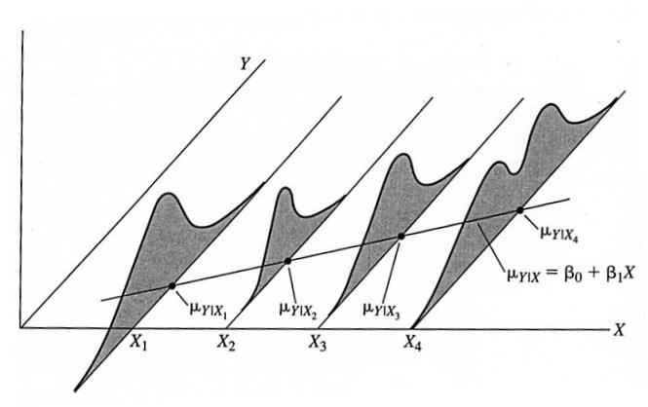

Equality of Variances
For any value of X, the variance of Y is constant (i.e., $σ_{Y|X}^{2}=σ^{2}$).
In the figure shown, the assumptions of normality and homoscedasticity are violated – why?

Slide 28
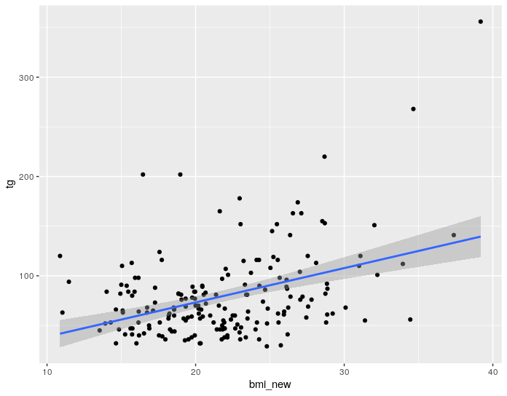
The Best Fit Line
Let’s examine the relationship between BMI and triglycerides
We can have ggplot add the “best fit” line… but how is this line actually fit?
chol %>% ggplot(aes(x=bmi_new, y=tg)) + geom_point() + geom_smooth(method="lm")

Slide 29
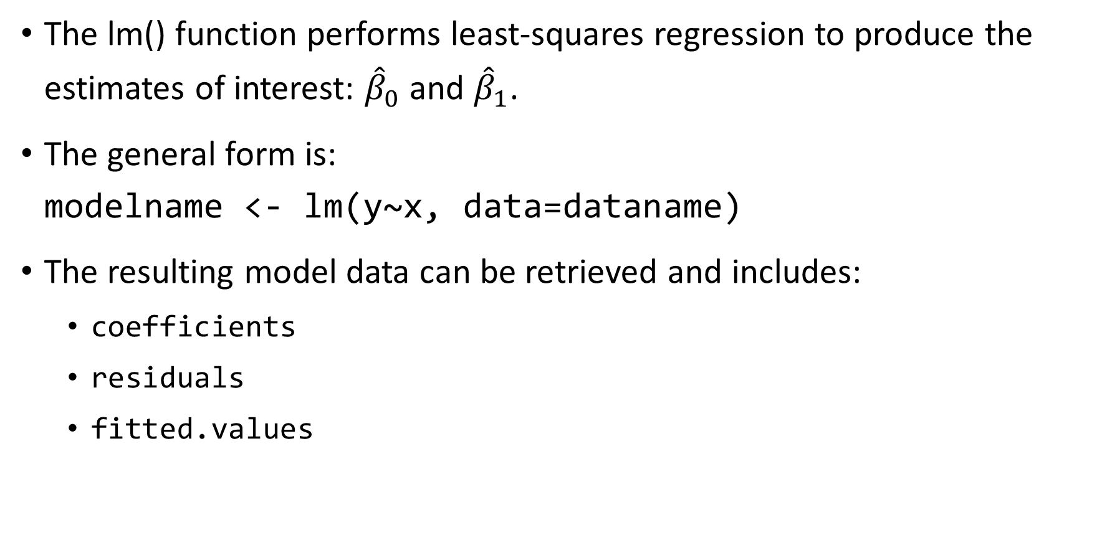
Finding the Best-Fit Line in R
The lm() function performs least-squares regression to produce the estimates of interest: ${\hat{β}}_{0}$ and ${\hat{β}}_{1}$.
The general form is: modelname <- lm(y~x, data=dataname)
The resulting model data can be retrieved and includes:
coefficients
residuals
fitted.values

Slide 30
The Best Fit Line
Your Turn
Find the best-fit line by using the lm() function
Write the best-fit equation
Interpret the parameter estimates

Slide 31

More Output Interpretation
> model1 <- lm(tg ~ bmi_new, data=chol)
> summary(model1)
Call:
lm(formula = tg ~ bmi_new, data = chol)
Residuals:
Min 1Q Median 3Q Max
-67.135 -25.703 -6.967 14.450 216.508
Coefficients:
Estimate Std. Error t value Pr(>|t|)
(Intercept) 4.1458 12.9107 0.321 0.748
bmi_new 3.4544 0.5774 5.983 1.1e-08 ***
---
Signif. codes: 0 ‘***’ 0.001 ‘**’ 0.01 ‘*’ 0.05 ‘.’ 0.1 ‘ ’ 1
Residual standard error: 40.12 on 186 degrees of freedom
Multiple R-squared: 0.1614, Adjusted R-squared: 0.1569
F-statistic: 35.79 on 1 and 186 DF, p-value: 1.104e-08
> anova(model1)
Analysis of Variance Table
Response: tg
Df Sum Sq Mean Sq F value Pr(>F)
bmi_new 1 57612 57612 35.794 1.104e-08 ***
Residuals 186 299380 1610
---
Signif. codes: 0 ‘***’ 0.001 ‘**’ 0.01 ‘*’ 0.05 ‘.’ 0.1 ‘ ’ 1
This gives information about the residuals. Remember: we want them to be normally distributed with mean 0.
$$\hat{Y}=4.15+3.45X_{BMI}$$
???
Sum of squares explained by the regression line/model.
Sum of squares that hasn’t been explained (residuals).
So—how much of the data (variation in Y values) has been explained by our model?

Slide 32
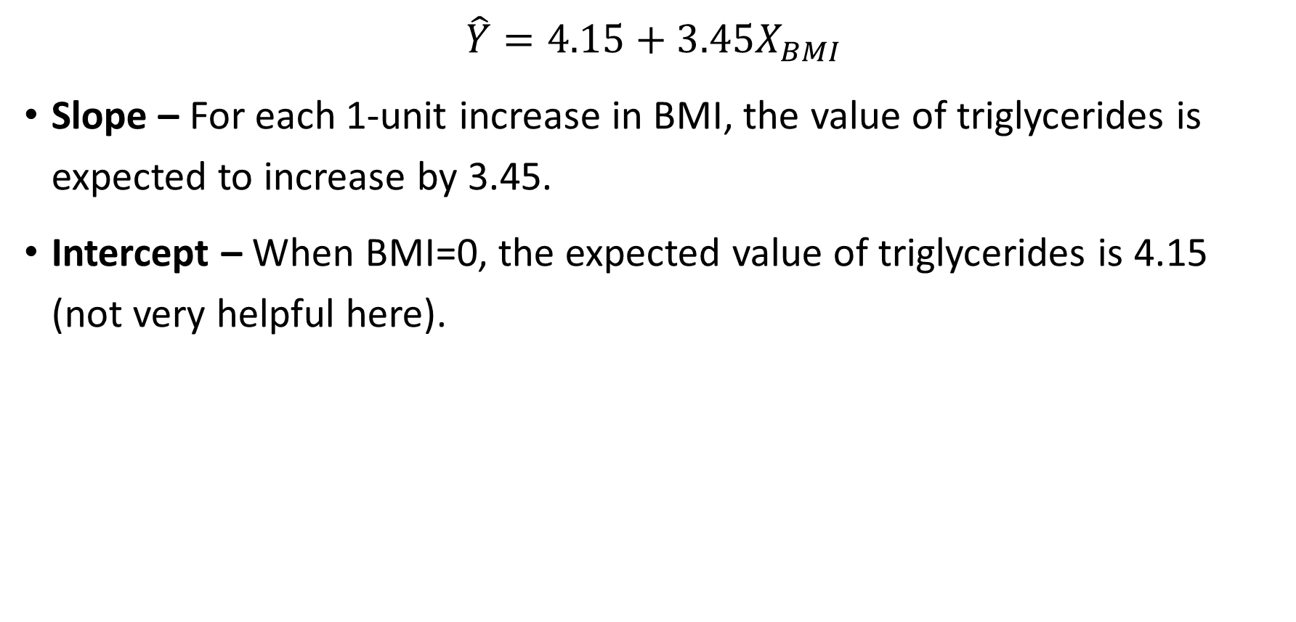
More Output Interpretation
$$\hat{Y}=4.15+3.45X_{BMI}$$
Slope – For each 1-unit increase in BMI, the value of triglycerides is expected to increase by 3.45.
Intercept – When BMI=0, the expected value of triglycerides is 4.15 (not very helpful here).

Slide 33

Coefficient of Determination
$R^{2}$ is the amount of variation in Y explained by the model
It is closely associated with the correlation coefficient – it is literally $r^{2}$
Larger values indicate that our model fits better
In our example, 16.1% of the variation in triglycerides is explained by BMI

Slide 34
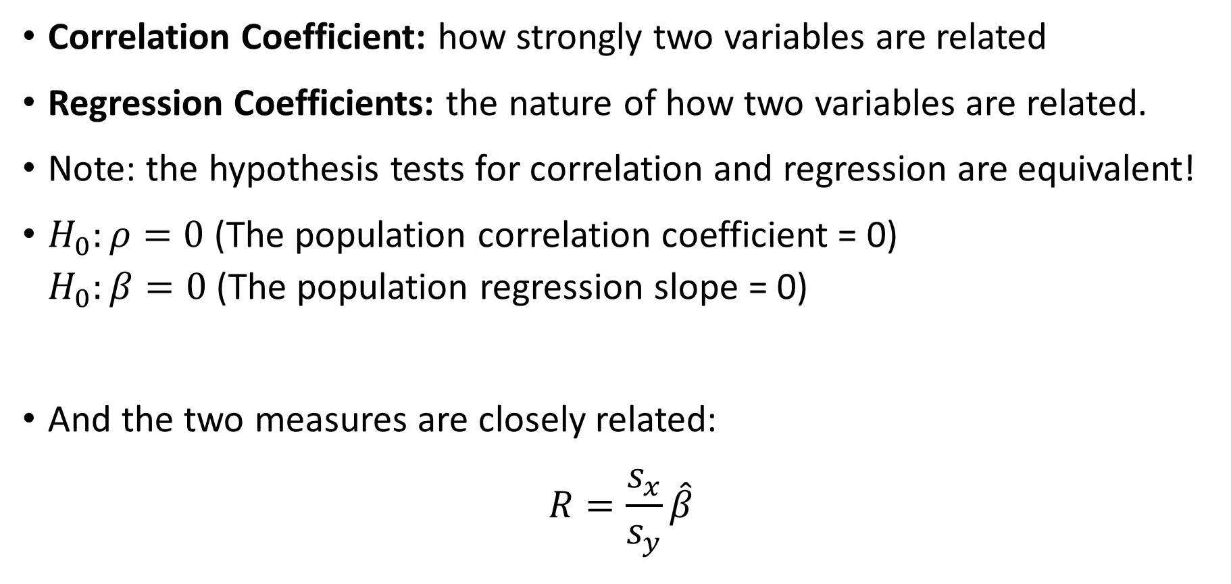
Correlation vs. Regression
Correlation Coefficient: how strongly two variables are related
Regression Coefficients: the nature of how two variables are related.
Note: the hypothesis tests for correlation and regression are equivalent!
$H_{0}:ρ=0$(The population correlation coefficient = 0) $H_{0}:β=0$(The population regression slope = 0)
And the two measures are closely related:
$$R=\frac{s_{x}}{s_{y}}\hat{β}$$

Slide 35
Checking Assumptions
Let’s go back to our example and check the assumptions of linear regression

Slide 36
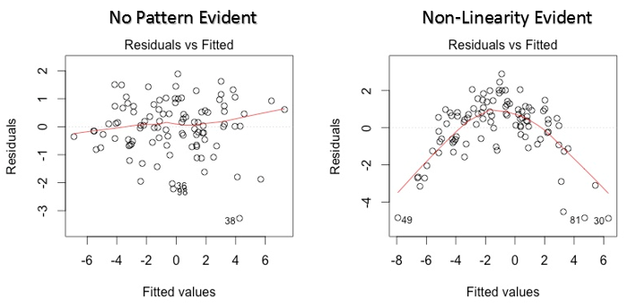


Checking Linearity
Plot the residuals vs. the fitted values
We want to see that there is no pattern evident in this plot

Slide 37
Checking Linearity
Does it seem like there is a pattern evident?
> chol %>%
+ ggplot(aes(x=model1$fitted.values, y=model1$residuals)) +
+ geom_point() +
+ geom_smooth()

Slide 38
Checking Normality
Plot a histogram of the residuals, a QQ plot, and get diagnostics on the residuals
> chol %>%
+ ggplot(aes(x=model1$fitted.values, y=model1$residuals)) +
+ geom_point() +
+ geom_smooth()
> chol %>%
+ ggplot(aes(sample=model1$residuals)) +
+ geom_qq() +
+ geom_qq_line()
> summary(model1$residuals)
Look for a normal distribution
Look for points that align with the line
Look for mean roughly equal to the median

Slide 39
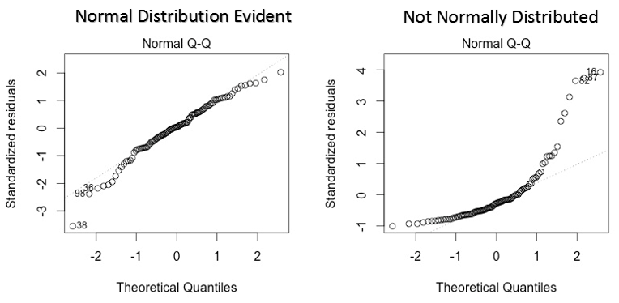
Checking Normality
Plot a histogram of the residuals, a QQ plot, and get diagnostics on the residuals

Slide 40
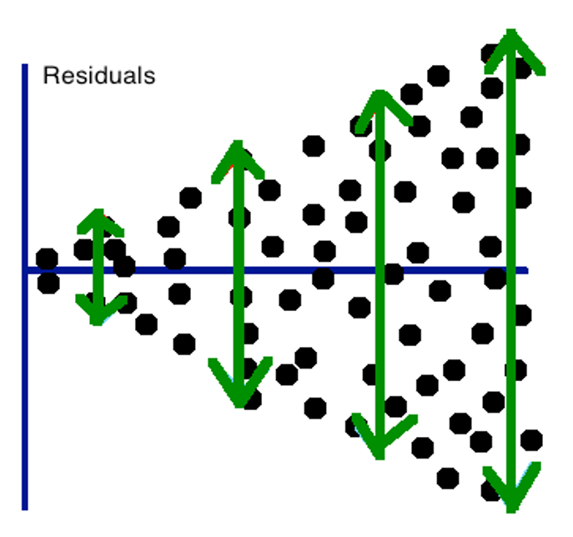
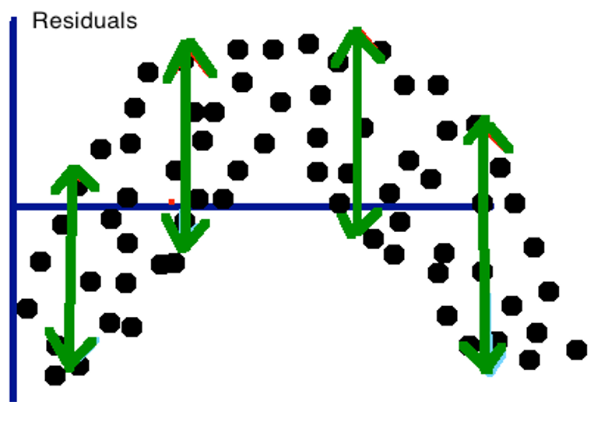
Checking Homoscedasticity
Plot the residuals across the X values
The variance of the residuals shouldn’t change across X

Slide 41
Checking Homoscedasticity
What do we think about the assumption of constant variance?
> chol %>%
+ ggplot(aes(x=bmi_new, y=model1$residuals)) +
+ geom_point() +
+ geom_smooth()

Slide 42
When Assumptions Are Not Met
Change our variables
Convert variables to categorical
Transform the outcome variable
Transform the predictor variable
Examine your predictors
You may be omitting important predictors – we will discuss in multiple regression
Change your modeling approach
Use another model such as logistic, Poisson, etc.

Slide 43
Binary Predictors
We know how to look at the relationship between a continuous predictor and a continuous outcome
Let’s look at how to model a dichotomous/binary predictor
Example: how does gender relate to HDL cholesterol?

Slide 44
Binary Predictors
Option 1. We already know how to perform a t-test for this relationship! (I’m going to assume the variances in HDL are equal between genders.)
> t.test(hdl ~ gender, var.equal=T, data=chol)
Two Sample t-test
data: hdl by gender
t = 3.1333, df = 186, p-value = 0.002009
alternative hypothesis: true difference in means is not equal to 0
95 percent confidence interval:
1.855813 8.165463
sample estimates:
mean in group Female mean in group Male
51.22340 46.21277

Slide 45
Binary Predictors
Option 2. Another way we can examine this is through the regression framework.
We need to make sure our X value is coded the correct way: as a “dummy” variable.
Some coding guidelines to make interpretation easier:
The “baseline” category should be coded 0.
The “other” category should be coded 1, which makes a 1-unit difference in X between the two groups.

Slide 46
Binary Predictors
Here we create our new dummy-coded variable for sex, then verify that it was coded as we wanted
Next, we plot HDL vs. sex
What would happen if we tried to fit a regression line through this?
chol$sex01 <- chol$sex – 1
table(chol$sex01)
chol %>%
ggplot(aes(x=sex01, y=hdl)) +
geom_point() +
geom_smooth(method="glm")

Slide 47
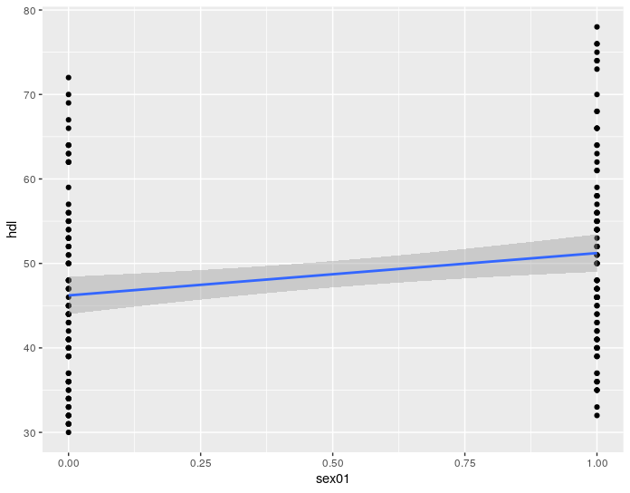
Binary Predictors
Run the regression of HDL vs. sex. What are the coefficients?
What is the value of the y-intercept, and what is its interpretation?
What is the value of the slope and what is its interpretation?
What would be the value of the slope if there were no difference in HDL between males and females?

Slide 48
Comparing the t-test and regression
> t.test(hdl ~ gender, var.equal=T, data=chol)
Two Sample t-test
data: hdl by gender
t = 3.1333, df = 186, p-value = 0.002009
alternative hypothesis: true difference in means is not equal to 0
95 percent confidence interval:
1.855813 8.165463
sample estimates:
mean in group Female mean in group Male
51.22340 46.21277
> lm(hdl~gender, data=chol) %>% summary()
Call:
lm(formula = hdl ~ gender, data = chol)
Residuals:
Min 1Q Median 3Q Max
-19.223 -9.213 -1.223 6.779 26.777
Coefficients:
Estimate Std. Error t value Pr(>|t|)
(Intercept) 51.223 1.131 45.299 < 2e-16 ***
genderMale -5.011 1.599 -3.133 0.00201 **
---
Signif. codes: 0 ‘***’ 0.001 ‘**’ 0.01 ‘*’ 0.05 ‘.’ 0.1 ‘ ’ 1
Residual standard error: 10.96 on 186 degrees of freedom
Multiple R-squared: 0.05014, Adjusted R-squared: 0.04503
F-statistic: 9.818 on 1 and 186 DF, p-value: 0.002009

