Slide 1
Spatial Statistics
Introduction to Spatial Data
Lu Zhang

Slide 2
The key components of spatial analysis and spatial statistics are:
Visualization “A major pleasure in working with spatial data is their visualization. Maps are amongst the most compelling graphics, because the space they map is the space we think we live in, and maps can show things we cannot see otherwise”. Bivand, Pebesma, Gomez-Rubio, Applied Spatial Data Analysis with R, Springer 2008.
Exploration This involves looking for patterns in data such as clusters and the behavior of events that are close in space or very distant.
Modeling We incorporate what we learn from data visualization and exploration into a formal statistical setting. This allows for estimation and inference.

Slide 3
Historical examples of spatial analysis
John Snow: Early spatial analysis
In August 1854 there was a major Cholera outbreak in the Soho neighborhood of London, UK. There were 127 cholera-related deaths around the area.
At the time, germ theory (microorganisms causing disease) was not known.
Dr. John Snow spoke to local residents and mapped where cholera cases occurred. As a result of his map, he was able to pinpoint the public water pump on Broad Street as the source of contaminated water causing the cholera outbreak.

Slide 4
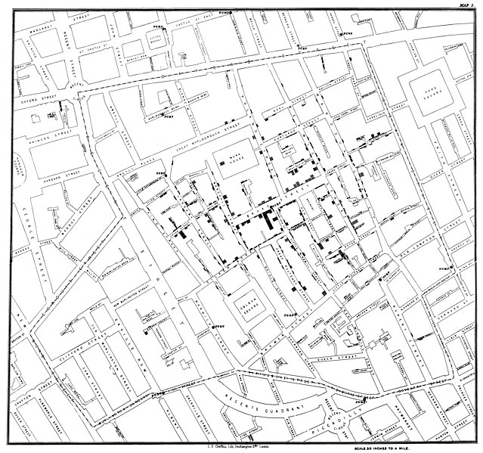
Historical examples of spatial analysis

Slide 5
Historical examples of spatial analysis
John Snow: Early spatial analysis
Dr. Snow used statistics to find a relationship between water quality and cholera cases
He found that the company supplying water to the Broad Street pump was taking water from the sewage polluted area of the Thames river

Slide 6
Spatial analyses: past and present
Historical examples of spatial data were often stumbled upon “by chance”
Today, spatial data are seemingly everywhere. Not only do we see countless examples of spatial data in a variety of fields of research (public health, economics, sociology, earth sciences, etc.), we often find them used in news articles, apps and pop culture
Let’s first explain what is a spatial analysis and what are spatial data

Slide 7
Introduction to spatial analysis: general concepts
What is spatial analysis?
The quantification of phenomena referenced in space
The study of methods to describe and explain a process that operates in space based on a sample of observations taken at particular locations
Quantitative spatial analysis: Methods
Visualization
Maps, graphical display
Exploration
Tools to broadly look at spatial patterns
Modeling
Fitting models, testing hypothesis, formalizing spatial dependence

Slide 8
Spatial data
What are spatial data?
Data that are location specific and that vary in space
Referenced by a spatial location, s where s = (x,y)
  x is longitude (easting) and y is latitude (northing)
Spatial locations may represent the center of an area e.g., zip code, county, state
We typically have multiple spatial locations to examine, denoted as s₁, s₂,…, s_{n} = (x₁,y₁), (x₂,y₂),…, (x_{n}, y_{n})
In terms of thinking of how to approach the analysis of spatial data, the motto taken is:
Data that are close together in space (time) are often more alike than those that are far apart
  Often labeled as Tobler’s first law of geography - “everything is related to everything else, but near things are more related than distant things”

Slide 9
Types of Spatial data
We can dissect the broad definition of spatial data into three sub-categories.
Point process data – Geostatistical data
Areal data (sometimes called aggregate data or lattice data)
Point pattern data
There are specific statistical analyses for each of these types of spatial data.

Slide 10
Types of Spatial data
Geostatistical data (point process)

Slide 11
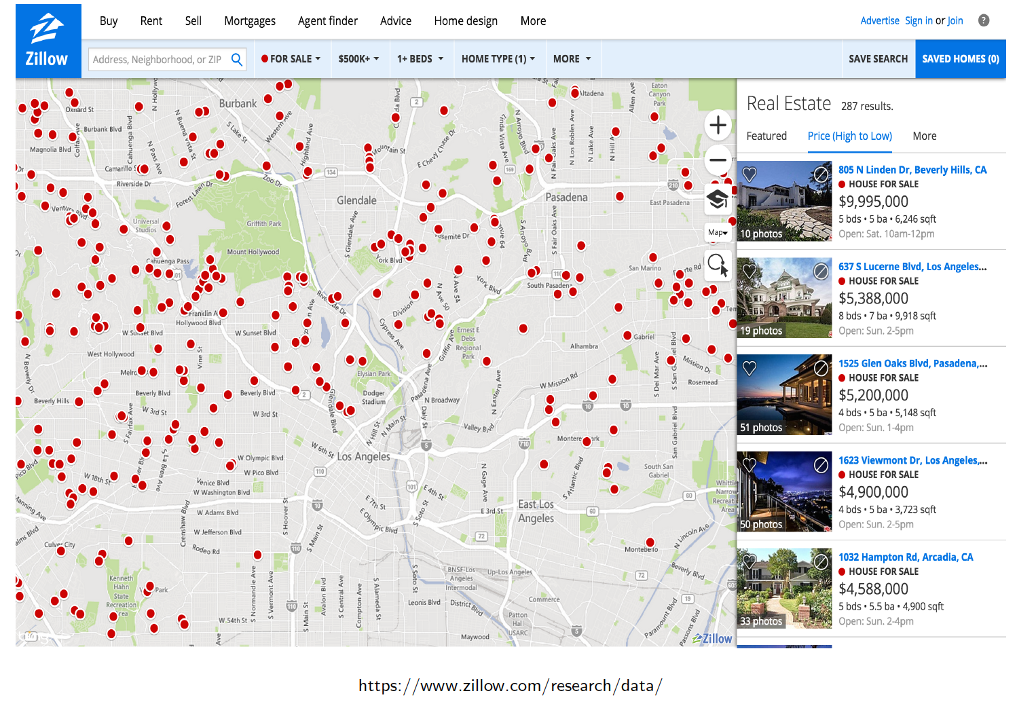
Geostatistical Data: Example

Slide 12
Geostatistical Data: Example
Data that vary continuously over space, but measured only at discrete locations
Examples:
housing prices in a metropolitan area
field observations such as soil samples, air pollution measurements (environmental exposures)
meteorological and climate data

Slide 13
Visualizing Geostatistical Data
The components of geostatistical data are:
  the locations (s_{i})
  the measurements at each location (z_{s})
The best way to visualize these data is to display on a map and differentiate the values of the measurements of interest by color or size
Let’s examine field observations of air pollution measurements in the northeast US.

Slide 14
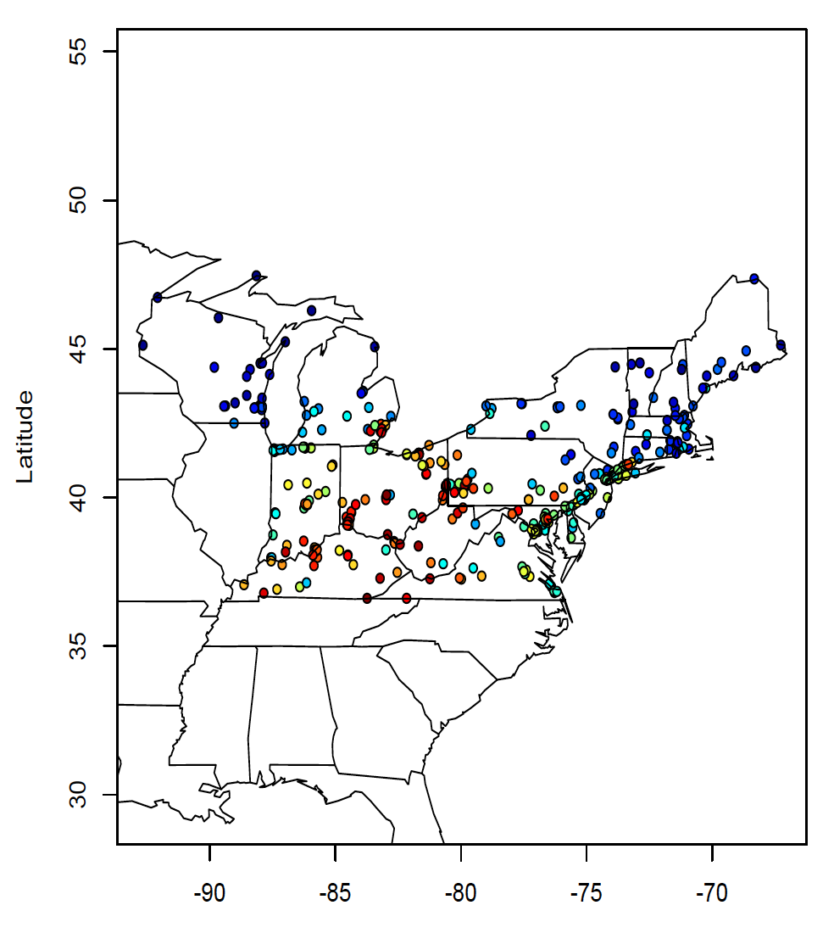
Visualizing Geostatistical Data
We display:
The points, which are air pollution monitors
The monthly average PM_{2.5} concentration. Color coded using a gradient from blue (low) too red (high)

Slide 15
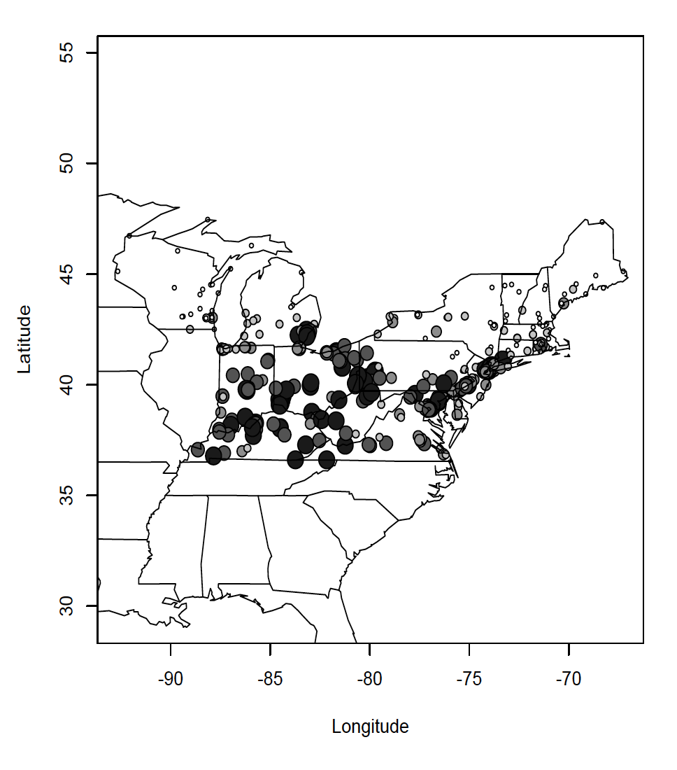
Visualizing Geostatistical Data
Instead of using colors, we can display the points as gradients in size:
the points are air pollution monitors
the monthly average PM_{2.5} concentration where larger circles represent higher concentrations, smaller circles are lower concentrations

Slide 16
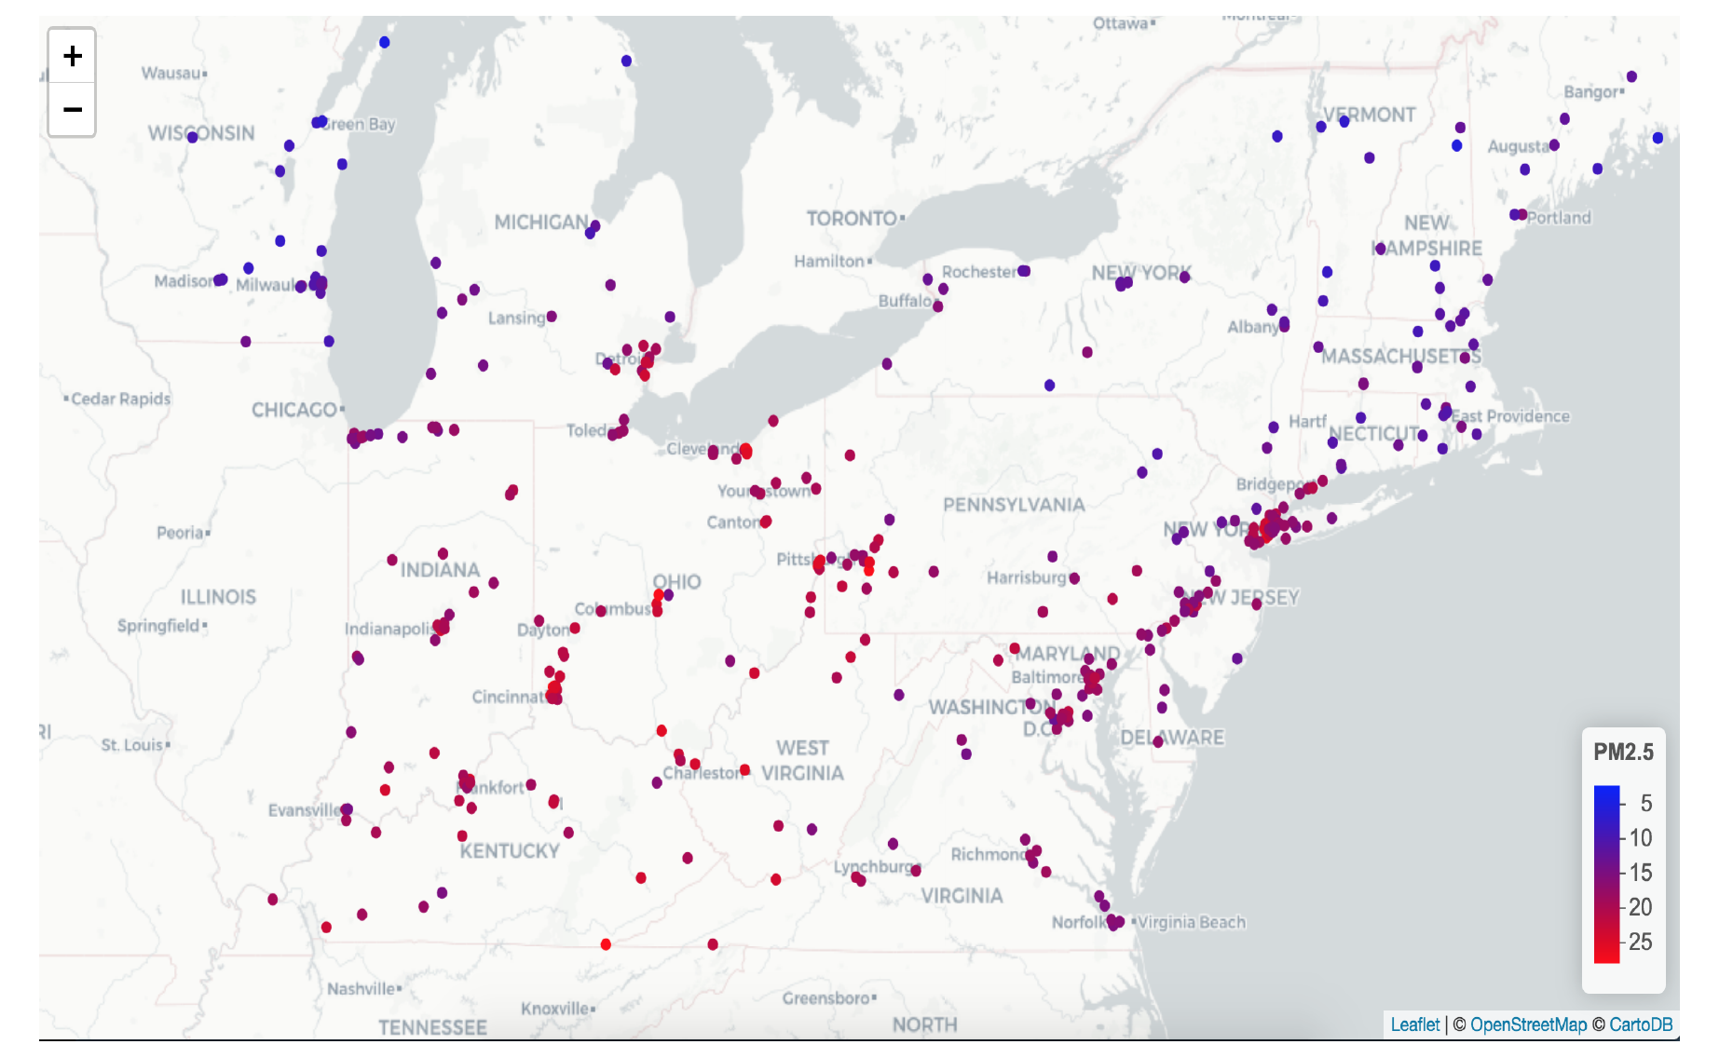
Visualizing Geostatistical Data
Adding a basemap helps provide a spatial reference frame
Adding a legend helps provide context for what is being mapped

Slide 17
Visualizing Geostatistical Data in R
The leaflet package is very useful for generating interactive maps
Let’s build a couple of maps for
  Northeast city populations and
  Weather data in California

Slide 18
Exploring and Modeling Geostatistical Data
Goals of spatial statistics applied to geostatistical (point referenced) data
Explore the spatial pattern in the observations
Quantify the spatial pattern with a function
Model the spatial correlation in the observations
Make predictions at unobserved locations: interpolation, smoothing
Additional considerations:
Account for spatial structure in regression models
Test a null hypothesis of no spatial correlation

Slide 19
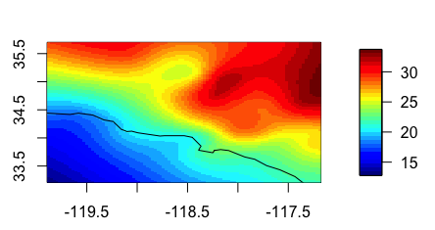
Exploring and Modeling Geostatistical Data
For example, interpolating temperature data from the point measurements can give a map like this

Slide 20
Types of Spatial Data
AREAL DATA

Slide 21
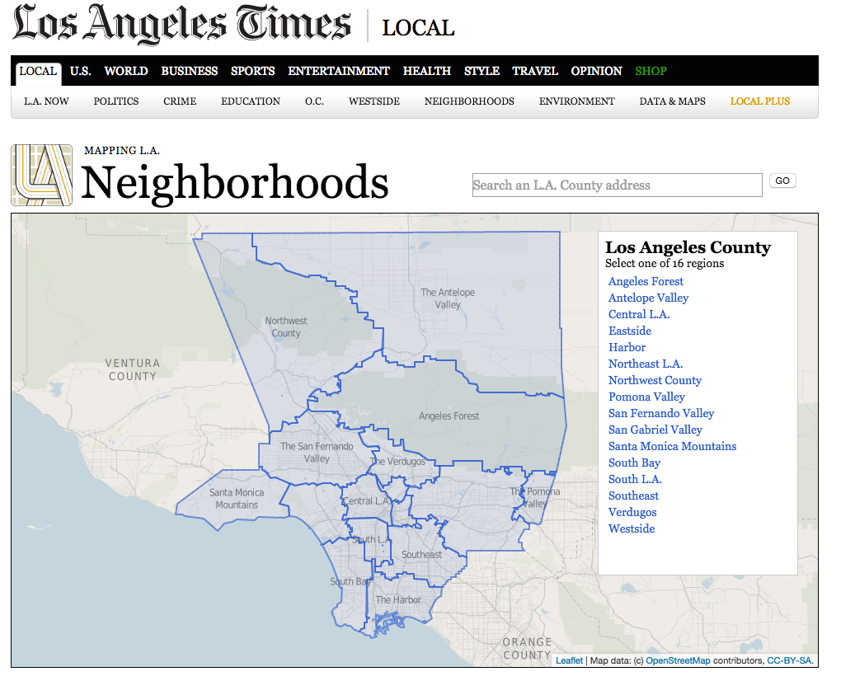
Areal Data: Example 1
AREAL DATA
https://maps.latimes.com/neighborhoods/

Slide 22
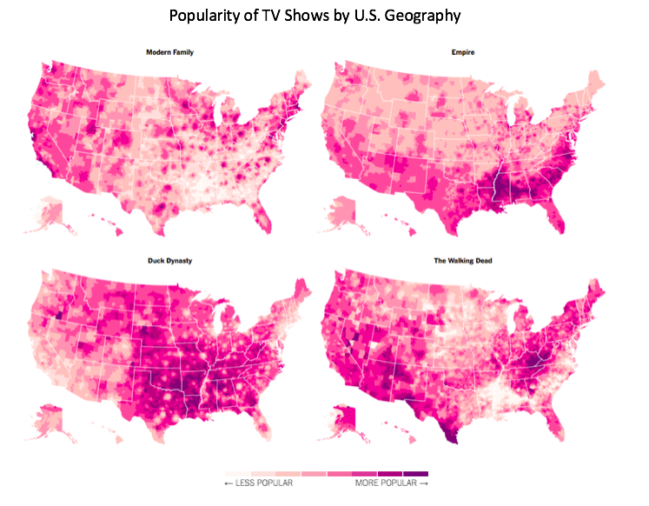
Areal Data: Example 2
https://www.nytimes.com/interactive/2016/12/26/upshot/duck-dynasty-vs-modern-family-television-maps.html

Slide 23
Areal Data: Description
Data are associated with an area and are aggregate in nature
Areal units tend to be irregular in shape (e.g., zip code, county) but can be regular grids (e.g., remote sensing data)
Information collected in areal units may be census related, health related, environmental (satellite estimates of air pollution)
We want to determine spatial pattern of areal units within a region

Slide 24
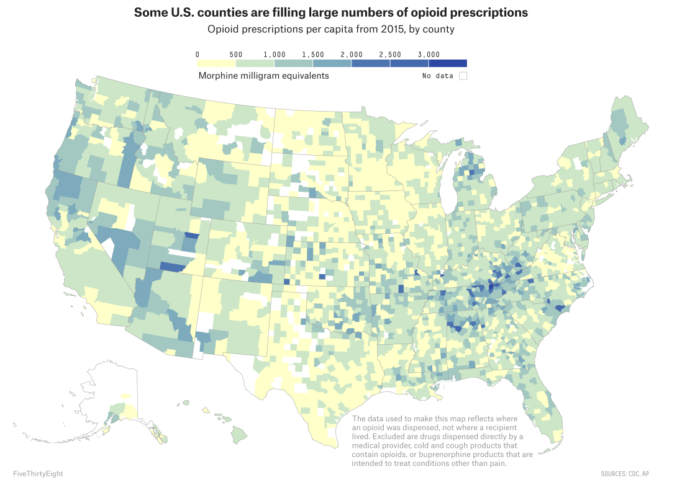
Visualizing Areal Data
We display:
The areal units (polygons), in this case counties
The color represents a quantity, in this case Morphine (mg) categorized into 7 ordinal groups
Labels and legends to relate the data to the areal units
Note that we often look at “per capita” information when examining areal data
https://fivethirtyeight.com/features/opioid-prescriptions-across-the-u-s/

Slide 25
Types of Spatial Data
POINT PATTERN DATA

Slide 26
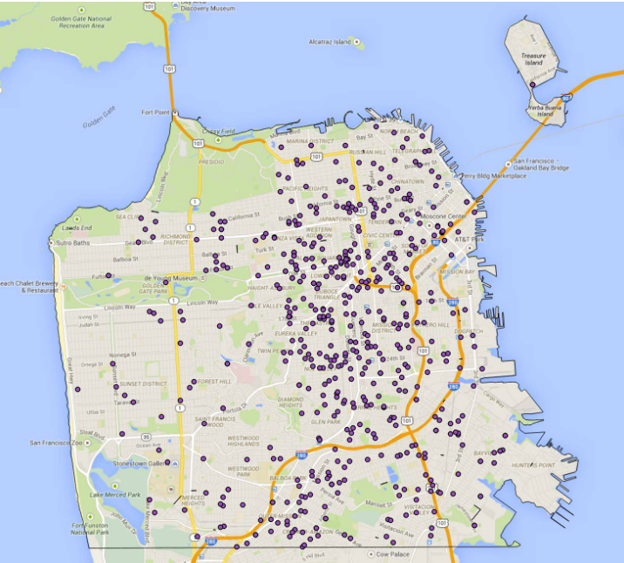
Point Pattern Data: Example 1
Car thefts in San Francisco

Slide 27
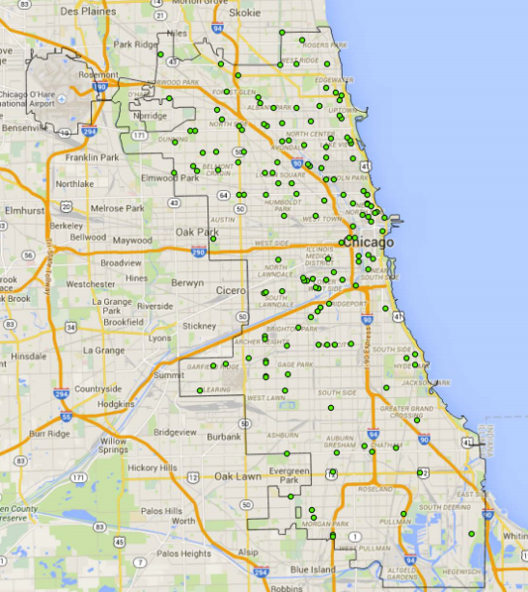
Point Pattern Data: Example 2
Grocery stores in Chicago

Slide 28
Exploring and Modeling Point Pattern Data
Questions about point pattern data that we would like to answer are:
Is there a regular pattern in the points?
Is there a clustering of the points?
There may be additional features that we need to take into account:
Is there an underlying population distribution from which events arise in a region?
Are events clustering in regions of high population?

Slide 29
Types of Spatial Data
Dr. John Snow’s map of cholera cases are what type of spatial data?
Geostatistical
Areal
Point Pattern
Notes:
Point Pattern

Slide 30
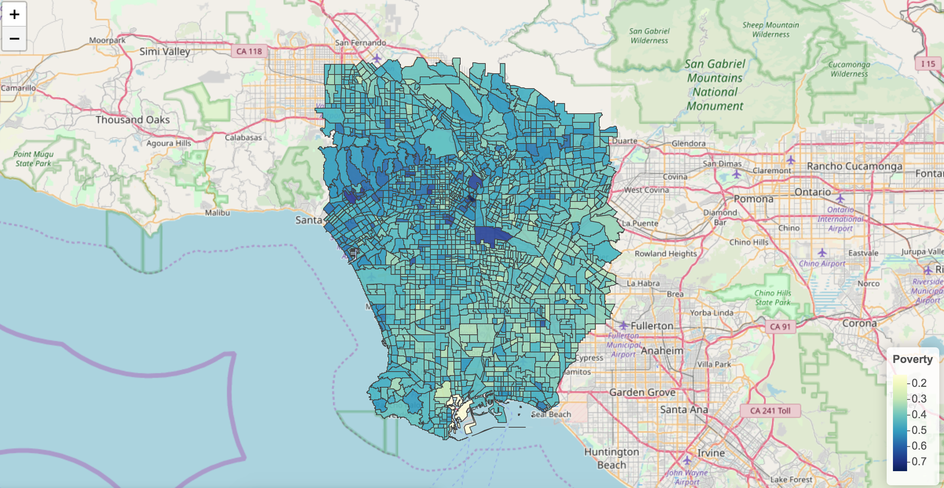
Geostatistical, Areal, or Point Pattern?
Notes:
Areal

Slide 31
Types of spatial data: spatio-temporal
All three types of data may be referenced in space and in time
Each observation has a location, time and value
Similar methods for analysis, with an added dimension
Often encountered in environmental epidemiology:
  Geostatistical: Relationship between daily air pollution measured at discrete locations and hospital admissions
  Areal: Changes in birth rates in census tracts in US states(2000 to 2010 census)
  Point process: Changes in spatial clustering of Malaria cases 2000 to 2015
Notes:
Areal

Slide 32
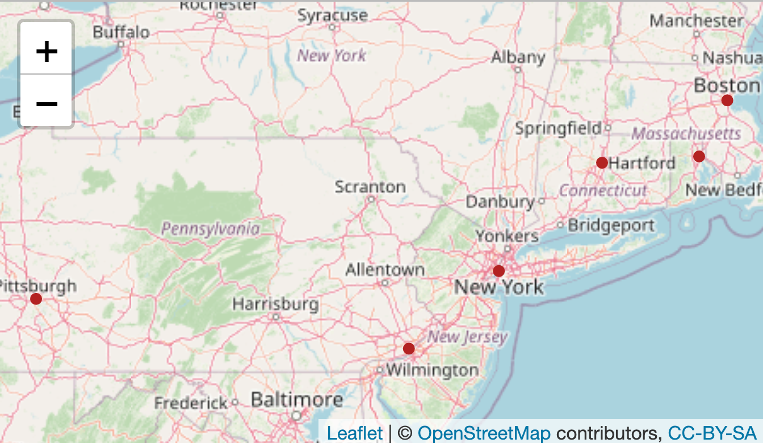
leaflet package for generating interactive maps
## city lat lon pop
## 1 Boston 42.3601 -71.0589 645966
## 2 Hartford 41.7627 -72.6743 125017
## 3 New York City 40.7127 -74.0059 8406000
## 4 Philadelphia 39.9500 -75.1667 1553000
## 5 Pittsburgh 40.4397 -79.9764 305841
## 6 Providence 41.8236 -71.4222 177994
leaflet(cities) %>%
addTiles() %>%
addCircles(lng = ~lon, lat = ~lat, color='firebrick’, fillOpacity=1, opacity=1, radius=700)

Slide 33
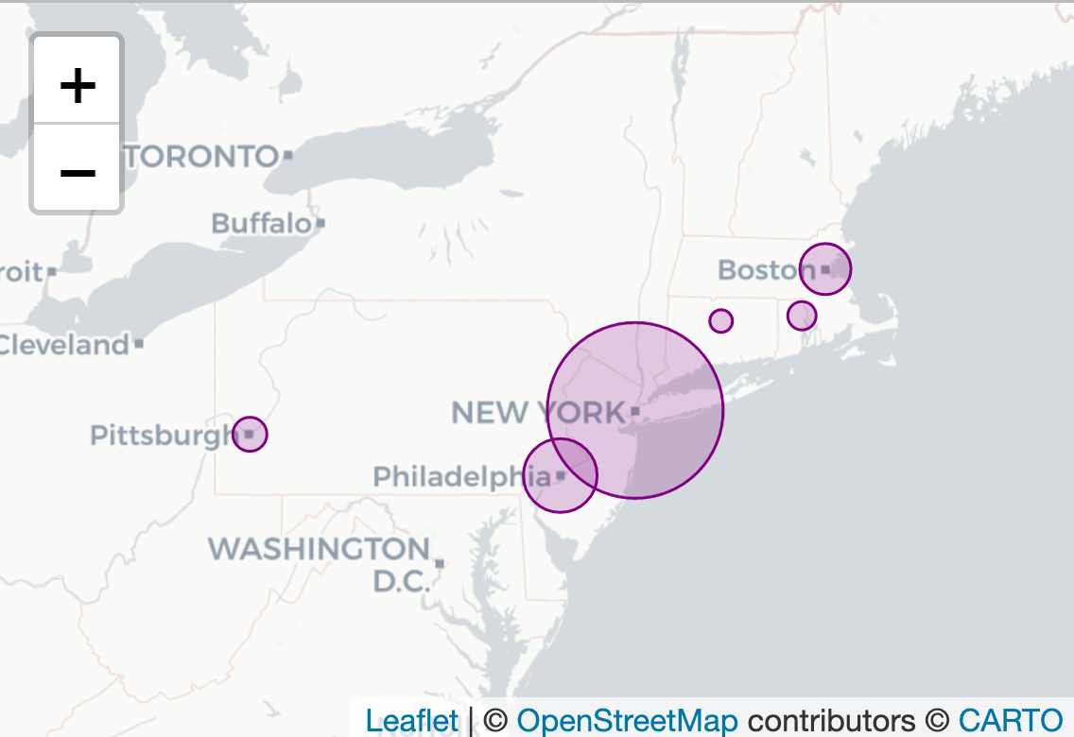
Scale the circles to population size
For the tile providers, check this out: https://leaflet-extras.github.io/leaflet-providers/preview/
leaflet(cities) %>%
addProviderTiles('CartoDB.Positron') %>%
addCircles(lng = ~lon, lat = ~lat,
weight = 1, color = "purple", opacity = 1,radius = ~sqrt(pop) * 40, popup = ~city)
These maps are static. Now let’s see what we can do when we create html figures.

Slide 34
Run: lasbest-spatial.Rmd

