Slide 1

Linux Tutorial - ScINET
August 29, 2017
Jonathan Shao, Computational Biologist, NEA

Slide 2
Howto get on SciNet
Windows http://www.putty.org/
Linux - Terminal
Mac - Terminal -
Method 1 Opening with Finder
Open a new Finder window by clicking the Finder icon to the far left of your Dock.
From the sidebar, choose Applications, and then go to Utilities. Alternatively, you can just press ⌘ Command + ⇧ Shift + U .
Double click on the Terminal.

Slide 3
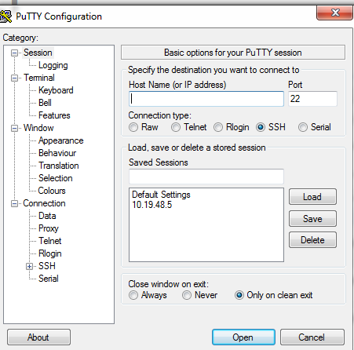
SSH to SciNet
ssh john.smith@scinet-login.bioteam.net - Terminal
ssh -o TCPkeepAlive=yes -o ServerAliveInterval=20 -o ServerAliveCountMax=100 mary.smith@scinet-login.bioteam.net -XA
Note: when you ssh in for the first time - hit “yes” to accept.
Putty.ext

Slide 4
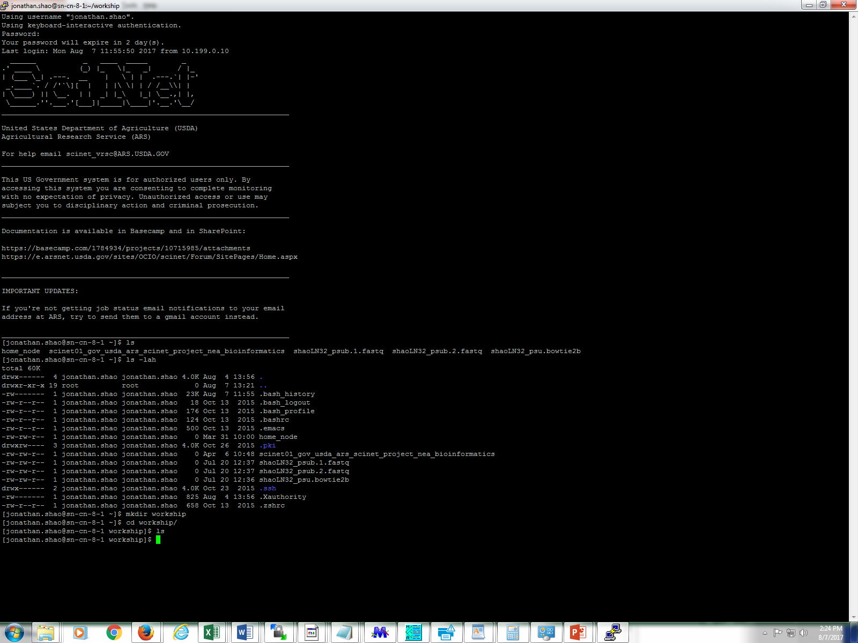
SSH to SciNet

Slide 5
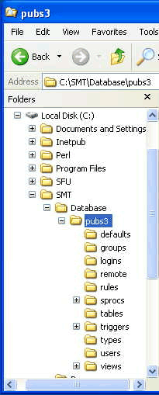
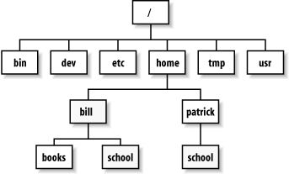
Basic Linux Commands - Directory Tree
linux commands are in lowercase
http://www.shril-sy.info/page/l/linux-directory-tree.html
https://technet.microsoft.com/en-us/library/bb497051.09sybm04_big(l=en-us).gif

Slide 6
Basic Linux Commands - Listing files “ls”
(all linux commands in lowercase)
Example:
>ls
This command lists the contents of the current directory.
>ls helloworld
This lists the name of a specific file
>ls -lah
This command lists all the contents in the current directory in great detail

Slide 7
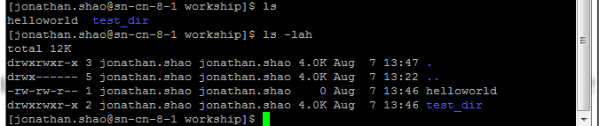
Basic Linux Commands - Listing files ls
Notice a few things and the difference between an ls and a ls -lah
In blue is is a directory called “test_dir” and in white is the name of a file “helloworld”
drwxrwxr_x
d stand for directory
r - read
w -write
x - execute
Jonathan.shao jonathan.shao - who owns the file (user and group ownership)
4.0K is the size of the file
Aug 7 is the Aug date of this year.
helloworld/test_dir are the names of the files and directory

Slide 8
Basic Linux Commands Changing Directories cd
>cd <path to where you are going>
cd means change directory
Example:
>cd /test_dir
>cd /scinet01/gov/usda/ars/scinet/project/
cd space “and the name of a directory” moves you down or forwards
>cd ..
cd dot dot means move up a directory or backwards

Slide 9
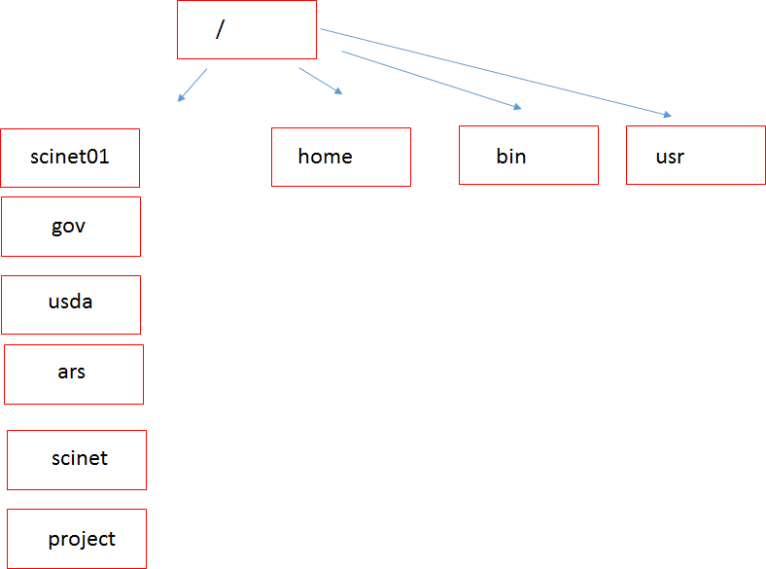
Basic Linux Commands - Directory Tree -SciNet
cd /usr
Changes directory to the usr directory
Note: (execute the commands in order for the comments to make sense)
>cd /scinet01/gov/usda/ars/scinet/project/
This changes directory to the project directory. This is the hard-path to the project directory.
>cd ..
This will move you up or backwards to the scinet directory
>cd project
This will move you forwards to the project directory from the scinet folder
>cd ../../../../../../
This will move you all the way up to the root / directory
Scinet

Slide 10
Basic Linux Commands, Help, Where am I, Changing Owners
>man <name of linux command>
man cp
man pwd
man chmod
man is the help file for each command
>pwd
pwd shows the path of working directory
>chown john.smith:john.smith helloworld
changes the owner of the files of helloworld
>chmod 755 helloworld
changes rwx of helloworld and makes it executable
chgrp -R proj-nea_bioinformatics /project/nea_bioinformatics

Slide 11
Basic Linux Commands, Moving and Renaming files, History
>mv <original file> <file to be renamed or moved>
>mv helloworld helloworld2
This renames the file from helloworld to helloworld2
>mv helloworld test_dir
This moves the file helloworld to test_dir
>history > my_history_August8_2017.txt
The command history gives your saved commands and the “>” redirects the output from history into a file.

Slide 12
Basic Linux Commands – Coping Files
>ls
helloworld
>cp <original file to be copied> <copy of file>
>cp helloworld helloworld.txt
Here we have copied the helloworld file to helloworld.txt
>ls
helloworld helloworld.txt
>cp <path><original file to be copied> <path><copy of file>
>cp helloworld /home/shaoj/test_dir
>cd /home/shaoj/test_dir
>ls
helloworld

Slide 13
Basic Linux Commands – Unzip and Untar Files
>gunzip test.gz
gunzip unzips a .gz file
>tar -xvf test.tar
tar untars a tar file

Slide 14
Linux Commands useful for SciNet
>module load bowtie2
>which bowtie2
>module unload bowtie2
>srun --pty -p short -t 48:00:00 -n 20 -N1 /bin/bash -l
>lfs quota -gh project_folder /scinet01
>squeue
>sinfo
>chgrp -R proj-nea_bioinformatics /project/nea_bioinformatics

Slide 15
Linux Commands- Getting Your Files Off the SciNet
scp <file> <folder location>
Putting a file on the scinet:
>scp file.txt mary.smith@scinet-login.bioteam.net:/scinet01/gov/usda/ara/scinet/project/work_dir
Getting a file to your home directory from the scinet:
>scp mary.smith@scinet-login.bioteam.net:/scinet01/gov/usda/ara/scinet/project/work_dir/file.txt /home/smithm

Slide 16
Linux Commands – Running a Program
>blastn -query test.fas -db nr -out test.blastn
The red dashes are switches/parameters that are passed into the blastn executable.
The first entry blastn in green is usually the executable program.
Here I am passing the query name test.fas using the query switch, the database nr using the db switch and outputting the file test.blastn using the out switch to the executable blastn.

Slide 17
How Do I Remove My Mess? Practice Good Hygiene
rm <file>
Note that the the rm command is unforgiving. It will delete the file permanently.
>ls
helloworld helloworld.txt
>rm helloworld
The file helloworld will be deleted
>ls
helloworld.txt
Here you will only see helloworld.txt, since helloworld was deleted

Slide 18
Yikes! My Linux Program is Stuck or I Made a Mistake
>control+C
>control+Z
Halts commands
Hit the X button and close your terminal.
>squeue
Look at jobs in the queue and find your rogue id
133432 medium at-258 john.s R 12:09:23 1 sn-cn-13-1
>scancel <job id>
Example: scancel 133432

Slide 19
I Can’t Find My Files, Please Help
This will find file1 on your hard-drive
find file1 /home/smithmary
This will find file1 on /home/smithmary
find file1 /
This will find file1 on whole computer starting with root

Slide 20
Helpful Hints in Linux
You can cheat and hit the tab button to auto-complete
Example:
>ls
file_this_is_along_file_name.txt
>ls file_this_(hit tab button)
Auto-complete will
>ls file_this_is_along_file_name.txt
Notice that I used underscores and all lowercase for my file names. This can make life easier, since Linux is case sensitive!

Slide 21
How Do I View a File?
>nano file1
control X – hit y to save
Note that vi is the other editor. It is more powerful, but has a much harder learning curve.
gedit file1
If you have gedit installed, it works much like wordpad in windows
>head file.txt
shows the top of the file
>tail file.txt
shows the bottom of the file
head and tail are useful for viewing large files

Slide 22
More Helpful Hints in Linux
You can cheat and use the wildcard “*”
The use of * is a regular expression.
Example:
>ls
file_this_is_along_file_name.txt
apple.txt
pear.txt
file2.txt
>ls file*
file_this_is_along_file_name.txt
file2.txt

Slide 23
More Helpful Hints in Linux
Qiime meta data tabulate \
--m-input-file taxonomy.qza \
--o-visualization taxonomy.qzv
These lines are equivalent
Qiime meta data tabulate --m-input-file taxonomy.qza –o-visualization taxonomy.qzv

Slide 24
Linux Cheat sheet
>cd - change directory
>cd .. - moves up a directory
>cd /project/microbiome_workshop/amplicon/data/ - moves you to this directory
>ls - lists the contents of a directory
>pwd - path of working directory
>cp file1 file2 – copies file1 and creates a duplicate file2
>mkdir dir – create new directory dir
>rm file1 – removes file1
>chmod 777 file – 4 read, 2, write , 1 execute – adds up to 7
Read write execute for owner, group world
ssh user@host
>gunzip file.gz – decompress file
>tar –xvf – untar file
>control+C, or control+Z – halts command
>mv file1 renamedfile – renames file
>mv file1 test_dir – moves file1 to test_dir

Slide 25
Thank you
Next - Adam Rivers - Amplicon Analysis with QIIME2

