Slide 1
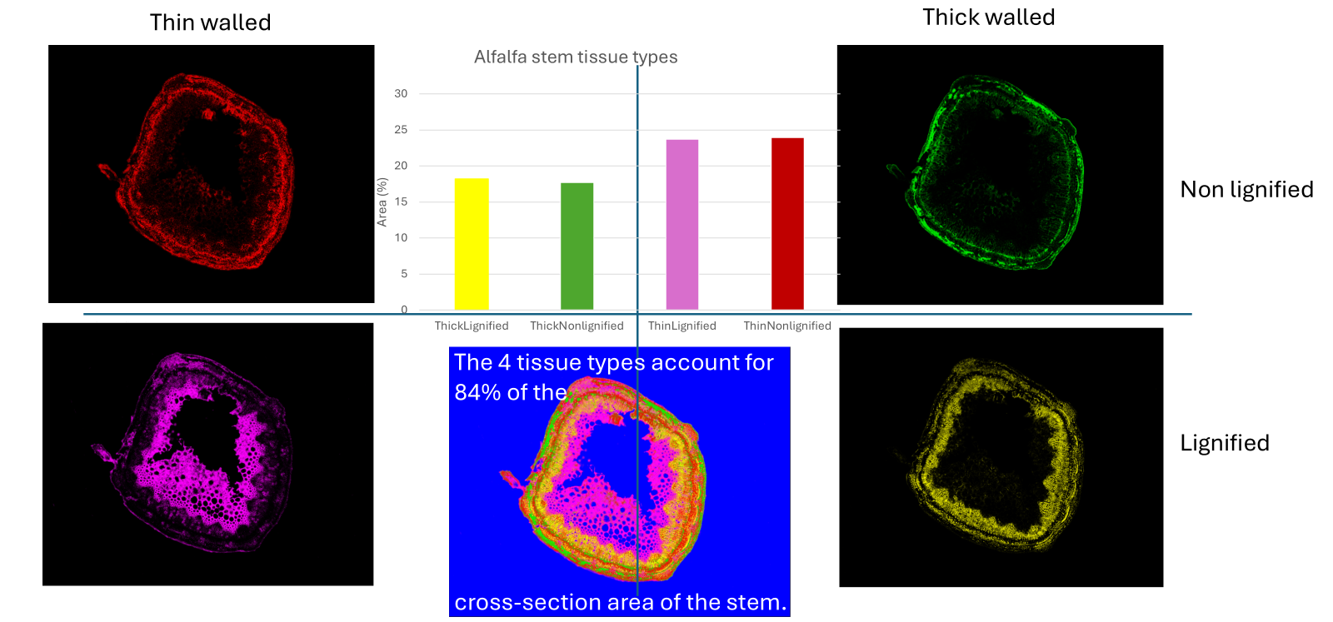
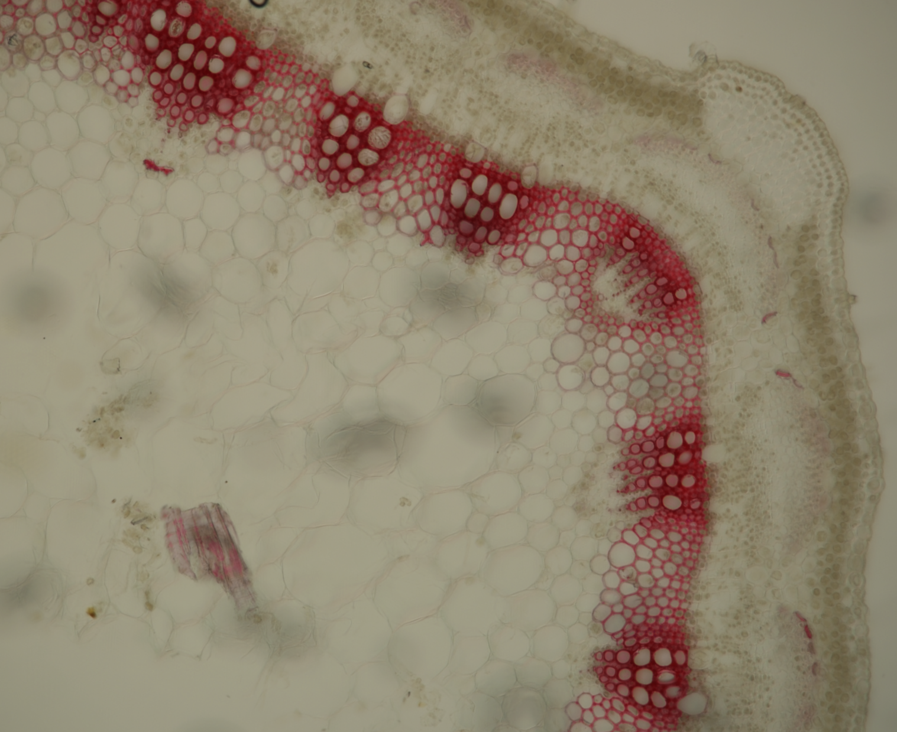
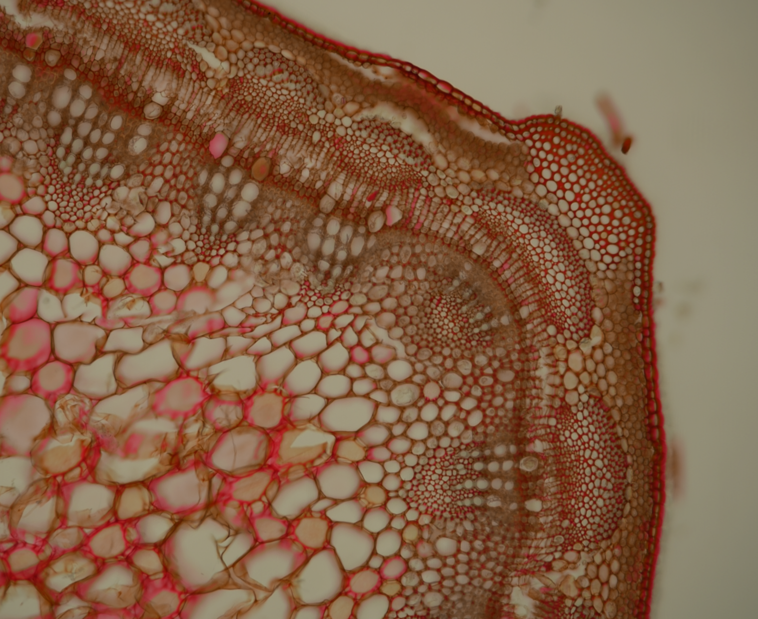
Quantifying Lignin and Pectin Distribution Project Description:
USDA is imaging alfalfa stem cross sections to understand patterns of lignin and pectin development and degradation across different cell wall types of five modern alfalfa lines. In this project, you will develop and apply data analysis tools to extract biologically relevant information from images to inform alfalfa breeding efforts and management recommendations. You will develop a segmentation pipeline to identify the distribution and quantify the amount of lignin and pectin in alfalfa stem tissues. This data will address the following research questions: 1) Do the alfalfa lines evaluated here differ in their proportion of nonlignified tissues? 2) How does the quantity of lignin and pectin change with the exposure of stems to in vitro fermentation with rumen fluid?
The project team will develop pipelines for image analysis and data extraction using a collection of approximately 15,000 images (.nd2 format) of alfalfa stems harvested at the early flower stage and subjected to incubation in rumen fluid for 0, 4, 8, 24, 48, and 96 hr then stained with phloroglucinol to visualize lignin or ruthenium red to visualize pectin (Fig. 1). The team will develop a classification method to distinguish between four types of cell walls that occur in different types of cells: 1) thin walled, non-lignified; 2) thick walled, non-lignified; 3) thin walled, lignified; and 4) thick walled, lignified (Fig. 2). Then, the amount (e.g., intensity) of lignin (or pectin) in each will be quantified for each of the incubation time intervals. The team will work with Subject Matter Experts (SMEs) to distinguish the four cell wall types in images stained for lignin, and images stained for pectin across the time intervals.
Following the development of the pipelines, the project team will develop validation methods to ensure the quality of the data derived from the images. Deliverables must include a written protocol, code, and data sets that are ready to be run for statistical analysis. Importantly, the deliverables must be provided in a format that can be run independently by the agronomy SMEs. This effort is expected to result in a publication in a crop science journal and student efforts in this project would be recognized in acknowledgements or a co-authorship depending upon participation.
Figure 1. Alfalfa cross sections stained for lignin with phloroglucinol (PG; a) and ruthenium red (RR; b). Figure 2. Classification of pectin in four types of cell walls: thin walled, non-lignified (red), thick walled, non-lignified (green), thin walled, lignified (purple), and thick walled, lignified (yellow). The area of each cell wall type are graphed and shown in composite (center).
a
b

Slide 2
Deliverables | Type of work | Activities | Resources | Tech Skills | Priority
Understanding the data and apply data preprocessing techniques | Automate data preprocessing | Identifying removing noise from images (e.g., air bubbles, tape, organic material) | FIJI, research | Clean up images for analysis | High
Properly format data for data extraction | Format data | Convert .nd2 images to the appropriate format suitable for feature extraction | FIJI, research | Ensure compatible file type & software | High
Requirements analysis document | Requirements analysis in collaboration with SMEs; Documentation of agreed results | Defining what constitutes "good" classification Distinguishing types of stem tissues that will be distinguished by software Defining how results of classifications will be presented Identifying workflow of processing full data set |  | Define boundaries or thresholds for decision making | High
Settings for color thresholding of lignin and pectin | Color thresholding | Determine the appropriate color threshold for quantifying lignin and pectin in images of full alfalfa cross sections (10xstitch). | FIJI, research | Thresholding | High
Identify and quantify cell wall types | Classification | Distinguish between cell wall types that are 1) thin walled, non-lignified; 2) thick walled, non-lignified; 3) thin walled, lignified; and 4) thick walled, lignified | FIJI with Labkit plugin, research | Feature extraction | Medium
Usable dataset for ML | ID of usable data for training ML | Convert imaging data types into format suitable for input into selected ML codes | Microsoft Excel, research | Generate numerical data | Medium
Identification of cell concentrations in digested cross sections | Extend the application of color thresholding and classifying cell wall types to digested tissues | Identifying the quantities of lignin and pectin within images of digested cross sections of varying clarity (10x stitch and/or 40x above and below vascular cambium). | Research | Improve details in low-quality images | Low
Hand over documentation | Summary of activities | Record and report the process to accomplish the different activities. Include recommendations for future work. This document will allow for the next group to pick up where this group left off to make further progress. | Microsoft Word | Technical report writing skills | Low

