Slide 1
Using ‘mod_spatialite.dll’ as an extension module with DB Browser for SQLite

Slide 2
Online references used:
GAIA-SINS project home-page with MS Windows binaries
http://www.gaia-gis.it/gaia-sins/
Dynamically loading Spatialite as an extension module
https://www.gaia-gis.it/fossil/libspatialite/wiki?name=mod_spatialite
SQL functions for spatialite database
http://www.gaia-gis.it/gaia-sins/spatialite-sql-5.0.1.html

Slide 3
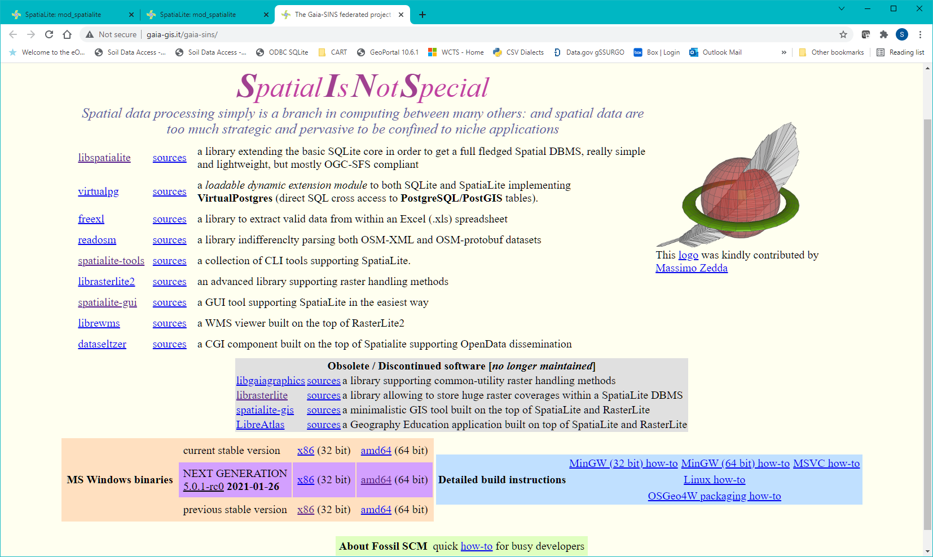
Download 64-bit DLLs

Slide 4
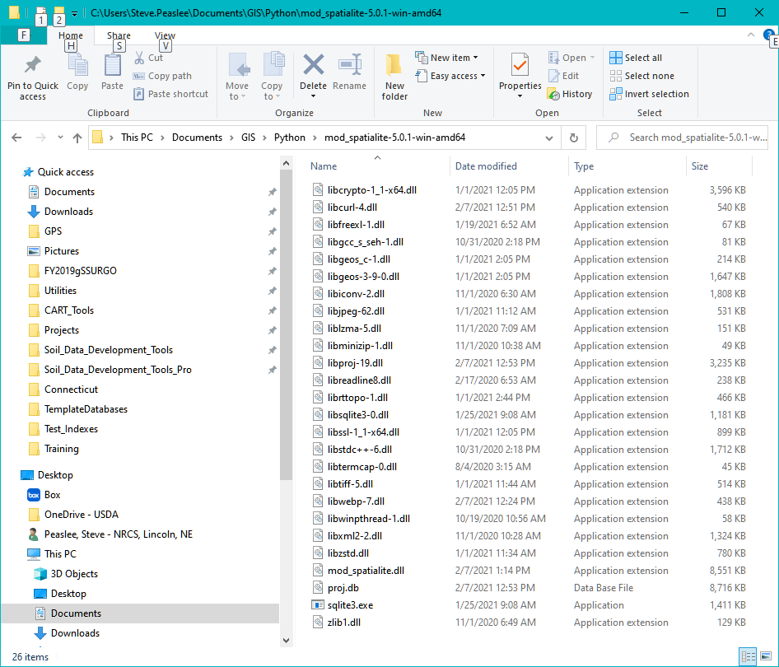
Spatialite DLLs (v 5.0.1) were downloaded from the Gaia-SINS federated projects page and placed under the MyDocuments\GIS\Python folder on a CCE computer using standard user privileges.
The primary item of interest is the ‘mod_spatialite.dll’ file.

Slide 5
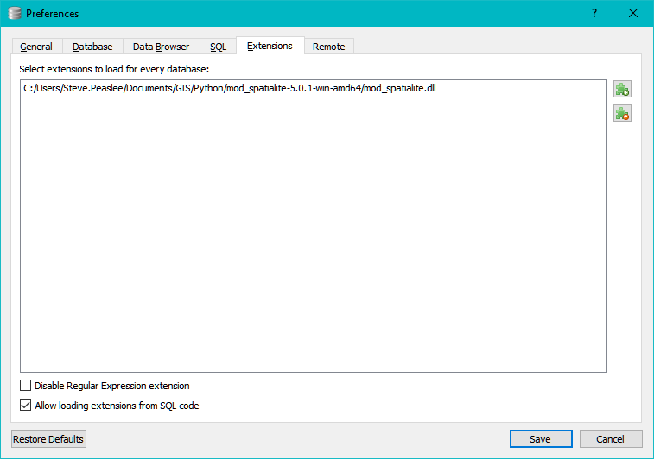
Using DB Browser for SQLite Version 3.12.2 (Windows 10).
Built for x86_64-little_endian-llp64, running on x86_64
Qt Version 5.12.8
SQLite Version 3.35.5.
Using Edit\Preferences, mod_spatialite was loaded as an extension to DB Browser.

Slide 6
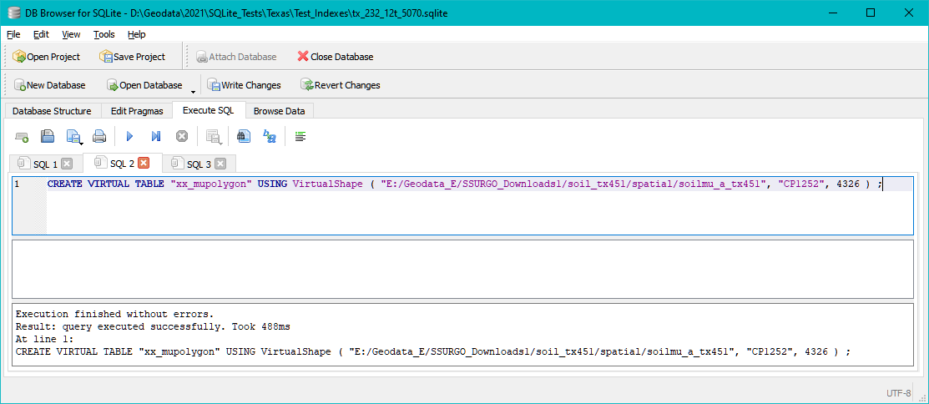
Tests were run to see if the spatial queries available using spatialite.exe could be duplicated in DB Browser.
The first test was to access one of the self-intersecting soil polygon shapefiles (TX451).

Slide 7
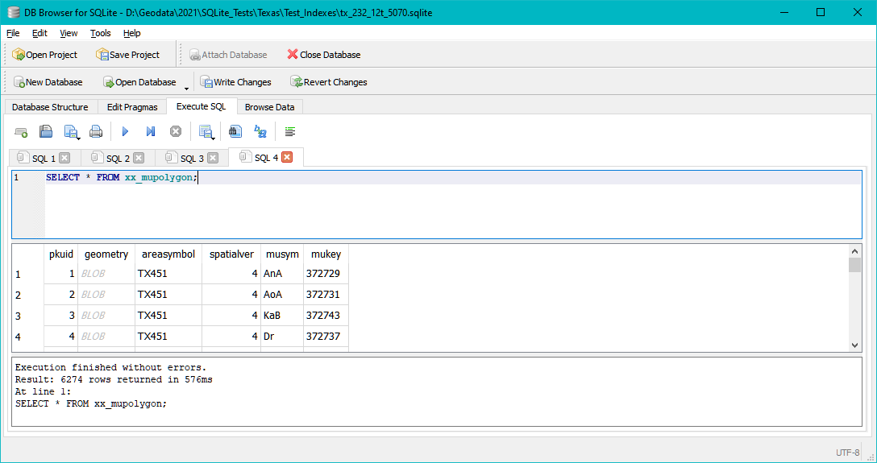
Displaying the contents of ‘xx_mupolygon’, the virtual table.

Slide 8
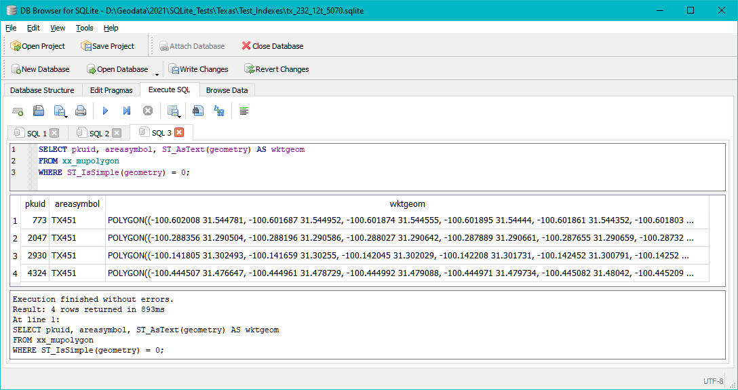
The second test was to identify polygons with non-simple geometry (according to Spatialite).

Slide 9
I’m not sure how useful this demonstration is, but it is very interesting.
It appears that with the correct version of Python and sqlite3, mod_spatialite.dll can be loaded as an extension and can perform the necessary spatial functions for populating a SSURGO-Lite database.
I have not yet tried to use DB Browser to create geometry columns or spatial indexes.
The challenge still remains to successfully load mod_spatialite as an extension with the sqlite3 library that comes with ArcGIS Pro.

