Slide 1
SELF-INTERSECTING GEOMETRY ERRORS IN SSURGO POLYGON SHAPEFILES
2021-05-19
In this example, nine Texas soil surveys from the October 2020 SSURGO Refresh were imported into a geopackage database. Three of the nine shapefiles had polygons with invalid geometries that had to be ‘fixed’ before they could be imported into the geopackage database. All the errors I found all appeared to be instances of self-intersecting polygons.
We have found this same issue will prevent layers from being published to ArcGIS Online. I did not check to see how pervasive this issue is, but assume it is quite common.
If possible, I would like to see if the method(s) for generating the SSURGO shapefiles updated to prevent this type of geometry error.
Listing of the three shapefiles having invalid geometries along with feature IDs:
Shapefile soilmu_a_tx345.shp has 2 polygons with invalid geometry: (2145, 2571)
Shapefile soilmu_a_tx153.shp has 5 polygons with invalid geometry: (789, 1155, 1761, 2765, 2914)
Shapefile soilmu_a_tx107.shp has 1 polygons with invalid geometry: (2872)

Slide 2
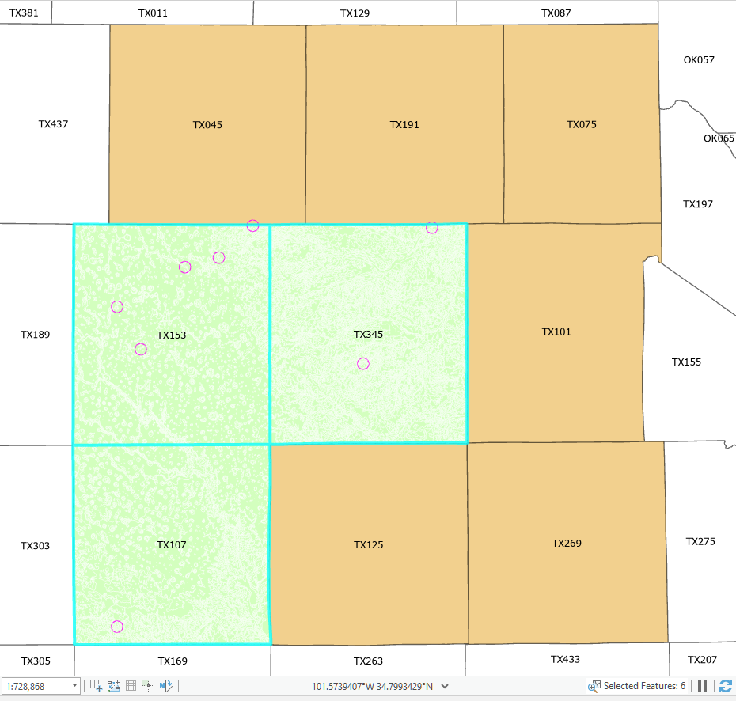
Nine soil polygon shapefiles were imported into a geopackage database. Three of the nine shapefiles had geometry errors that had to be repaired before they could be successfully imported using ogr methods. The arcpy.Append_management tool automatically repaired the self-intersecting polygons.

Slide 3
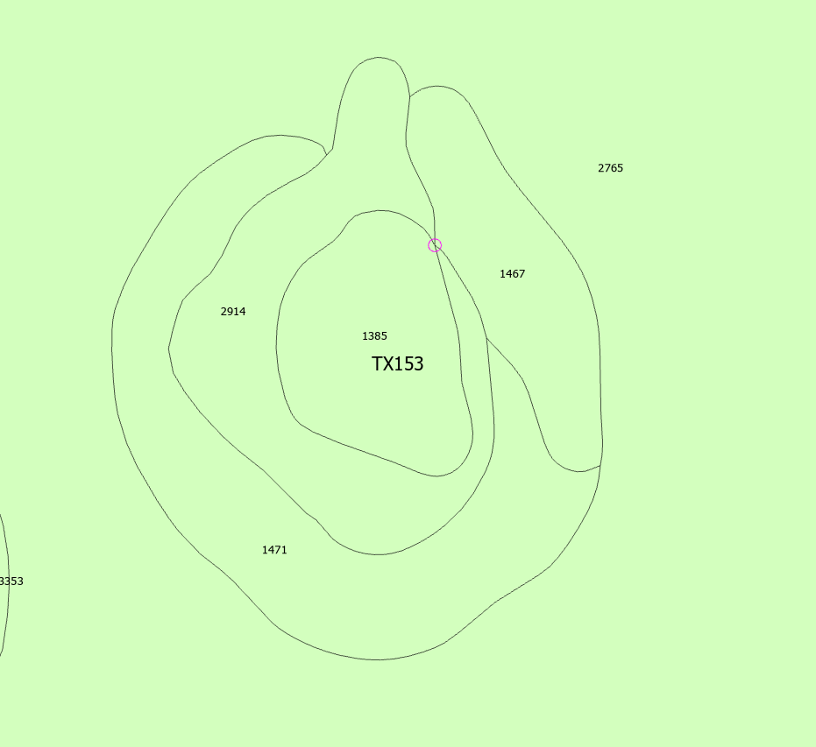
This closeup shows polygon #2914 in the soilmu_a_tx153 shapefile and the point at which it self-intersects.

Slide 4
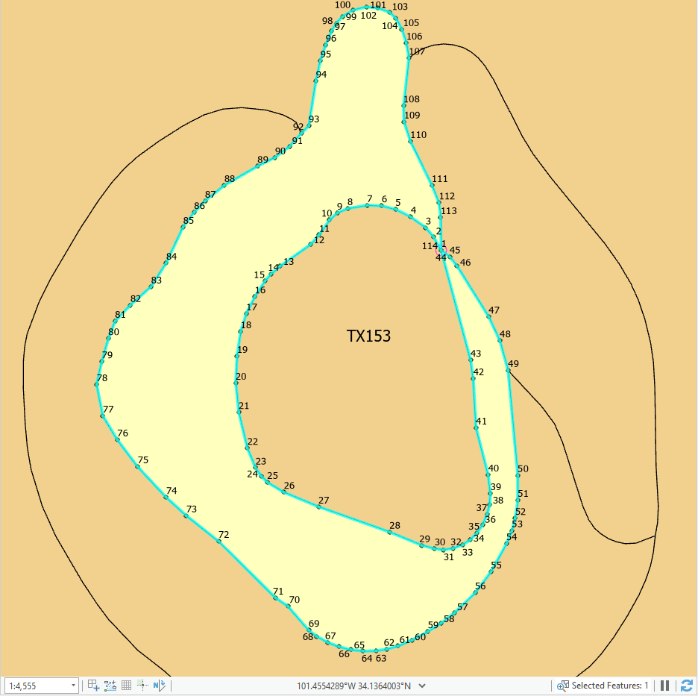
ArcGIS doesn’t appear to have a problem displaying the invalid geometries such as this when in shapefile or file geodatabase format.
However, they become a problem when using OGC methods to import them into a geopackage or sqlite database.
Invalid geometry

Slide 5
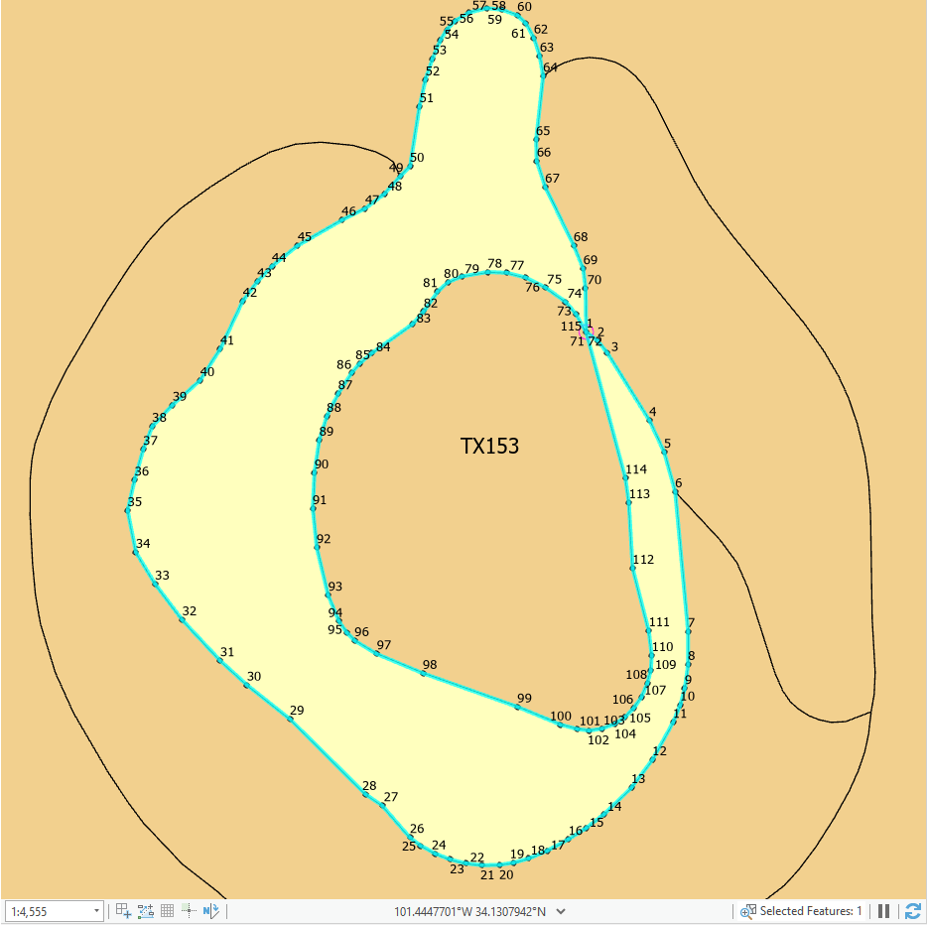
Re-ordered geometry now meets OGC specification for MULTIPOLYGON.
Using the Buffer(0) method or using arcpy.Append seems to correct the problem. This polygon is no longer flagged as an Invalid geometry.
Valid geometry

