Slide 1
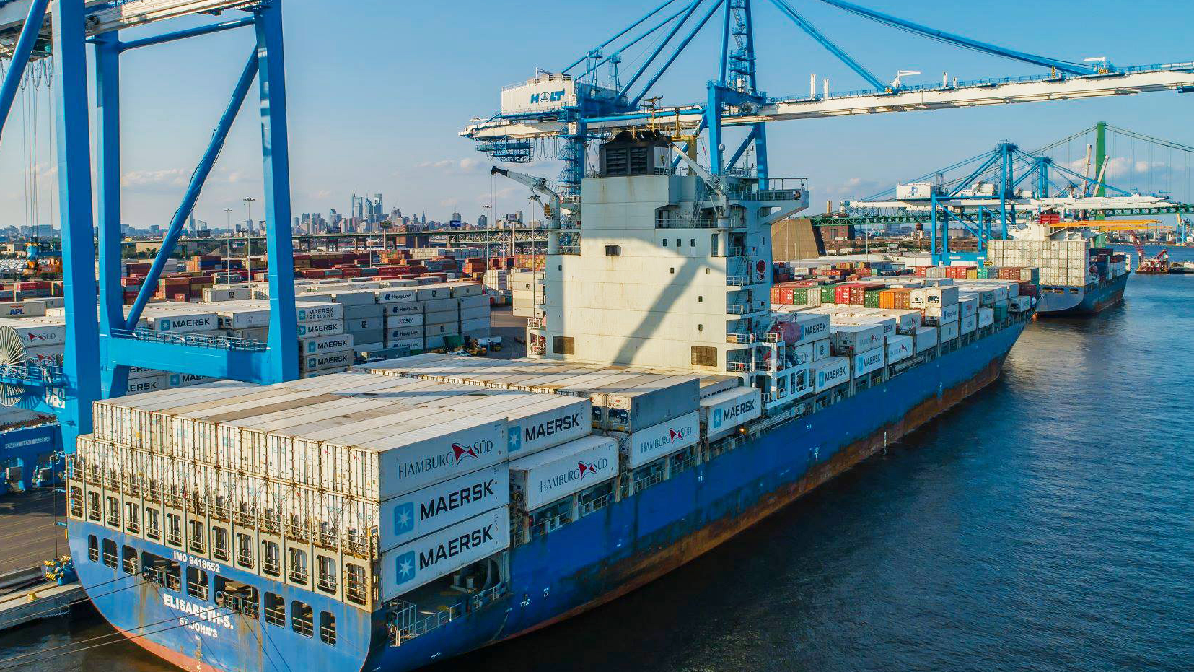
FlySpy
Predicting Invasive Fruit Fly Entry Into the US

Slide 2
Concept
Invasive fruit flies cause millions of dollars of damage to the USA every year.
They enter through ports of entry, land, sea and airports.
Our systems goal is to determine the riskiest times and countries from which imports and passengers arrive every year.
We seek to make suggestions on a triaged approach to stopping the most fly outbreaks for the least investment of money and manpower.

Slide 3
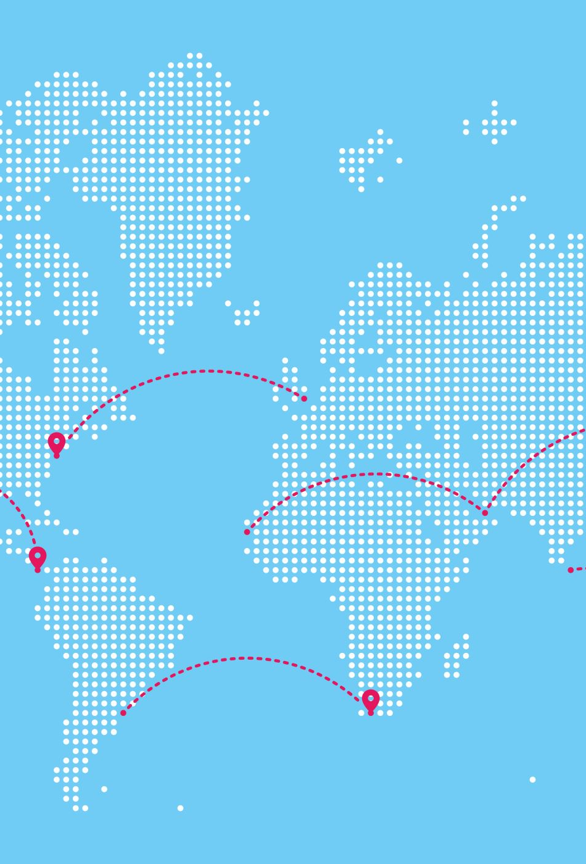
Approach
Aggregate data related to fruit fly outbreaks in the US, sorted by jurisdiction, fly type, date, etc.
Collect trade and flight data from countries around the world, land, sea, and air imports and passengers.
Design a statistical/ML model to determine the riskiest countries to import from during certain times of the year.
Make suggestions regarding increased screening for imports and flights from those countries, during only their riskiest seasons, to increase efficiency of resources in preventative screening.

Slide 4
Dataset explanation
Predownloaded data
API restrictions
Internet issues
Covert into CSV
GeoPandas issues
Better fit for SQLite conversion

Slide 5
Risk score
For each country, we compute the Pearson correlation between lagged inbound traffic (flights or freight) and fruit fly detections.
We sum the total detections for that country.
Base Risk =(max(correlation,0)+0.05)×(0.5×log(1+traffic total))×log(1+detection total). This lowers the effect of massive volumes of freight to try and stop it from over selecting for just high traffic.
If a country is a known fruit fly origin, the risk is multiplied by 2.5. This is an attempt to outweigh the impact of confounding variables and have our calculations focus on fruit flies.

Slide 6
Tech Demo

Slide 7
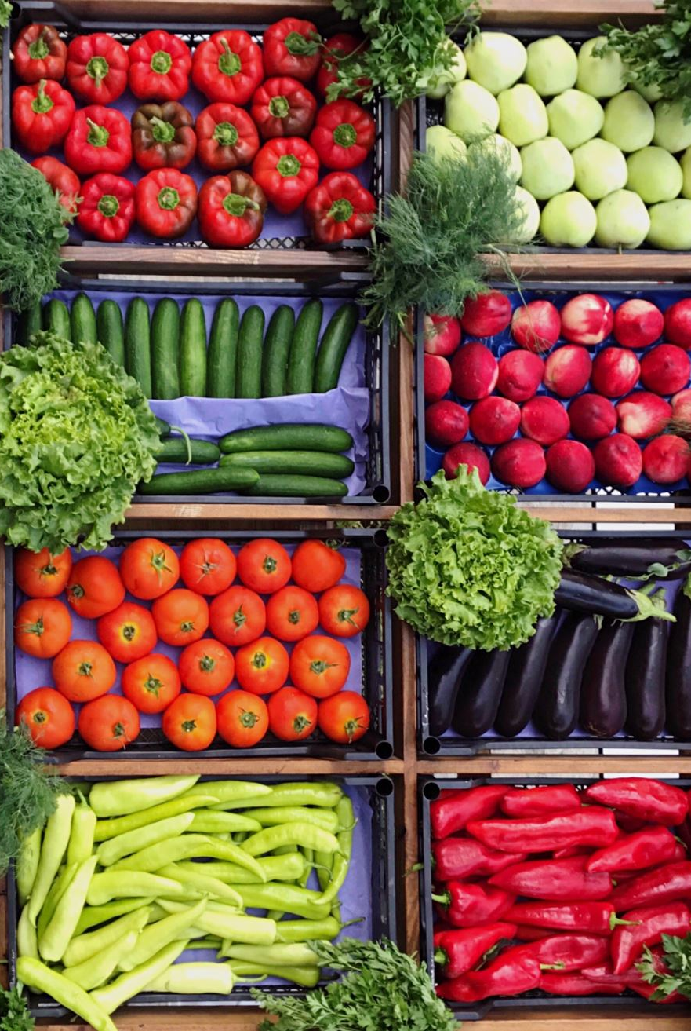
Reflection
Our data was not large enough or specific enough to make reliable predictions about fruit fly risk. For example, we did not have data about import contents, nor a sufficient way to map the destination of imports to counties. More time would allow for more in-depth research on datasets to use in our system.
Confounding variables. The seasonality of fruits, vegetables, and international travel means that we have high correlations between outbreaks and recreational travel from other countries. This makes our conclusions less reliable, as we do not have specific enough data to rule out erroneous correlations.
Considering expanding our project, more time and investment into data aggregation and linking would be the highest ROI improvement we could make. Suggested data to procure, product data for outbreaks (what the flies were found infesting), domestic shipping and receiving data, specific imported items and produce data.

Slide 8

Vision
The data we want to use to better predict outbreaks and recommend screening would be massive. Thus our system is designed to trim it.
Our system seeks to only consider incoming flights/shipments to counties of interest and surrounding counties. Our system would only seek to consider import/travel data during the months leading up to past outbreaks.
This trimming of the data should reduce the computation needed and increase the relevance of all data considered.
Our system, if fully worked out, would seek to provide recommendations of the most efficient increases in screening at our ports of entry.

