Slide 1
ACM presents: Digital Art Show!!!

Slide 2
Out of This World!
By
Clemente Rivetti
and Sean Schrag-Toso

Slide 3
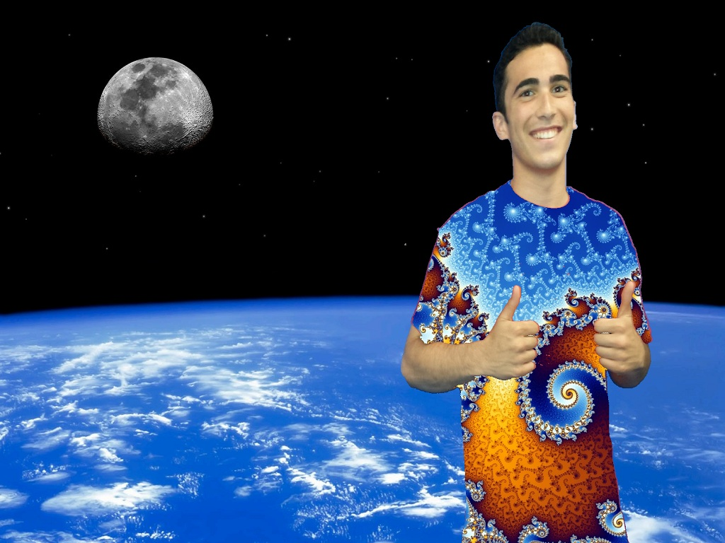

Slide 4
Ian, Fresh Prince, Pitchfork
By
Ian Lituchy
and Michael Thilenius

Slide 5
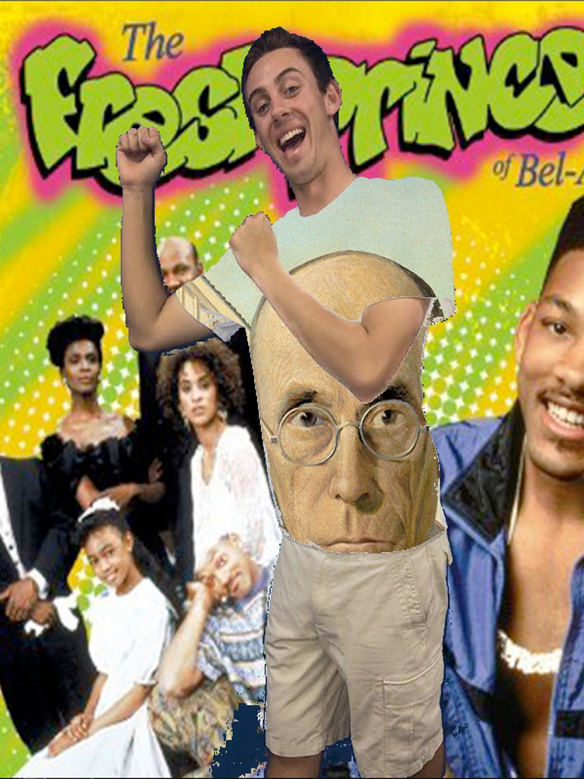

Slide 6
Green Minions
By
Valeria Estrada
and Kimberly Ramirez

Slide 7
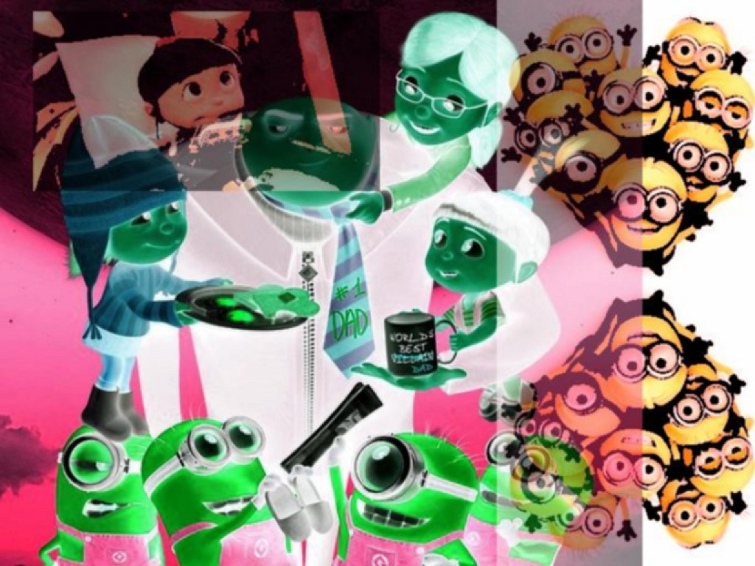

Slide 8
A Taste of Summer
By
Allison Heimlich
and Nicole Peterson

Slide 9
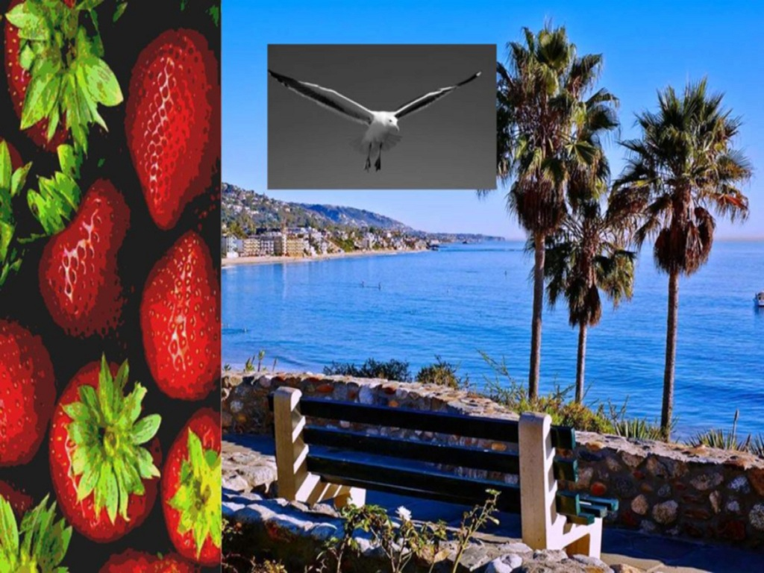

Slide 10
Final Canvas
By
Rachel Lincoln
and Brianna Castaldo

Slide 11
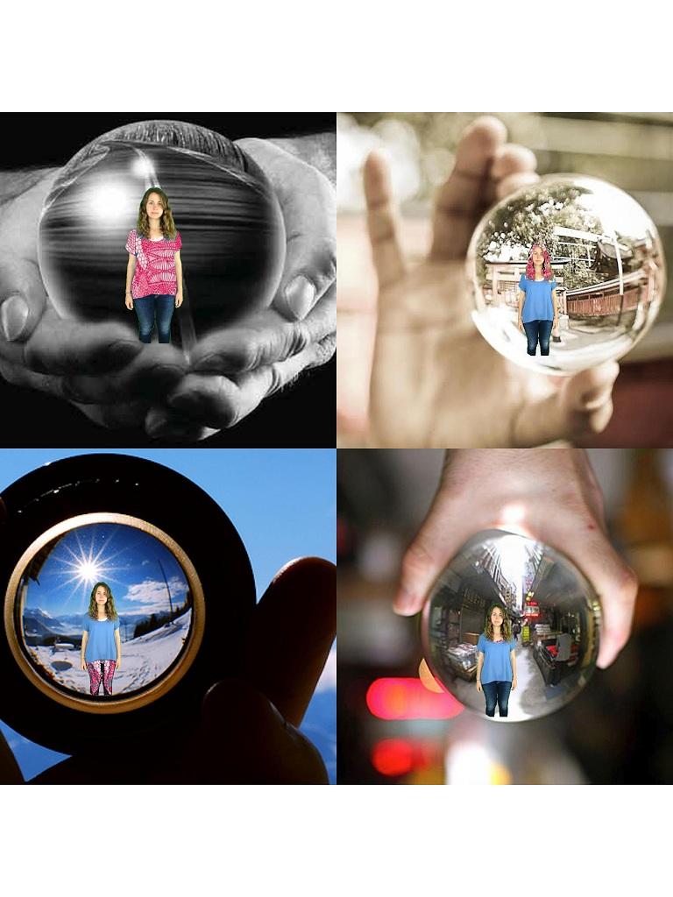

Slide 12
Chromakey
By
Felicia Wang, Lily Wang,
And Jennifer Garcia

Slide 13
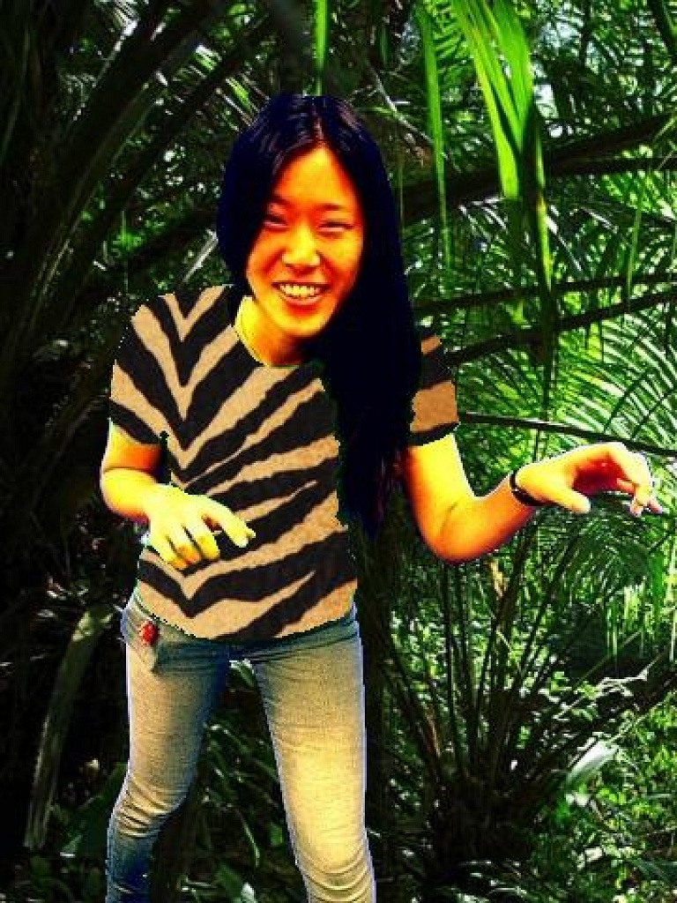

Slide 14
Art Show Picture
By
Sami Armstrong
and Danielle Watson

Slide 15
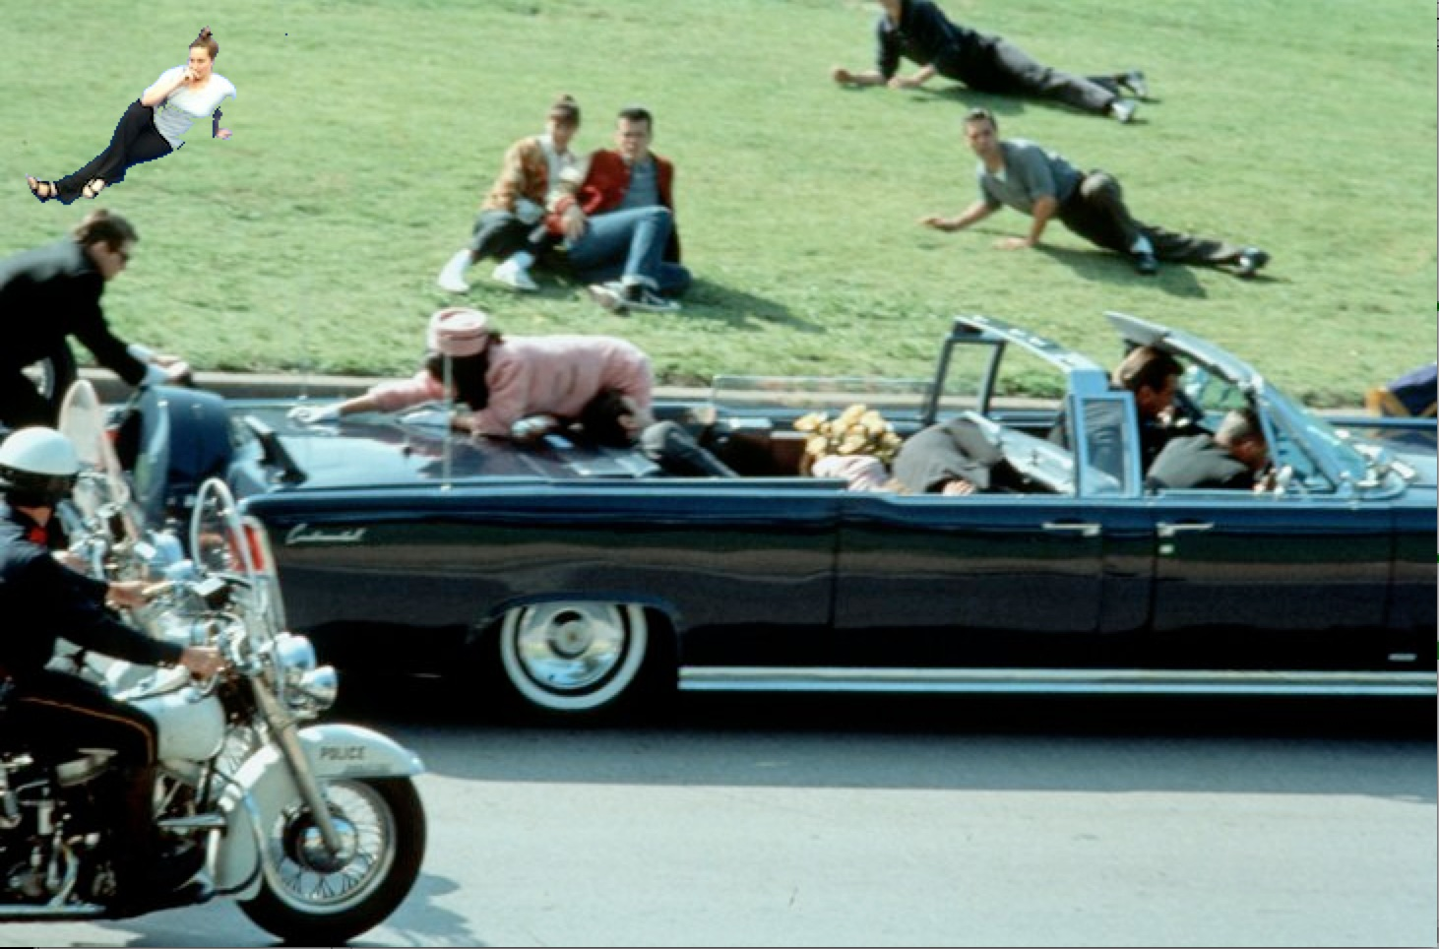

Slide 16
Thank You, Enjoy the show!

