Slide 1
Sequence of Events Open Forest – NRM Web Service Development
Complete Web Service Setup – Open Forest (Target Completion date, 8/24)
Includes ensuring that ports are open for two way communication
Done
Test Connectivity to Web Service – NRM (Target Completion date, 8/26)
Done
Determine exceptions in the web service processing and data validations for reporting – NRM (Target Completion date, 8/28)
Done
Review exceptions and establish expectations - NRM & Open Forest (9/7)
Web Service Provision i.e. develop components to expose data to NRM - Open Forest (??)
Web Service Consumption i.e. develop components to consume data from Open Forest – NRM

Slide 2
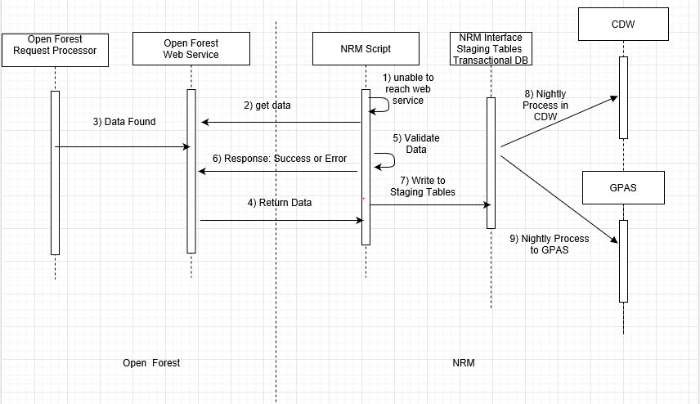
NRM TIM-Open Forest Permit Data Process TIM-Open Forest Permit Data Sequence Diagram – The following diagram explains the sequence of events in the WEB SERVICE, to retrieve the permit data from Open Forest

Slide 3
NRM-Open Forest WS Process
Start
Fix and Rerun
1 . NRM calls Open Forest WS (Connect to WS);
HTTP Fault/Unable to Connect?
Y
Exception Error Message; Auto send email message to Open Forest;
Rollback
N
No data Found
2. Get Data (Status = PENDING?)
N
3. Data Found
Y
Exception Error Message; Auto send NRM-REJECT Message to Open Forest;
Rollback
4. Return Data; 5. Validate Data
6. Success
N
Y
End
Populate/Insert into Staging Table. Auto Send Success Response: NRM-PROCESSED message to Open Forest

Slide 4
Assumptions
Open Forest will maintain a set of statuses for all transactions so NRM will know what transactions to pull when we access the service.
Three statuses are proposed so far:
PENDING (Initial Status),
NRM-PROCESSED (Final Status)
NRM-REJECT (Intermediate status)
NRM will use the ii_emails procedure to send messages on connection failures.

