Slide 1

Administrator User Manual
JULY, 2024
Implemented by ELEVATE Ltd.
Funded by the Bureau of International Labor Affairs, USDOL IL358082075K

Slide 2
Table of contents
Background on the GTP
Creating your account
Administrator Functionality
User Management: Overview
User Management: Inviting Users
Farm Management
Farm Management: Add new farm group
Grievance Reports
Grievance Reports: Create new
QR Code Management

Slide 3
Global Trace (GT)
Some background information for the project here

Slide 4
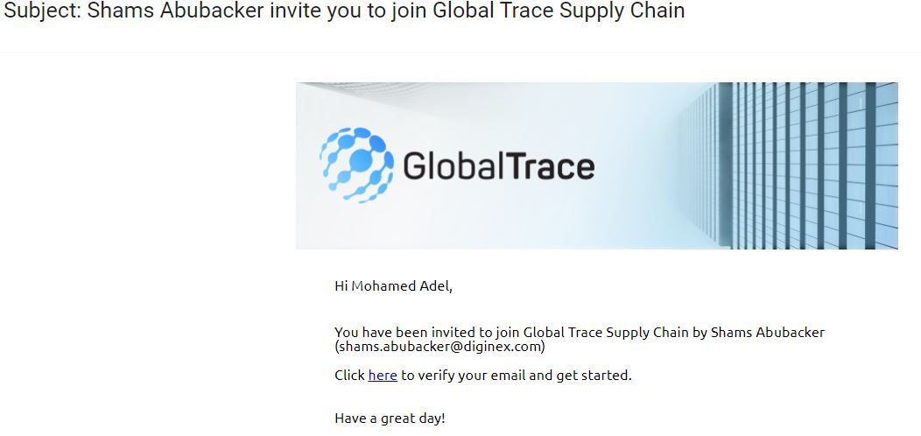
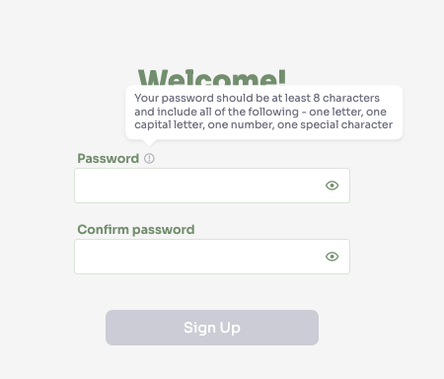
Creating your account
You will receive an invitation in your mailbox to create an account
Click on the link in the email, and set a password
Follow the guidelines on how to create a strong password
After setting a password, login with your new account.

Slide 5
Administrator Functionality
User Management
Farm Management
Incident Reports
QR Code Management
DNA Test
Settings

Slide 6
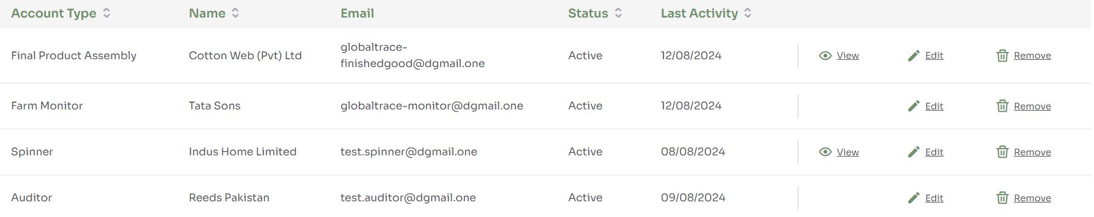
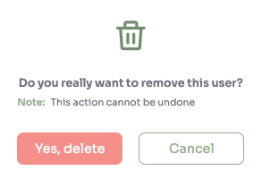
User Management: Overview
List of users with: type of account, name of business (or name of individual user when farm monitor or administrator), email address, status of account, last activity
When user is invited but has not accepted, can resend invitation
Click on View to view supplier risk assessment
if ‘Remove’ selected, a warning is displayed

Slide 7
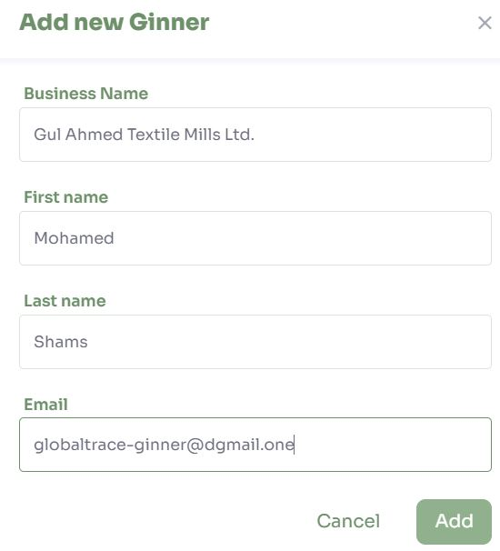
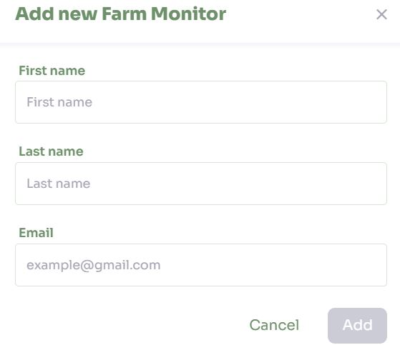
User Management: Inviting Users
For admin, auditor and farm monitor accounts, require basic contact details: name, email
For brand, require: brand name, contact name, email
For supplier(ginner/spinner/fabric mill), require: business name, contact name, email
Email invite sent to user

Slide 8
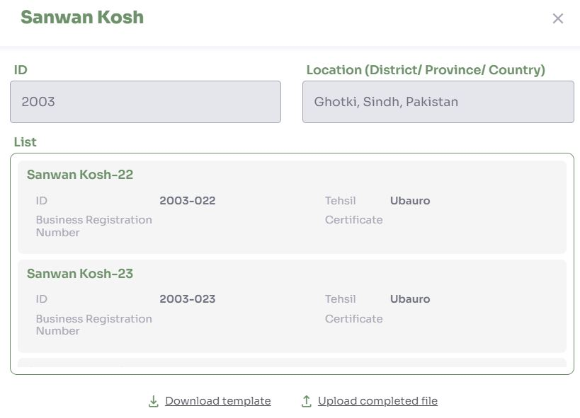
Farm Management
List of existing farm groups, with ‘View’ and ‘Remove’ functions
When ‘View’ is selected, details farm risk assessment are displayed
Download current risk assessment as .xlsx
Update risk assessment

Slide 9
Farm Management: Add new farm group
Download farm group template and perform offline baseline assessment
See farm group definition for details on creating farm groups by inputting basic information – Farm Group ID, name, location; selecting a sample
Upload farm group risk assessment
System will validate input

Slide 10
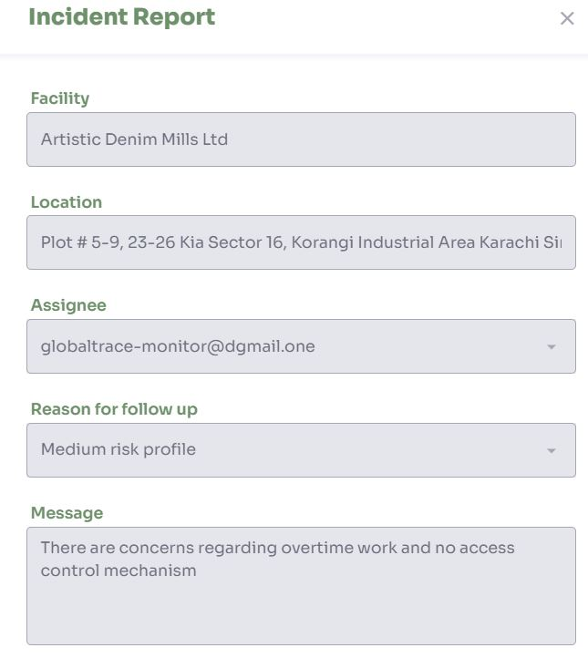
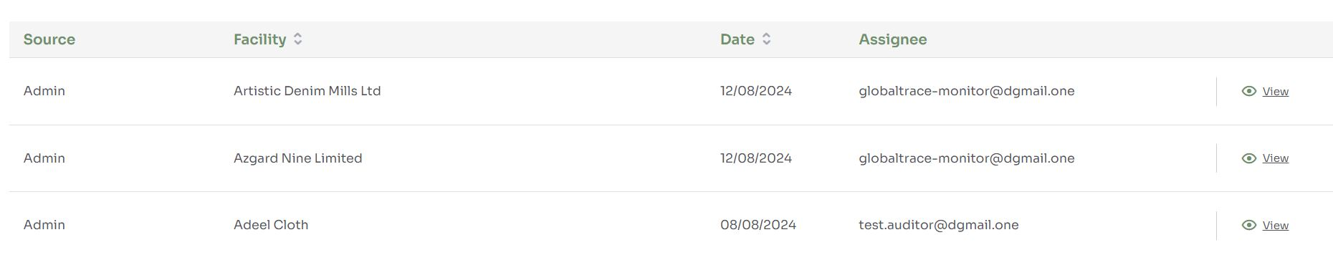
Incident Reports
View list of all incidents created by administrators and community risk requests received from farm monitor
Select to view detailed information of the grievance

Slide 11
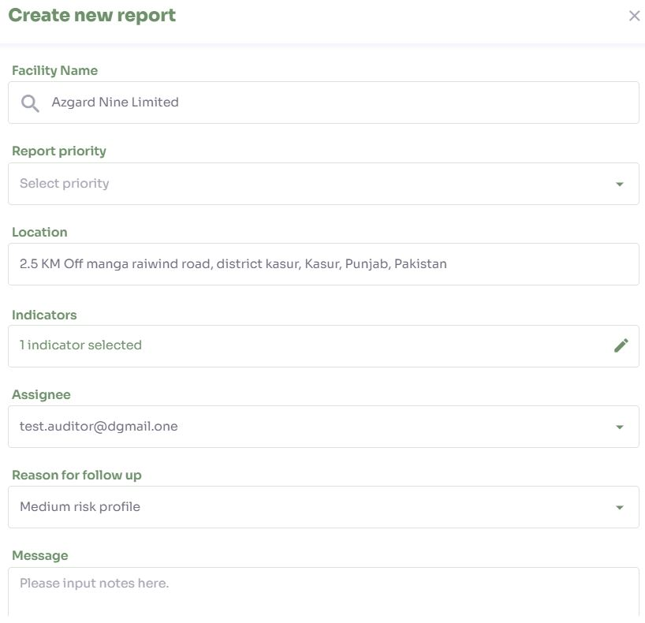
Incident Reports – Create new
Admins receive incident report from external mechanisms
Create new report on GTP
Facility Name – Business name
Report priority – select priority between 1 to 5
Location – Pulled based on facility
Forced/Child labor indicators
Assignee – Farm Monitor/Auditor who can provide a response to the grievance
Reason for follow up – High/Medium/Low/Annual
Message – Detailed notes of the issue

Slide 12
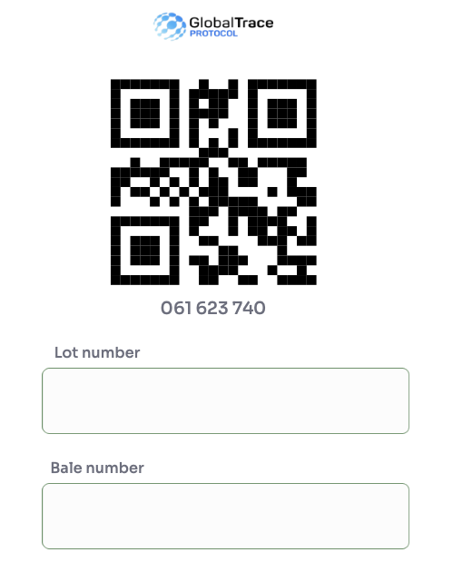
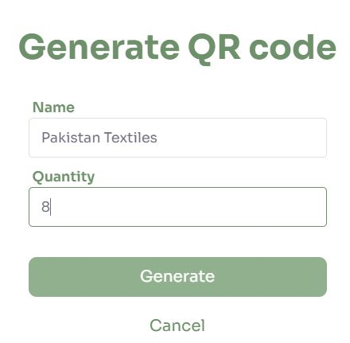
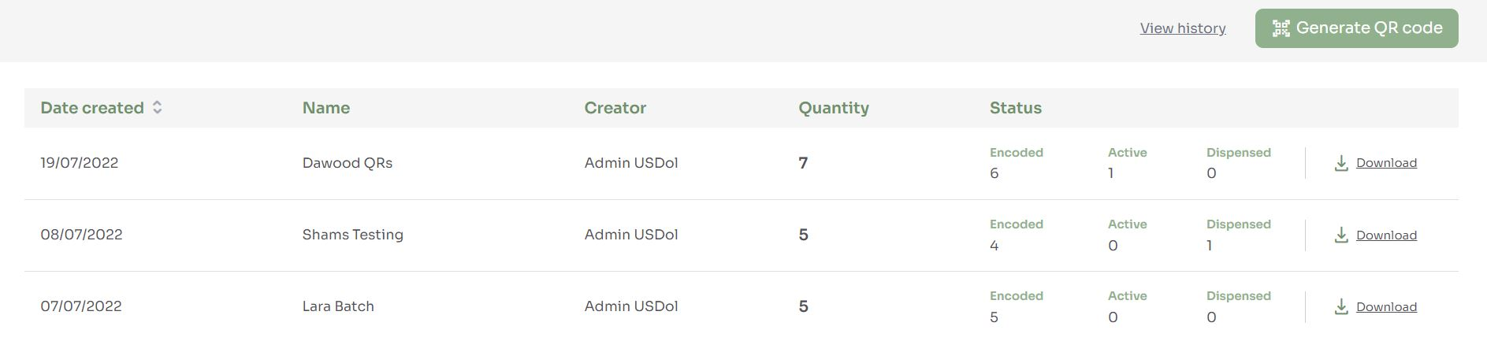
QR Code Management
View all batches of QR codes
Status options
Encoded- created but not used
Active – assigned to a product(bale)
Dispensed – assigned to a product(bale) and bale converted into another product
Download QR codes of each batch
Create batches to QR codes
Delete individual batches of QR codes from history

Slide 13
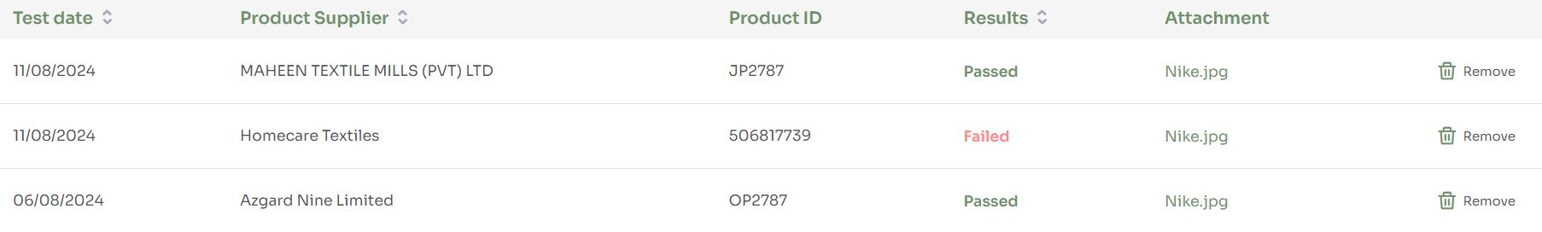
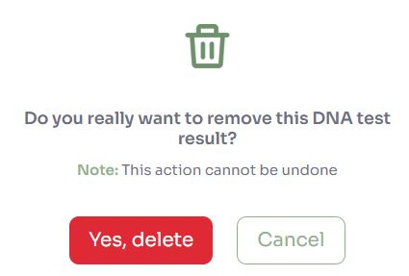
DNA Test
DNA tests are used to verify to origin of cotton product
Displays DNA test records with test date, product supplier, product ID, status and attachment
Remove DNA test records

Slide 14
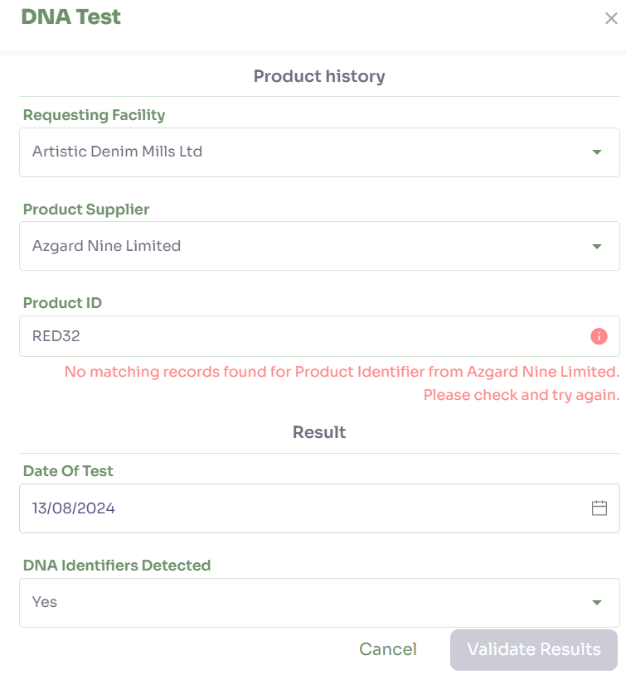
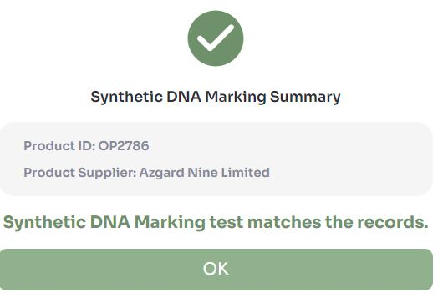
Create DNA test
Input product information such as product supplier and product ID to be traced
System shows inline error if there are no product ID registered to the supplier
Select test date and list of DNA identifiers
System will validate results with input data and displays results

Slide 15

Funding is provided by the United States (U.S.) Department of Labor (DOL) under cooperative agreement number IL-35808-20-75-K. One hundred percent of the total costs of the project or program is financed with USG federal funds, for a total of $4 million dollars. This material does not necessarily reflect the views or policies of the United States Department of Labor, nor does mention of trade names, commercial products, or organizations imply endorsement by the United States Government.

Slide 16
Administrator User Manual
THANK YOU
Implemented by ELEVATE Ltd.
Funded by the Bureau of International Labor Affairs, USDOL IL358082075K

