Slide 1

Brand User Manual
JULY, 2024
Implemented by ELEVATE Ltd.
Funded by the Bureau of International Labor Affairs, USDOL IL358082075K

Slide 2
Table of contents
Introduction to the platform
Creating your account
Onboarding
View/Add supplier
Supplier risk assessment
Trace Product
Corrective Action Plan
My Profile- Edit Profile, User Management
Forgot Password

Slide 3

Introduction to the platform
Application can be accessed from the below URL
https://globaltrace.uat.dgnx.io/sign-in

Slide 4
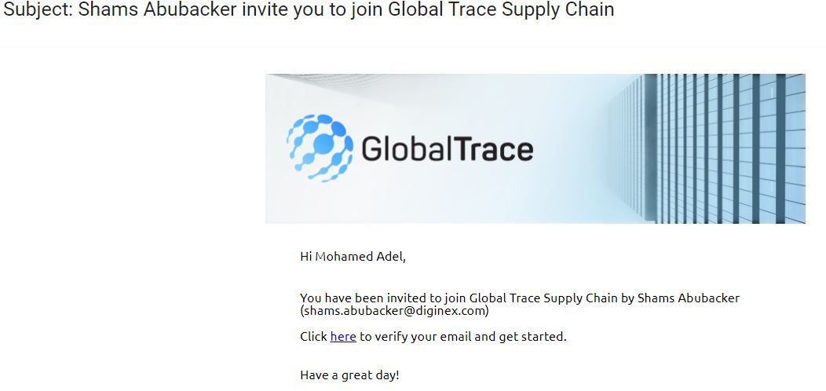
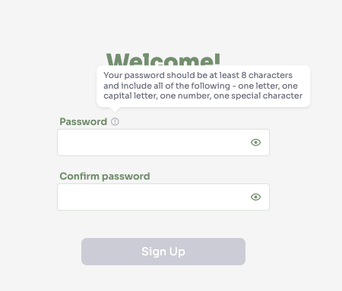
Creating your Account
On receipt of the invitation from GT, please click the link
Setup password
Follow the guidelines on how to create a strong password
On successful sign-up, you will begin process of onboarding

Slide 5
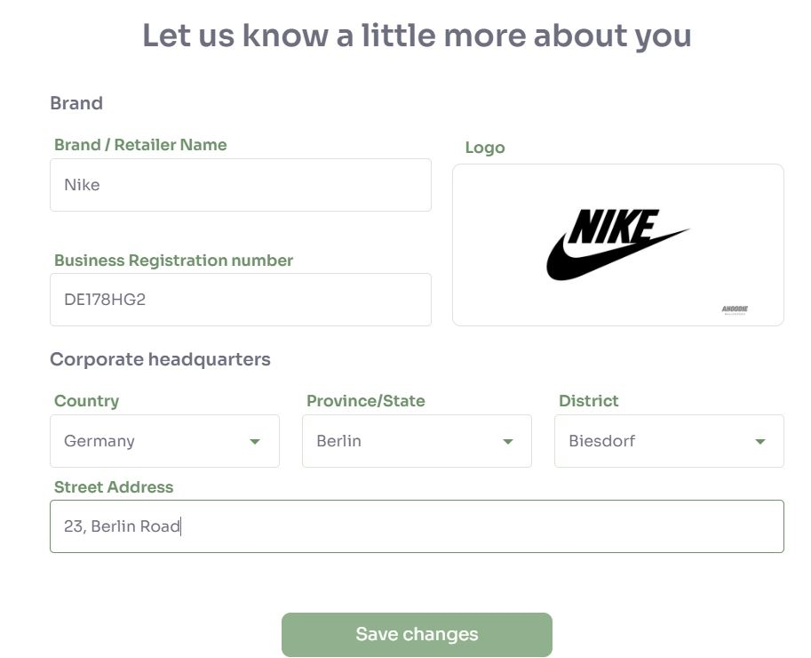
Onboarding: My Profile
Input basic details such as name, business registration number, logo
Corporate Headquarters – detailed address

Slide 6
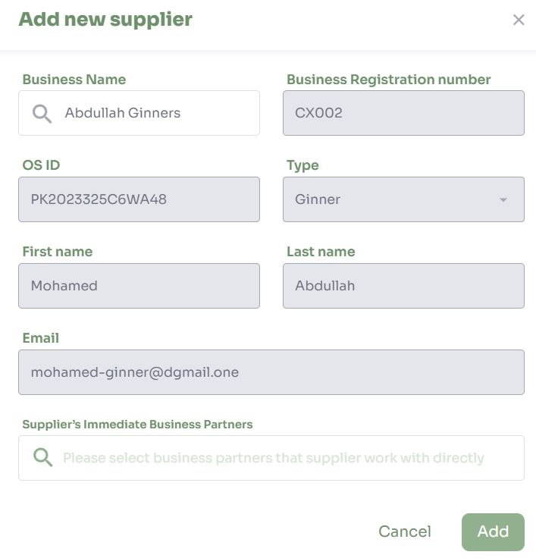
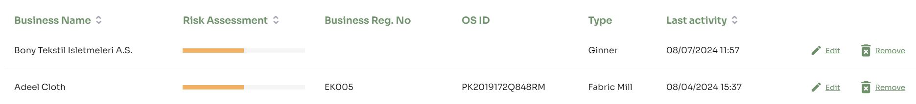
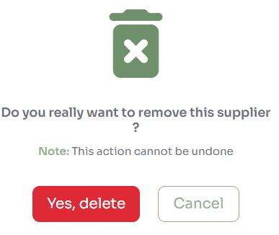
Add Supplier
Suppliers can be added individually or bulk import
List of suppliers with their type, Business name, Risk Assessment, Business Reg. no, Open Supply Hub ID and Latest activity
Delete supplier by clicking ‘Remove’

Slide 7
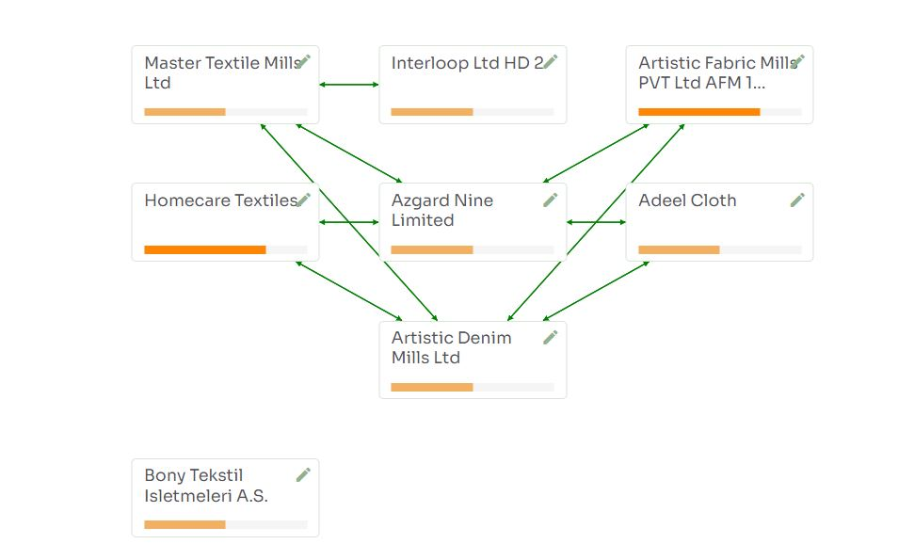
View supplier – Map view
Map view shows relationship between suppliers in the value chain
Click on any box to view detailed risk assessment

Slide 8
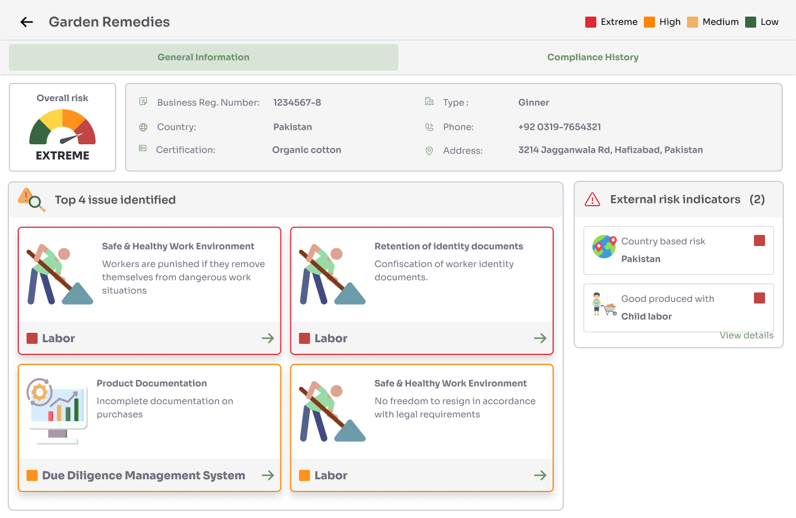
Supplier risk assessment
General Information – Shows summary of top 4 issues, list of external risk indices, demographic information and overall risk
External risk indices – Click view details to find the URL and detailed description of each external risk source

Slide 9
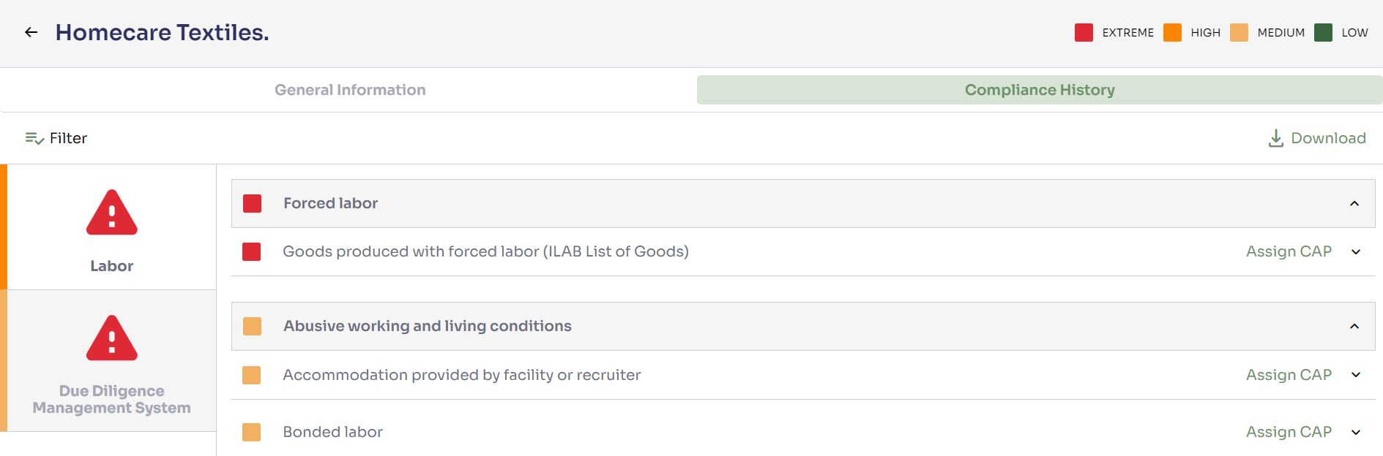
Compliance History
List of all incident reports from all sources – SAQ’s, Assessment (ESG) users, external risk indices
Category on left and corresponding reports on the right pane
Click ‘Download’ to get PDF version of detailed risk assessment
Assign Corrective action plan to suppliers

Slide 10
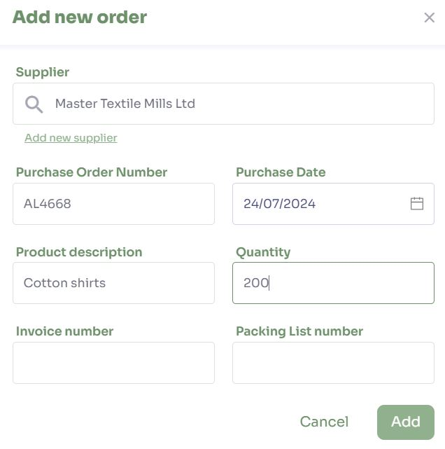
Create order
New order can be created by submitting
Purchase order number
Product description
Product quantity
Purchase date and Purchase Order/Invoice/Packing List number
An order is required to begin product trace

Slide 11
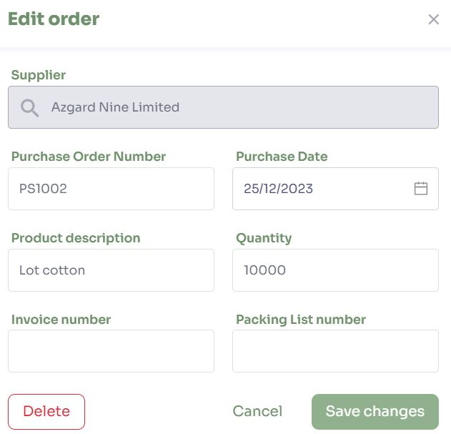
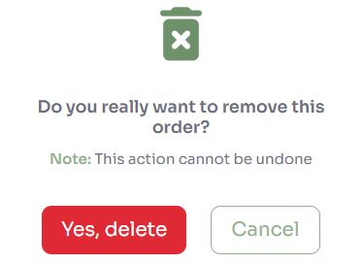
Edit/Delete order
Edit details of an existing order
Delete an order

Slide 12
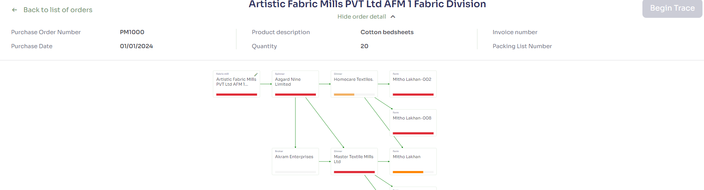
Trace an order
Display summary of order details at the top of the page​
Add business partners by clicking ‘Add another supplier’
Add as much information as you know
Once all details have been input, click 'Begin Trace’
System will find all transactions through the chain based on purchase date and purchase order number/Invoice number and Packing list number
If there is no match based on input data, then system will display all transactions within 2 weeks period from purchase date​ for each supplier type
System displays error alert if unable to make any connections​

Slide 13
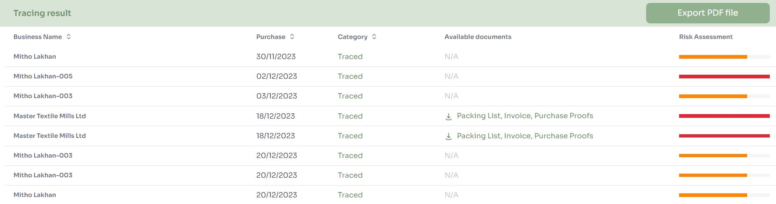
Results of Trace
Tracing table shows the following information for transaction based on the search criteria
Business Name - Name of the facility​
Purchase date of transaction​
Category - Supplier mapping(user added)/Traced​
Available documents - Supporting documents uploaded during purchase/sale transaction​
Risk assessment - overall risk of the facility​

Slide 14
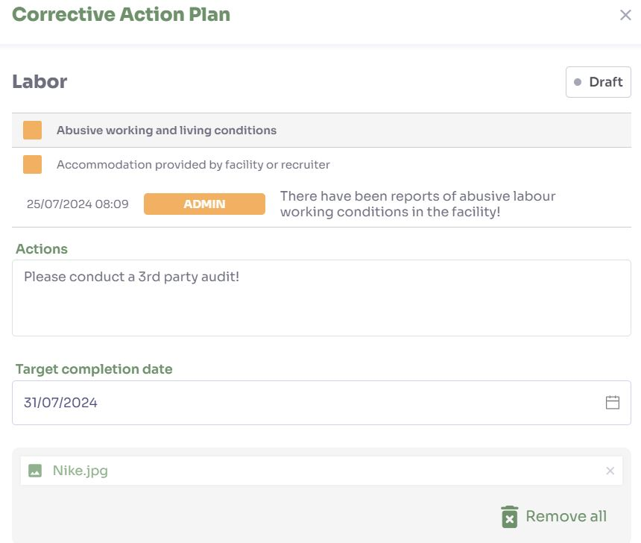
Assign Corrective Action Plan
Click ‘Assign CAP’ against any incident report
Input detailed corrective actions and set target completion date
After submit, CAP will be assigned to the facility

Slide 15
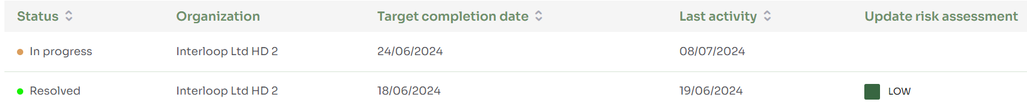
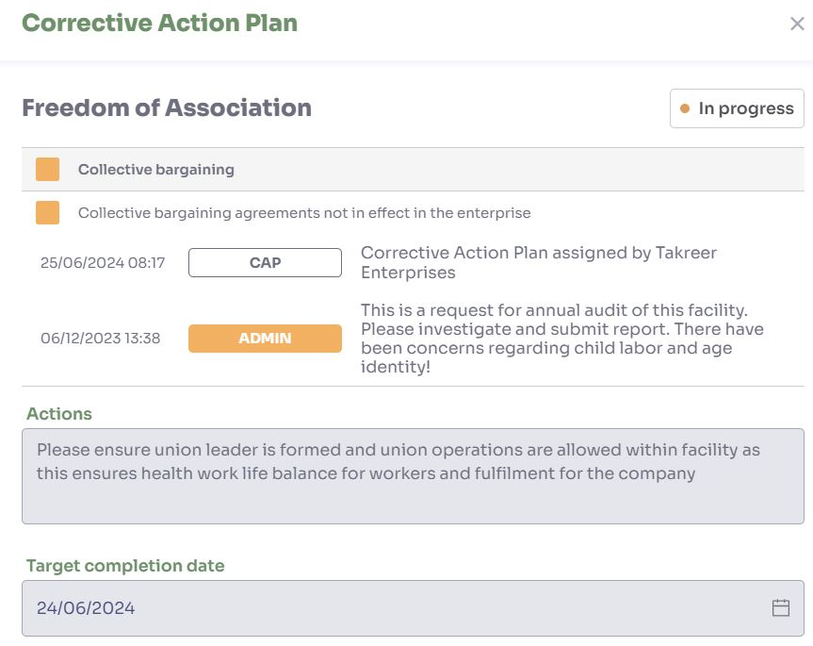
Corrective Action Plan
View all CAP records with their status and target completion date
Click on CAP record to view detailed information with actions, communication exchange and target completion date
CAP can be approved after satisfied with actions taken by the facility
After the CAP resolution, new risk level is assigned

Slide 16
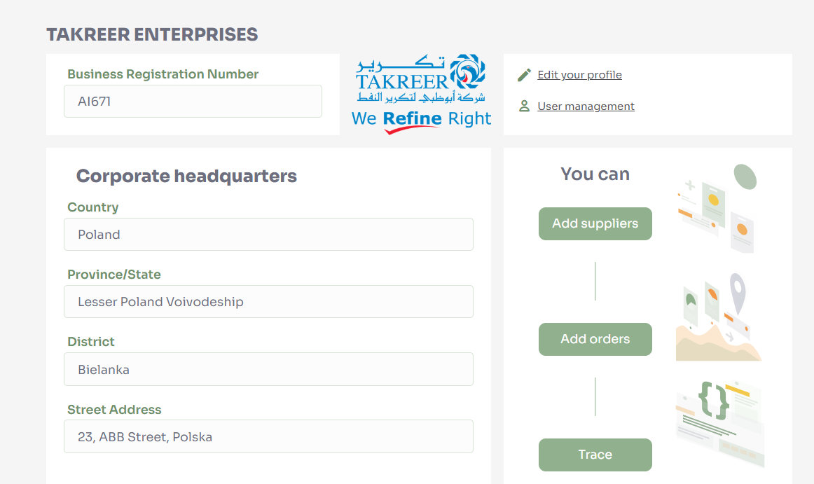
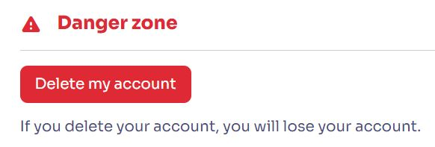
My Profile: Edit Profile, Delete own account
Enables brand to edit details set during onboarding
User can delete their own account: if the account is deleted, all data will be lost

Slide 17
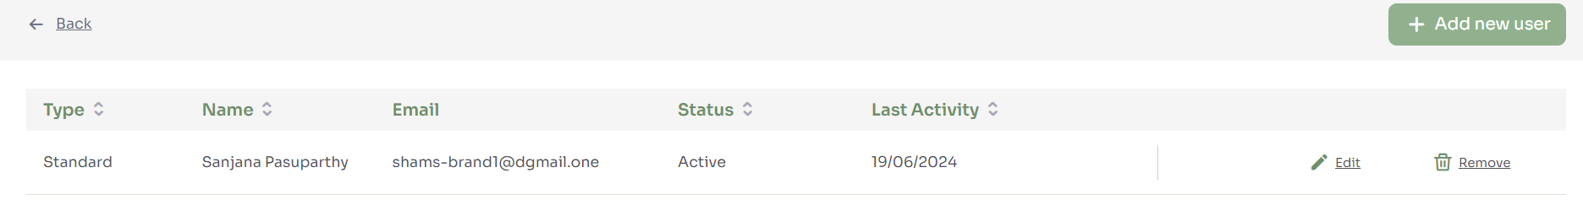
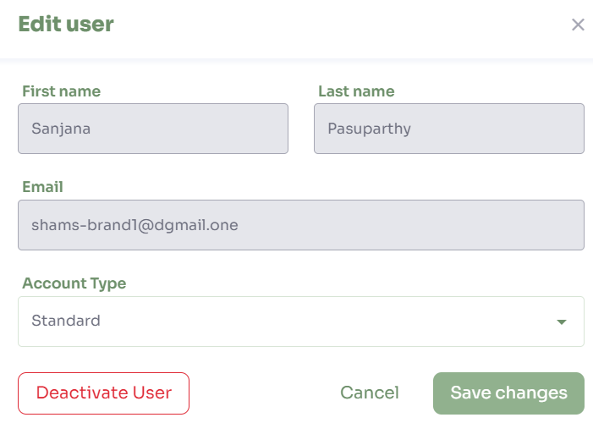
My Profile – User Management
Organization admin can invite multiple users as Standard/Admin
Can deactivate and delete users

Slide 18
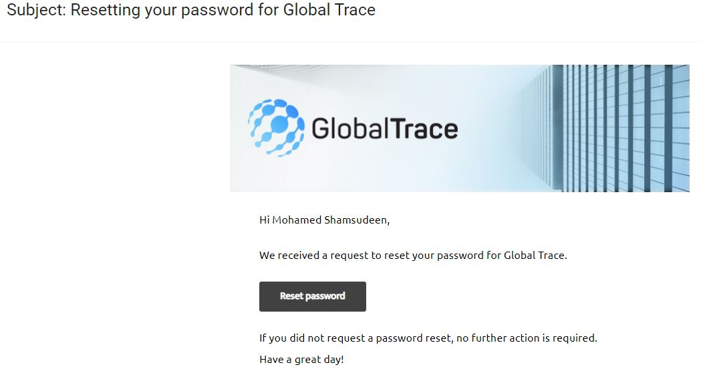
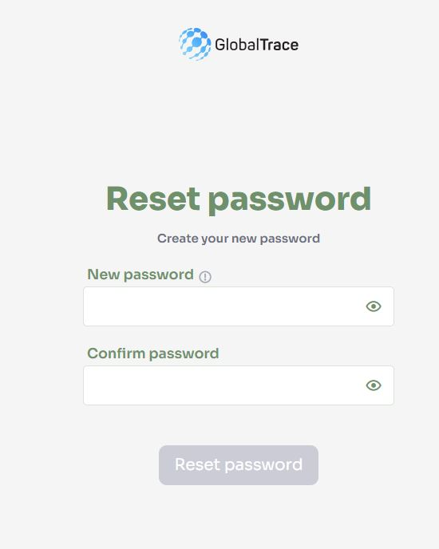
Forgot Password
If you forget your password, use ‘Forgot Password’ link on login page
Email sent to registered address
Click on link in email to reset your password

Slide 19

Funding is provided by the United States (U.S.) Department of Labor (DOL) under cooperative agreement number IL-35808-20-75-K. One hundred percent of the total costs of the project or program is financed with USG federal funds, for a total of $4 million dollars. This material does not necessarily reflect the views or policies of the United States Department of Labor, nor does mention of trade names, commercial products, or organizations imply endorsement by the United States Government.

Slide 20
Brand User Manual
THANK YOU
Implemented by ELEVATE Ltd.
Funded by the Bureau of International Labor Affairs, USDOL IL358082075K

