Slide 1

Ginner User Manual
JULY, 2024
Implemented by ELEVATE Ltd.
Funded by the Bureau of International Labor Affairs, USDOL IL358082075K

Slide 2
Table of contents
Introduction to the platform
Creating your account
Onboarding
Home Screen
Product activities
View History
Side Menu - Edit Profile, Manage Business Partners
Forgot Password

Slide 3
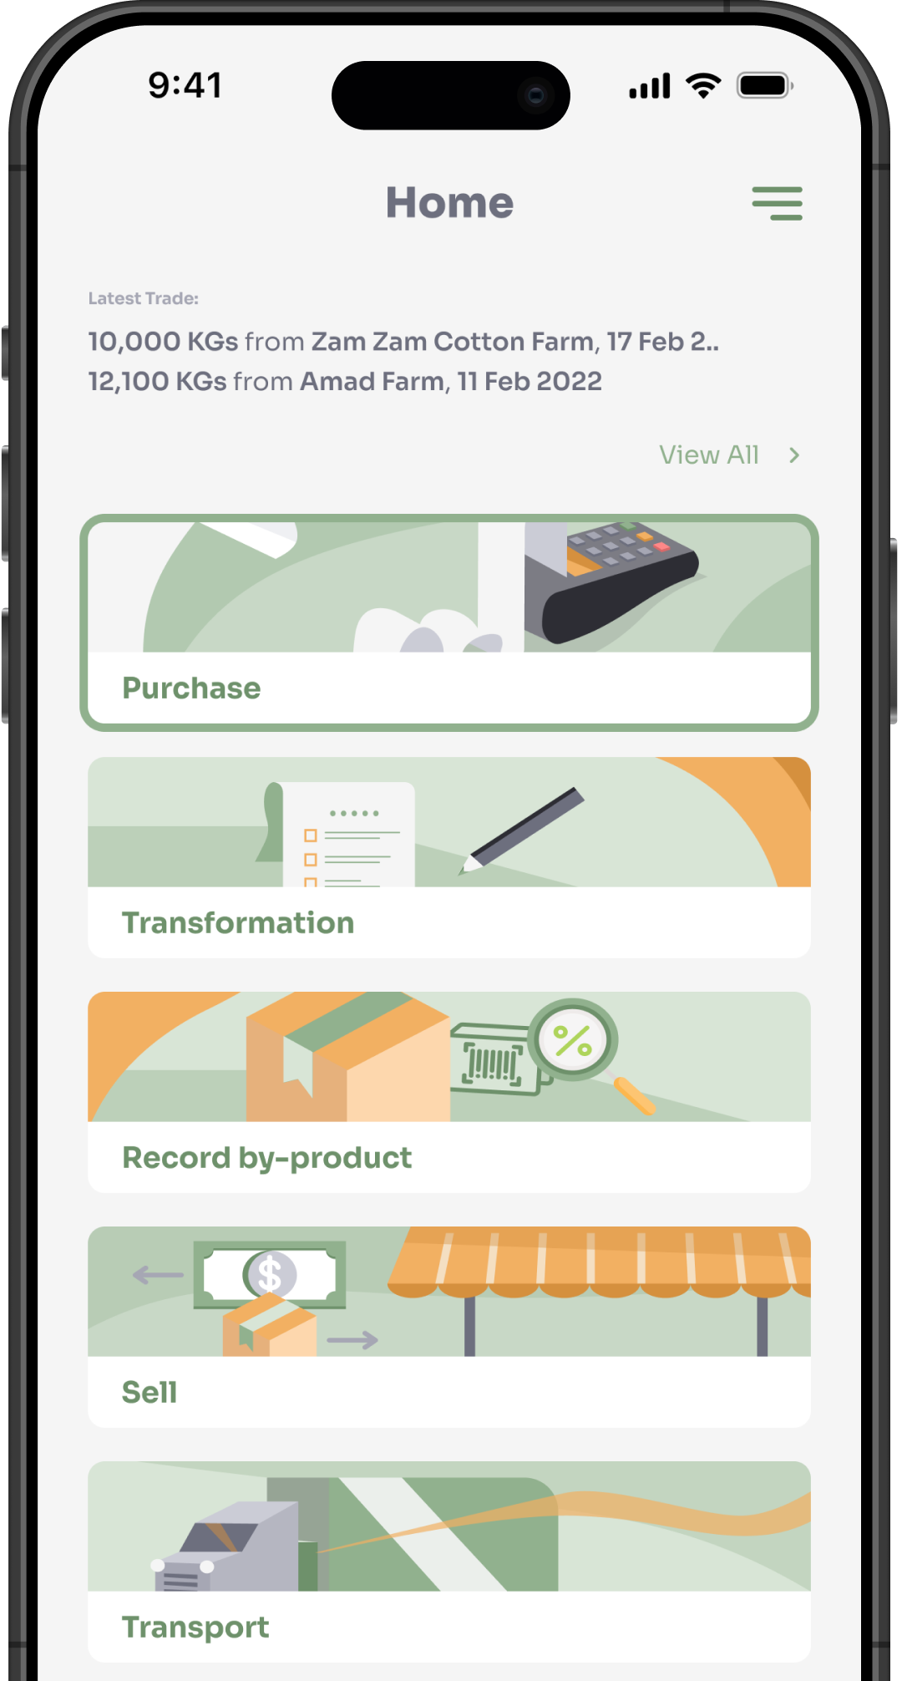

Introduction to the platform
Application can be accessed from the below URL
https://globaltrace.uat.dgnx.io/
Mobile application can be downloaded from Google Play Store and the App Store
AppStore Download:
[AppStore Link]
Play Store Download:
[Play Store Link]

Slide 4
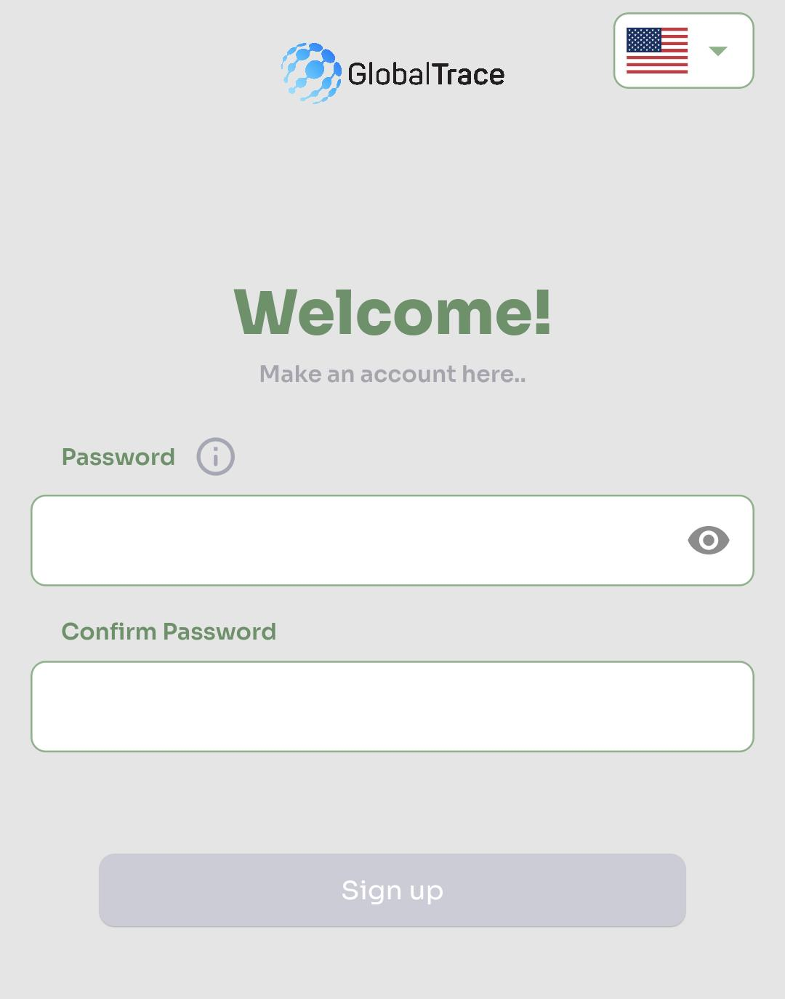
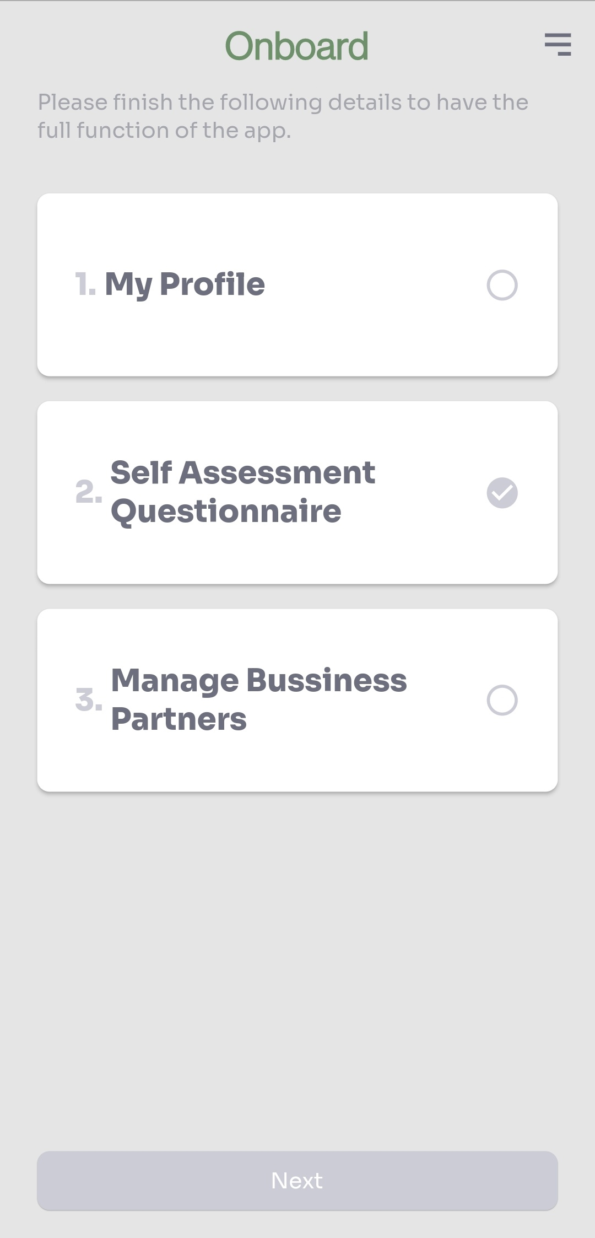
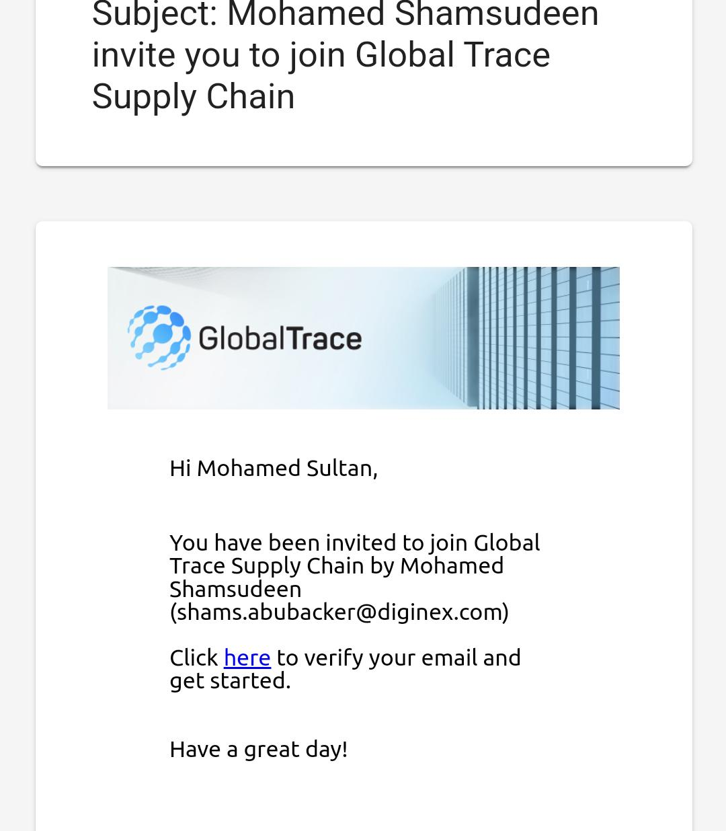
Creating your Account
On receipt of the invitation from GT, please click the link
Setup password
Follow the guidelines on how to create a strong password
On successful sign-up, you will begin process of onboarding
Complete Profile
Self Assessment Questionnaire
Manage Business Partners
Each process must be complete to access GT functionality

Slide 5
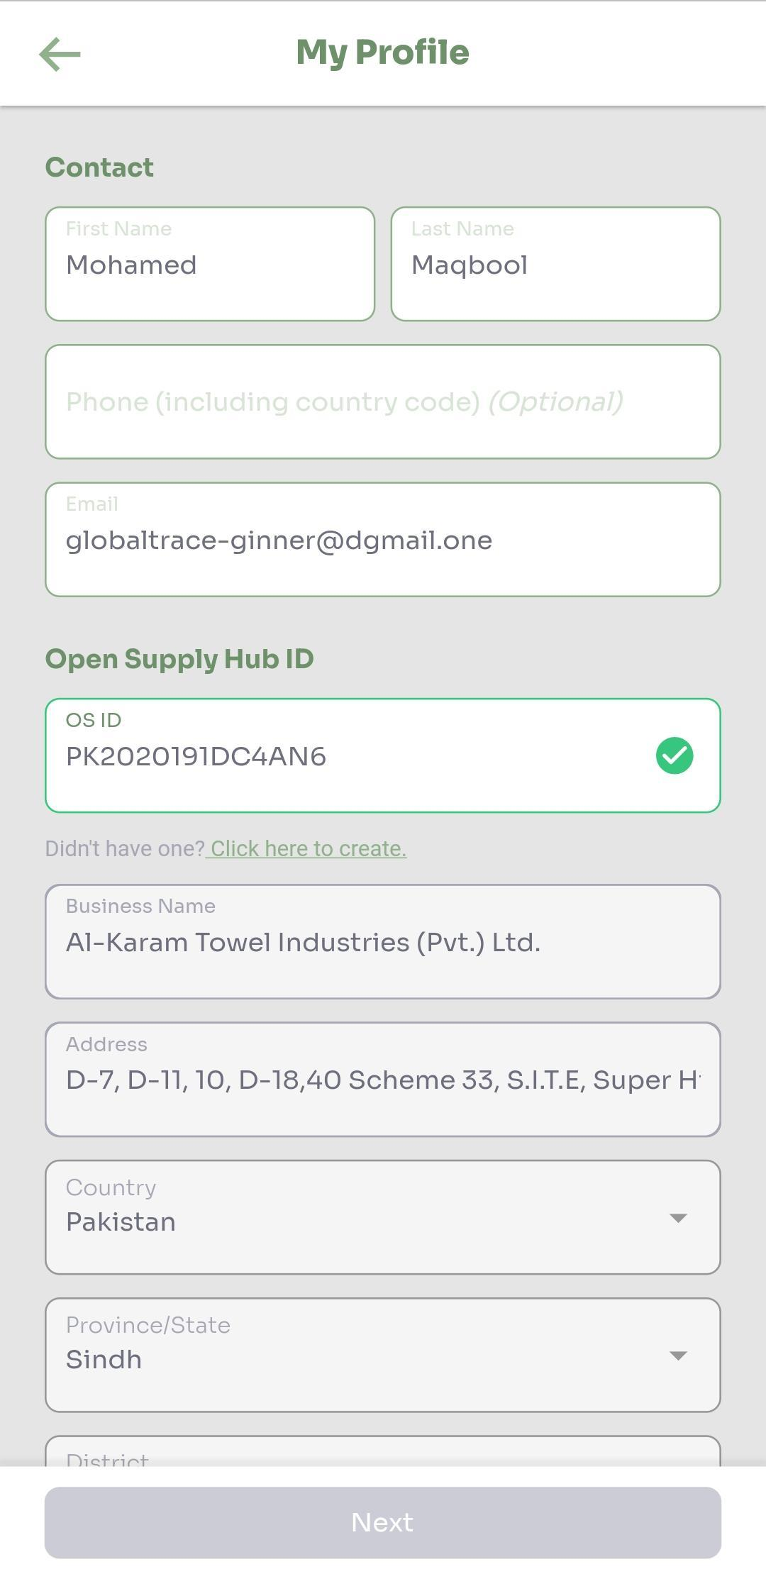
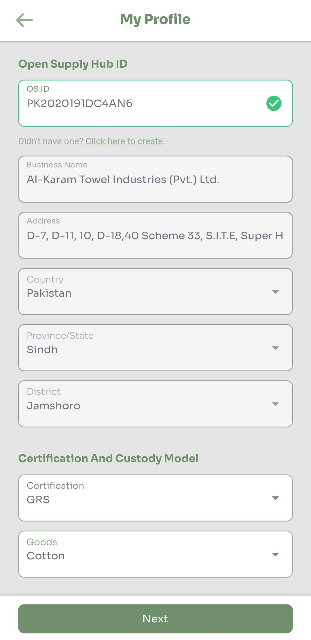
Onboarding: My Profile
First/Last Name - auto-populated from the GT’s invitation request, but can be updated
Business Registration Number – government assigned business registration number
OSH ID – unique identifier assigned by the Open Supply Hub
Add existing OSH ID, or register for a new ID
Certification – Select your cotton certification
Goods – Select goods that your facility produces
Chain of Custody – Product Segregation

Slide 6
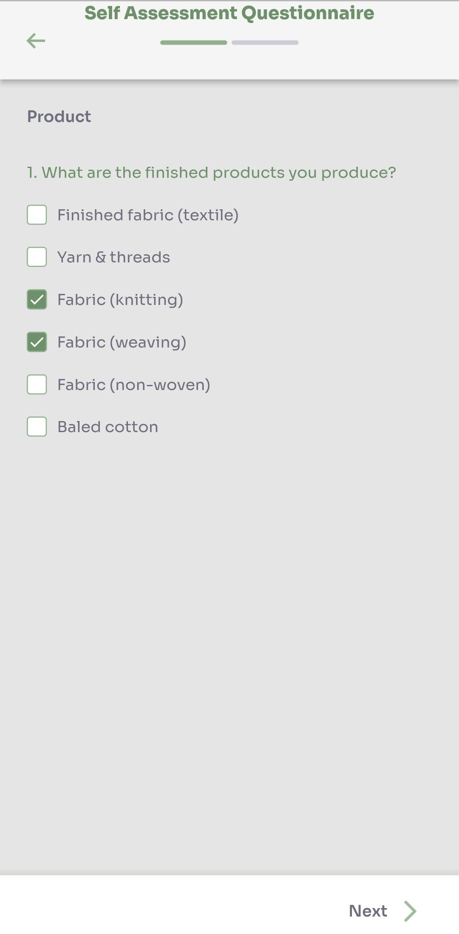
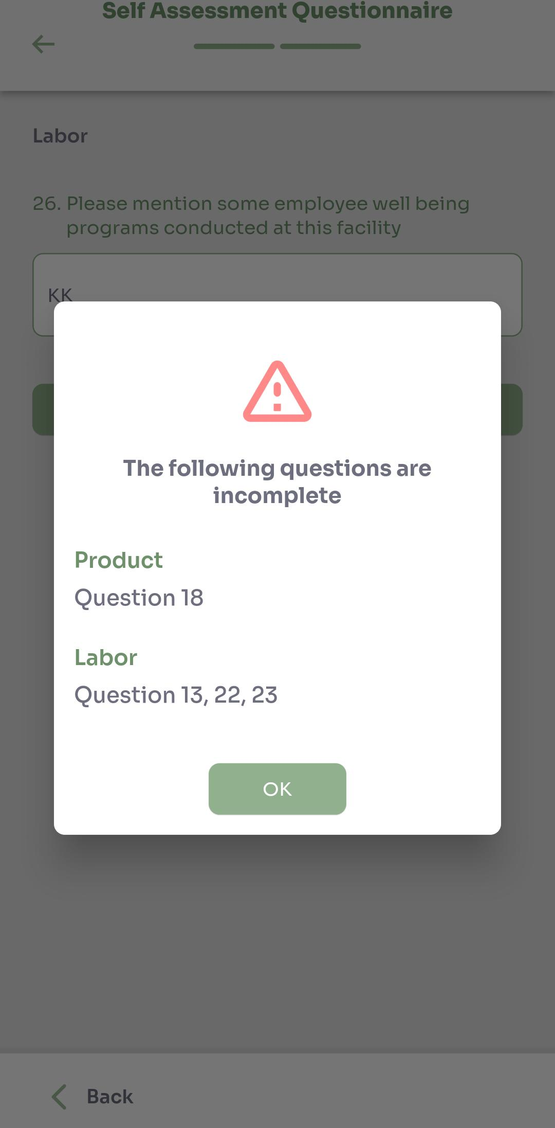
Onboarding: Self Assessment Questionnaire
Complete Self Assessment Questionnaire (SAQ)
Product Information
Labor risk Information
Save draft and continue later
On submission, automatic validation that each step is complete

Slide 7
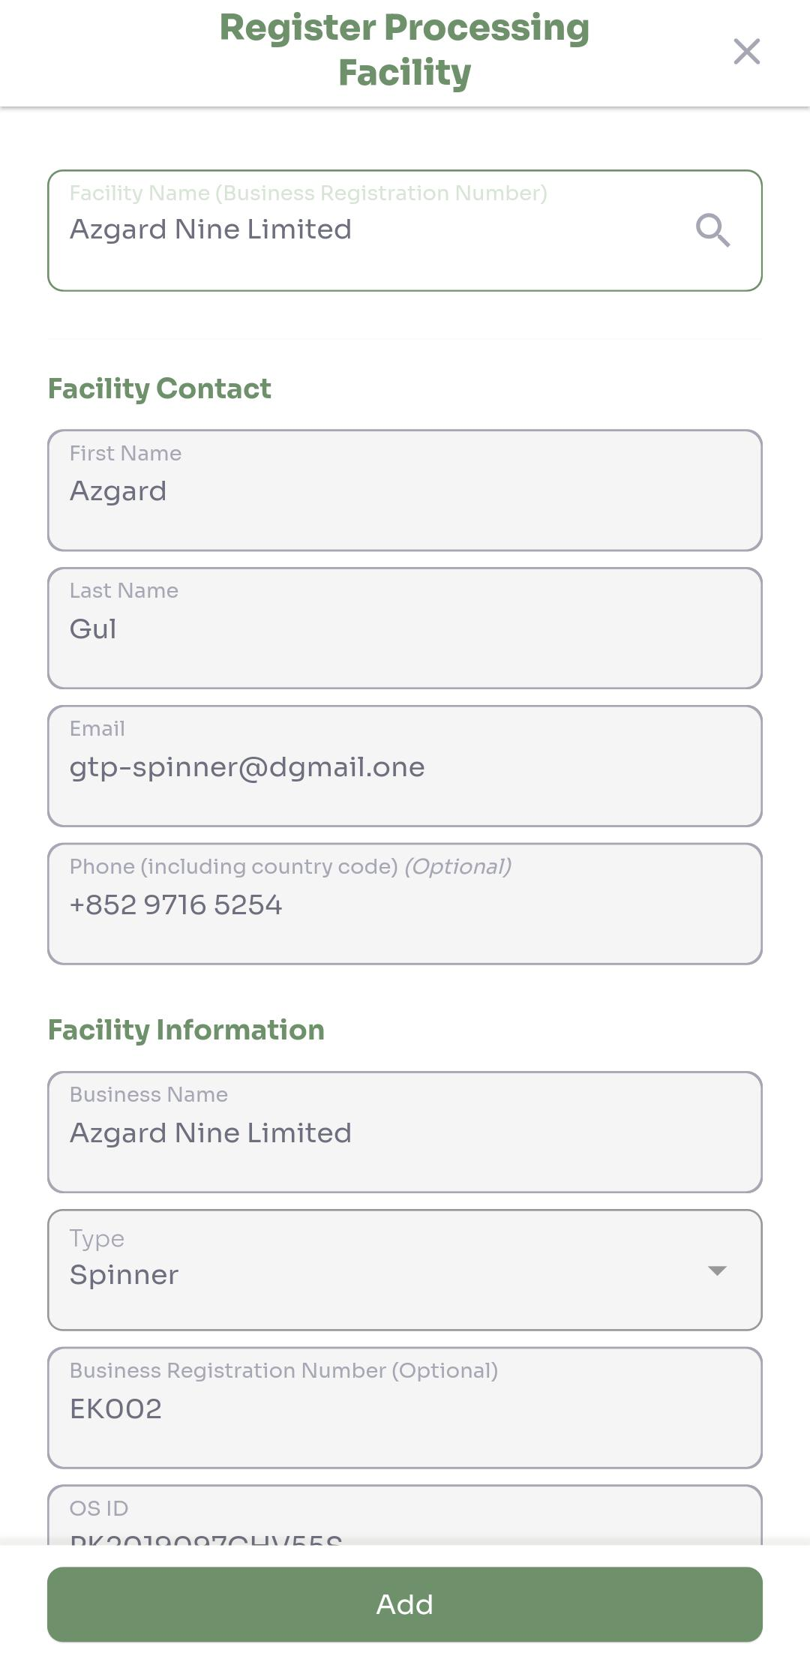
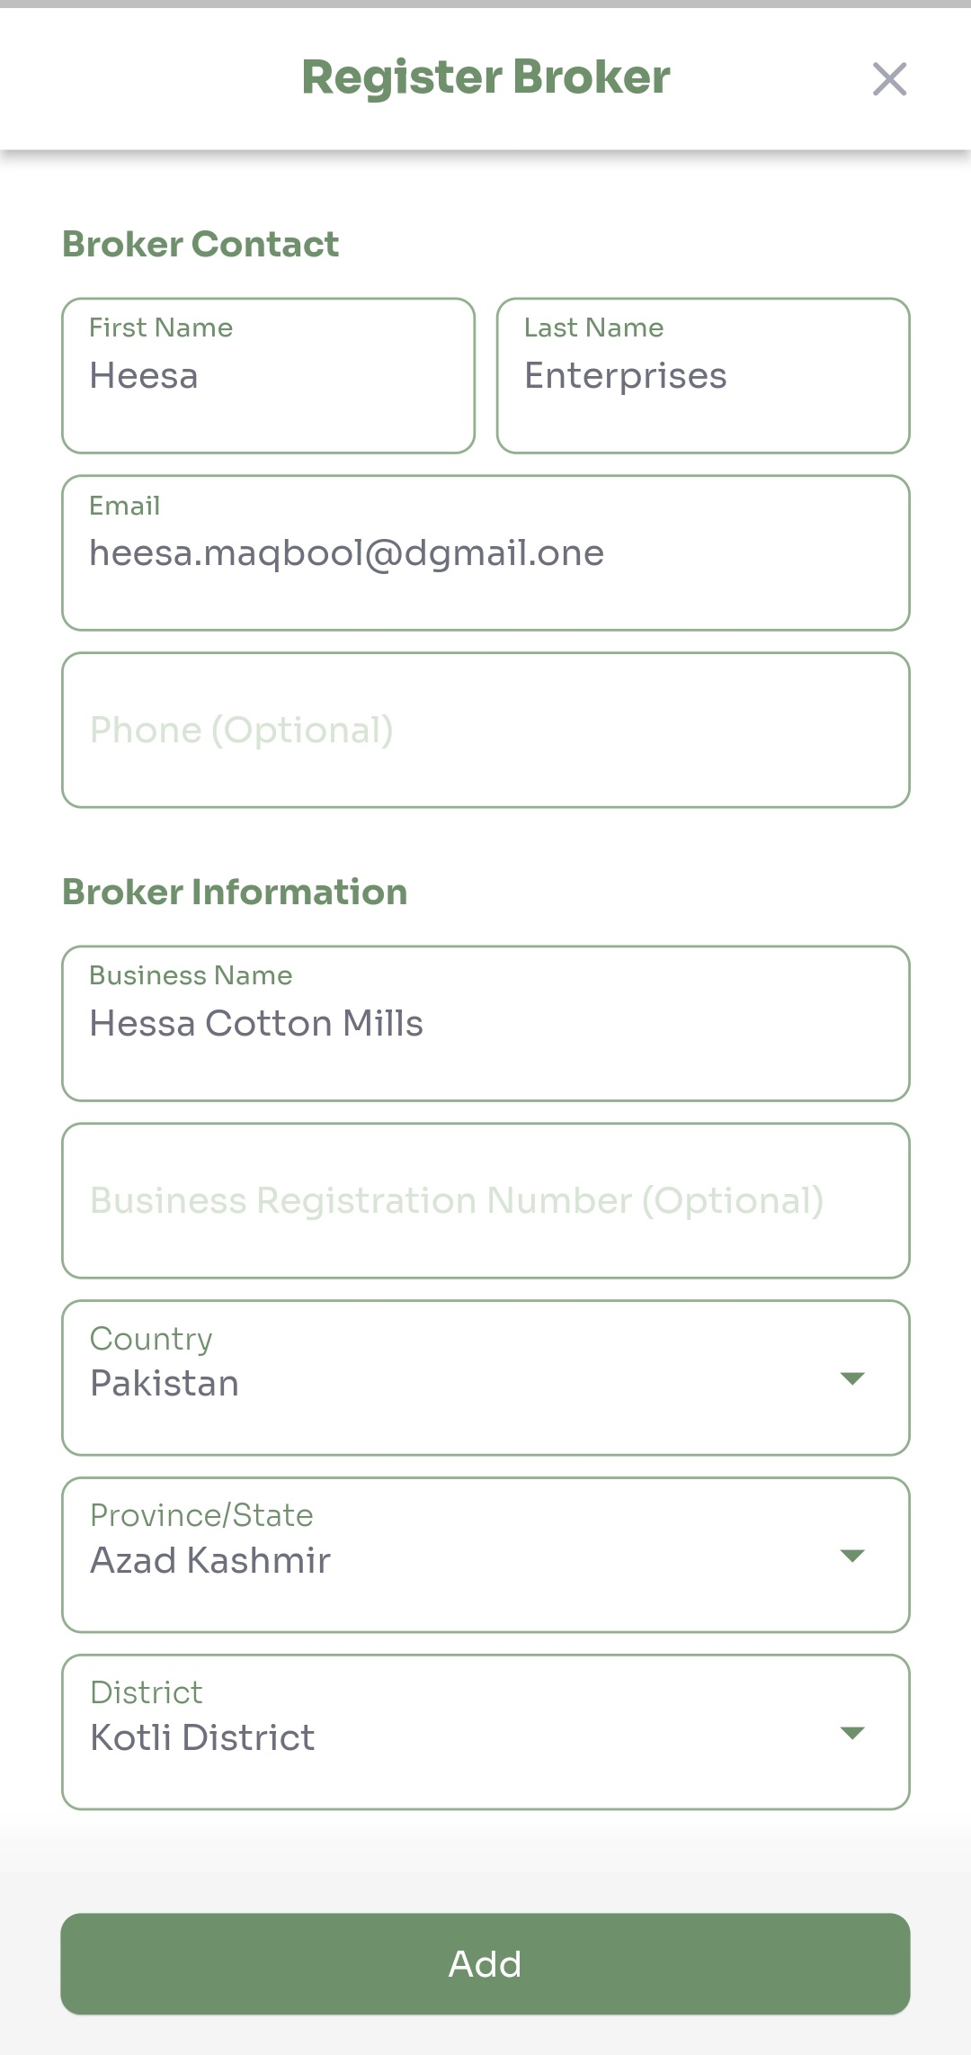
Onboarding: Add Business Partners
Business partner can be added in 2 ways – creating new or choosing existing from database
Search for business partners already registered on system
Add new business partner (spinner) to invite to the platform
Add new broker, by providing basic information

Slide 8
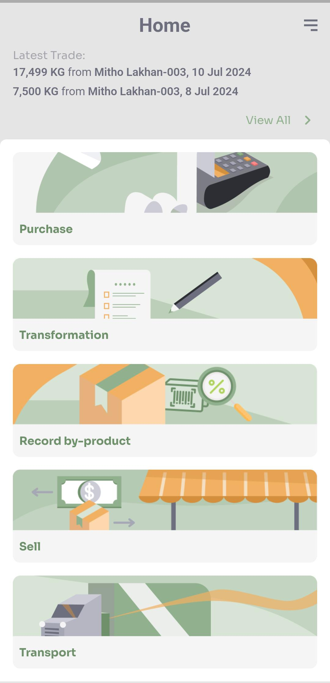
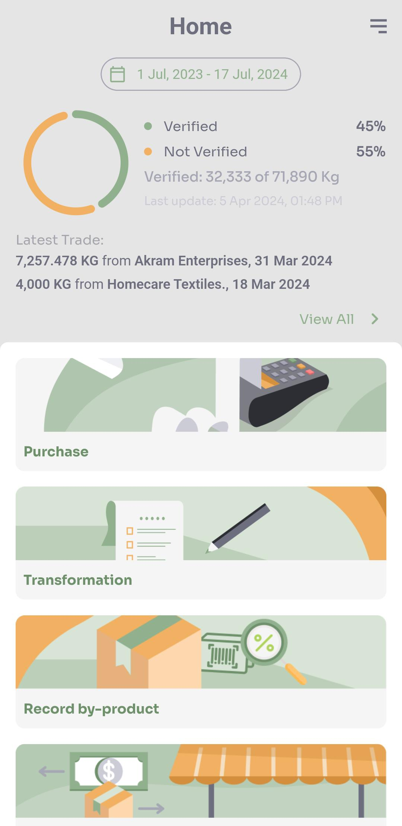
Home Screen
Tool tips for self help on first login
Displays all functions that ginner can perform
For mass balance, verified / not verified ratio displayed
Latest Trade shows most recent purchase / sale transactions
View All for an overview of all transactions logged by ginner

Slide 9
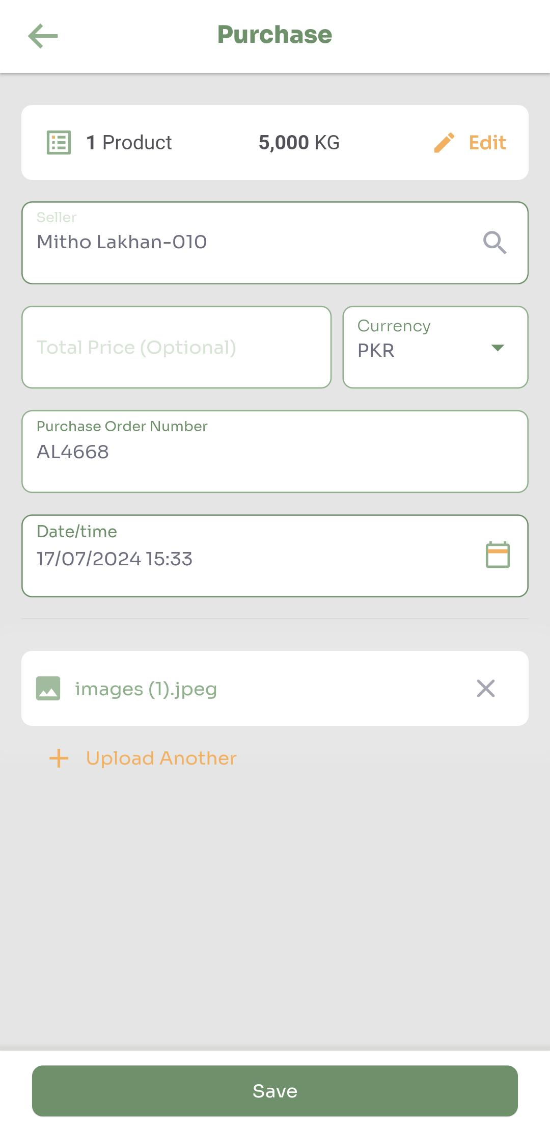
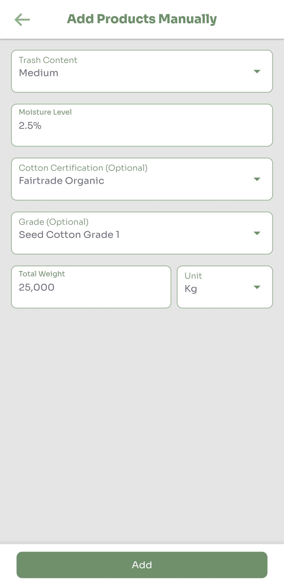
Product Activities -Purchase
Record purchase of seed cotton from business partner
Trash, moisture content
Purchase Order number (or receipt) and attachment
Date / time of purchase
Optional: Certification, Grade, Price are optional fields
Attachment can be uploaded from device or you can take a photo using the camera app​
Evidence of purchase​

Slide 10
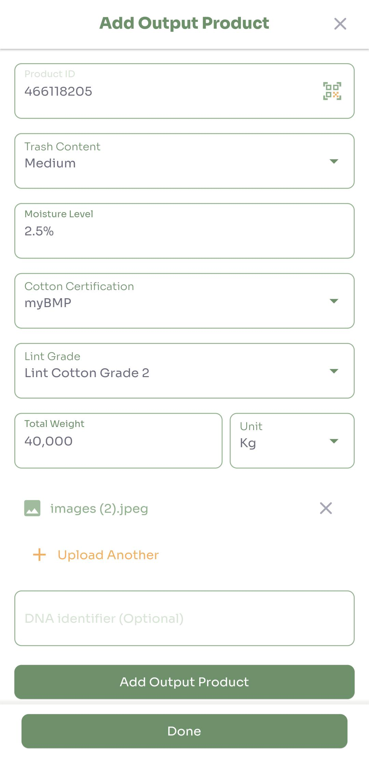
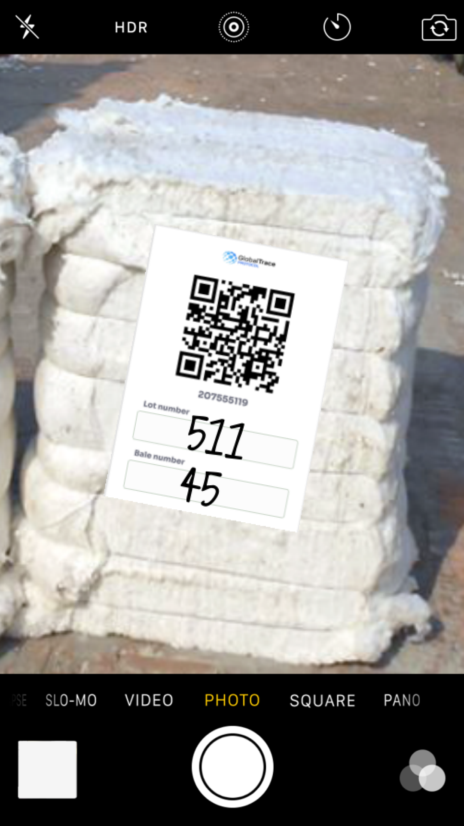
Product Activities - Transformation
Assign product ID to output product(lint cotton) by scanning the administrator provided QR code
Trash, moisture content
Cotton certification, Lint grade
Optional: DNA Identifier
Attachment can be uploaded from device or you can take a photo using the camera app
Evidence of product transformation

Slide 11
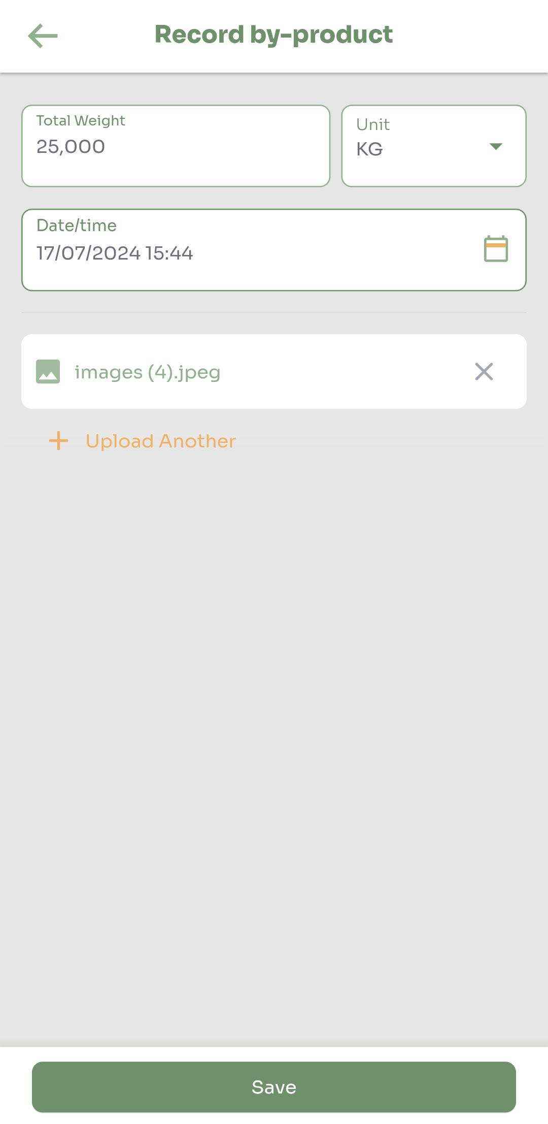
Product Activities – By-product
Record weight of by-product generated during transformation
Date of creation of by-product
Attachment can be uploaded from device or you can take a photo using the camera app
Evidence of creation of by-product

Slide 12
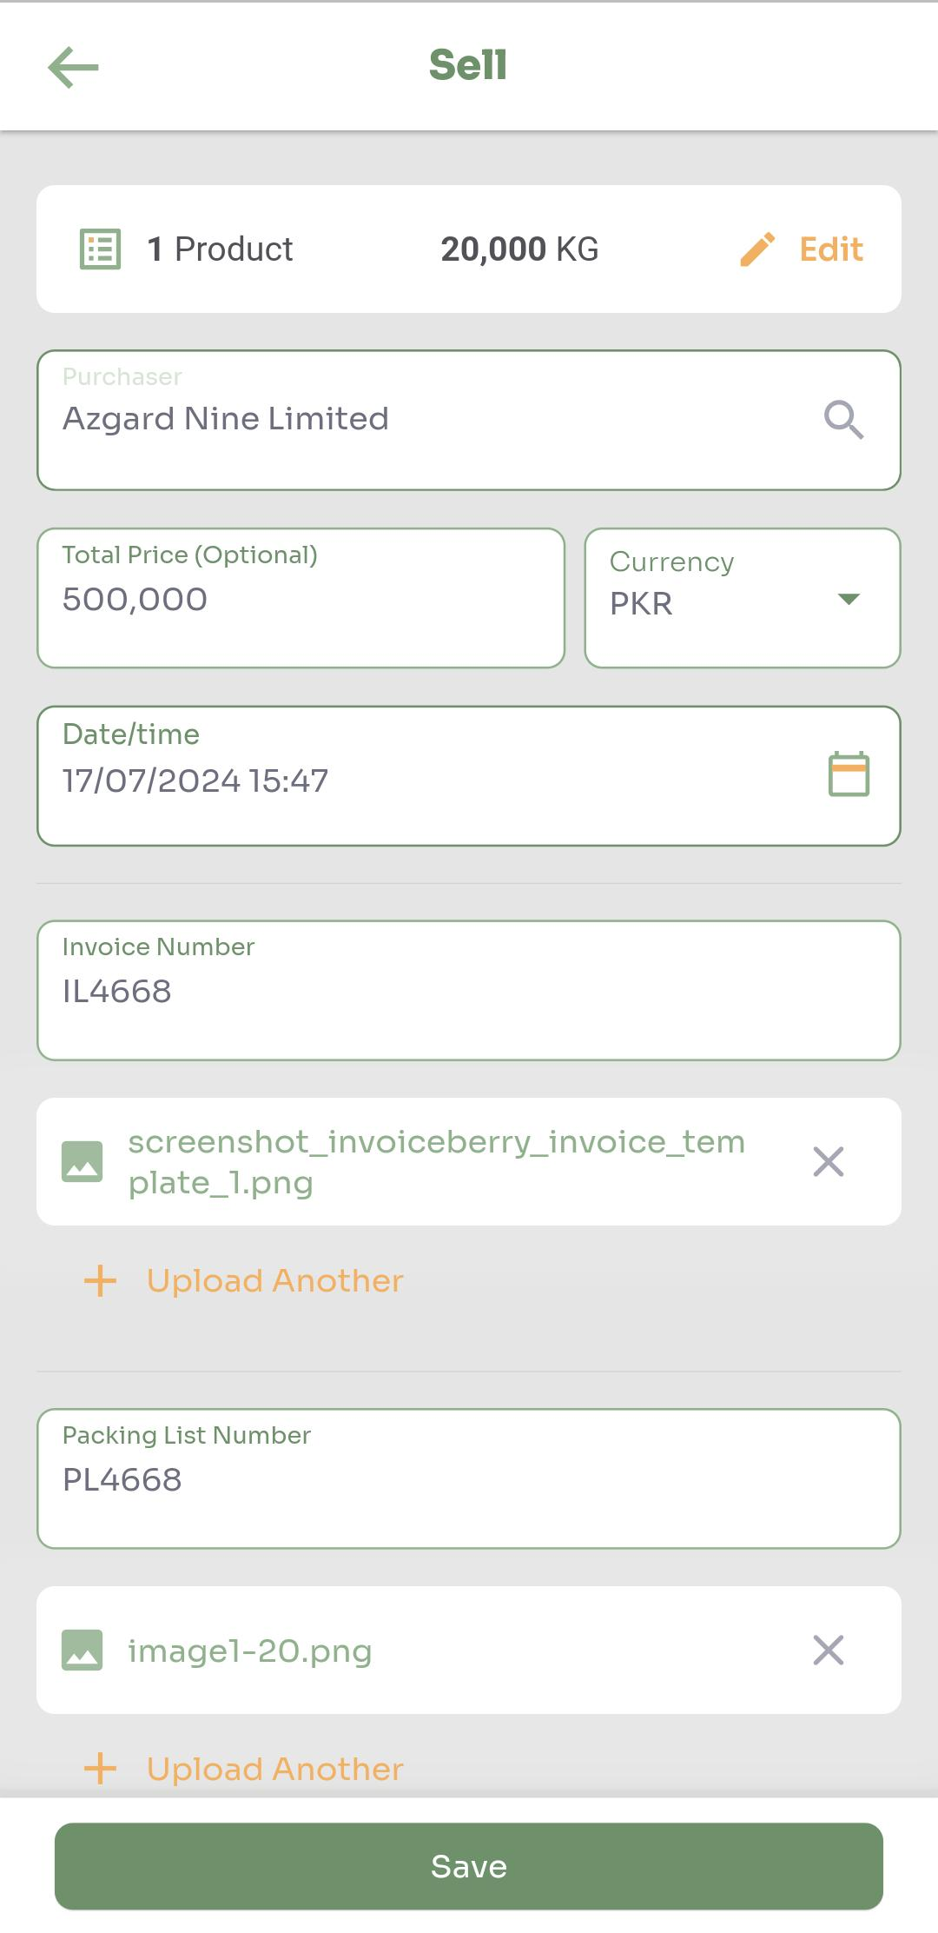
Product Activities - Sale
Record sale of output product(pressed lots) to business partner(Spinner)
Date / time of sale
Invoice number and attachment
Packing List number and attachment
Optional: Price
Attachment can be uploaded from device or you can take a photo using the camera app
Evidence of product sale

Slide 13
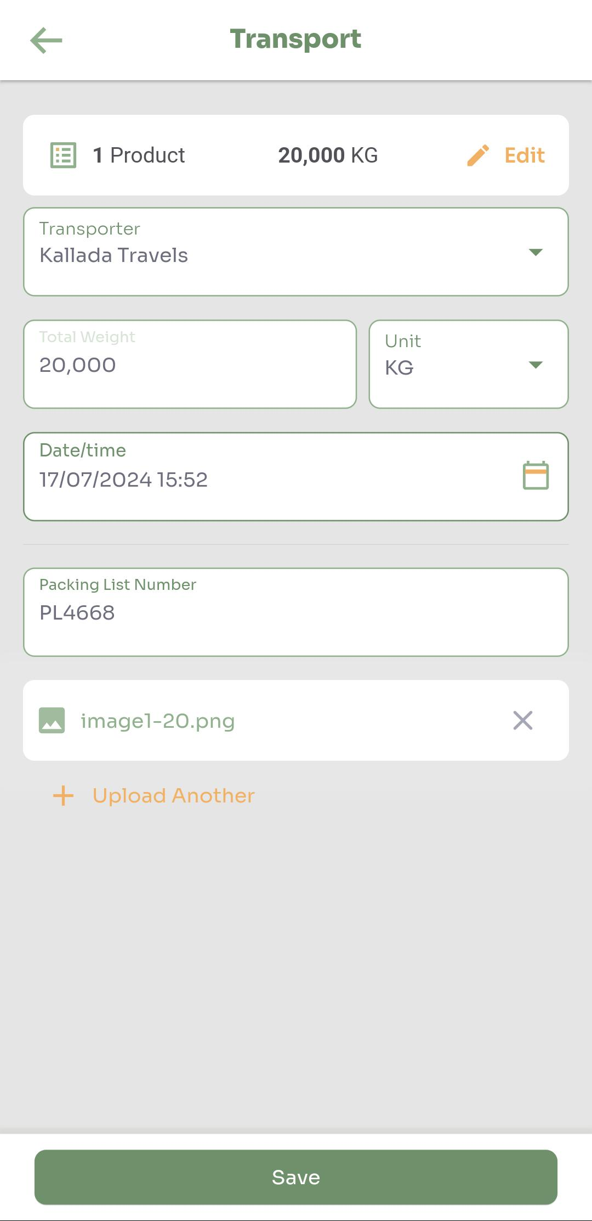
Product Activities -Transport
Record transportation of sold products to business partner
Transporter: Firm transporting the lot
Total weight
Date / time of shipment
Packing List number and attachment
Attachment can be uploaded from device or you can take a photo using the camera app
Evidence of product transportation

Slide 14
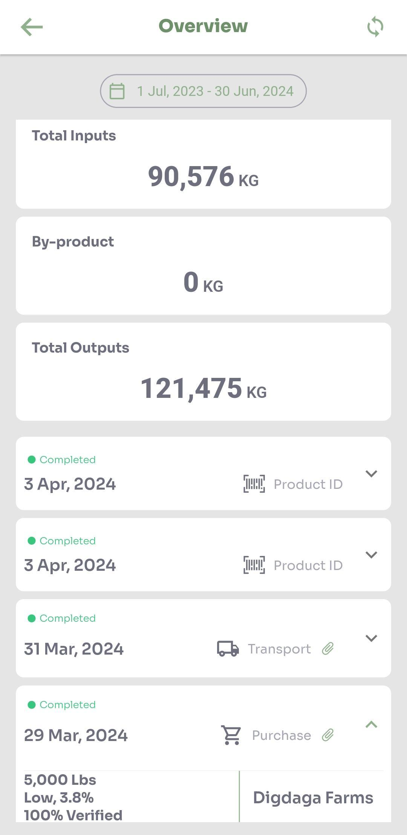
View History
History of all operations performed by ginner
Display total quantity of input products purchased from business partners and output products sold to business partners; total quantity of by-products recorded during transformation​
When transactions are performed offline, status displayed here
Completed, pending, failed
To retry all pending, select refresh button
Click on individual record to view or download attachments

Slide 15
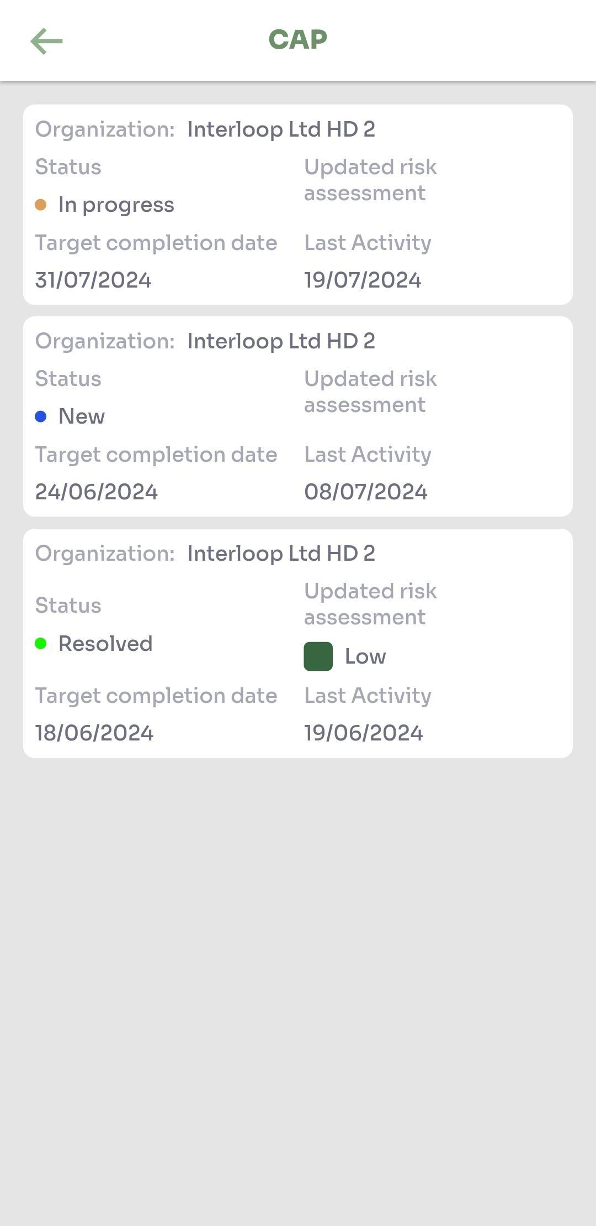
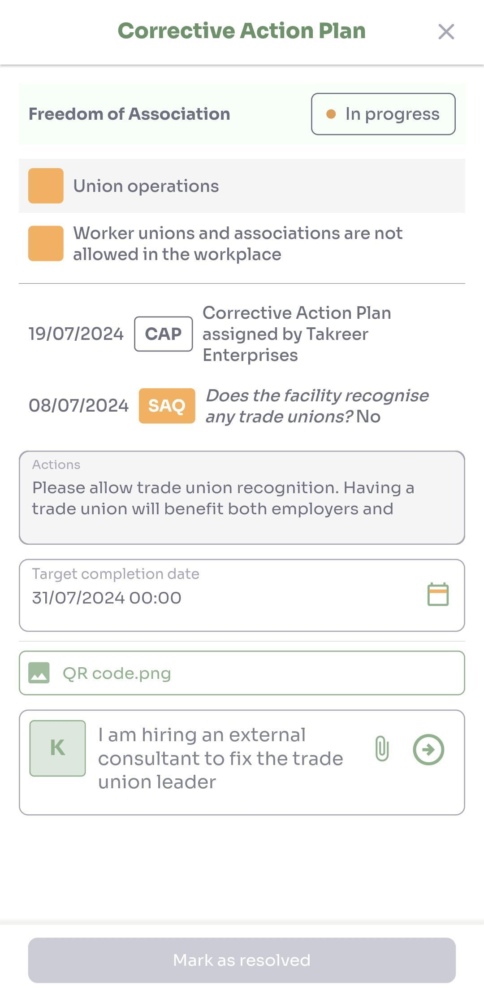
Side menu – Corrective Action Plan
View all CAP records with their status and target completion date
Click on CAP record to view detailed information on actions, comments and target completion date
After the CAP resolution, new risk level is assigned

Slide 16
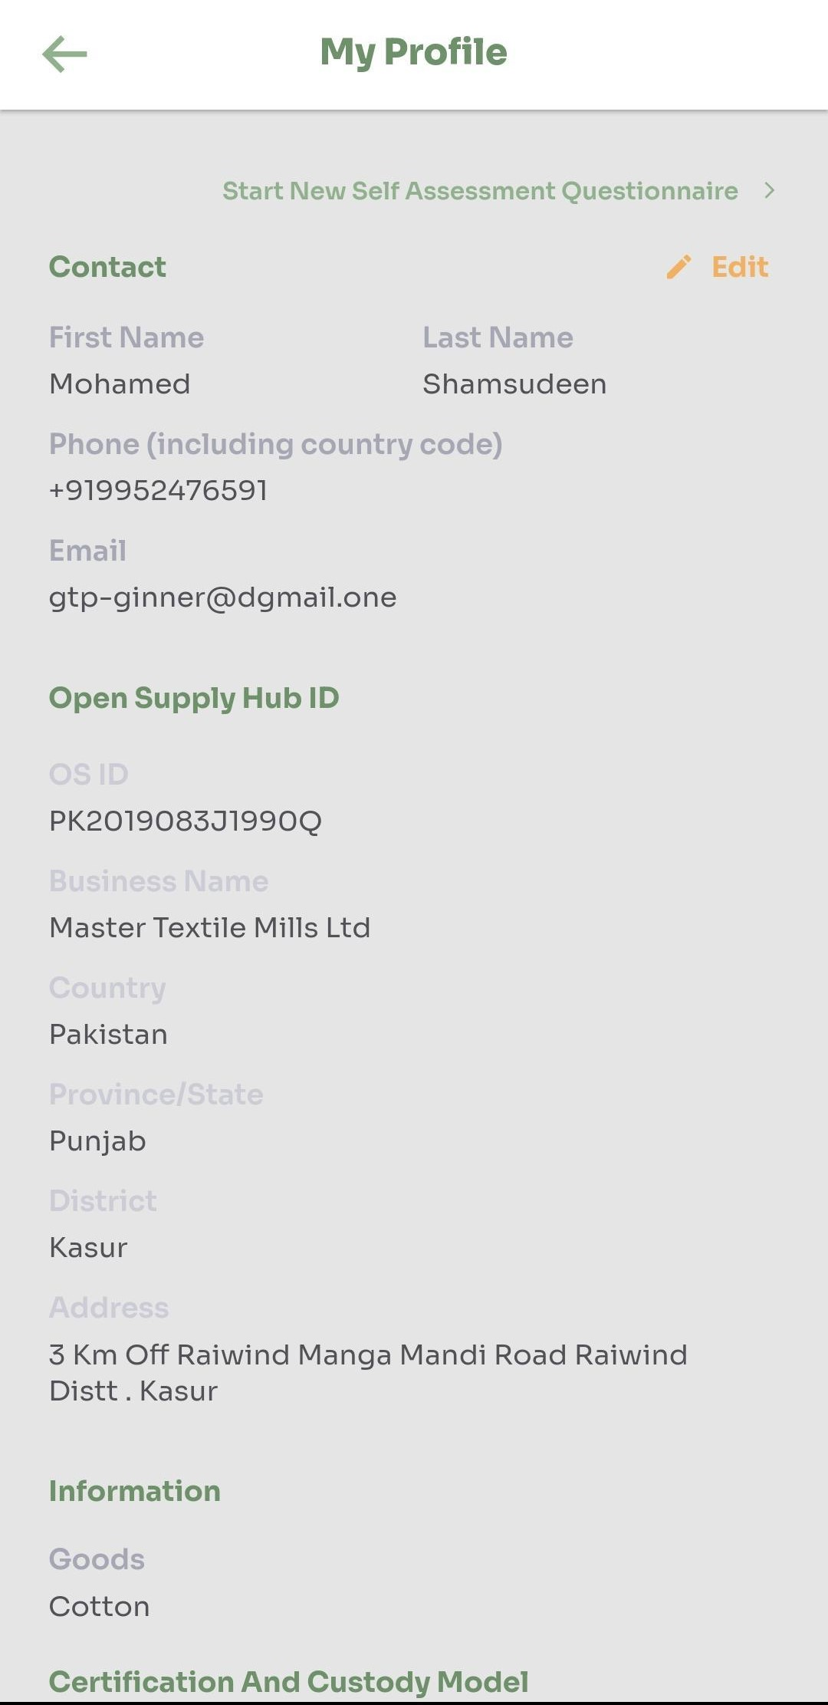
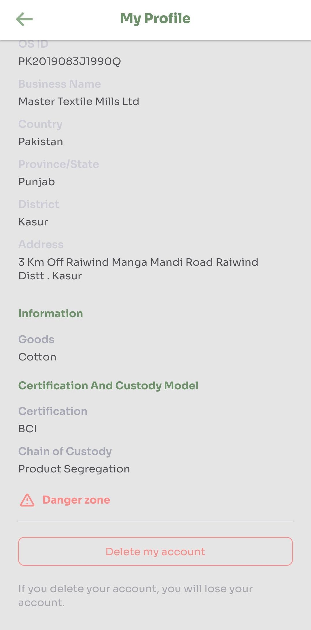
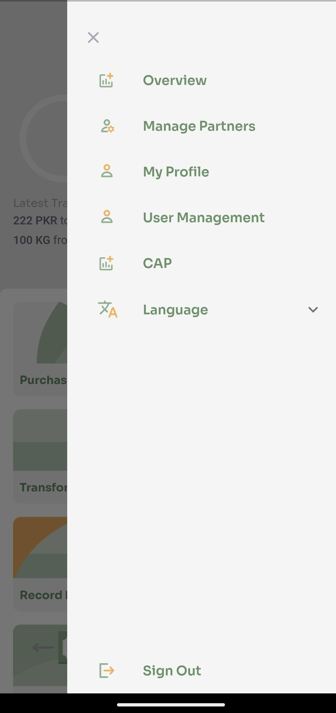
Side Menu: Edit Profile, Manage Partners, Delete own account
Enables ginner to edit details set during onboarding
User can delete their own account: if the account is deleted, all data​ will be lost

Slide 17
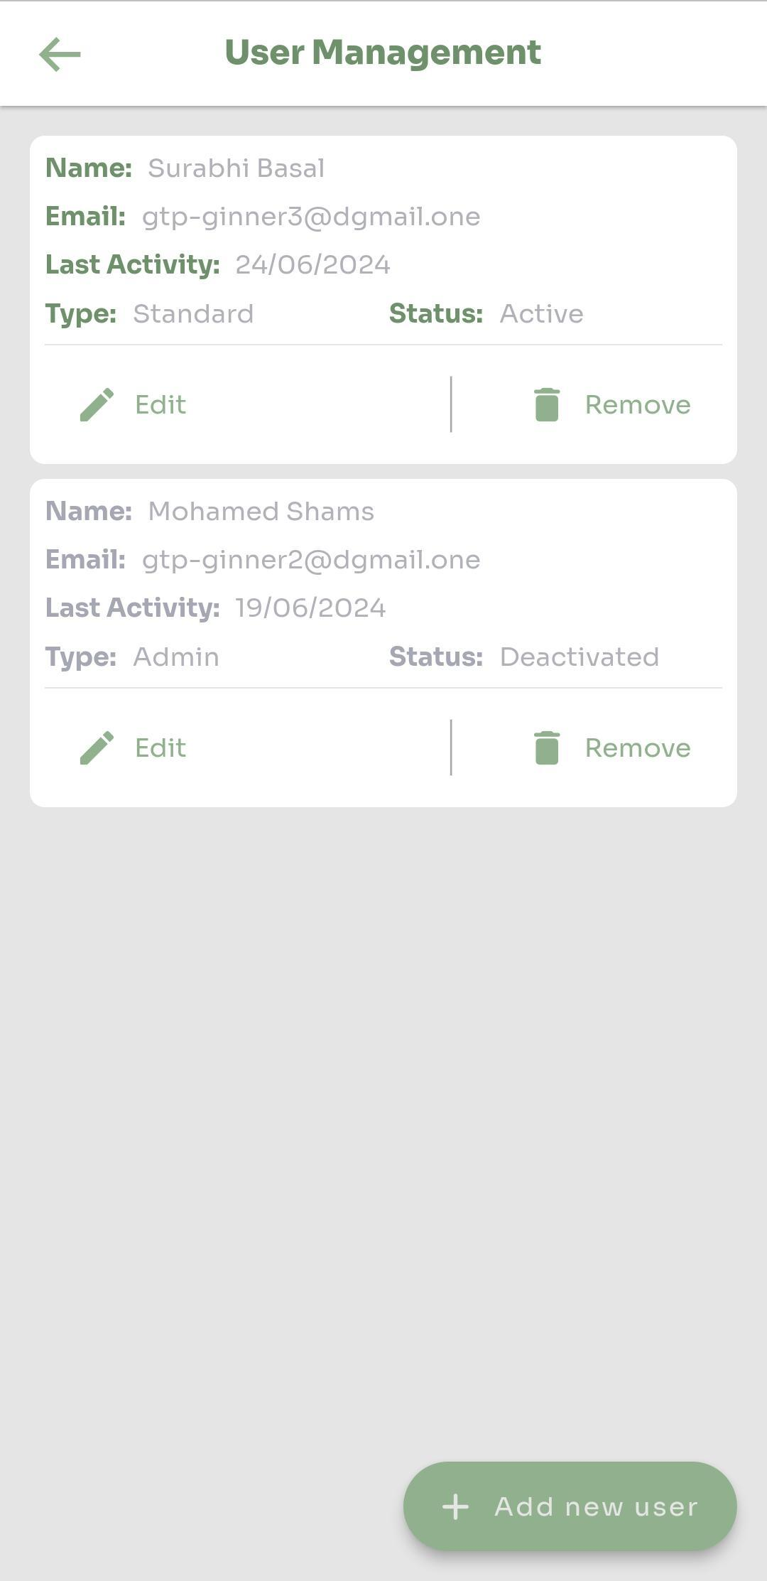
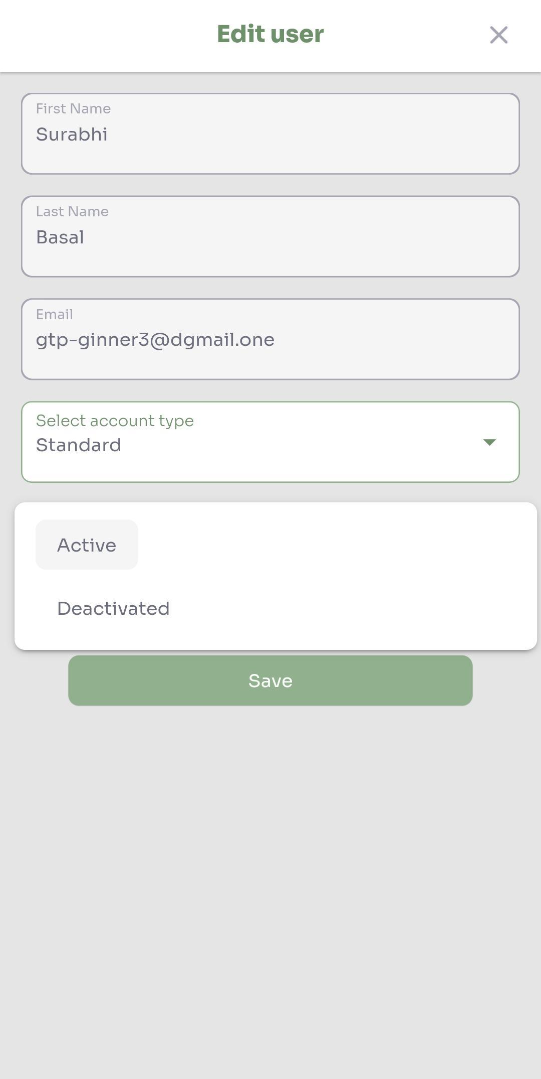
Side Menu: User Management
Organization admin can invite multiple users as Standard/Admin​
Can deactivate and delete users​

Slide 18
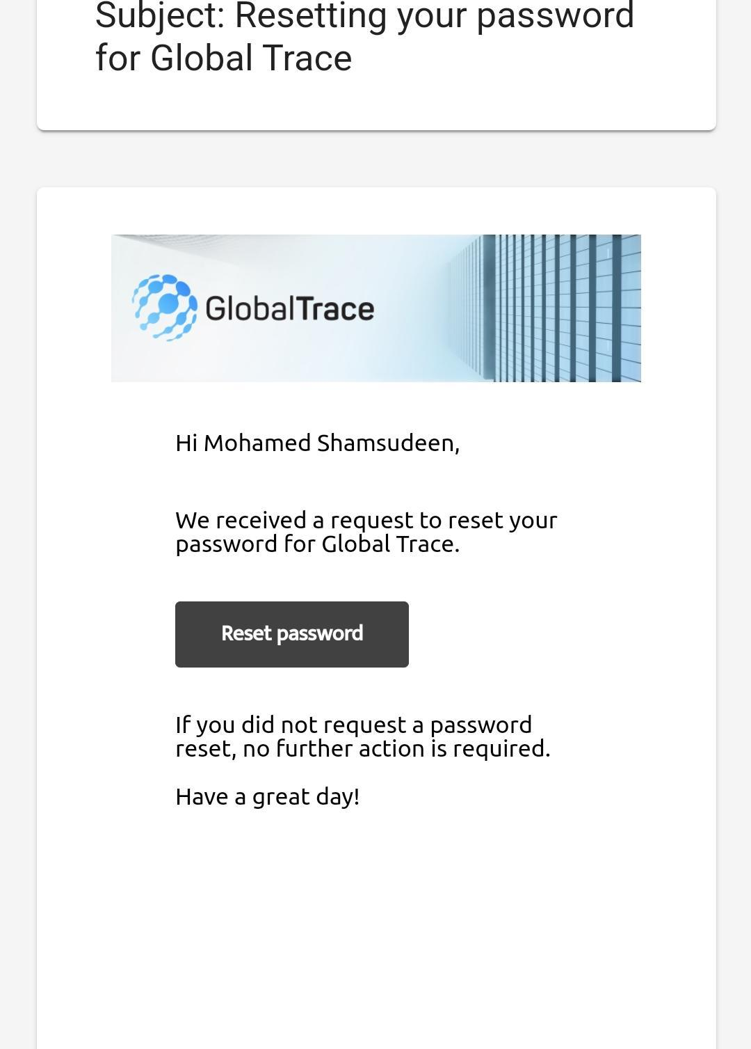
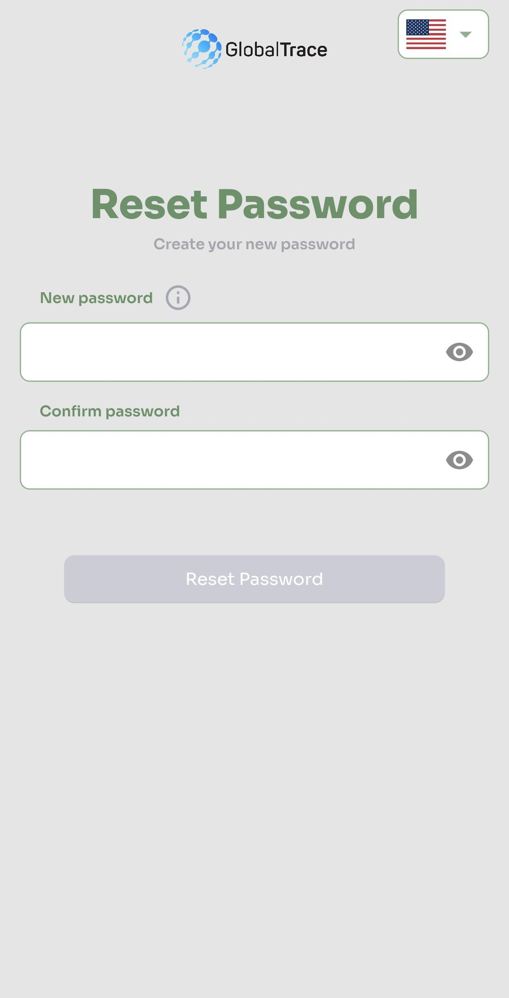
Forgot Password
If you forget your password, use ‘Forgot Password’ link on login page
Email sent to registered address
Click on link in email to reset your password

Slide 19

Funding is provided by the United States (U.S.) Department of Labor (DOL) under cooperative agreement number IL-35808-20-75-K. One hundred percent of the total costs of the project or program is financed with USG federal funds, for a total of $4 million dollars. This material does not necessarily reflect the views or policies of the United States Department of Labor, nor does mention of trade names, commercial products, or organizations imply endorsement by the United States Government.

Slide 20
Ginner User Manual
THANK YOU
Implemented by ELEVATE Ltd.
Funded by the Bureau of International Labor Affairs, USDOL IL358082075K

