Slide 1
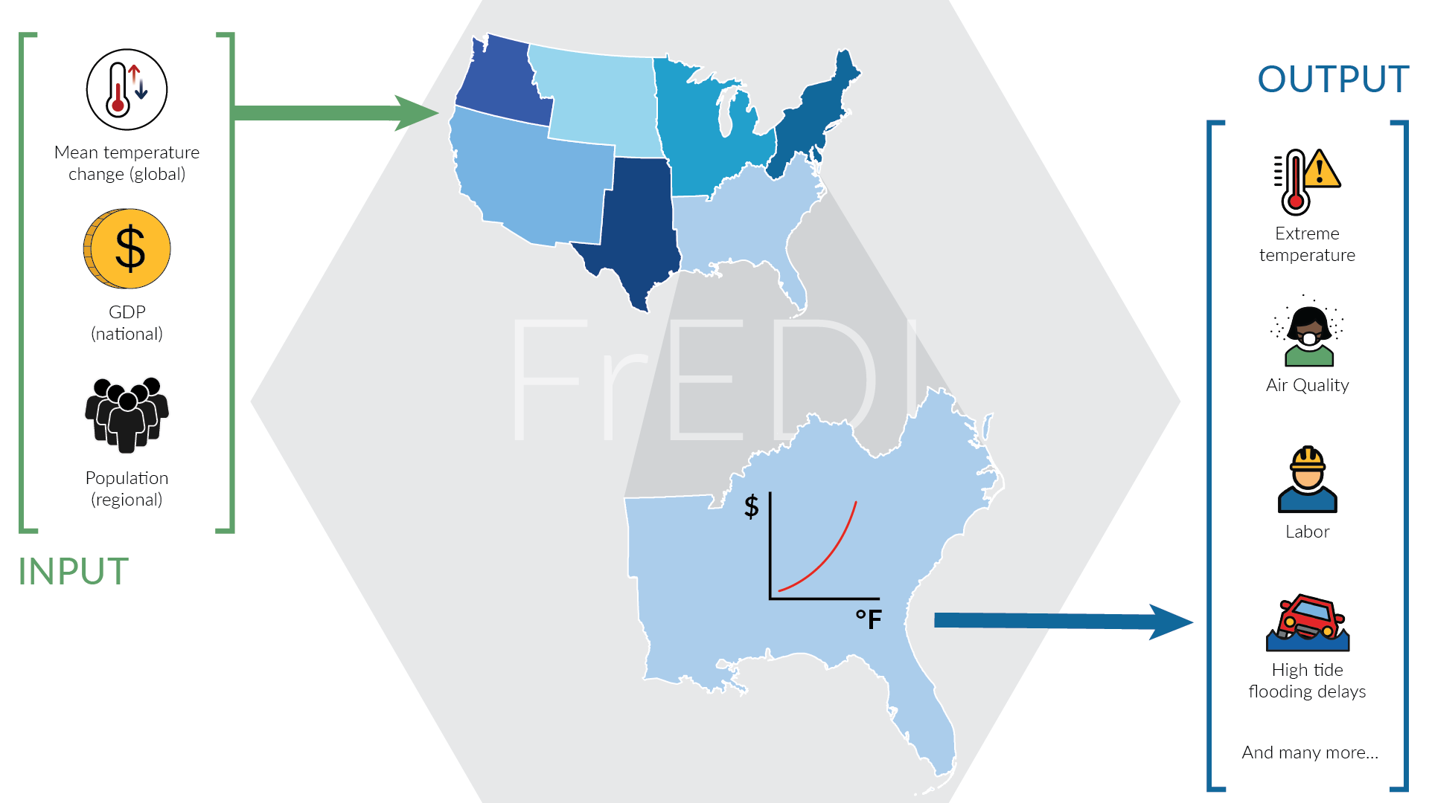
Mean Temperature Change (global)
Temperature-Related Mortality
GDP
(national)
Climate-Driven Air Quality Mortality
Population
(regional)
Labor
C
Transportation Impacts from High Tide Flooding
+ many more
+ many more

