Slide 1

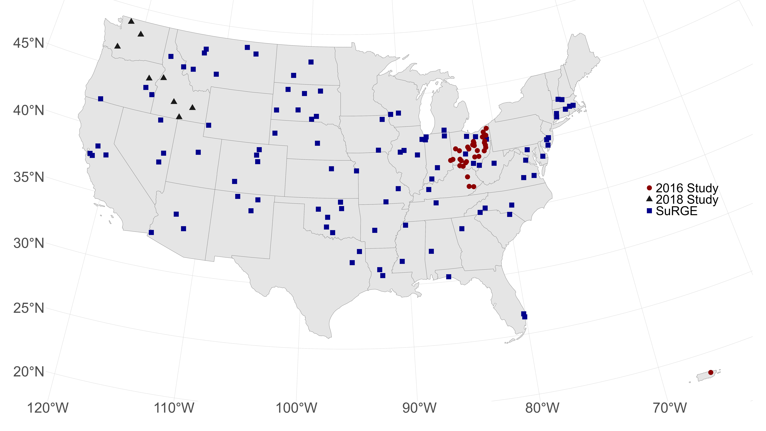
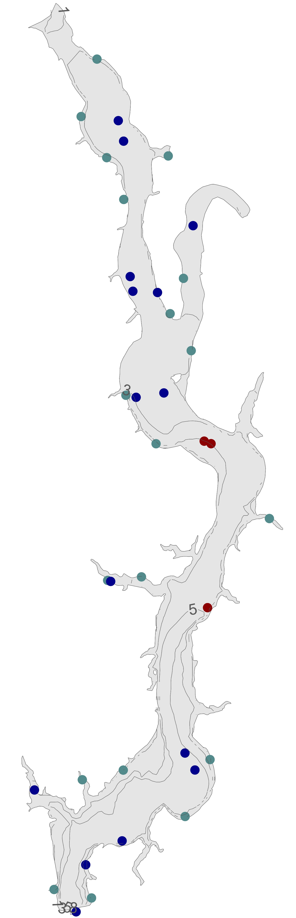
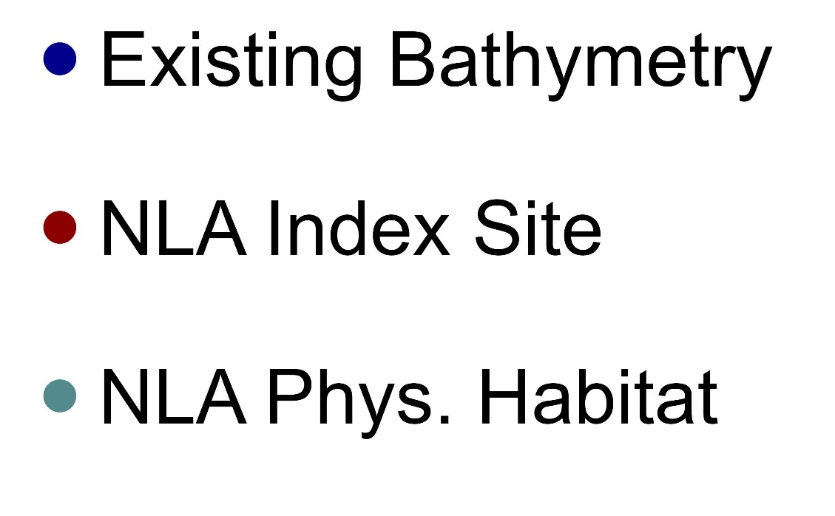
Development of a reservoir morphology dataset to inform modeling greenhouse gas emissions from U.S. reservoirs.
Jeffrey Hollister¹, Jake Beaulieu¹, Bridget Deemer², and Alex Hall¹
¹ U.S. Environmental Protection Agency, Office of Research and Development, ² U.S. Geological Survey, Southwest Biological Science Center
Contact: Jeff Hollister l hollister.jeff@epa.gov l 401-782-9655
Introduction
Figure 1.Map of SuRGE sampled reservoirs
The United States is party to both the 1992 UNFCCC and the 2015 Paris Agreement. These agreements require state signatories to create an inventory of anthropogenic sources of greenhouse gas emissions from “flooded lands” (i.e., reservoirs). The EPA prepares an annual report on these sources and sinks of greenhouse gases for the United Nations Framework Convention on Climate Change. Understanding GHG emissions from lentic systems, such as reservoirs, requires the quantification of waterbody shape and size (i.e., morphology). Understanding the relationship between lake morphology and GHG emissions can aid in providing better, more accurate estimates of GHG emissions from US flooded lands. This poster describes a database of lake morphology metrics for reservoir measurements from EPA’s Survey of Reservoir Greenhouse Gas Emissions (SuRGE).
Database Development
We use a combination of existing, publicly available datasets and data collected specifically as part of the SuRGE project. The data are measures of whole lake morphology or point depths. Details on each are as follows.
Existing Data Sources
Several existing data sources were identified that contained key morphology metrics. The SuRGE morphology database includes estimates for 147 reservoirs measured as part of the Survey of Greenhouse Gas Emissions project led by the U.S. Environmental Protection Agency (Figure 1). Spatial joins were used to link up the SuRGE reservoirs with these existing databases (Figure 2, Table 1).
Calculated Metrics
Many metrics may be calculated from the polygon representing the reservoir shoreline and surrounding topography. We used two R packages, elevatr and lakemorpho, that facilitate these calculations. We calculated the following: surface area, shoreline length, shoreline development, maximum depth, volume, mean depth, maximum width, mean width, maximum length (Figure 2, Table 1).
Measured Metrics
Field measured depths are available from several sources. The point locations and measured depths were obtained from the SuRGE sampling, National Lakes Assessment index sites, National Lakes Assessment physical habitat survey sites, and existing bathymetry survey for a small proportion of reservoirs (Figure 2).
R Code and Data
Assembly of the dataset, creation of a crosswalk table, and calculation of the metrics were all accomplished with R v 4.4.1 and the code is available at https://github.com/usepa/surge_morpho. When released, the data will be available in several formats:
Crosswalk between datasets: A .csv file containing SuRGE IDs and IDs from several other datasets.
Reservoir morphology: Either a .csv file of the metrics linked via the SURGE ID or as a polygon layer in a geopackage.
Point depths: A point layer in a geopackage. Each point includes the measure depth and the source of that depth.
Figure 2. Example reservoir (Delaware Reservoir near Columbus, Ohio) showing sampling location with example depths from different sources.
Table 1. Reservoir morphology metrics from various sources for Delaware Reservoir
source | type | variables | values
lagos | existing | maxdepth | 10.03
lagos | existing | lakearea | 454.15
nhdplus | existing | meandepth | 0.92
nhdplus | existing | lakevolume | 3,622,493
nhdplus | existing | maxdepth | 3.12
nhdplus | existing | meandused | 0.92
nhdplus | existing | meandcode | 4.00
nhdplus | existing | lakearea | 3,916,293
NLA 2012 | existing | index_depth | 3.20
NLA 2012 | existing | index_depth | 3.00
NLA 2017 | existing | index_depth | 3.30
surge_morpho | calculated | surfacearea | 4,234,663
surge_morpho | calculated | shorelinelength | 37,291
surge_morpho | calculated | shorelinedevelopment | 5.11
surge_morpho | calculated | maxdepth | 7.96
surge_morpho | calculated | volume | 9,872,807
surge_morpho | calculated | meandepth | 2.33
surge_morpho | calculated | maxwidth | 1,194.47
surge_morpho | calculated | meanwidth | 1,021.15
surge_morpho | calculated | fetch | 2,157.67
surge_morpho | calculated | maxlength | 4,464.33
globathy | existing | dmax_use | 20.22
0.91 meters
3 meters
Next Steps
We continue to develop this database and in addition to using it to support modelling of greenhouse gas emissions from reservoirs (see poster B23A-1546), we plan to publish the data set for others to use.
Our specific next steps will be to:
Determine a rubric for deciding “best available depth” data. Several sources provide estimates of depth. Measured are better that modeled, but maximum depth is not always measured
Use the point dataset to calculate volume for each reservoir
Continue to explore additional sources of morphology data.
1.2 meters
Disclaimer
Any mention of trade names, products, or services does not imply an endorsement by the U.S. Government or the U.S. Environmental Protection Agency. The EPA does not endorse any commercial products, services, or enterprises.

