Slide 1
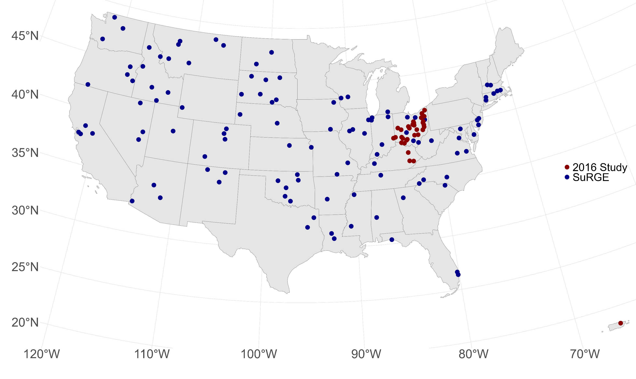
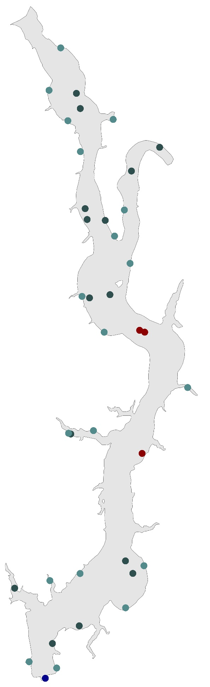
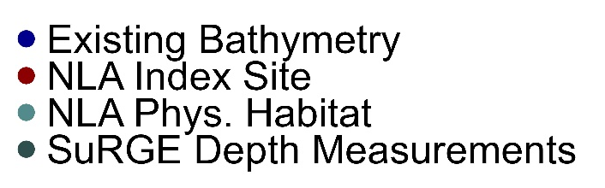
Development of a reservoir morphology dataset to inform modeling greenhouse gas emissions from U.S. reservoirs.
Jeffrey Hollister¹, Jake Beaulieu¹, Bridget Deemer², and Alex Hall¹
¹ U.S. Environmental Protection Agency, Office of Research and Development, ² U.S. Geological Survey, Southwest Biological Science Center
Next Steps
Contact: Jeff Hollister l hollister.jeff@epa.gov l 401-782-9655
Introduction
Best available data
many sources of maximum depth
Volume calculations
Additional Sources?
Understanding ecological processes in lentic systems, such as reservoirs, often requires the quantification of metrics of the waterbody’s shape and size (i.e. morphology). In particular, we are interested in exploring the relationships between lake morphology and greenhouse gas emissions from reservoirs as measured via the US. EPAs Survey of Reservoir Greenhouse Gas Emissions (SuRGE). This poster describes a database of lake morphology metrics for the reservoirs measured as part of SuRGE.
Links and References
Database Development
GitHub Repo:
Lakemorpho
data source links
We use a combination of existing, publicly available datasets and data collected specifically as part of the SuRGE project. The data are measures of whole lake morphology or point depths.
Existing Data Sources
Calculated Metrics
Measured Metrics
R Code and Data
Existing databases with relevant reservoir morphology metrics, such as LAGOS and the National Inventory of Dams, are also included. The database includes estimates for 147 reservoirs measured as part of the Survey of Greenhouse Gas Emissions project led by the U.S. Environmental Protection Agency (Figure 1) and efforts are underway to expand the number of included reservoirs.
We currently calculate 13 lake morphometry metrics including descriptors of lake shape (e.g. area, shoreline length), depth (e.g. mean depth, volume), and fetch. We present our procedures for developing the reservoir database and approaches for calculating each of the metrics.
The Data
SuRGE Polygons
Two separate efforts
Original effort in 2016
n =
n sites per reservoir =
depth at each taken from existing bathymetry
SuRGE in 2020-2023
n =
n sites per reservoir ~ 15
depth measured at each
Existing Datasets
SuRGE Crosswalk to
List
Output geopackage
Metrics for each resrvoir
Point dataset with measured depth
List sources
Output flat file
These reservoirs had an average size of 516 hectares, predicted mean depth on average was 10 meters, and average maximum fetch was 2762 meters.
The final database will be publicly available and will support modeling of greenhouse gas emissions for the U.S. Inventory of Greenhouse Gas Emissions and Sinks.
Figure 1. Map of reservoirs measured as part of SuRGE and a 2016 preliminary survey
Figure 2. Example reservoir detailing lake level metrics, sampling locations, and sampling location metrics from different efforts

