Slide 1
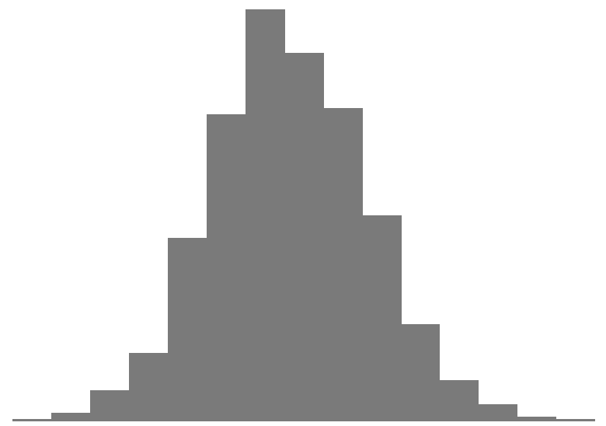
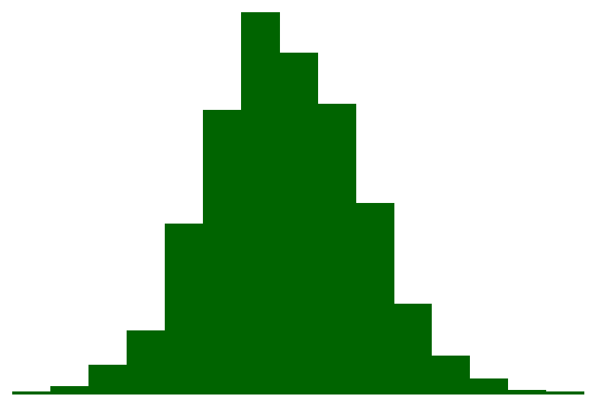
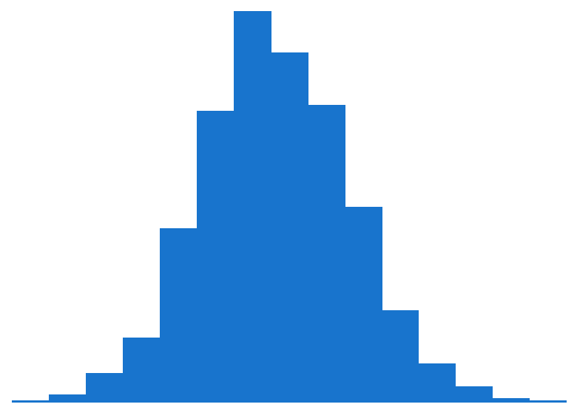
ASTAR HIPPTox EC10 (µM)
ToxCast AC50 (µM)
Apply high-throughput toxicokinetics (httk) to get mg/kg-bw/day
Bioactivity-exposure ratio
POD_{trad} : POD_{NAM} ratio
Exposure
POD_{NAM}
POD_{traditional}
95th
95th 50th
5th

