Slide 1
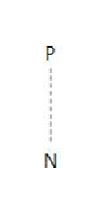
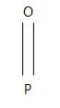
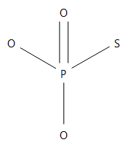
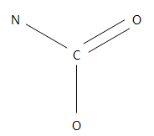
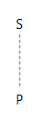
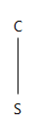
ChemoType Information |  | Appearance of the ToxPrint |  |  | Metrics |  |  | ChemoType Information |  | Appearance of the ToxPrint |  |  | Metrics
Label | ToxPrint | Total | POD ratio ≤ 0 | POD ratio > 0 | BA | OR | p-value | Label | ToxPrint | Total | POD ratio ≤ 0 | POD ratio > 0 | BA | OR | p-value
bond:P=O_ phosphorus_oxo |  | 18 | 12 | 6 | 0.62 | 22 | 7.4E-09 | bond:P~N_ generic |  | 5 | 4 | 1 | 0.54 | 36 | 0.00055
bond:P=O_ phosphate_thio |  | 3 | 3 | 0 | 0.53 | NA | 0.0012 | bond:C(=O)N_ carbamate |  | 20 | 6 | 14 | 0.54 | 3.9 | 0.014
bond:P~S_ generic |  | 27 | 13 | 14 | 0.62 | 10 | 3.5E-7 | bond:CS_sulfide |  | 53 | 15 | 38 | 0.61 | 4.3 | 0.00011

