Slide 1
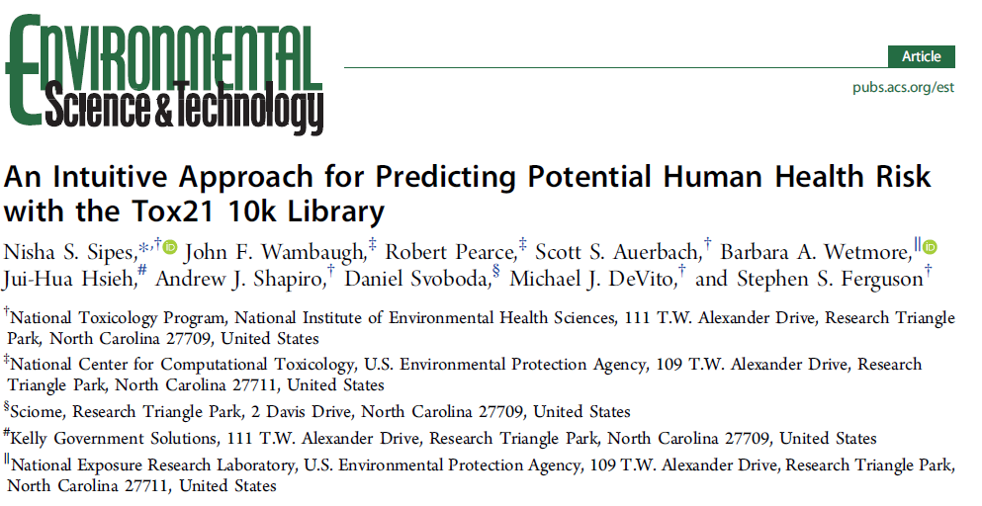
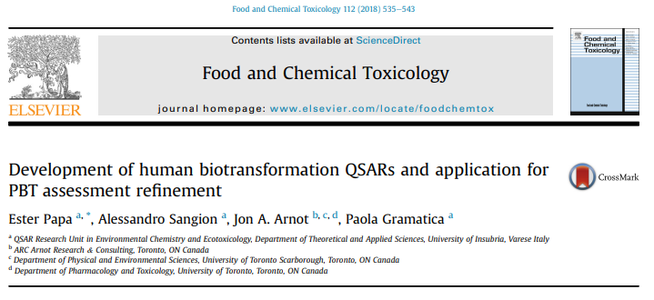
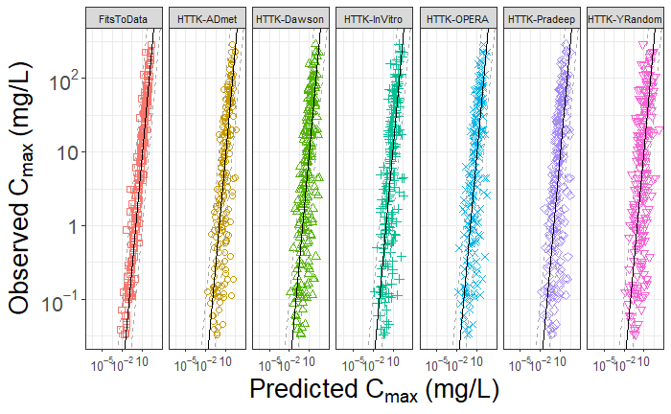
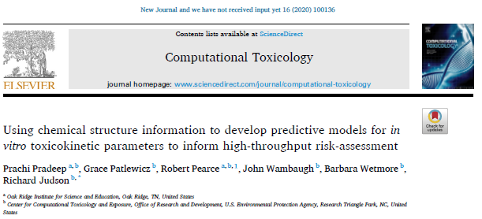
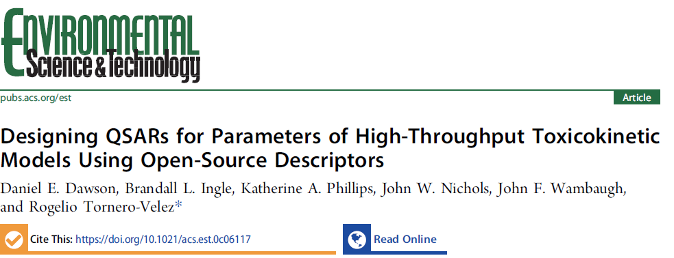
QSPRs (Quantitative Structure-Property Relationships)
for HTTK (High Throughput Toxicokinetics)
After a decade of collecting in vitro TK data we have measured over a thousand non-pharmaceutical chemicals
For sufficiently similar chemicals we may not always need to measure
EPA is leading a collaborative evaluation of various QSPRs trained to both pharma and non-pharma chemicals for predicting HTTK
Open-source QSPR predictions currently available for thousands of chemicals, including full Tox21 library

