Slide 1


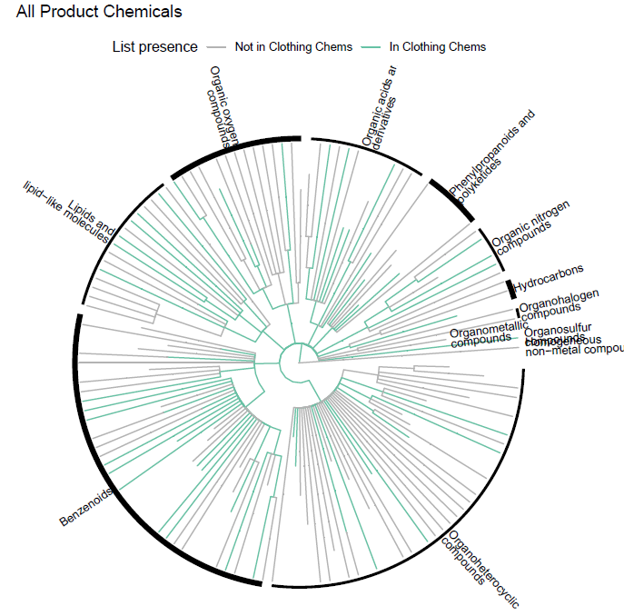
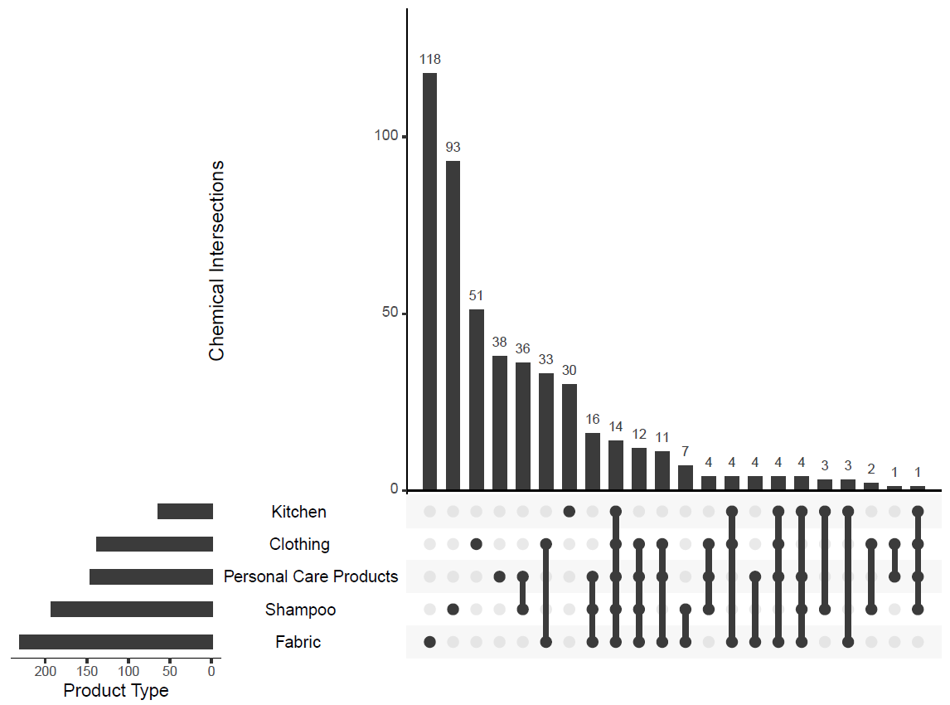
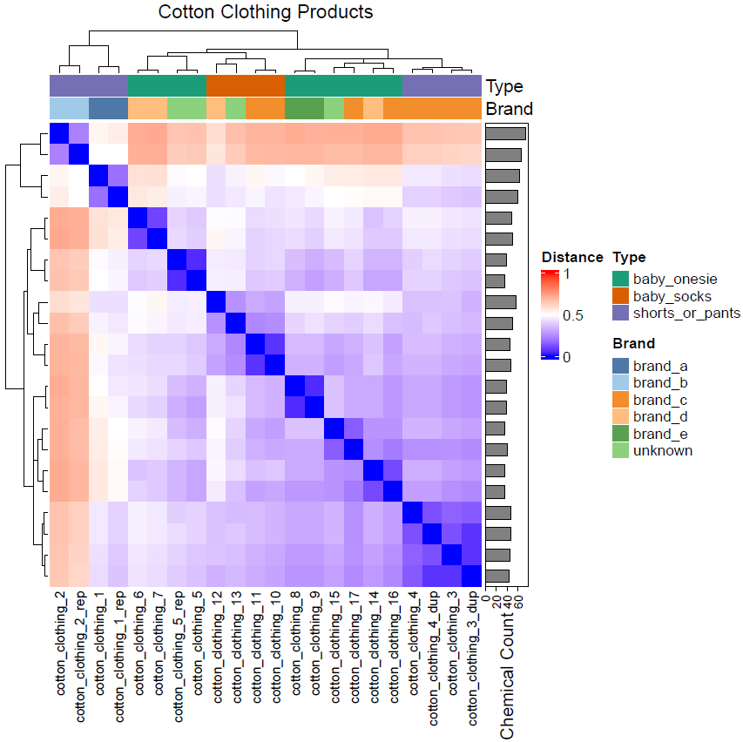
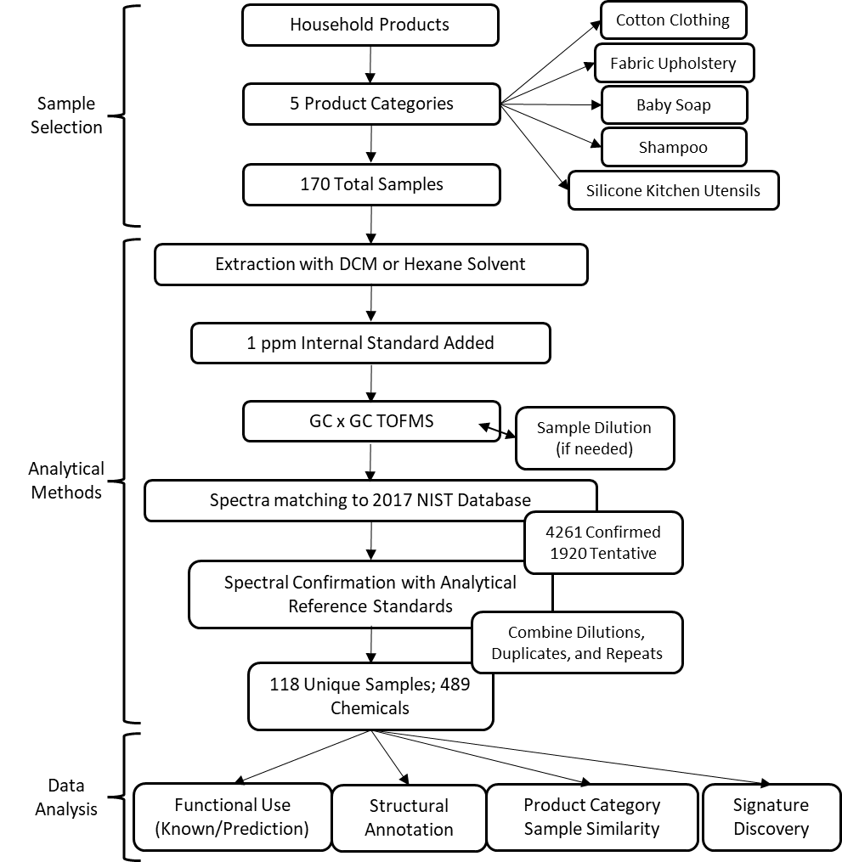

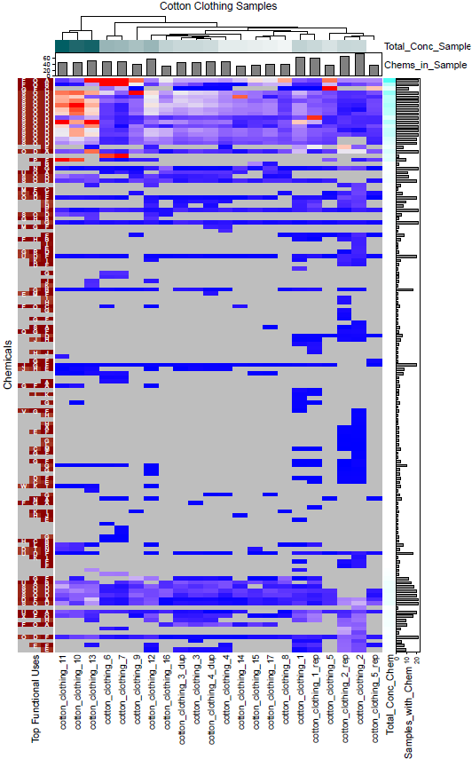

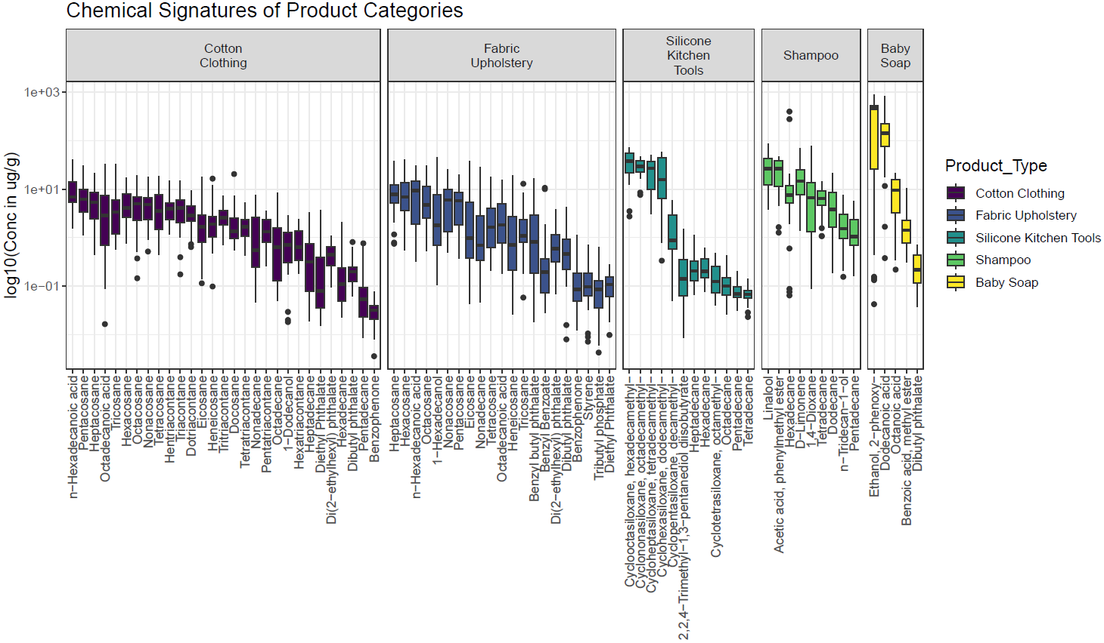



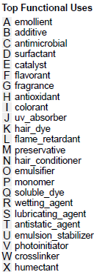
Developing Chemical Signatures for 5 Categories of Household Products Using Non-Targeted Analysis
Zachary Stanfield¹, Kristin Favela², Alice Yau², Katherine Phillips¹, Antony J. Williams¹, Kristin Isaacs¹, John F. Wambaugh¹
Center for Computational Toxicology and Exposure, Office of Research and Development, U.S. Environmental Protection Agency, Research Triangle Park, North Carolina 27711, United States
Southwest Research Institute, San Antonio, Texas 78238, United States
Abstract #: 537
stanfield.zachary@epa.gov
linkedin.com/in/zachstanfield
orcid.org/0000-0002-7579-7873
Symposium Session #: 122
Introduction
Consumer products are a major source of chemical exposure and therefore potential risk.
Knowing what chemicals are typically present in different types of products is needed for risk evaluation
Assessing similarity of new products with existing ones can identify any uncommon chemical ingredients
Results
Figure 3. Upset plot showing how chemicals occurring in our five product categories intersect. The largest intersection is between baby soap and shampoo (36 shared chemicals). The left histogram shows the total number of chemicals measured across all samples in each product type.
Structural Category Presence
Not in Cotton Clothing
In Cotton Clothing
Chemical Intersections
Kitchen Utensils
Cotton Clothing
Methods
Non-targeted analysis (NTA) using two-dimensional gas chromatography time-of-flight mass spectrometry (GC x GC-TOFMS) was applied to 170 unique samples of selected consumer products from 5 categories.
Baby Soap
Shampoo
Fabric Upholstery
Figure 2. Chemical space spanned by all chemicals from all samples represented as a tree with chemicals occuring in cotton clothing products highlighted (green). Figure was created using the R package treecompareR using ClassyFire annotations and the ChemOnt tree.
Household consumer products in a particular category have some chemicals in common. Identifying those chemicals common to each category can help us evaluate the safety of new and existing products.
Figure 4. Sample similarity heatmap for all cotton clothing samples based on chemical occurrence. The binary distance was used to calculate similarity and cluster samples hierarchically. Anonymized product brand and category subtype are also indicated.
Cotton Clothing Products
Figure 1. Workflow of non-targeted analysis of products from 5 types of household consumer products. Products were extracted with dichloromethane (DCM). After addition of an internal standard, each extraction was analyzed via GC X GC-TOFMS to obtain its mass spectra. The spectra were matched to the 2017 NIST database and analytical standards were used to confirm a subset of the chemical identifications. Chemicals were annotated by reported or predicted functional uses¹⁻³ and structural classification via ClassyFire⁴.
log10 Chemical Signal Normalized to 1ppm Internal Signature
Conclusions
This study provides a baseline set of chemical ingredients (that is, representative mixtures) across common types of consumer products, which will help in evaluating new and existing products.
Separating constituent chemicals into typical and atypical might inform exposure assessment, in vitro bioactivity screening, and ultimately the risk related to using such products.
Figure 6. Chemical signatures for each product category with the distribution of estimated sample concentrations. Chemicals were included in a signature if they occurred in ≥ 80% of product category samples. The number of chemicals per signature, from left to right, are 29, 21, 12, 9, and 5. Number of shared chemicals across signatures: clothing-fabric (16), clothing-kitchen (4), shampoo-kitchen (3), clothing-shampoo (2), clothing-soap (1), fabric-soap (1).
Figure 5. Heatmap of all chemicals in cotton clothing products. Rows (chemicals) and columns (products) are clustered hierarchically using Euclidean distance. Concentrations and top 3 chemical uses and are shown.
Disclaimer: This poster do not necessarily represent the views or policies of the U.S. EPA.
Funding Source(s): Office of Research and Development, US EPA
Conflict of Interest: None to disclose
Employment: None to disclose
Personal Financial Interests: None to disclose
Innovative Research for a Sustainable Future
www.epa.gov/research

