Slide 1
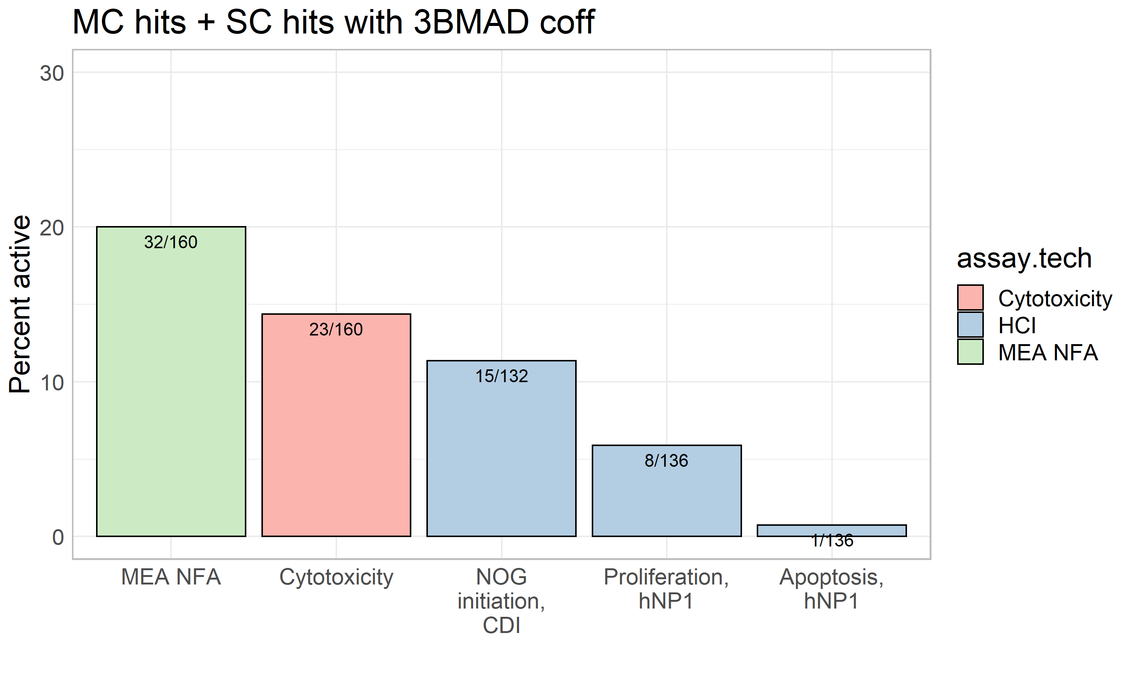
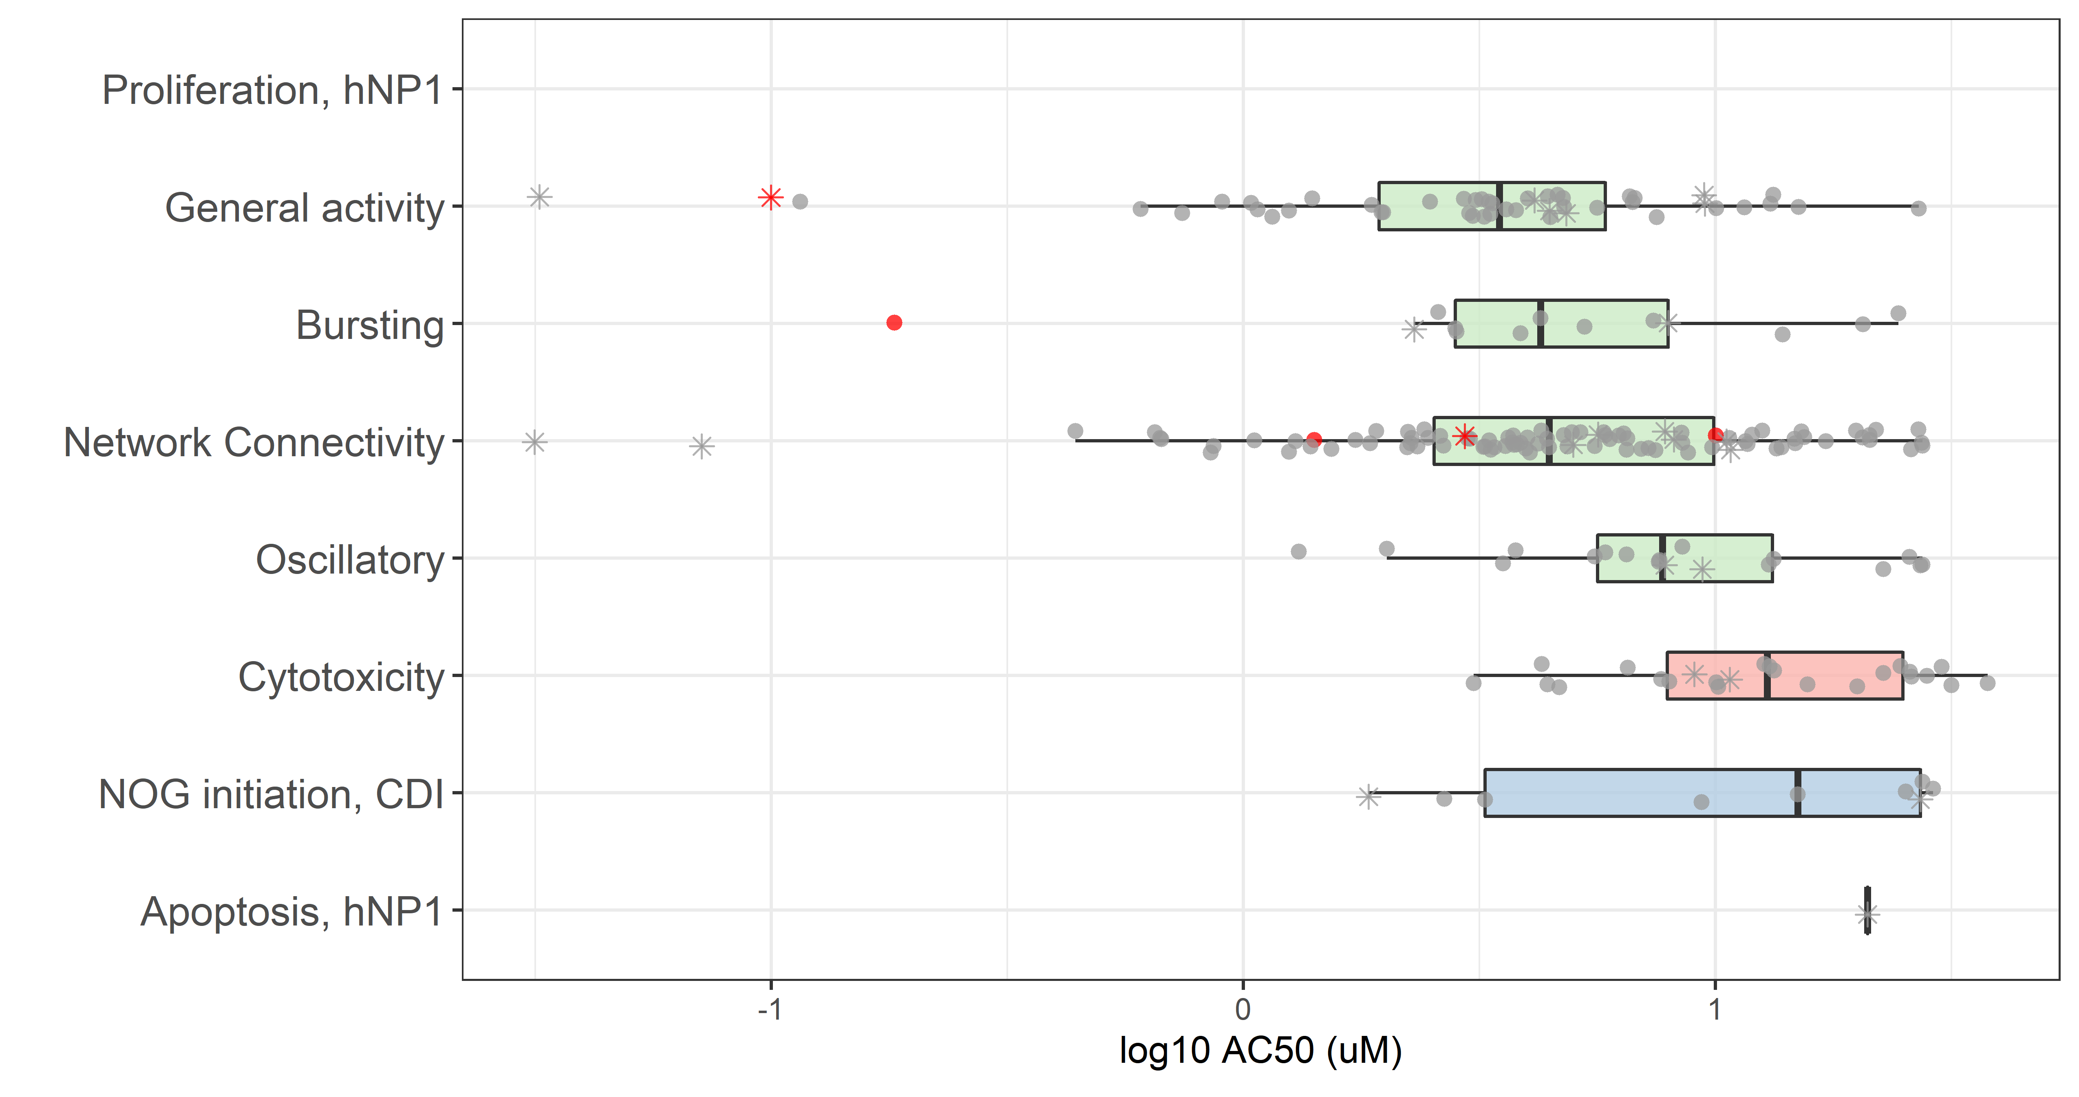
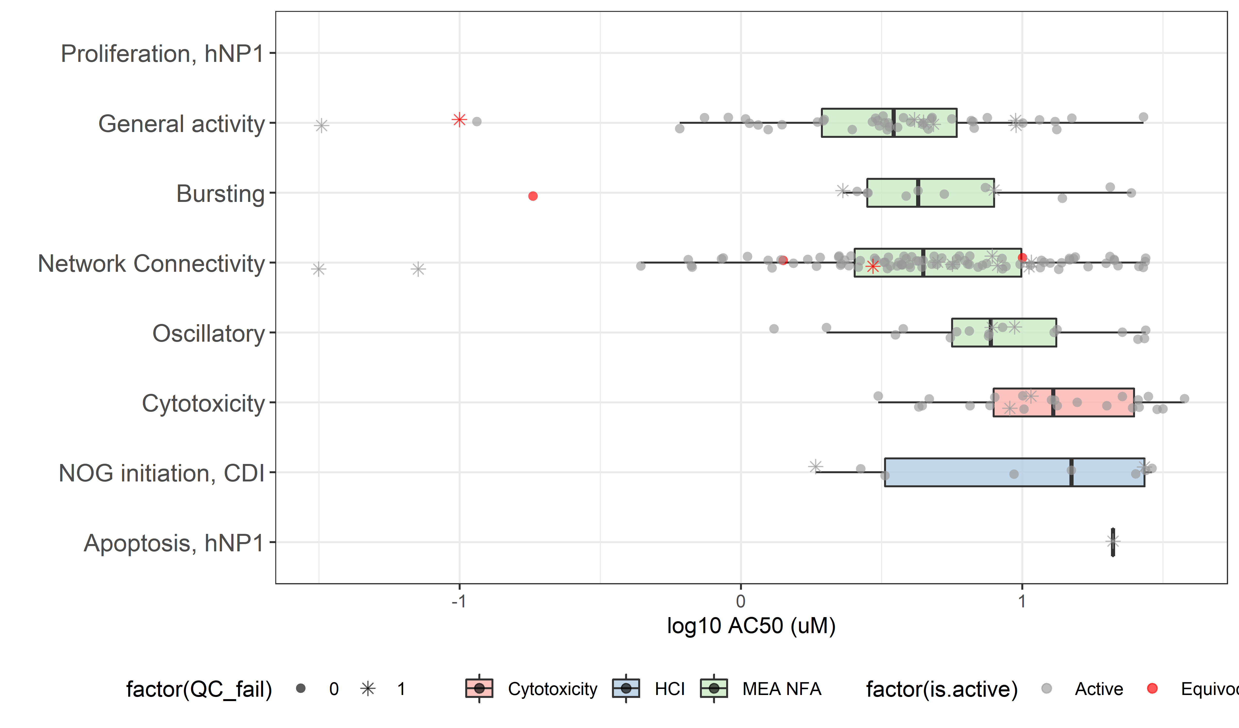
Figure 1
A) Percent of PFAS that were hits in each assay: multi-concentration (mc) + single-concentration (sc) screening
B) Potency range of active PFAS by activity type (mc screening only)
QC score:
Pass
Fail
Assay:
Bioactivity:
Active
Equivocal

Slide 2
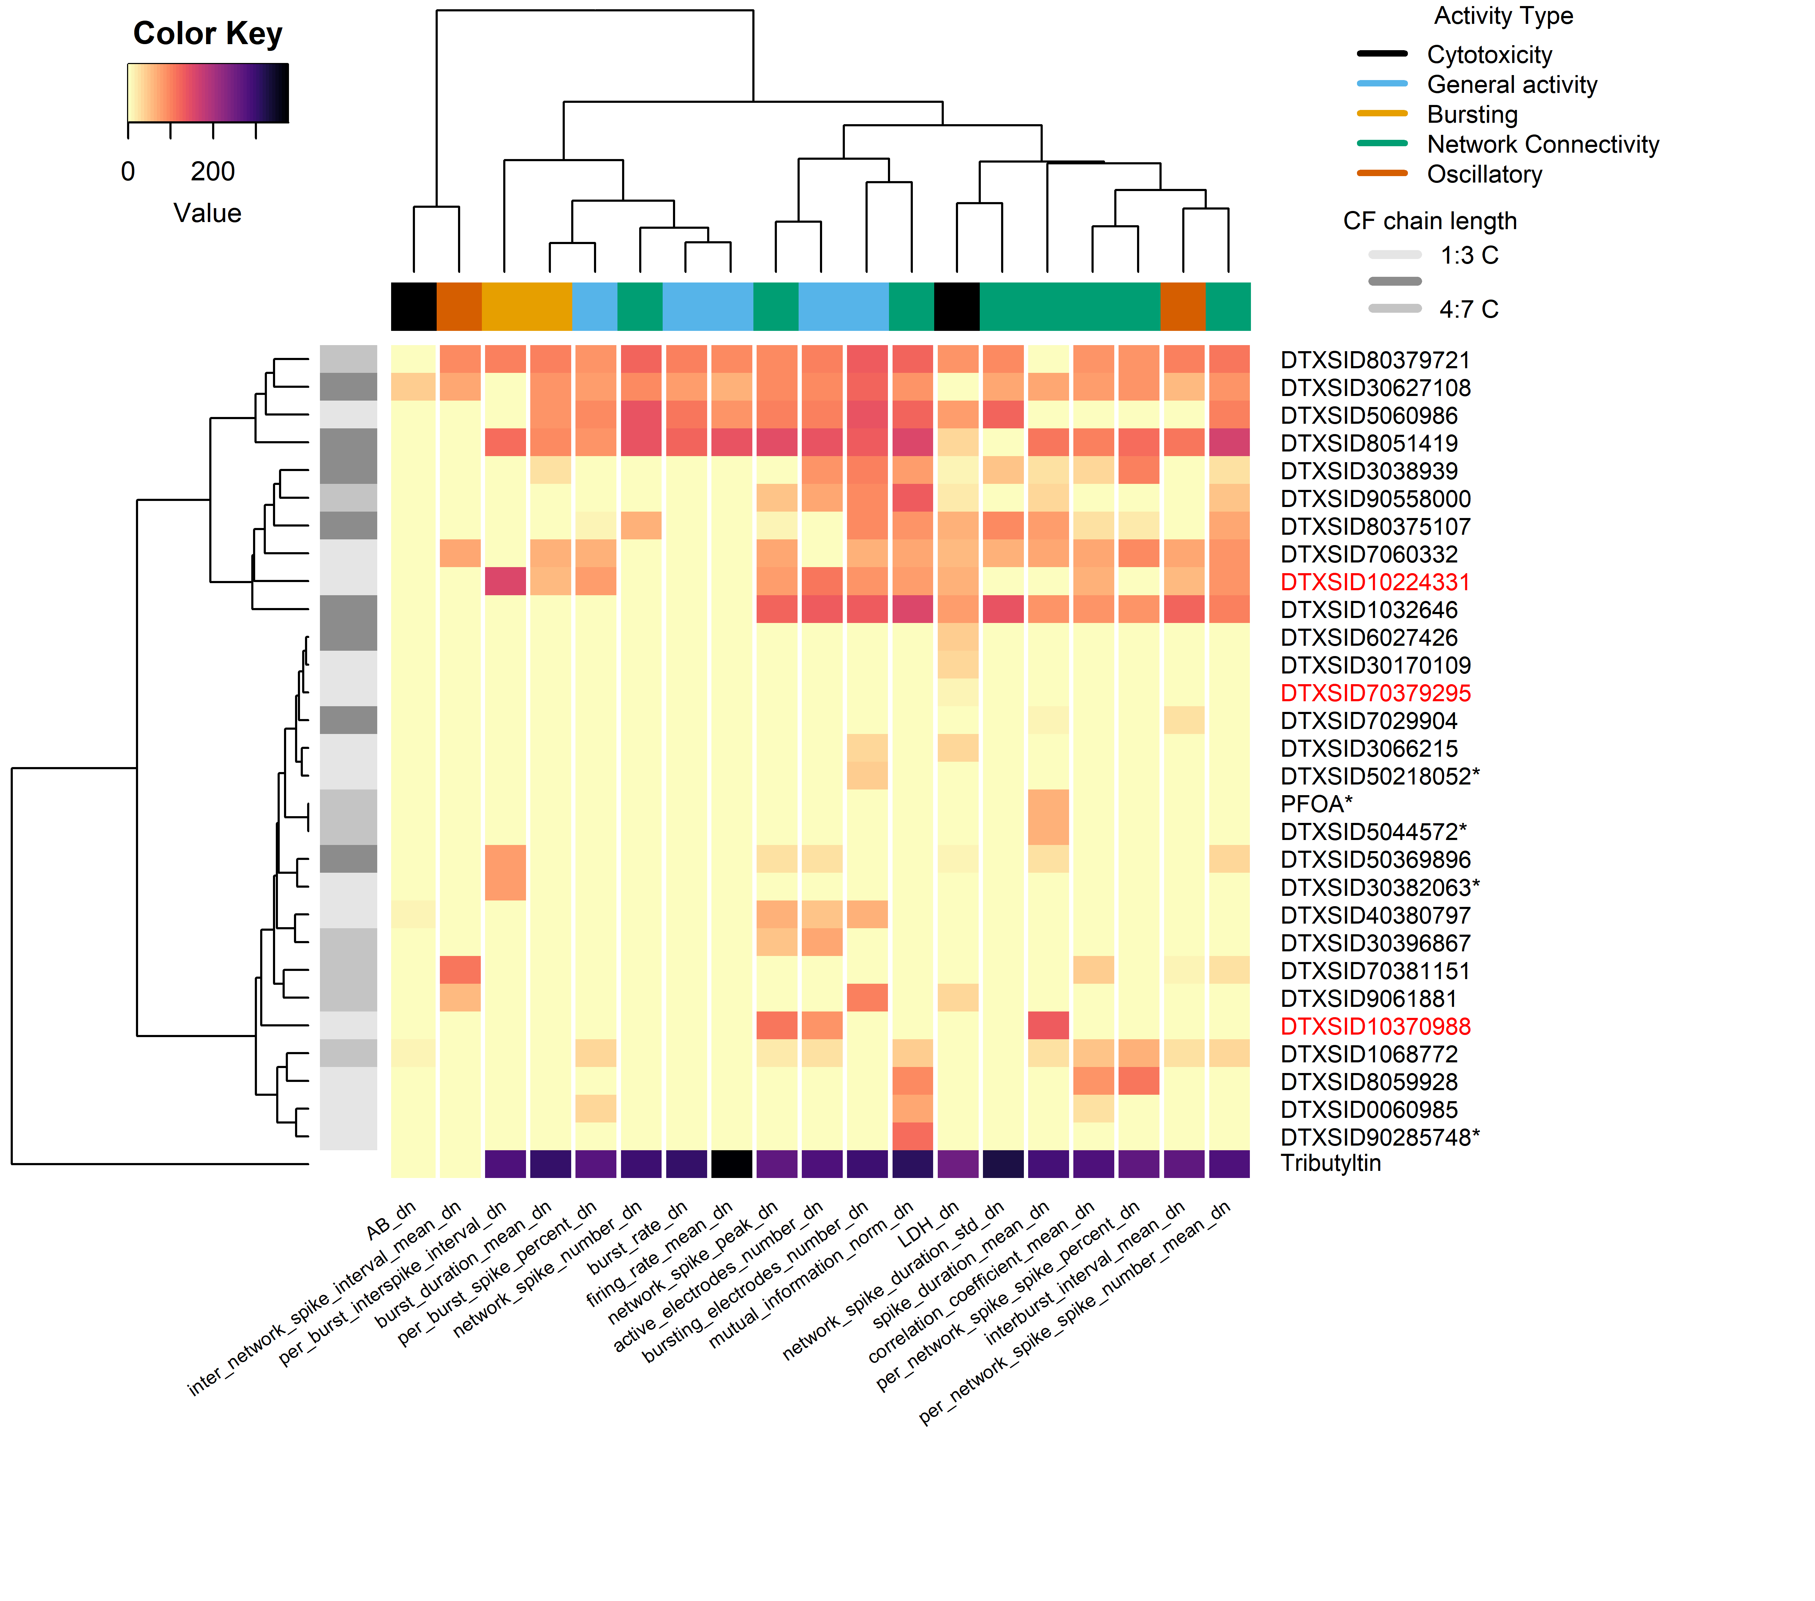


Figure 2. AUC heatmap for PFAS screened in the MEA NFA
AUC
1
2
3
4

Slide 3
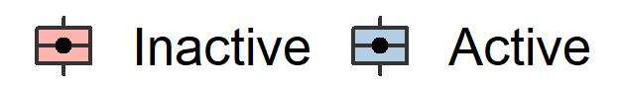
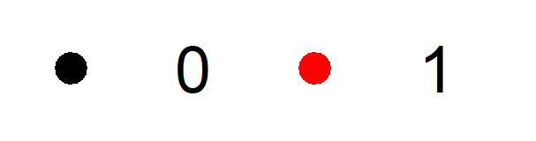
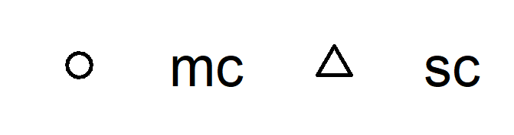
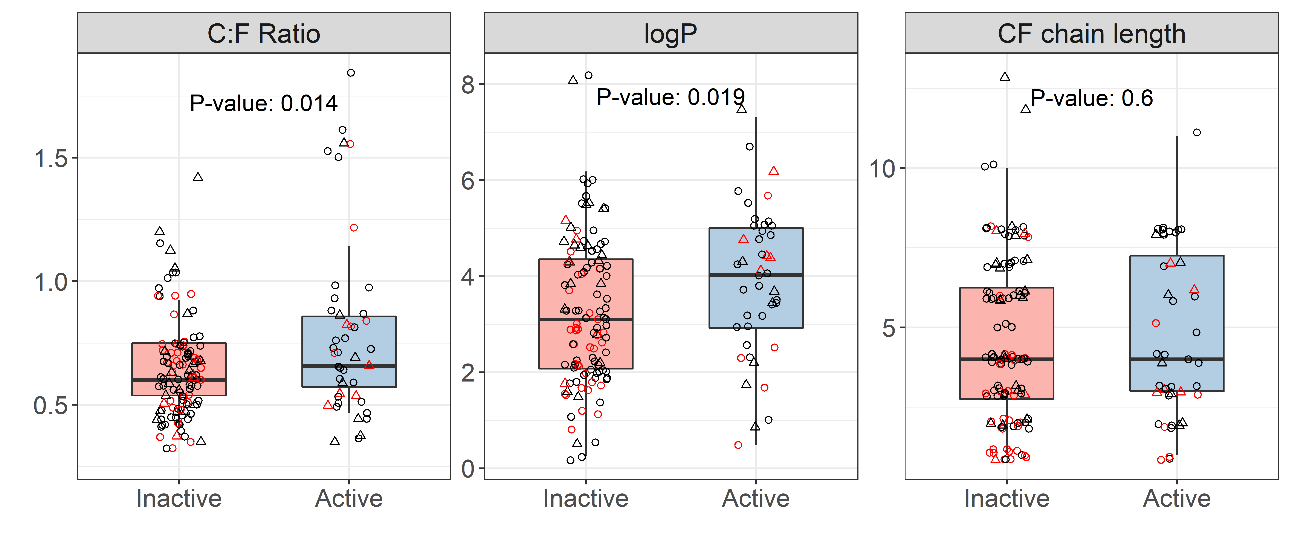
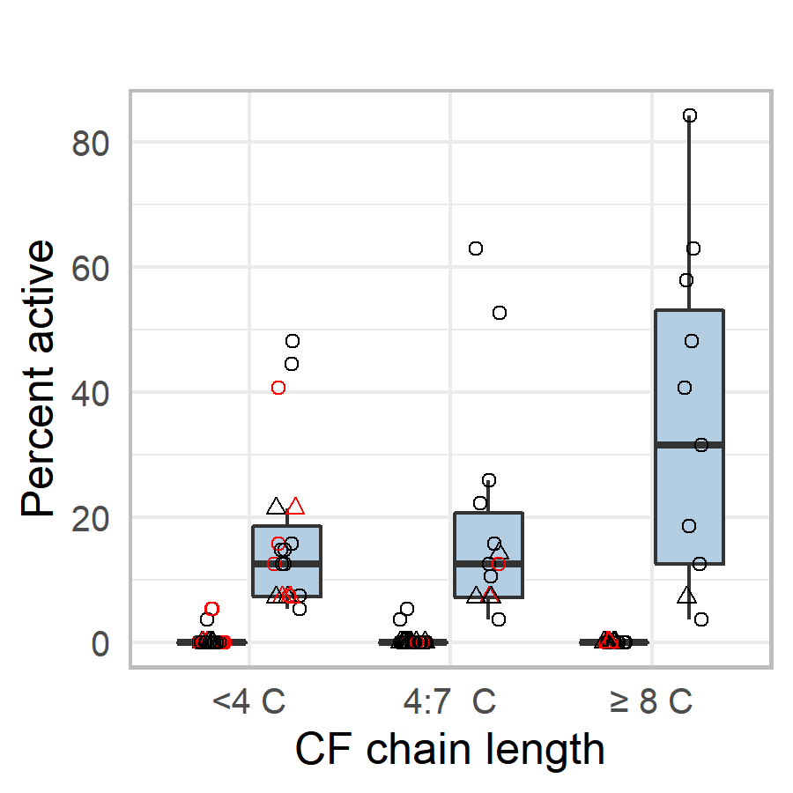
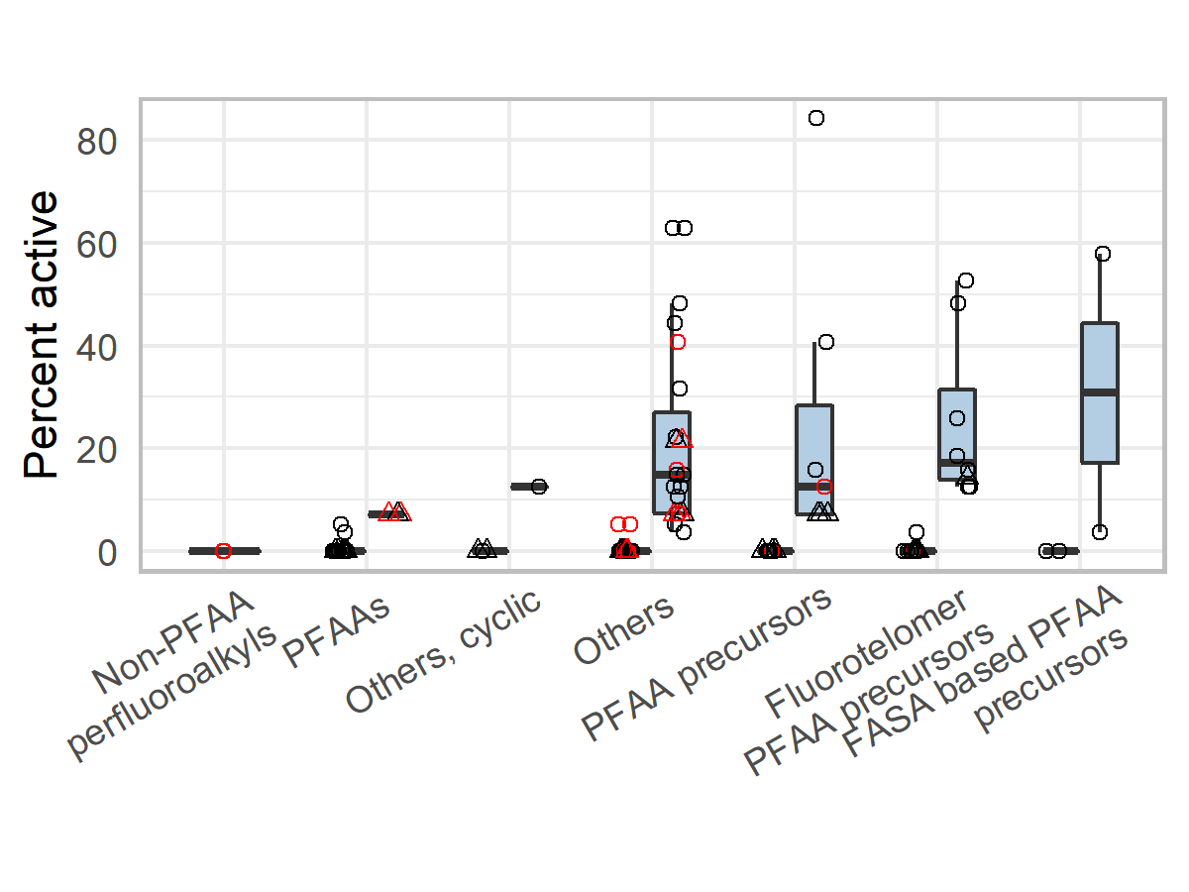
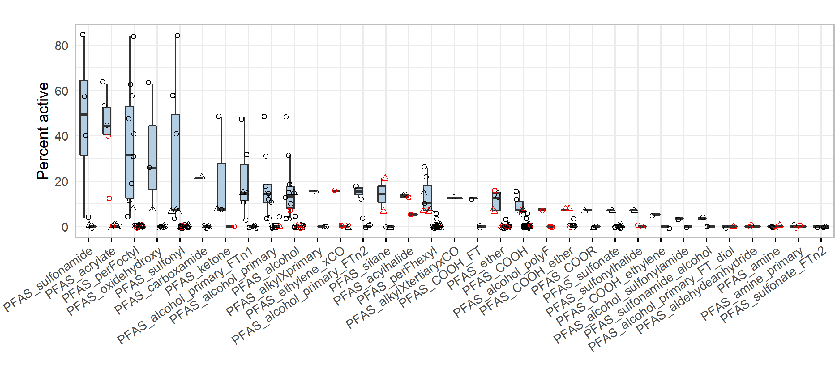
Figure 3
DNT NAM bioactivity
QC score
Sc or mc screening
Pass
Fail
A. Structure feature descriptors and DNT NAM activity
B. CF chain length and DNT NAM activity
C. PFAS-Map OECD categories and DNT NAM activity
D. PFAS ToxPrints and DNT NAM activity

Slide 4
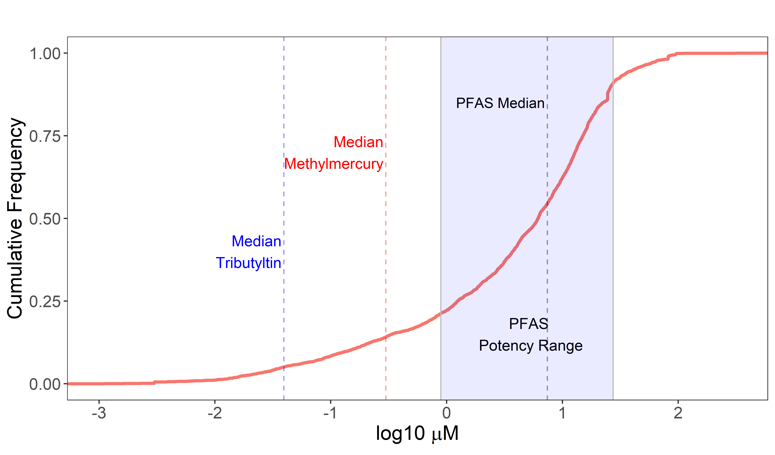
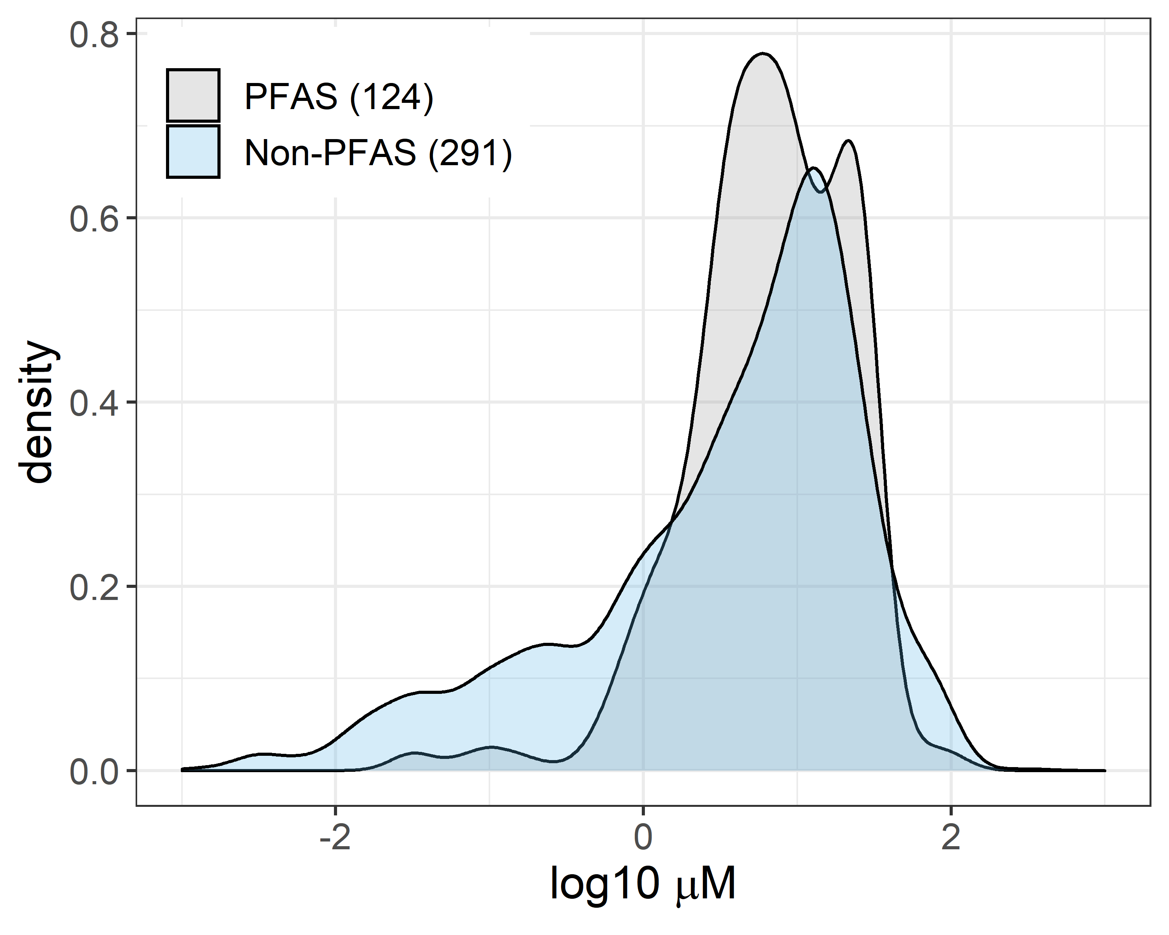
Figure 4.
A. Cumulative density distribution of DNT NAM potency (AC₅₀)
B. Density Plot of DNT NAM potency (AC₅₀)

Slide 5
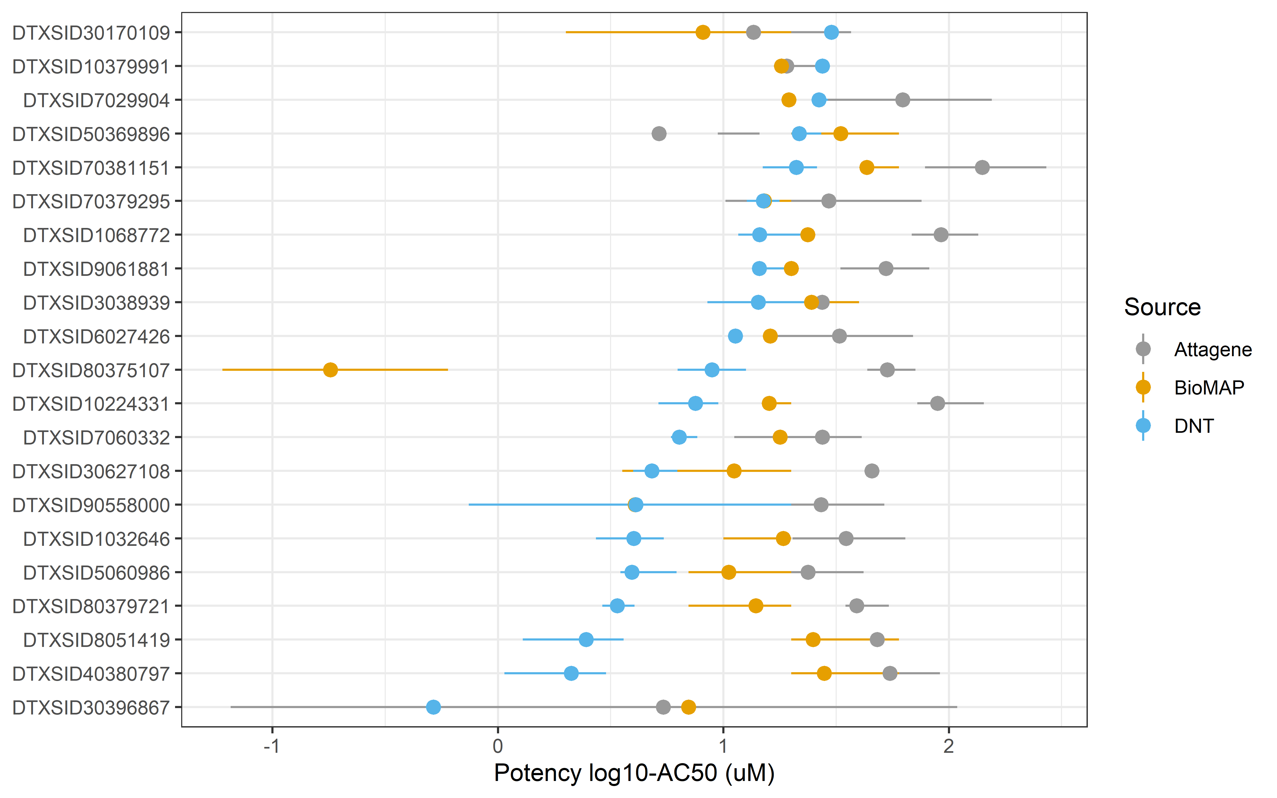
Figure 5
PFAS in DNT NAMs versus BioMap/ Attagene assays

