Slide 1
A. Training Dataset Assembly
B. Descriptor Dataset Assembly
Physico-Chemical Properties (OPERA)
Kidney Physiological Characteristics
Endogenous Chemical Similarity
Literature Sources
Albumin Binding Affinity
Ether-Bond Moiety
Liver Fatty Acid Binding Protein Affinity
Monte Carlo Synthesis
C. Dataset Processing and Preparation
PFAS t_{½} Dataset
Raw Training Dataset
Removal of Low Variance Descriptors
Reduction of Highly Correlated Descriptors
D. Random Forest Model Construction
RF Classification
Final Training Dataset
Reduced Classification Model
Recursive Feature Elimination
Full Classification model
Bin Selection
E. Application of Model to CompTox Chemicals Dashboard (CCD) PFAS Master List
t_{½} Predictions
Steady-State Internal Concentrations (C_{ss})
CCD List
Classification Model
Applicability Domain Calculation

Slide 2
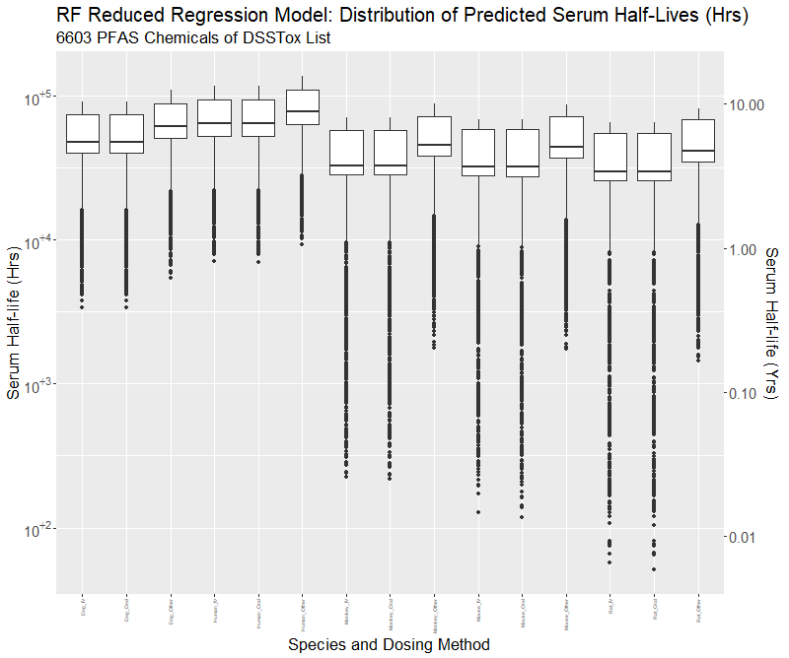
IV Oral Other
IV Oral Other
IV Oral Other
IV Oral Other
IV Oral Other
Dog
Human
Monkey
Mouse
Rat

Slide 3
Lau_references: collection of PDF’s and MS Doc files for data sources (29 publications): most provided by Chris Lau
PFAS_PK_references_v3_DEDupdate.docx: list from Chris Lau, referenced by species and chemical
Note: All R scripts and data files are located in an R project called “PFAS_HL_QSAR”
PFAS_Tables_For_Manuscripts_DED100920.xlxs
Parameter_determination_DED10212020.R
PFAS_HLH_Revised_DED_10212020_matched_names.xlsx
PFAS_QSAR_ModelBuilding_DED11062020.R
PFAS_Dataset_Building_DED11052020.R
PFAS_11Chemicals_QSARdataset_DED11062020.RData

Slide 4
FishBone Chart
Because they have different ecologies
Because of basic differences is physiology between male/females
Because they different kidney and liver structures and receptors
Because re-uptake is influenced by hormones
Because there are different re-uptake and metabolic activities
Why is modeling PFAS half-lives hard?
Because they vary by sex
Because they vary by species
Because empirical data is limited
Because structures are highly variable with different functional groups
Because it takes along time do
Because it takes technical expertise
Because hard to collect info for humans
Because you need to do in-vivo studies
Because they are manufactured for different purposes
Because PFAS has tricky chemical properties

