Slide 1
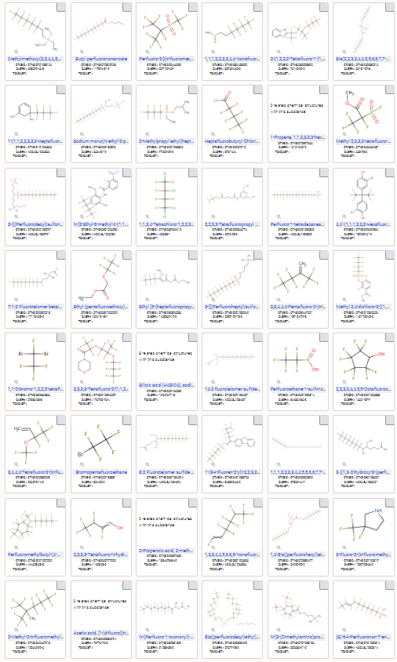
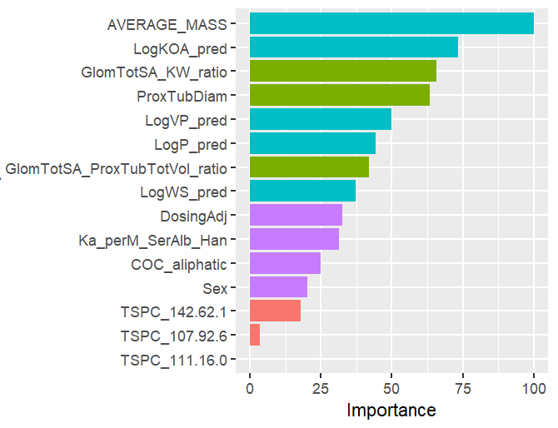
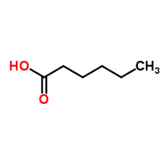
Machine Learning for PFAS Toxicokinetic Half-Life
1000’s of PFAS
Physiological
Parameters for
“Transporter Expression”
Proximal Tubule Geometry
Descriptors
Similarity to Endogenous Ligands for
“Transporter Affinity”
Structural similarity to:
Hexanoic acid

