Slide 1

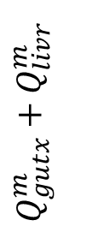













Lung Tissue
Lung Blood
$$Q_{artb}^{m}$$
Gut Lumen
$$Q_{artb}^{m}$$
Venous Blood
Gut Tissue
Arterial Blood
Gut Blood
$$Q_{gutx}^{m}+Q_{livr}^{m}$$
Liver Blood
Liver Tissue
$$Q_{gutx}^{m}$$
Thyroid Tissue
$$Q_{livr}^{m}$$
Thyroid Blood
$$Q_{thyr}^{m}$$
Kidney Tissue
$$Q_{thyr}^{m}$$
Kidney Blood
$$Q_{kidn}^{m}$$
Adipose Tissue
$$Q_{kidn}^{m}$$
Adipose Blood
$$Q_{adip}^{m}$$
Rest of Body Tissue
$$Q_{adip}^{m}$$
Rest of Body Blood
$$Q_{rest}^{m}$$
Conceptus Tissue
$$Q_{rest}^{m}$$
Conceptus Blood
$$Q_{conceptus}$$
$$Q_{conceptus}$$

