Slide 1
DeconST Quick Start User Training

Slide 2
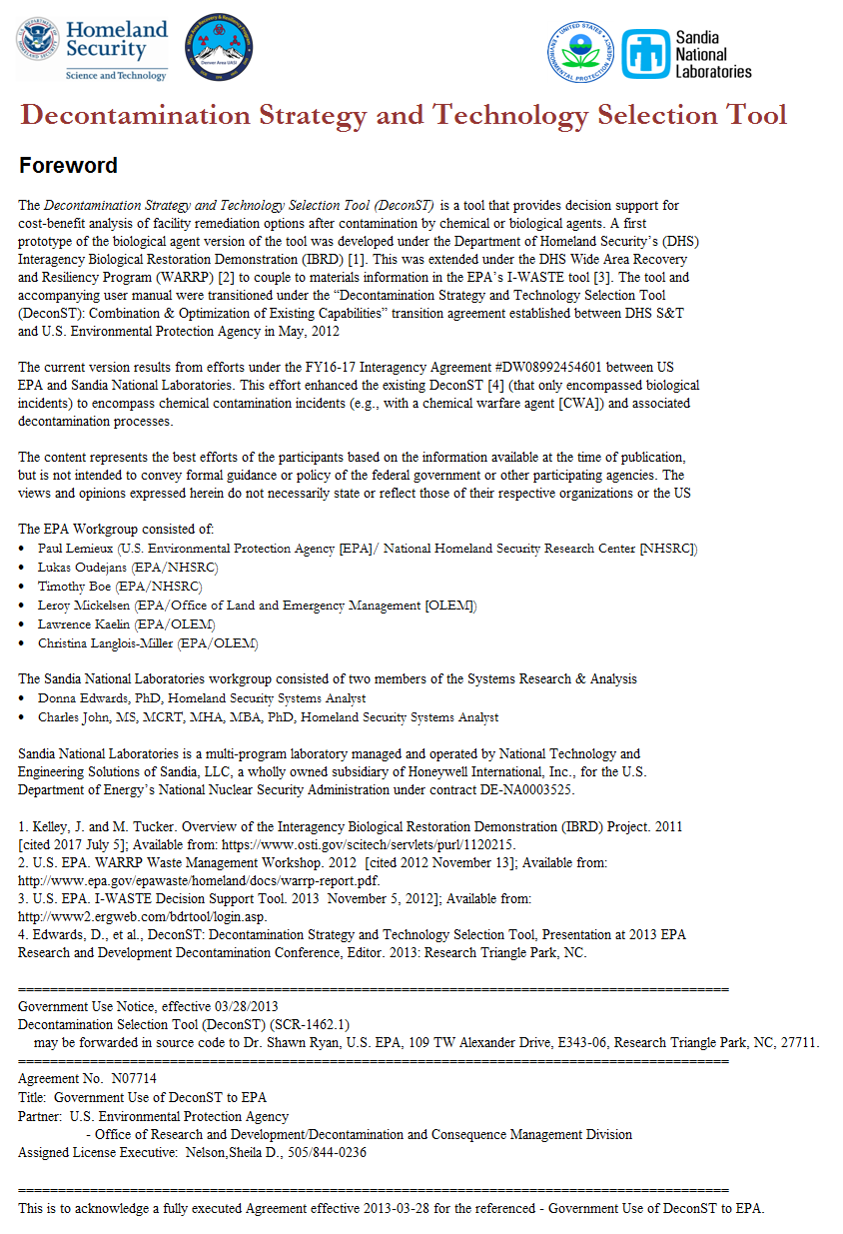
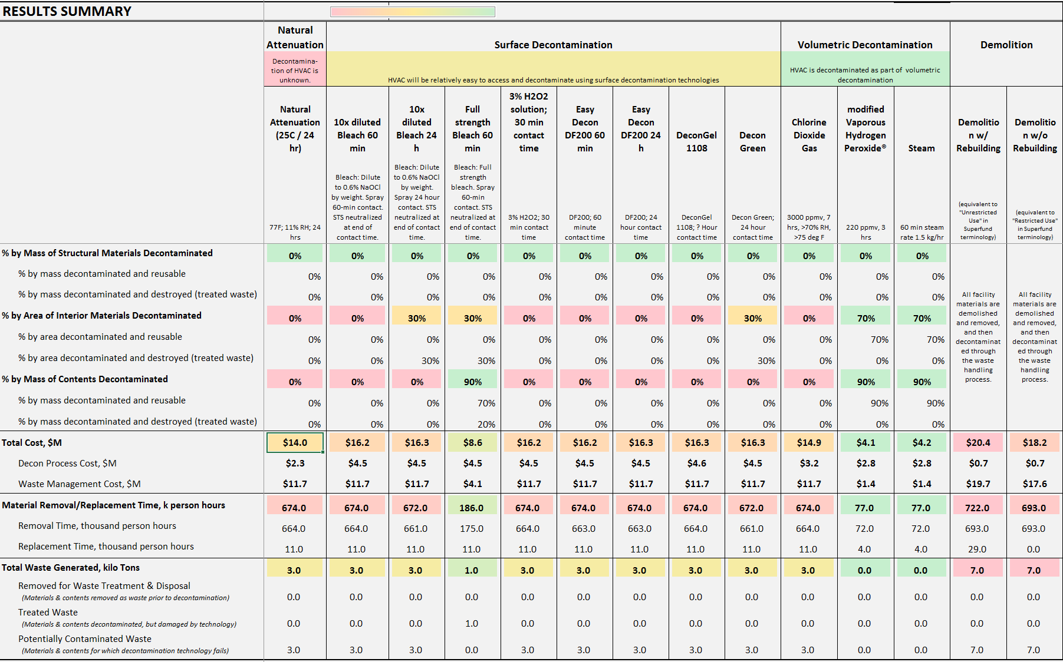
DeconST at a Glance
The DeconST goal is to provide information so that a Technical Working Group can assess potential decontamination strategies and technology options for a particular facility, using a systems approach, comparing the options on the basis of their relative effectiveness, costs, destructiveness, and waste generated.
DeconST presents a series of options and recommendations, with color-coded estimates of likelihood of success, cost implications, and waste estimates of decontamination technologies appropriate to a given building.
DeconST provides outputs, including tables of waste composition, cost distribution charts, and other information that would justify the recommendations given to an Incident Commander.
Need to fix

Slide 3
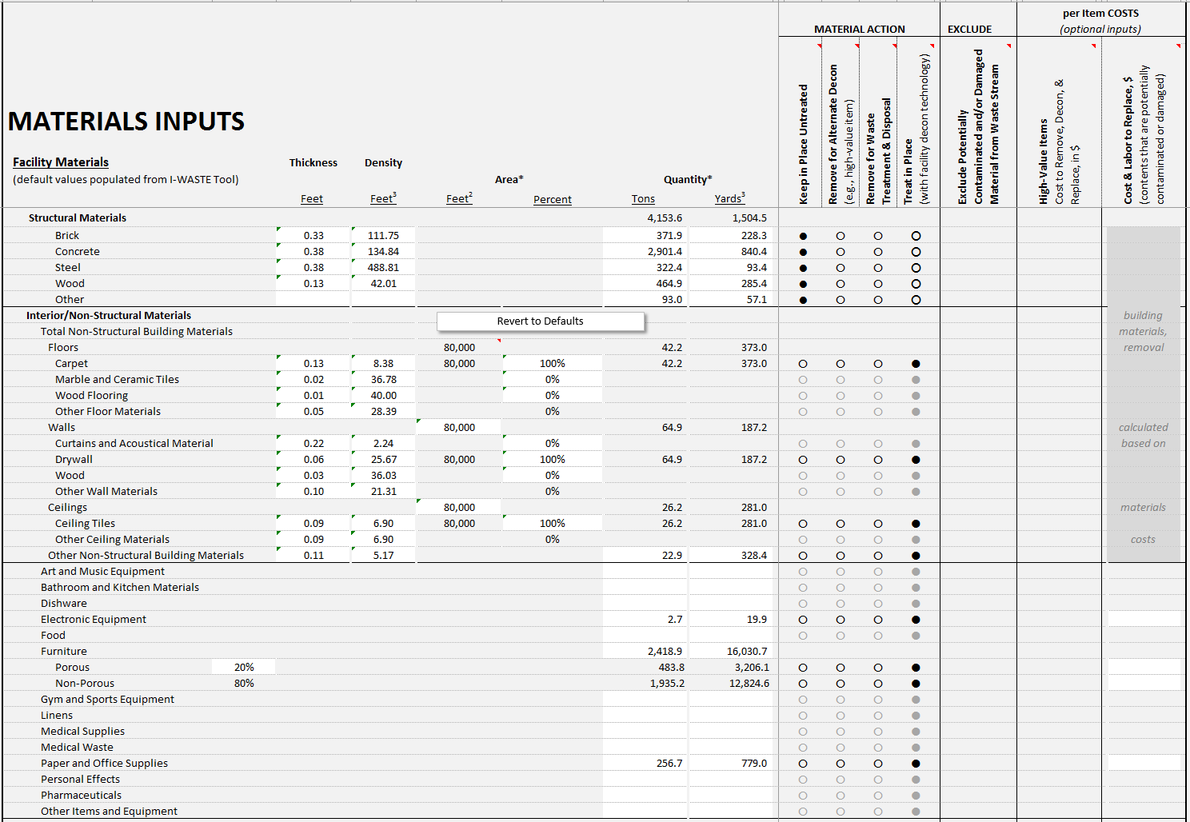
Key Stakeholder Messages
DeconST provides a comprehensive, data-rich framework for considering decontamination options and facilitating the development of facility-specific, efficient, and effective remediation approaches following attack or contamination with Bacillus anthracis (B.a.) or a chemical agent.
Stakeholders can….
Assess the decontamination strategy and technology options for a particular facility, comparing the options on the basis of their relative effectiveness, costs, destructiveness, and waste generated.
Identify and recommend a decontamination strategy to the incident commander so that remediation operations can be planned, approved, and implemented more quickly.

Slide 4

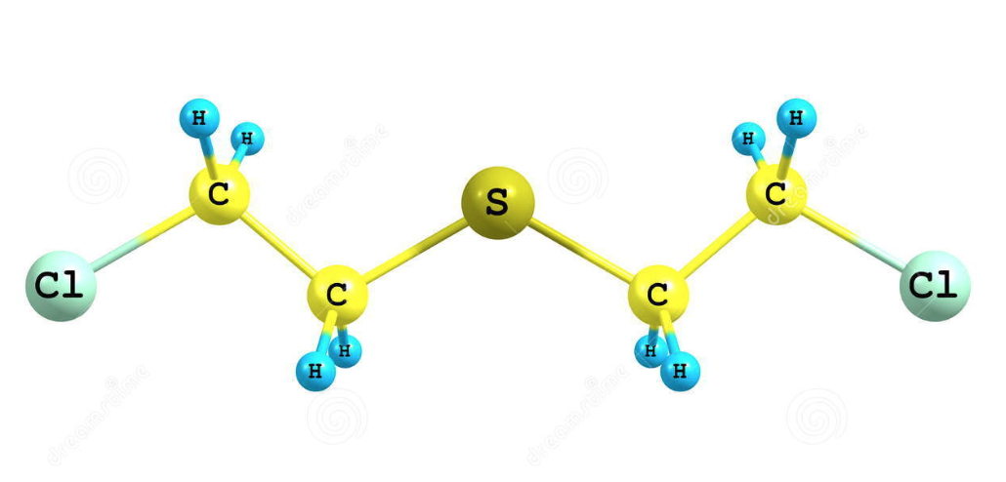

DeconST Initial Startup
DeconST-bioBa – Bacillus anthracis (anthrax)
DeconST-chemHD – Sulfur Mustard (blister agent)
DeconST-chemVX – VX (nerve agent)

Slide 5
Let’s get started!
DeconST Fundamentals

Slide 6
DeconST Main Screen
Key Messages
The first 3 Excel Worksheets contain the pertinent content in the Quick Start Guide as a reference if needed during operation.
Data are entered into the tool beginning with the User Input Worksheet.
Need to fix
Need to fix

Slide 7
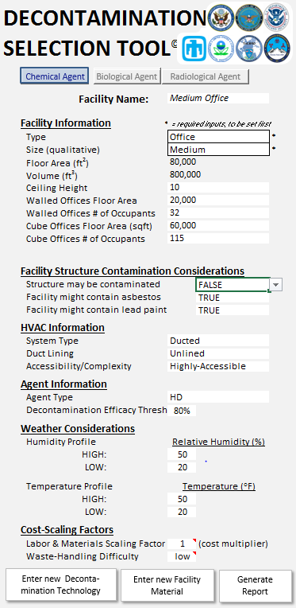
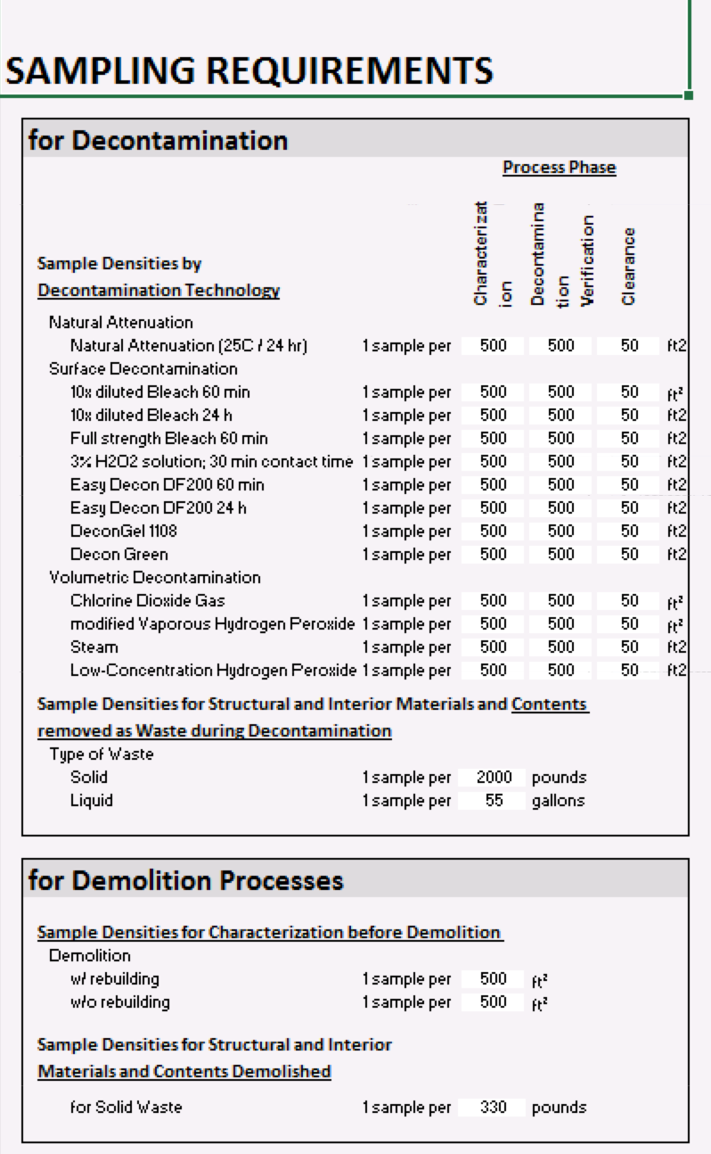
User Input Worksheets
User Input Worksheet
Materials Input Worksheet
Sampling Input Worksheet
7

Slide 8
Results Summary
Results Summary Worksheet

Slide 9
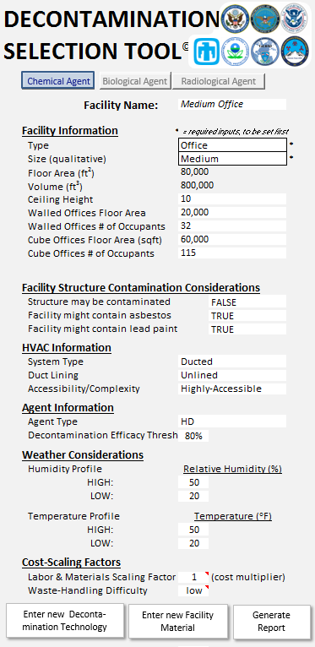
User Input Worksheets: Facility
Instructions
Once again, verify you are using the correct version of the tool.
DeconST Screenshot Interpretation
The User Input Worksheet collects the information about the:
Facility
Facility structure contamination considerations
HVAC system
Agent or chemical
Weather
Cost-scaling factors if there are any
Key Messages
DeconST requires minimal user input to get initial data results
Customizable assessments can be done based on a variety of different building types.

Slide 10
User Input Worksheets: Facility
Instructions
Name the building
Enter a Name for the facility in the Facility Name box.
Key Messages
Use easily recognizable nomenclature when naming the facility.

Slide 11
User Input Worksheets: Facility
Instructions
Verify or change the facility information.
Select the facility type and qualitative size from the drop down menus in order to populate default parameters.
Key Messages
If a facility type is NOT in the drop-down menu, refer to the Advanced Features section of the User Guide for instructions.
When the Size (qualitative) is selected from the drop down menu, the Floor Area and Volume data fields are auto-populated to reflect the size.
Other facility specific parameters also auto-populate.

Slide 12
User Input Worksheets: Facility
Instructions
If desired, update the facility parameters. In the case of an office building, these are:
Ceiling Height
User Input Individual-Walled Office Area
Individual-Walled Office Number of Occupants
User Input Cube Area
Cube Number of Occupants
Key Messages
There are default values supplied for all input parameters
Users can adjust these values as needed

Slide 13
User Input Worksheets: Facility
Instructions
Enter the facility contamination considerations as True or False:
Structure may be contaminated
Facility might contain asbestos
Facility might contain lead paint
Key Messages
If the facility structure is not contaminated, the structural materials are not included in the decontamination calculations.
The presence of asbestos and/or lead paint are additional considerations for waste handling and demolition.

Slide 14
User Input Worksheets: HVAC
Instructions
Now, enter the building HVAC information.
Select the HVAC system type – ducted or unducted.

Slide 15
User Input Worksheets: HVAC
Instructions
For ducted systems, select whether ducts are lined or unlined.

Slide 16
User Input Worksheets: HVAC
Instructions
Select the best descriptor of the accessibility of the system for cleaning, considering location and lengths of ducts.
DeconST Screenshot Interpretation
Duct work does not change the waste and the efficacy
Decontamination for duct work may be different than the decontamination for the rest of the building
Pay attention to the implications of the duct work for using a particular decontamination strategy
Key Messages
Due to complexities of decontamination of HVAC, DeconST recommendations for HVAC are given as caveats to the overall assessment of different technologies.

Slide 17
User Input Worksheets: Agent
Instructions
Next, verify the agent information.
Verify that this box lists the correct chemical agent (or biological agent).
DeconST Screenshot Interpretation
If the correct agent is NOT listed, switch to the correct version of the tool:
B. anthracis – DeconST-bioBa
Sulfur Mustard – DeconST-chemHD
VX – DeconSTVX
In this example, Sulfur Mustard is the chemical agent (Agent Type = HD).
For chemical agents, the desired minimum Decontamination Efficacy may be found in the dropdown menu OR can be typed in the box.
Key Messages
Double check the contaminant again to ensure the correct version of DeconST is being used.

Slide 18
User Input Worksheets: Weather Conditions
Instructions
Information about the weather considerations is next.
Input the daily high and low relative humidity and high and low outdoor temperatures.
DeconST Screenshot Interpretation
Values are required for both the High and the Low.
Key Messages
There are default values supplied for all input parameters.
Users can adjust these values as needed.

Slide 19
User Input Worksheets: Cost-Scaling
Instructions
Adjust urban-area premium, which is a multiplicative factor for all labor and materials costs.
DeconST Screenshot Interpretation
There may be cost multipliers due to location or incident that may be needed to be applied to correct cost estimates.
Often cost multipliers are not needed.

Slide 20
User Input Worksheets: Cost-Scaling
Instructions
Select the waste-handling difficulty (high, moderate, low).
DeconST Screenshot Interpretation
Depending on the location, waste may be more or less difficult to handle.
Low indicates similar to municipal solid waste.
Medium is more difficult (e.g., similar to hazardous waste).
High is very difficult (e.g., similar to waste that only very limited number of available facilities exist or increased requirements for managing the waste).
Key Messages
Waste handling (Low, Medium, High) will impact the cost estimates.

Slide 21
User Input Worksheets: Generate Report
Instructions
The Generate Report button runs a “Print Preview” on the main input and output pages, from which the user may print a report.
DeconST Screenshot Interpretation
Note that the preview of the report is not in color unless a color printer is chosen.
Color is used to help convey the results comparison.
Key Messages
A full report will be available that can be used to develop the key content sections of the technical briefing provided to the incident commander.

Slide 22
Switch to the materials input worksheet

Slide 23
Materials Input Worksheet
Key Messages
The Materials Input Worksheet shows default quantities of structural and interior non-structural building materials and contents for the particular facility type selected on the User Input worksheet.
These quantities were auto-populated from the EPA’s I-WASTE tool based on the facility type that is identified on the User Input Tab. See Users Guide for more information on I-WASTE).
The user may customize the quantities on this page, select appropriate actions for each material, and input per item costs as necessary.

Slide 24
Materials Input Worksheet: Quantities
Instructions
Adjust the quantities of the structural materials for Thickness (feet), Density (feet³), and Quantity (Tons and Yards³).
DeconST Screenshot Interpretation
Default quantities are based on Hazus and I-WASTE for the building type selected on initial page. See Users Guide for more information on Hazus.
Often these quantities do not need editing.

Slide 25
Materials Input Worksheet: Quantities
Instructions
The same adjustments can be made for the quantities of the interior materials.

Slide 26
Materials Input Worksheet: Quantities
Instructions
The same adjustments can be made for the quantities of the contents.
Key Messages
Note that the quantities must be positive numeric values and that the total percentages must not exceed 100%.
To adjust the floor area, return to the User Input worksheet .

Slide 27
Materials Input Worksheet: Material Action
Instructions
For each material or item, use the radio buttons to select the appropriate action:
Keep in Place Untreated
Remove for Alternate Decontamination (e.g., for high-value items)
Send Directly to Waste
Treat in Place (with the Facility Decontamination Technology)
DeconST Screenshot Interpretation
The user can assign different types of decon/waste management for each of the different materials
The default is to treat all of the materials in place.

Slide 28
Materials Input Worksheet: Exclusion
Instructions
For any materials to be excluded from the waste stream calculations, for example structural materials, check the corresponding box in the Exclude Column.
Key Messages
Note that the checkboxes do not apply to materials successfully decontaminated by the technology, since these materials would not be sent to waste in any case.

Slide 29
Materials Input Worksheet: Per Item Cost
Instructions
For each high-value material or item to be removed for alternate decontamination, enter the cost to remove, decontaminate, and replace the material or item.
For other facility contents, input the costs and labor to remove and replace a given item, in the event that the item is sent directly to waste or in the event that the given item is treated by facility decontamination method but remains potentially contaminated or becomes damaged.
Key Messages
Note that leaving blank entries in the white cells assumes zero costs.

Slide 30
Switch to sampling inputs worksheet

Slide 31
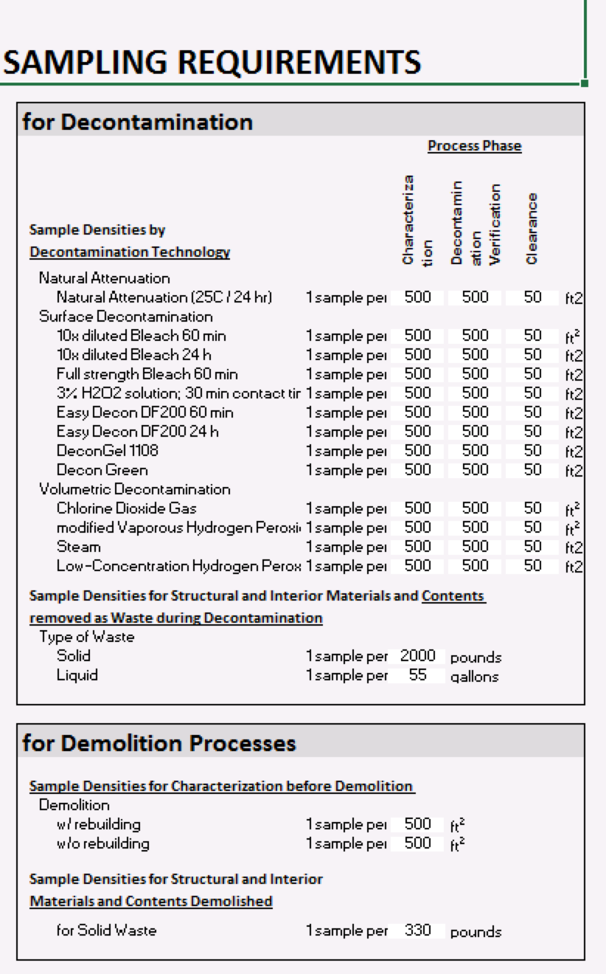
Sampling Input Worksheet
Key Messages
The Sampling Inputs worksheet shows the sampling densities for the process phases and waste generated from both decontamination and demolition processes.

Slide 32
Sampling Input Worksheets: Decon Processes
Instructions
For each Decontamination Technology, set the sampling density for each of the three Process Phases.
Characterization
Decontamination Verification
Clearance
DeconST Screenshot Interpretation
Very simple input of sampling requirements can be adjusted based on visual sampling plan (known as VSP) or other tools, but the input must be in terms of samples per unit area.

Slide 33
Sampling Input Worksheets: Decon Processes
Instructions
Set the sampling densities for the solid waste and the liquid waste generated during decontamination processes.

Slide 34
Sampling Input Worksheets: Demo Processes
Instructions
Set the Sample Densities for Characterization for Demolition.

Slide 35
Sampling Input Worksheets: Demo Processes
Instructions
Set the Sample Densities for Structural and Interior Materials and Contents Demolished.

Slide 36
Switch to results summary

Slide 37
Results Summary Worksheet
DeconST Screenshot Interpretation
The Results Summary worksheet shows a comparison across the different decontamination strategies and technologies (one for each column) of the high-level decision considerations:
Percentages of Materials Decontaminated
Total Cost
Material Removal and Replacement Time
Total Waste Generated
The first rows of the summary table show the default types of decontamination strategies and technologies, the HVAC considerations, and the decontamination technology conditions.
The default decontamination strategies considered in the tool are the following:
Natural Attenuation (chem only)
Volumetric Decontamination
Surface Decontamination
Demolition: with and without rebuilding
Other technologies (including hybrid technologies) can be added by the user

Slide 38
Decon Strategies & Technologies: HVAC
DeconST Screenshot Interpretation
The first row under the Strategy Categories shows the HVAC Considerations.

Slide 39
Decon Strategies & Technologies: HVAC
DeconST Screenshot Interpretation
Under Natural Attenuation, decontamination of the HVAC system is unknown.

Slide 40
Decon Strategies & Technologies: HVAC
DeconST Screenshot Interpretation
For Surface Decontamination processes, decontamination of the HVAC system may present a separate and difficult challenge.

Slide 41
Decon Strategies & Technologies: HVAC
DeconST Screenshot Interpretation
For Volumetric Decontamination processes, the HVAC system is decontaminated as part of the volumetric decontamination process.
Key Messages
In particular, decontamination of less-accessible ducted HVAC systems may require significant efforts that are not explicitly incorporated into the cost calculations in the DeconST.

Slide 42
Decon Strategies & Technologies: Conditions
DeconST Screenshot Interpretation
The first row under the name of each decontamination technology shows the conditions under which that technology must be applied.

Slide 43
Decon Strategies & Technologies: Percentages
DeconST Screenshot Interpretation
The Percentages of Materials Decontaminated show: the total percent of each type of material (structural materials, interior non-structural materials, and contents) that is successfully decontaminated by each technology, as well as the percentages of those that are reusable versus destroyed.
The same information is presented graphically on the % of Materials Decontaminated by Decontamination Technology plot (the Materials Decon % Plot chart).
Details on the disposition of each material type can be found on the Results Materials Lists worksheets (with and without the quantities of materials listed) and on the Results Materials Disposition worksheet
Key Messages
Note that the color coding is a gradation from red to green, with red being the less-desirable and green being the more-desirable outcome.

Slide 44
Decon Strategies & Technologies: Total Cost
DeconST Screenshot Interpretation
The Total Cost rows show the sum and the components of the Decontamination Process Cost (including incident command, characterization and clearance sampling and analysis, temperature and humidity adjustment, decontamination, and long-term monitoring) and the Waste Management Cost (including the costs for removing, decontaminating, disposing of, and replacing all materials and contents damaged and/or not decontaminated by the technology).
The cost information is presented graphically in the Total Relative Costs of Decontamination Technologies plots (on the Costs Plot and Costs Plot wDemo charts) and in detail on the Results Costs worksheet.
The true total cost would need to consider the cost of facility downtime, which for many facilities would likely overwhelm the cost of the remediation.
Key Messages
Remember that the HVAC decontamination is not included and may incur considerable costs; see the HVAC considerations row for this particular facility.
Note that the costs of the decontamination strategies and technologies are provided as relative costs for purposes of strategy and technology comparison.

Slide 45
Material Removal/Replacement Time
DeconST Screenshot Interpretation
The Material Removal and Replacement Time rows show the total labor hours required for the Removal and Replacement.
Note that these times are provided as relative labor requirement times for purposes of strategy and technology comparison.
The actual facility downtime would need to take into consideration resource availability.

Slide 46
Decon Strategies & Technologies: Waste
DeconST Screenshot Interpretation
The Total Waste Generated rows show the total and component quantities of waste in three categories:
Sent Directly to Waste: the materials and contents removed as waste prior to decontamination
Treated Waste: the materials and contents decontaminated, but damaged by the decontamination technology
Potentially Contaminated Waste: the materials and contents for which the decontamination technology fails
The information is shown graphically on the Waste Generated by Decontamination Technology plots (on the Waste Generated Plot wDemo and woDemo charts).
Key Messages
Details on the disposition of each material type can be found on the Results Materials Lists worksheets (with and without the quantities of materials listed) and on the Results Materials Disposition worksheet.

Slide 47
Results Materials Disposition Lists

Slide 48
Waste Generated by Decontamination Technology

Slide 49
Total Relative Costs of Decontamination Technologies

Slide 50
Results – Relative Costs

Slide 51
Percentage of Materials Decontaminated by Decontamination Technology

Slide 52
Conclusion
This concludes the tutorial on DeconST.
For additional information on the tool’s capabilities, consult the DeconST User’s Manual.
Paul M. Lemieux, PhD
US EPA Office of Research and Development
National Homeland Security Research Center
919-541-0962
919-541-0496 fax
513-300-9958 cell
lemieux.paul@epa.gov
www.epa.gov/nhsrc

Slide 53
Disclaimer
Reference herein to any specific commercial products, process, or service by trade name, trademark, manufacturer, or otherwise, does not necessarily constitute or imply its endorsement, recommendation, or favoring by the United States Government. The views and opinions of authors expressed herein do not necessarily state or reflect those of the United States Government, and shall not be used for advertising or product endorsement purposes

