Slide 1
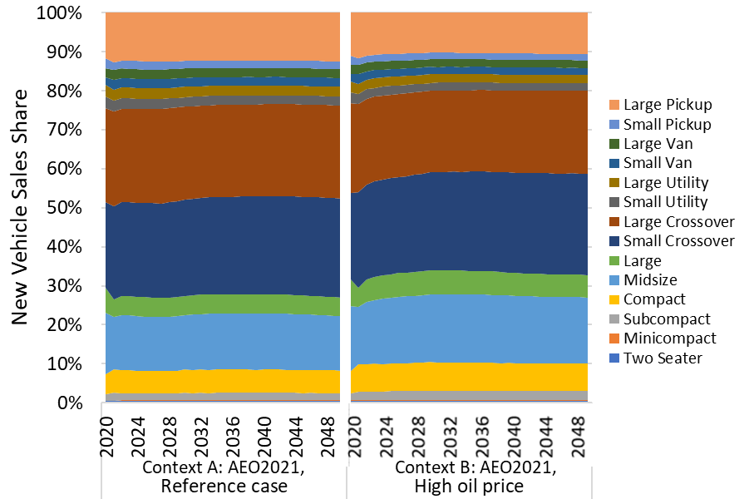

Slide 2
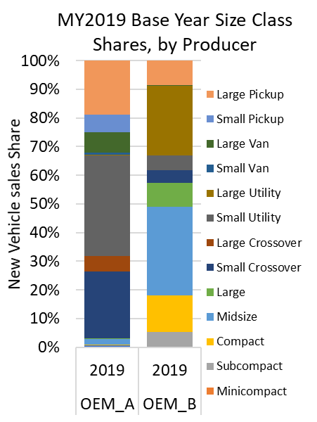
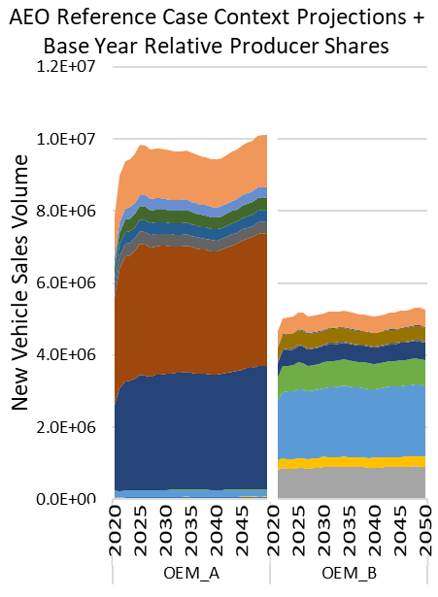

Slide 3
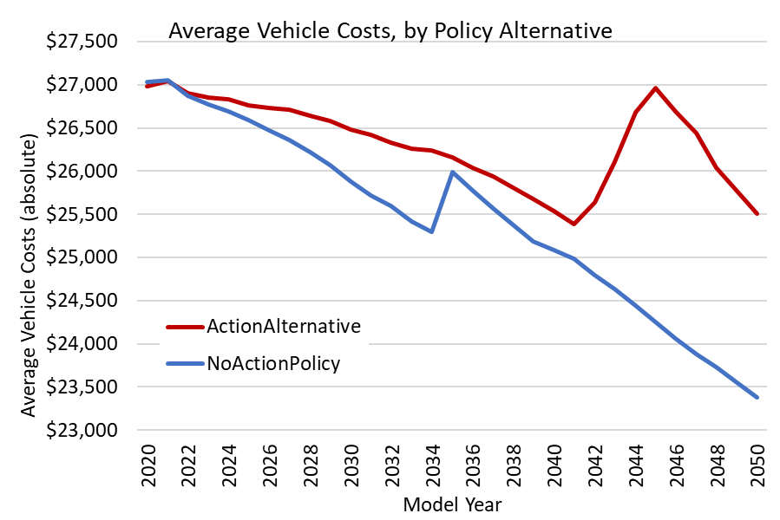
2042: start higher year-over-year target stringency
2046: first year where targets are not met
(alt1)
(alt0)
2035: start upstream accounting

Slide 4
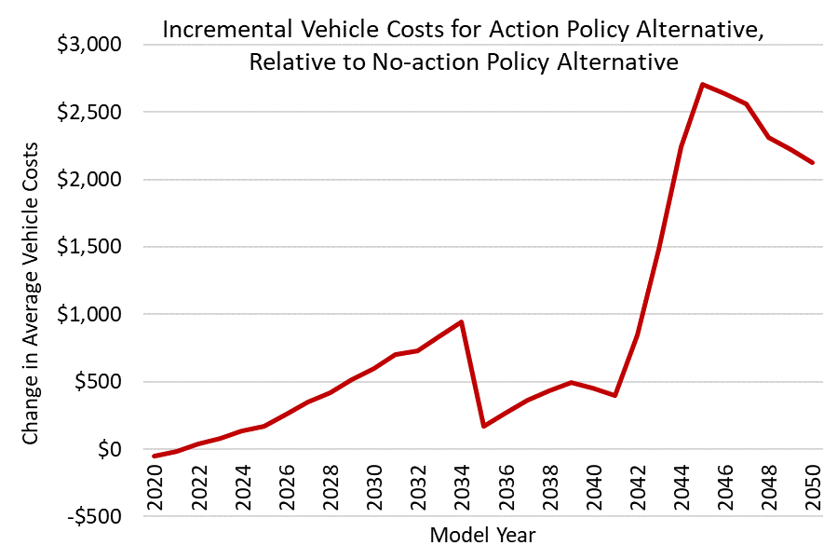
2046: first year where targets are not met
2042: start higher year-over-year target stringency
2035: start upstream accounting

Slide 5
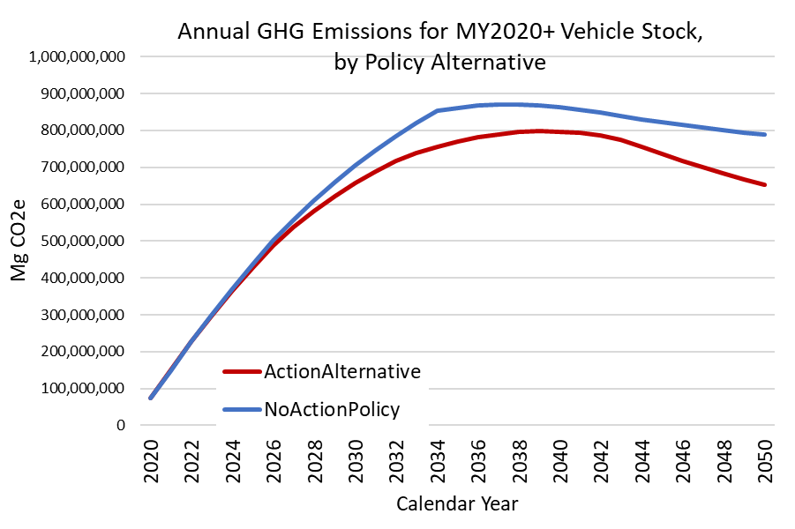
2035: start upstream accounting
2042: start higher year-over-year target stringency
(alt1)
(alt0)

Slide 6
2035: start upstream accounting
2042: start higher year-over-year target stringency
(alt1)
(alt0)

Slide 7
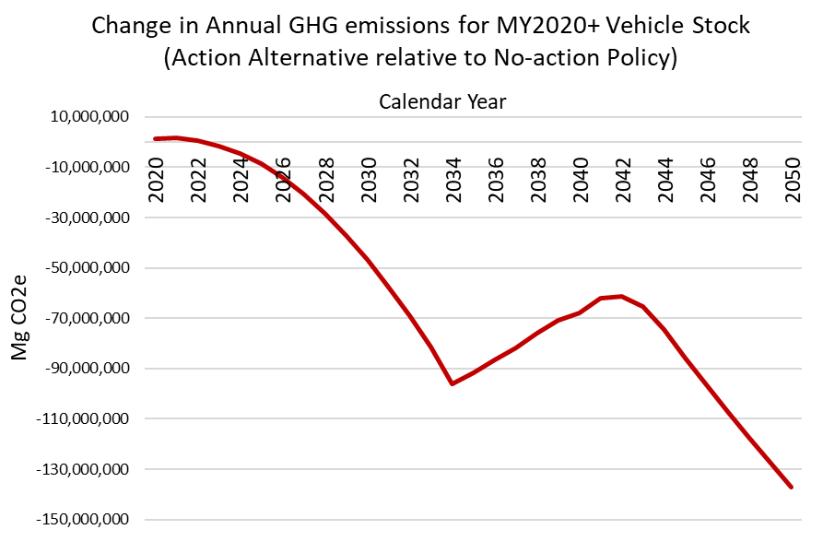

Slide 8
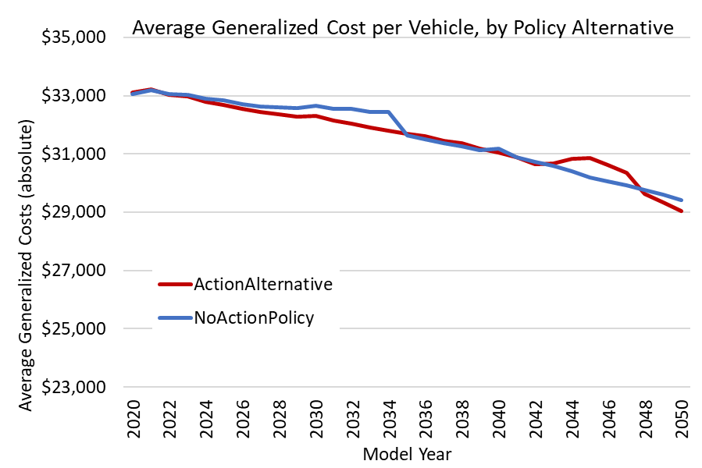
(alt1)
(alt0)

Slide 9
